Slide 1
FPCCD VTX R&D Status and Prospects
Yasuhiro Sugimoto
KEK
2014/9/8 @ILD meeting

Slide 2
R&D issues
FPCCD sensor
Readout electronics
  Front-end ASIC
  Peripheral circuit
Engineering R&D
  Support structure including ladders
  Cooling system

Slide 3
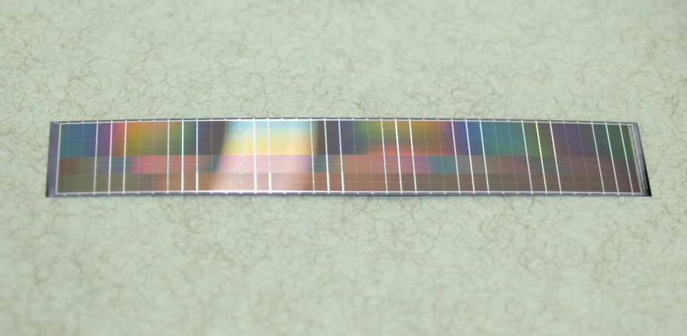
FPCCD Sensor
R&D Goal | Achievement | Prospect
Pixel size; 6um → 5um | 6um fabricated, under evaluation | 5um after ILC approval
Chip size; 1x6.25cm² → 2x12.5cm² | 1.2x6.24cm² achieved, to be evaluated | 2x12.5cm² after ILC approval
Chip thickness; 50um | 50um achieved for 1.2x6.24cm² chip
Speed; >10Mpix/s | Under investigation → Improved clock circuit needed | New clock circuit/cable in coming 2~3 years
Power; <10mW/ch | Achieved in design | To be verified soon
Radiation tolerance; >1x10¹³e/cm² |  | Neutron irradiation test soon (2014/Oct.)
12x62.4mm, 50um thick CCD

Slide 4
Readout electronics
R&D Goal | Achievement | Prospect
ASIC speed; >10Mpix/s | OK
ASIC power; <6mW/ch | OK
ASIC noise; <30electrons | OK
3-value clock driver |  | To be developed in 2~3 years
Low mass FPC |  | To be developed in 2~3 years
Data compression circuit |  | To be developed in 2~3 years

Slide 5
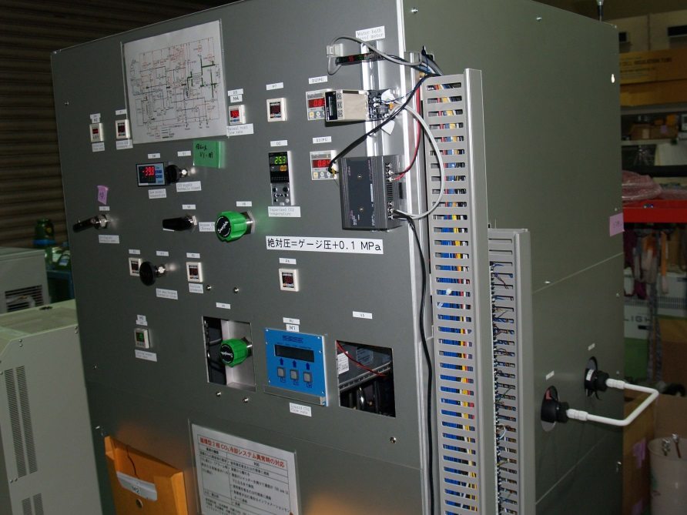
Engineering R&D
R&D Goal | Achievement | Prospect
Low mass ladder |  | To be developed in 2~3 years
2-phase CO2 cooling system; −40°C using gas compressor | Principle demonstrated | More stable and practical system in 2~3 years
Support structure |  | To be developed in 2~3 years
Engineering prototype |  | To be developed in 3 years
2-phase CO2 cooling system
for proof of principle
−40°C here

Slide 6
Backup slides

Slide 7
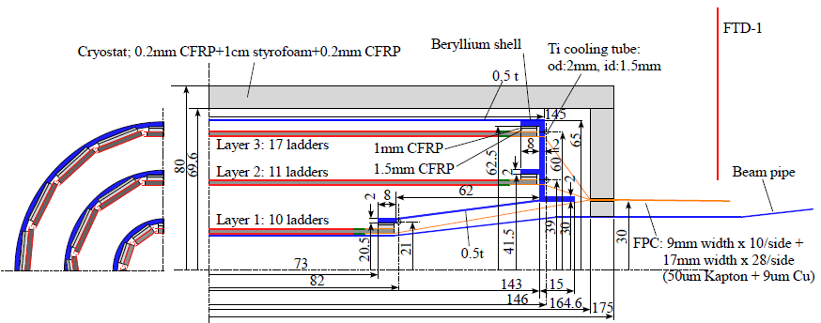
FPCCD VTX

