Slide 1
Report on SDHCAL
I.Laktineh

Slide 2
Outline
SDHCAL status
Road map for the two coming years
Some personal ideas on the selection of the baseline HCAL

Slide 3
SDHCAL Status
-SDHCAL is the first option of ILD that has built a complete
TECHNOLOGICAL prototype : All requirements concerning compactness, robustness and power-recycling were fully fulfilled;
Energy resolution results obtained with TB are very good and new
techniques to improve on are being constantly developed/improved.
Tracking capabilities are demonstrated;
-Description of SDHCAL included in the ILD simulation is the one of the
prototype. Digitizer is based on prototype studies. No future surprise
Physics studies based on SDHCAL are limited. Applying PANDORA in
optimized way is needed. Arbor developments are ongoing.

Slide 4
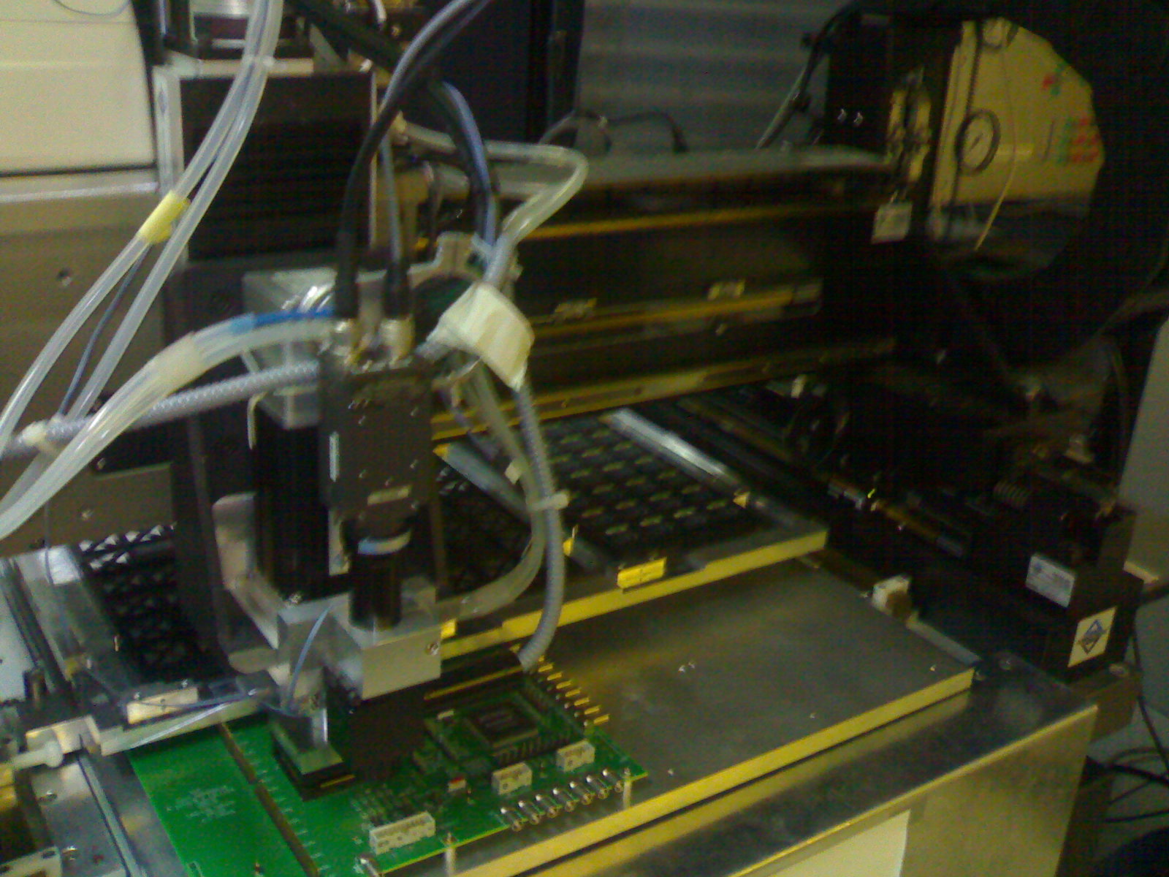
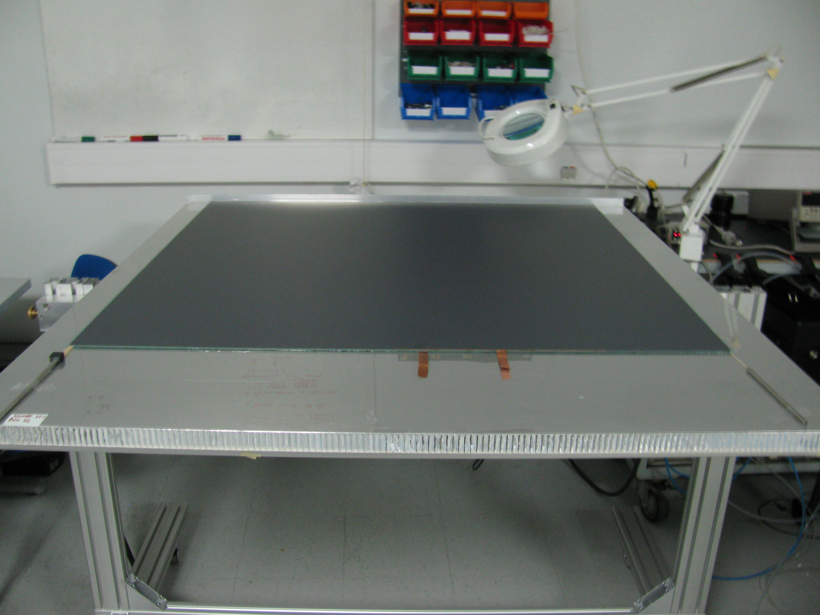
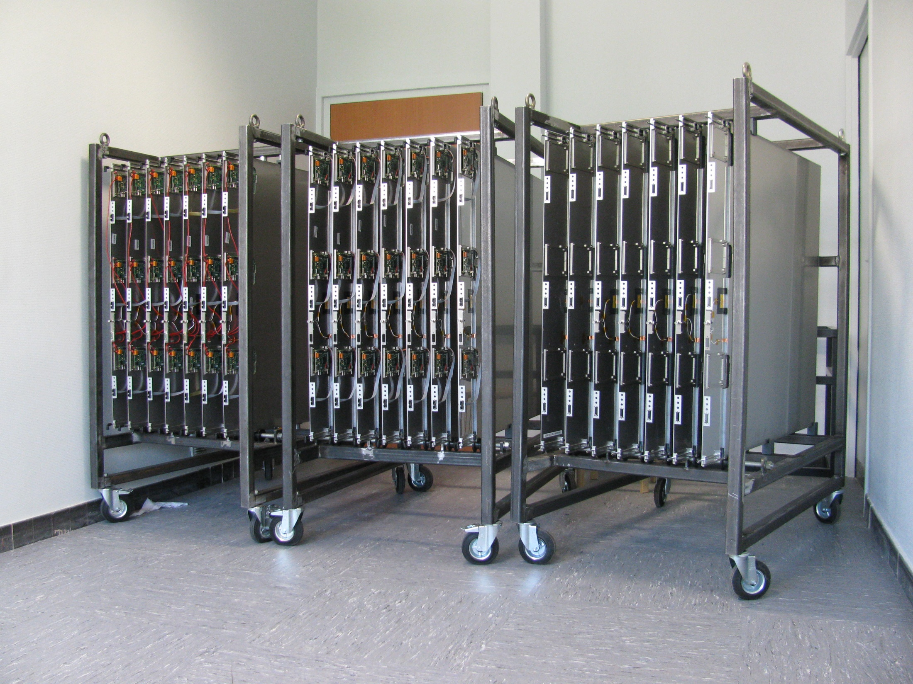
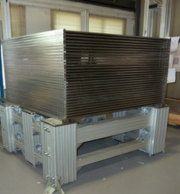
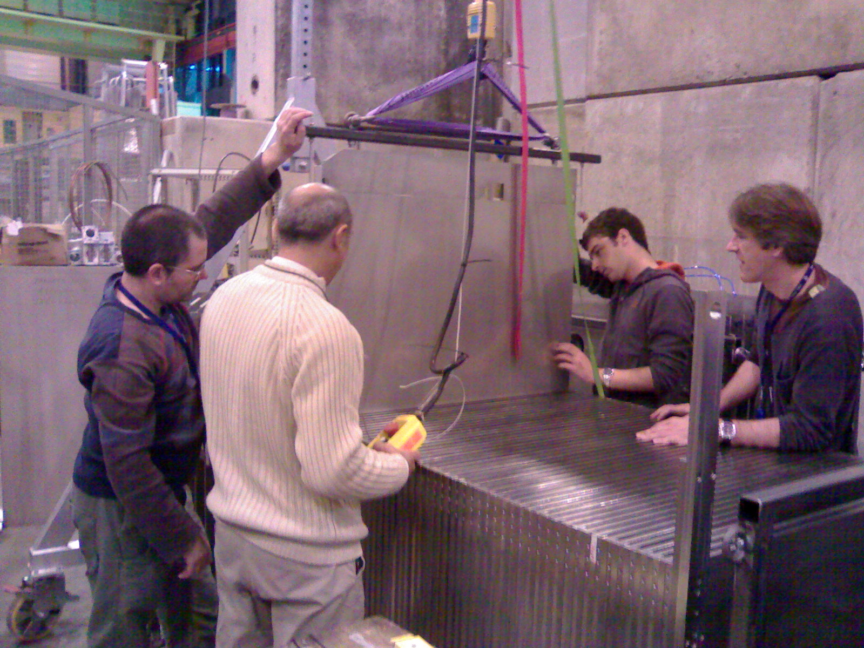
SDHCAL prototype construction
10500 ASIC were tested and calibrated using a
dedicated robot that was used by CMS (IPNL, OMEGA)
(ASICs layout : 93% ).
310 PCBs were produced, cabled and tested (IPNL).
They were assembled by sets of six to make 1m²
ASUs
170 DIF(LAPP), 20 DCC(LLR) were built and tested.
50 detectors were built and assembled with
their electronics into cassettes. Cassettes were tested
by sets of 6 using a cosmic test bench (IPNL).
The mechanical structure was built in CIEMAT.
HV, cooling services were built by UCL, Gent.
Full assembly took place at CERN.

Slide 5
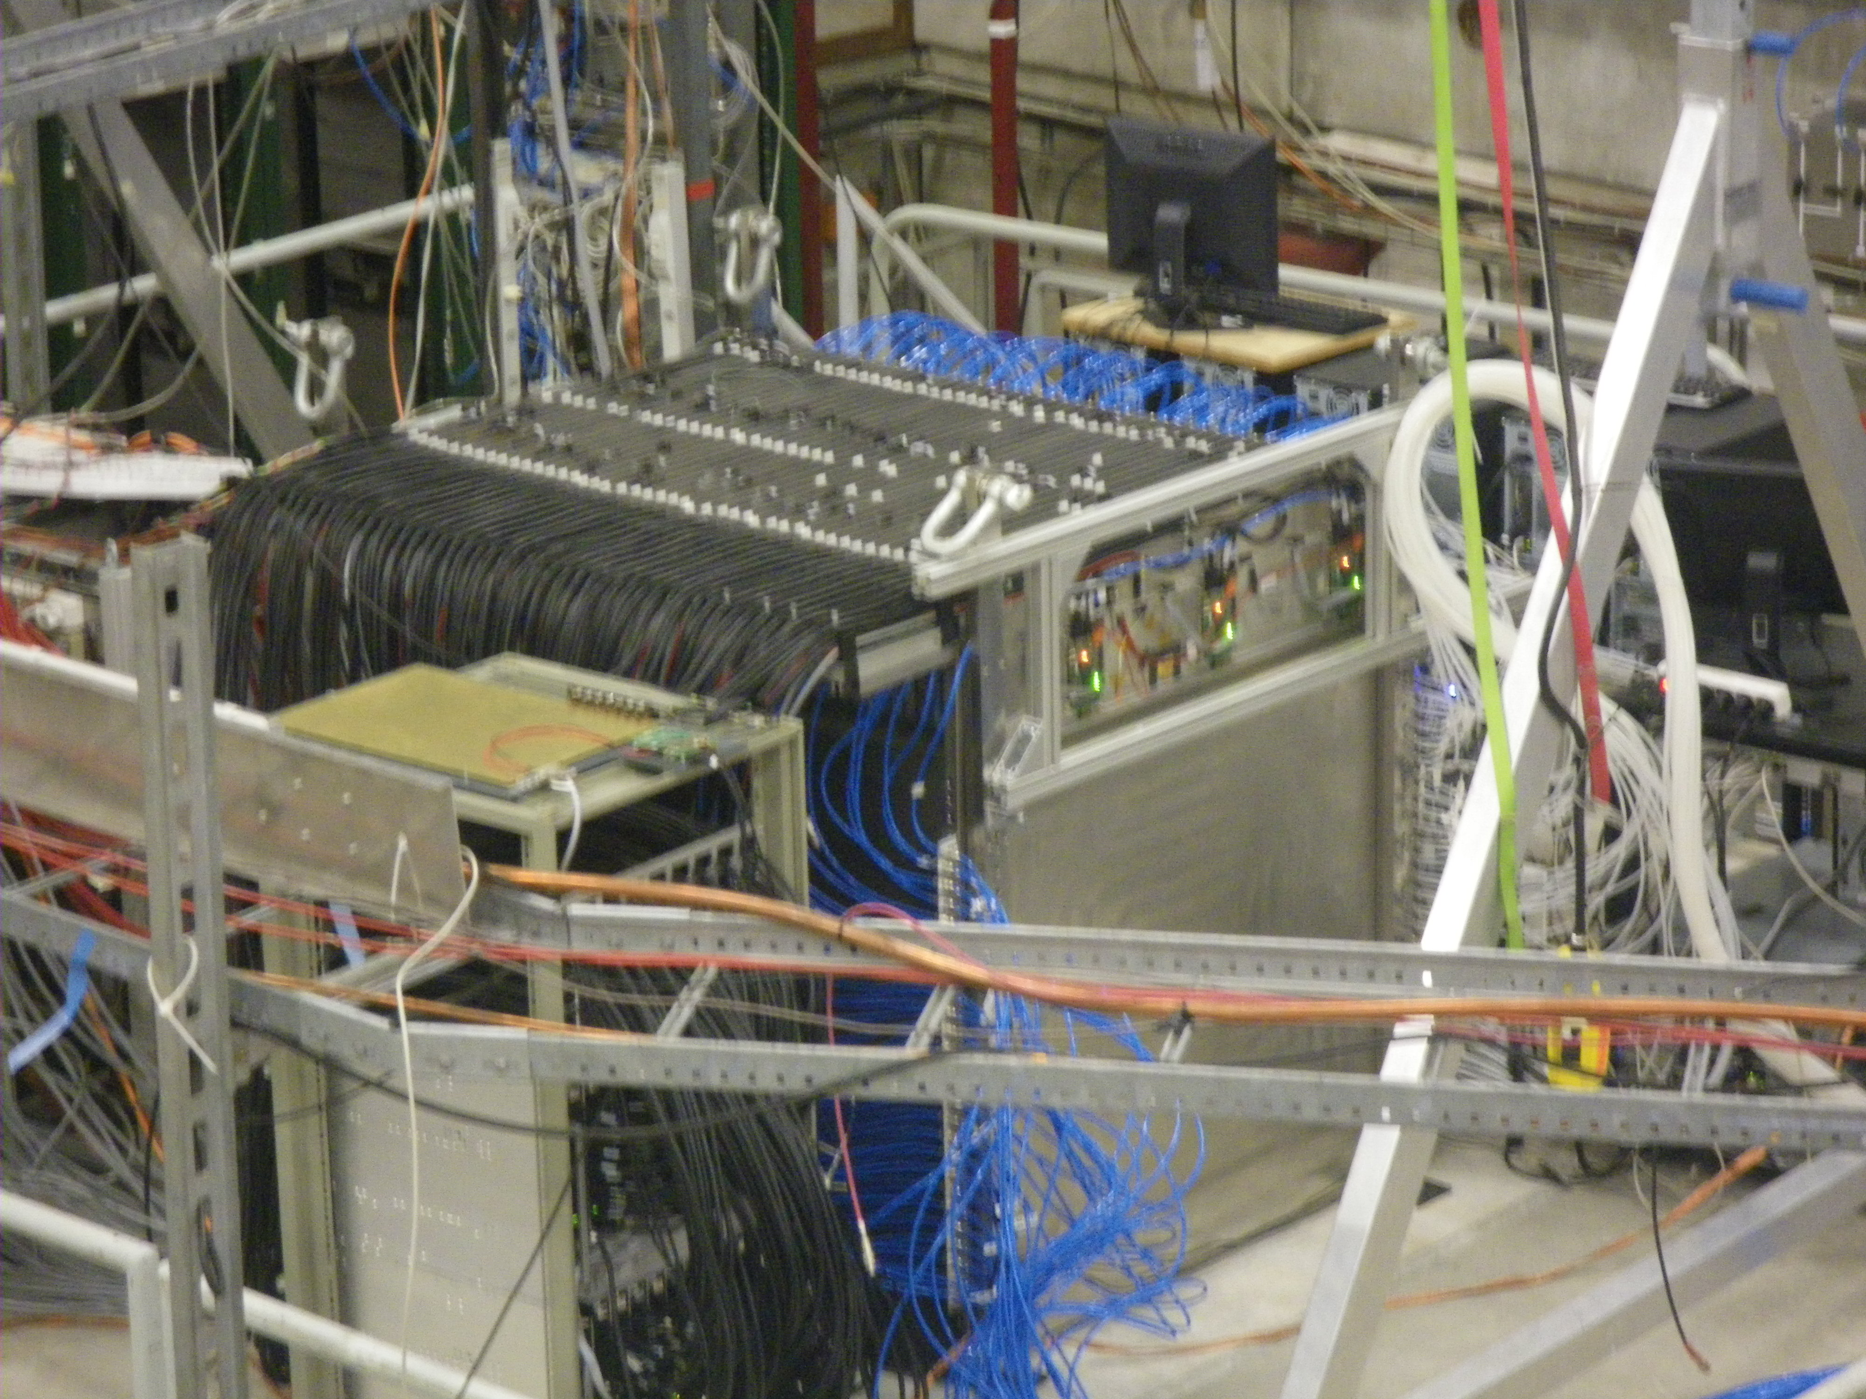
Prototype @TB
3 periods of TB in 2012
( 5 weeks)
SDHCAL Commissioning with
Trigerless, Power-Pulsing modes;
Thresholds choice
optimization;
Muons run calibration;
→ Pion, electron runs
to study EM and
hadronic showers;
No particle identification
detector was used.

Slide 6
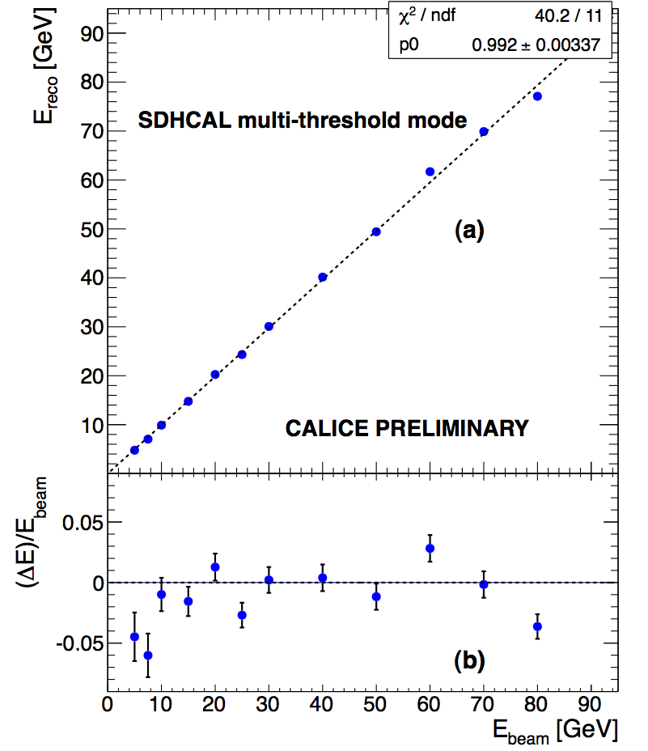
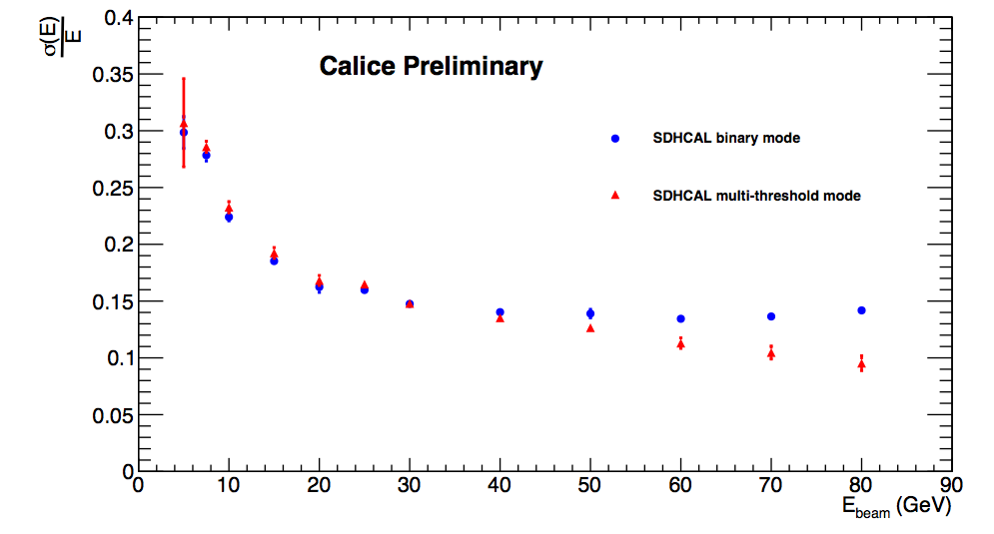
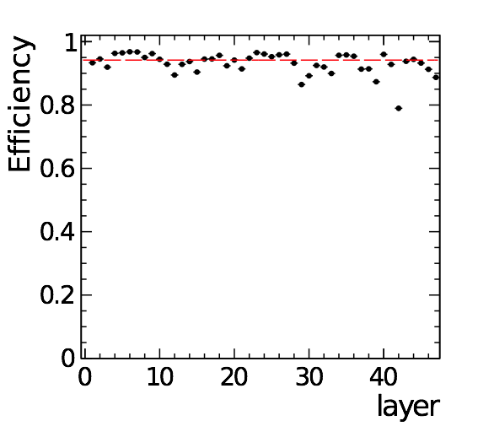
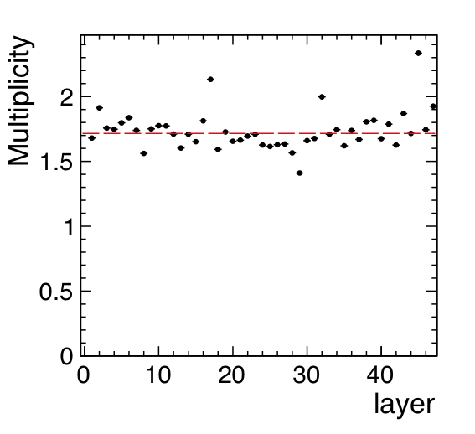
First results on linearity and energy resolution
with no calibration and with no gain correction,
No tail-catcher
Efficiency
Pad multiplicity
BINARY
Multi-threshold
Calice note CAN-037
Semi-digital improvement with respect to digital version.

Slide 7
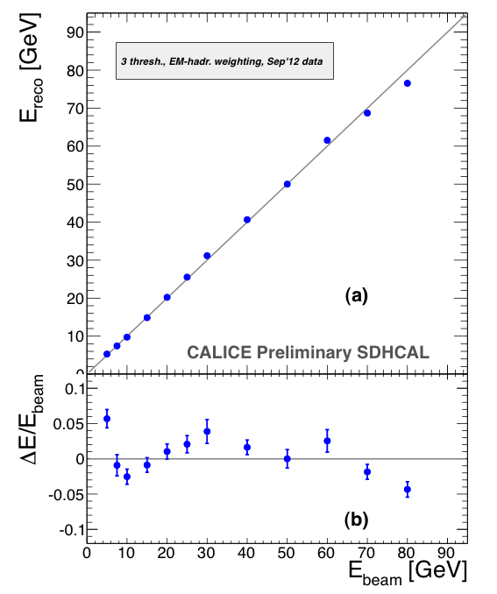
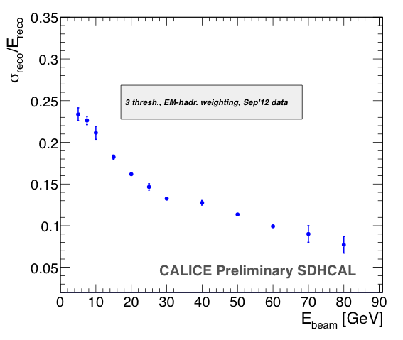
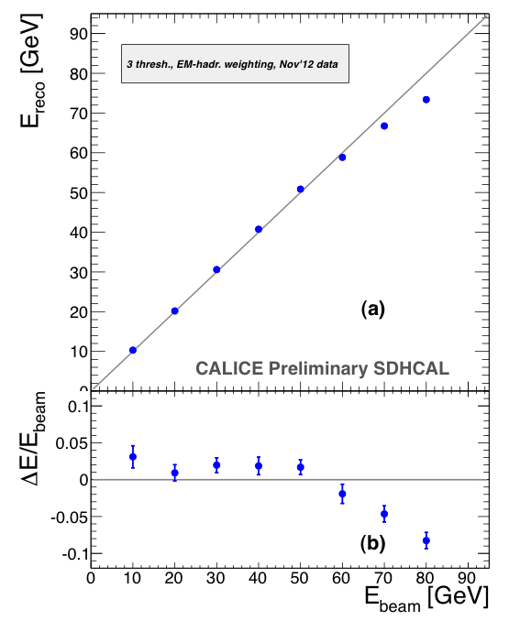
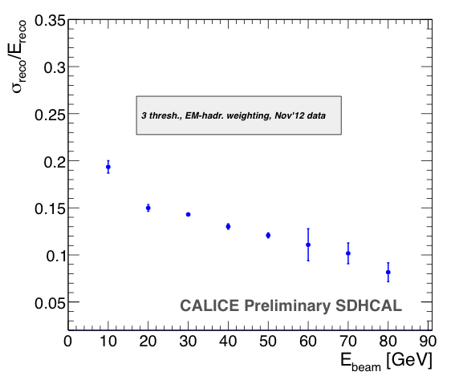

Slide 8
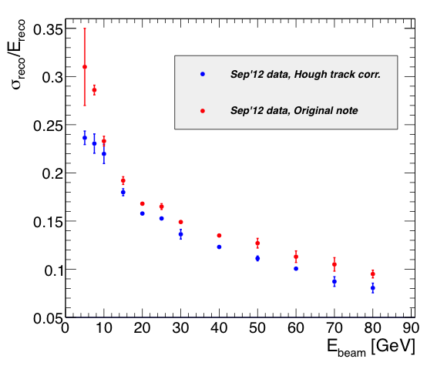
Improvement of energy resolution

Slide 9
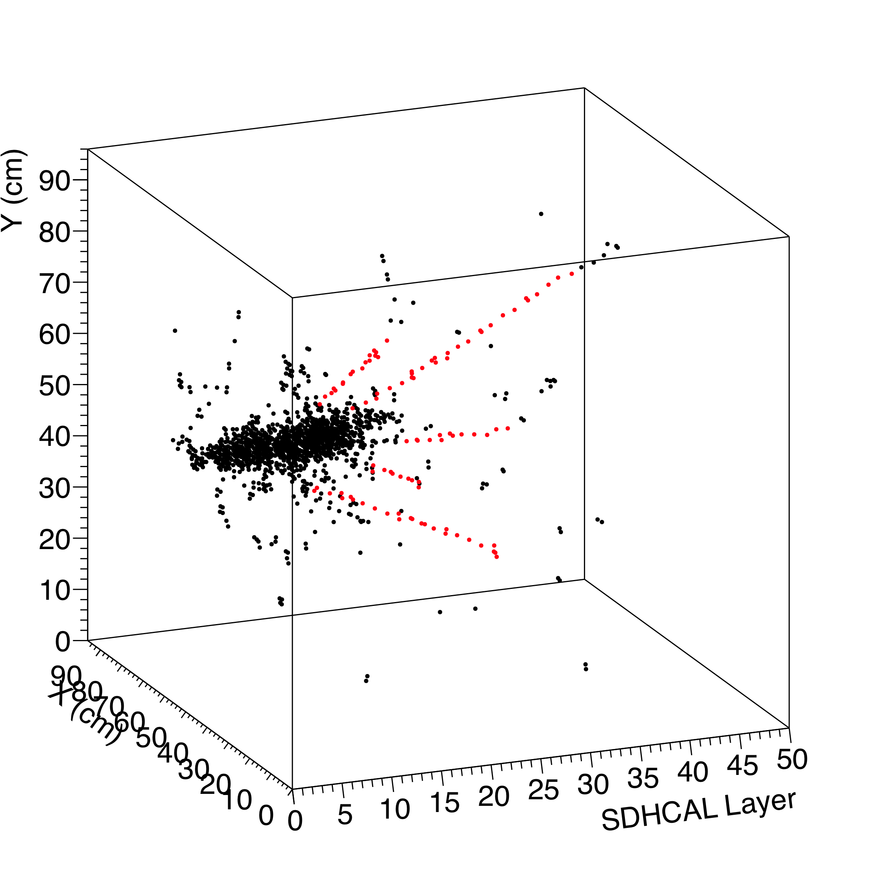
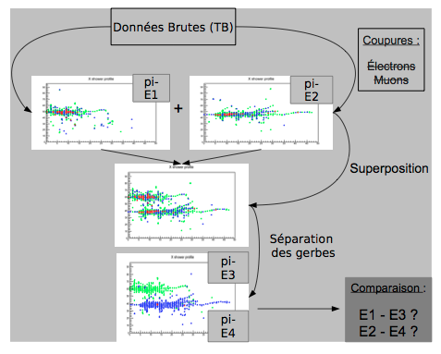
Ongoing analyses
Calibration study;
Electron-Pion separation;
Energy resolution improvement by taking into account hadronic shower
structure and calibration correction: an improvement of up to 20 % already
achieved with respect to the preliminary ones obtained immediately after TB;
Imaging algorithm developments (HT, Arbor, MST) → PFA
Hough Transform
Arbor, Pandora, MST..
Calibration in situ, energy resolution improvment

Slide 10
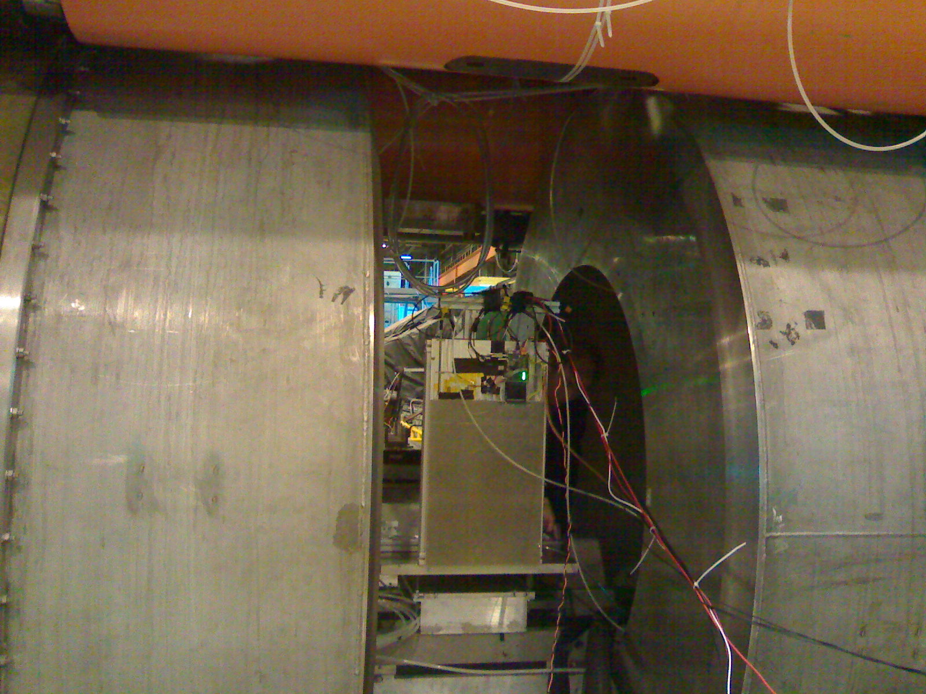
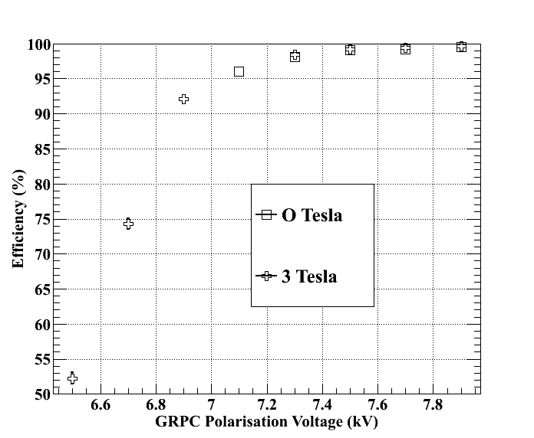
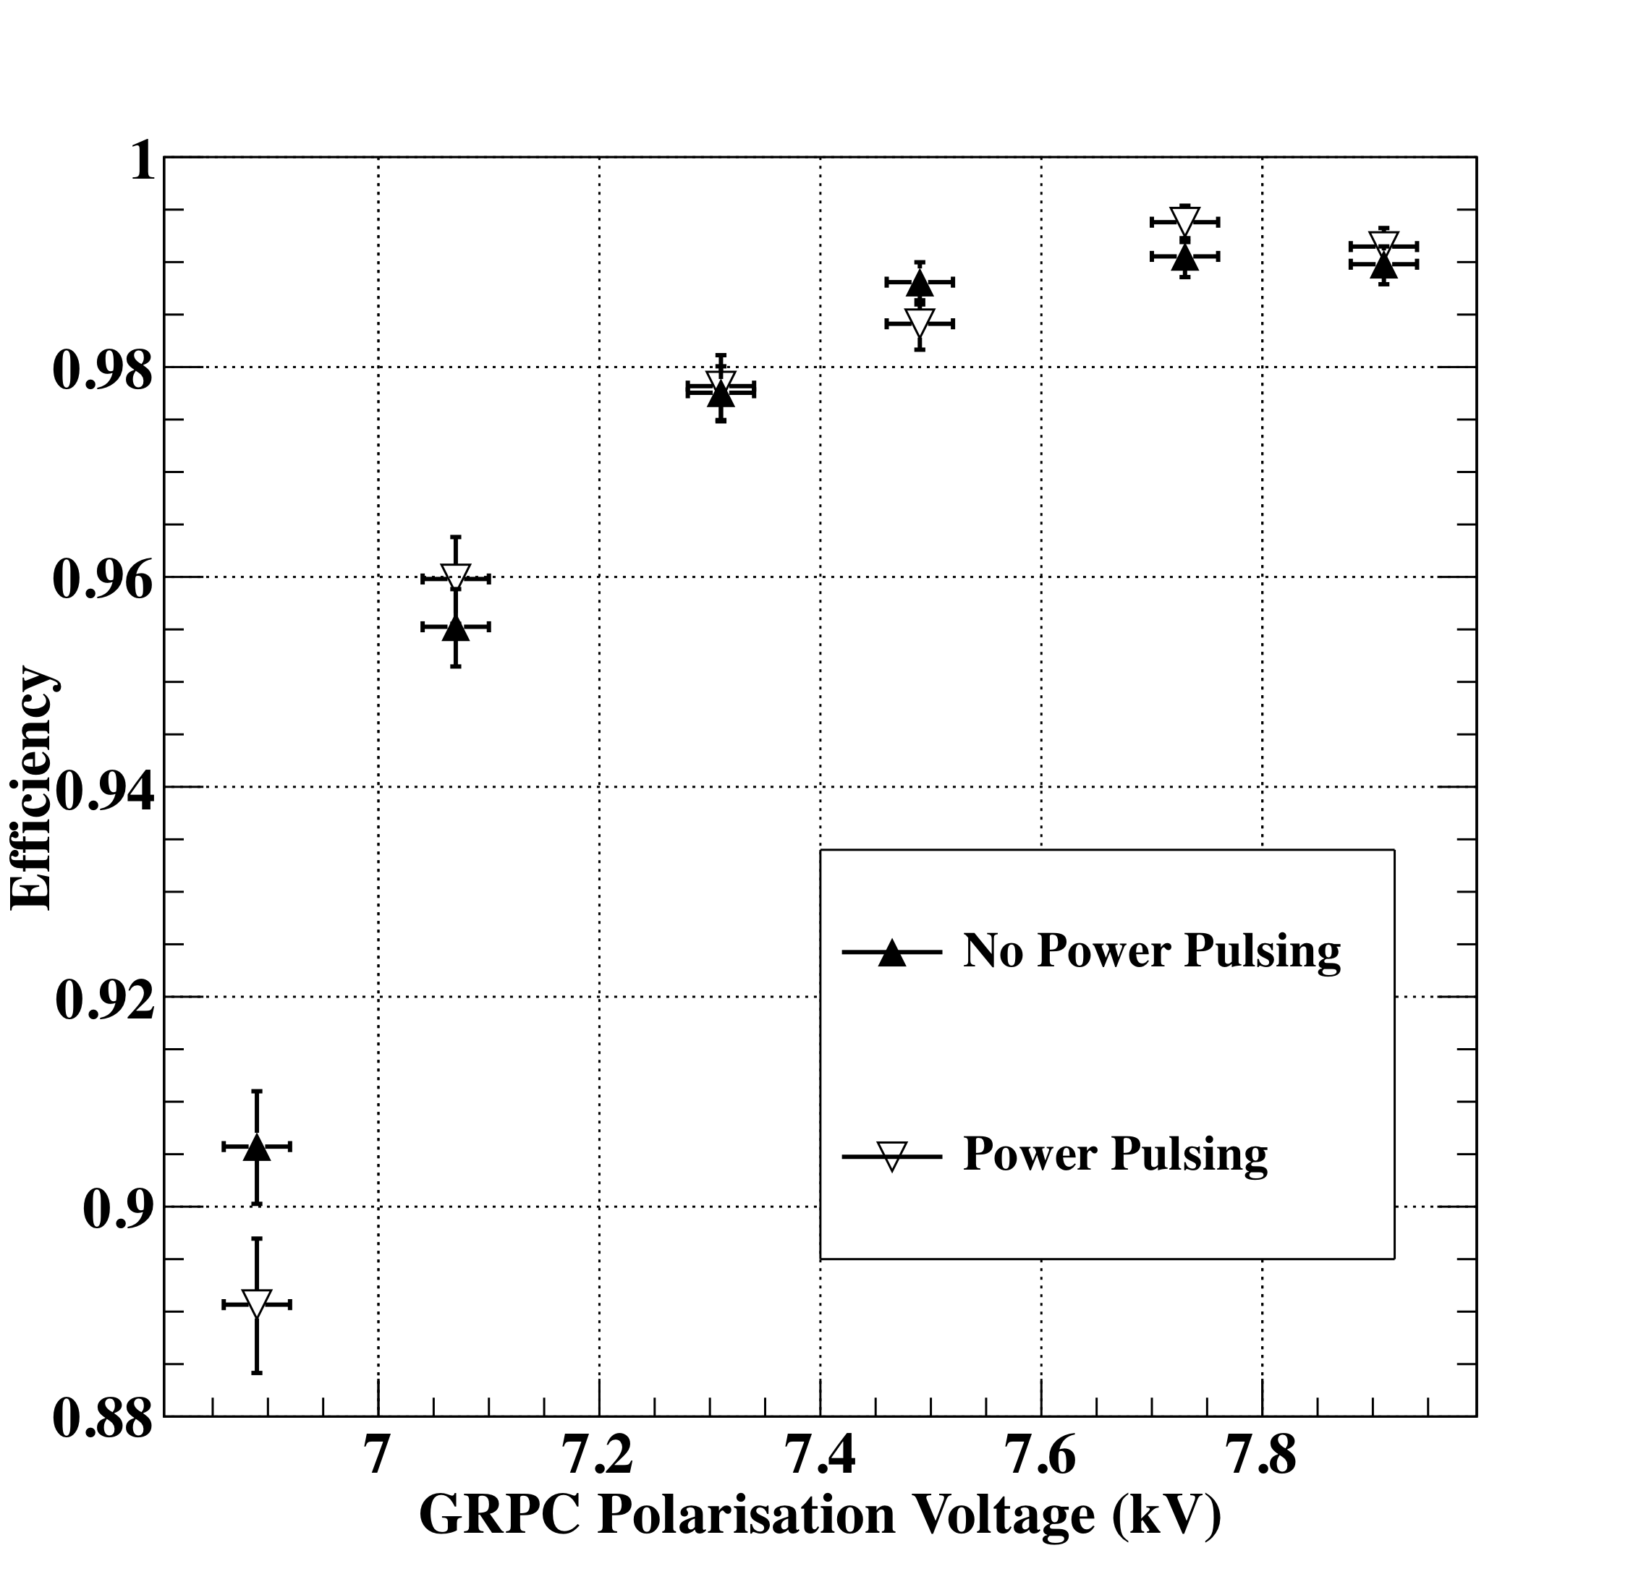
Power-Pulsing mode was tested in a magnetic field of 3 Tesla
The Power-Pulsing mode was
applied on a GRPC in a 3 Tesla
field at H2-CERN
(2ms every 10 ms)
No effect on the detector
performance
ILC duty cycle :
1ms (BC) every 200 ms
10
Notes:
10
10

Slide 11
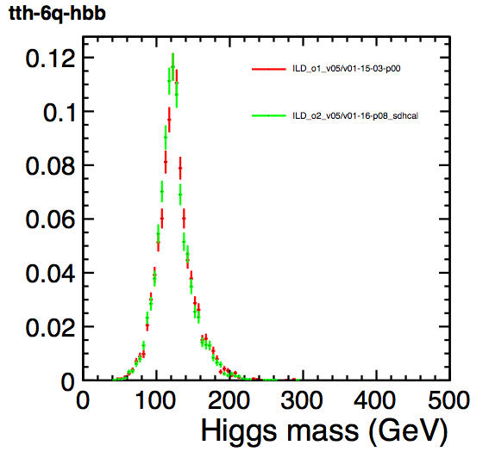
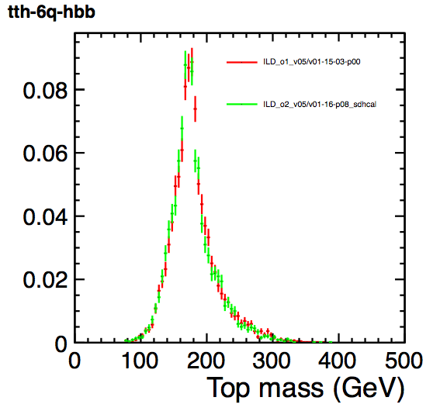
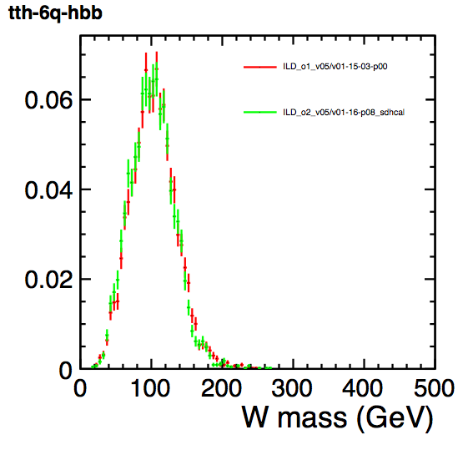
Simulation and optimization studies
The SDHCAL simulation was re-performed taking into account the constraints and the results of the prototype. The new version was used for the DBD studies, showing that same performance are obtained as for the AHCAL (albeit the PFA optimization was done for the AHCAL topology)
Higgs, top and W in the tth 8jet mode (1000 GeV).
Tomohiko Tanabe

Slide 12
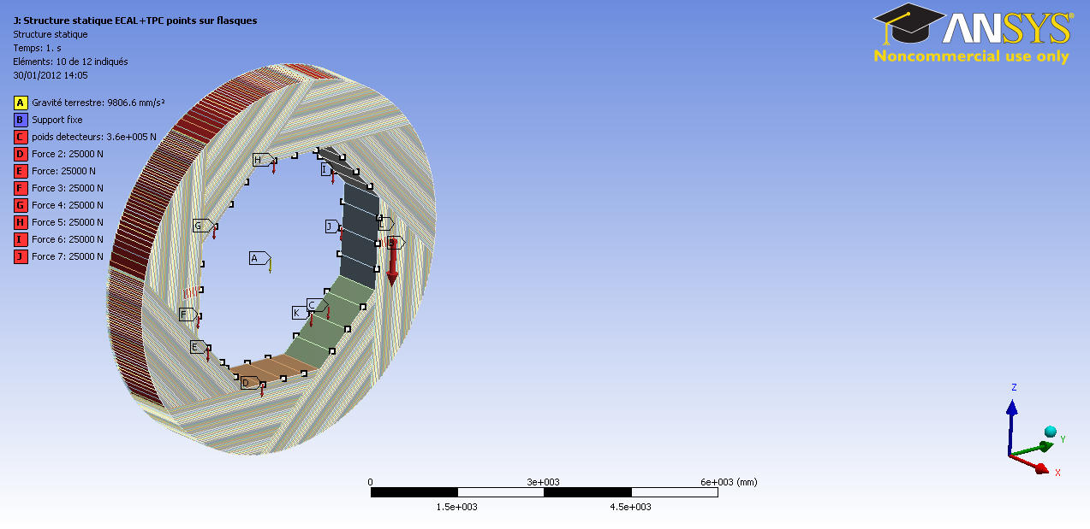
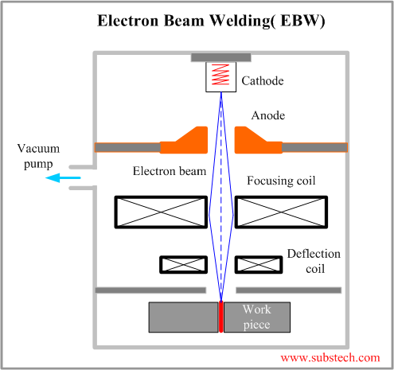
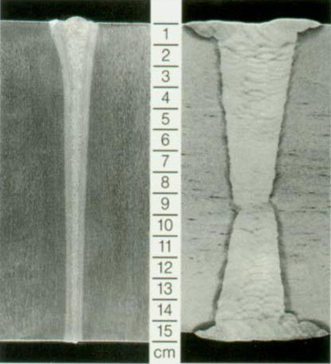
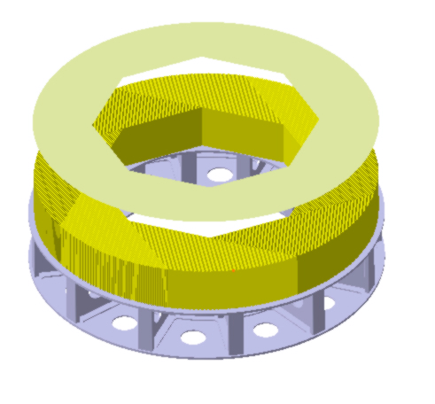
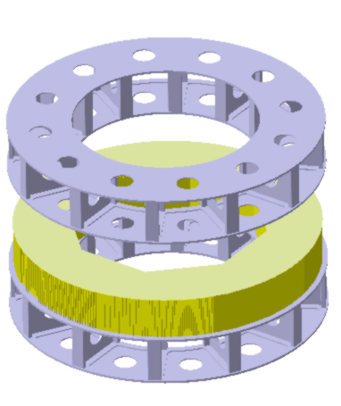
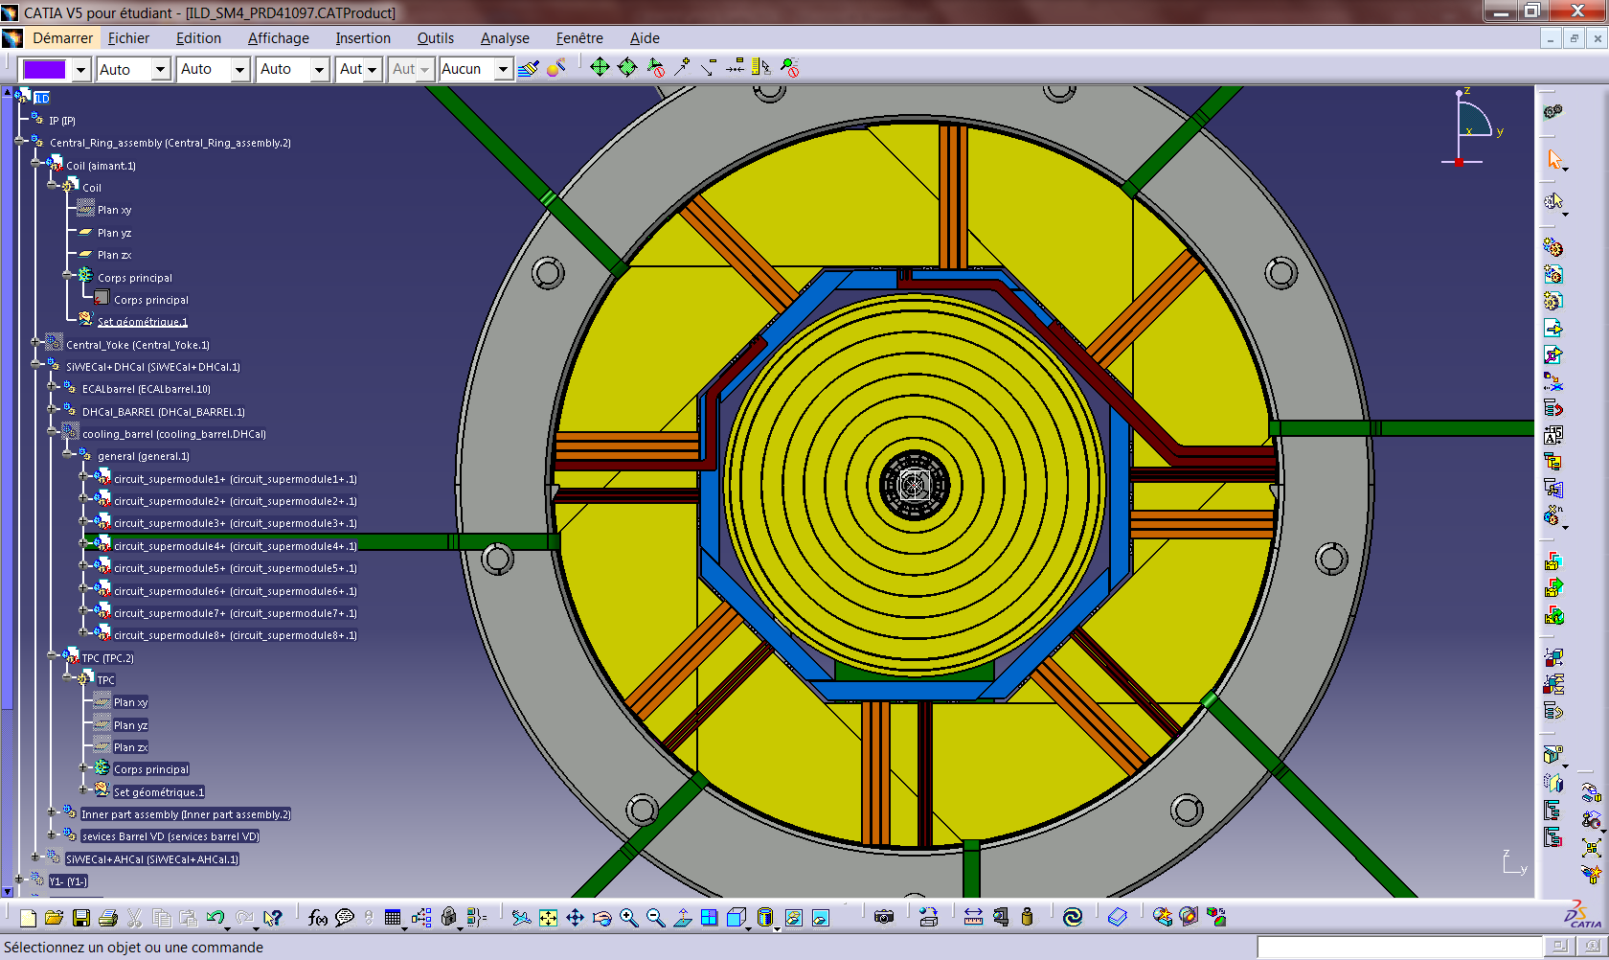
Mechanical, integration, service studies
ECAL Loads on points
Welding techniques
Building scenarios
9-15H supports
DHCAL with 8 x ECAL modules (8x2.5 t)
And TPC (4t)
180°
Deformation max SDHCAL + ECAL + TPC = 0,4 mm

Slide 13
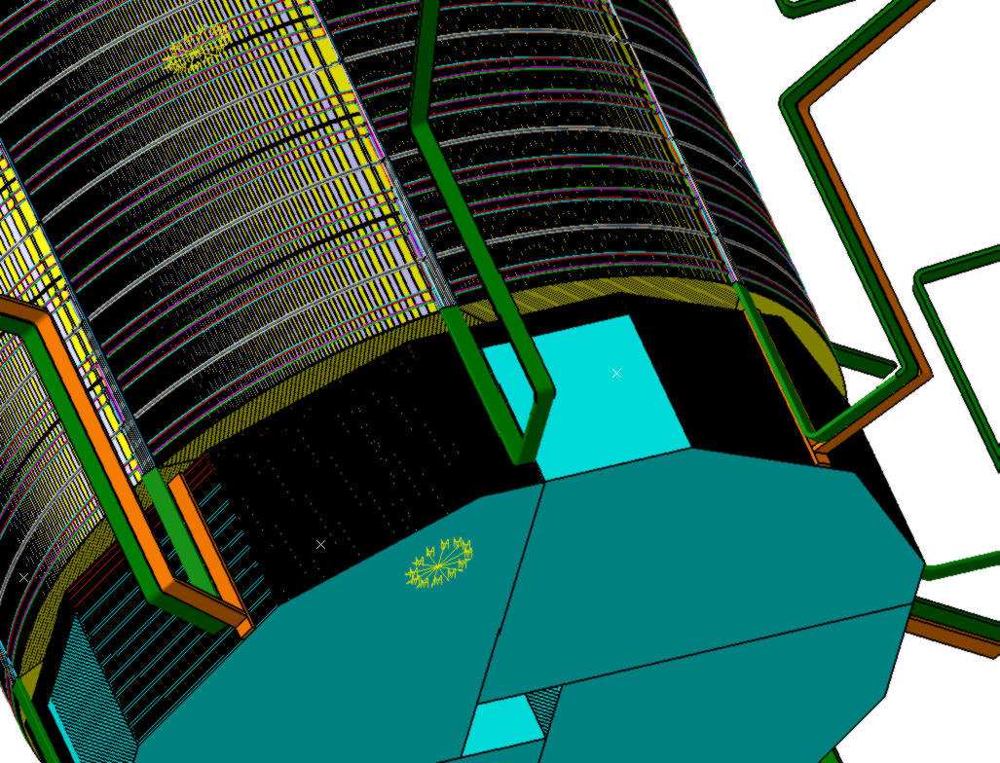
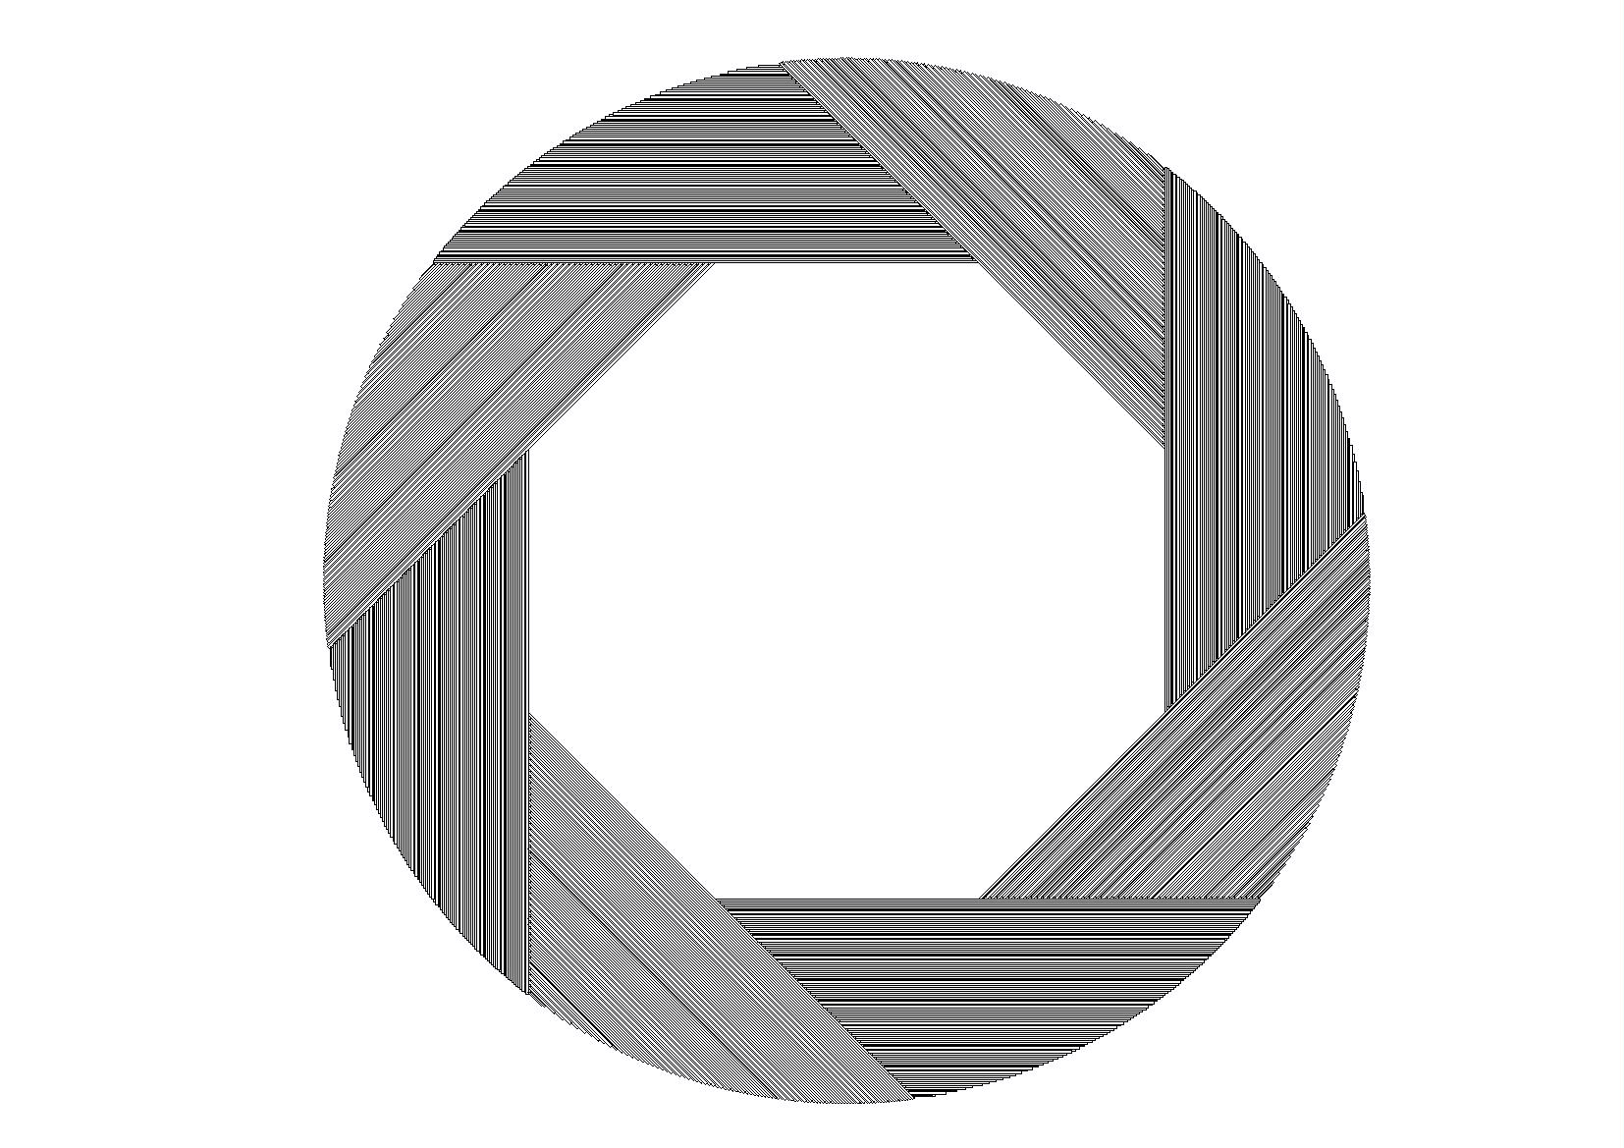
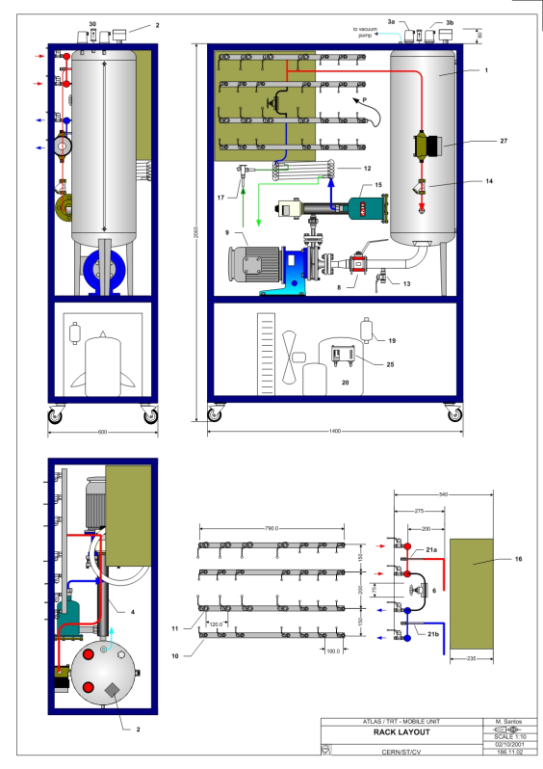
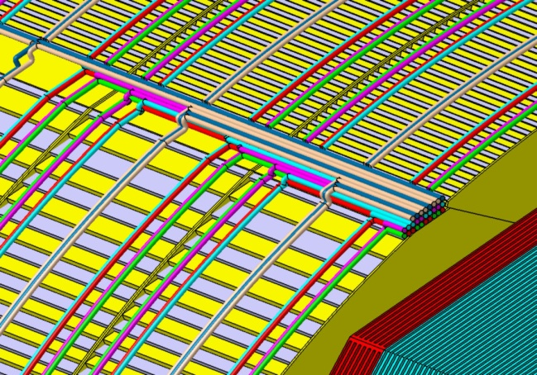
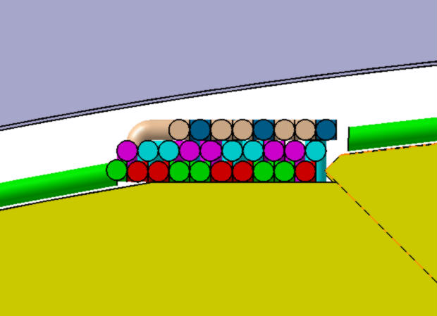
Mechanical, integration, service studies
Few cooling scenarios were studied and compared with each other
Services were studied in detail to provide a realistic model for the ILC DBD
47
168
  Mono-phasic gas like C6F14 : limited effect in case of leak, good quality/price ratio, adapted to low heat extract, simple to use

Slide 14
Road map in the 2 coming years
Improve on the energy reconstruction using new techniques;
-Improve on simulation (digitizer) and compare hadronic shower models to data;
Develop PFA techniques to be used to separate close-by hadronic showers;
Perform combined TB (…+ECAL+SDHCAL+…);
--------- ---- ------
Build few very large GRPC detectors (2-3 m2) : gas circulation system, thickness…;
Test the new version of electronics (I2C, ..) ;
Adapt the ASU architecture to read the large GRPC (up to 3 m²);
Develop a new DIF (low consumption, reduced size, new functionalities);
Build a small mechanical prototype to host the few large chambers and test it.

Slide 15
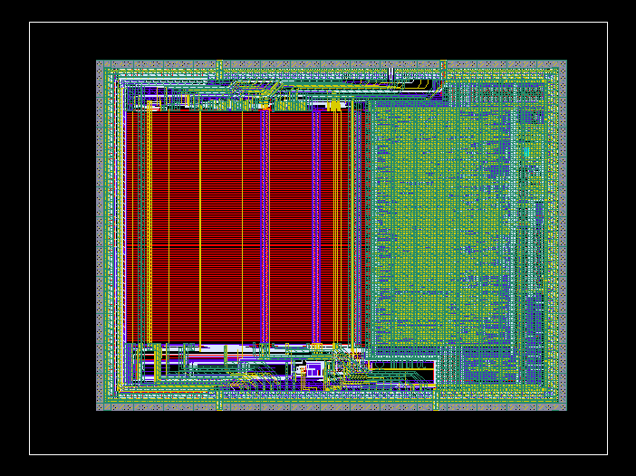
New version of the readout electronics
New features in
the DAQ boards
RJ-45 (Data)
External Network chip
RJ-45 (TTC)
TTC electrical layer
(ADN2814)
ASU
connectors
Fiber/copper
(future use)
SFP cages
Spare I/Os
Clock in/out
Power out
FPGA
The new version improves on the previous one:
Independent channels and
zero suppression;
Independent ASICs (I2C);
Better dynamic range (up to 50 pC).
successfully tested. Production of ASICs to equip at least one large detector is foreseen for next year
Large enough to embed processor if needed
Micro USB
USB2
WatchDog
Temp
Power in
Power supply
DIF and ASU
Goldcaps to handle power pulsing ?
Current/voltage monitoring
Only one DIF per plane. For the maximum
length plane (1x3m) the DIF will handle
432 HR3 chips;
Slow control through the new HR3 I2C bus;
→ Data transmission to DAQ by Ethernet using commercial switches;
Clock and synchronization by TTC.
New ASU design for large detectors under study

Slide 16
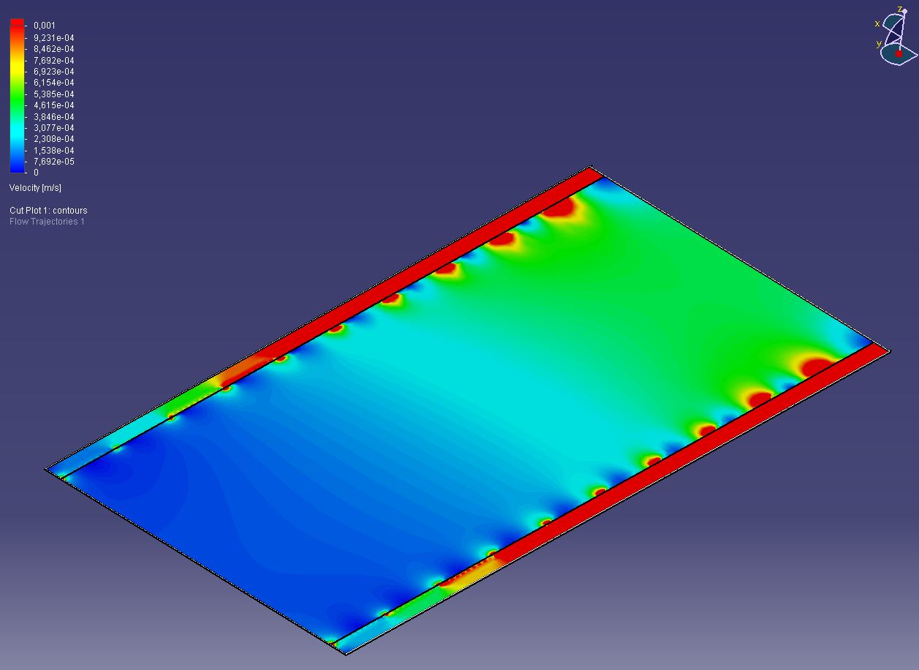
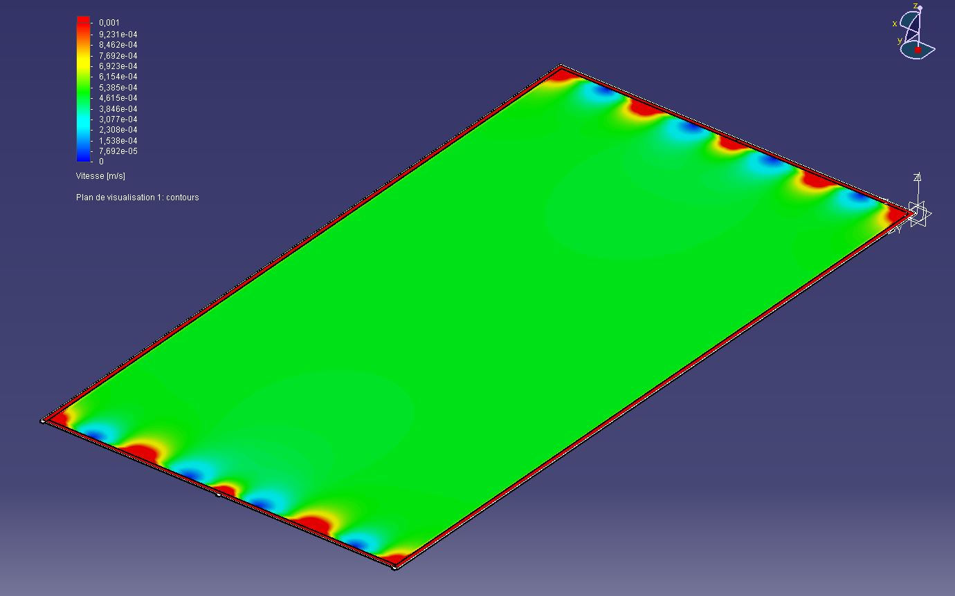
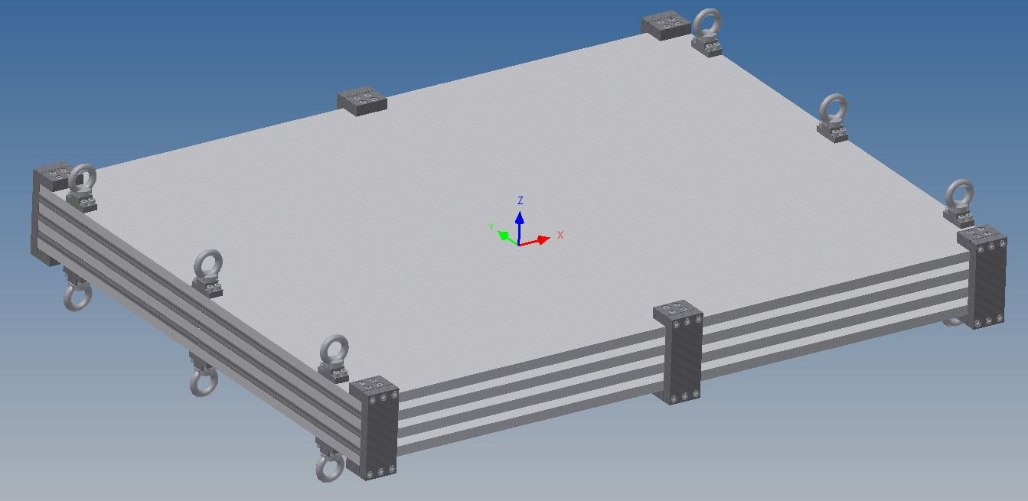
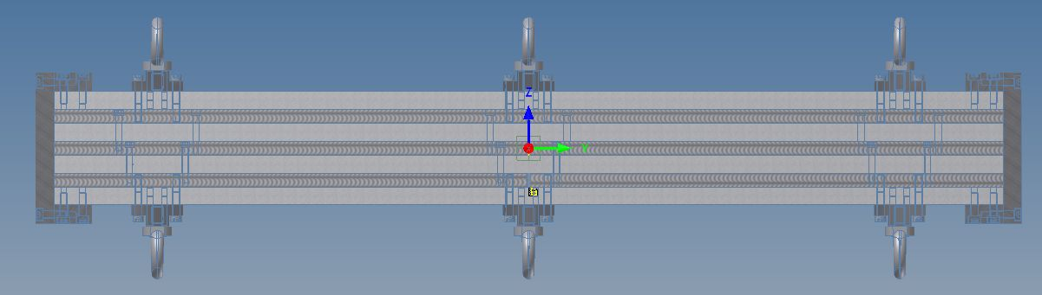
Detector improvement : to achieve same performances with very large GRPCs
Prototype circulation system
New circulation system
inlet
outlet
2 m
1 m
Mechanical structure : to be built with EBW techniques and to host few large detectors GRPCs

Slide 17
A few personal ideas about the selection of the baseline option
To be able to select one technology as the baseline option :
1- The comparison should be based on ILC-like prototypes.
Results are relevant only in the conditions of ILC (power-pulsing, compactness…)
2- The options should be compared according to their PFA&physics performances. This takes into account the role of other detectors. Combined tests are of big importance to clarify things.
3- If PFA&physics performances are similar then the cost becomes an issue. In this case cost estimate should be based only on the one of the TDR time.
4- If all aspects are similar one should take into account the robustness of the collaboration to support the different options.
5- Finally, one should be able to change the baseline even after the TDR if the if the previous criteria change.

Slide 18
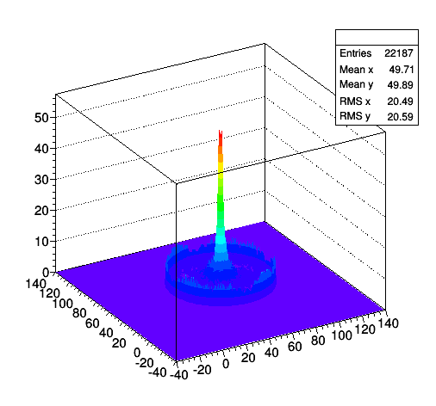
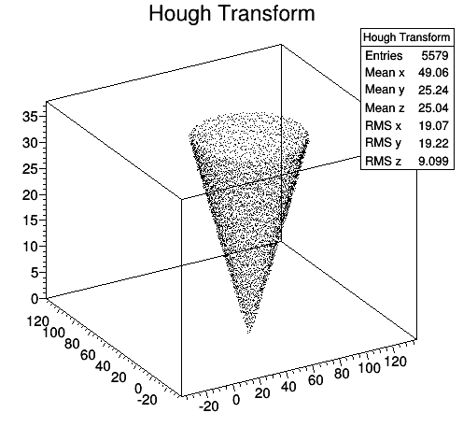
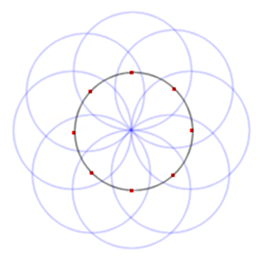
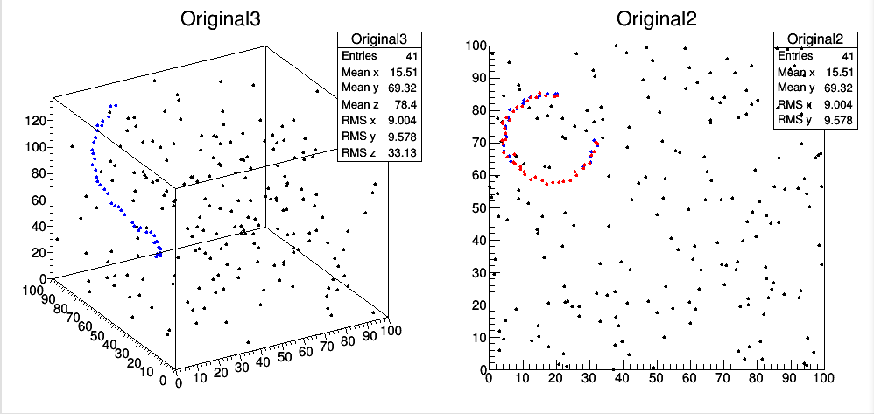
Y.Feng

Slide 19
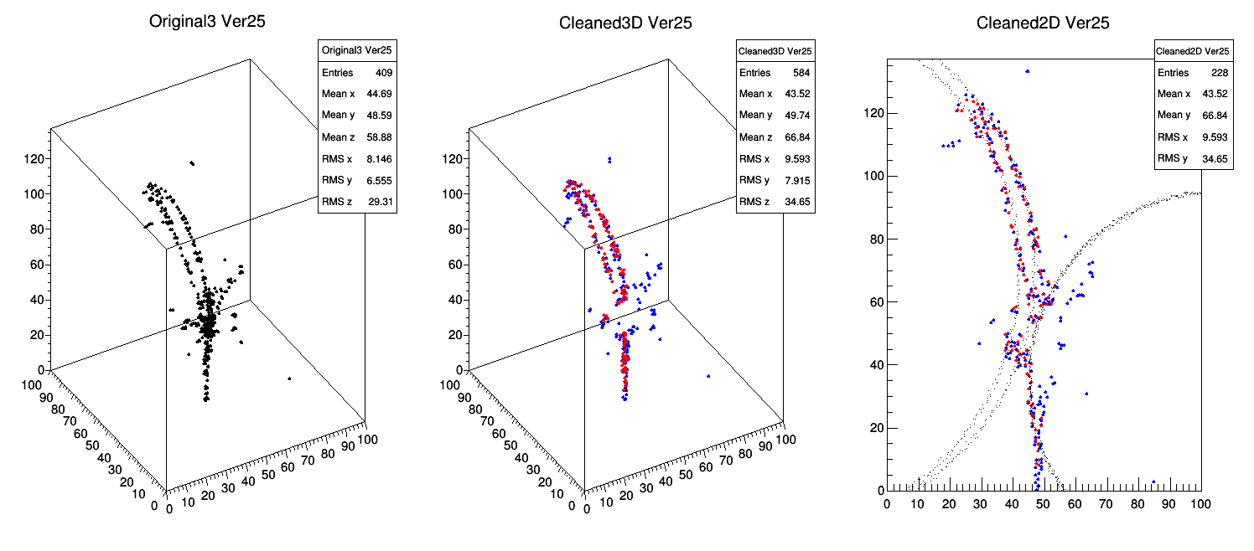
Y.Feng

