Slide 1
Calibrations over IP LO power scan
N. Blaskovic
N. Blaskovic

Slide 2
Introduction
Data taken on 140314
Beam on waist in x and y using QD0FF and QF1FF currents from shift on 130314
RF variable attenuator set to 10 dB
LO variable attenuator set from 0 to 10 dB
IPC mover calibration preformed at each LO variable attenuator setting
N. Blaskovic

Slide 3
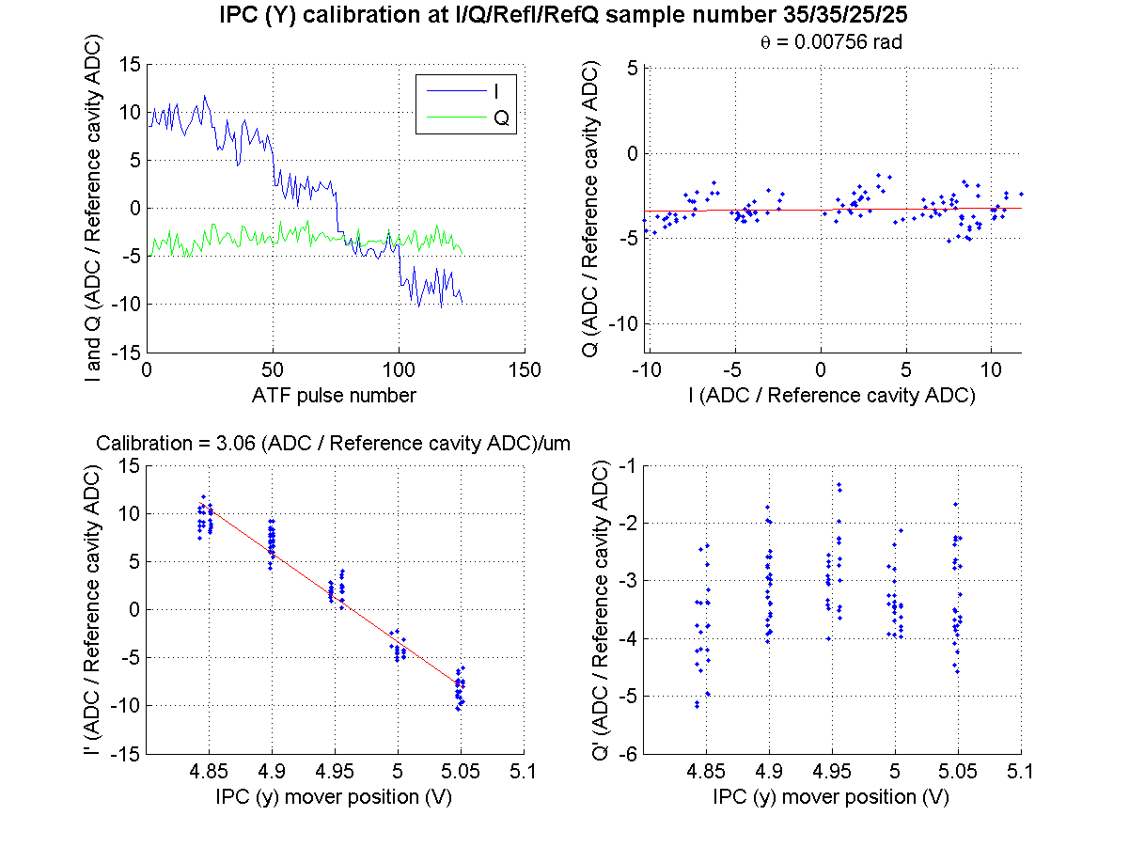
LO: 0 dB
N. Blaskovic

Slide 4
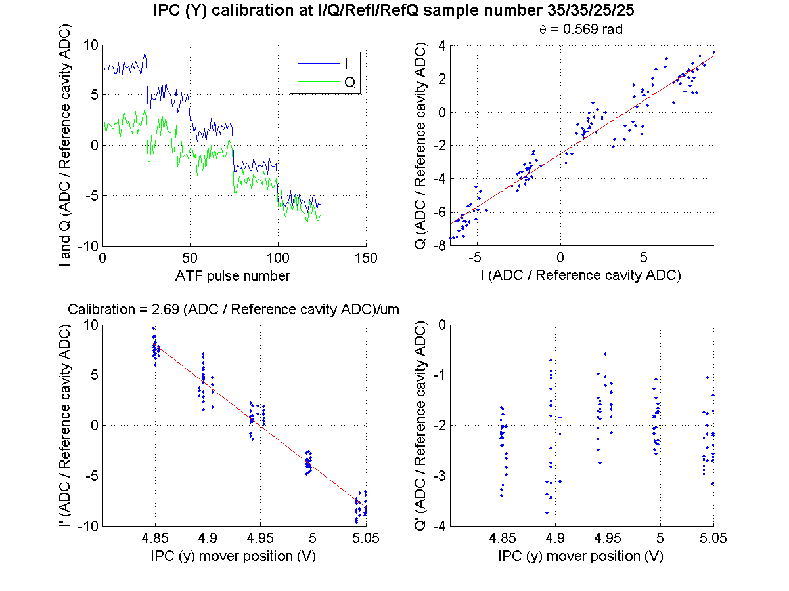
LO: 2 dB
N. Blaskovic

Slide 5
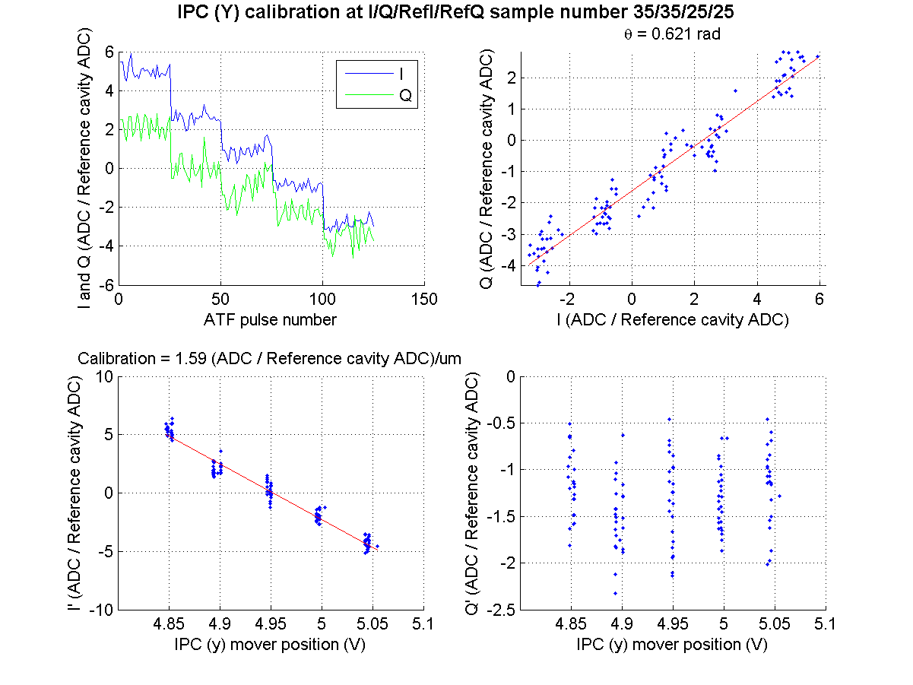
LO: 4 dB
N. Blaskovic

Slide 6
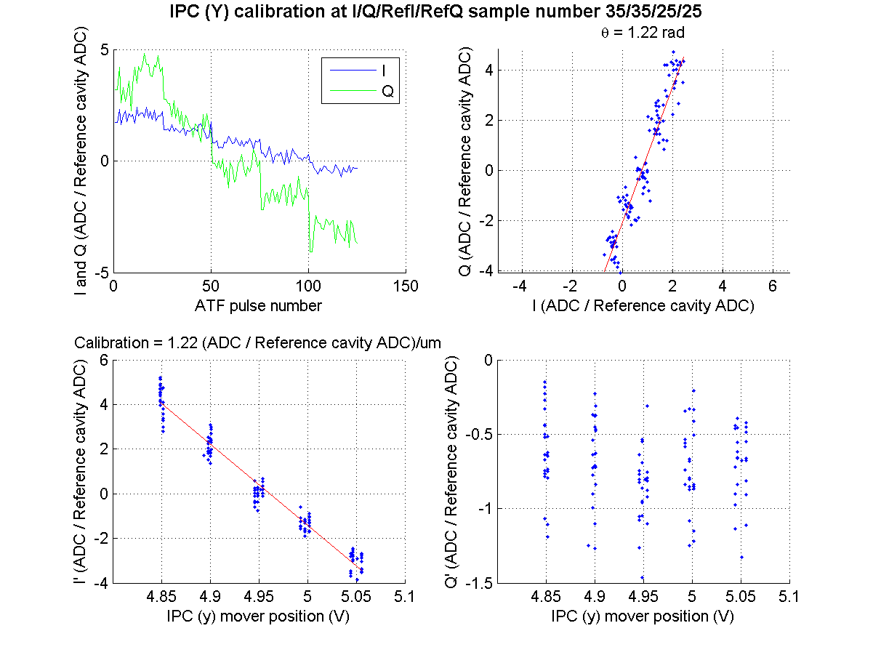
LO: 6 dB
N. Blaskovic

Slide 7
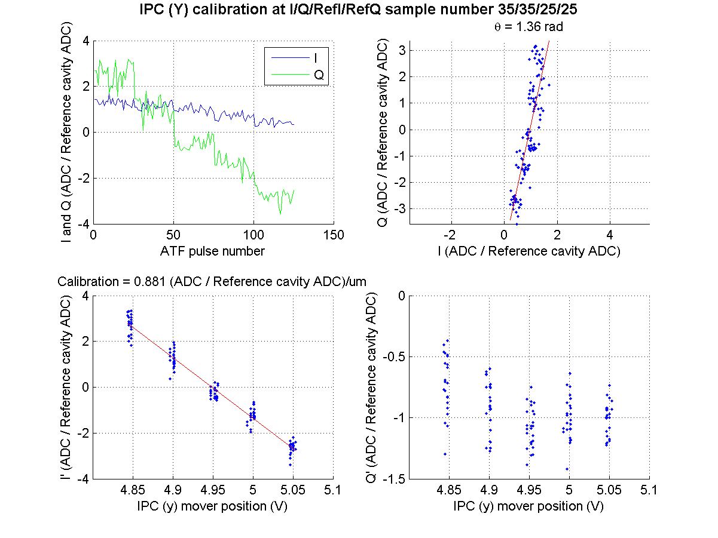
LO: 8 dB
N. Blaskovic

Slide 8
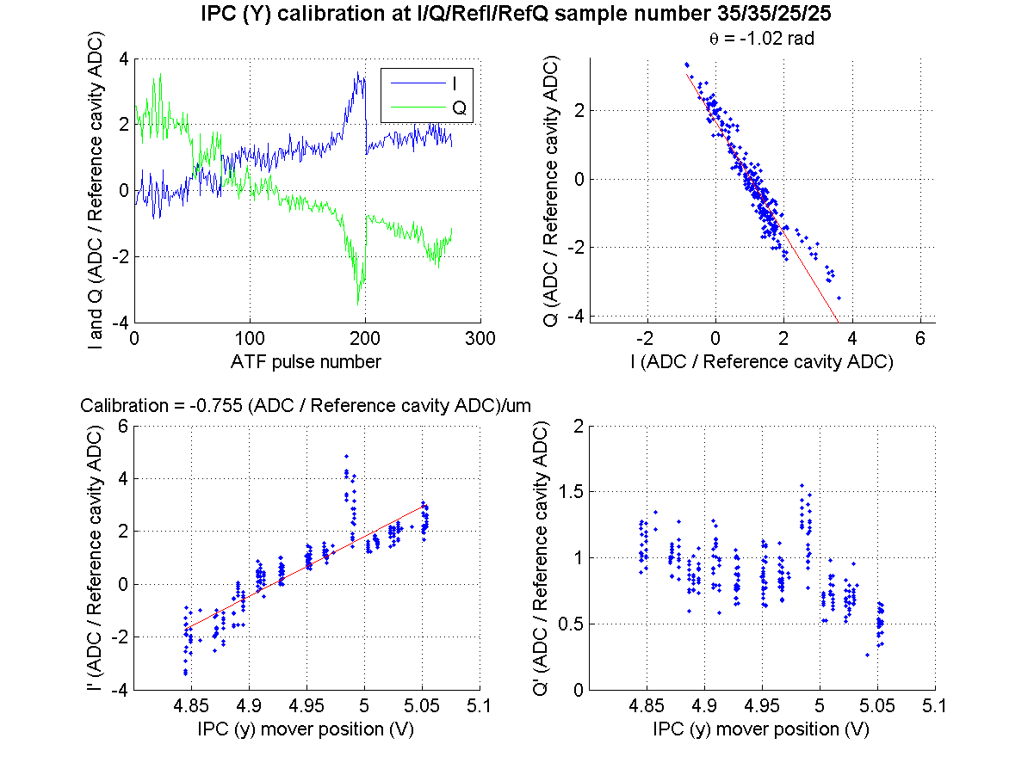
LO: 10 dB
N. Blaskovic

Slide 9
Calibration vs. LO attenuation
Calibration constant falls off with higher LO attenuation
Next slides show:
Summary of calibrations in this presentation
Siwon’s plot of mixer output vs. LO input
N. Blaskovic

Slide 10
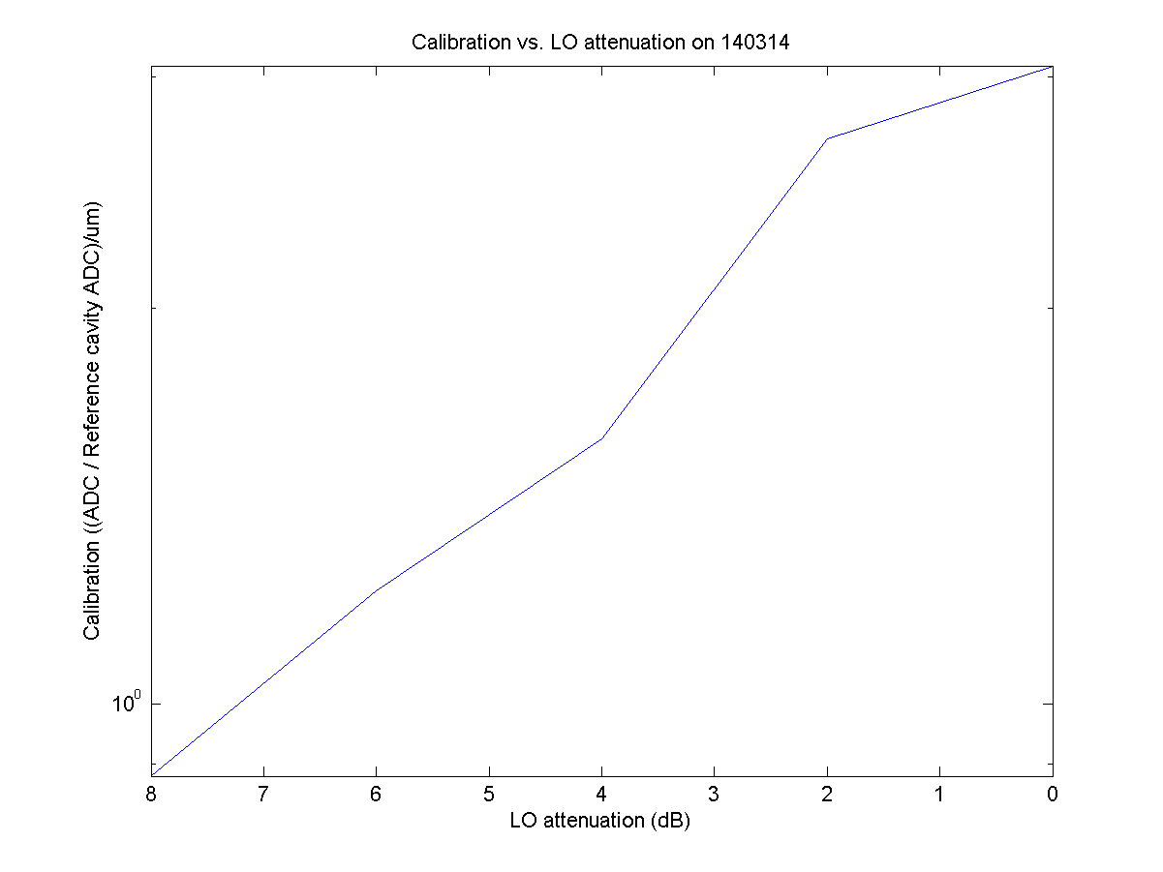
N. Blaskovic

Slide 11
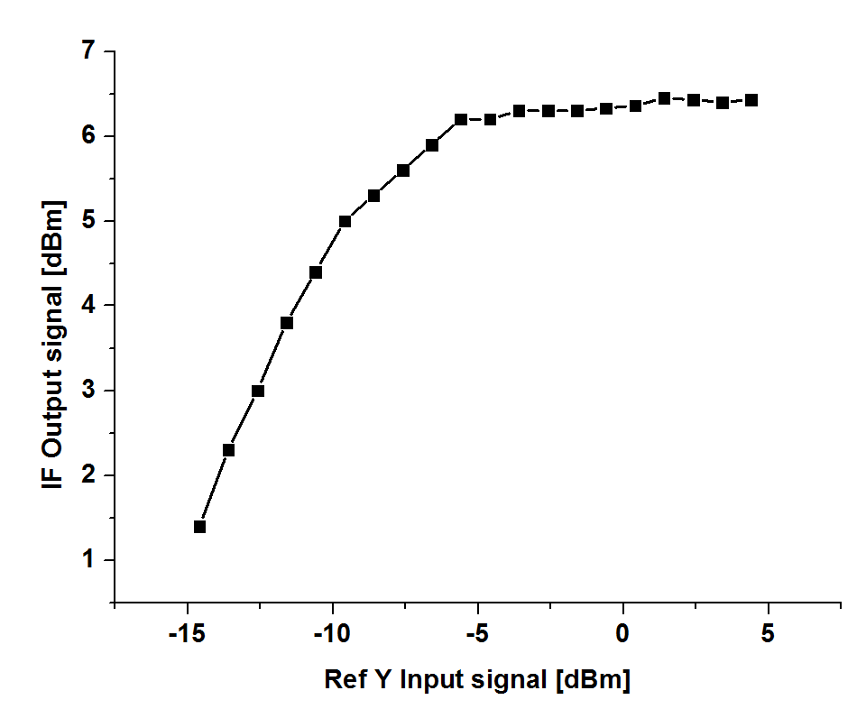
Linear IF output range due to LO input
N. Blaskovic

