Slide 1
JLab Update
Rongli Geng
April 30, 2014
4th LCC ILC Cavity Group Meeting

Slide 2
High Gradient SRF Themes
Understand and reduce field emission
  Cavity vertical testing at Epk 100 MV/m
  Gradient and Q0 degradation due to field emission from vertical testing to operation in cryomoudle
    CEBAF upgrade cavity experiences
Improve efficiency at high and very high gradient
  New shape – higher R/Q and lower Hpk/Eacc
  Large-grain material
  Frozen-in flux (and response to thermal cycling)

Slide 3
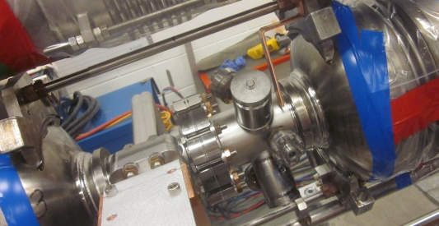
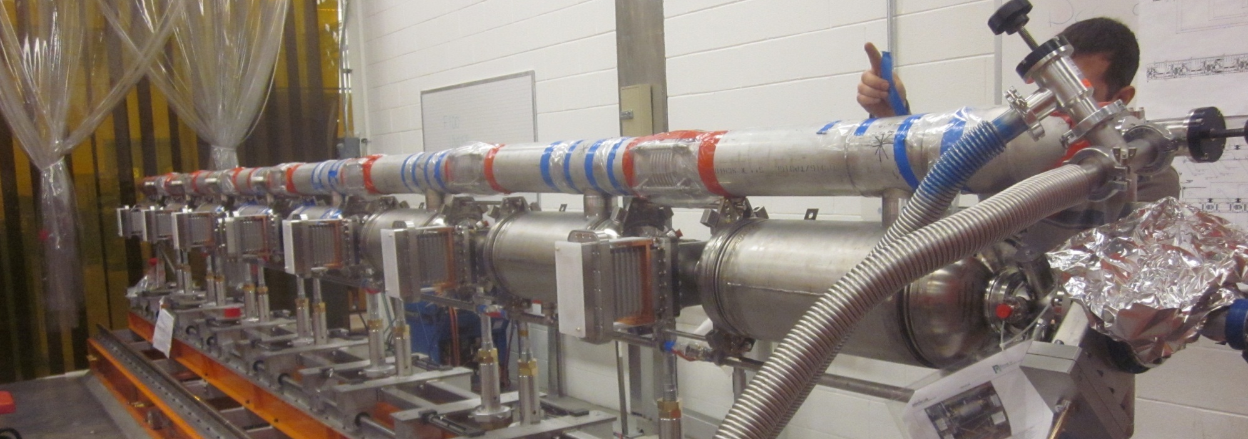
JLab Status: Field Emission Instrumentation
Installation X-ray sensors (Hamamatsu S1223-01) at all cavities in full FEL cryomodule
  Compare field emission data at VTA testing with cryomodule testing
  Establish correlation between FE induced X-ray and FE induced Q0 loss and dark current at end of cryomodule
  Cryomoudle in test cave. Test to be started soon.
One X-ray sensor for each cavity
near beam tube flange
F100 cryomodule cavity string
being assembled and to be tested

Slide 4
JLab Status: High Q0 at 45 MV/m
Two single-cell large-grain niobium cavities under processing and testing for high Q0 at ultra high gradient regime of > 45 MV/m
  New LSF shape 1-cell large-grain cavities (Two each)
    In collaboration with Peking University, Ningxia Large grain material.
    Processing procedure: BCP + 800CX2hr + BCP + 120C bake.
    Test data later slide.
One new single-cell large-grain niobium cavity under processing and testing
  Cavity PJ1-2
    In collaboration with Peking University and OTIC, Ningxia large-grain Nb material and fabrication.
    CEBAF upgrade cavity Low-loss shape, 1.5 GHz.
    Processing procedure: BCP60um+800Cx2hr+BCP60um+HPR+120Cx48hr.
    Max. Eacc 34 MV/m with Q0=1.6E10 at 2K, limited by quench, no FE.
    Max. Eacc 34 MV/m with Q0=2.5E10 at 1.8K, limited by quench, no FE.
    Next is EP and re-test.
    Test data later slide.

Slide 5
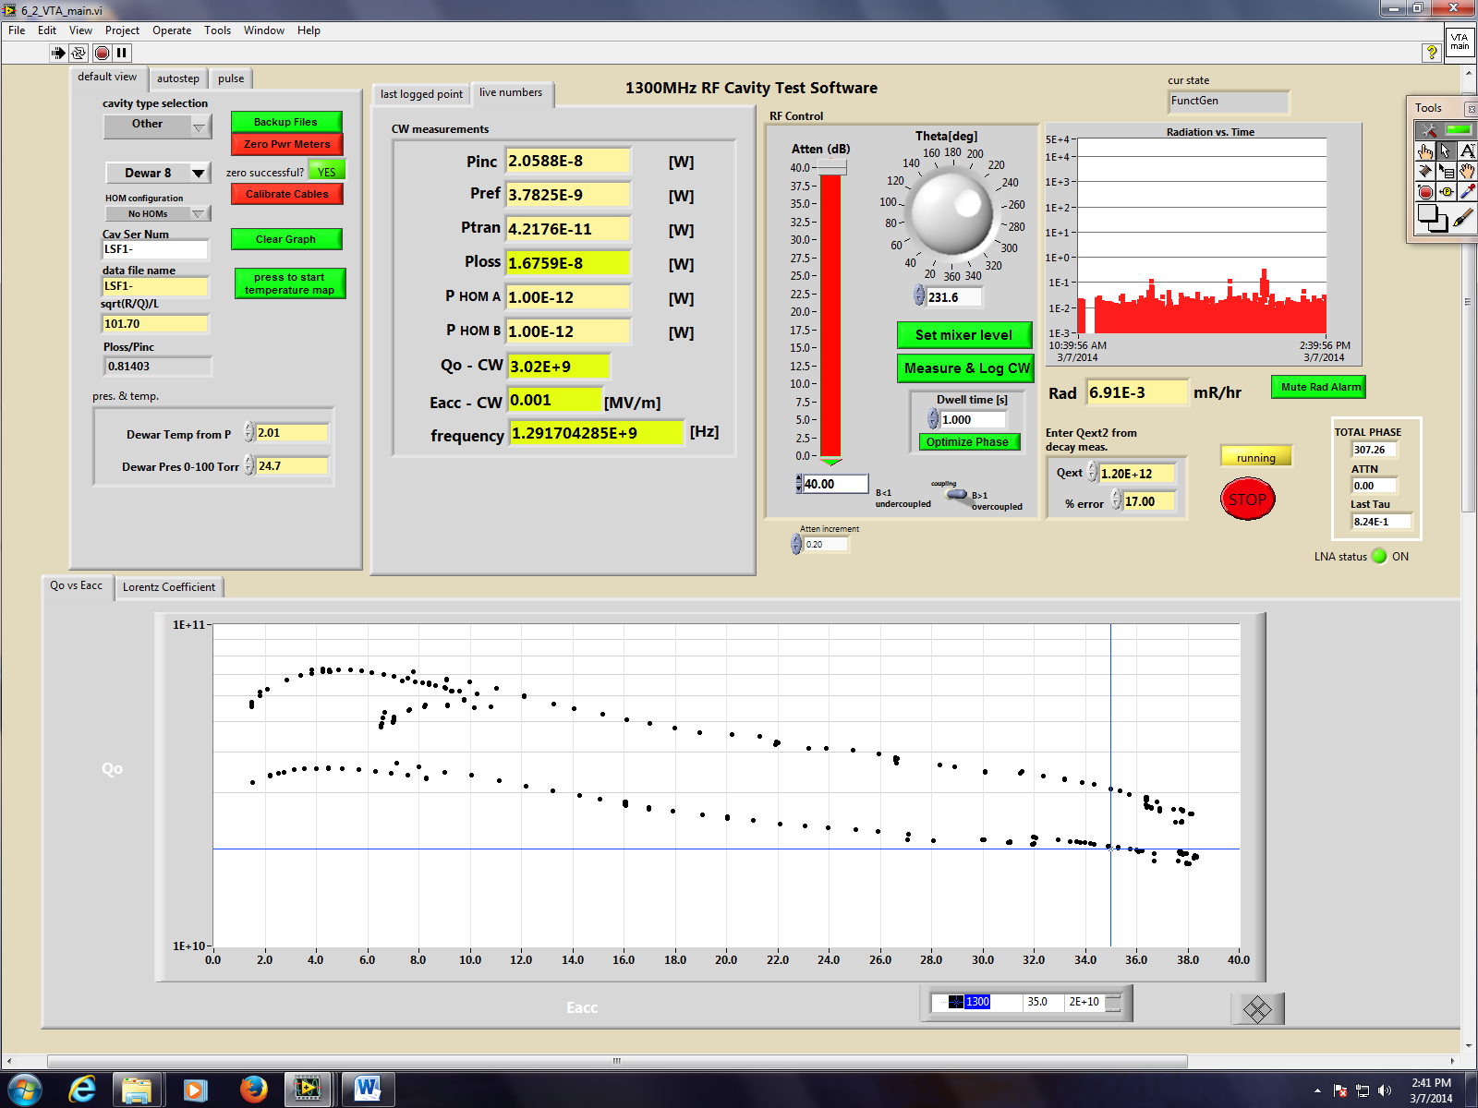
LSF1-2 Cold Test Result
Max. Eacc=38 MV/m with Q0=2E10, no X-ray, quench limit

