Slide 1
Commissioning the SIS3316 Digitizer
D. R. Bett

Slide 2
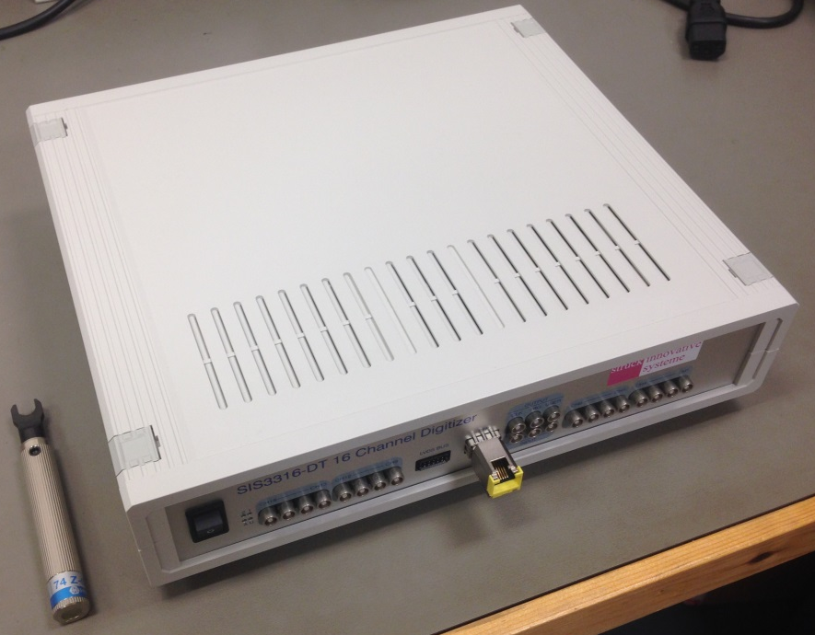
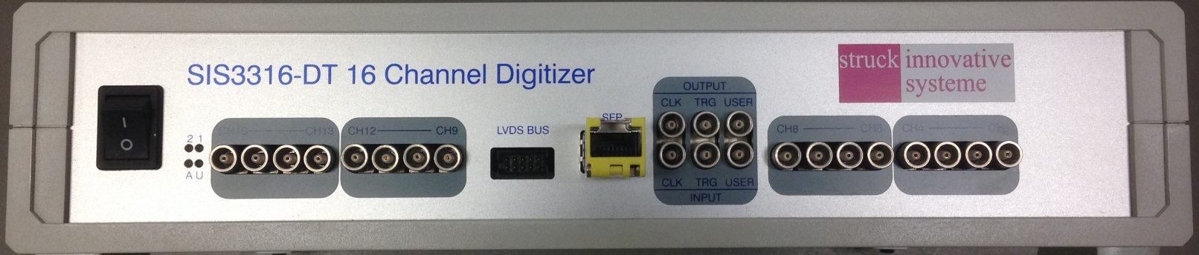
Specification
Property | Value
№ channels | 16
Max sample clock freq. | 250 MHz
Resolution | 14-bit
Max record length | 64 million
ethernet port
NIM in/out
ADC inputs
MAC address 00-00-56-31-60-76

Slide 3
Documentation and software
sis3316
datasheets (ADC, clock, DAC)
doc (manual)
software
ROOT installer
example LabVIEW VIs
C++ applications
xilinx (.bit and .mcs files)

Slide 4
State of the included software
LabVIEW example VIs
complained about missing msvcr100d.dll
after downloading this file from the internet (!) the VIs could be opened and run as expected
C++ applications
a few diagnostics work
most are missing various required libraries
ROOT GUI
now runs but appears to require VME version

Slide 5
Commissioning plan
Establish communication
Read out data with default settings
Read out data using external trigger
Read out data using external clock
Read out data using external clock to drive the internal clock multiplier

Slide 6
Establish communication
Must assign an IP address
ATF: use their DHCP server
Oxford: connect via cable to wired interface of OXFONTDAQLAP01 and manually add the digitizer to the ARP table Enter in Windows Command Prompt: arp –s <inet_addr> <eth_addr> <if_addr> inet_addr = desired IP address for SIS3316 (212.60.16.200) eth_addr = MAC address of SIS3316 (00-00-56-31-60-76) if_addr = IP address of wired network connection
Communication verified using firsttest_userledtoggle.vi

Slide 7
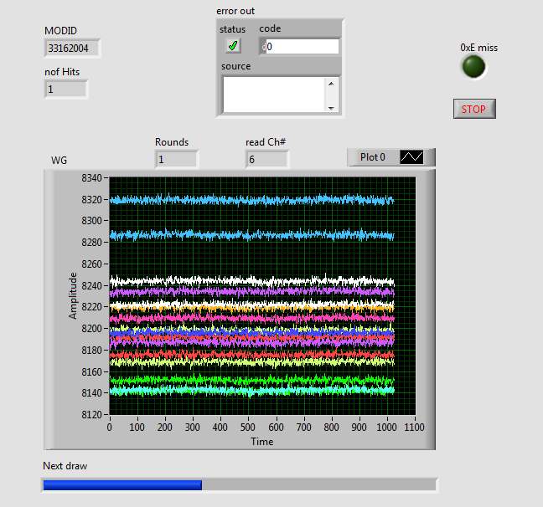
Read out data
Trivial using provided sample_test.vi
had to modify to use internal trigger

Slide 8
Read out data (external trigger)
0 V
NIM levels required
TGA12104 borrowed from Colin
Triggers as expected in sample_test.vi
–0.8 V

Slide 9
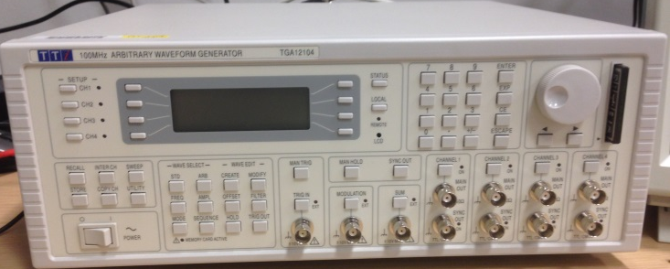
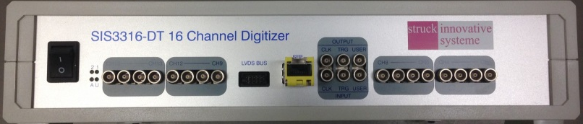
Lab setup
TGA12104 100 MHz
Arbitrary Waveform
Generator
NIM trigger
10 MHz sine wave
SIS3316
crossover cable
OXFONTDAQLAP01

Slide 10
Summary
Milestone | Done? | Comment
Establish communication | ✓ | Manually added the MAC address of the digitizer to the ARP table
Read out data with default settings (125 MHz, internal trigger) | ✓ | Used sample_test.vi (required downloading msvcr100d.dll)
Read out data using an external trigger | ✓ | Used TGA12104 to generate a trigger signal with NIM levels
Read out data using an external trigger and an external clock | - | Generate a clock with NIM levels
Read out data using an external trigger and a multiplied version of the external clock | - | Reverse engineer configuration of the clock multiplier from the provided C++ functions and the documentation for the Si5325

