Slide 1
Toohig Finalist Presentation
Douglas Bett
UNIVERSITY OF OXFORD

Slide 2
Contents
Toohig Finalist Presentation
Douglas Bett
UNIVERSITY OF OXFORD
Contents
BACKGROUND - FONT concept - FONT5 schematic - FONT5 @ ATF2
- Upstream feedback
- BPM electronics - FONT5 firmware - BPM performance - Feedback results
ACCOMPLISHMENTS - LO phase - Long train firmware - FONT DAQ
WITHIN LARP
Final
Background
Accomplishments
Within LARP

Slide 3
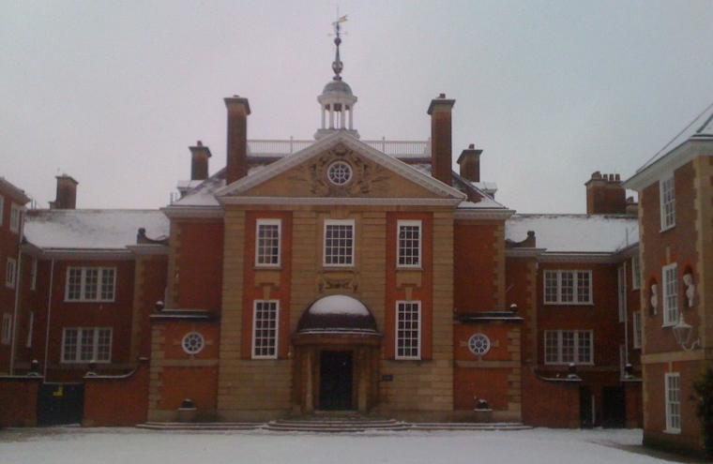
Background
Toohig Finalist Presentation
Douglas Bett
UNIVERSITY OF OXFORD
Contents
BACKGROUND - FONT concept - FONT5 schematic - FONT5 @ ATF2
- Upstream feedback
- BPM electronics - FONT5 firmware - BPM performance - Feedback results
ACCOMPLISHMENTS - LO phase - Long train firmware - FONT DAQ
WITHIN LARP
Final
MPhys University of Oxford
DPhil (Particle Physics) University of Oxford Thesis title: “The Development of a Fast Intra-train Beam-based Feedback System Capable of Operating on the Bunch Trains of the International Linear Collider”
Post-doctoral Research Assistant John Adams Institute (University of Oxford)

Slide 4
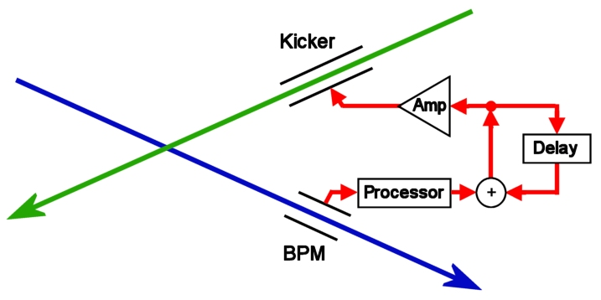
FONT concept
Toohig Finalist Presentation
Douglas Bett
UNIVERSITY OF OXFORD
Contents
BACKGROUND - FONT concept - FONT5 schematic - FONT5 @ ATF2
- Upstream feedback
- BPM electronics - FONT5 firmware - BPM performance - Feedback results
ACCOMPLISHMENTS - LO phase - Long train firmware - FONT DAQ
WITHIN LARP
Final
Feedback on Nanosecond Timescales
Position feedback system for future LC

Slide 5
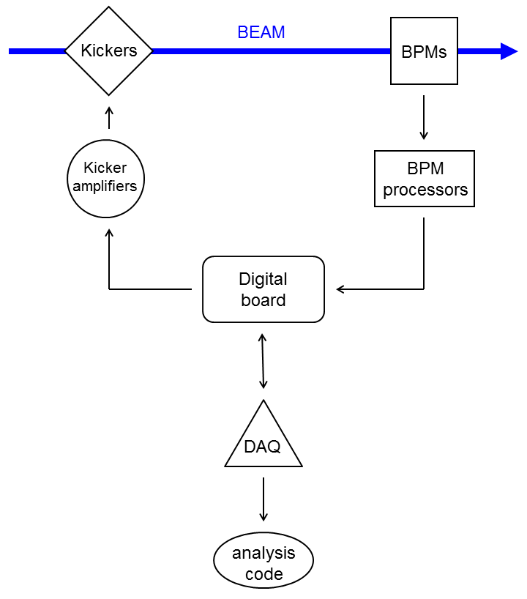
FONT5 schematic
Toohig Finalist Presentation
Douglas Bett
UNIVERSITY OF OXFORD
Contents
BACKGROUND - FONT concept - FONT5 schematic - FONT5 @ ATF2
- Upstream feedback
- BPM electronics - FONT5 firmware - BPM performance - Feedback results
ACCOMPLISHMENTS - LO phase - Long train firmware - FONT DAQ
WITHIN LARP
Final
Beamline hardware
Support hardware
Feedback control unit
User
interface
Interpret data

Slide 6
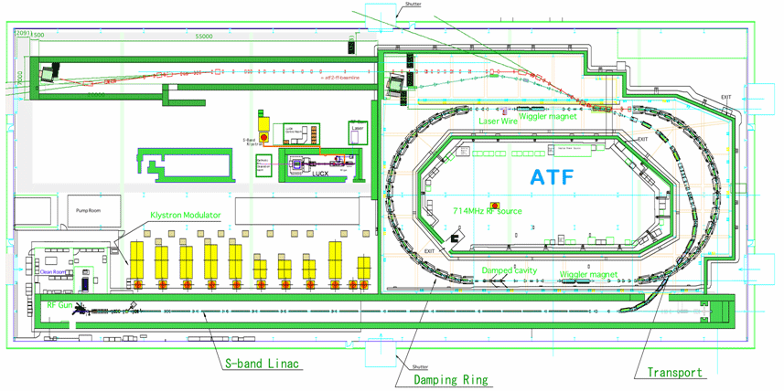
FONT5 at ATF2 (KEK)
Toohig Finalist Presentation
Douglas Bett
UNIVERSITY OF OXFORD
Contents
BACKGROUND - FONT concept - FONT5 schematic - FONT5 @ ATF2
- Upstream feedback
- BPM electronics - FONT5 firmware - BPM performance - Feedback results
ACCOMPLISHMENTS - LO phase - Long train firmware - FONT DAQ
WITHIN LARP
Final
Upstream feedback
FF
P3
P2
K2
K1
IPB
IPK
IP feedback

Slide 7
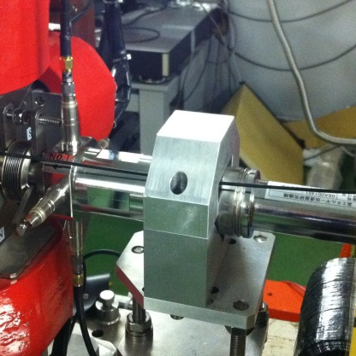
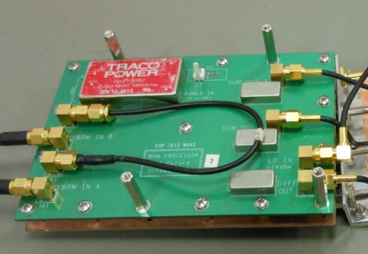
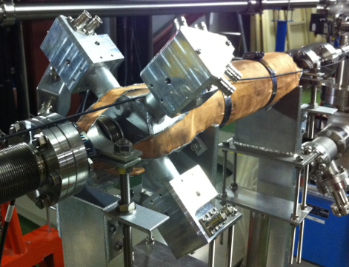
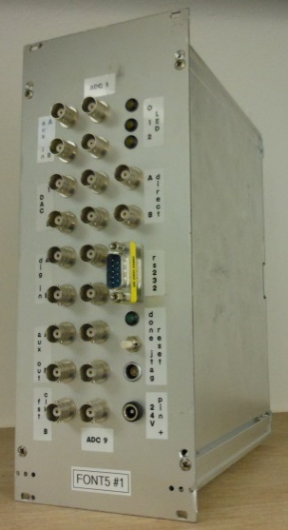
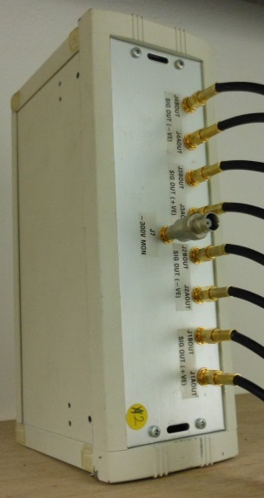

Upstream feedback
Toohig Finalist Presentation
Douglas Bett
UNIVERSITY OF OXFORD
Contents
BACKGROUND - FONT concept - FONT5 schematic - FONT5 @ ATF2
- Upstream feedback
- BPM electronics - FONT5 firmware - BPM performance - Feedback results
ACCOMPLISHMENTS - LO phase - Long train firmware - FONT DAQ
WITHIN LARP
Final
FONT BPM processors
Form $Δ, Σ$ signals Downmix with 714 MHz
stripline BPMs
Length = 120 mm Radius = 12 mm
stripline kickers 3 ns fill time 20 µrad kick
Kicker amplifiers 35 ns rise time
30 A of drive current
FONT5 digital board Virtex-5 FPGA
9 ADC inputs (357 MHz)
2 DAC outputs

Slide 8
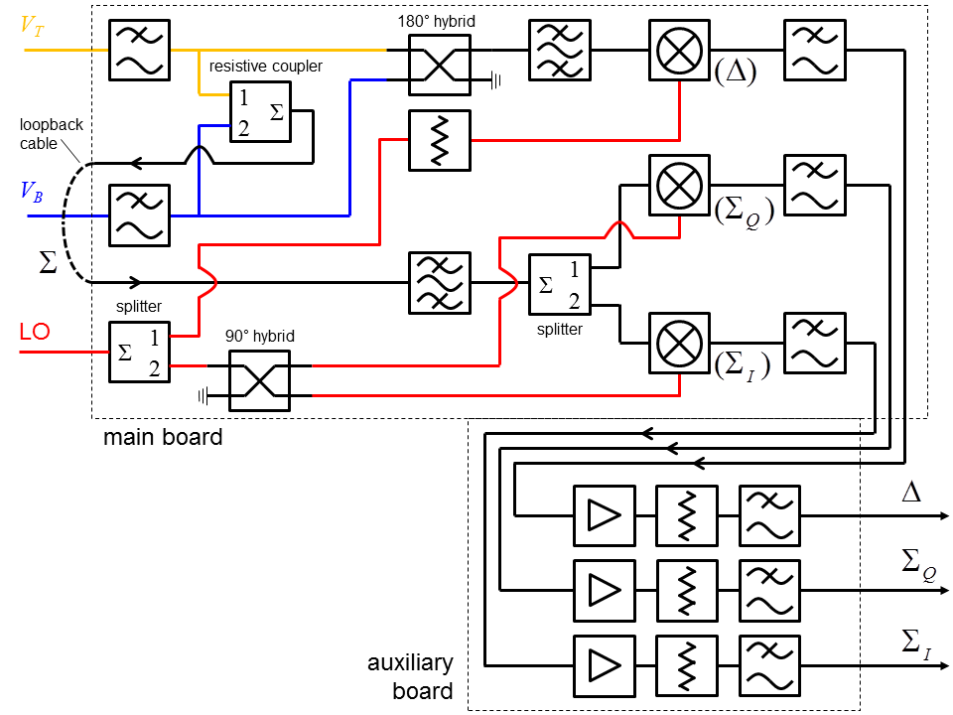
BPM electronics
Toohig Finalist Presentation
Douglas Bett
UNIVERSITY OF OXFORD
Contents
BACKGROUND - FONT concept - FONT5 schematic - FONT5 @ ATF2
- Upstream feedback
- BPM electronics - FONT5 firmware - BPM performance - Feedback results
ACCOMPLISHMENTS - LO phase - Long train firmware - FONT DAQ
WITHIN LARP
Final

Slide 9
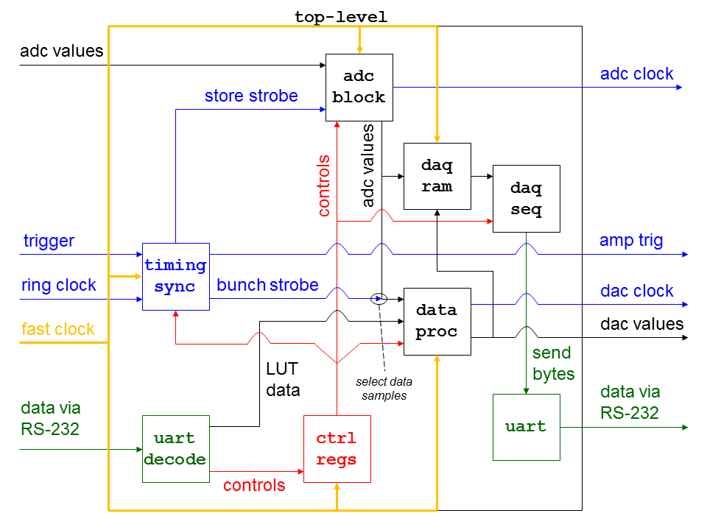
FONT5 firmware
Toohig Finalist Presentation
Douglas Bett
UNIVERSITY OF OXFORD
Contents
BACKGROUND - FONT concept - FONT5 schematic - FONT5 @ ATF2
- Upstream feedback
- BPM electronics - FONT5 firmware - BPM performance - Feedback results
ACCOMPLISHMENTS - LO phase - Long train firmware - FONT DAQ
WITHIN LARP
Final
Written in Verilog HDL

Slide 10
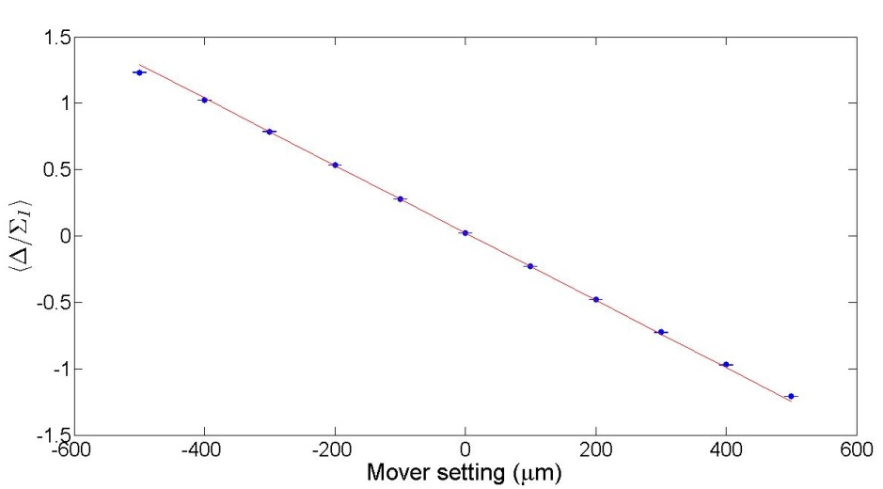
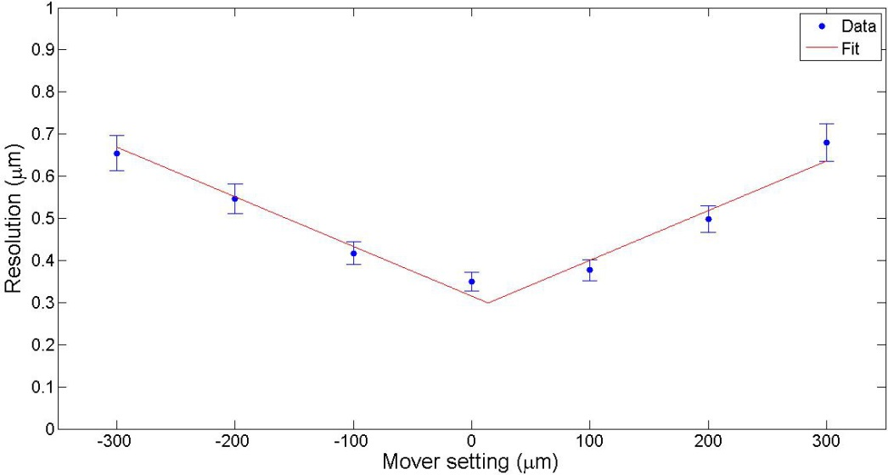
BPM system performance
Toohig Finalist Presentation
Douglas Bett
UNIVERSITY OF OXFORD
Contents
BACKGROUND - FONT concept - FONT5 schematic - FONT5 @ ATF2
- Upstream feedback
- BPM electronics - FONT5 firmware - BPM performance - Feedback results
ACCOMPLISHMENTS - LO phase - Long train firmware - FONT DAQ
WITHIN LARP
Final
Dynamic range ± 400 µm
Resolution
~ 300 nm

Slide 11
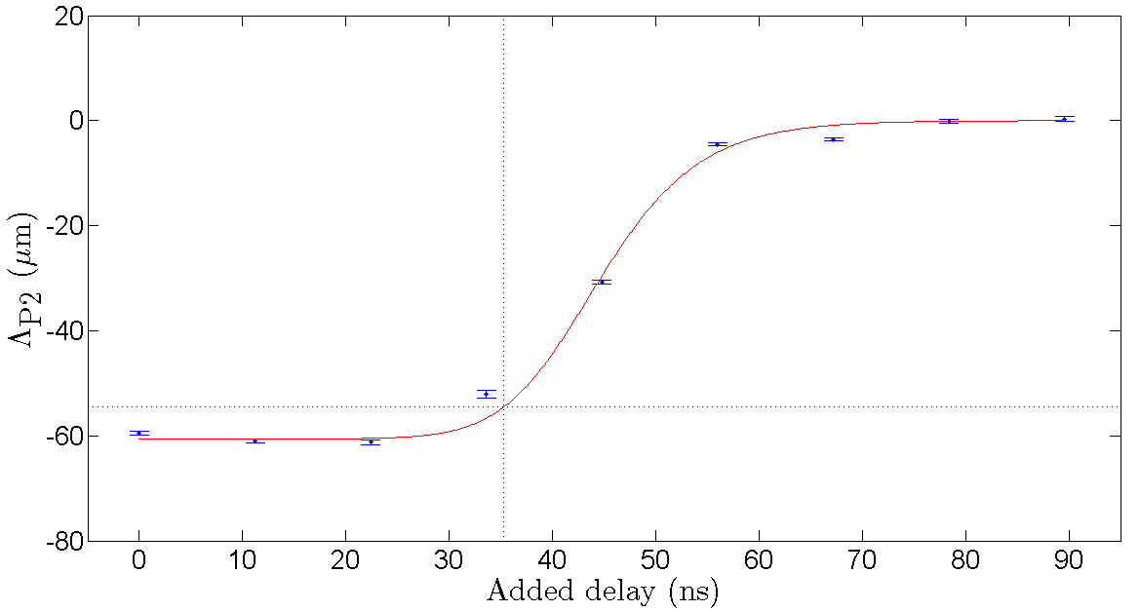
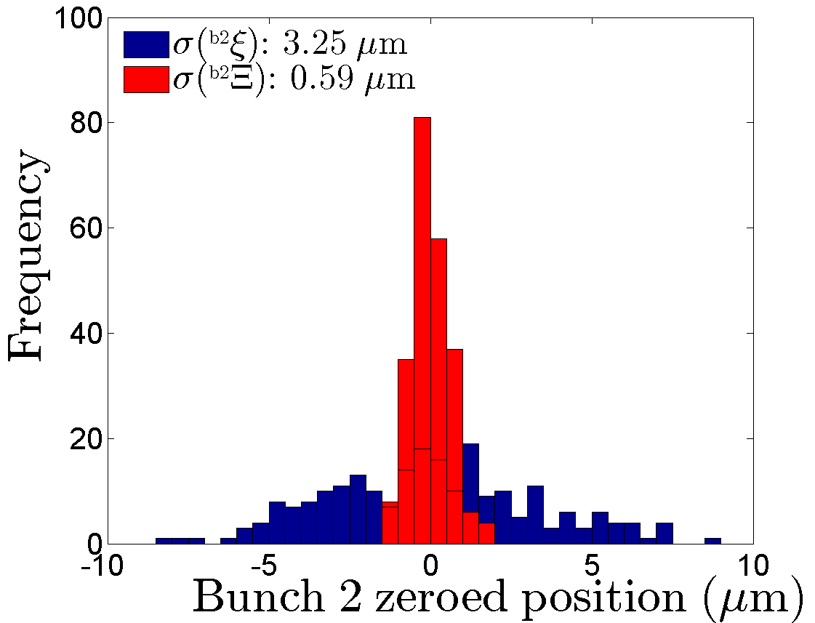
Feedback results
Toohig Finalist Presentation
Douglas Bett
UNIVERSITY OF OXFORD
Contents
BACKGROUND - FONT concept - FONT5 schematic - FONT5 @ ATF2
- Upstream feedback
- BPM electronics - FONT5 firmware - BPM performance - Feedback results
ACCOMPLISHMENTS - LO phase - Long train firmware - FONT DAQ
WITHIN LARP
Final
Added delay = 30 ns
→ System latency = 155 ns
Jitter of second bunch < 500 nm

Slide 12
Accomplishments
Toohig Finalist Presentation
Douglas Bett
UNIVERSITY OF OXFORD
Contents
BACKGROUND - FONT concept - FONT5 schematic - FONT5 @ ATF2
- Upstream feedback
- BPM electronics - FONT5 firmware - BPM performance - Feedback results
ACCOMPLISHMENTS - LO phase - Long train firmware - FONT DAQ
WITHIN LARP
Final
LO phase sensitivity
Long train firmware
FONT DAQ

Slide 13
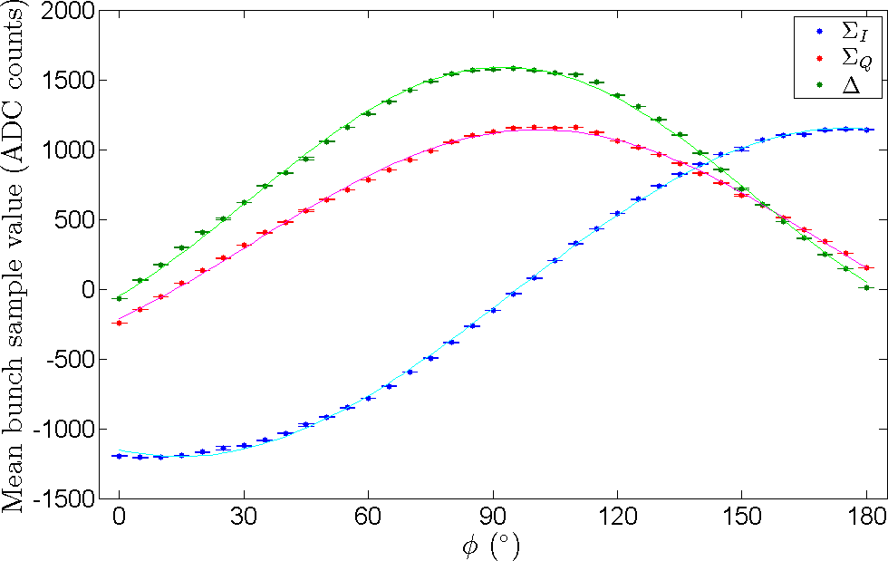
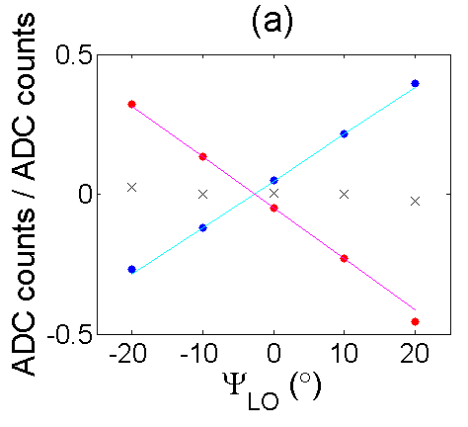



LO phase
Toohig Finalist Presentation
Douglas Bett
UNIVERSITY OF OXFORD
Contents
BACKGROUND - FONT concept - FONT5 schematic - FONT5 @ ATF2
- Upstream feedback
- BPM electronics - FONT5 firmware - BPM performance - Feedback results
ACCOMPLISHMENTS - LO phase - Long train firmware - FONT DAQ
WITHIN LARP
Final
$Δ$ signal has large
quadrature component due
to phase difference between stripline output signals
→ LO phase jitter appears as position jitter
$$Σ_{Q}/Σ_{I}$$
By subtracting the spurious position component arising from the phase mismatch, the true position of the beam can be recovered.
$$Δ/Σ_{I}$$
y

Slide 14
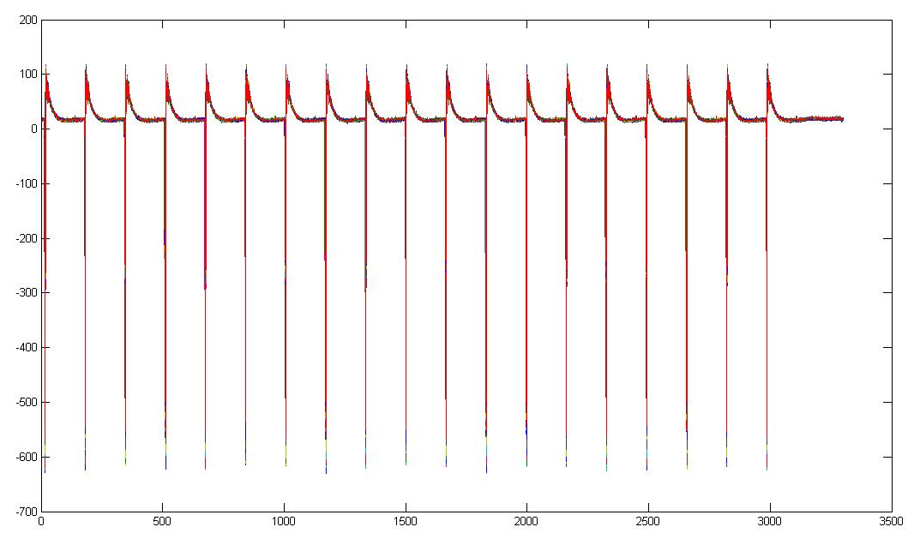
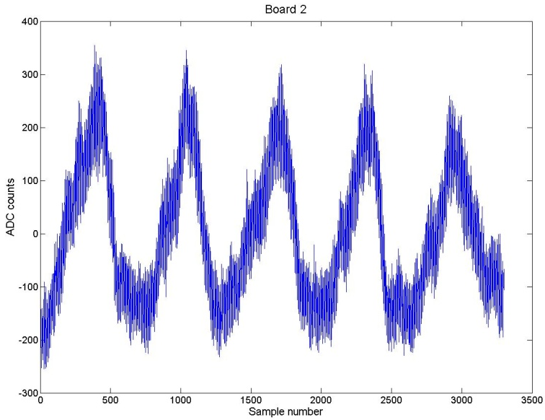
Long train firmware
Toohig Finalist Presentation
Douglas Bett
UNIVERSITY OF OXFORD
Contents
BACKGROUND - FONT concept - FONT5 schematic - FONT5 @ ATF2
- Upstream feedback
- BPM electronics - FONT5 firmware - BPM performance - Feedback results
ACCOMPLISHMENTS - LO phase - Long train firmware - FONT DAQ
WITHIN LARP
Final
for use with ATF2 fast extraction kicker
used for several diagnostic studies
ADC counts
sample number
Waveforms from a testbench setup designed to isolate sources of sample timing jitter
Waveforms from FONT5 board monitoring ATF2 damping ring BPM over last 19 turns before extraction

Slide 15
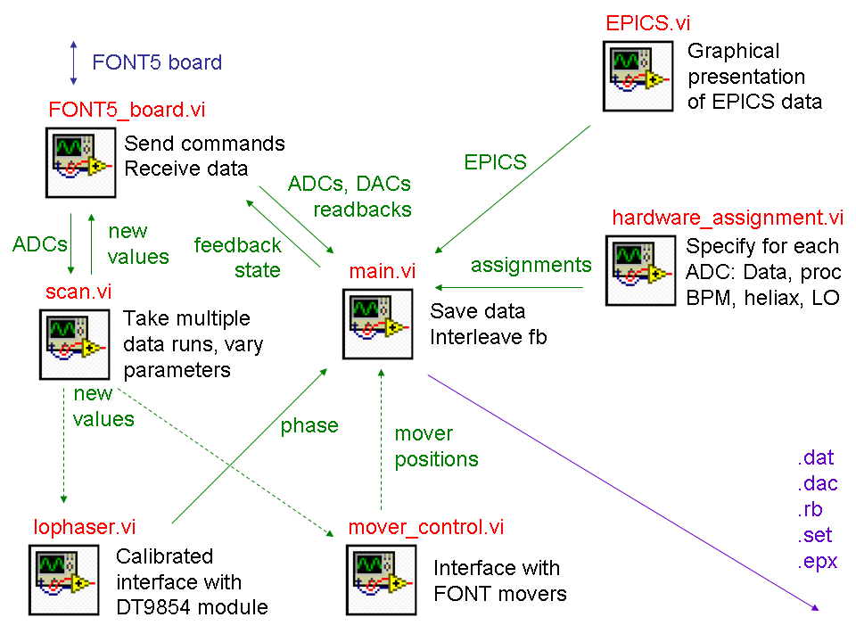
FONT DAQ
Toohig Finalist Presentation
Douglas Bett
UNIVERSITY OF OXFORD
Contents
BACKGROUND - FONT concept - FONT5 schematic - FONT5 @ ATF2
- Upstream feedback
- BPM electronics - FONT5 firmware - BPM performance - Feedback results
ACCOMPLISHMENTS - LO phase - Long train firmware - FONT DAQ
WITHIN LARP
Final
Written in LabVIEW

Slide 16
Within LARP
Toohig Finalist Presentation
Douglas Bett
UNIVERSITY OF OXFORD
Contents
BACKGROUND - FONT concept - FONT5 schematic - FONT5 @ ATF2
- Upstream feedback
- BPM electronics - FONT5 firmware - BPM performance - Feedback results
ACCOMPLISHMENTS - LO phase - Long train firmware - FONT DAQ
WITHIN LARP
Final
pending

Slide 17
Toohig Finalist Presentation
Douglas Bett
UNIVERSITY OF OXFORD
Contents
BACKGROUND - FONT concept - FONT5 schematic - FONT5 @ ATF2
- Upstream feedback
- BPM electronics - FONT5 firmware - BPM performance - Feedback results
ACCOMPLISHMENTS - LO phase - Long train firmware - FONT DAQ
WITHIN LARP
Final
Thank you for your attention!
Questions?

Slide 18
Extras follow

Slide 19
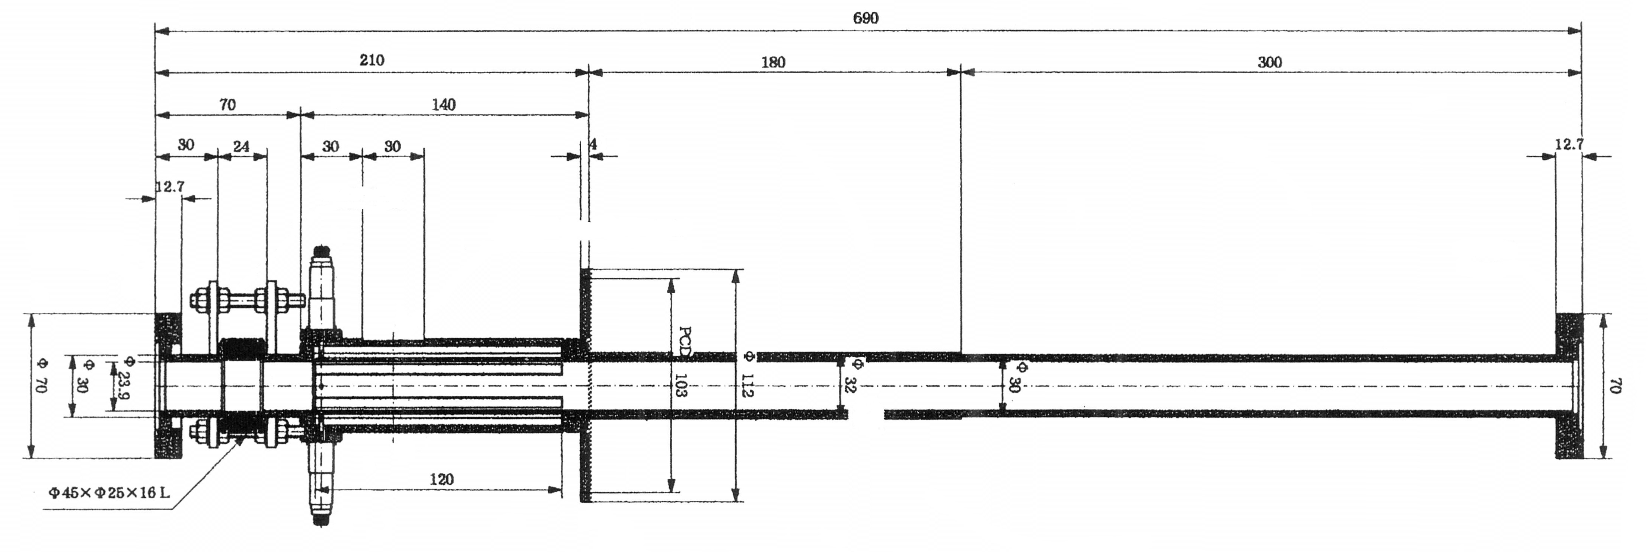
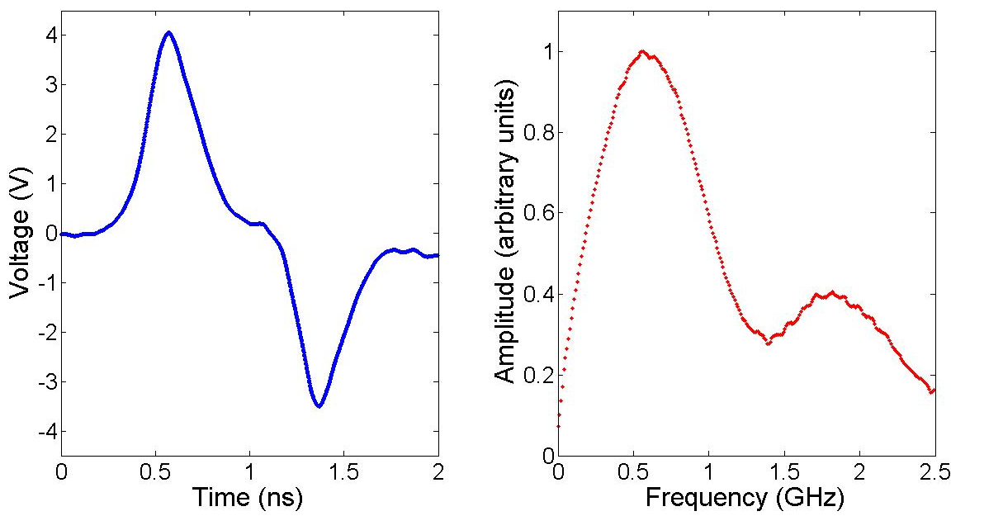
Stripline BPM signals
Time domain
Frequency domain

Slide 20
FONT concept
kicker
Good alignment
Luminosity restored
Poor alignment
Low luminosity
FONT
BPM

Slide 21
Collaboration
ATF2 – KEK, Japan
CTF3 – CERN, Switzerland
Phase stuff
KNU - New IPBPM readout system

