Slide 1
Jitter propagation to the IP waist
N. Blaskovic
N. Blaskovic

Slide 2
Contents
Ballistic path in IP area propagated from measured P2 and P3 positions using MAD linear transfer matrices
Upstream feedback results propagated to on-waist and off-waist locations in IP area
Propagation of slow orbit drift to IP area
Position correlation of off-waist locations
Position correlation off-waist to on-waist
N. Blaskovic

Slide 3
Propagation method
P2 and P3 positions propagated using MAD linear transfer matrices to obtain position and angle of each trigger at IP marker
Straight lines drawn through IP area given ballistic trajectory
Beam jitter deduced over a range of s
Waist identified as point with least jitter
N. Blaskovic

Slide 4
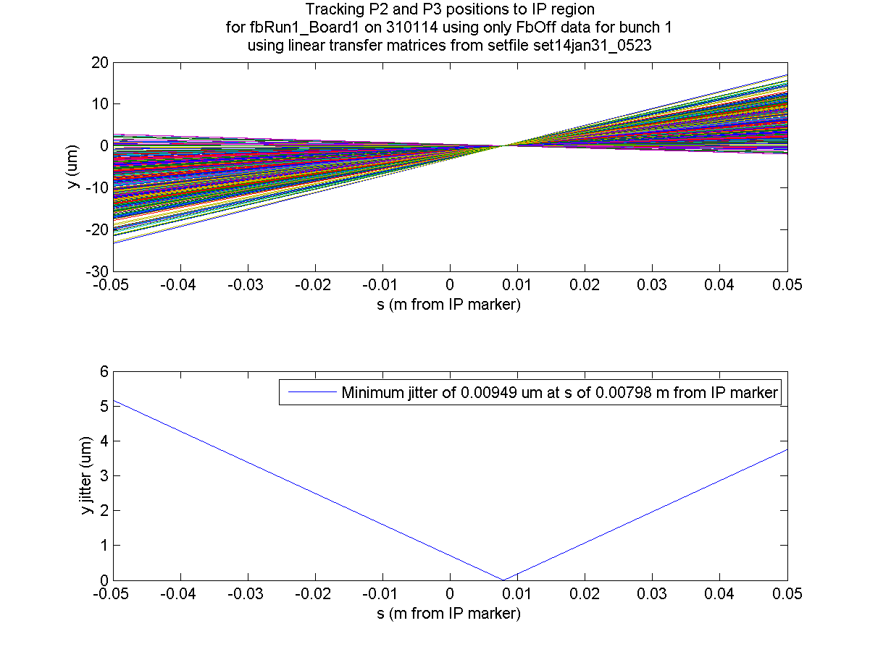
Bunch 1
FbOff
N. Blaskovic

Slide 5
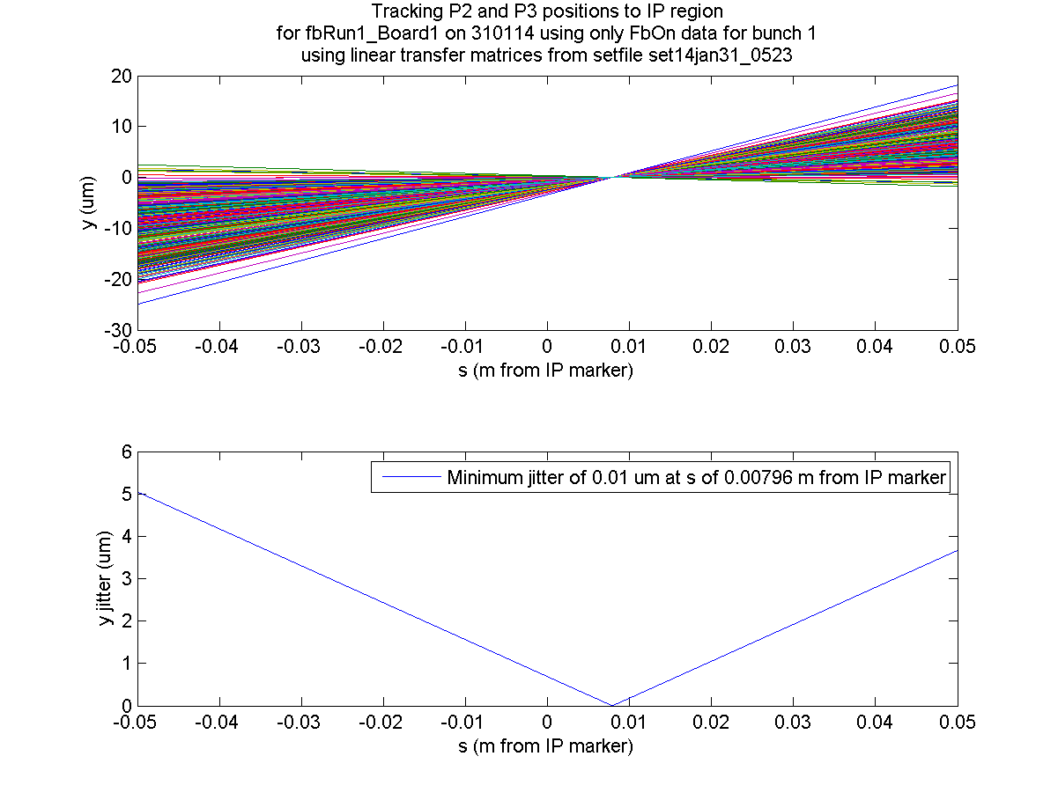
Bunch 1
FbOn
N. Blaskovic

Slide 6
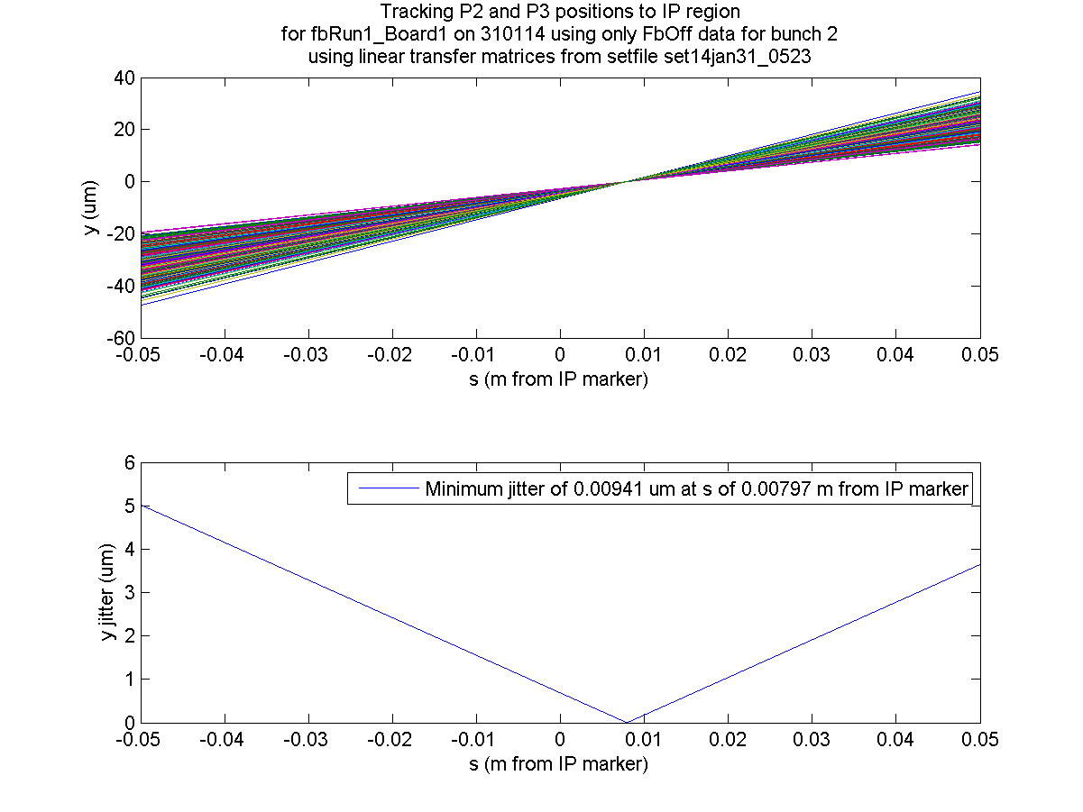
Bunch 2
FbOff
N. Blaskovic

Slide 7
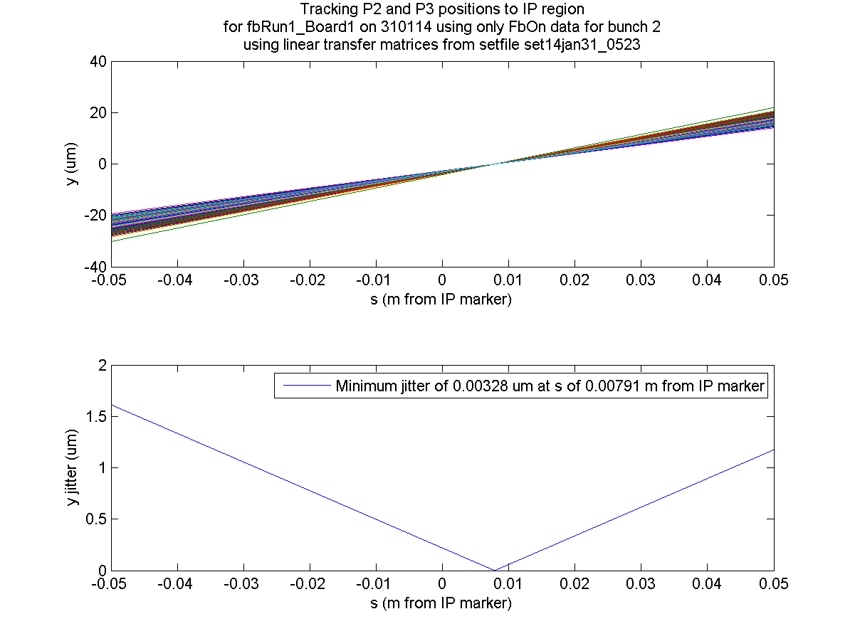
Bunch 2
FbOn
N. Blaskovic

Slide 8
Feedback
Nominal, coupled loop feedback run fbRun1 on 31st January 2014
Following histograms shown:
  Measured positions at P2, P3 and MFB1FF
  Propagated positions at IP waist
Propagation to IP waist by propagating to s-location of IP marker plus 7.96 mm drift
N. Blaskovic

Slide 9
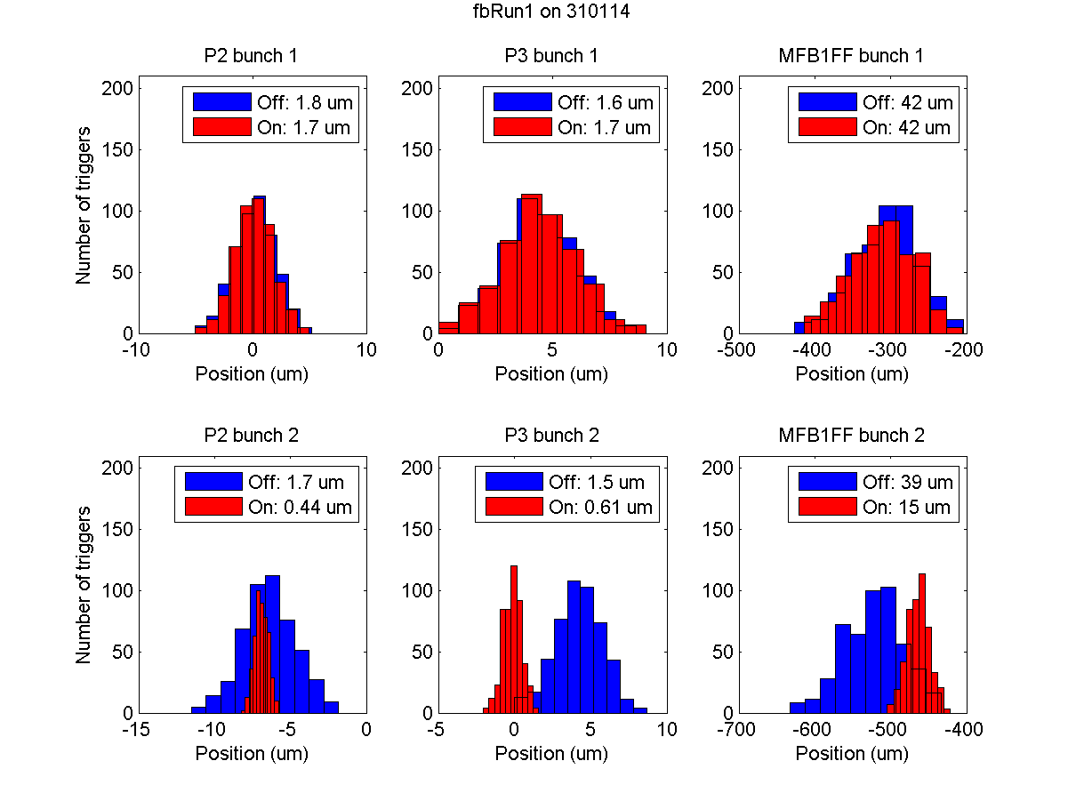
N. Blaskovic

Slide 10
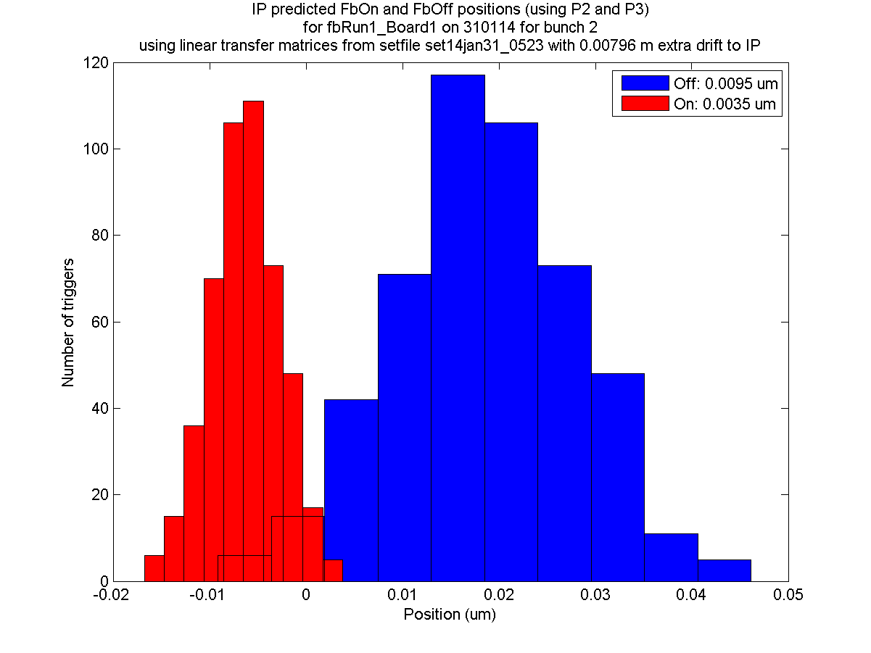
Bunch 2
N. Blaskovic

Slide 11
Slow drift
Slow drift seen upstream, e.g. at MFB1FF
Slow drift not seen at IP waist
N. Blaskovic

Slide 12
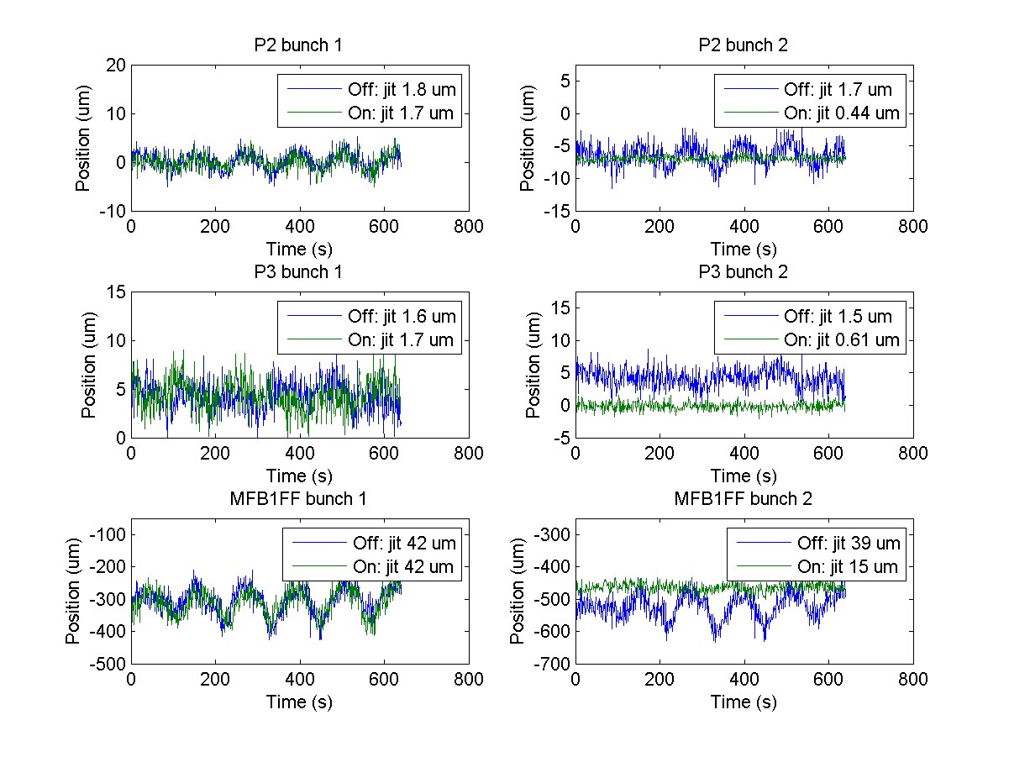
N. Blaskovic

Slide 13
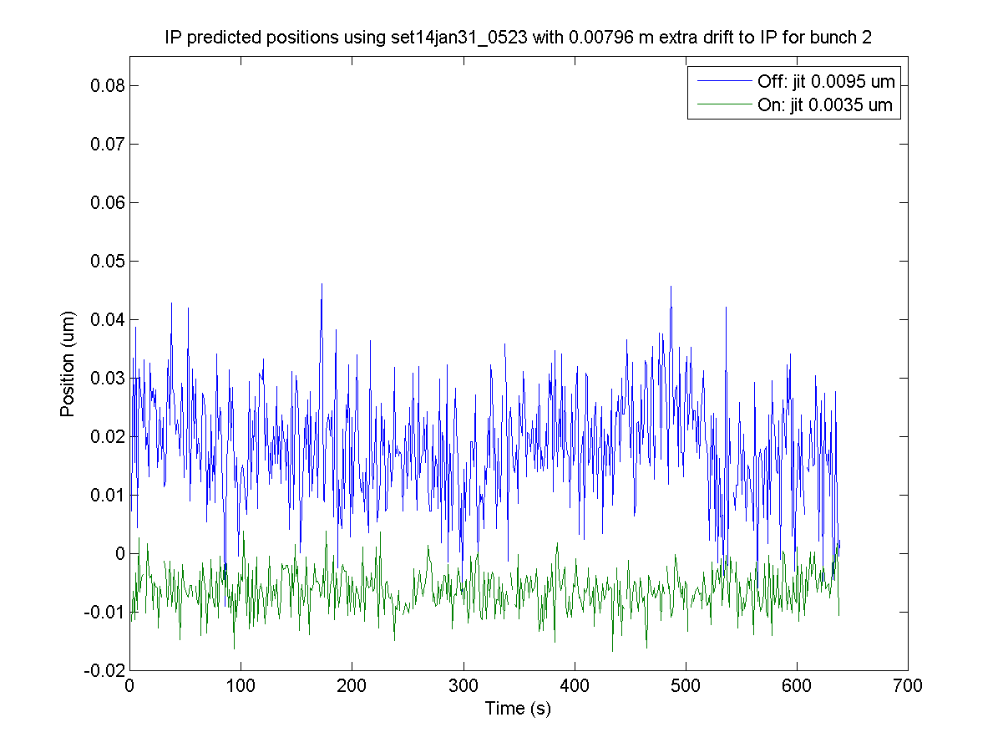
Bunch 2
N. Blaskovic

Slide 14
Slow drift
Slow position drift present in IP area when not on waist
Slow drift present at IP waist only as slow angular drift, and not as slow position drift
N. Blaskovic

Slide 15
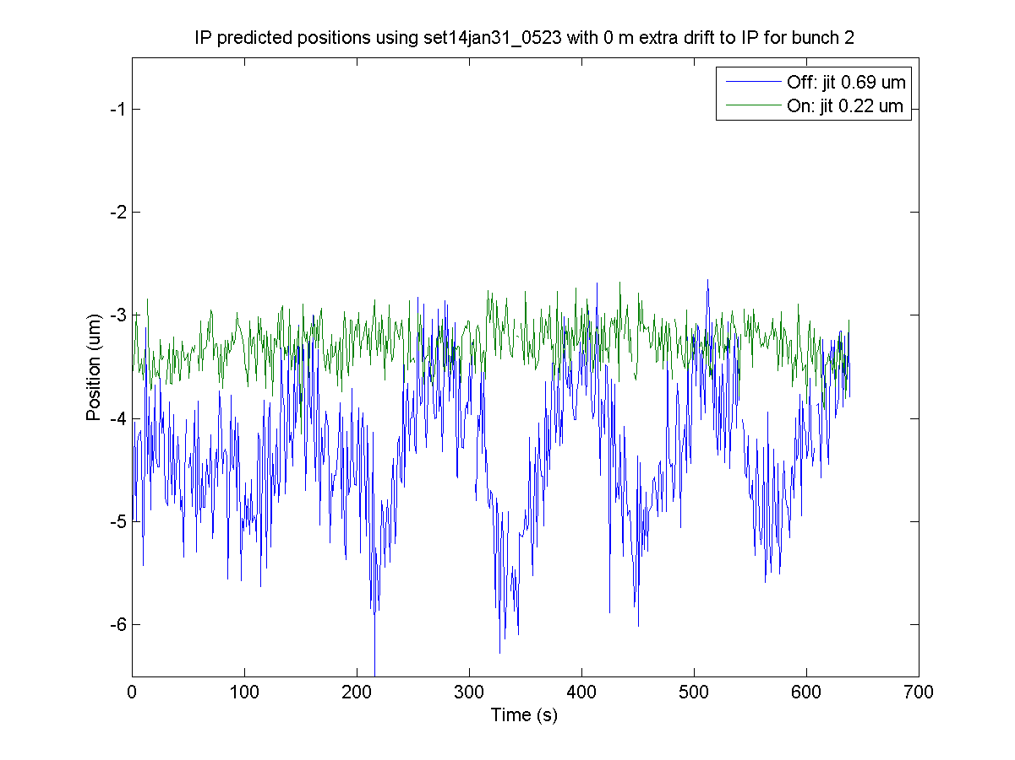
Bunch 2
N. Blaskovic

Slide 16
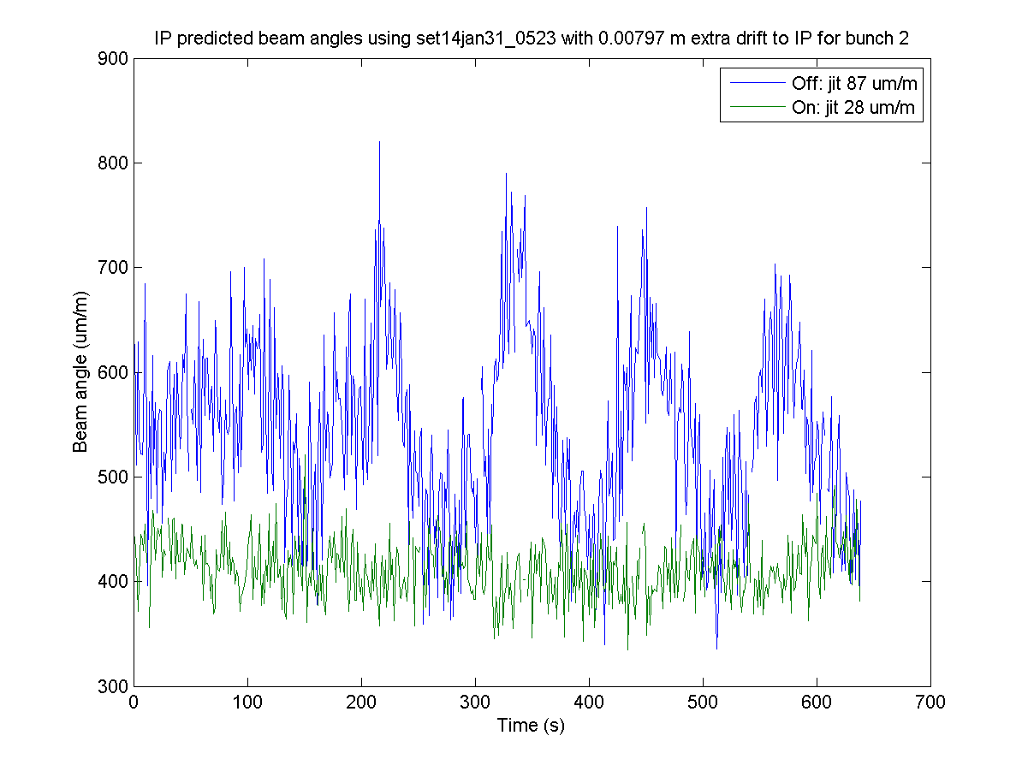
Bunch 2
N. Blaskovic

Slide 17
Off-waist position correlation
Beam position propagated to points 5 cm upstream and 5 cm downstream of IP
Position correlation between the 2 points is -99.999 %, perhaps allowing a 2 BPM resolution calculation (e.g. IPB & IPC)
N. Blaskovic

Slide 18
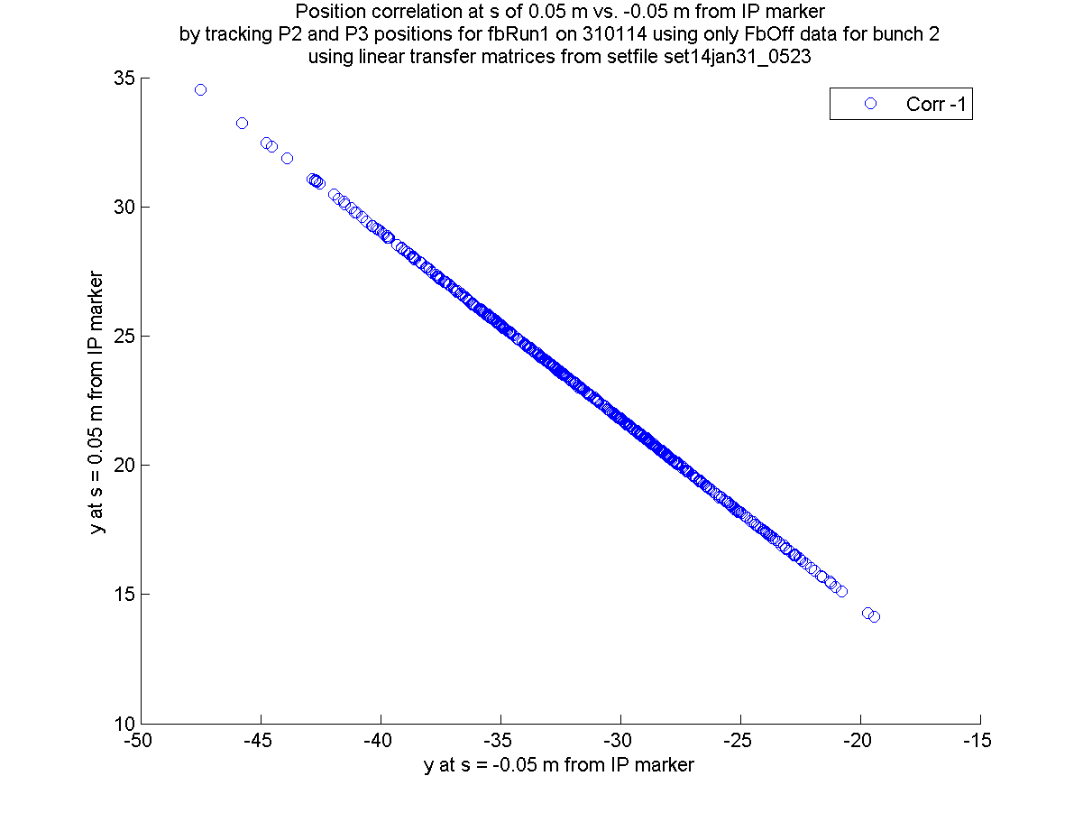
N. Blaskovic

Slide 19
On-waist position correlation
Beam position propagated to point 5 cm upstream of IP and propagated to IP waist
Position correlation of off-waist to on-waist location is 0 due to focal nature of IP waist (90° phase advance off-waist to on-waist)
N. Blaskovic

Slide 20
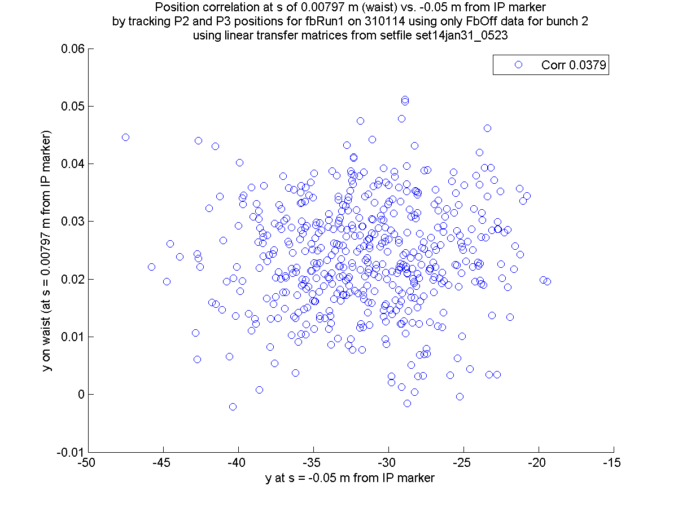
N. Blaskovic

