Slide 1
Initial Results From FONT5/ Phase Feedforward Optics Tests 15th April 2014
Jack Roberts
Glenn Christian
Piotr Skowronski

Slide 2
Introduction
Initial results from data taking 15th April
Tests with FONT5 board.
General tests
Viewing Frascati monitor signals.
Frascati monitor calibration.
Phase feedforward correction output.
TL2 phase feedforward optics.
Optics/phase propagation studies.
Comparisons between Frascati and PETS phase measurements.
Using correctors in TL2 chicane to shift phase (data and comparison to model).

Slide 3
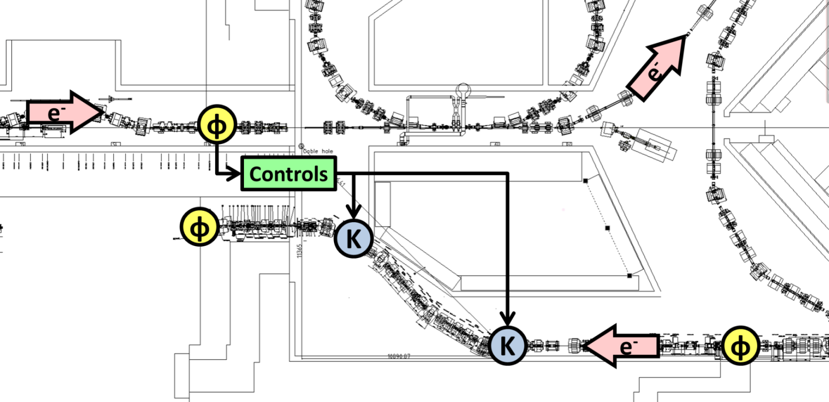
Phase Feedforward System Layout
ɸ
PETS Phase Measurement

Slide 4
Tests with FONT5 Board
Second time FONT5 board used at CERN.
First tests were successful but identified one or two issues to be fixed (e.g. droop in ADC response).
New phase feedforward firmware now implemented.
LabVIEW DAQ run locally on PC in gallery. Will look at integrating with the control system in the future.
Split signals to be able to acquire both at the same time.
Viewing inputs from Frascati monitor, output PFF correction, monitor calibration etc.

Slide 5
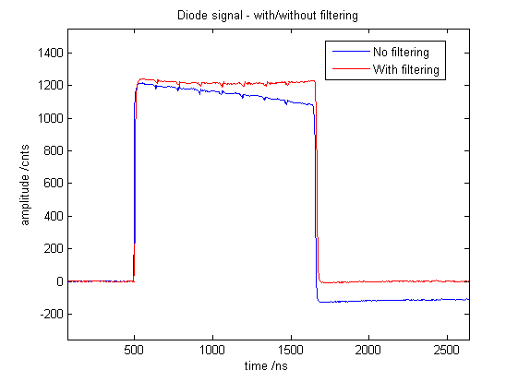
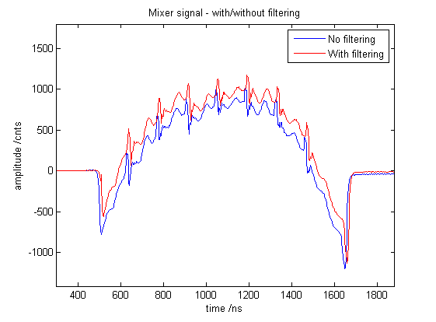
IIR Filter on Processor ADCs
AC coupling seen on ADC outputs during first tests in May 2013.
Transformers changed to reduce droop and exponential filter implemented in firmware to eliminate remaining component.
Filter adds delay of 3 clock cycles.

Slide 6
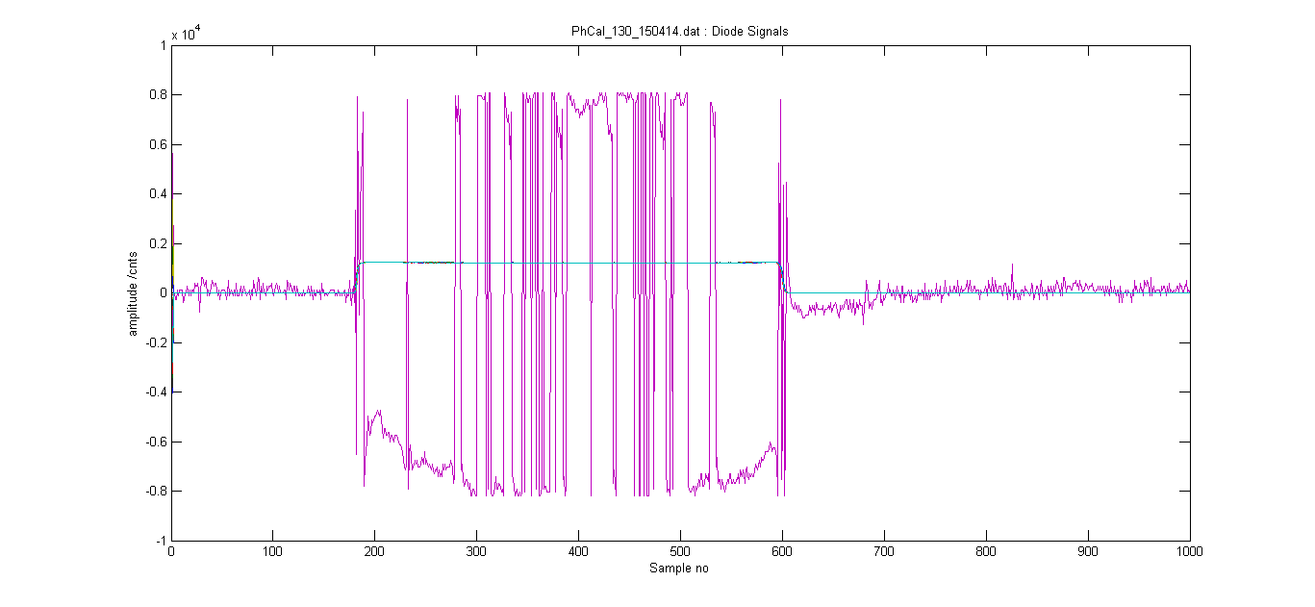
Corrupted Pulses
A few scrambled pulses observed on diode channel.
Caused by firmware bug (1/128 chance of timestamp being mistaken for data).
Now fixed.

Slide 7
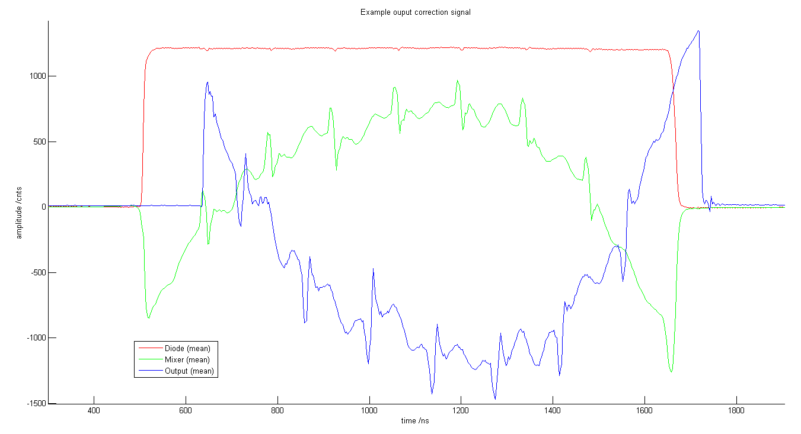
DAC Output (Output PFF correction)
Observed signal that will be sent to amplifiers for PFF correction.
Offset between DAC output (blue) and input signal (green/red) shows latency of the processor: ~23 clock cycles/~65ns.
Final design optimisations should reduce this by a few clock cycles.

Slide 8
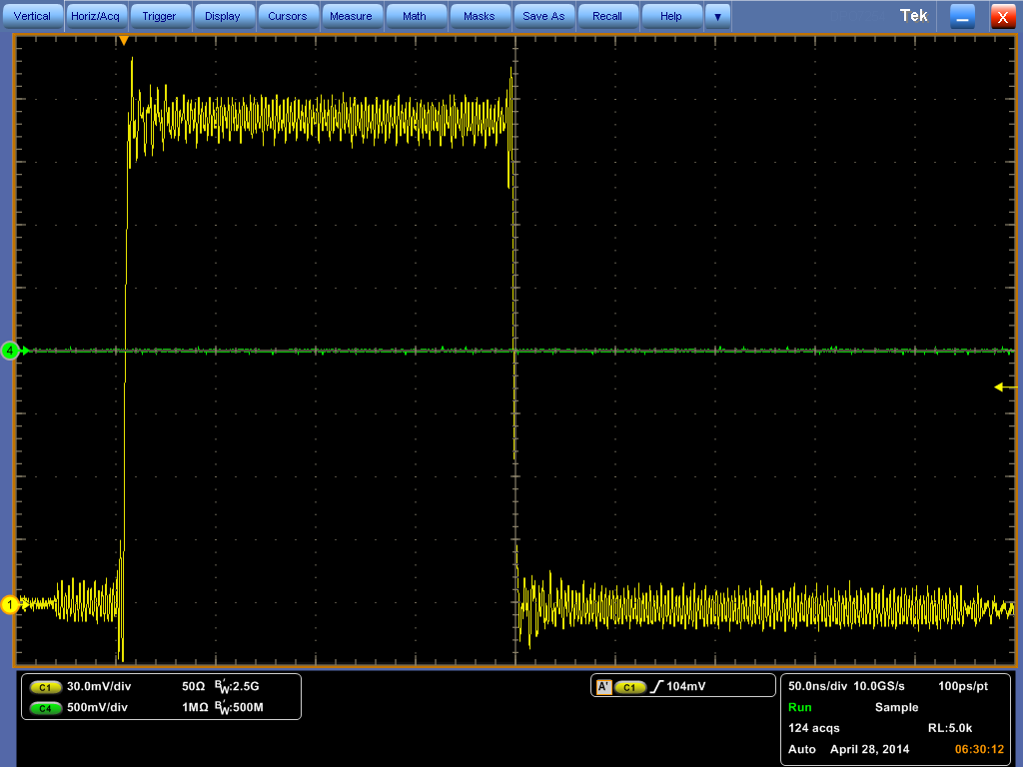
Noise on DAC Output
Observed noise on the DAC output coming from the 360 MHz clock and other sources.
It is outside the bandwidth of the amplifier and won’t cause a problem for the PFF correction.
FULL BANDWIDTH OF SCOPE

Slide 9
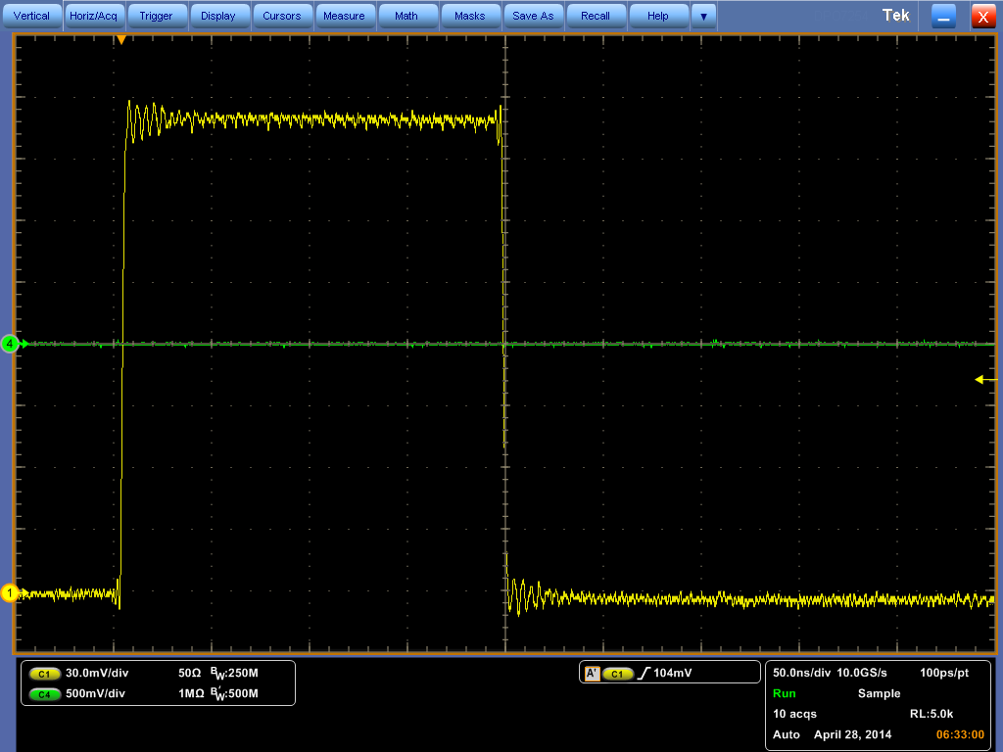
Noise on DAC Output
Observed noise on the DAC output coming from the clock and other sources.
It is outside the bandwidth of the amplifier and won’t cause a problem for the PFF correction.
250 MHz
Filter

Slide 10
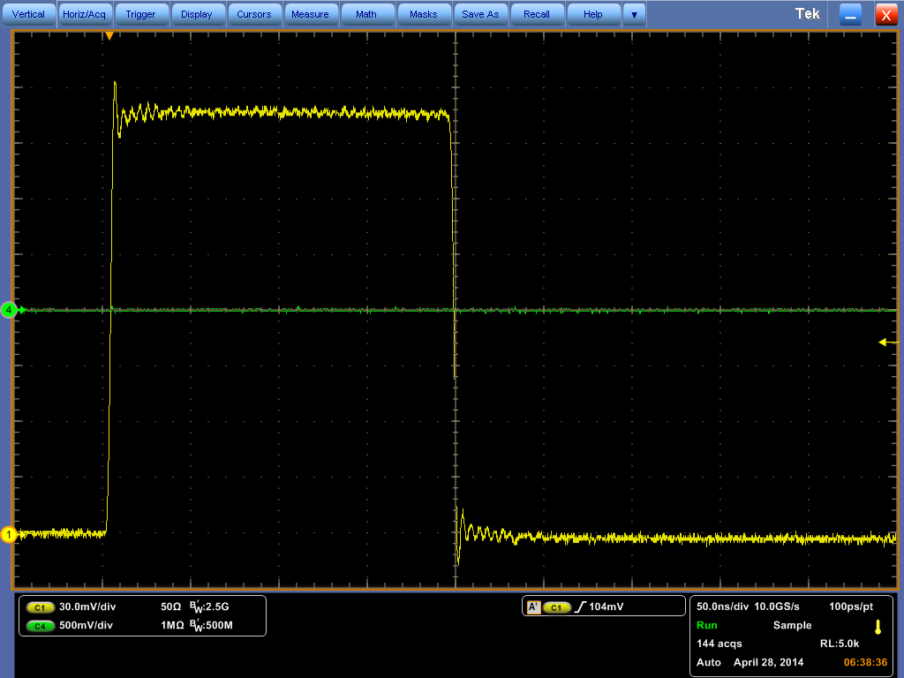
Noise on DAC Output
Observed noise on the DAC output coming from the clock and other sources.
It is outside the bandwidth of the amplifier and won’t cause a problem for the PFF correction.
125 MHz
Filter

Slide 11
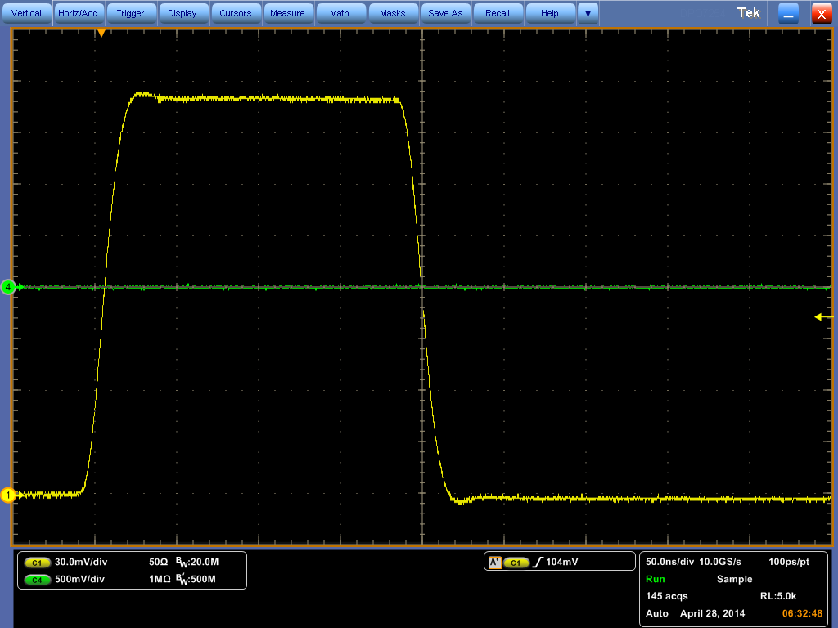
Noise on DAC Output
Observed noise on the DAC output coming from the clock and other sources.
It is outside the bandwidth of the amplifier and won’t cause a problem for the PFF correction.
20 MHz
Filter

Slide 12
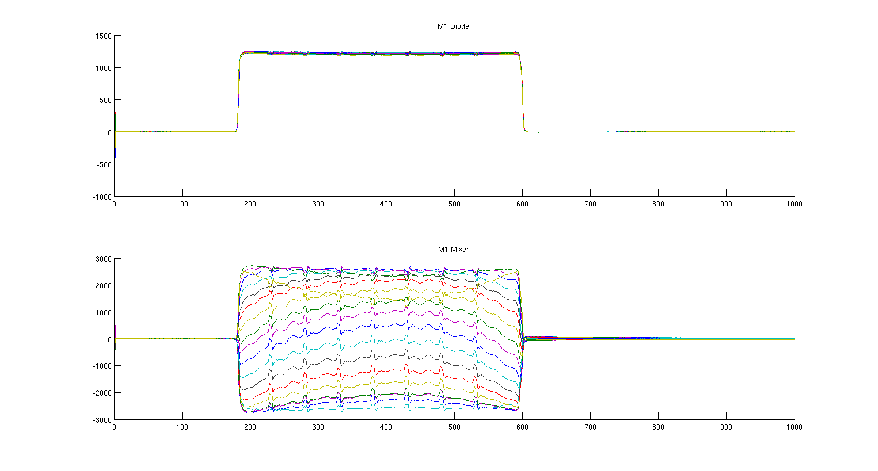
LO Scan (Frascati Monitor Calibration)
19 point scan of reference LO through 180 degrees.

Slide 13
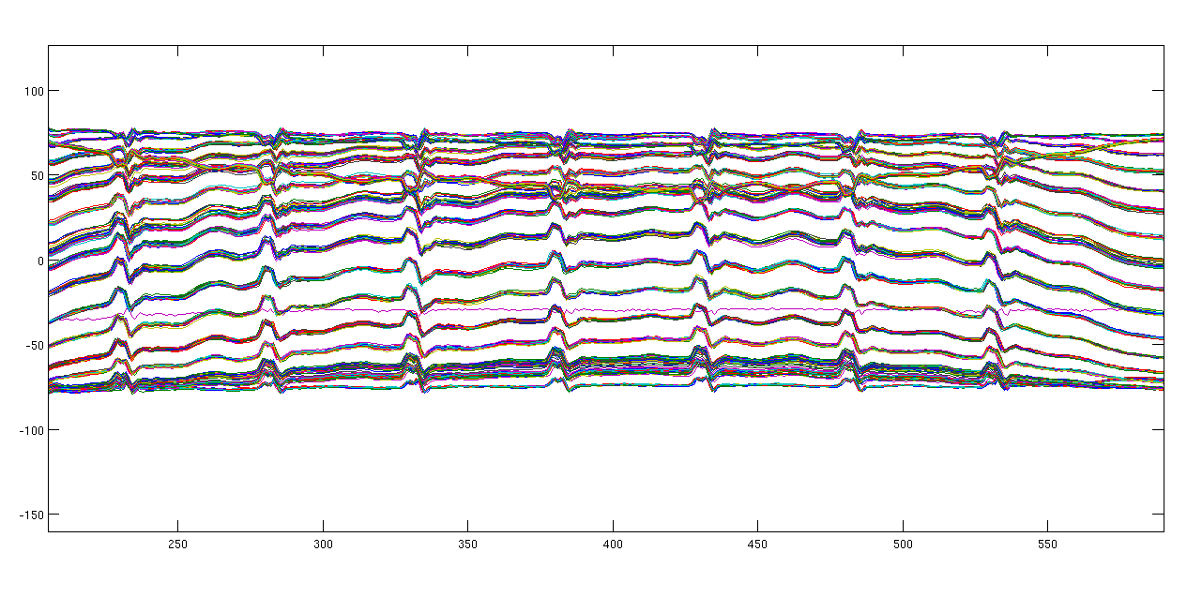
LO Scan: Mixer/sqrt(Diode)
Proportional to sin(phi).

Slide 14
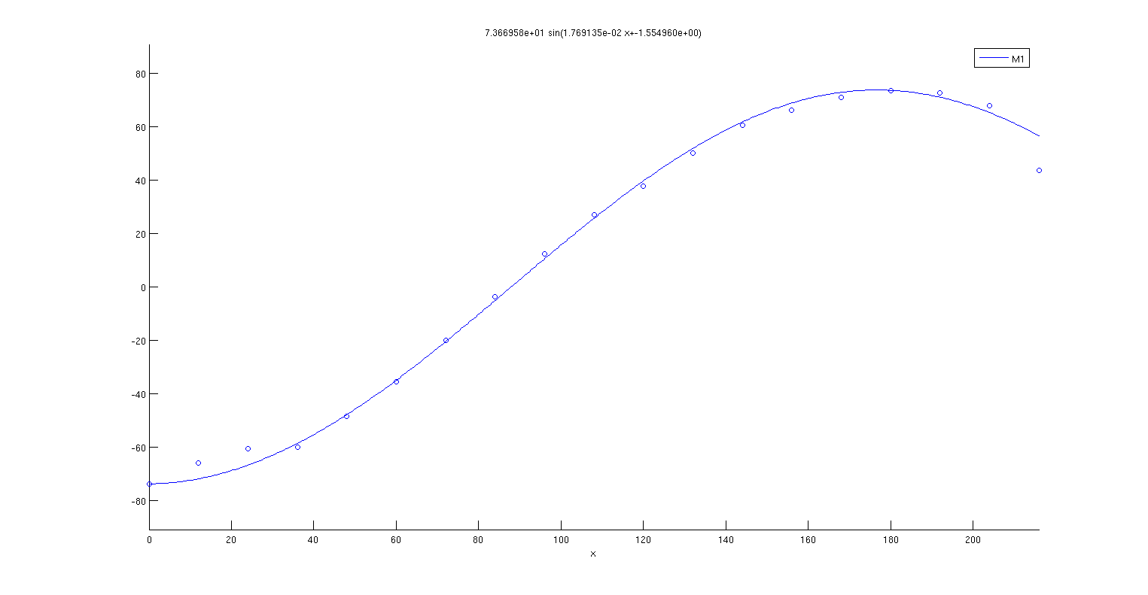
Sine fit to Mixer/sqrt(Diode): Sample 400
Few points at start/end maybe should be removed.

Slide 15
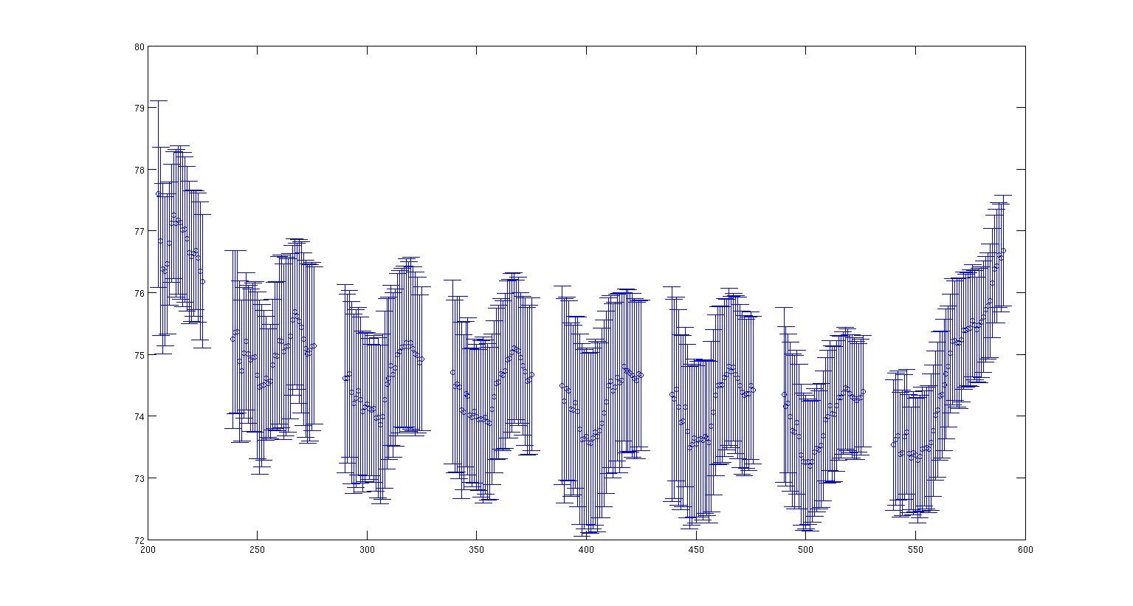
Fitted amplitude vs. Sample no.
Central location of phase switches removed.
10% change start/end pulse.
Oscillations in central part of pulse caused by transient of phase switches?
Mean Amplitude: 74.7
Phi = asin(Mixer/74.7*sqrt(Diode))

Slide 16
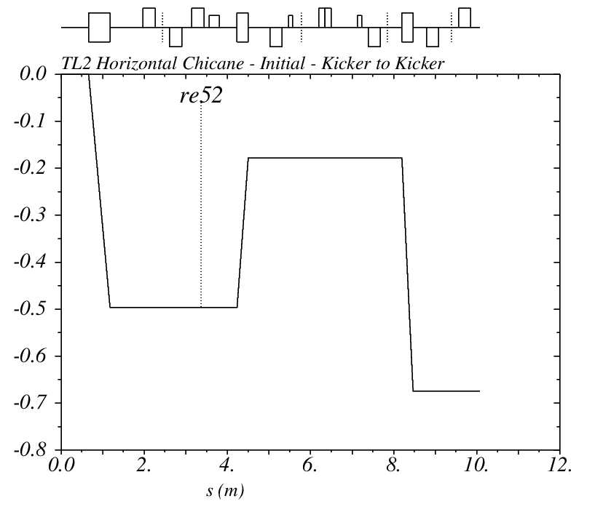
PFF Optics for TL2 Horizontal Chicane
New PFF optics based on corrected MADX model for TL2.
Only 10 degree correction but low dispersion (1.2m) – will be used for initial PFF tests.

Slide 17
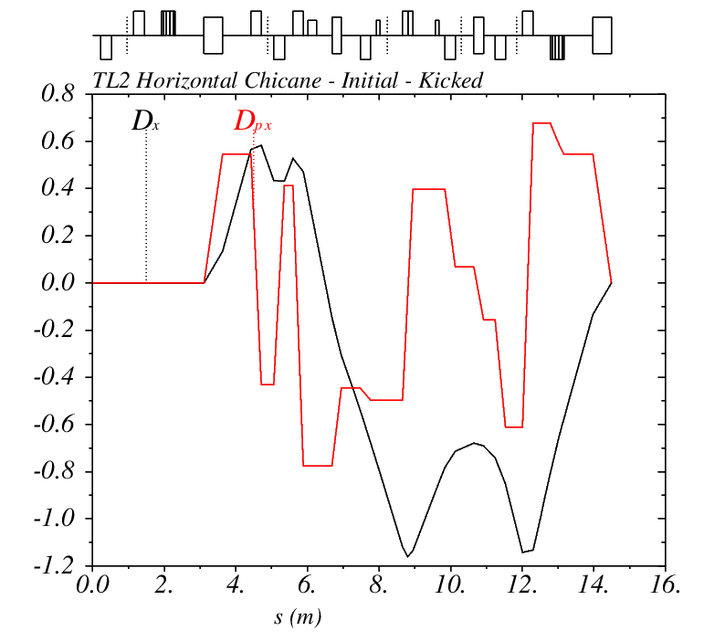
PFF Optics for TL2 Horizontal Chicane
New PFF optics based on corrected MADX model for TL2.
Only 10 degree correction but low dispersion (1.2m) – will be used for initial tests.

Slide 18
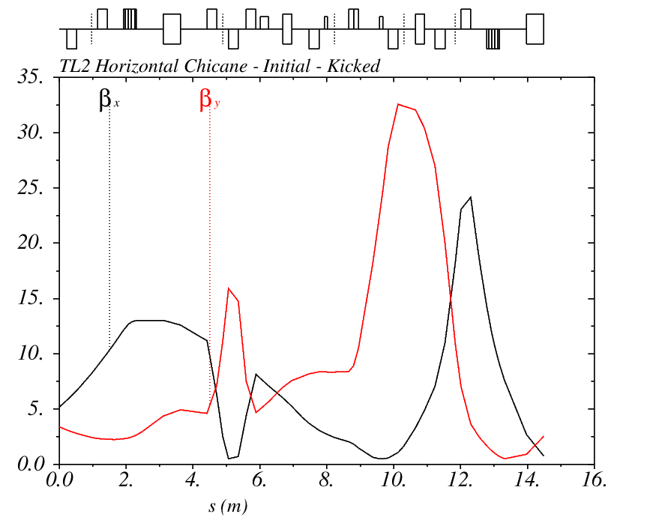
PFF Optics for TL2 Horizontal Chicane
New PFF optics based on corrected MADX model for TL2.
Only 10 degree correction but low dispersion (1.2m) – will be used for initial tests.

Slide 19
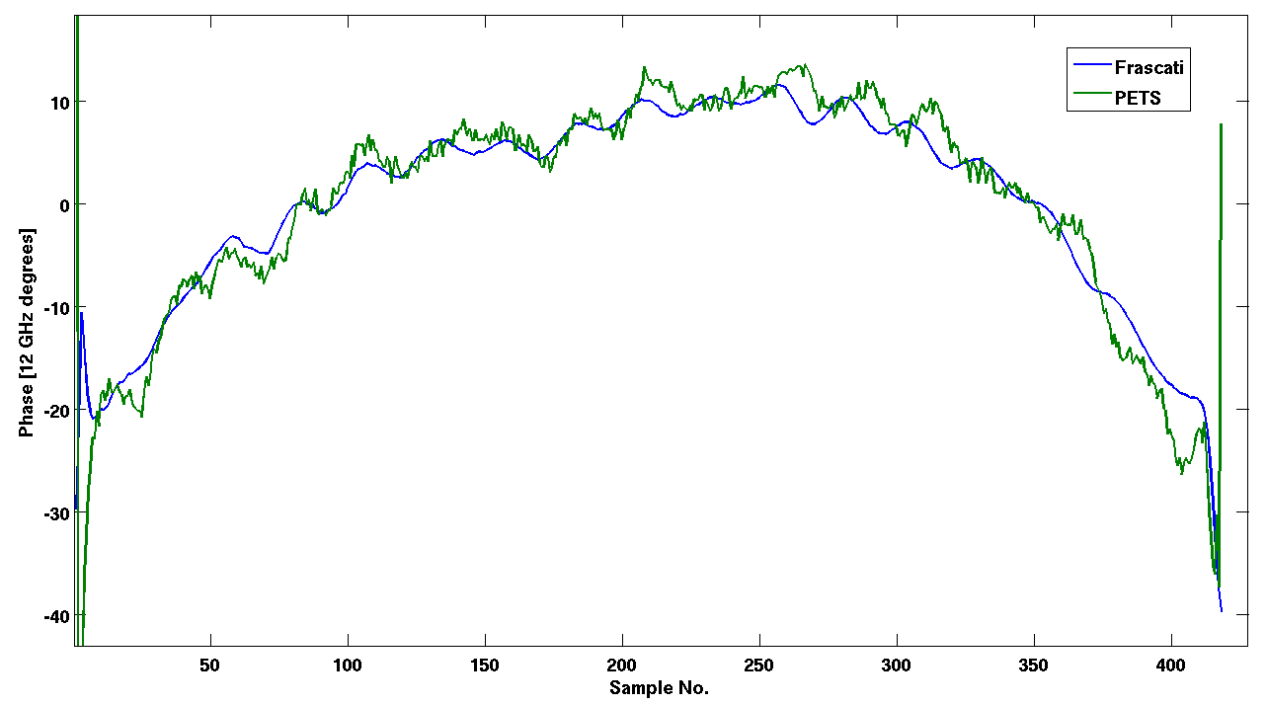
Phase Propagation: Frascati Monitor (CT) to PETS Monitor (TBL)
Frascati vs. PETS pulse shape.
Need to check alignment of sampling windows but general agreement in shape is pretty good.
Directly phase from calibration with mean offset removed (no cheating with scaling).
50º
1.2 µs

Slide 20
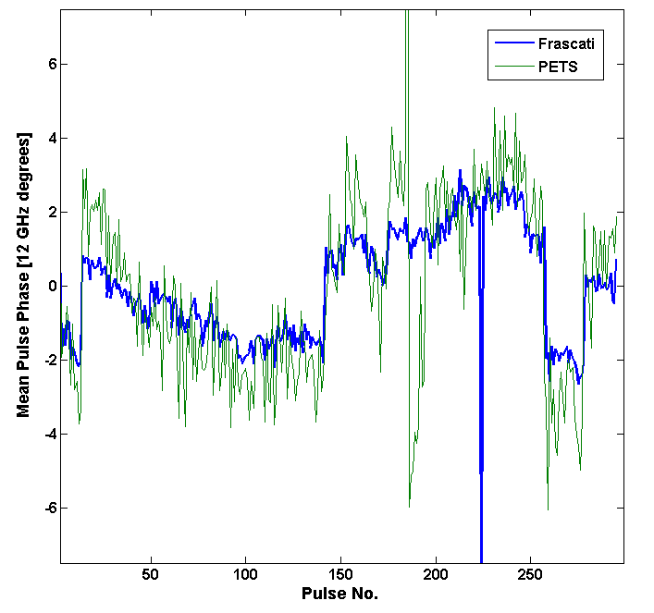
Phase Propagation: Frascati Monitor (CT) to PETS Monitor (TBL)
Mean phase.
Drift of around +/- 4 degrees in 5 mins.
5º
5 mins

Slide 21
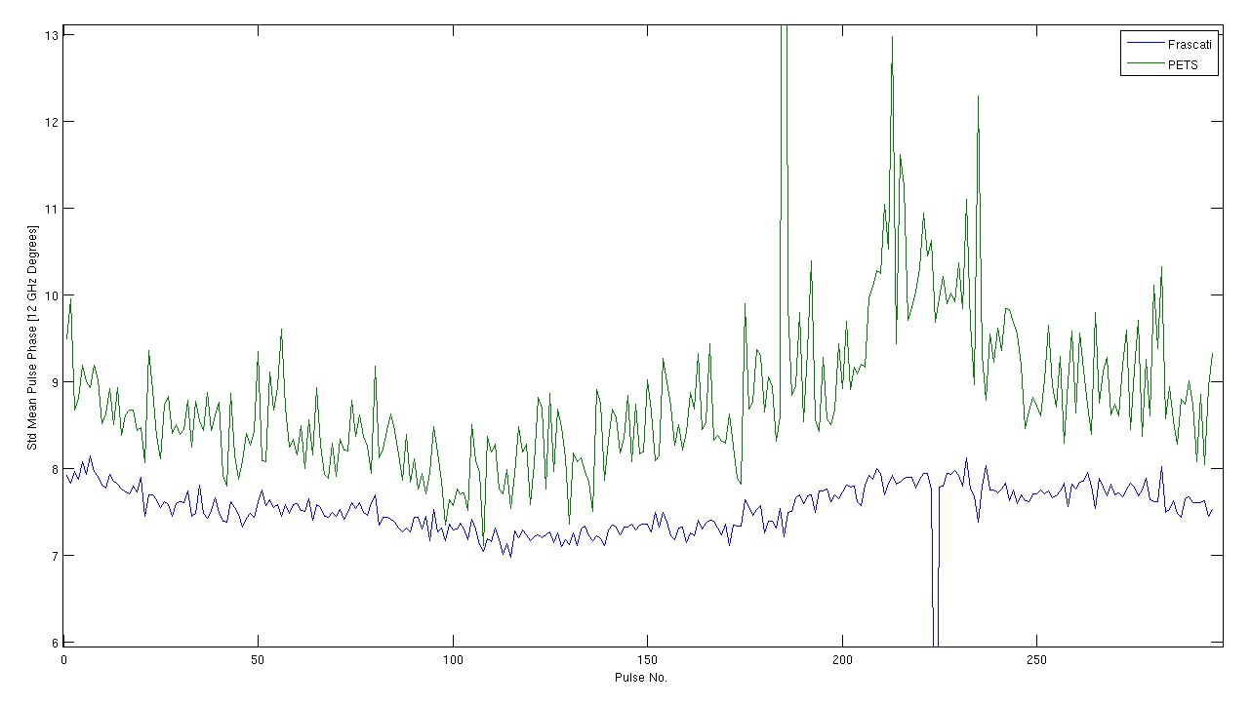
Phase Propagation: Frascati Monitor (CT) to PETS Monitor (TBL)
Standard deviation in mean phase.

Slide 22
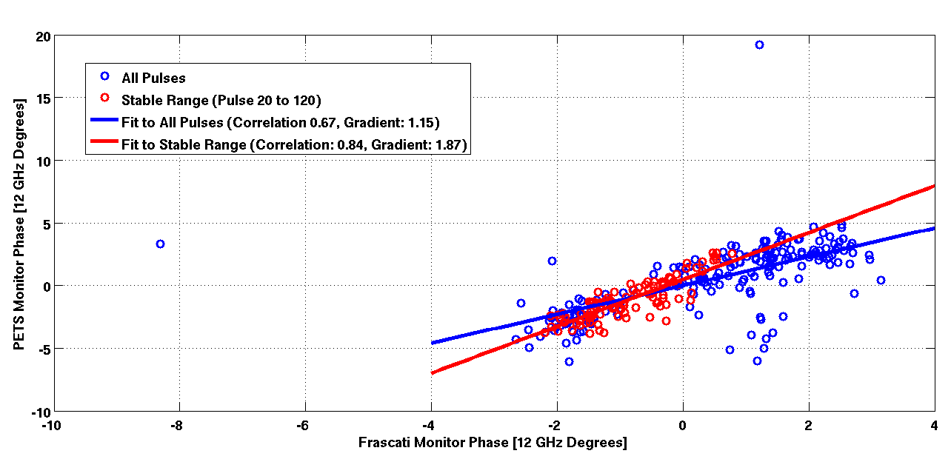
Phase Propagation: Frascati Monitor (CT) to PETS Monitor (TBL)
~15% growth in phase error.
Correlation: 0.67

Slide 23
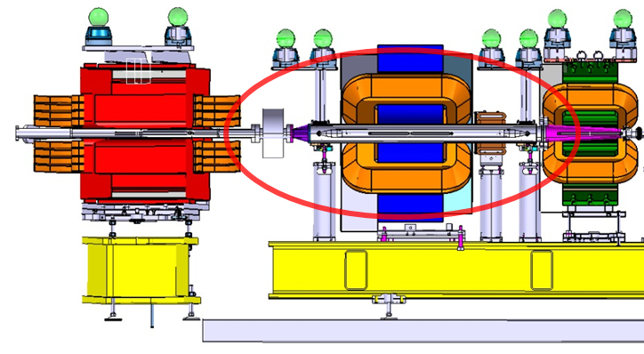
Corrector Kick Tests
2 correctors installed around the phase feedforward kickers.
Will be used to provide a slow phase feedback – prevent drifts outside the feedforward range.
First tests using constant corrector kicks to manipulate phase.

Slide 24
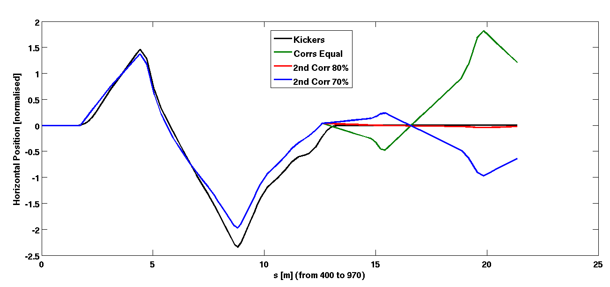
Corrector Kick Tests – Model Prediction
The correctors are offset from the (middle of the) kickers by ~30cm.
The chicane optics is closed for the PFF kickers but not for the correctors!
The orbit can be closed by applying 80% of the first corrector kick to the second corrector.

Slide 25
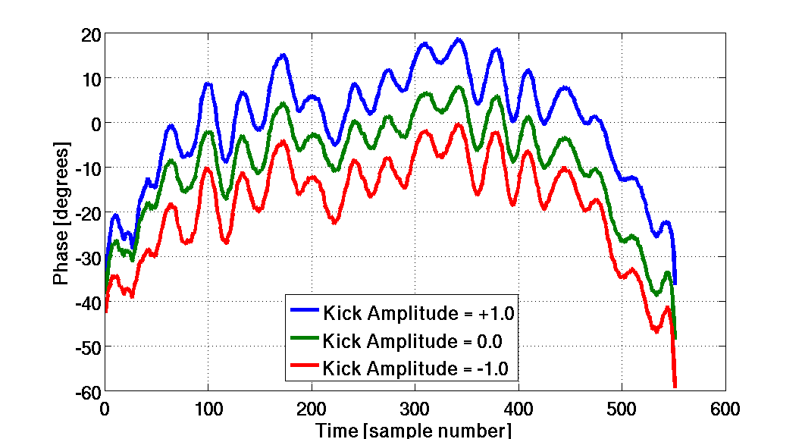
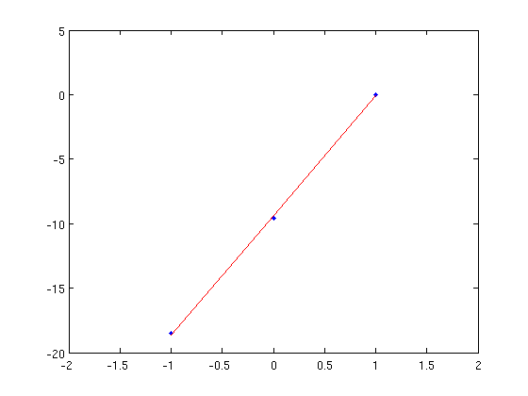
Corrector Kick Tests: Equal Amplitude
Phase shift:
Data: 9.3 degrees / A
Model: 10.2 degrees / A

Slide 26
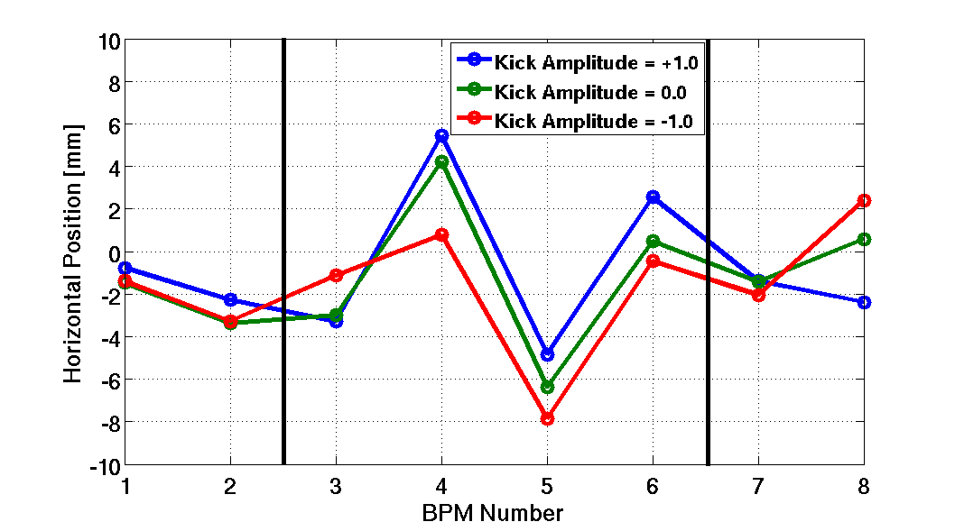
Corrector Kick Tests: Equal Amplitude
Closure (CC.BPM0930):
Data: 2.4 mm / A
Model: 2.3 mm / A

Slide 27
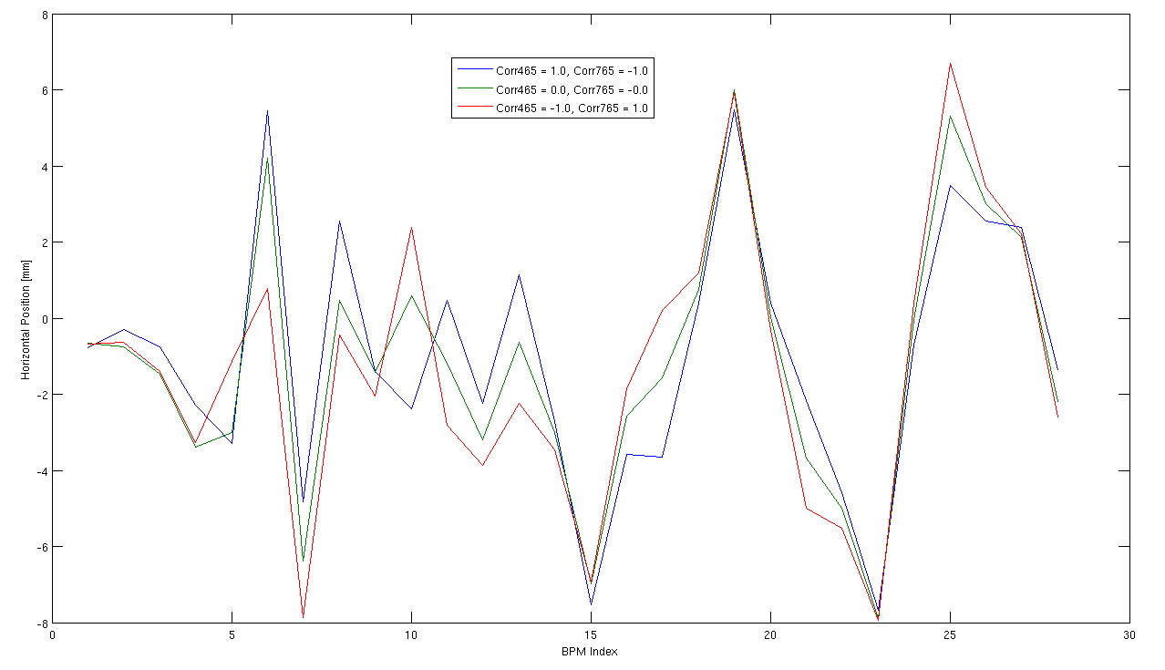
Corrector Kick Tests: Equal Amplitude
Closure (CC.BPM0930):
Data: 2.4 mm / A
Model: 2.3 mm / A
BPMs: TL2 - TBL
TL2 Chicane: 5-8

Slide 28
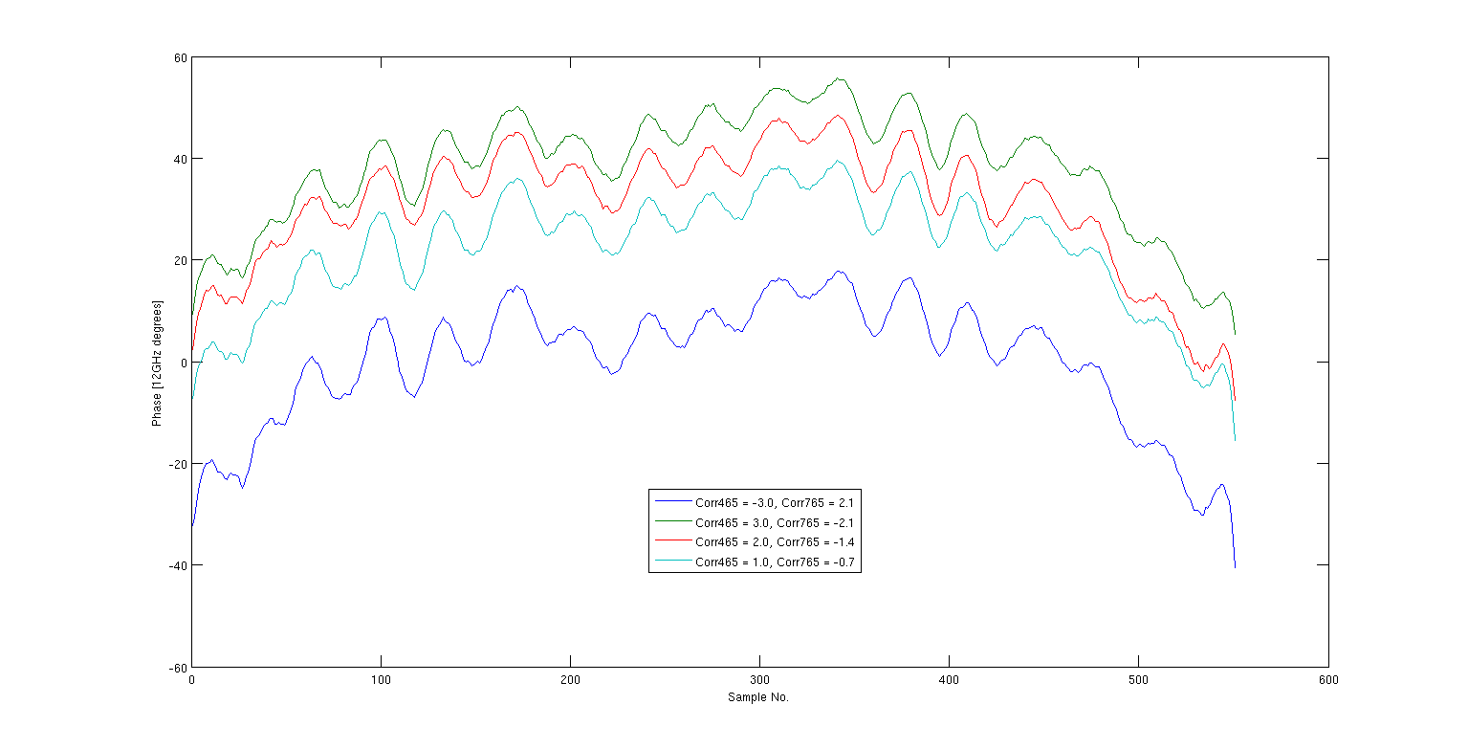
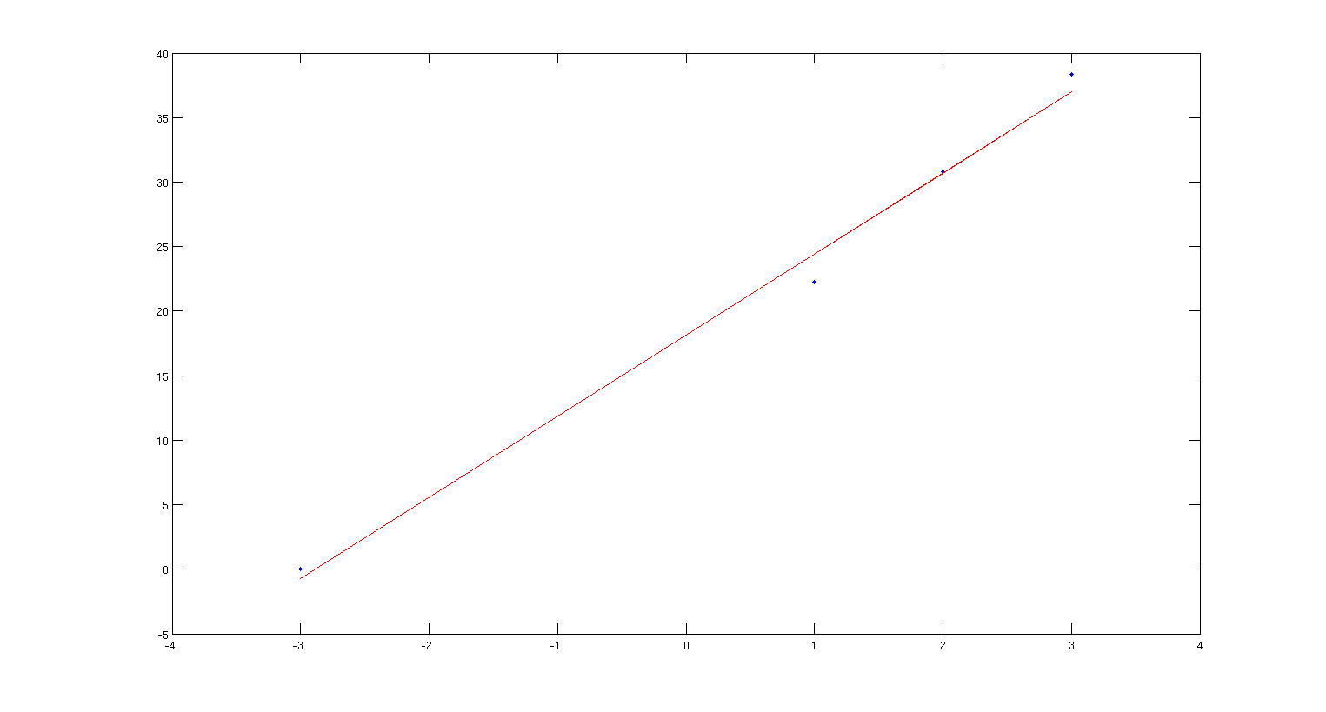
Corrector Kick Tests: 70% 2nd Corrector
Phase shift:
Data: 6.3 degrees / A
Model: 7.2 degrees / A
3 A
2 A
1 A
-3 A

Slide 29
Corrector Kick Tests: 70% 2nd Corrector

Slide 30
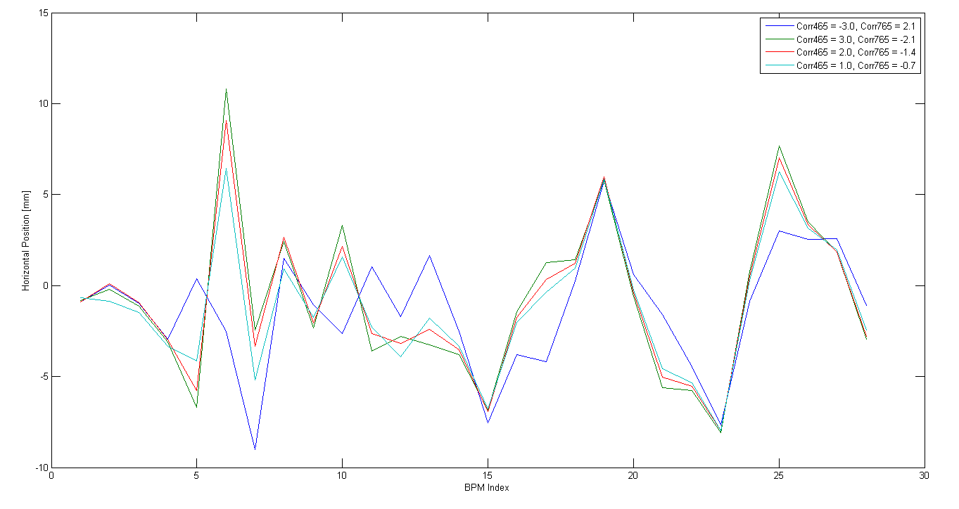
Corrector Kick Tests: 70% 2nd Corrector
Closure (CC.BPM0930):
Data: 1.0 mm / A
Model: 1.2 mm / A
BPMs: TL2 - TBL
TL2 Chicane: 5-8

Slide 31
Summary
Very productive day of data taking. Only initial results here, still a lot that can be looked at in this data.
Digital processor:
Filtering to remove ADC droop is working.
Noise on DAC output is out of bandwidth for the correction so not a concern.
Correction Latency ~65 ns.
Frascati monitor calibration:
Some dependence on fitted amplitude along the pulse at 10% level (start/end).
Should look at calibration without phase switches.
Frascati vs. PETS monitor comparison
Overall pulse shape is consistent in both monitors.
~15% growth in phase error between the two monitors.
~70% correlation between the two.
Phase stability:
Slow drifts of ~+/- 4 degrees in range of slow correction.
Corrector kick tests
Orbit not closed with equal amplitude kicks from corrector, but is closed with 80% applied to the 2nd corrector.
Phase shifts/position offsets in agreement with model.

