Slide 1
SIS3316 external clock
D. R. Bett

Slide 2
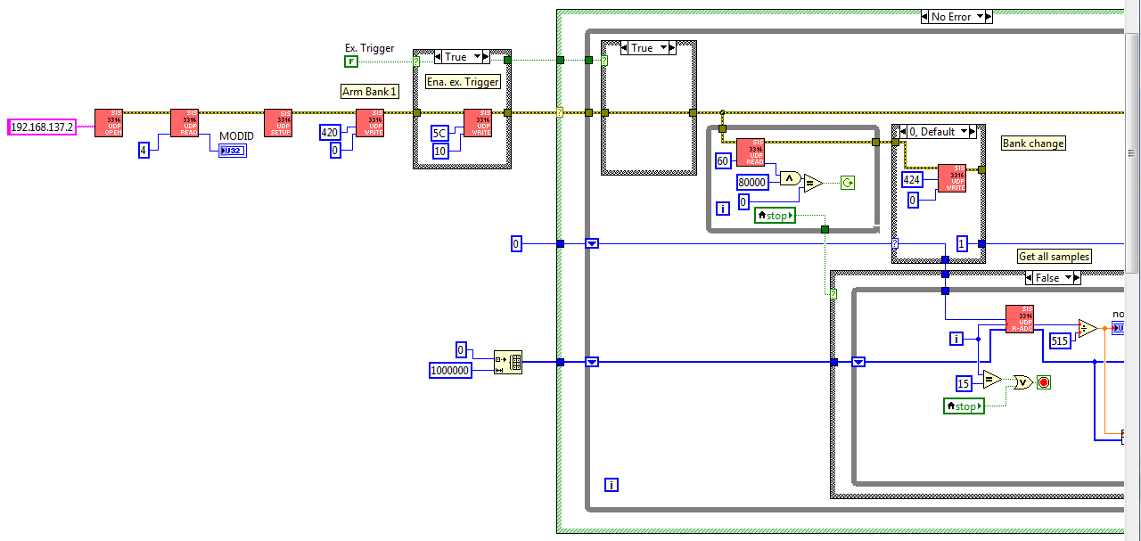
sample_test.vi
enable/disable external trigger
configure digitizer (sis3316_udp_setup.vi)

Slide 3
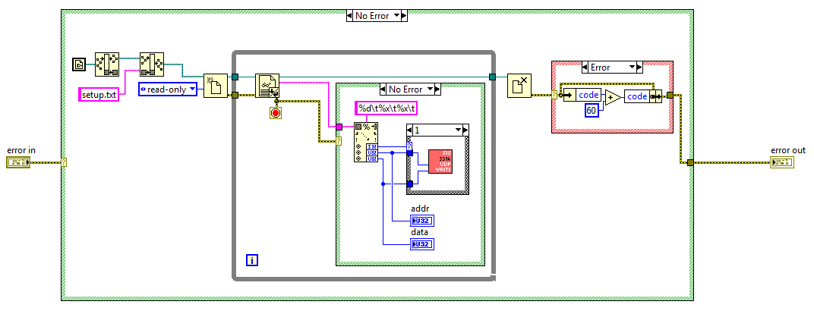
sis3316_udp_setup.vi
read setup.txt file
write data to digitizer (sis3316_udp_write.vi)

Slide 4
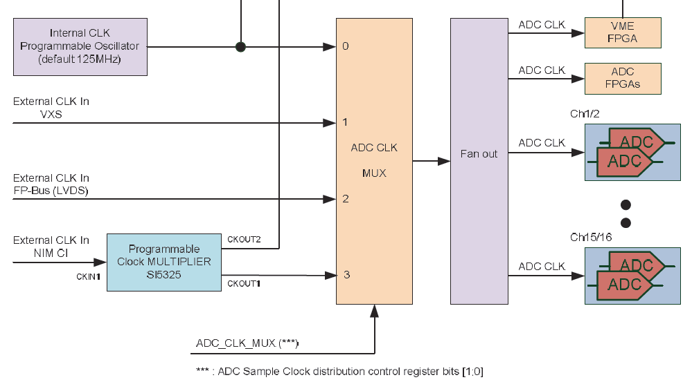
SIS3316 clock distribution
SI570
p11 of SIS3316 User Manual

Slide 5
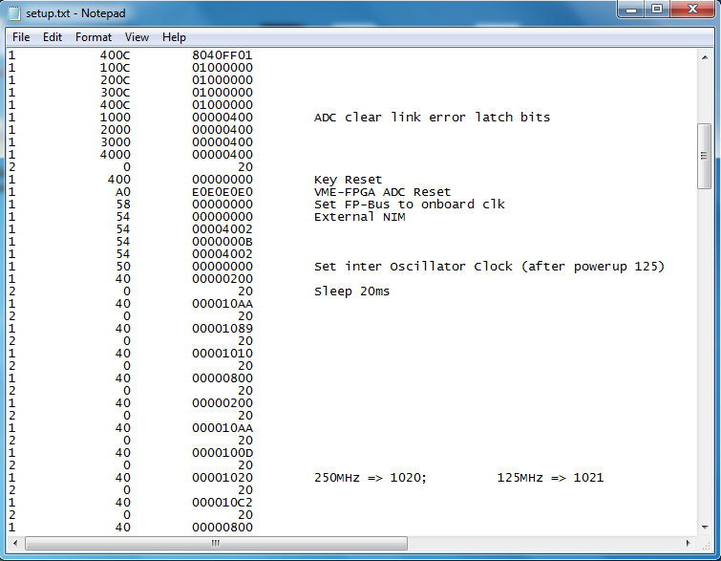
setup.txt
communicate with Si5325 clock multiplier
set clock multiplexer to 0 (internal clock)

Slide 6
Si5325 via SPI
Register 0x54 SIS3316_NIM_CLK_MULTIPLIER_SPI_REG
Set Address instruction
p91 of Si53xx Family Reference Manual
execute SPI read/write command p82 of SIS3316 User Manual
Selected address
31 | 30 | 29 | 28 | 27 | 26 | 25 | 24 | 23 | 22 | 21 | 20 | 19 | 18 | 17 | 16 | 15 | 14 | 13 | 12 | 11 | 10 | 9 | 8 | 7 | 6 | 5 | 4 | 3 | 2 | 1 | 0
0 | 0 | 0 | 0 | 0 | 0 | 0 | 0 | 0 | 0 | 0 | 0 | 0 | 0 | 0 | 0 | 0 | 0 | 0 | 0 | 0 | 0 | 0 | 0 | 0 | 0 | 0 | 0 | 0 | 0 | 0 | 0
0 | 0 | 0 | 0 | 0 | 0 | 0 | 0 | 0 | 0 | 0 | 0 | 0 | 0 | 0 | 0 | 0 | 1 | 0 | 0 | 0 | 0 | 0 | 0 | 0 | 0 | 0 | 0 | 0 | 0 | 1 | 0
0 | 0 | 0 | 0 | 0 | 0 | 0 | 0 | 0 | 0 | 0 | 0 | 0 | 0 | 0 | 0 | 0 | 0 | 0 | 0 | 0 | 0 | 0 | 0 | 0 | 0 | 0 | 0 | 1 | 0 | 1 | 0
0 | 0 | 0 | 0 | 0 | 0 | 0 | 0 | 0 | 0 | 0 | 0 | 0 | 0 | 0 | 0 | 0 | 1 | 0 | 0 | 0 | 0 | 0 | 0 | 0 | 0 | 0 | 0 | 0 | 0 | 1 | 0
Write instruction
Write data
CKOUT_ALWAYS_ON = 0 BYPASS_REG = 1
p19 of Si5325 data sheet

Slide 7
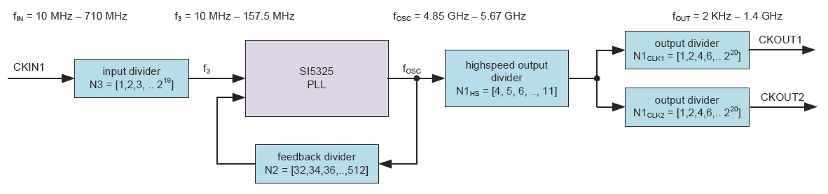
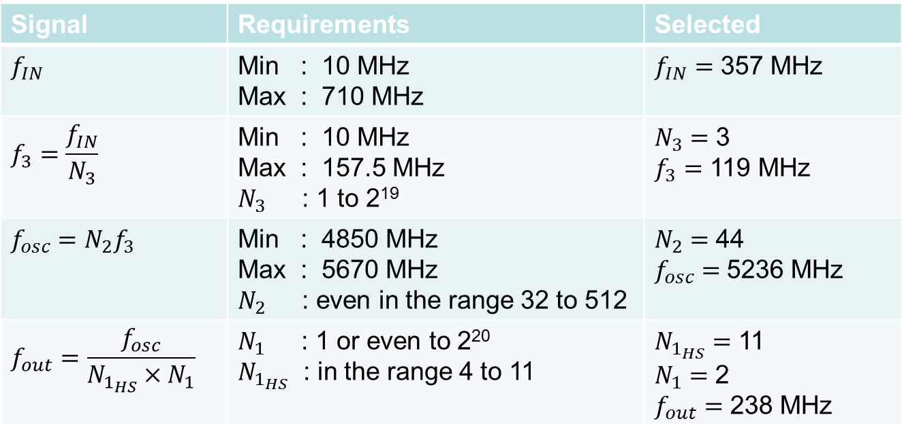
p13 of SIS3316 User Manual
Signal | Requirements | Selected
$$f_{IN}$$ | Min : 10 MHz Max : 710 MHz | $f_{IN}=$ 357 MHz
$$f_{3}=\frac{f_{IN}}{N_{3}}$$ | Min : 10 MHz Max : 157.5 MHz $N_{3}$ : 1 to 2¹⁹ | $N_{3}=$ 3 $f_{3}=$ 119 MHz
$$f_{osc}=N_{2}f_{3}$$ | Min : 4850 MHz Max : 5670 MHz $N_{2}$ : even in the range 32 to 512 | $N_{2}=$ 44 $f_{osc}=$5236 MHz
$$f_{out}=\frac{f_{osc}}{N_{1_{HS}}×N_{1}}$$ | $N_{1}$ : 1 or even to 2²⁰ $N_{1_{HS}}$ : in the range 4 to 11 | $N_{1_{HS}}=$ 11 $N_{1}=$ 2 $f_{out}=$ 238 MHz

Slide 8
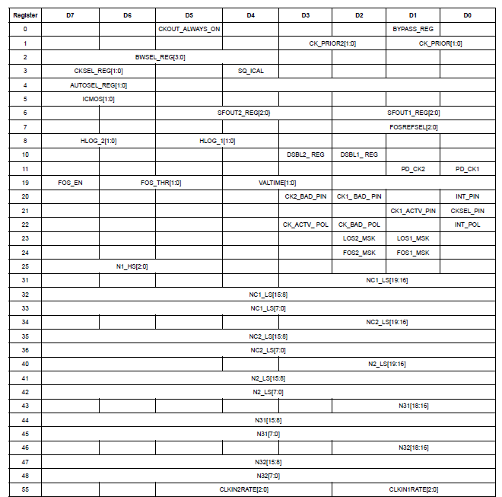




Si5325 register map
p17 of Si5325 data sheet
$$N_{1_{HS}}$$
$$N_{1}$$
$$N_{2}$$
$$N_{3}$$

