Slide 1
Radiation Cooling
of the ILC positron target
LCWS 2014, Belgrade, Serbia
7th October 2014
Sabine Riemann, DESY, Peter Sievers, CERN/ESS,
Andriy Ushakov, Hamburg U

Slide 2
ILC positron target
Ti alloy wheel
  diameter = 1m
  Thickness 0.4 X0 (1.4cm)
  Spinning with 2000rpm
Pulsed energy deposition
peak energy deposition (PEDD) per bunch train:
  Nominal: 67.5 J/g ⬄ ΔT_{max} = 130K
  Lumi upgrade: 101.3 J/g ⬄ ΔT_{max} = 195K
  Fatigue strength in Ti alloy ΔT ~ 425K (240MPa)
We do not expect thermal shocks
  Degradation during irradiation and pulsed heat load should be studied/tested
Average power deposition 2-7 kW
TDR: water cooling
Alternative solutions:
  cooling by radiation
  cooling pads (W. Gai)

Slide 3
Radiative cooling
Length of bunch train on target (2000rpm): ~10cm
Same area of 1m-wheel is hit again after ~6s
→ Time sufficient for heat dissipation and removal ?
Stefan-Boltzmann radiation law:
  σ = Stefan-Boltzmann constant
  ε = emissivity
  A = surface area
  G = geometric form factor
Estimate:
  W = 5kW
  ε = 0.8
  T = 240 C
  T_{cool} = 20 C
  G = 1
We need a surface of A > 1.8m²
Radiative cooling should be possible

Slide 4
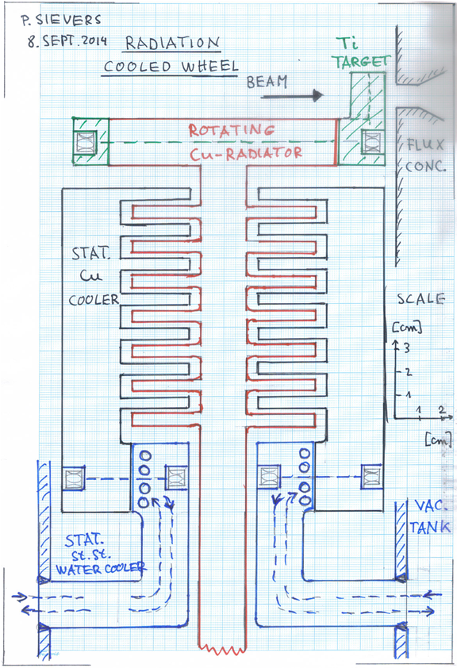
Radiative cooling
Heat path:
  thermal conduction Ti → solid Cu wheel
  radiation Cu wheel → stationary water cooled coolers, placed inside the vacuum
Cooling area can be easily increased by additional fins
thermal contact Ti → Cu is very important
  Ti-blocks are clamped by springloaded bolts to Cu wheel → thermal contact, even under cyclic loads of Ti target

Slide 5
Radiative cooling
Emissivity
  Realistic emissivity
  "corroded" Cu; influence of irradiation on emissivity?
  Coating? (Experience available?)
Thermal pulses at rotating radiators are small/negligible
choice of materials
  Cu-alloys (Al-alloys) with high strengths at elevated temperatures are required for the wheel and the radiators

Slide 6
To be considered in detail
Average temperature in target and cooling wheel looks ok
Temperature evolution in the whole system to be considered
Dynamic temperature distribution at target rim
  Temperature ⬄ peak stress values
  can be calculated with existing codes, including radiative cooling
Total stress in target rim
  σ_{static} + σ_{dynamic}
  Acceptable limit?
Degradation of Ti-target under cyclic thermal load and irradiation must be taken into account
  Ti – Cu contact after months of target operation
  Heat transfer coefficient after irradiation

Slide 7
Mechanical issues
energy of order 1 MJ is stored in the wheel → Respect safety rules.
Bearings:
  Experience exists over 30 years for the use of magnetic bearings (see Peter Siever’s talk at POSIPOL2014)
  Industrial suppliers are SKF/Gemany/Calgary/Canada and KFZ/Juelich/Germany
  Loads above 100 kg with more than 7000 rpm are possible.
  Temperatures of up to 300 oC can be accepted by the bearings.
  Active vibration control of the axis at the magnetic bearings is available
  Thermal barriers should be arranged to prevent heat flowing into the rotation axis.
Very precise velocity control is standard

Slide 8
vacuum
  Outgassing must be checked (temperatures ~300 oC) , and if required, differential pumping should be applied
monitoring of temperatures
  Contactless temperature infrared sensors
    Wheel temperature ⬄ sensors placed inside the vacuum close to the rotating wheel
    Temperature of rotating parts of magnetic bearing and motor
vibration sensors

Slide 9
Summary
Radiative cooling is a very promising option
Scheme will be studied
  Ultimate temperature of the target wheel
  Cooling of the chamber
Design an experimental mock up in real size which could serve as a systems test of the whole unit.
→ verification of temperature regime and cooling
efficiency
→ optimal target + cooling design
Resources / support

Slide 10
Resources
First estimates (POSIPOL14)
 | k€
Vacuum tank, design + manufacture: | 170
Wheel design + manufacture | 230
Coolers | 80
Magn. bearings and motor | 170
Instrumentation plus electronics and control | 80
Pumps for differential pumping | 80
Infrastructure, lab space, safety | 70
Dummy run with heaters of rim and water cooling | 70
Total | 950

Slide 11
Resources (manpower)
Estimate at POSIPOL 2014
 | FTE
Initial performance studies (ANSYS, modelling,... ) | 0.5
Physicist, engineers, designers | 3.0
Technicians for assembly, commissioning and test | 2.0
total | 5.5

Slide 12
backup

Slide 13
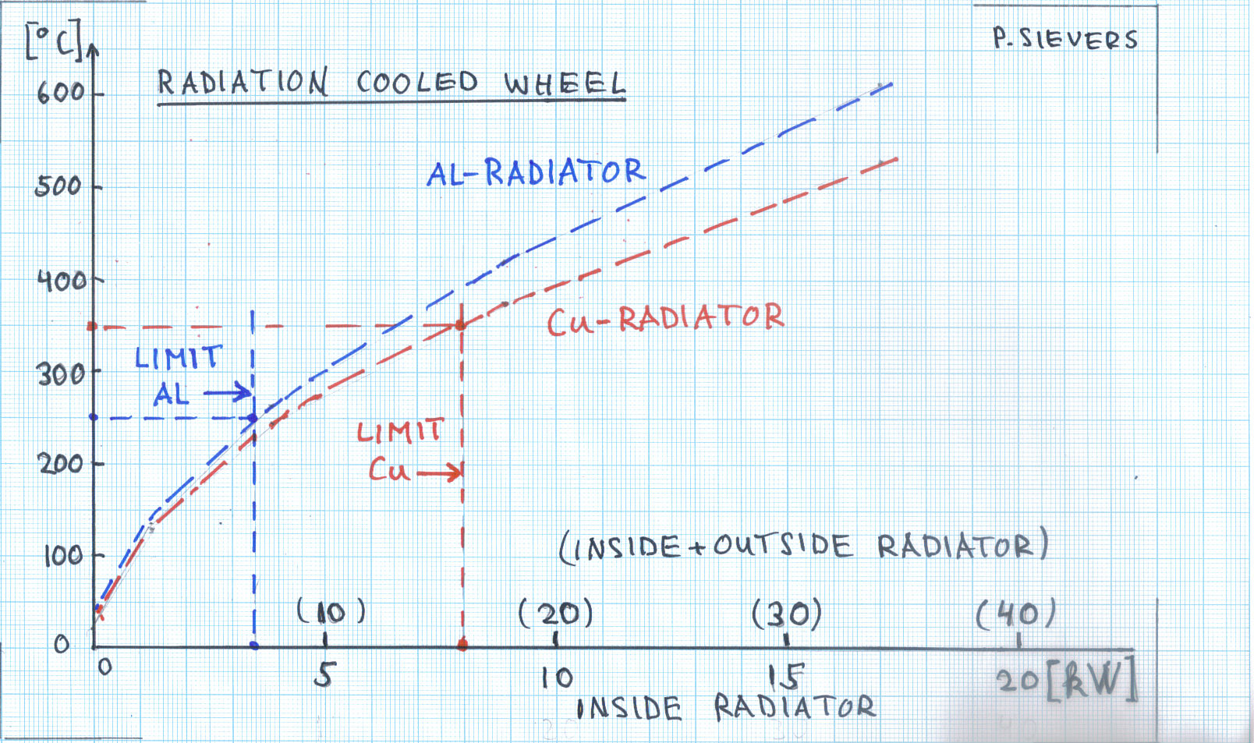

Slide 14
