Slide 1



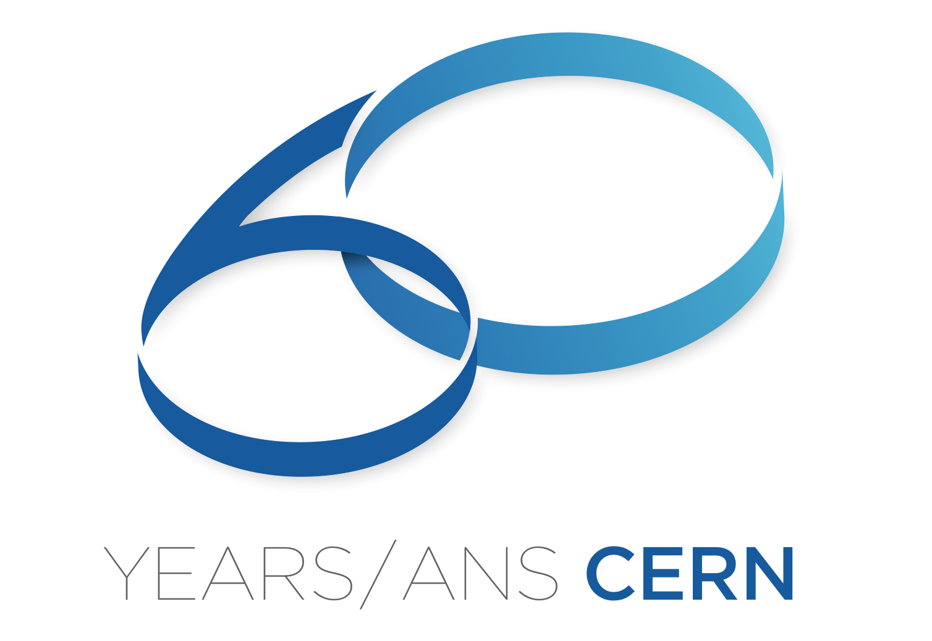
Investigation threads on fabrication technologies for the CLIC X-band Accelerating Structures
C. Rossi on behalf of the CLIC X-band Activity
Thanks for contributions and discussions to S. Calatroni, N. Catalan Lasheras, R. Corsini, A. Grudiev, D. Gudkov, R. Montonen, A. Perez, N. Shipman, A. Solodko, I. Syratchev, A. Xydou, W. Wuensch, H. Zha, W. Zhou, E. Zisopoulou.
9th October 2014

Slide 2
Consolidating a baseline
Areas of Possible Development
Push the investigation on the integration of the different elements of the accelerator to a higher level of detail, in the perspective of assembling modules and the complete accelerator, in the end. Clarify issues at the interfaces.
Clarify some technological aspects of the AS fabrication process that were inherited from other labs and from the work of different study groups and consolidate them in the form of validated procedures.
Start building a consolidated baseline for the project. This will not prevent further developments, on the contrary it will allow a better tracking of changes.
Adopt a
Quality Assurance Policy ?

Slide 3
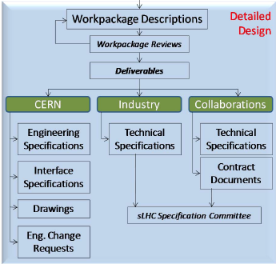
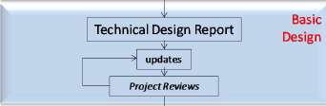
Consolidating a baseline
Quality Assurance Policy
A Quality Assurance Policy would contribute to progressively consolidate the project baseline by means of an agreed published procedure, which stakeholders can trust.
The QAP will create the conditions for an effective control of changes within the project baseline and their follow-up.
To provide an example ... (Linac4)
Linac4 CDR

Slide 4
Motivation for a review of the technical / technological aspects of the AS fabrication
Make structure cheaper
Make structure faster to deliver
Review the fabrication process
Improve the testing / validation process
Design review
Waveguide optimization
Surface treatment
Brazing / bonding
Quadrants / halves
H bonding
Chemistry / etching
Vacuum brazing / bonding
Heat treatment
Alignment

Slide 5
Outline
A primary goal for the CLIC X-band Study Group is to establish reliable and ready to be industrialized procedures for the fabrication of X-band accelerating structures and modules. This may require:
Reviewing some aspects of the design.
Optimizing the fabrication process:
  machining and assembly tolerances;
  etching;
  disk alignment;
  assembly technologies and bake-out.
Enlarging the park of investigation tools beyond AS RF tests
  DC breakdown
  Fixed gap system (field emission and breakdown)
Extending the testing capability:
  X-box 1 and dog-leg is in production;
  X-box 2 soon in-line;
  X-box 3 in preparation, expected in 2015.
See presentations from:
W. Wuensch, I Syratchev and A. Solodko.
Consolidating the baseline: Quality Assurance Policy.

Slide 6
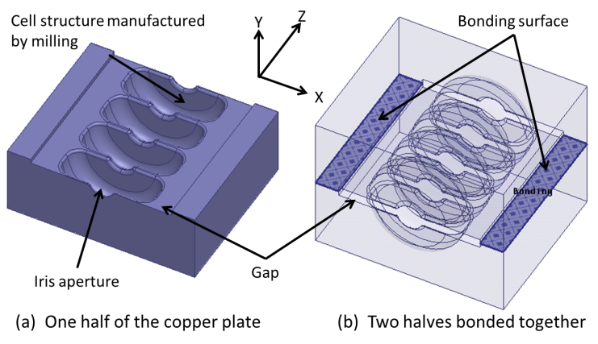
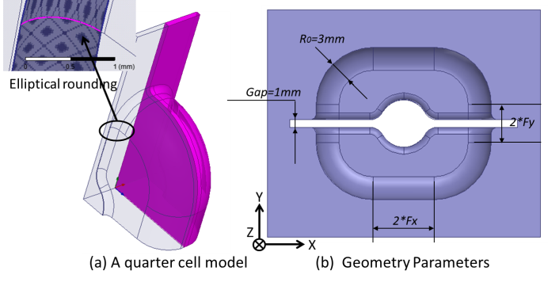
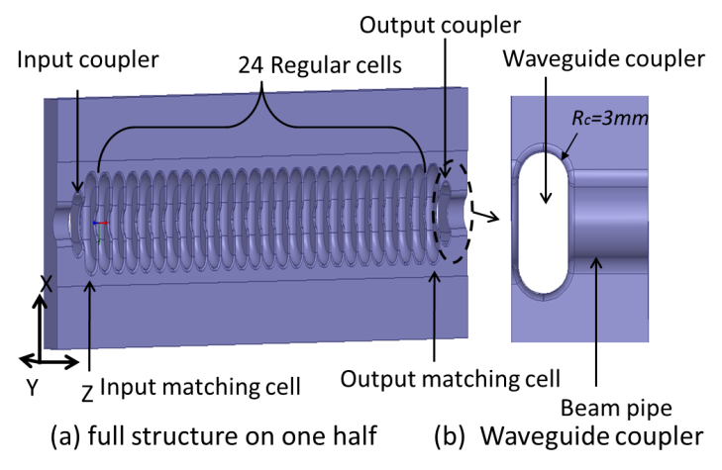
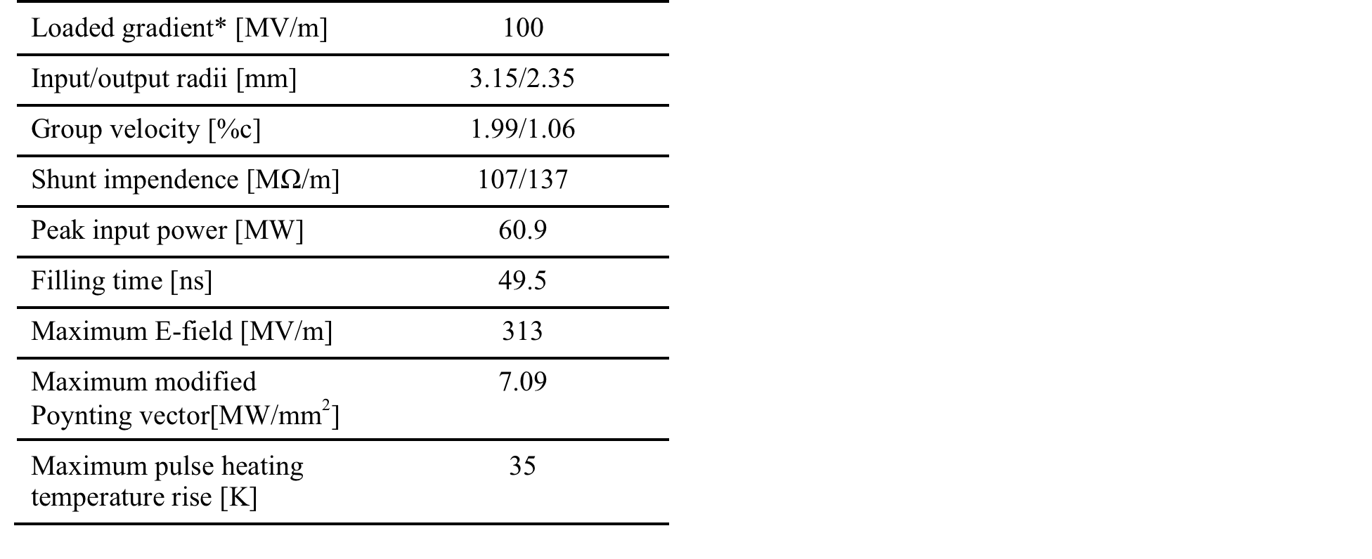
Review the design
New structure concepts (A. Grudiev and H. Zha)
CLIC structures optimized for milling with a potential for reducing the fabrication cost. Based on CLIC-G design.

Slide 7
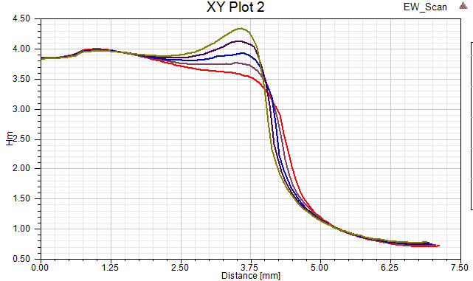
Review the design
Optimization of waveguide geometry (A. Grudiev and H. Zha)
-- c
-- eow = ac/bc
Optimized for magnetic field
Independed parameters:
-- iw: waveguide opening
-- w: wavegude width
Optimized for wakefield damping
ldw
bc
w/2
When eow increases:
iw/2
45º
rdw
ac=eow*bc
b
Beam axis
c

Slide 8
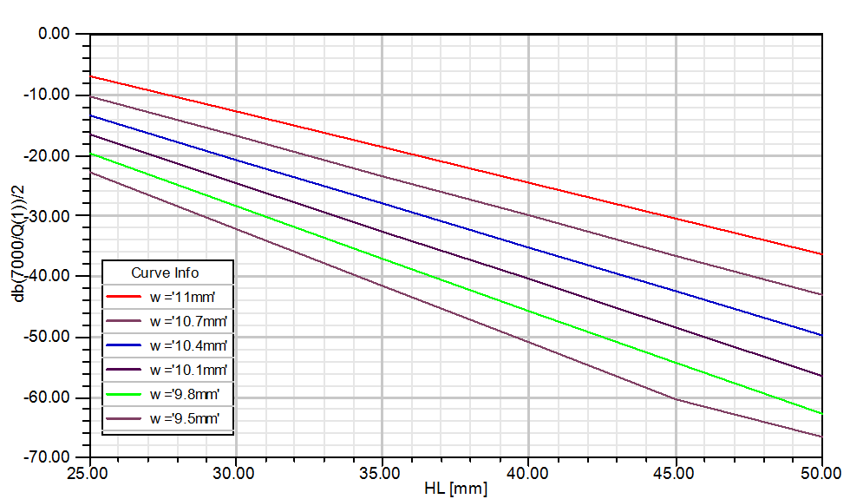
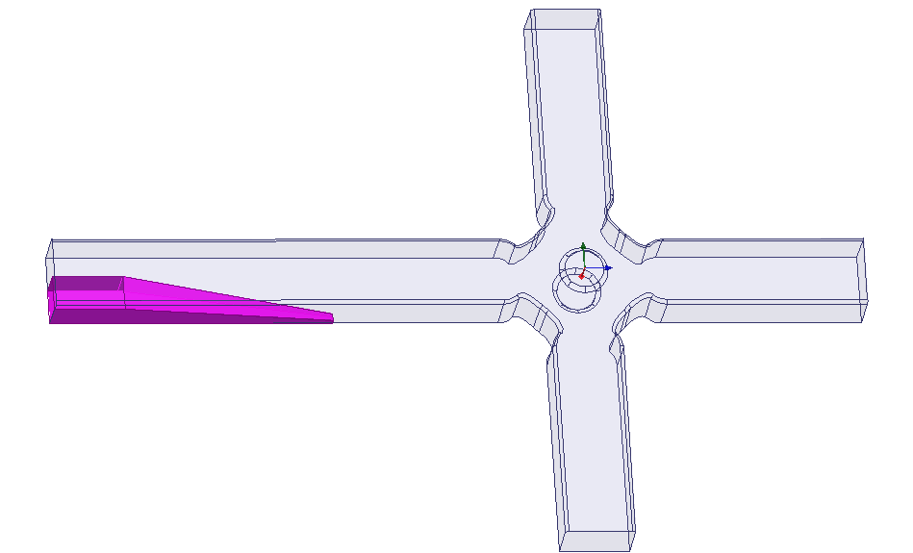
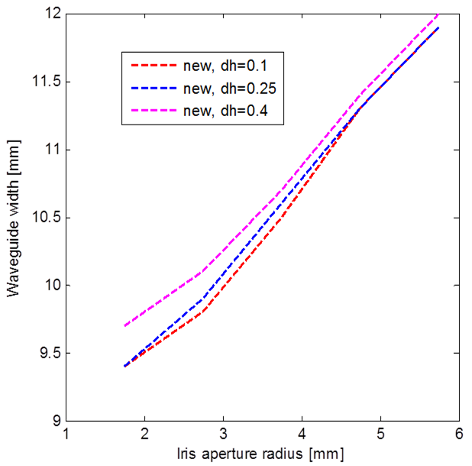
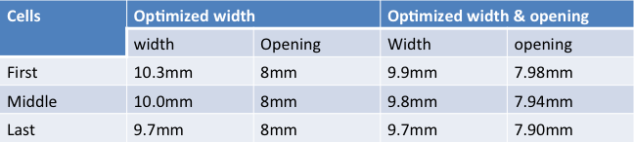
Review the design
Optimization of waveguide geometry (A. Grudiev and H. Zha)
A considerable reduction of the disk diameter can be expected by this change with a beneficial impact on the Linac cost.
safety distance
Here is CLIC-G

Slide 9
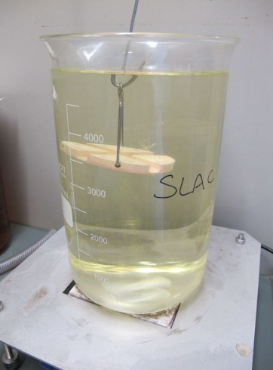
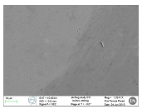
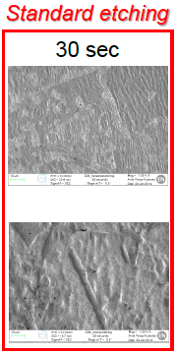
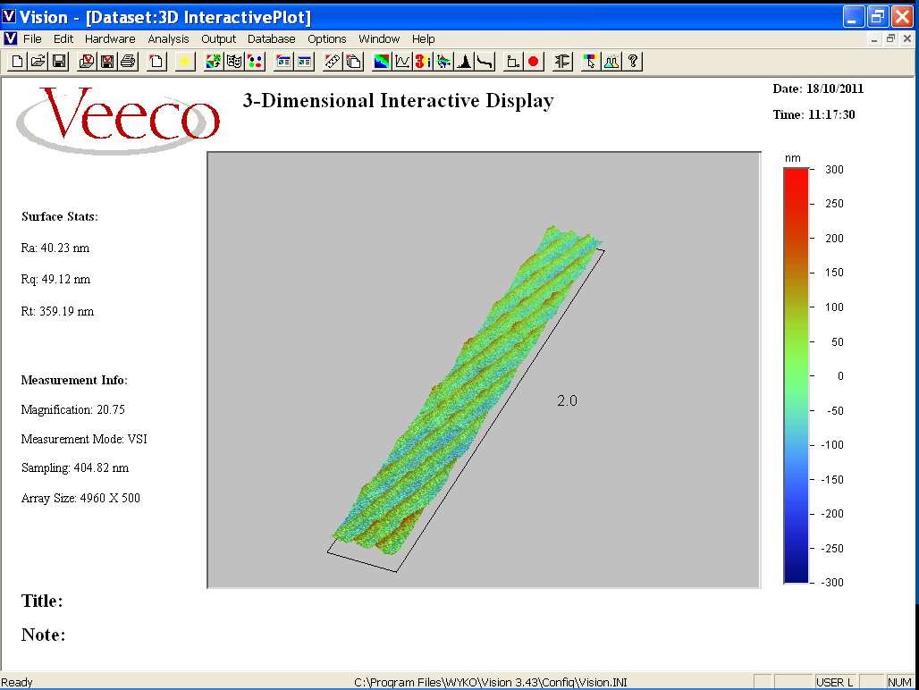
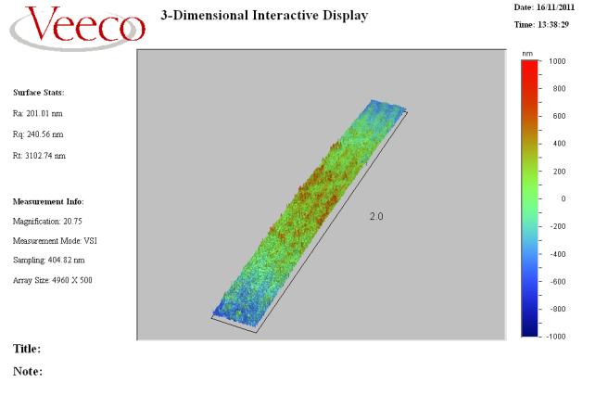
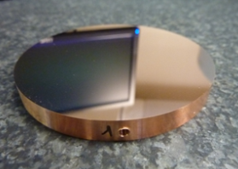
Optimizing the fabrication process
Etching (A. Xydou and W. Zhou)
According to SLAC studies, during the NLCTA program: 30 s etching starts revealing grain edges in SC-D, between 5 and 10 s is the correct duration to preserve diamond finish. Minimize hillocks by limiting furnace time.
hor
Before etching
After etching
At CERN we etch during 30 sec; it has been estimated (weight loss) that 1.7 μm are removed from the surface.
ver
Copper surface morphology before and after etching (EDMS 1277865)
Surface roughness is required by RF to be better than 0.3 μm; it is 0.02 μm after machining.
Possible purposes of etching:
To remove the stress layer at the copper surface caused by machining, and obtain a homogenous copper surface;
To enhance RF behaviour (breakdown threshold and breakdown rate);
To remove oxide layer (CuO, Cu2O) for bonding, burrs and other possible surface defects.

Slide 10
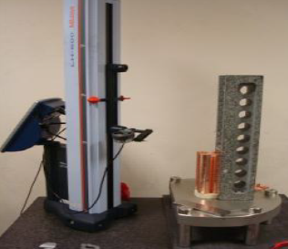
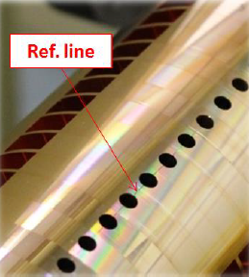
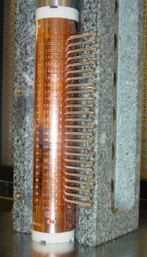
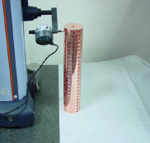
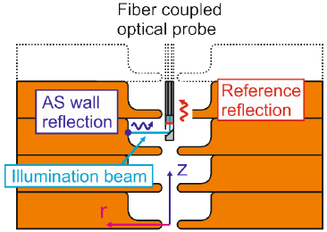
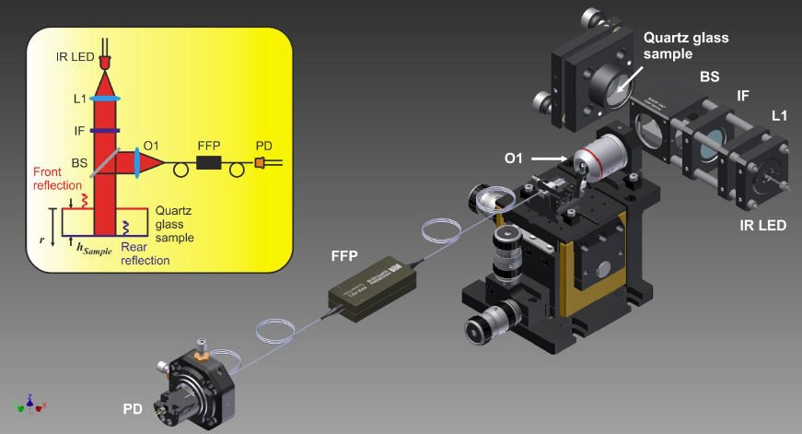
Optimizing the fabrication process
Disk Alignment (E. Zisopoulou and R. Montonen)
Current alignment strategy of CERN structures (26 cells) based on V-block. Achieved accuracy is ± 5 μm.
Axial sensitivity 40 nm
Development ongoing by collaborators at HIP (Helsinki Institute of Physics) on an interferometry-based technique to measure inside assembled structures.

Slide 11
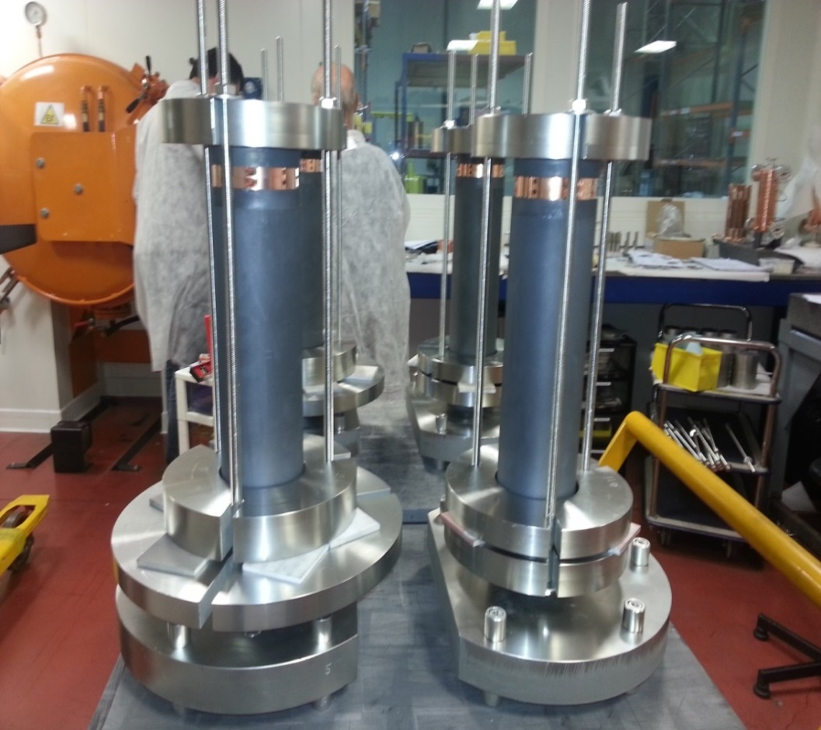
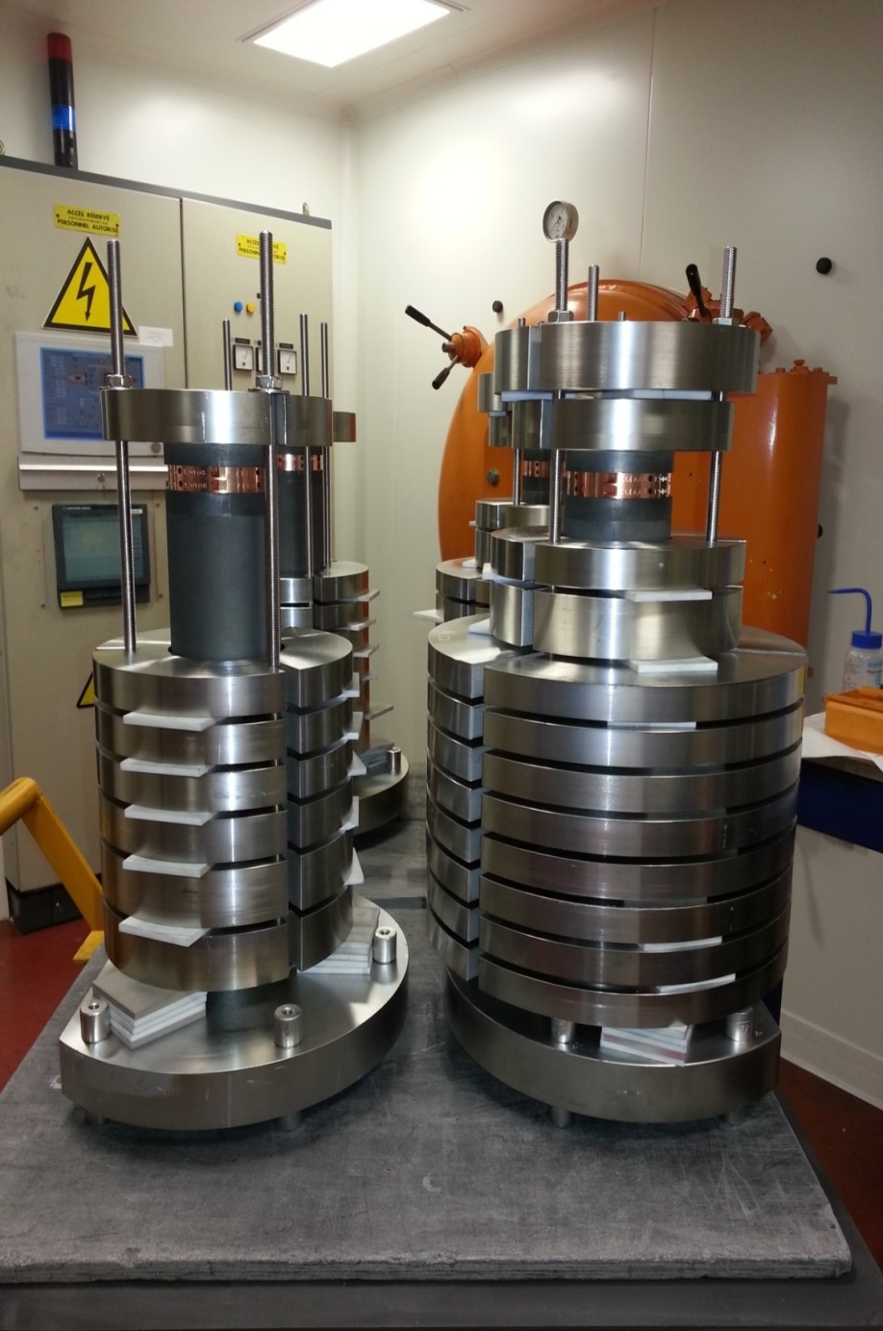
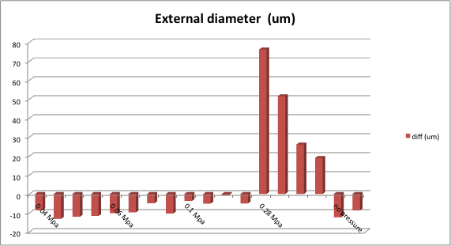
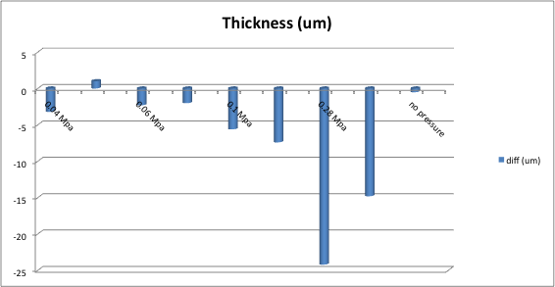
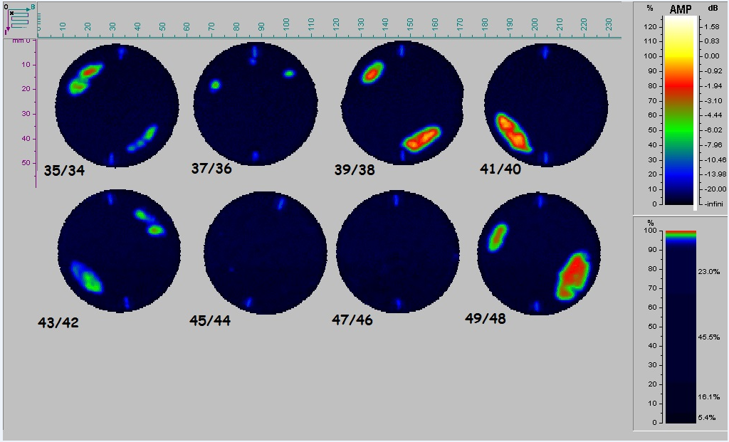
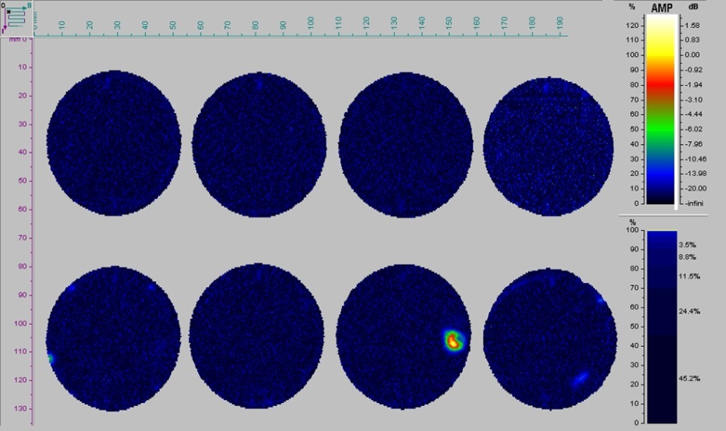
Optimizing the fabrication process
Structure Assembly (A. Xydou)
Diffusion bonding in hydrogen atmosphere is the current technology for the X-band AS assembly at CERN.
STACK#17
STACK#18
STACK#19
STACK#20
0.1 MPa
STACK#6
STACK#5
STACK#7
STACK#8
STACK#2
STACK#4
STACK#3
STACK#1
We have started investigating on the impact of the required load for bonding on disk dimensions; however alternative technologies are being considered.
STACK#21
STACK#22
STACK#23
STACK#24
0.04 MPa

Slide 12
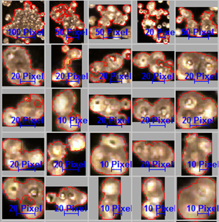
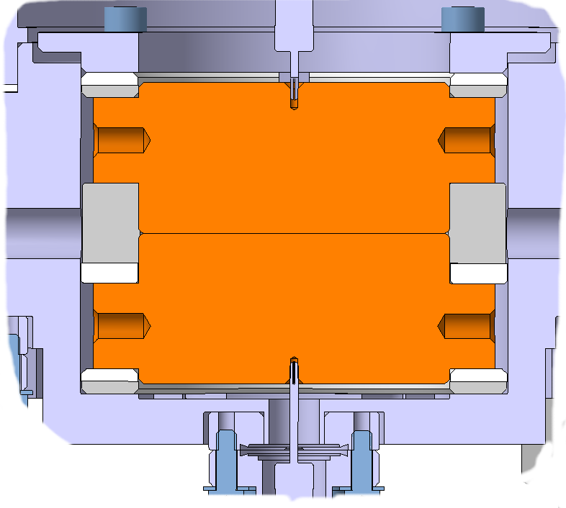
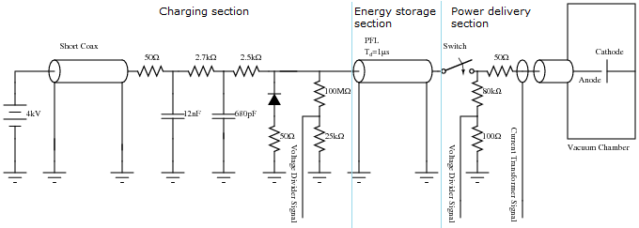
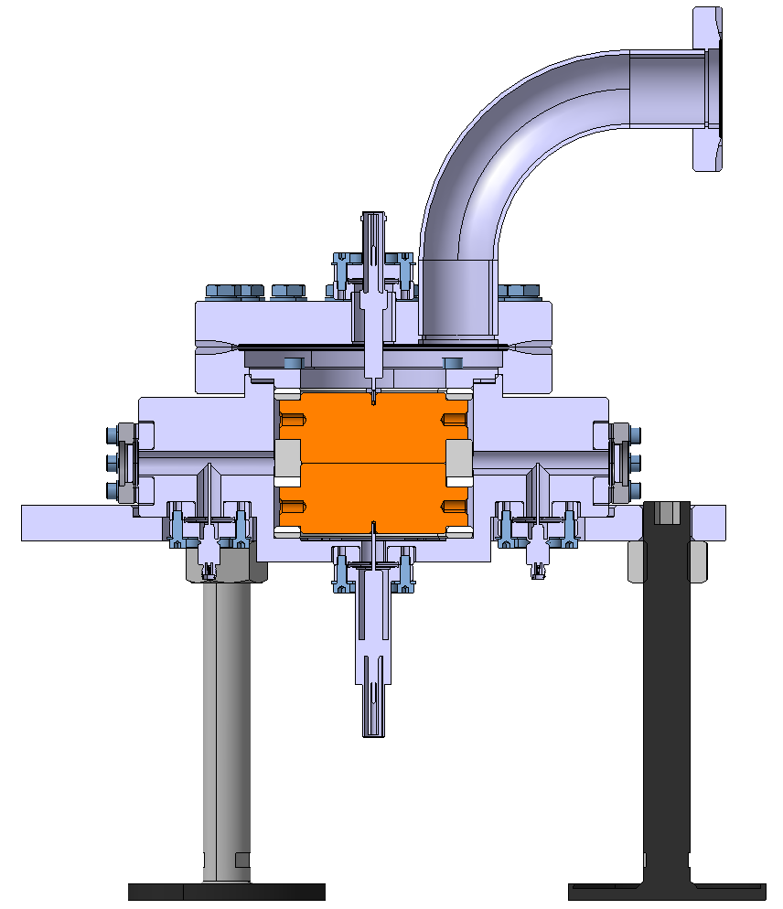
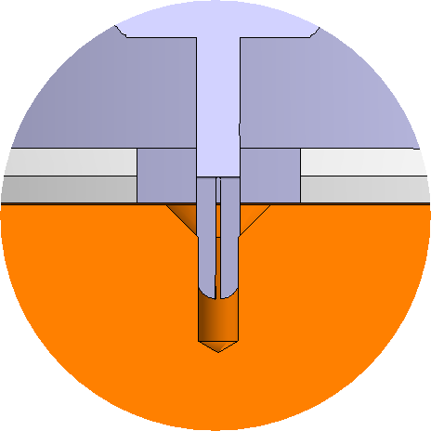
investigation tools
Fixed Gap System (S. Calatroni, A. Perez, N. Shipman)
Disk diameter = 60 mm
Disk gap down to 2 μm
Repetition rate = 1 kHz.
Clamping Ring
Ceramic Rings (Separators)

Slide 13
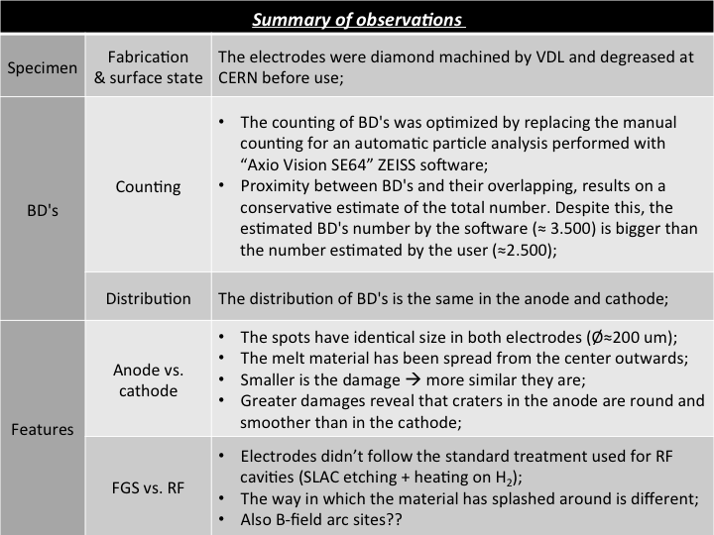
investigation tools
Fixed Gap System – preliminary test (S. Calatroni, A. Perez, N. Shipman)

Slide 14
Thank you
9th October 2014

