Slide 1
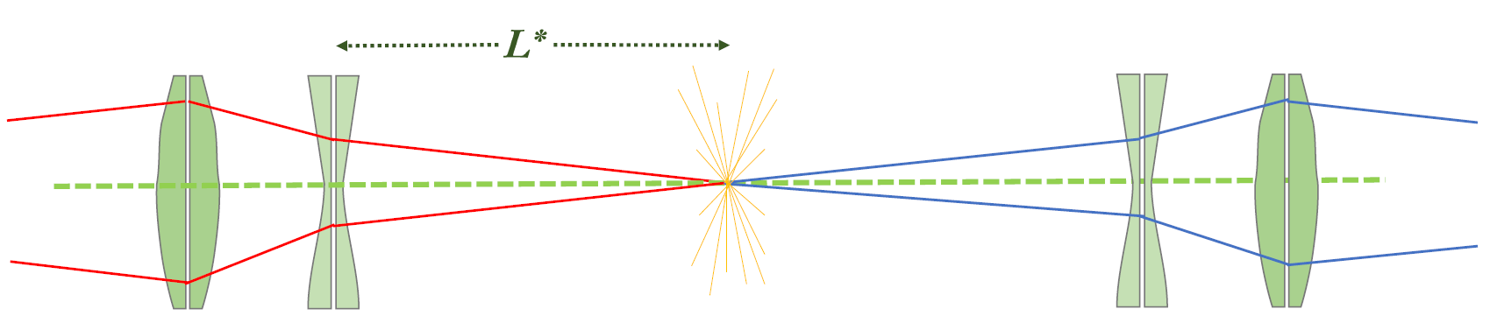


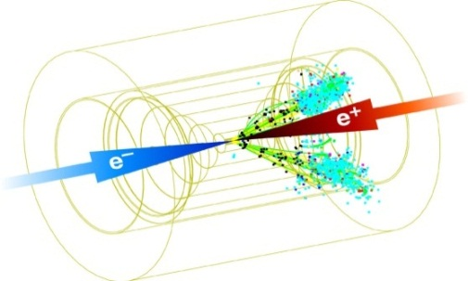



European Organization for Nuclear Research
International Linear Collider
Long $L^{∗}$ option for ILC Final Focus System
Design and Tunability of a short Traditional FFS scheme with $L^{∗}$ = 8 m
1,3
3
Fabien Plassard, Rogelio Tomas Garcia,
Andrea Latina , Hector Garcia Morales
3
2,3
1
Polytechnic Institute of Applied Sciences (IPSA) , France
2
Royal Holloway University of London, UK
3
CERN, Switzerland
$7^{th}$ October 2014
ЛЦВС14
Vinča Institute of Nuclear Sciences, Belgrade, Serbia
INTERNATIONAL WORKSHOP ON FUTURE LINEAR COLLIDERS
LCWS14
ILC FFS
slide 1/21

Slide 2



OUTLINE
1
ILC Final Focus System
Review of the traditional design
Long $L^{∗}$ option for ILC Final Focus
2
Design optimization and results
Traditional lattice design and optimization for $L^{∗}=$ 8 m
Comparison for shorter $L^{∗}$ design
3
Tuning simulation using extra sextupoles
Tuning set up
Alignment procedure (A. Latina algorithm)
Steps before tuning the FFS
Tuning preliminary results
4
Summary and conclusions
LCWS14
ILC FFS
slide 2/21

Slide 3
ILC Final Focus System
Review of the traditional design
1
Review of the FFS chromaticity correction
Traditional design
Chromaticity corrected in dedicated section but not in the Final Telescope
- I
- I
- I
- I
Bending magnet
Sextupoles
IP
QF1
QD0
CCX
CCY
Local Chromaticity correction
Chromaticity corrected at the Final Doublet
- I
- I
Bending magnet
IP
QF1
QD0
LCWS14
ILC FFS
slide 3/21

Slide 4


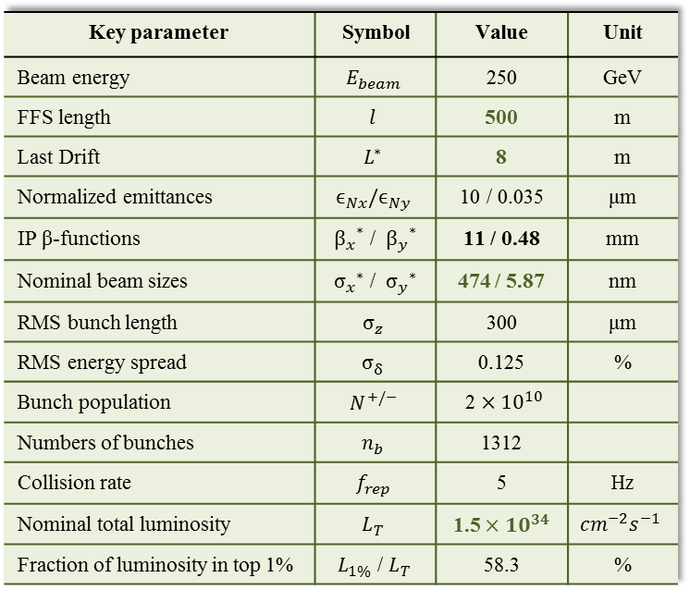
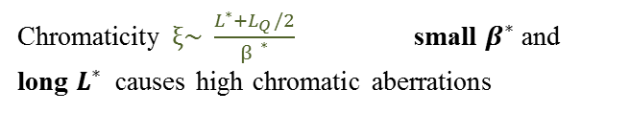
ILC Final Focus System
Review of the traditional design
1
Review of the FFS chromaticity correction
FFS length $≈$ 500 m
$L^{∗}$= 8 m
IP
Key parameter | Symbol | Value | Unit
Beam energy | $$E_{beam}$$ | 250 | GeV
FFS length | $$l$$ | 500 | m
Last Drift | $$L^{∗}$$ | 8 | m
Normalized emittances | $$ϵ_{Nx}/ϵ_{Ny}$$ | 10 / 0.035 | μm
IP β-functions | ${β_{x}^{}}^{∗}$ / ${β_{y}^{}}^{∗}$ | 11 / 0.48 | mm
Nominal beam sizes | ${σ_{x}^{}}^{∗}$ / ${σ_{y}^{}}^{∗}$ | 474 / 5.87 | nm
RMS bunch length | $$σ_{z}^{}$$ | 300 | μm
RMS energy spread | $$σ_{δ}^{}$$ | 0.125 | %
Bunch population | $$N^{+/−}$$ | 2 $×{10}^{10}$
Numbers of bunches | $$n_{b}$$ | 1312
Collision rate | $$f_{rep}$$ | 5 | Hz
Nominal total luminosity | $$L_{T}$$ | 1.5 $×{10}^{34}$ | $${cm}^{−2}s^{−1}$$
Fraction of luminosity in top 1% | $L_{1\%}$ / $L_{T}$ | 58.3 | %
FINAL DOUBLET
FFS design is driven by correcting chromatic and geometric aberrations
Traditional scheme offers separated functions and straightforward cancellation of geometrical aberrations.
Chromaticity $ξ\sim \frac{L^{∗}+L_{Q}/2}{{β }^{∗}}$ small $β^{∗}$ and long $L^{∗}$ causes high chromatic aberrations
Not locally corrected unavoidable lack of cancellation of high order chromatic aberration.
LCWS14
ILC FFS
slide 4/21

Slide 5




ILC Final Focus System
Long $L^{∗}$ option for ILC Final Focus
1
Long $L^{∗}$ option for ILC Final Focus
Detector
ILC Baseline Design
Small ${ L}^{∗}$ using SC magnet
Less chromaticity generated at the IP
Large magnet vibration
Push-pull support
Long $L^{∗}$ option
QF1
QD0
Magnets outside of the detector on a stable ground
small magnet vibration
Same magnet for all detectors
Problem :
Luminosity and tuning of the FFS for the long $L^{∗}$ option
ground
LCWS14
ILC FFS
slide 5/21

Slide 6
Design optimization and results
Traditional lattice optimization for $L^{∗}=$ 8 m
2
Traditional lattice design and optimization for $L^{∗}$ = 8 m
Original traditional design
Defocusing Quadrupoles
Focusing Quadrupoles
CCX
CCY
Traditional design using extra sextupoles
New sextupoles
- I
- I
- I
- I
CCX
CCY
LCWS14
ILC FFS
slide 6/21

Slide 7
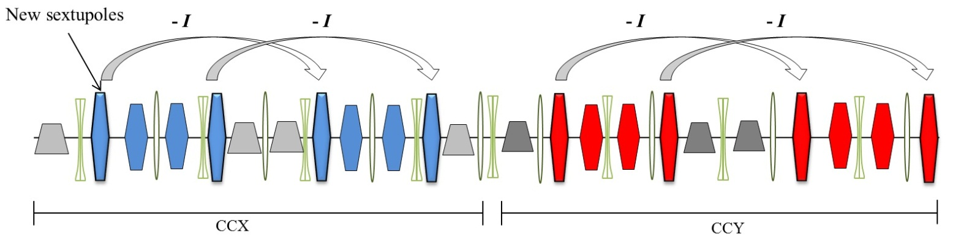
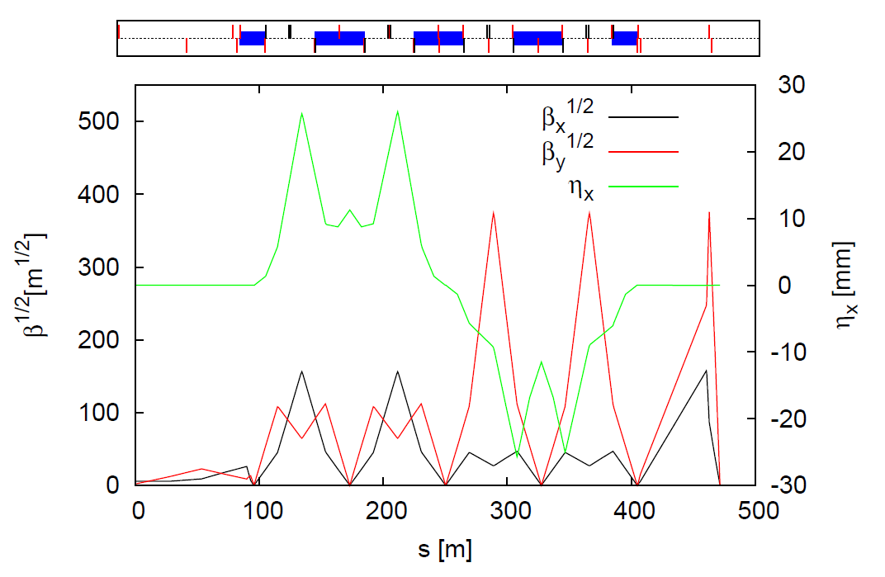
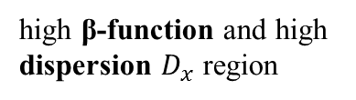
Design optimization and results
Traditional lattice optimization for $L^{∗}=$ 8 m
2
Traditional lattice design and optimization for $L^{∗}$ = 8 m
2 additional pairs of sextupoles located in each chromatic correction section CCX and CCY
high β-function and high dispersion $D_{x}$ region
-I transformation between pairs of sextupoles
LCWS14
ILC FFS
slide 7/21

Slide 8
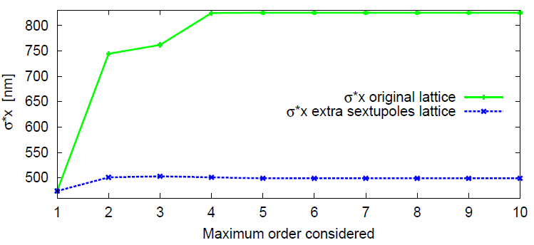
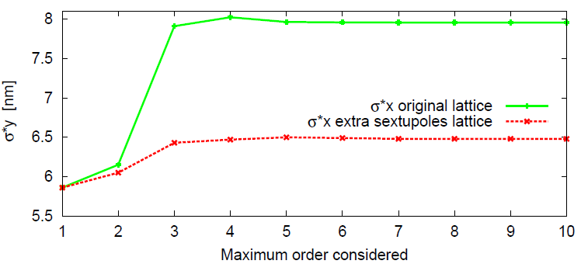
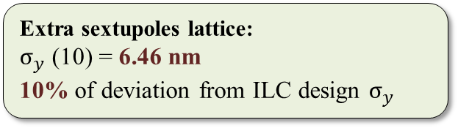
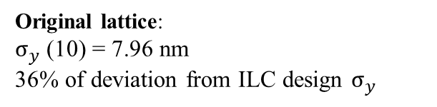
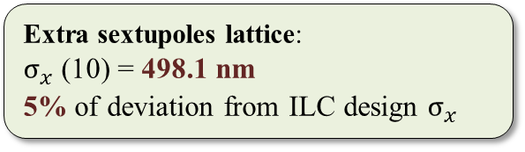
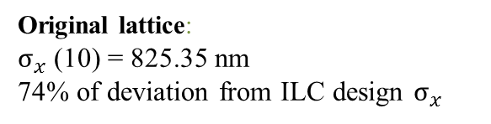
Design optimization and results
Traditional lattice optimization for $L^{∗}=$ 8 m
2
Nonlinear optimization (w/o SR)
Original lattice:
$σ_{x}$ (10) = 825.35 nm
74% of deviation from ILC design $σ_{x}$
Extra sextupoles lattice:
$σ_{x}$ (10) = 498.1 nm
5% of deviation from ILC design $σ_{x}$
Original lattice:
$σ_{y}$ (10) = 7.96 nm
36% of deviation from ILC design $σ_{y}$
Extra sextupoles lattice:
$σ_{y}$ (10) = 6.46 nm
10% of deviation from ILC design $σ_{y}$
Calculations made using MAPCLASS code
LCWS14
ILC FFS
slide 8/21

Slide 9
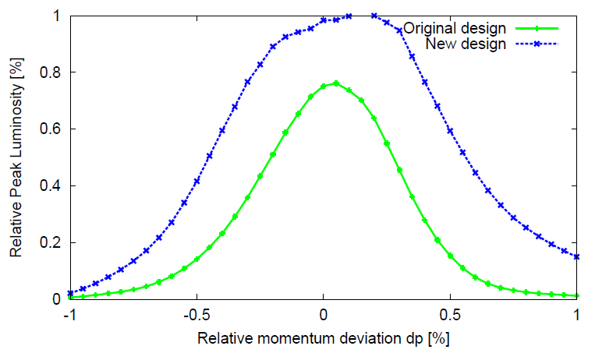
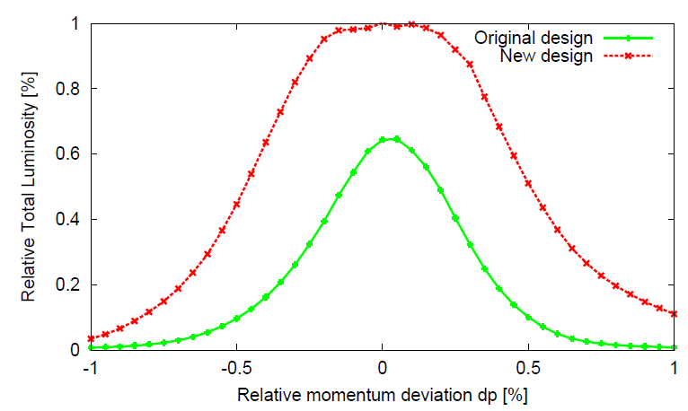
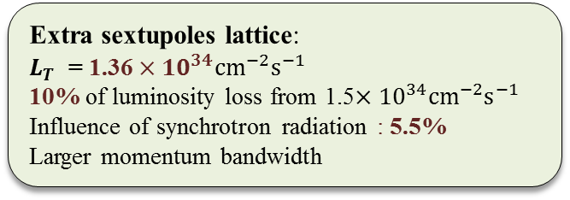
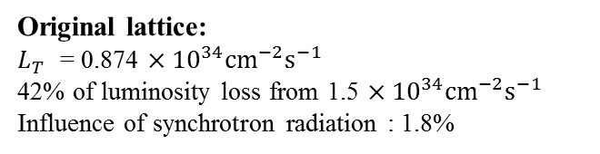
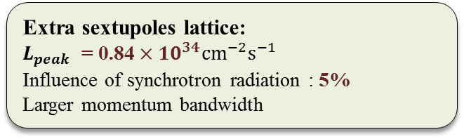
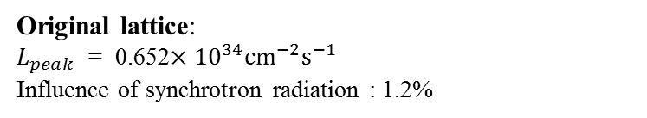
Design optimization and results
Traditional lattice optimization for $L^{∗}=$ 8 m
2
Luminosity and momentum bandwidth (with SR)
Original lattice:
$L_{peak}$ = 0.652$×{10}^{34}{cm}^{−2}s^{−1}$
Influence of synchrotron radiation : 1.2%
Original lattice:
$L_{T}$ = 0.874 $×{10}^{34}{cm}^{−2}s^{−1}$
42% of luminosity loss from 1.5 $×{10}^{34}{cm}^{−2}s^{−1}$
Influence of synchrotron radiation : 1.8%
Extra sextupoles lattice:
$L_{peak}$ = 0.84 $×{10}^{34}{cm}^{−2}s^{−1}$
Influence of synchrotron radiation : 5%
Larger momentum bandwidth
Extra sextupoles lattice:
$L_{T}$ = 1.36 $×{10}^{34}{cm}^{−2}s^{−1}$
10% of luminosity loss from 1.5$×{10}^{34}{cm}^{−2}s^{−1}$
Influence of synchrotron radiation : 5.5%
Larger momentum bandwidth
Calculations made using PLACET and Guinea-Pig
LCWS14
ILC FFS
slide 9/21

Slide 10



Design optimization and results
Traditional lattice optimization for $L^{∗}=$ 8 m
2
Comparison for shorter $L^{∗}$ design
What is the impact of the $L^{∗}$ on the traditional design performances?
(Optimization for $L^{∗}$ = 6 m)
LCWS14
ILC FFS
slide 10/21

Slide 11
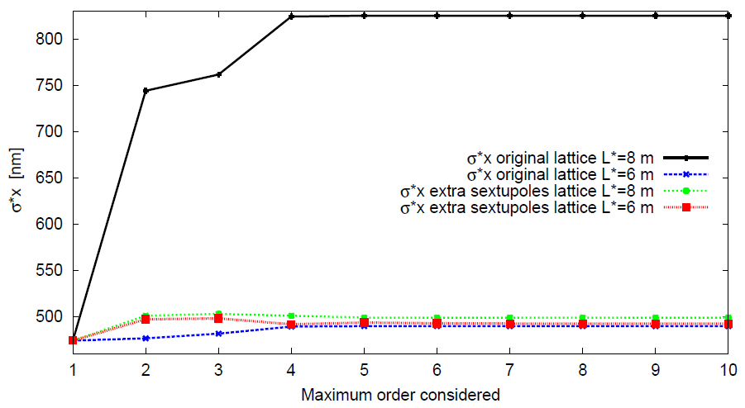
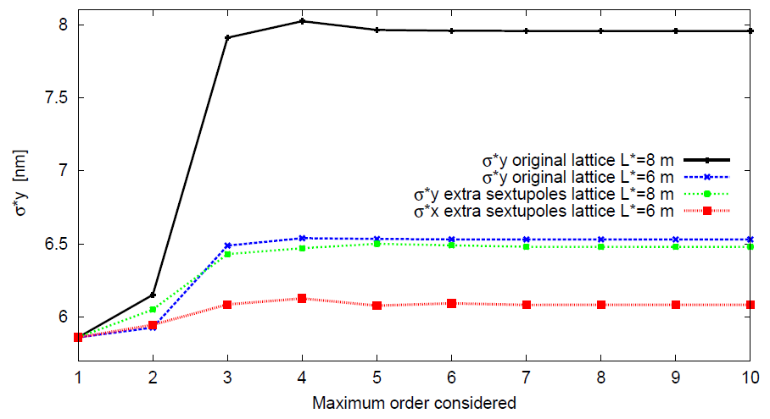



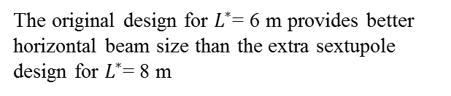
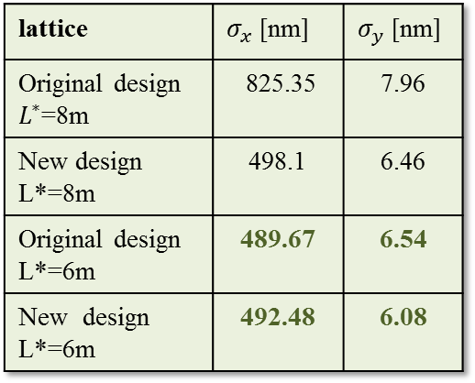
Design optimization and results
Traditional lattice optimization for $L^{∗}=$ 8 m
2
Shorter $L^{∗}$ design : nonlinear optimization (w/o SR)
lattice | $σ_{x}$ [nm] | $σ_{y}$ [nm]
Original design $L^{∗}$=8m | 825.35 | 7.96
New design L*=8m | 498.1 | 6.46
Original design L*=6m | 489.67 | 6.54
New design L*=6m | 492.48 | 6.08
The original design for $L^{∗}$= 6 m provides better horizontal beam size than the extra sextupole design for $L^{∗}$= 8 m
The extra sextupoles design for $L^{∗}$= 6 m reduces only the vertical beam size $σ_{y}$
The shorter $L^{∗}$ generates less chromatic aberrations at the FD
LCWS14
ILC FFS
slide 11/21

Slide 12
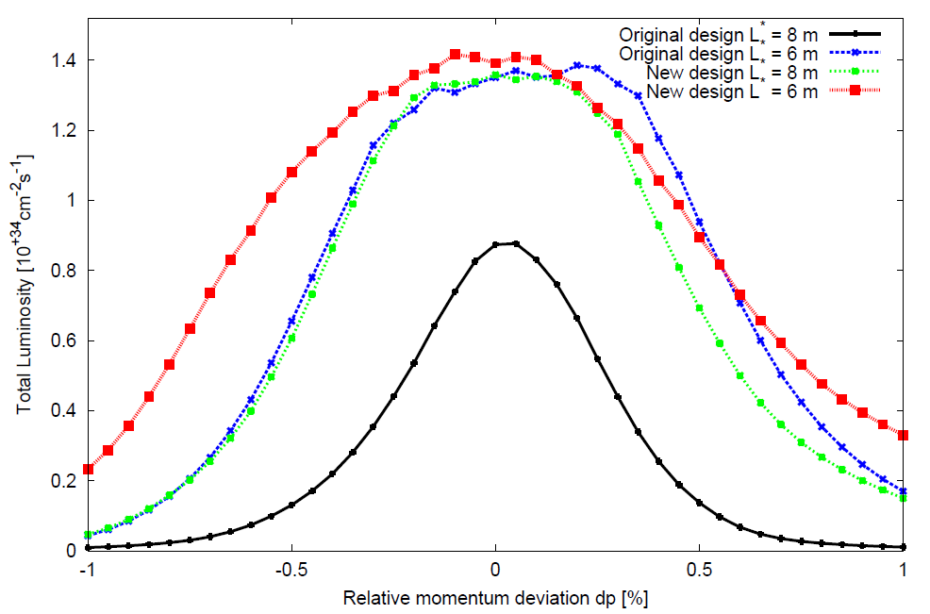
Design optimization and results
Traditional lattice optimization for $L^{∗}=$ 8 m
2
Shorter $L^{∗}$ design : momentum bandwidth (with SR)
Original design $L^{∗}$= 6 m : $L_{T}$ = 1.38 $×{10}^{34}{cm}^{−2}s^{−1}$
Extra sextupoles design $L^{∗}$= 6 m : $L_{T}$ = 1.42 $×{10}^{34}{cm}^{−2}s^{−1}$
Larger momentum acceptance for both design with $L^{∗}$= 6 m
Large impact of $L^{∗}$ on the traditional scheme performance
LCWS14
ILC FFS
slide 12/21

Slide 13
Tuning simulation using extra sextupoles ($L^{∗}$ = 8 m)
Tuning set up
3
Tuning simulation
The performance of a linear collider drops when we consider magnet misalignments
Under realistic conditions the luminosity is reduced and an alignment procedure is mandatory
Tuning process brings the system to its design performance using beam-based alignment techniques and beam parameters optimization algorithm
Tuning set up ( $≠$ ILC errors parameters)
Short Traditional lattice using extra sextupoles and $L^{∗}$= 8 m
Take into account nonlinearities and synchrotron radiation
110 randomly misaligned machines (seeds)
Initial misalignment : 10 μm RMS in transverse plane ($x,y$)
Elements misaligned : Quadrupoles, Sextupoles , BPMs
Dipole correctors : Corrector + Quad + BPM
BPM resolution : 10 nm
Tracking and luminosity measurement provided by PLACET and Guinea-Pig
Luminosity goal : $L_{T}$ = 1.5 $×{10}^{34}{cm}^{−2}s^{−1}$
LCWS14
ILC FFS
slide 13/21

Slide 14
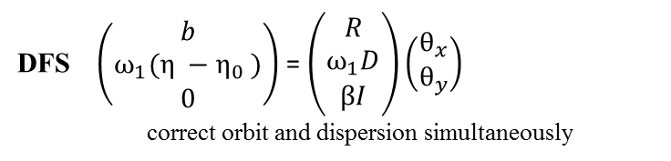
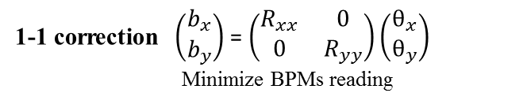
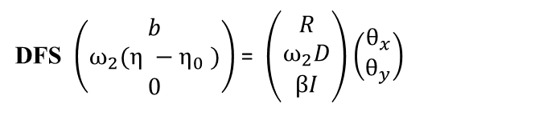
Tuning simulation using extra sextupoles ($L^{∗}$ = 8 m)
Alignment procedure
3
Alignment procedure (A. Latina algorithm)
Beam Based Alignment (orbit correction) : Sextupoles switched OFF
1
1-1 correction $\left(\begin{matrix}b_{x} \\ b_{y}\end{matrix}\right)$ = $\left(\begin{matrix}R_{xx} & 0 \\ 0 & R_{yy}\end{matrix}\right)\left(\begin{matrix}θ_{x} \\ θ_{y}\end{matrix}\right)$
Minimize BPMs reading
Multipole Knobs 1
4
DFS $\left(\begin{matrix}b \\ ω_{1}(η −η_{0} ) \\ 0\end{matrix}\right)$ = $\left(\begin{matrix}R \\ ω_{1}D \\ βI\end{matrix}\right)\left(\begin{matrix}θ_{x} \\ θ_{y}\end{matrix}\right)$
correct orbit and dispersion simultaneously
Beam parameters optimization using orthogonal knobs
2
Multipole-shunting (1)
Sextupoles Powered individually
3
Beam Based Alignment
Sextupoles switched ON
Multipole Knobs 2
DFS $\left(\begin{matrix}b \\ ω_{2}(η −η_{0} ) \\ 0\end{matrix}\right)$ = $\left(\begin{matrix}R \\ ω_{2}D \\ βI\end{matrix}\right)\left(\begin{matrix}θ_{x} \\ θ_{y}\end{matrix}\right)$
7
Beam parameters optimization using orthogonal knobs
5
Multipole-shunting (2)
6
LCWS14
ILC FFS
slide 14/21

Slide 15

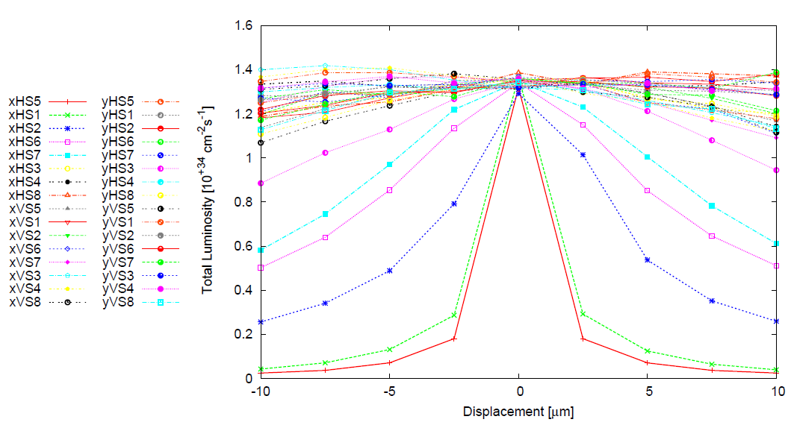

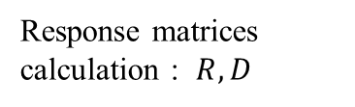
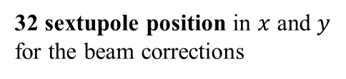
Tuning simulation using extra sextupoles ($L^{∗}$ = 8 m)
Steps before tuning the FFS
3
Steps before tuning
y
Response matrices calculation : $R, D$
16 sextupoles in the lattice
32 sextupole position in $x$ and $y$ for the beam corrections
Weigthing factors ${β,ω}_{1}$, $ω_{2}$
x
The tuning simulation time increases with the number of knobs
Knobs computation
1 iteration using 10 knobs
1 iteration using 23 knobs
1 iteration using 32 knobs
LCWS14
ILC FFS
slide 15/21

Slide 16
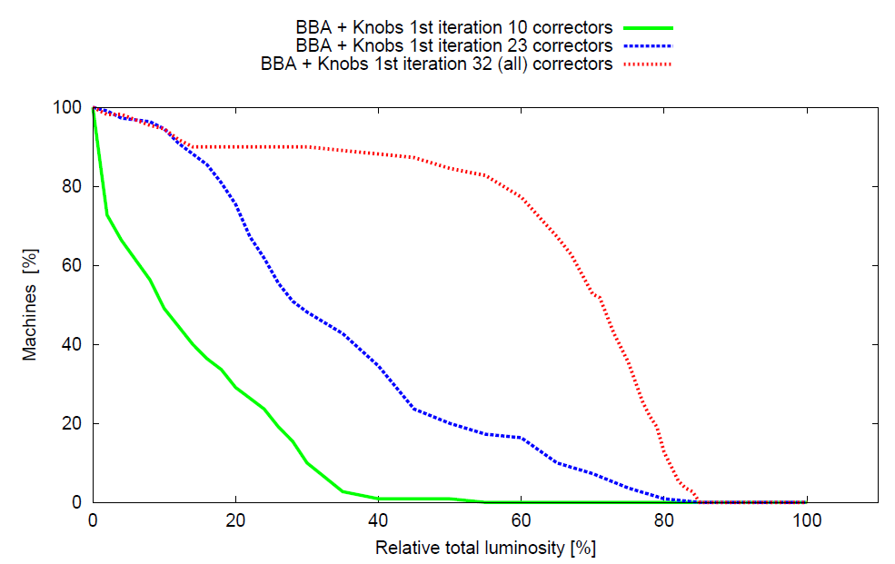
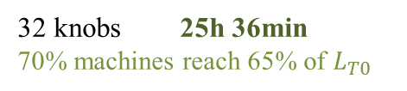

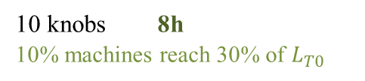
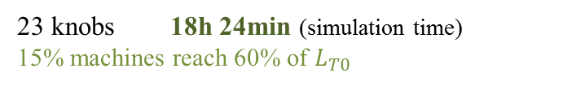
Tuning simulation using extra sextupoles ($L^{∗}$ = 8 m)
Tuning preliminary results
3
Tuning preliminary results : Number of knobs
23 knobs 18h 24min (simulation time)
15% machines reach 60% of $L_{T0}$
32 knobs 25h 36min
70% machines reach 65% of $L_{T0}$
10 knobs 8h
10% machines reach 30% of $L_{T0}$
$L_{T0}$ = 1.5 $×{10}^{34}{cm}^{−2}s^{−1}$
LCWS14
ILC FFS
slide 16/21

Slide 17
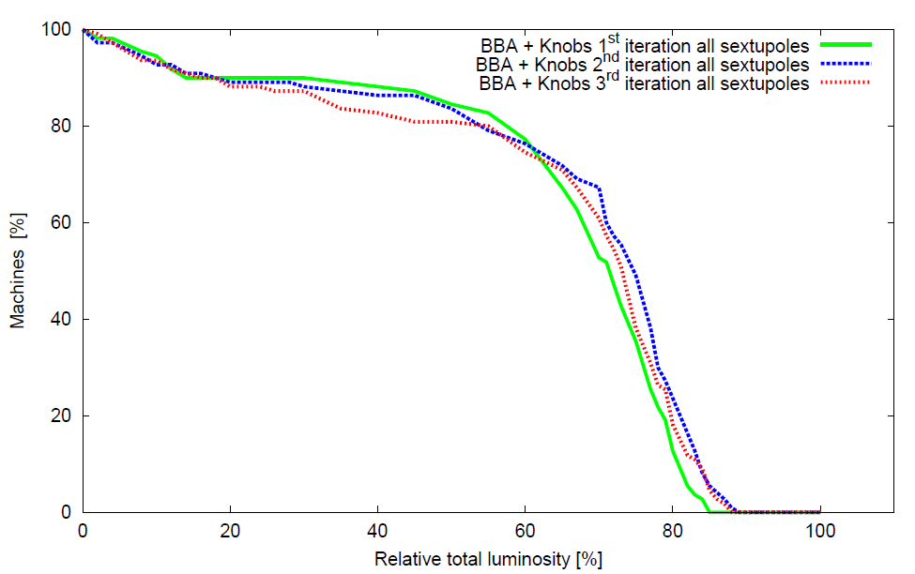

Tuning simulation using extra sextupoles ($L^{∗}$ = 8 m)
Tuning preliminary results
3
Tuning preliminary results : all knobs
$L_{T0}$ = 1.5 $×{10}^{34}{cm}^{−2}s^{−1}$
BBA + Knobs iterations do not improve the luminosity
Need to optimize the weights ${β,ω}_{1}$, $ω_{2}$
70% machines reach more than 70% of $L_{T0}$ and 25% machines reach more than 80% of $L_{T0}$
LCWS14
ILC FFS
slide 17/21

Slide 18
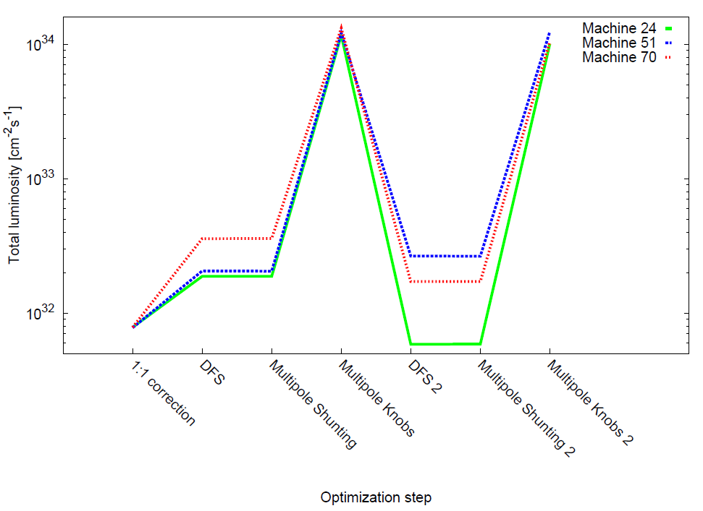
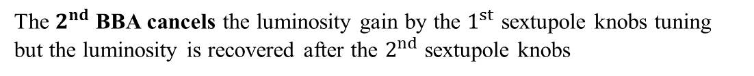
Tuning simulation using extra sextupoles ($L^{∗}$ = 8 m)
Tuning preliminary results
3
Tuning optimization steps
Luminosity evolution after each optimization step for 3 random machines
The $2^{nd}$ BBA cancels the luminosity gain by the $1^{st}$ sextupole knobs tuning but the luminosity is recovered after the $2^{nd}$sextupole knobs
Need to optimize the tuning algortihm?
LCWS14
ILC FFS
slide 18/21

Slide 19
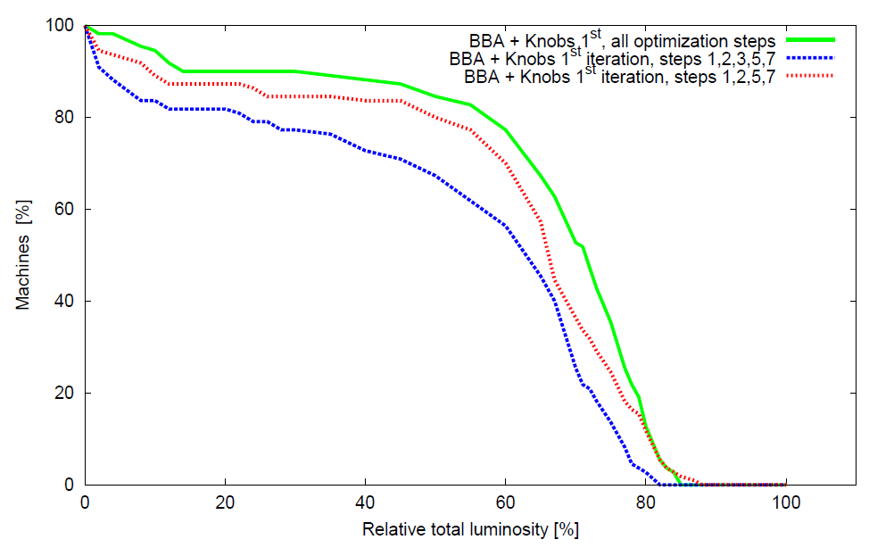

Tuning simulation using extra sextupoles ($L^{∗}$ = 8 m)
Tuning preliminary results
3
Tuning optimization steps
The full algorithm is still the best option for the BBA + Knobs tuning
1-1 correction
DFS1
Sextupole-shunting
Sextupole knobs 1
DFS2
Sextupole-shunting 2
Sextupole knobs 2
Other simulations are progressing for different optimization steps
Need to optimize the weigths $β , { ω}_{1}$ and $ω_{2}$
1-1 correction
DFS1
Sextupole-shunting
Sextupole knobs 1
DFS2
Sextupole-shunting 2
Sextupole knobs 2
1-1 correction
DFS1
Sextupole-shunting
Sextupole knobs 1
DFS2
Sextupole-shunting 2
Sextupole knobs 2
LCWS14
ILC FFS
slide 19/21

Slide 20
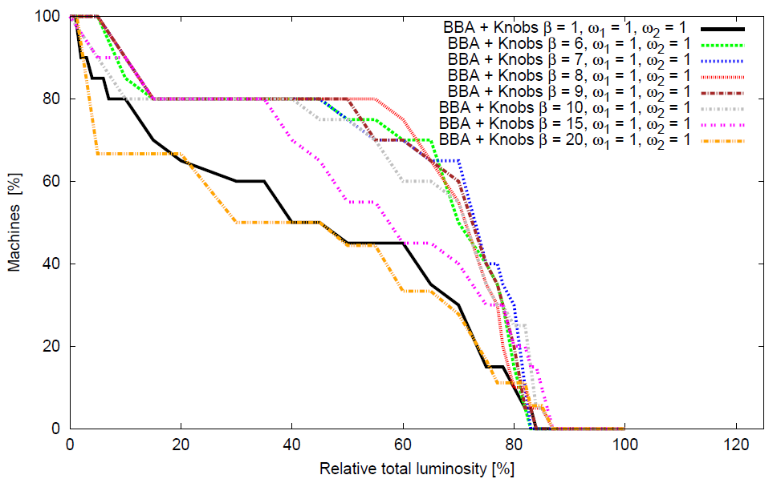

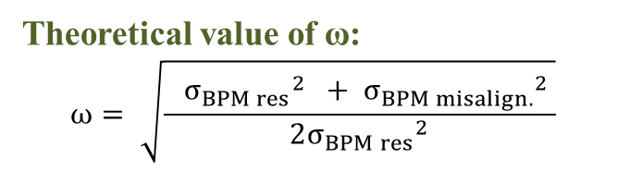
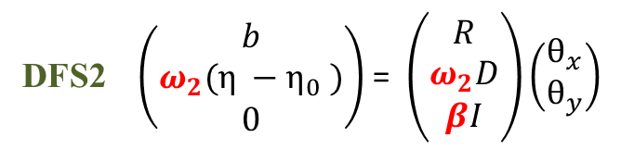

Tuning simulation using extra sextupoles ($L^{∗}$ = 8 m)
Tuning preliminary results
3
Weights optimization : $β , { ω}_{1}$ and $ω_{2}$
DFS1 $\left(\begin{matrix}b \\ ω_{1}(η −η_{0} ) \\ 0\end{matrix}\right)$ = $\left(\begin{matrix}R \\ ω_{1}D \\ βI\end{matrix}\right)\left(\begin{matrix}θ_{x} \\ θ_{y}\end{matrix}\right)$
DFS2 $\left(\begin{matrix}b \\ ω_{2}(η −η_{0} ) \\ 0\end{matrix}\right)$ = $\left(\begin{matrix}R \\ ω_{2}D \\ βI\end{matrix}\right)\left(\begin{matrix}θ_{x} \\ θ_{y}\end{matrix}\right)$
Theoretical value of ω:
$$ω= \sqrt{\frac{ {σ_{BPM res}}^{2} + {σ_{BPM misalign.}}^{2} }{2{σ_{BPM res}}^{2}}}$$
DFS equation must be weighted in order to have the same impact on the vector of observables on the left hand-side of the system
The weights ${ ω}_{1}$ and $ω_{2}$ are used for the dispersion terms while $β$ for the SVD to limit the amplitude of the correctors θ
Weight optimization is underway by simulating several combinations of weights on 40 seeds and by using as initial parameter the theoretical value of ω
LCWS14
ILC FFS
slide 20/21

Slide 21
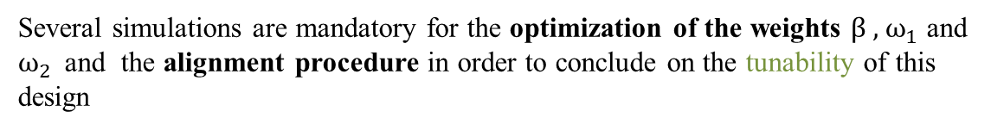
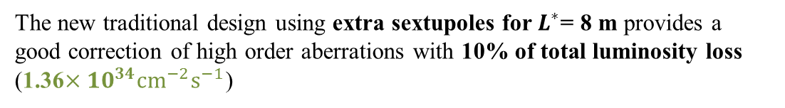
Summary and conclusions
4
Summary and conclusions
The new traditional design using extra sextupoles for $L^{∗}$= 8 m provides a good correction of high order aberrations with 10% of total luminosity loss (1.36$×{10}^{34}{cm}^{−2}s^{−1}$)
The long last drift $L^{∗}$ limits the FFS performance especially for the non-local chromaticity correction scheme $L^{∗}$= 6 m provides better performances
The tuning turns out to be long due to the number of sextupoles in the lattice
With optimistic set up and errors parameters, the tuning of the system seems feasible but must be improved ( 70% machines reach more than 70% of ILC design luminosity)
Several simulations are mandatory for the optimization of the weights $β , { ω}_{1}$ and $ω_{2 }$ and the alignment procedure in order to conclude on the tunability of this design
LCWS14
ILC FFS
slide 21/21

