Slide 1



















The CLARA Project - Rationale and Experimental Program of an X-Ray FEL Test Facility
Jim Clarke
STFC Daresbury Laboratory and The Cockcroft Institute
on behalf of the CLARA & VELA Project Teams
LCWS14, 9th October 2014

Slide 2
Free Electron Lasers
FELs have made huge advances in the past few years
  First X-ray FEL in 2009 (LCLS) then SACLA in 2011
  More X-ray facilities are under construction
  Advanced soft X-ray facilities are also now operating routinely for users as well (FLASH & FERMI)
The potential for improvements is enormous
  Increased temporal coherence
  Increased wavelength stability
  Increased power
  Increased intensity stability
  Ultra-short pulses of light (sub-fs)
  Two-colour or Multi-colour output
  …

Slide 3
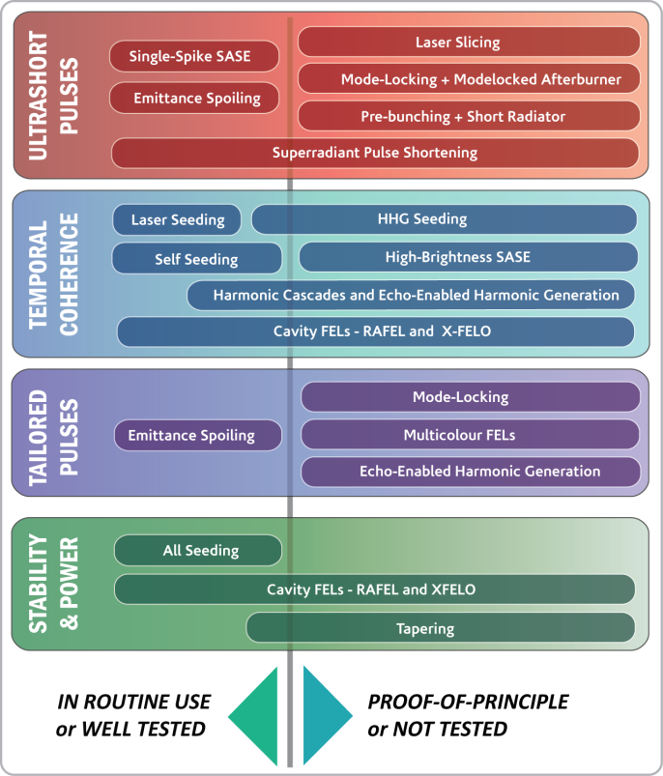
The ‘FEL Case’ for an FEL Test Facility
Free-Electron Lasers (FELs) are remarkable scientific tools
Short-wavelength FELs are operating for users around the world, for example LCLS (USA), SACLA (Japan), FLASH (Germany) and FERMI@Elettra (Italy).
There are still many ways their output could be improved:
  Shorter Pulses
  Improved Temporal Coherence
  Tailored Pulse Structures
  Stability & Power
There are many ideas for achieving these aims, but many of these ideas are untested
Beamtime on FELs is over subscribed by users and so little time for R&D

Slide 4
CLARA
We propose that the UK hosts a new dedicated flexible FEL Test Facility
  Capable of testing the most promising new schemes
We have strategically decided to target ultra short pulse generation
  We are focussing on the longer term capabilities of FELs, not short term incremental improvements
  Taking FELs into a new regime
  By demonstrating this goal we will have to tackle all the challenges currently faced by state of the art FELs (and a few more!)

Slide 5
The UK Strategic Case
The UK science community has identified that
X-ray FELs are critical to many science challenges
Novel and Functional Materials
Device Physics
Warm Dense Matter
Laboratory Astrophysics
Planetary Physics
Complexity and Emergence
Ultrafast Electron Dynamics
Structural Dynamics
Fast Biomolecular Dynamics/Structure
Single Molecule Imaging.
Imaging Nanoscale Cell Function
There is thus a high priority to secure access to an X-Ray FEL
This may be done initially through engagement in the European XFEL project, or looking further ahead, the UK may wish to construct its own X-ray FEL facility
R&D activities in support of this need to be put in place.

Slide 6
The CLARA Concept
There are many ways FELs can be improved, but limited scope with existing facilities
UK Scientists need FELs and we want to develop next generation FEL technology towards a possible UK facility
CLARA
Compact Linear Accelerator for Research and Applications
An upgrade of the existing VELA Photoinjector Facility at Daresbury Laboratory to a 250MeV Free-Electron Laser Test Facility
Proof-of-principle demonstrations of novel FEL concepts
Emphasis is ULTRA-SHORT PULSE GENERATION
Strathclyde
INFN Frascati
SwissFEL
DLS
Oxford
Liverpool
Imperial

Slide 7
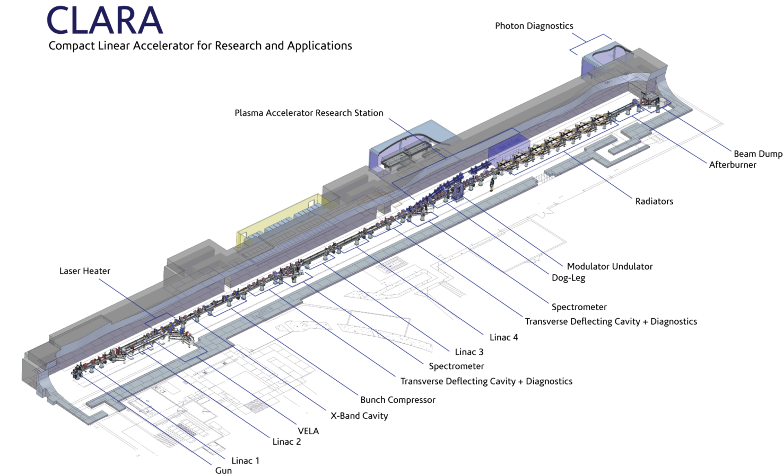
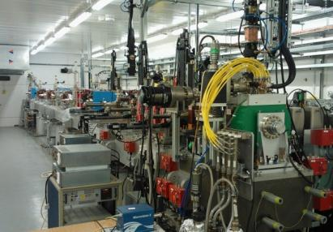
CLARA Layout
FEL OUTPUT STUDIED
PLASMA TEST LINE
FEL OUTPUT GENERATED
The existing VELA RF Photoinjector Facility
INTERACTIONS WITH LASER BEAMS
ELECTRONS ACCELERATED AND MANIPULATED
ELECTRONS GENERATED HERE
Notes:
1. CLARA uses European RF frequencies
2. X-band cavity is used for phase space linearisation
3. Total length ~90m

Slide 8
CLARA Layout
We would like to replace Linac 4 with X-band linac as test bed for this technology on FELs
Linacs 2 to 4 are 4m long S-band devices currently installed on SwissFEL Injector Test Facility – will be delivered to Daresbury later this year
Linac 1 is 2m long, S-band on order from Research Instruments

Slide 9
Other Goals and Benefits of CLARA
ASTeC
CERN
FERMI@Elettra
RHUL
INFN Frascati
SwissFEL
DLS
Lancaster
INR Moscow
The opportunity for R&D on advanced technologies:
  New photoinjector technologies
  Novel undulators (short period, cryogenic, superconducting….)
  New accelerating structures: X-Band etc...
  Advanced diagnostics
The enhancement of VELA beam power and repetition rate, enabling additional industrial applications.
The possibility to use the electron beam for other scientific research applications:
NOVEL PHOTON SOURCES (CDR, SMITH-PURCELL, …)
COMPTON SCATTERING FOR GAMMA BEAMS
PLASMA ACCELERATOR RESEARCH
ULTRAFAST ELECTRON DIFFRACTION
NOVEL ACCELERATION (DWA, DLA, THZ, …)
NOVEL TYPES OF STORAGE RING
ASTeC RHUL
Oxford
ASTeC Strathclyde
Manchester
INFN Frascati
ASTeC York
Swansea
UCL
ASTeC
RHUL
Liverpool
Lancaster
Manchester Oxford

Slide 10
Design Philosophy and Parameters
CLARA will be a flexible test facility allowing the broad range of accelerator and FEL R&D necessary to ensure a future UK FEL facility is world leading.
Many of the FEL research topics are in two main areas which are intended to demonstrate improvement of FEL output beyond that available from SASE
  The generation of ultra-short pulses
    Our emphasis for the short pulse schemes is to generate pulses with as few optical cycles as possible with durations of the order of, or shorter than, the FEL cooperation length.
    For these schemes we will lase at 400–250 nm, where suitable nonlinear materials for single shot pulse profile characterisation are available.
    A suitable wavelength range for seed sources to manipulate the electron beam longitudinal phase space is 30 – 120 μm
  Improvement of temporal coherence.
    For these schemes we will lase at 266-100nm because here only spectral characterisation is required.
    A suitable seed source for harmonic upconversion, if required, is an 800nm Ti:S.
In all cases, we aim to study the essential physics of the schemes which can often be independent of the FEL wavelength.
Using a hybrid planar undulator, with minimum gap 6mm, and gap tuning range of 400–100 nm, the required electron beam energy is ~230 MeV.

Slide 11

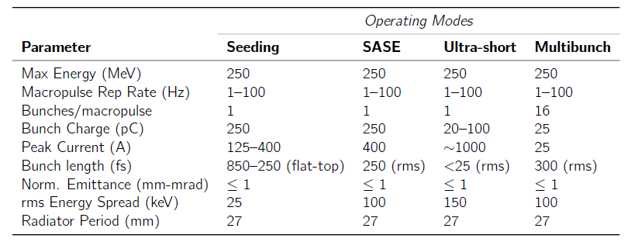
CLARA Parameters
Parameters have been generated to cover 4 different operating modes.
25
FEL output wavelengths from 400 nm to 100 nm
Can make use of 800 nm laser for harmonic generation experiments
Can use well established laser diagnostics for single shot pulse length measurements
No need for long photon beamlines, can deflect by 90°

Slide 12
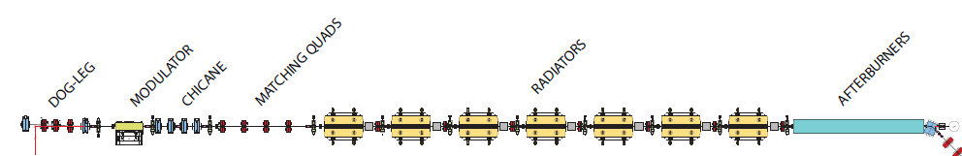
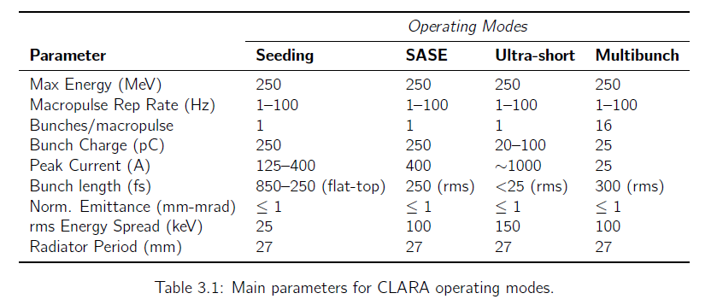
FEL Layout + Operating Modes
1.1m GAPS, with QUAD, BPM, SCREEN + DELAY CHICANE
7 x 1.5m RADIATORS, 27mm PERIOD, ON-AXIS FIELD HORIZONTAL
Seeding Mode is for
Short Pulse Schemes
FEL lasing: 400-250nm
(Seed: 30-120µm)
+
Temporal Coherence Schemes
FEL lasing: 266-100nm
(Seed: 800nm)

Slide 13
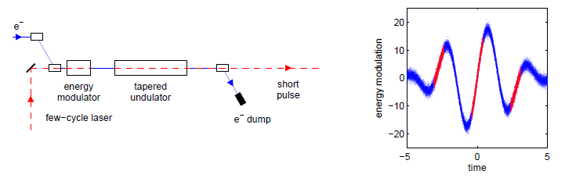
Short Pulse Scheme Example:
Sliced Chirped Beam + Taper*
Principle of scheme
Few-cycle laser interacts with electron beam to generate strong energy chirp in short region of bunch
Radiator taper is matched to energy chirp to maintain resonance as FEL pulse slips forwards to electrons with different energies
FEL gain strongly suppressed in remainder of bunch
Constraints
Length of chirp needs to match cooperation length for single SASE spike to grow
Amplitude of chirp needs to be greater than natural bandwidth of FEL
* E. Saldin et al., PRST-AB. 9, 050702, (2006)
Slide courtesy Ian Martin, DLS

Slide 14
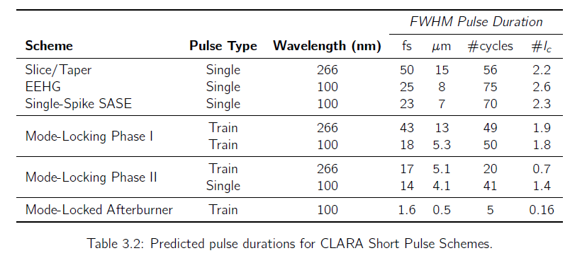
CLARA Short Pulse Schemes:
Predicted Pulse Durations
Typical SASE output is ~100,000 cycles

Slide 15
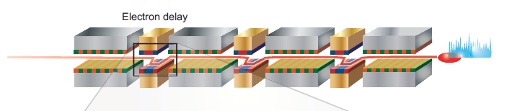
Temporal Coherence Scheme Example:
High-Brightness (HB) SASE*
As in the mode-coupled FEL, delays are used between undulator modules
Each delay is different to prohibit growth of modes
Increased slippage gives increased communication length between radiation and electrons, delocalising the collective FEL interaction and allowing coherence length to grow exponentially by up to 2 orders of magnitude (compared to SASE)
In contrast to other schemes for improving temporal coherence:
  No seed laser or photon optics are required
  It’s all done with magnets, and is thus applicable at Any Repetition Rate and Any Wavelength.
Was demonstrated (over a limited parameter range) on LCLS, using detuned undulators as delays, and shown to reduce linewidth in inverse proportion to the increased slippage – can’t test optimum scheme
* B. W. J. McNeil, N. R. Thompson & D. J. Dunning, Transform-Limited X-Ray Pulse Generation from a High-Brightness SASE FEL, PRL 110, 134802 (2013)

Slide 16
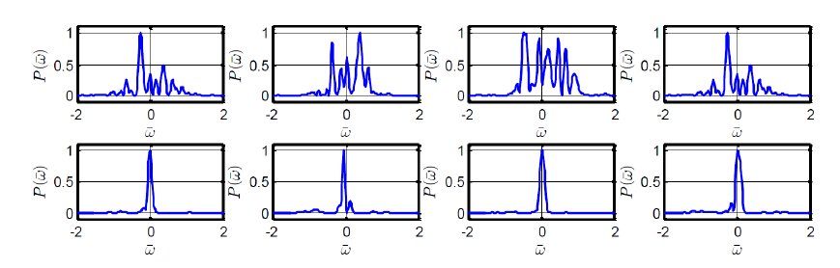
Temporal Coherence: HB-SASE
100nm HB-SASE on CLARA, CDR lattice
SASE
HB-SASE
Four different shots on CLARA demonstrate variability of SASE & advantage of HB-SASE

Slide 17
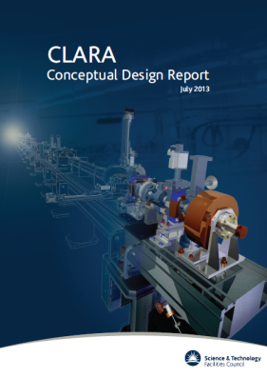
CLARA Status
The CDR was published in July 2013
  SwissFEL are providing required 3 linacs, together with a number of quadrupoles and solenoids (available Q4 2014)
The project has now been split into Two Phases
PHASE 1 – Front End, 50 MeV
  This is happening now, with procurement progressing, and installation in 2015.
  Will enable access to bright, short, up to ~50 MeV electron bunches for UK accelerator science and technology community
  Will enable new high rep rate photoinjector to be characterised with beam whilst VELA/CLARA Phase 1 still operational (i.e. two guns)
  Potential for early exploitation of 20 TW laser
PHASE 2a – 150 MeV, up to bunch compression section
  Funded, procurement starting this year
PHASE 2b – 250 MeV FEL Test Facility
  Not Yet Funded – Part of Ongoing UK Capital Consultation Exercise – CLARA is a priority for STFC
JINST 9 (2014) T05001

Slide 18
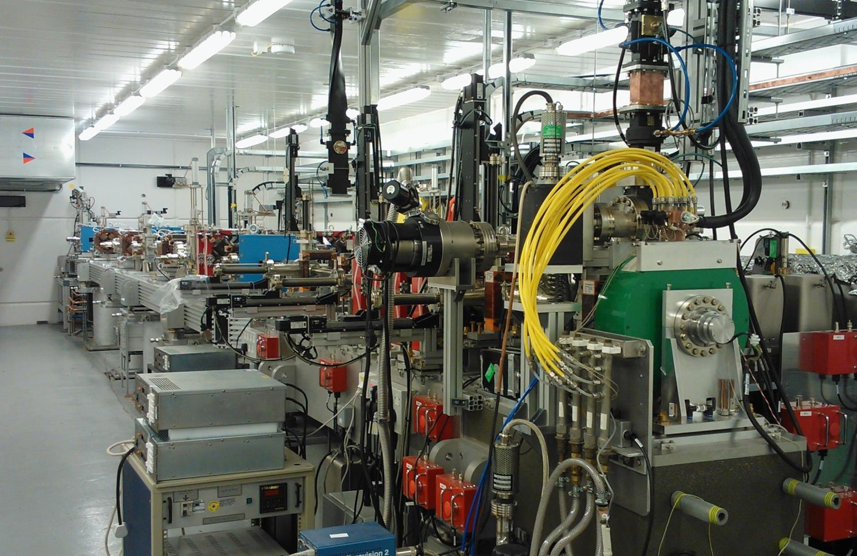
VELA
VELA Specification
Beam Energy | 4 - 6 MeV
Bunch Charge | 10 - 250 pC
Bunch length (σ_{t,rms}) | 1 – 10 ps
Normalised emittance | 1 - 4 µm
Beam size (σ_{x,y,rms}) | 0.5 - 5 mm
Energy spread (σ_{e,rms}) | 1 – 5 %
Bunch repetition rate | 1 – 10 Hz
*Not all parameters achievable simultaneously
Notes:
1. VELA gun is from Strathclyde (ALPHA-X)
2. Max rep rate is 10 Hz but laser and RF capable of 400 Hz
3. 400 Hz gun under development at Daresbury

Slide 19
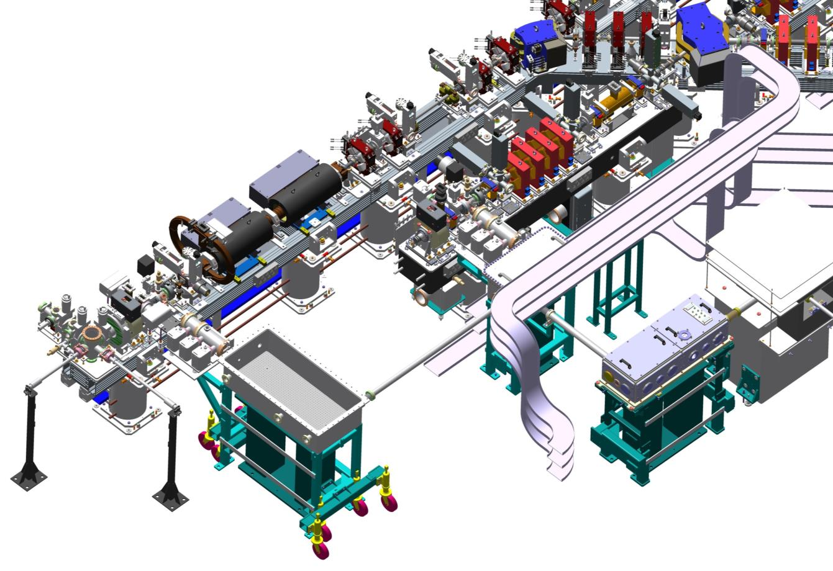
VELA + CLARA Phase 1 (2015)
Phase 1 parameters:
Max Energy ~50 MeV
Max Charge 250 pC
Norm. Emitt. <1 mm mrad
Min Bunch Length 50fs (rms), (10 MeV)
Max Peak Current 2kA
Bunches/RF pulse 1
Pulse Rep Rate 10 Hz (400Hz later)
~50MeV
~50MeV
~5 MeV

Slide 20
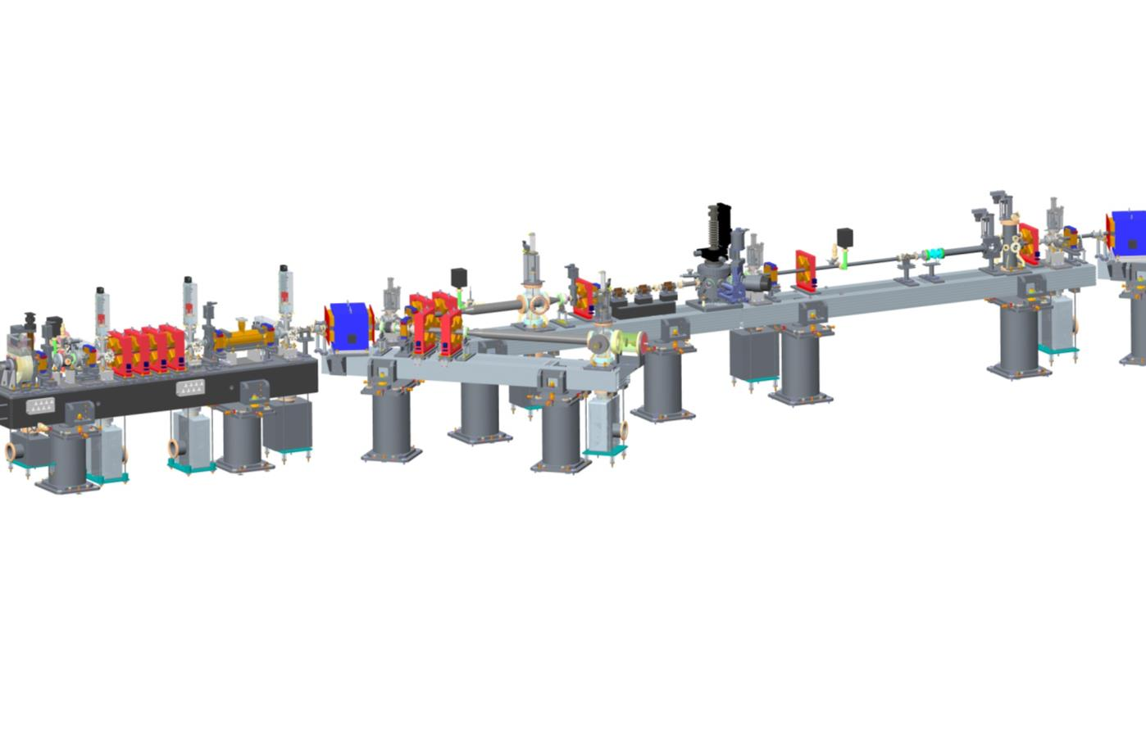
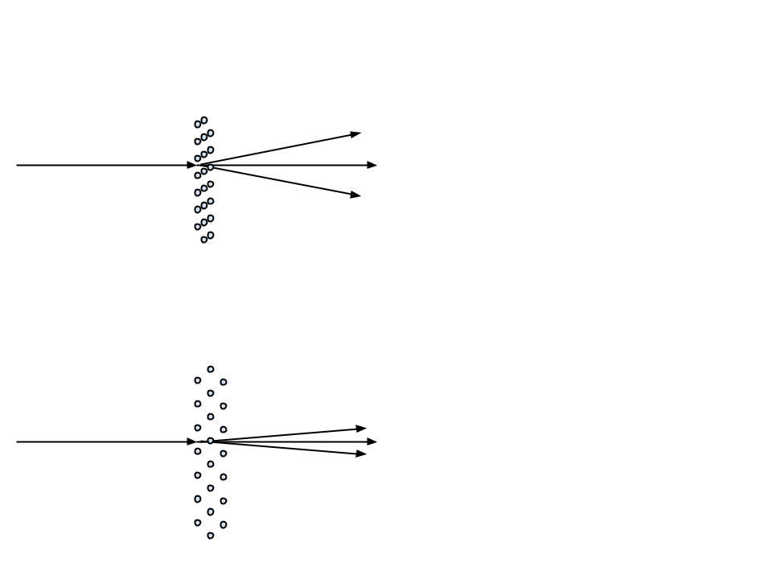

Ultrafast Electron Diffraction
Studying structural evolution in fs regime
Synergy with XFEL Structural Science
Sample Chamber
Electron beam
Image intensifying camera with single photon sensitivity to capture diffraction pattern
This sensitivity will allow single shot diffraction pattern to be recorded with a 1 pC ultrashort bunch
Faraday Cup
Monitor change to single shot diffraction pattern
Structure at t=0
Pre-pump
Structure at t=t1
Post pump

Slide 21
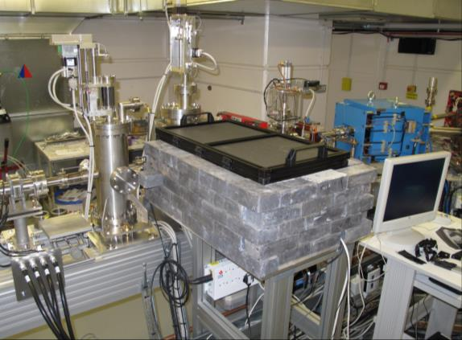
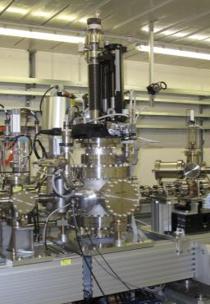
Ultrafast Electron Diffraction
Sample Chamber
Electron beam
Image intensifying camera with single photon sensitivity to capture diffraction pattern
This sensitivity will allow single shot diffraction pattern to be recorded with a 1 pC ultrashort bunch
Faraday Cup

Slide 22
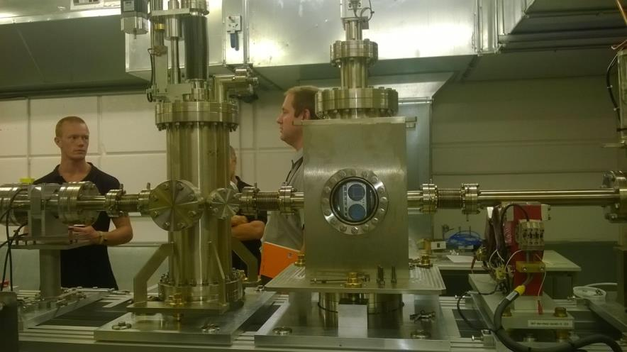
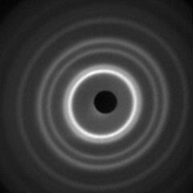
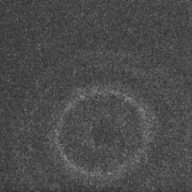
Faraday Cup chamber and Lanex screen detection chamber. Screen located 3.4 m downstream of sample
First Results:
September 2014
Charge at detector
<<1 pC
Reconfiguring VELA in future will allow <100 fs time resolution.
Au sample
1000 shots
Pt sample
Single shot
Already have sufficient information in single shot
to follow sample melting (order – disorder transition)

Slide 23
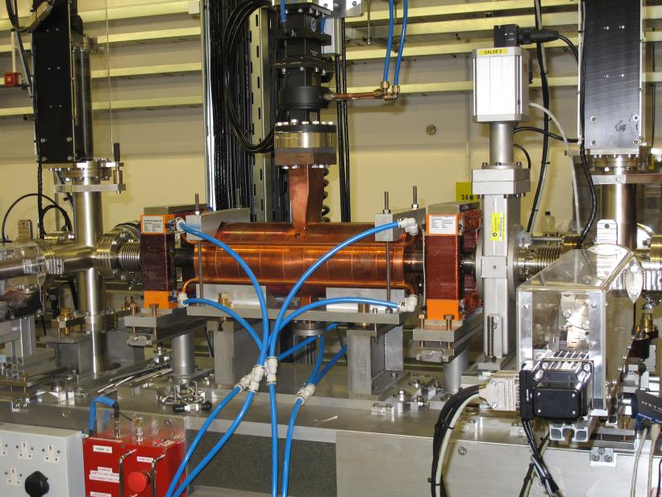
TDC
S-band Transverse Deflecting Cavity now installed and ready to be conditioned with RF – scheduled for Nov ‘14
Will allow much more detailed diagnosis of bunches (slice properties, bunch length with fs resolution)

Slide 24
UK FEL Aspirations
Two FEL facility proposals in the UK have been generated
  4GLS (2006), ERL-based accelerator incorporating single pass, seeded, FEL (8 to 100 eV, 1 kHz, 600 MeV electrons)
  NLS (2010), SC Linac-based accelerator with 3 single pass seeded and upconverted FELs after beam spreader (50 to 1000 eV, 1MHz, 2.25 GeV electrons)
A third proposal is now deing actively discussed
  Results from LCLS especially seem to have convinced the UK life science community that FELs offer new capabilities
  Implications are that higher photon energies will be required (<100eV to >15 keV) and so higher electron energies (~6 to ~9 GeV)
  To keep costs manageable this is likely to mean that NC RF will be selected (users will compromise on repetition rate)
  Hence our interest in the application of X-band accelerating technology

Slide 25
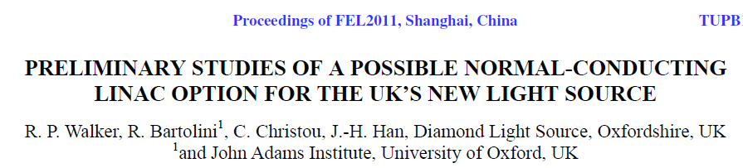
X Band Technology
STFC is a member of the XbFEL (H2020) bid – our prime contribution would be towards the design of an X-ray FEL based upon X-band technology
We are therefore very interested in the development of X-band accelerating structures & sources by CERN & others for the potential application towards a UK X-ray FEL
A major issue for the application of X-band for FELs currently appears to be the capital cost
  “Comparing S-band and X-band solutions for the particular choice of 1 kHz repetition rate, it appears that S-band would currently be a cheaper option. For X-band to be competitive with S-band, the currently estimated costs of X-band components, particularly the klystron, would have to come down significantly.”

Slide 26
X Band Technology
Development of accelerating structures (and linearising structures) applicable to FELs is crucial
Development of economic RF sources is just as vital for widespread adoption by the community
Progress is required in both these areas
Demonstrations with beam (at CERN or CLARA or elsewhere) are also essential to alleviate concerns over possible detrimental wakefield effects
In the UK (and elsewhere), the operating costs of new facilities are very important – energy consumption costs money but is also politically sensitive – increasing the advantage of X-band technology in this area would be very beneficial
  The green accelerator technology?

Slide 27
Summary
CLARA is an FEL Test Facility for the UK Accelerator Community
  NC RF (up to 400 Hz)
  Emphasis on ultra short pulse generation
  Enabling other electron beam applications
  Major upgrade to VELA
VELA is an RF Photoinjector with two user areas
  Generating ~4.5 MeV bunches for use by industry and academia
  First industrial users already
  Electron diffraction station taking data now
CLARA Phase 1 (50 MeV) will be installed in 2015
  Phase 2 not yet fully funded
UK FEL aspiration to hard X-ray makes NC RF very likely and X-band acceleration very interesting
  CLARA looks well suited to carry out technology tests and could effectively duplicate front section of multi-GeV FEL
XbFEL (H2020) will enable UK participation in X-ray FEL design with X-band technology and also bring the technology a step closer
For widespread adoption the capital costs need to decrease or operating costs become more advantageous (or ideally both)

