Slide 1
ILD meeting at LCWS2014
Ties Behnke, Yasuhiro Sugimoto
Belgrade, 8.10.2014

Slide 2

#Mylinearcollider
Please be a part of the video campaign to support the ILC:
Come see the communicators Thursday, Crown plaza, room VIP2 to make a recording
  your Name your Institution
  Why you think the ILC is a good machine / what you find exciting about the ILC

Slide 3
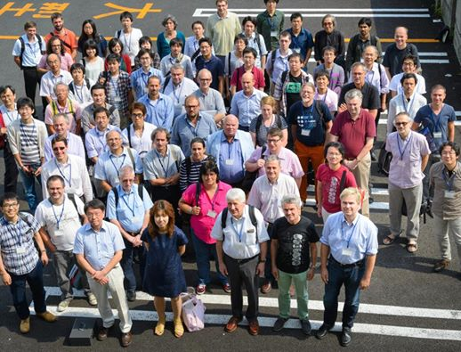
ILD meeting@Oshu
85 registered
participants
from 32
institutes

Slide 4
ILD Members
Current ILD member-list: grown to 57 institutes

Slide 5
Organisation
Proposal made at Oshu on preliminary rules and regulations: accepted by IA
by remote vote
Call for candidates for the IA chair: received some 10 nominations.
Four people agreed to stand for election
First round of the election finished (34 votes received: quorum has been met)
Second round will be done between places 1 and 2, since no absolute majority for
one of the candidates was found

Slide 6
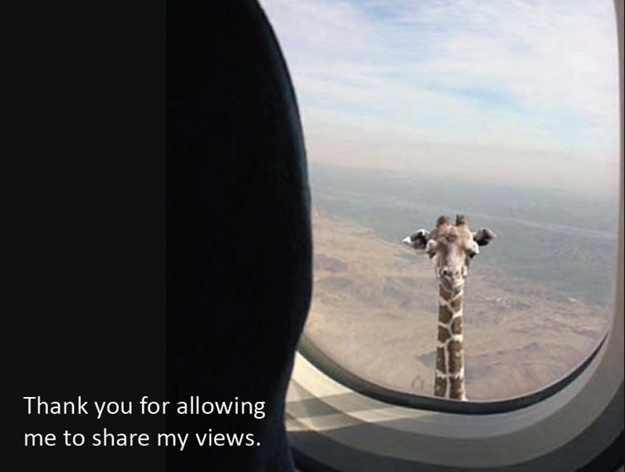

Lessons Learned
Silicon tracking: justification/ optimization
TPC tracking: why a TPC?
Forward region
Calo: Cost- performance optimization
Yoke: optimization
Review by Marcel Demarteau at the Oshu meeting
We need to sharpen our arguments.
We need to make sure that we can demonstrate the physics justification
(see Jennys presentation on proposed physics benchmarks)

Slide 7
ILD optimization
Issue 1:
Re-optimize the overall layout:
  Size
  Granularity
  Resolutions etc.
Issue 2:
Move towards decision on central layout issues (independent of size)
  Silicon system layout
  Geometry of the calorimeter (Videau vs TESLA, other questions)
  Forward region layout
Issue 3:
Move towards defining a methodology to eventually make a technology decision
  Agree on a work plan
  Agree on questions asked

Slide 8
Concrete Steps
TPC: organise an internal review/ discussion to make the arguments for the TPC,
then prepare a concise writeup on that.
Si tracking: review the choices of the overall system, including SET,
and decide a new baseline.
Calorimeter: intense discussion is ongoing, need to discuss how to converge to
a decision
Forward: tighly coupled to L* issue (see next slide)
Yoke: depends critically on the overall integration discussions on things like stray field
etc.

Slide 9
ILD on change requests
L*: Distance between end of last magnet and IP
ILD supports the move to a common value
A length >= 4m can be adopted within the current ILD scheme
Anything smaller will require significant work
Vertical access shaft:
ILD is supporting this without any conditions.

Slide 10
ILD in 2015
ILD schedule will depend on overall planning by LCC (which is not yet known)
We should have a dedicated meeting in the summer
(which however could be synchronised with other meeting schedules)

Slide 11
This meeting
Yasuhiro: Survey of ILD resource needs
Frank: Simulation Software plans and options
Jenny: Proposals for optimization benchmarks

