Slide 1

Hybrid ECAL: optimization and related developments
Taikan Suehara
H. Hirai, H. Sumida, Y. Sudo, T. Yoshioka, K. Kawagoe
(Kyushu University, Japan)

Slide 2
Topics
Why hybrid?
Optimization
Combined DAQ
Plans

Slide 3
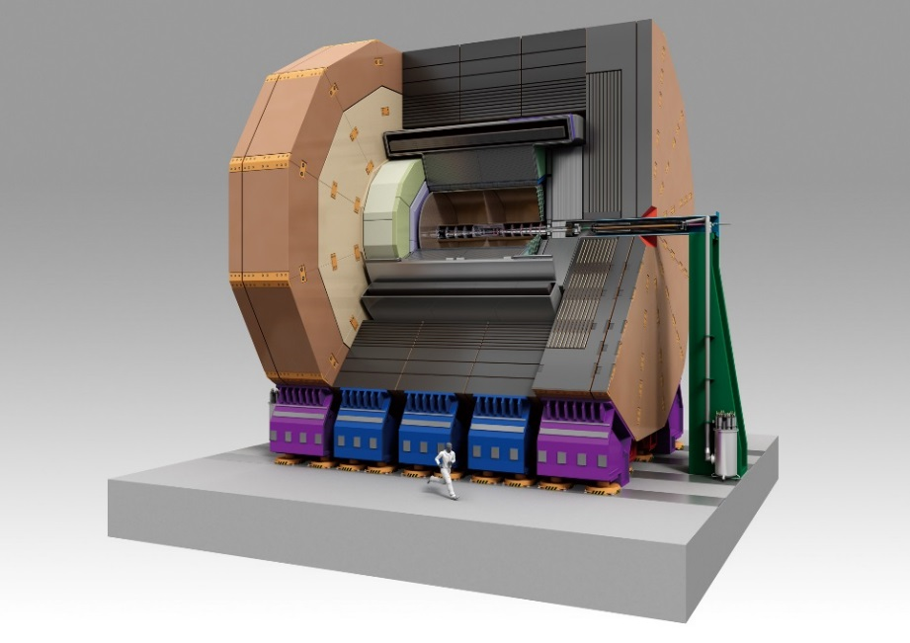
ILD & ECAL
ILD: Intl. “Large” Detector
r_{ECAL} = 1800 mm (SiD: 1200 mm)
Excellent PFA power
but expensive ECAL/Yoke
ILD cost in DBD: 391.8 MILCU in total
mean cost
for ECAL/HCAL

Slide 4
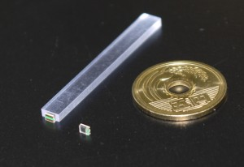
ILD ECAL: Silicon and Scintillator
SiECAL
ScECAL
Tungsten absorber + Silicon
320 μm (maybe 500 μm)
5 x 5 mm² pixels
256 pixels / chip
Expensive sensor
Tungsten + Scintillator strips
1 mm thick (10-20 photons)
5 x 45 mm² crossing strips
Each strip should be wrapped
Price is about half of Silicon
(dominated by PPD)

Slide 5
A comparison
V. Balagura (LLR),
ILD meeting in Oshu

Slide 6
Cost-conscious options
Small detector: r_{ECAL} ~ 1400 mm with silicon only
+ Robustness in ECAL, Simple
+ Cheaper not only in ECAL but also in York
Performance degraded (both trackers and CALs)
esp. 1 TeV upgrade should be a problem
Very similar to SiD: redundancy reduced
performance
→ equivalent
luminosity
→ operation cost
Hybrid ECAL (Silicon + Scintillator)
- A bit more complexity, careful calibration needed
(with AHCAL complexity will be reduced)
- Cheaper only in ECAL:
competitive if stray field restriction can be revisited for yoke
+ Performance degradation is very small
+ Large detector → more possibility for 1 TeV
+ Variety remained to SiD, more redundancy

Slide 7
Consideration for Calibration
MIP calibration
LED calibration (Scintillator only)
  No specific procedure for hybrid
  Fluctuation can be seen by Si/Sc ratio
Electron calibration
  Compare with momentum in trackers
    Bhabha monochromatic (125 GeV?) many stats.
    Bhabha radiative return, WW/ZZ, continuous
  Si/Sc ratio can be confirmed with various Es
  Will be studied by MC
Pion calibration – using tau (continuous only)

Slide 8
Optimization

Slide 9
What to optimize
Thickness(es) of absorber
(number of layers)
Granularity (pixel size)
How to combine Si/Sc
  Fraction of Si/Sc
  Alternate or grouped

Slide 10
N layers & Granularity
Jet energy resolution is
dominated by
  Intrinsic resolution @ low E
  (Mainly HCAL)
  Confusion @ high E
Other physics
  π₀ reconstruction in tau (Higgs CP etc.)
  → relatively high energy photons
  H→γγ (higher energy)
  Photon pointing (BSM study)

Slide 11
A study of # layers
Preliminary

Slide 12
Hybrid: alternate or grouped?
Essentially the same
performance in DBD detector
→ grouped setup is favored
for simplicity
More check (tau etc.) needed

Slide 13
Optimization - ToDo
Optimization still in early stage
→ One proposal should be shown in a year
Plans
  Hadron energy resolution study
  Confusion study with different granularity
  and combination of Si/Sc
  Tau/π₀ separation study
  Test of calibration procedure in MC
  Goal: cheaper (similar to 1400 mm) detector
  without significant degradation of performance

Slide 14
DAQ

Slide 15
Combined DAQ - motivation
“CALICE DAQ” was aimed to unify all efforts involving DAQ of calorimeters to save resource.
  “ROC” chips → successful
  DIF/LDA board → spilt some years ago
  Software → completely independent
At some point, we should unify (again)
→ Hybrid ECAL is a good start point

Slide 16
EUDAQ: a high level structure
Calice
Producer
TCP connection
calicoes / others

Slide 17
Planned test of combined DAQ
2nd TB period at CERN in this Autumn
- 26th November to 8th December
  Mainly AHCAL testbeam with 3 ScECAL layers
We will put a Si layer in front of Sc layers
Minimum-combined DAQ will be tested
  Developing now
  based on EUDAQ

Slide 18
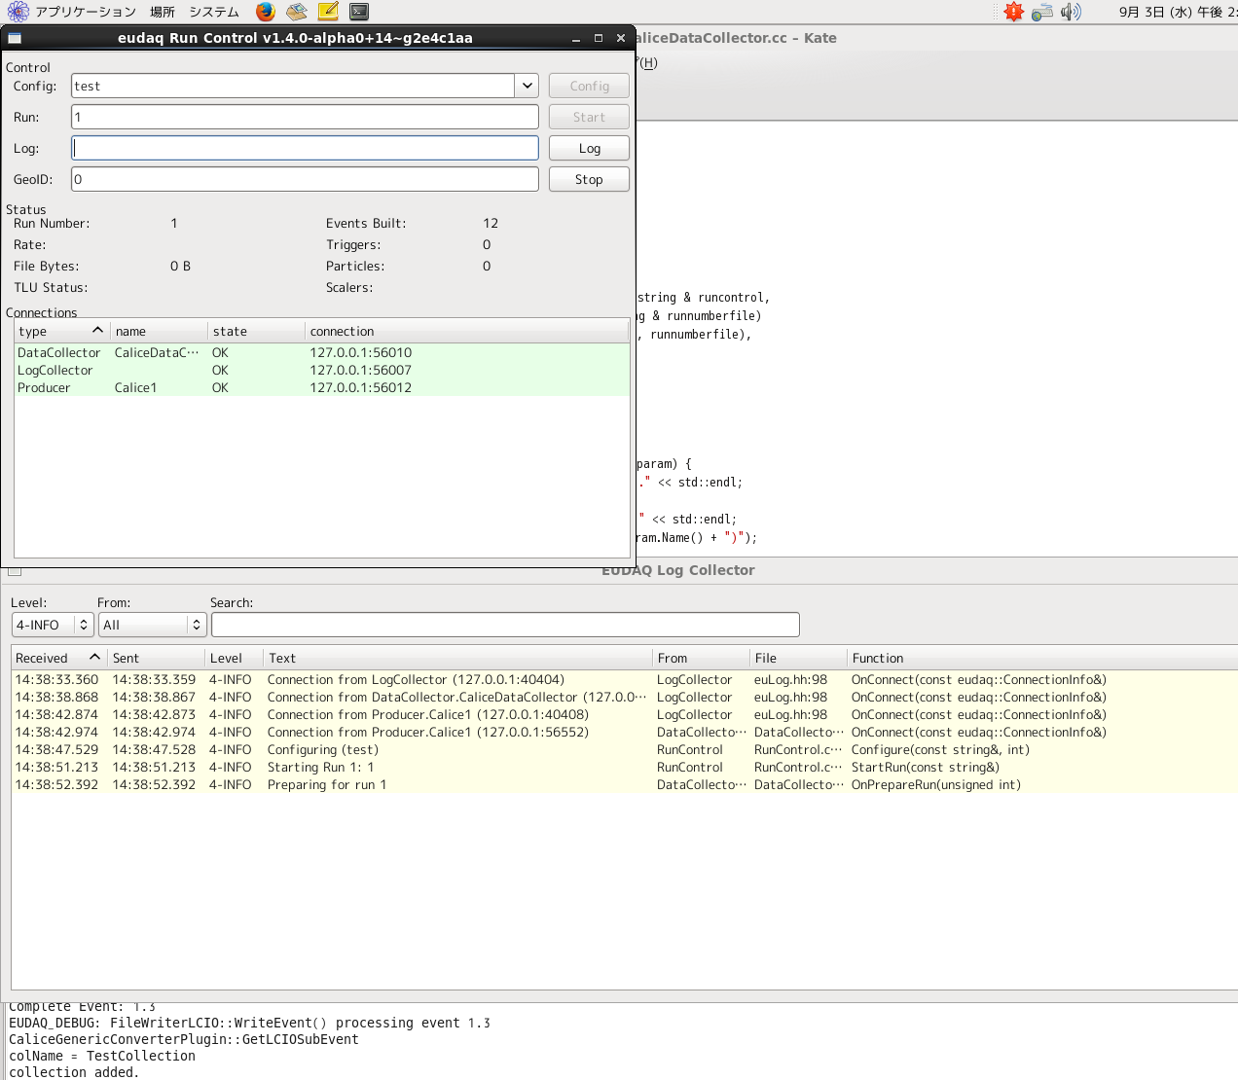
Current status
Succeeded to run EUDAQ
with CaliceProducer producing
dummy data encoded to LCIO object
and save to LCIO file using DataCollector
Ready to attach to calicoes/others

Slide 19
Combined DAQ - ToDo
General discussion has started at last CALICE technical board
Agreement at all-CALICE is needed about the framework to be used (at least)
Gradual approach is the only possibility now
- if we don’t have a strong group doing everything
I hope it well proceed in several years
to one “ILC DAQ”

Slide 20
Summary
We think Hybrid ECAL is a strong option for cost-effective ILD
We plan to finish a “optimized hybrid” setup in a year
Combined DAQ is another issue
we will try to combine Si/Sc DAQs
as a first step to more generic DAQ

