Slide 1
Hybrid Access Optional Study
Baseline | Hybrid-A | Hybrid-Op (by AWLS2014)
1 HT (11x11m grad 7%) Detector assembling is inside of DH | 1 HT (8.0x7.5m grad 7%) 2 VS (D18m, D10m) ILD assembly:on-g, SiD assembly:un-g. | 1 HT (8.0x7.5m grad 10%) 3 VS (D18m, D10m, D7.5m) ILD assembly:on-g, SiD assembly:un-g..
UT lines in DR/AT | UT lines in UT shaft (N/A Main shaft) | Ditto
DH Excavated vol. 175,000m3 L144m H42m W25m | DH Excavated vol. 156,000m3 L126m H42m W25m | Ditto
Detector parts are transported by Heavy weight transporter | ILD is installed by Heavy lowering crane SiD parts transported by HWT | ILD is installed by Heavy lowering crane SiD parts transported by crane
Location of DH and assembly yd. can be selected individually. | Assembly hall is above D/H | Ditto
Human pass way : tunnel by vehicles Machine and materials: tunnel by vehicles | Human pass way :elevator in UT shaft Machine and materials : Shaft and tunnel | Ditto
Environmental impact : smaller during construction. | Need countermeasure for noise reduction of construction | Ditto
Emergency evacuation ways Main AT and DR AT. | Emergency evacuation ways Main AT , DR AT , and shaft stair. | Ditto
Assembly Yd
Assembly Yd
Assembly Yd
Upper A/T
Main AT
W11m Grad7%
D/H
Main AT
W8m Grad10%
Main AT
W8m Grad10%
D/H
D/H
2014. 5. 27 CFS-Weekly Meeting

Slide 2
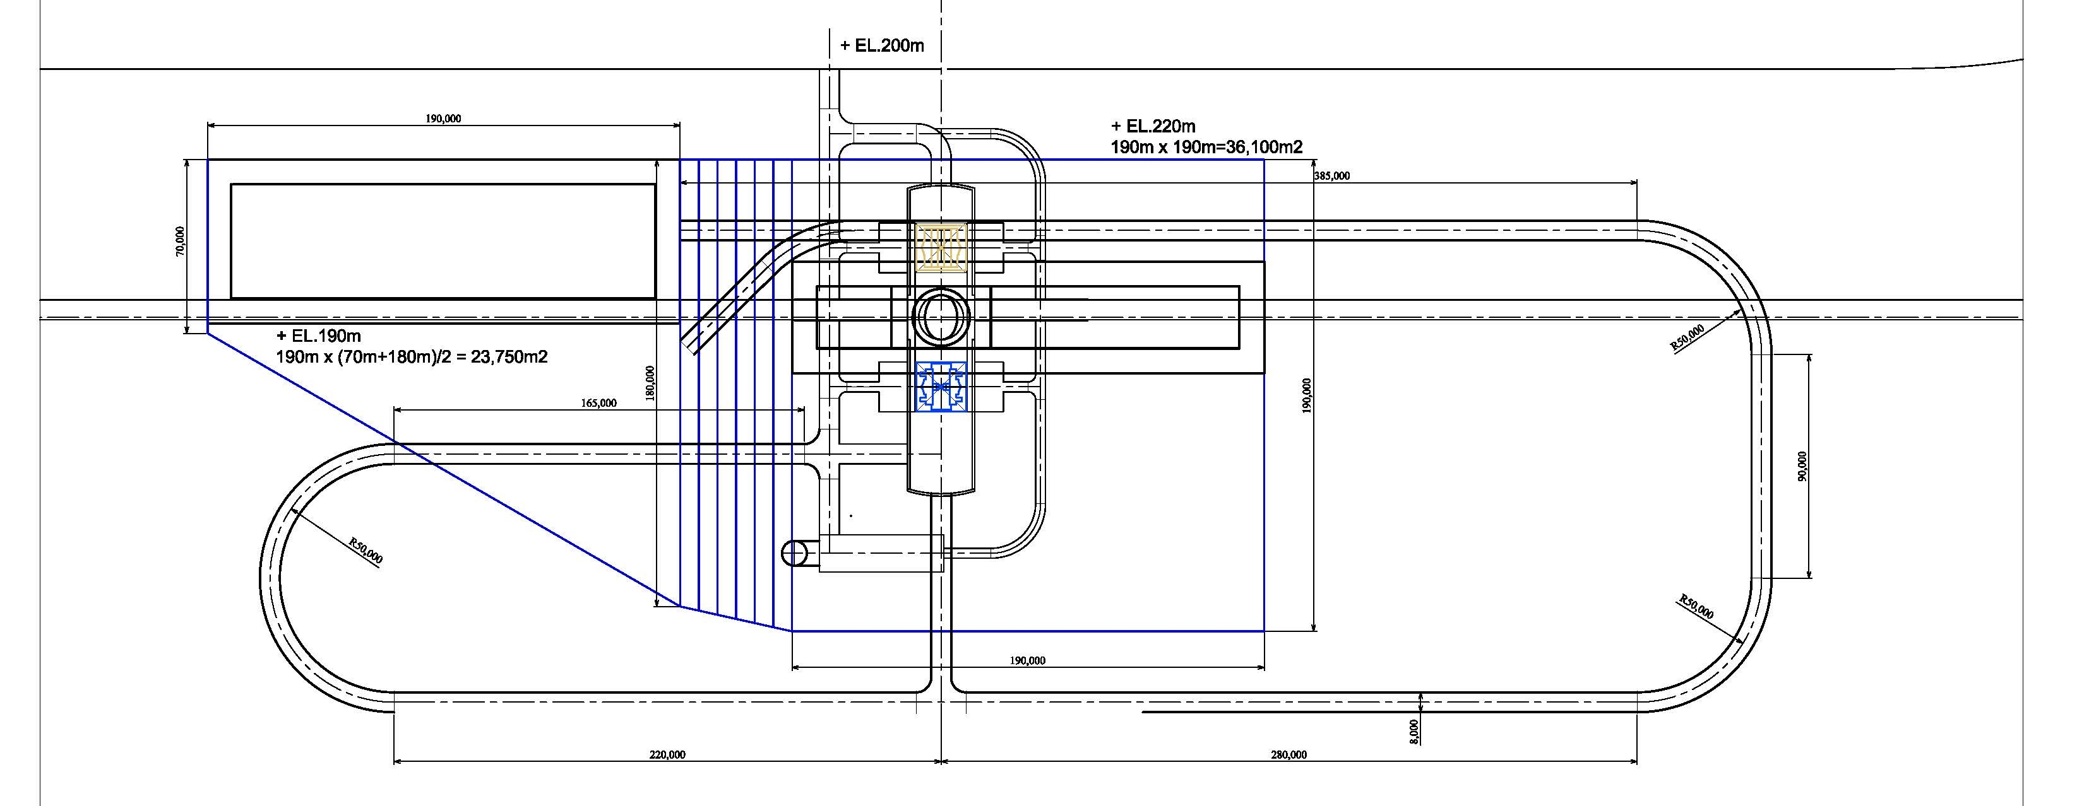
Hybrid-A Example
Function
Main shaft : for ILD installation, and SiD heavy parts lowering.
Access tunnel : for SiD parts transportation, and cavern construction.
SiD assembly hall
ILD assembly hall
2014. 5. 27 CFS-Weekly Meeting

Slide 3
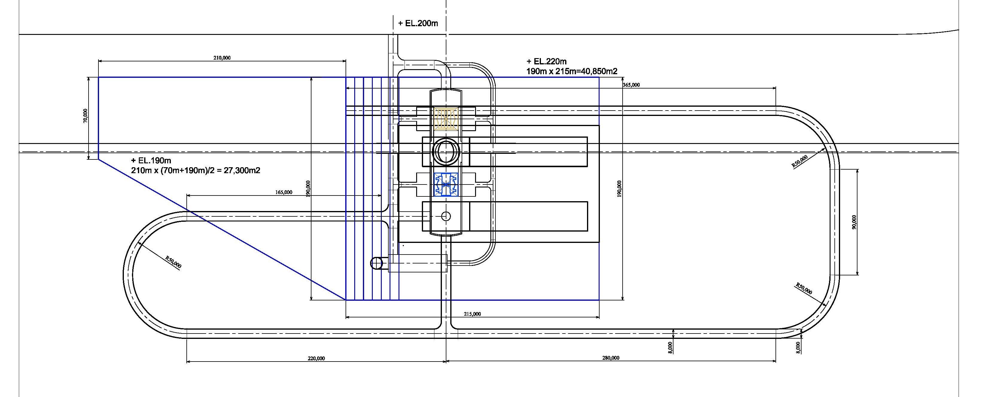
Hybrid-Option Example (by AWLS2014)
Assumption
SiD shaft is located at the intersection point of DH and AT
if located at SiD park position, assembly halls are too close each other.
Inner diameter is assumed 7.5m
Function
Main shaft : for ILD installation and SiD heavy parts lowering.
SiD shaft : for SiD parts transportation.
Access tunnel : for construction.
ILD assembly hall
SiD assembly hall
2014. 5. 27 CFS-Weekly Meeting

Slide 4
Civil work break down
Items | Unit | Baseline |  | Hybrid-A |  | Hybrid-Op (AWLC2014)
 |  | Spec | Qt. | Spec | Qt. | Spec | Qt.
Portal work | LS | W11.0 H11.0 | 1 | W8.0, H7.5 | 1 | W8.0, H7.5 | 1
Main A/T D2 | m | W11.0 H11.0 | 150 | W8.0, H7.5 | 150 | W8.0, H7.5 | 150
Main A/T | m | W11.0 H11.0 | 610 | W8.0, H7.5 | 780 | W8.0, H7.5 | 510
Upper A/T | m | W8.0, H7.5 | 100 | W8.0, H7.5 | 100 | W8.0, H7.5 | 100
Lower A/T | m | W11.0 H11.0 | 540 | W8.0, H7.5 | 540 | W8.0, H7.5 | 360
Main Shaft D18m | LS |  |  | Portal | 1 | Portal | 1
 | LS |  |  | Shelter | 1 | Shelter | 1
 | m |  |  | Soil | 20 | Soil | 20
 | m |  |  | Rock | 61.6 | Rock | 61.6
UT Shaft D10m | LS |  |  | Portal | 1 | Portal | 1
 | LS |  |  | Shelter | 1 | Shelter | 1
 | m |  |  | Soil | 20 | Soil | 20
 | m |  |  | Rock | 88.6 | Rock | 88.6
SiD Shaft D7.5m | LS |  |  |  |  | Portal | 1
 | LS |  |  |  |  | Shelter | 1
 | m |  |  |  |  | Soil | 20
 | m |  |  |  |  | Rock | 61.6
EH | m3 | W25.0, H42.0, L144 | 157,560 | W25.0, H42.0, L126 | 137,900 | W25.0, H42.0, L126 | 137,900
EH ILD Alcove | m3 | W20.0, H19.6, L12.5 | 9,000 | W20.0, H19.6, L12.5 | 9,000 | W20.0, H19.6, L12.5 | 9,000
EH SiD Alcove | m3 | W20.0, H18.0, L12.5 | 9,200 | W20.0, H18.0, L12.5 | 9,200 | W20.0, H18.0, L12.5 | 9,200
Drainage for Hall | m | @10m mesh | 910 | @10m mesh | 630 | @10m mesh | 630
PS Anchor | pcs |  | 1,850 |  | 1,640 |  | 1,640
Based Concrete | m3 | t=1.0 | 4,550 | t=1.0 | 4,100 | t=1.0 | 4,100
Side Wall Concrete | m3 | t=1.0 h30m | 13,020 | t=1.0 h30m | 11,940 | t=1.0 h30m | 11,940
2014. 5. 27 CFS-Weekly Meeting

Slide 5
Architectural and Mechanical facility
Architectural |  | Spec | Unit | Baseline | Hybrid-A | Hybrid-Op (AWLC2014)
A/T | DH-A/T Evac. pass way | H2.5 x W2.0m | m | 1,285 | 1,470 | 1,470
 | DH-A/T Doors | 4.5 m2 | pcs | 20 | 20 | 20
 | DR-A/T Evac. pass way | H2.5 x W2.0m | m | 1,000 | 1,000 | 1,000
 | DR-AT Doors | 4.5 m2 | pcs | 20 | 20 | 20
Shaft | Elevator | 17 psn 150m/min | set | - | 1 | 1
 | Evacuation Stair | 140m | set | - | 1 | 1
 | Evacuation Doors | 4.5 m2 | pcs | - | 55 | 55
Assembly Hall |  |  | m2 | ILD 46m x 170m SiD 46m x 170m 15,600 | ILD 46m x 170m SiD 25m x 190m 12,600 | ILD 25m x 190m SiD 25m x 190m 12,600
Mechanical | Spec | Unit | Baseline | Hybrid-A | Hybrid-Op (AWLC2014)
LCW | φ750mm CS 2way | m | 2,000 | 260 | 260
ChW | φ200mm CS 2way | m | 2,000 | 260 | 260
Pipes for supply | φ100mm SUS | m | 1,000 | 130 | 130
Pipes for return | φ200mm SUS | m | 1,000 | 130 | 130
Ducts | 2.6m × 2.0m 2way | m | 2,000 | 260 | 260
2014. 5. 27 CFS-Weekly Meeting

Slide 6
Handling equipment
Permanent crane
Items | Specifications | Unit | Baseline | HB-A | HB-Op (AWLC2014)
DH Main/H Crane | 250t S25m h35m | pcs | 2
 | 215t S25m h35m | pcs
 | 80t S25m h35m | pcs | 2
 | 40t S25m h35m | pcs |  | 2 | 2
DH Alcove Hoist Crane | 2.5t S25m h25m | pcs | 4 | 4 | 4
Assembly Hall | 250t S25m h35m | pcs | 2 | 1 S
 | 250t S25m h130m | pcs |  | 1 L | 2 L,S
 | 215t S25m h35m | pcs
 | 80t S25m h35m | pcs | 2 | 2 | 2
Heavy equipment transportation
Items | Specifications | Unit | Baseline | HB-A | HB-Op (AWLC2014)
Tunnel heavy transporter | 220 t carrier | times | 12 | 5
Shaft Lowering system | 4100t h130m gantry crane | pcs |  | 1 | 1
2014. 5. 27 CFS-Weekly Meeting

