Slide 1
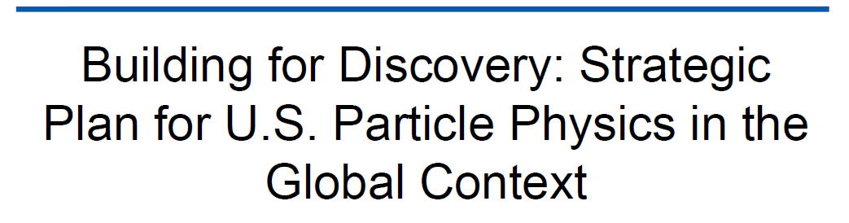
P5
Rapport express
P. Colas
23 mai 2014

Slide 2
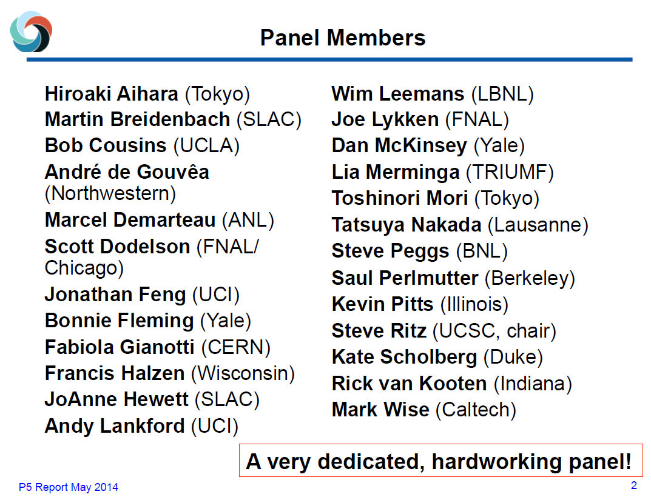

Slide 3
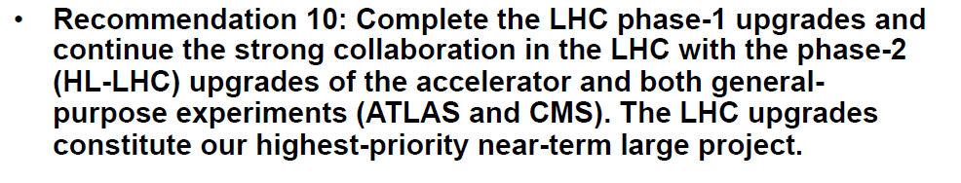
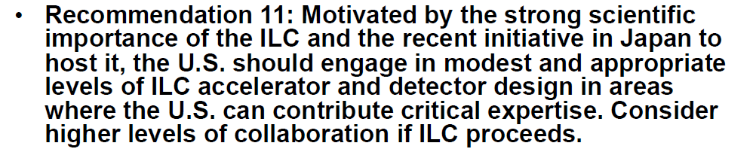
Method, 3 scenarios, 30 recommendations

Slide 4
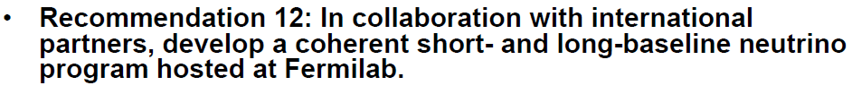
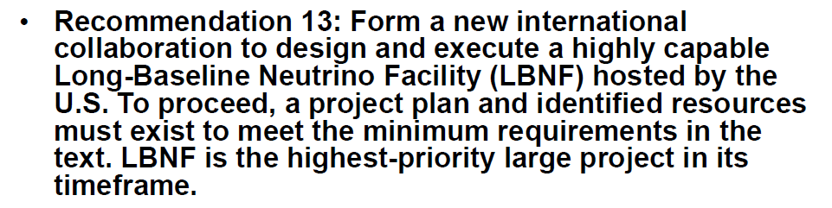
Increase Fermilab intensities to MW powers
Strongly recomment DESI
Continue LSST, CMB, reinforce Generation 2 DM
Keep CTA as a small project with NSF Astro support
Continue mu->e, g-2
In scenario A (3 years + 2%/y) DESI and R&D have to be cut
In scenario B (3 years+ 3%/y, that is +500 M$ after 10y) DESI and some R&D are possible

