Slide 1
The LC TPC Review by ECFA Detector Panel
On 4-5 Nov. 2013 at DESY
&
After
T. Matsuda
LCTPC Collaboration Meeting
30 July, 2014
DESY

Slide 2
Review by the ECFA Detector Panel
http://ecfa-dp.desy.de/
3-4 November , 2013
(ECFA DP is the successor of the DESY PRC in effect)
The ECFA Detector Panel, a European committee to review the R&D effort for future projects, was created by ECFA in its last meeting 24 Nov - 25 Nov 2011. It is aimed at the R&D efforts of large scale projects in their preliminary and preparatory phase, not yet approved and supported by a unique leading or host lab, as for example the European LC community's R&D.
This new European committee receives R&D proposals on authors’ request, makes recommendations after evaluation, and monitors their progress.
It helps to create a coherence of the global R&D effort by encouraging synergies between different activities and advising the funding agencies if they wish.
It is primarily concerned with large R&D projects, related to accelerator experiments, involving many laboratories and requiring significant resources.
DESY will host this new committee which is planned to meet twice per year. Chair: Yannis Karyotakis (director of the Laboratoire d’Annecy le Vieux de Physique des Particules) Scientific Secretary: Doris Eckstein (DESY)

Slide 3
ECFA Detector Panel
Meetings: Twice a year at DESY since May 2012 (2 days meeting)
– Calorimetry for LC (CALICE) (2012)
– Forward Calorimetry (FCAL) 2013)
– LC-TPC (Nov. 2013)
Member | Institute | Contact
Yannis Karyotakis (chair) | Director of the LAPP Annecy (FR) | karyotak_at_lapp.in2p3.fr
Richard Brenner | Uppsala University (SE) | Richard.Brenner_at_cern.ch
Marcella Diemoz | Universita e INFN, Roma I (IT) | marcella.diemoz_at_roma1.infn.it
Els Koffeman | NIKHEF (NL) | Els.Koffeman_at_cern.ch
George Mikenberg | Weizmann Institute of Science (IL) | Giora.Mikenberg_at_cern.ch
Hans-Günther Moser | Max-Planck-Institut fuer Physik (DE) | moser_at_mppmu.mpg.de
Takayuki Sumiyoshi | Tokyo Metropolitan University (JP) | sumiyoshi_at_phys.se.tmu.ac.jp
Cristobal Padilla | Universitat Autònoma de Barcelona (ES) | Cristobal.Padilla_at_cern.ch
Andy White | University of Texas at Arlington (US) | awhite_at_uta.edu

Slide 4
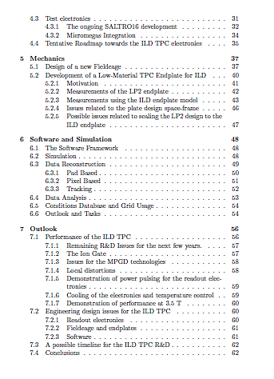
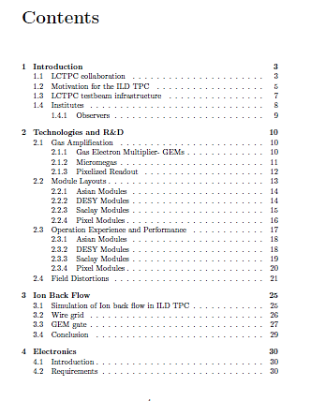
ECFA Detector R&D Panel LCTPC Review Report by LCTPC collaboration
November 3, 2013

Slide 5
LCTPC Review by the ECFA Detector Panel
4 – 5 Nov. 2013
ECFA Detector Panel Meeting - Open Session (4 Nov.2013 13:00-16:25)
13:00 - 13:15 Welcome Yannis Karyotakis (LAPP, Université de Savoie, CNRS/IN2P3)
13:15 - 13:55 Introduction/Overview Jan Timmermans (NIKHEF)
13:55 - 14:35 Technologies Jochen Kaminski (University of Bonn)
14:35 - 15:15 Ion feed back & Gate Philippe Gros (LLR) (*)
15:45 - 16:25 Electronics Paul COLAS (CEA/Irfu Saclay)
16:25 - 17:05 Studies on mechanical aspects Jochen Kaminski (University of Bonn)
17:05 - 17:45 Software / simulations Astrid Muennich (CERN)
17:45 - 18:25 Outlook Takeshi Matsuda (KEK)
ECFA Detector Panel Meeting - Closed Session (5 Nov.2013 in the morning)
(We did have a discussion with the committee for more than a hour.)

Slide 6

European R&D Committee report
2013 Report No. 3
(Received in March 2014 )

Slide 7
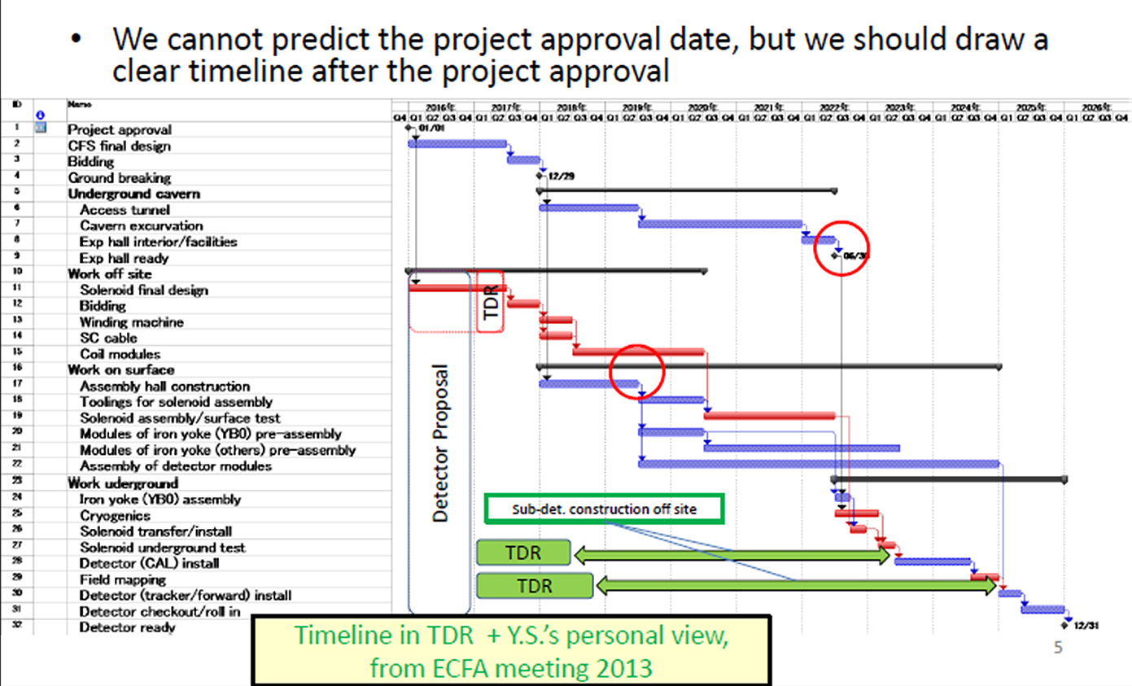
A Possible Schedule of ILC in Japan
As presented in the 2013 ILD meeting in Cr
Kakow
There is at least two years delay. We may
have 2 + 3 years before the proposal call, or,,,,

Slide 8
Some Excerpts from
The European R&D Committee Report: 2013 Report No. 3
(Received in March 2014 )
Executive Summary
All these aspects of the system are known to be critical but, up to now, have been studied only at the conceptual design testing level. In order to prepare for a TDR when required, the committee has the following recommendations:
The collaboration will need to increase resources in the area of technological and system R&D, with larger prototypes that can explore the possible technological challenges of the construction of a TPC for the LC detector.
The committee encourages the collaboration to prepare an overall plan with a more detailed schedule in the system aspects of the detector, including clear milestones to decide among the different technologies in time for a possible TDR within the next two/three years.

Slide 9
General issues:
The time is now approaching when it will be essential for all the diverse activities to converge on an overall plan for completion of R&D, technology choice, and the development of a complete design for the TPC system to be captured in a Technical Design Report. This plan should be developed over the next year and should include milestones/goals for completion of each aspect of R&D, what constitutes “completion” for each area, and a schedule for reviews of progress on an annual basis.
Electronics:
Design of new front-end electronics (readout chip) at this point does not make sense because of the rapid advances in semiconductor industry and the uncertain schedule of the LC project. Refinement of electronics requirements should however continue.
The integration of the electronics in the end-plates (pad) is a challenge….. The thermal and electrical properties of the integrated end-plate should be simulated and experimentally verified. In particular the use of high density multi-pin connectors is not desirable for long term reliability. ……. New low cost flip-chip interconnection techniques are rapidly becoming available and the use of new (and old) technologies should be evaluated. The design of readout-chip, pad plane and corresponding interconnection technology is a major challenge which would require the effort of a few dedicated electronics engineers.

Slide 10
MPGD detectors:
There are two options for the GEM based detector. …. Since the rate for LC-TPC is expected to be not so high, the CERN type GEM would be a good candidate. In order to decide the GEM option a long term test (more than 6 month with an expected rate at the inner part of LC-TPC coverage) is absolutely necessary. After this long term test a merger of two groups (DESY and Asian) is recommended to cure the common problem of manpower shortage.
Beam test results show deterioration of position resolution at the module boundaries, which is attributed to possible field deformation. This also is a big issue to finalize the TPC design.
Gridpix detector
…… The development of large area anode planes has been proven to be difficult up till now and the analysis of the test beam results are somewhat less far advanced. The collaboration should clarify the acceptance criteria that would allow the further development of this interesting TPC readout concept.

Slide 11
Ions back flow:
The committee recommends that in view that the ion back flow only affects the position resolution (due to the higher occupancy) in a limited radial region (385 to 550mm) the collaboration should look into the possibility of limiting the gating arrangements to the affected region. Since determination of the gating grid structure is most urgent for LC-TPC, it should be concluded as early as possible with detailed design and prototype tests.
Radial deformations in the TPC end-plates:
The proposed mechanical coupling between the end-cap readout (GEM’s or MicroMegas) made mainly of PCB boards that have different thermal and humidity expansion coefficients could, due to the strong mechanical coupling to the supporting Aluminium frame, introduce stresses in the combined mechanical structure that could lead to deformations that are hard to predict. The committee recommends that the collaboration looks into the possibility of using low friction O-rings between the Aluminium structure and the readout units, to guarantee a good gas isolation, combined with a kinematic mounting, which would allow to decouple the deformations of the different materials.

Slide 12
Summering the Recommendations Again
An overall plan for completion of R&D, technology choice, and the development of a complete design for the TPC system to be captured in a Technical Design Report .
Design of new front-end electronics (readout chip) is too early.
Look into the flip-chip interconnection techniques in the integration of the electronics in the end (pad)-plates (“the advanced endplate”). Need a group of a few engineers.
Make a unified GEM group using the CERN GEM.
The distortions are the urgent issue.
The collaboration should clarify the acceptance criteria that would allow the further development of this interesting digital readout concept.
The gating grid structure is most urgent. It should be concluded as early as possible with detailed design and prototype tests.
Review the current mechanical design of the endcap where the combined mechanical structure of Al and PCB that could lead to deformations.

Slide 13
R&D for MPGD TPC
So far so good, but,,,,,,
We have demonstrated through the LP TPC beam tests at DESY:
The basic performance of the MPGD TPCs, in particular, the pad readout options, satisfy the basic requirements for ILD TPC at ILC:
The resolutions obtained by different pad modules so far are more or less compatible.
We are now facing to the common issue of distortions and the ion gate, except that the different technologies and modules have some different concerns which have to be clarified.
The prioritization would be determined by other important factors rather than the resolutions unless we have an idea to improve the resoltuions, namely an idea of new gas.
(2) How to build important components of ILD TPC:
However, we are still missing the engineering or the system design of ILD TPC, which will have to be developed in time., in 5 years?

Slide 14
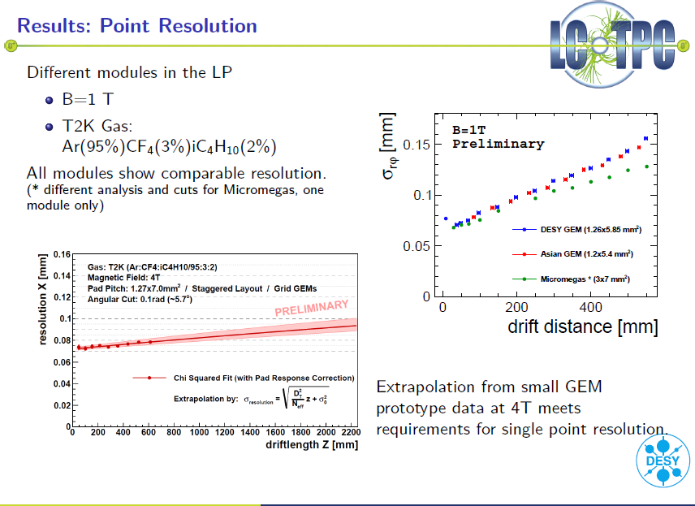

Slide 15
Remaining R&D Issues
Before entering the engineering design of ILD TPC, we still need to study the following issues:
  Ion gate: the most urgent issue,
Some issues with MPGD technologies and MPGD modules,
Local distortions of MPGD modules,
Demonstration of power pulsing (with the S-ALTRO16 electronics)
Cooling of readout electronics and temperature control of TPC
Measurement of basic parameters and demonstration of the performance of MPGD TPC in 3.5T magnetic field. Also some engineering issues to be confirmed in the high magnetic field.
G) A common analysis method and software for a better understanding of the beam test results by different MPGD technologies (the technology prioritization in a few years time).

Slide 16
In Addition
Form (or resume the activity) of the following two groups consists of a few physicists and a few engineers (if possible at all. If not, ,,,,,,)
A group for the frontend electronics of ILD TPC
A group for the ILD TPC mechanics
And then,
At a certain time of this year, a group of a several people, including the spokes person and the chairman of CB, should gathered physically for a few days, to discuss about and make a proposal to the collaboration of the detailed time plan towards (so called) prioritization of the MPGD technology and Technical Design Report of ILD TPC.

Slide 17
A working plan to complete our reaming R&D tasks, and,
to prioritization the MPGD technologies/modules
Before the final Design of ILD TPC
has to be defined.
2014-2015 R&D on ion gate (GEM gate) with the decision on the ion gate
and the studies of the remaining issues.
  2015-2017 Beam tests of new LP modules with the gate
  2017-2018 Prioritization of the MPGD technology and module.
  Is it not too slow when ILC in Japan might get a Go sign in two years time? We may have another three years before the proposal call (the two years delay).
  (*) ILC LAB & ILD detector proposal
  2017-19 Final design of the readout electronics for ILD TPC and its verifications
  Design of ILD TPC
2018-19(*) TDR for the ILD tracking system:
2019-23 Prototyping and production: Electronics (chips→boards)
Prototyping and production: Modules
Production: Field cage/endplate and all others
All others
2024-25 TPC integration and test
2026(*) TPC Installation into the ILD detector
ILC commissioning
Here delay all by two years

Slide 18
Only when we have more time

Slide 19
Then
What is our standing position now?
Check our progress after the ECFA PD Review
Using the Outlook slides.
Because of the change of our (my) view of the ILC-in-Japan schedule with that at least two years delay, I do not discuss the engineering design aspects at all.

Slide 20
Remaining R&D Issues
Before entering the engineering design of ILD TPC, we still need to study the following issues:
  Ion gate: the most urgent issue for our next/final modules,
Some issues with MPGD technologies and MPGD modules,
Local distortions of MPGD modules,
Demonstration of power pulsing (with the S-ALTRO16 electronics)
Cooling of readout electronics and temperature control of TPC
Measurement of basic parameters and demonstration of the performance of MPGD TPC in 3.5T magnetic field. Also some engineering issues to be confirmed in the high magnetic field.
G) A common analysis method and software for a better understanding of the beam test results by different MPGD technologies (the technology prioritization in a few years time).

Slide 21
Remaining Issues
Ion Gate: The most urgent issue
We need a ion gate: To prevent the backflow of positive ions from the gas amplification region of the MPGD modules to the drift space of TPC. Distortions by the primary ions at ILC are still negligible.
Options of ion gate:
GEM gate: A simulation has shown that the ion stopping power is sufficiently high → < 10**-4 at around 10V reversed biases Need to confirm by measurements ; who can do this? Electron transmission: Can be high with large optical opening Under study; How far need to go; >80%?
Distortion due to the large GEM holes?
To be studied with a laser beam (and then in beam test)
Traditional wire gate: Known to work with high electron transmission (LEP etc.),
Distortion due to the radial wires?
-> To be studied with a laser beam soon
Mechanical issues to mount on the MPGD module.
Wire mesh or grid: A solution never have been tested.
High ion suppression with a accessible reverse voltage?
Mechanical issues to mount on the MPGD module.
Medium size Gate GEM of about the 80% optical transmission have been fabricated in Japan by two different fabrication processes. A measurement of the electron transmission has been measured for one type of the product. Next measurement scheduled in July.
Mechanically most friendly to the current MPGD modules

Slide 22
Remaining Issues
MPGD technologies and MPGD modules
Micromegas module w/ resistive anode: Possible signal pileup in the resistive anode at the ILC environment ? → No real action yet?
We need a confirmation by simulation that the performance of the Micrormegas with the resistive anode would not be deteriorated by the signal pile up in the resistive anode in the ILC environment. The real charges of Micromegas spread in the resistive anode toward the sides of the resistive anode with some time delays. When many hits, the pads see induced charge of the sum of the current. The pile up depends how the induced signals of different origins might overlap each other in “one event frame” of TPC (typically in the order of 1 μs).
GEM modules: Are the current modules reliable enough for ILD TPC?
Micro discharge of the Asian GEM (No discharge for the DESY modules)
→ Under test (we need the answer rather soon!)
HV connections to GEMs (Need more HV connections to suppress distortions.
→Trying a new miniature connection scheme.
→ How do we think of the DESY HV style?
InGrid module: An early transition to Timepix 3 for the though holes.
For all modules: Design with the gate, distortions and dead regiions!

Slide 23
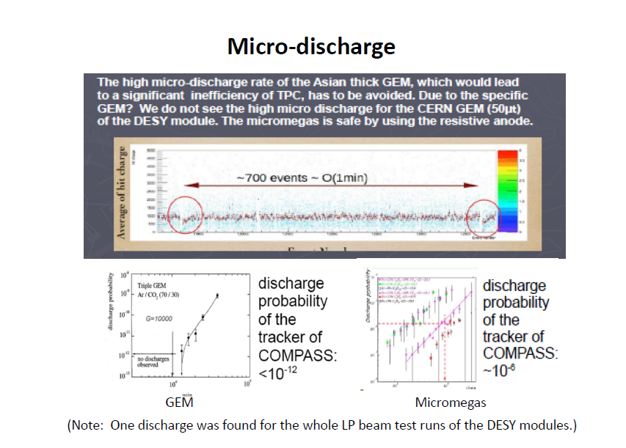

Slide 24
Remaining Issues
Local Distortion due to the MPGD modules
All current LP modules see large distortions; (The old TPC problem!)
We need to minimize the distortions in the hardware level, and, then correct remaining distortions by software.
Distortions due to specific module structures
  Micromegas module: Grounded guard structure around the module.
  To be modified only in next module. Wait for next module?
  Asia GEM module: Large gaps of the segmented electrodes on the top surface of GEM; Gaps moved. Still see small distortions partially due to the 2mm gaps on the bottom surface of the GEMs.
  (2) Distortions at the module boundaryies with 1+1mm gaps:
  The E-field calculation and simulation can suggest solutions to reduce the distortion. Then confirmation of the solutions by either the beam test or the laser- beam test .
  → Li Bo joins Klaus to do the simulation. Good agreement with the laser test.
  → Hope to get a guide line for (3).
  (3) Develop software to correct remaining distortion after (1) and (2)
  Some deterioration of the spatial resolution will remain after the correction.
  A global distortion of a few mm level at LP TPC is confirmed by monitoring the patterns on the cathode plane shined by a laser due to the non uniform magnetic field of PCMAG. Also the current LP filed cage has some imperfection and a alignment problem to the magnetic filed. → DESY is now working. Tests of software correction may be tried soon (Li Bo).

Slide 25
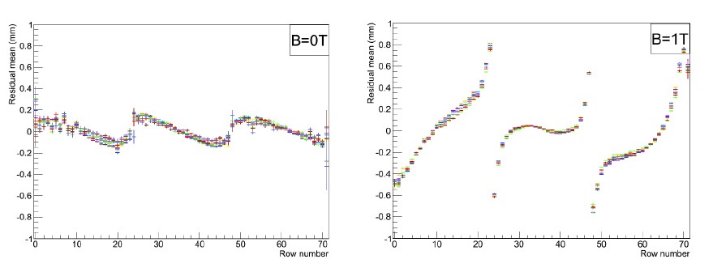
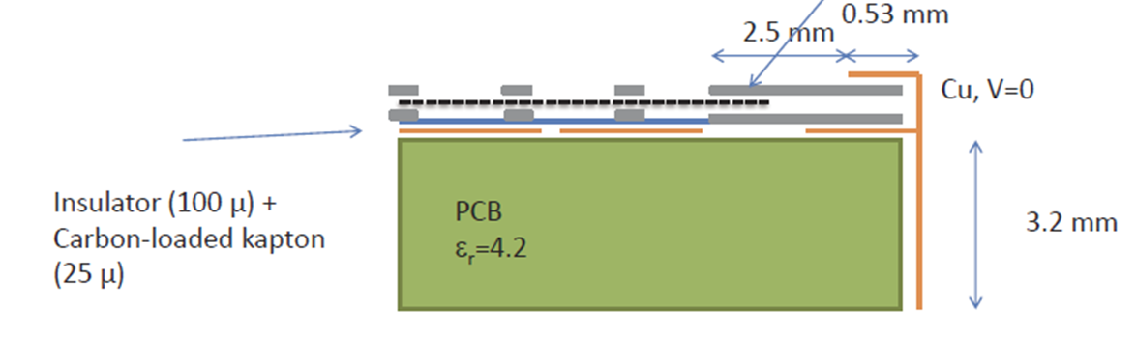
Distortions of LP Modules
The case of DESY GEM LP module
The case of Micromegas LP module

Slide 26
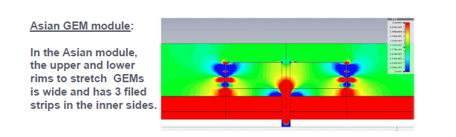
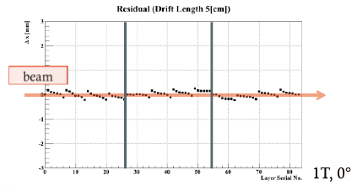
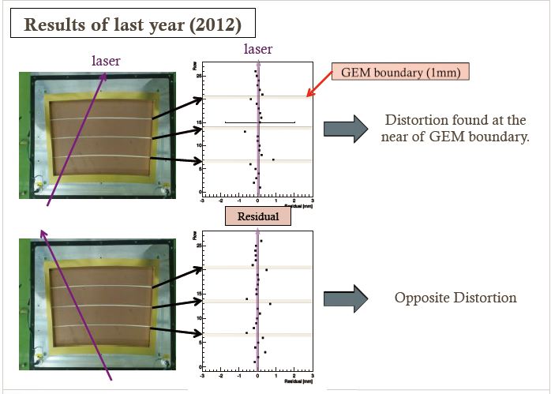
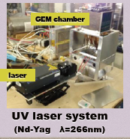
Compact Laser Beam Generator for Distortion Study
Due to the gap of the electrode of GEM
Due to the gap between modules

Slide 27
Remaining Issues
Cooling and Temperature Control of TPC endplate
Two phase CO2 (2PCO2) cooling for ILD TPC endplates:
Installing readout electronics directly on the MPGD module while we keep the pad plane of the module at a given TPC temperature. The temperature control of the pad plane of the module and a proper cooling of electronics become important. 2PCO2 cooling has advantages of constant temperature and high pressure and compact cooling circuit.
  (1) Set up two small 2PCO2 cooling units for test at DESY and KEK (by Sugimoto) in the beginning of 2014 → Almost done!
  The first cooling test of the T2K electronics on the Micromegas modules soon. → Done successfully!
  Mock up cooling tests for the S-ALTRO16 electronics In summer 2014?
  It is very good that people are starting to discuss the “advanced endplate” by seeing the complicated implementation of S-ALTRO16 electronics, the usefulness of the 2PCO2 cooling, and the ECFA PD review report. However no immediate solution for the integrated-cooling pad-plane. The ceramic CB is expensive and limited to the size of 10cm x 10cm? No real action.
  Thermal design of the whole ILD TPC :
  ILD TPC design has no thermal jacket on the field cages to minimize the material budget. Addressed in the final design of ILD TPC. No action yet.

Slide 28
Remaining Issues
Power Pulsing and Power Delivery
S-ALTRO16 electronics
Need power pulsing even for low power readout electronics at ILD TPC:
Power pulsing of SALTRO16 chip has been demonstrated in the chip test. The reduction factor expected for the ILC bunch structure was around 30.
(2) Power pulsing in LP TPC beam test by the SALTRO16 electronics is foreseen.
The power delivery issue → Has not been addressed so far.
Should be studied in the design of the final readout electronics for the ILD TPC.

Slide 29
Remaining Issues
Tests and demsonstration in the 3.5T magnetic field
Tests in the 3.5T magnetic field:
Confirmation of the performance of MPGD TPC and ion gates,
(2) Measurements of basic parameters of TPC gas, and ,
(3) Engineering issues such as possible mechanical vibration due to the power pulsing .
The problem: A high field solenoid need to be found!
The DESY 5T magnet (KOMAG) has been dismantled from the new He line at DESY for some time. We need either to revive the 5T magnet (by moving it to one of our institutes or by a modification), or to find another high field magnet available for us. With our limited human resource, very preferable to set it up in one of our institutes. A solenoid is preferred.
An early news of the 4T MRI magnet at ANL (for the g-2 experiment). Can be used at the FNAL test beams in future?
Can we use the 5T small magnet at Fujikura? We need a special set up.
Are we too lazy not to look for more possibilities in Japan and Europe?

Slide 30
Remaining Issues
Optimization of ILD TPC
Optimization of the ILD detector in coming few years:
Some specific issues for TPC such as dE/dX performance which we have not addressed very well both in measurement and simulation.
→ No real action?
Final specification of ILD TPC before prioritization of different MPGD technologies in TDR:
The final design of the ILD TPC will be given in TDR in 4 - 5 years. We review our specification of the ILD TPC, based on the results and experience from the LP beam tests. It includes pad size, module size, TPC gas, in particular, in the context of the neutron background, Specifications of TPC readout electronics, calibration and operation of ILD TPC, etc. We need to fully utilize our simulation tool for the optimization.
→ A significant software efforts to come to a common analysis method/software .
→ Noweverything in 5 years rather than in 2-3 years?

Slide 31
Toward the Final Design of ILD TPC
Readout Electronics
Our history of TPC readout electronics:
ALEPH electronics (for some small prototype tests)
T2K electronics (for LP TPC)
PCA16 + ALTRO electronics (for LP TPC)
SALTRO16 electronics (for LP TPC)
GdSP? (for ILD TPC)
SALTRO16 chip: The first analog-digital integrated chip for low noise application satisfies our specification except the packing density (16ch/chip) and power consumption (ADC- around 30mW).
Beside, the hard-wired digital processing of S-ALTRO16 may not be optimized for the MPGD TPC. The real problem of the S-ALTRO development is that the team has been resolved.!
The R&D implementation (limited in No. of channels or in No. of unit) of the S-ALTRO16 is underway by the Lund group. We need to cooperate with them for its test with modules and cooling.
How do we perform our future beam tests; with the ALTRO, or the S-ALTRO16, or something else?

Slide 32
Toward the Final Design of ILD TPC
Field cage, endplates and all
R&Ds in LP TPC so far:
Construction of the light and thin field cages for the LP TPC
Construction of the two types of Al endplates for the LP TPC
Some simulation study for the field cage and the Al endplate for ILD TPC
Some study of the TPC support.
Thin central cathode (in prep.)
Tool for the installation of LP module (in prep.)
Laser beam calibration (in prep.)
Many details of the ILD TPC still to be studied for TDR:
Details of mechanical design of ILD TPC and its support,
Design of a support structure for the outer silicon detector on the outer field cage Structures inside the field cage:
Details of the central cathode electrode and its HV supply, Resistor chains with a cooling and shielding etc.
Thermal design of ILD TPC
Monitoring system
Measures for earthquakes in Japan
We need to activate and enlarge our mechanical group asap.

Slide 33
Toward the Final Design of ILD TPC
Software
So far:
Software packages for the LP beam test with its core package Marlin TPC for reconstruction of TPC tracks and analysis with tools necessary for the data analysis at LP TPC.
Study of the local distortions has been made using CSTTM and Garfield++.
In coming few years: need to perform more simulation
Implementation of the resistive anode,
Tracking code for the digital TPC,
More studies of local distortion and its correction,
Simulation studies for the optimization,
Update of background including the neutrons,
Design and methods of TPC calibrations,
Demonstration of actual track reconstruction of events in one full bunch train
,,,,,,
What is missing here is not ideas, but human resource for simulation!

