Slide 1
Remaining Issues
Tests and demsonstration in the 3.5T magnetic field
Tests in the 3.5T magnetic field:
Engineering studies such as the possible mechanical vibration due to the power pulsing.
Measurements of the basic parameters of TPC gas.
The performance studies of MPGD TPC and ion gates in the high magnetic field.
The (final) beam test (a demonstration) of a large prototype of ILD TPC with a high energy hadron beam.

Slide 2
A High Field Solenoid for the Tests?
A. The DESY 5T magnet (KOMAG):
This magnet was used for (2) and (3). Unfortunately it has been disconnected from the Liq. He line at DESY for some time. After a study of its possible stand-alone operations of the magnet might be possible in principle, but in practice not too easy. We need either to reinstall the magnet in the new DESY Liq He line, which seems difficult in the current situation at DESY, or, to revive it by moving to one of our institutes where the direct connection to the Liq He line possible.

Slide 3
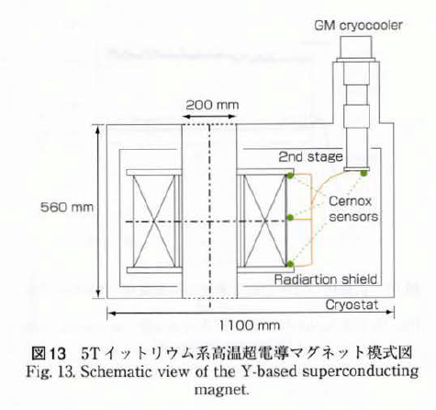
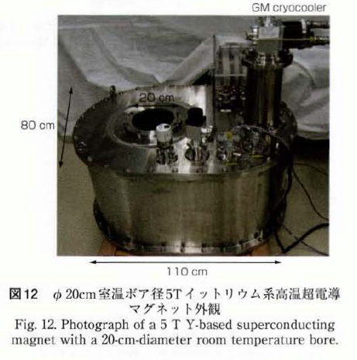
A High Field Solenoid for the Tests?
5T magnet at Fujikura, Japan
The magnet was made as a R&D of their high temperature super conductors, and is being used for their studies. The bore of the magnet is 20cm in the diameter and 56cm long. At least for the test of the Fujikura Gate GEM, They will allow us to use the magnet. One problem we need to find a solution is the use of the isotope?
The magnet is portable in principle.

Slide 4
A High Field Solenoid for the Tests?
ANL 4T MRI magnet for the g-2 experiment
The main purpose is the testing of the in-vacuum NMR trolley system of the g-2 experiment and systematics studies related to an absolute calibration probe. Achieving the precision of the measurement of the anomalous magnetic moment of the muon at the level of 140ppb, NMR equipment at the level of less than 20ppb is necessary, which requires a test magnet facility to provide a 1.45T field with high stability and homogeneity. They chose to install a 4T ActiveShield MRI magnet. The bore diameter is > 68cm with the gradient coils and 90cm without it. The g-2 experiment which will use the magnet for about two years. After that this magnet may become a general testing facility for large detector R&Ds such as for Mu2e and TPC.
(ANL has also the HELIOS facility, another 3T ActiveShield Oxford OR 63 magnet.)
From The “the proposal for the installation of a 4T test magnet facility”
https://www.dropbox.com/sh/uutr081exmbfprm/frUEQg6T4D

Slide 5
ANL 4T MRI magnet for the g-2 experiment

Slide 6
H2 Beam-line CMS Magnet
(I heard of this magnet only today!)
( Taken from slides by Imad Laktineh)

Slide 7
A High Field Solenoid for the Tests?
Our effort to find other magnets which might be available in part time for us in Europe and in Japan?
When we look for a similar magnet in the market, it may cost 2-3M$.
When we want to make a new (thin coil) MRI type magnet of 3T by ourselves (for an example at KEK), we need > 1M$.

