Slide 1
Status and outlook of the Micromegas modules
LCTPC Collaboration meeting
DESY, 30/05/2014
D. Attié, D.S. Bhattacharya, P. Colas, S. Ganjour, et al.

Slide 3
History of Micromegas data taking

Slide 4
Micromegas tests
July 2008 : Installation of the SiPM trigger
Oct. 2008 : Commissionning of the SiPM trigger
Oct. 2008 : tests in the gasbox of a standard anode (non-resistive, module 1), CERN routing, run 133 with P5
Switch to resistive (C-loaded kapton, module 2) runs 134-141 with P5, runs 142-146 with T2K gas
Nov. 2008 : mount standard module + T2K electronics on the TPC. Runs 148-217. Switch to resistive anode Runs 218-279 (beam and cosmics)
Dec. 2008 : B=1T Runs 281-469
Z scans, but the only way was to slide the TPC in the magnet, thus the field was not uniform for large drift distances. Pub in TIPP.

Slide 5
Micromegas tests
March 2009. New electronics allowing shaping bypass (M. Dixit’s request)
May 2009. Runs 471-565 with standard pads, Runs 566-624 with resistive anode.
June 2009. First Laser run. Runs 625-653
August 2009. Second laser run, with standard pads. Runs 659-771
October 2009. Tests at CERN with the gasbox
November 2009. Si enveloppe tests. Runs 800-821
December 2009. Runs 900-986. Comparison module 4 (CERN routing, runs 900-924) and module 5 (Saclay routing, 929-986) both with Carbon-loaded kapton.

Slide 6
March 2010. Module 3 (resistive ink) Runs 1003-1059. Module 2 (Carbon-loaded kapton) runs 1060-1115. Those runs were used for the resolution ‘final’ analysis.
June 2008 data taking at CERN with high-intensity pion and muon beams
Nov. 2010 : 1st Octopuce test.
May 2011 Commissioning of 1 module with new electronics. Apparent x-talk problem, data not usable (runs 1070-1412)
Build 10 modules in 2011-2012
July 2012 Pilot run with 6 modules. Runs 2000-2204
Jan-Feb. 2013 7-module data taking. Runs 3000-3230
Feb. 2014 7-module with 2P CO2 cooling. Runs 4000-4110
Laser tests runs 4111-4156
March 2014 : 5 modules + 2 octopuces

Slide 7
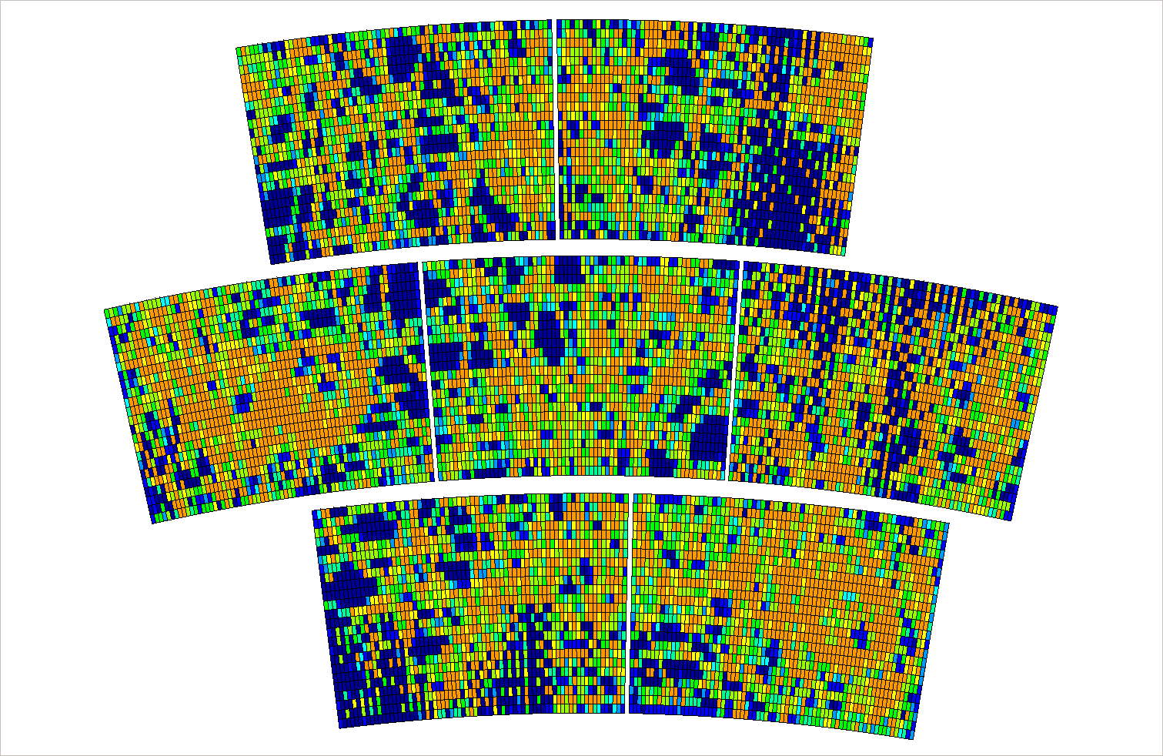

Slide 8
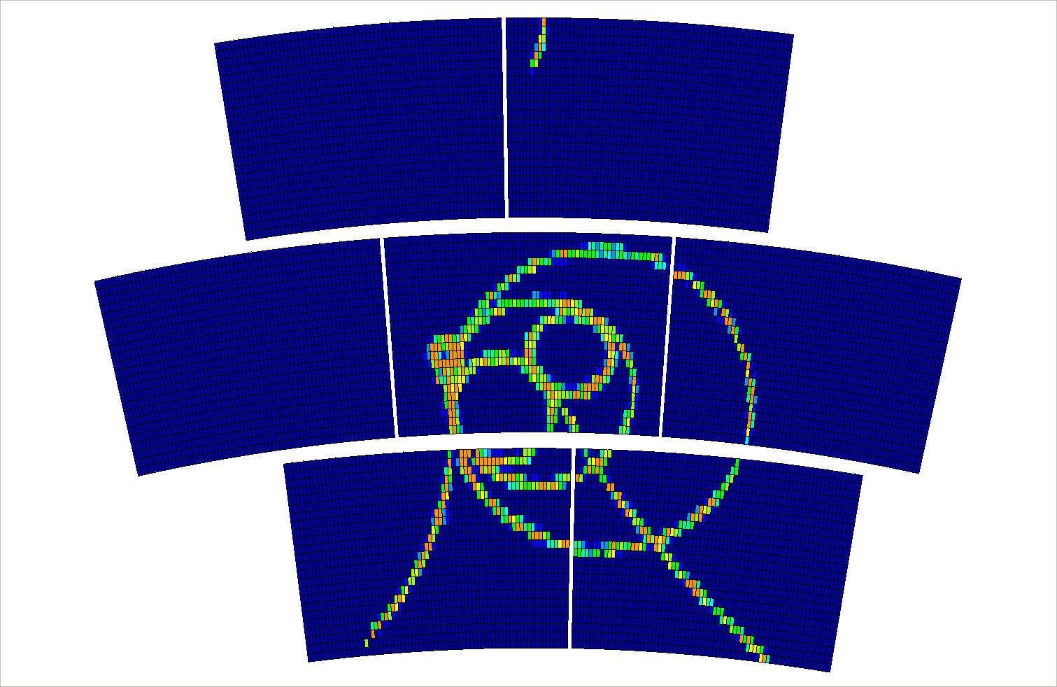

Slide 9
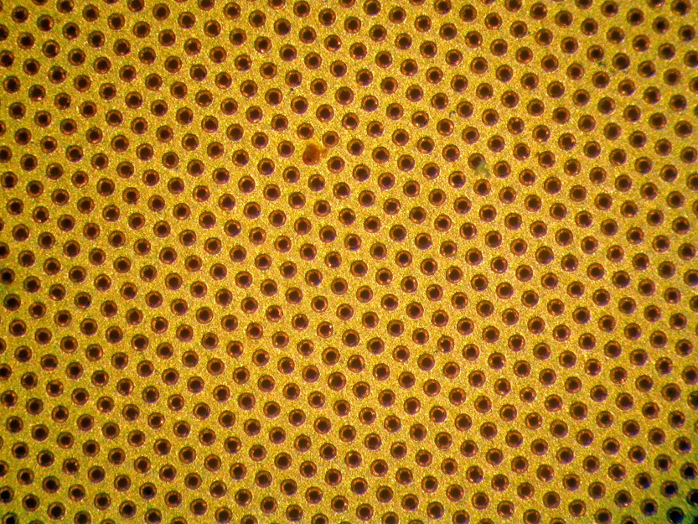
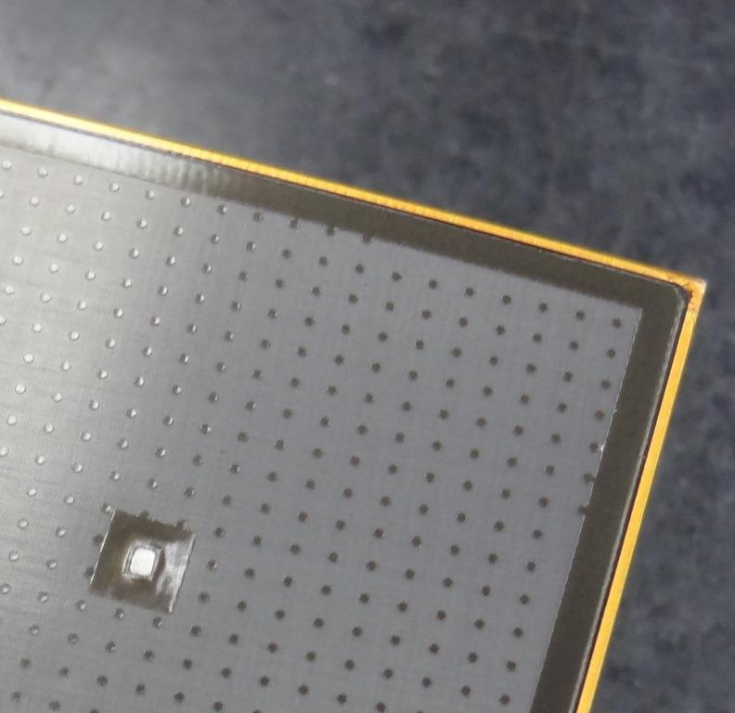
Improvements in progress
New mesh (developped for MIMAC DM TPC): metallized and thinned 17 micron GEM.
New resistive foil (Diamond-like Carbon, « black diamond, from RD51 Japan, Ochi). 2 modules in preparation
Re-design the resistive foil grounding to mitigate distortions at the edges (set the guard ring to the mesh voltage or leave it float)

Slide 10
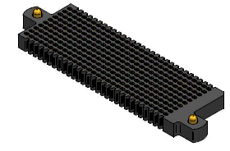
Improve the pad connections. Try new connectors, improve mechanical fixation of the FECs
Try new versions of AFTER-based electronics (AGET, DREAM)

Slide 11
Next step: Larger module with smaller pads
About 40x40 cm² module
  Which electronics?

