Slide 1
Progress Report From Asian CFS Team
Status of Hybrid A’ Option
A. Enomoto, Y. Nishimoto, G. Orukawa
5 September 2014

Slide 2
Introduction
Progress Notes
Overview of Talks from CFS
CFS requests to this meeting

Slide 3
Progress of IR Access Study
(LCWS2013 @ Tokyo) Instead of horizontal tunnel (HT), vertical shaft (VS) requested for detector installation.
Feasibility study initiated under the control of LCCTB.
(ADI-CFS Joint meeting @ Tokyo in Feb) For this request some VS-HT hybrid cases discussed and narrowed.
(AWLC14 @FNAL) The baseline and a hybrid cases compared in design, cost and schedule; A VS alternative (two VSs w/o HT) proposed by SiD team at this meeting.
Instead of two VSs, a plan with a common VS and an auxiliary HT (Hybrid A’) proposed by CFS team in July 8 CFS weekly meeting.
Effort to reach consensus on this plan is continuing.

Slide 4
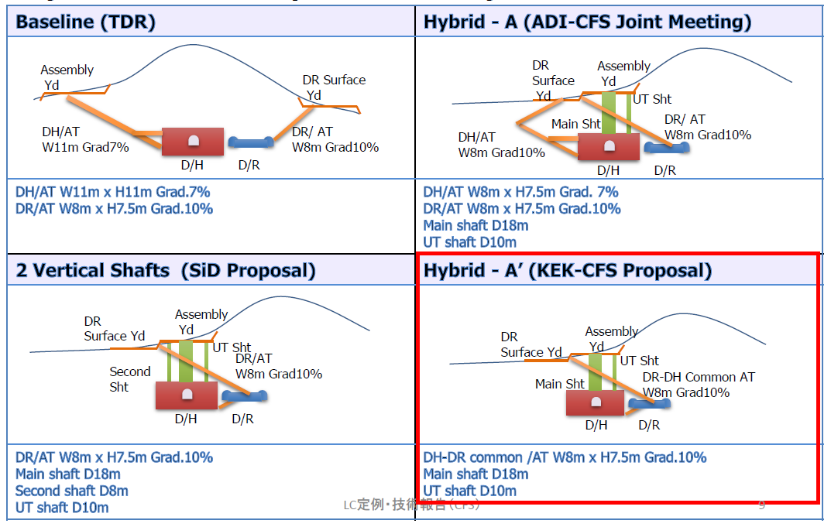
Progress of VS/HT Access Study

Slide 5
Overview of CFS talks
(Status of Hybrid A’ Option)
    Layout and dimensions of the underground structures (access shafts and tunnel, passages, DH, UH).
(Costs and Timelines for Hybrid A’ (HA) and Baseline(BL))
    Rough comparison of overall CFS costs between HA and BL.
    Integrated schedule of CFS works in IR.
(Status of Assembly Area)
    Current study of surface yard development and possible building configurations.
(Implications of Moving ILC IR Position)
(Boundary Conditions for Heavy Duty Transport)

Slide 6
Our requests to this meeting
Consensus on Hybrid A option by ILD, SiD and CFS teams.
  Numbers and dimensions of major structures (Shaft, tunnel, DH, UH, Assembly building)
  Necessary handling equipment
  CFS and Detector construction schedule

