Slide 1


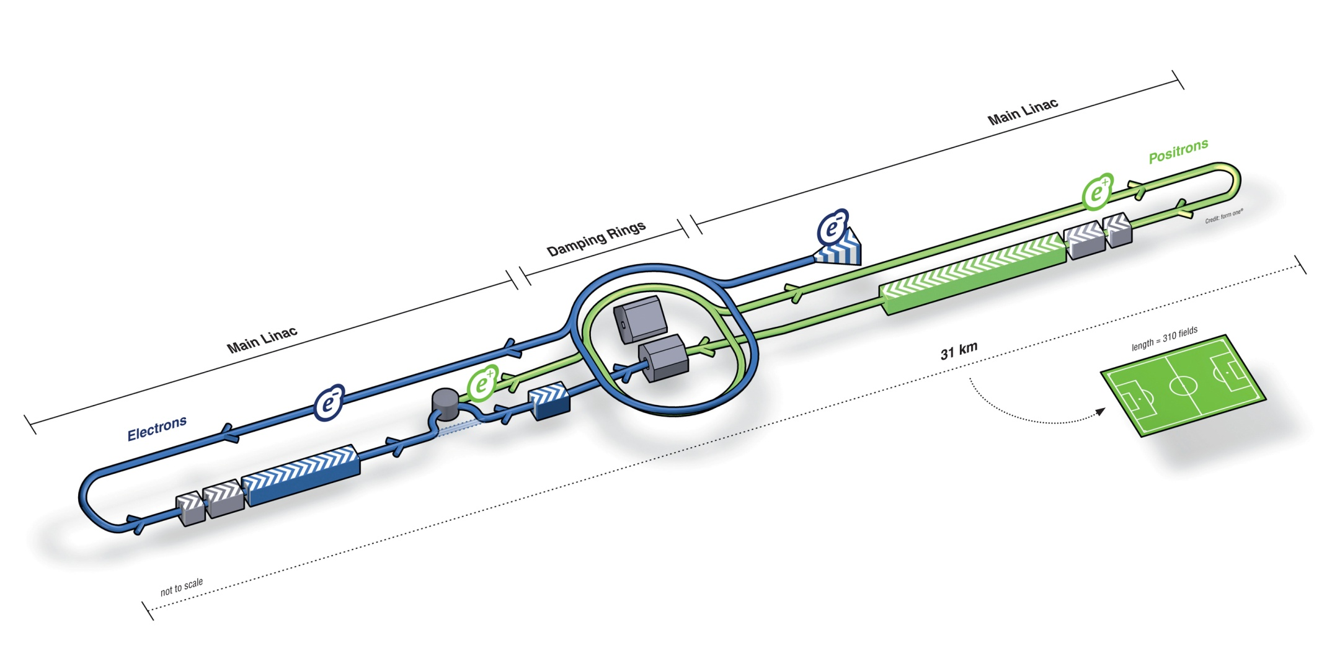
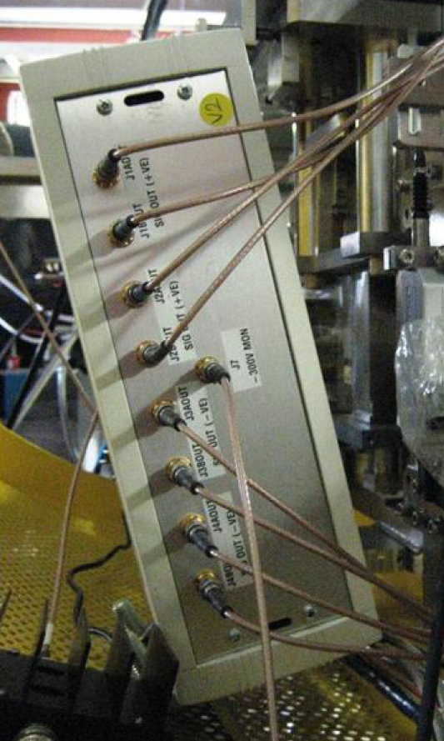
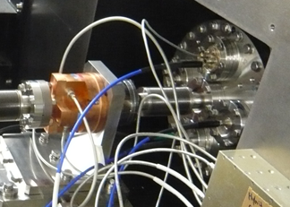
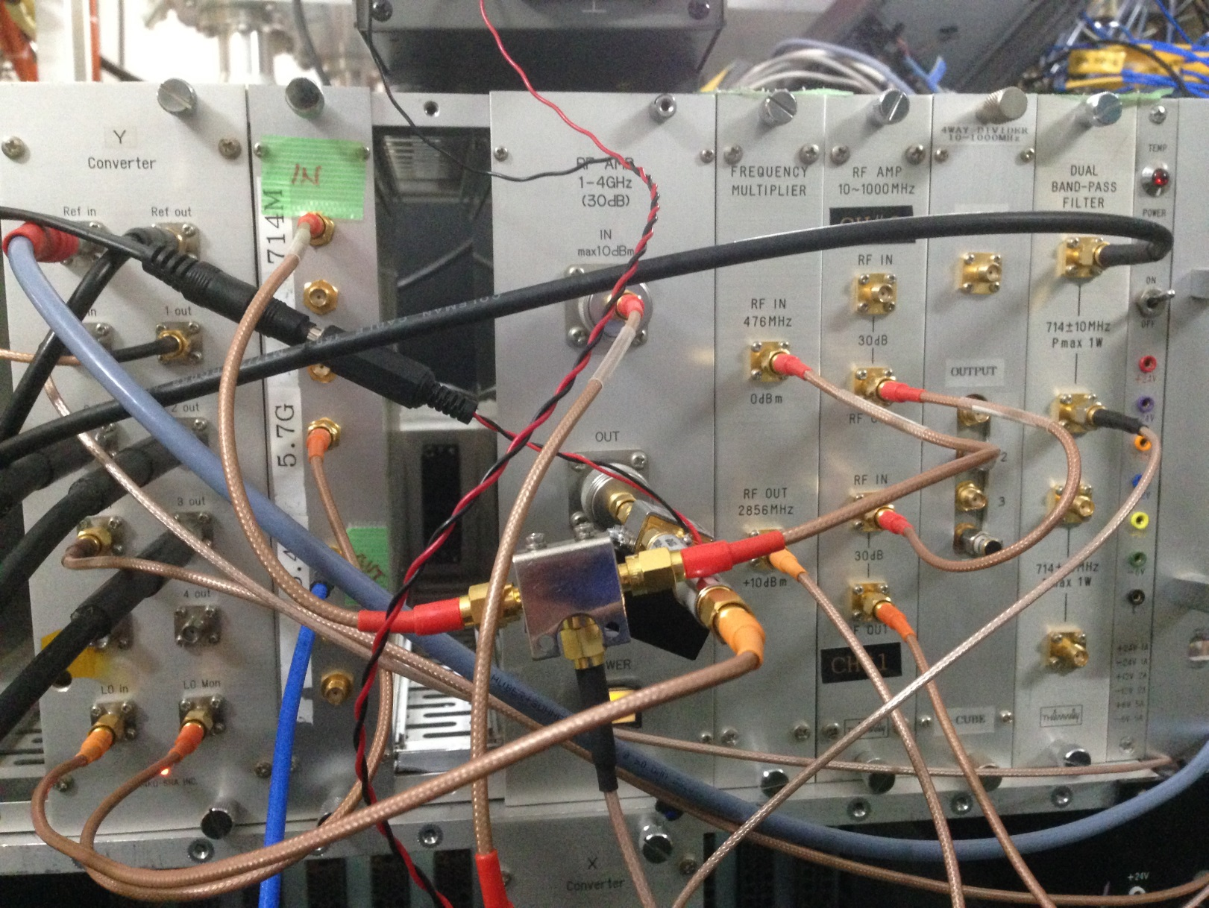
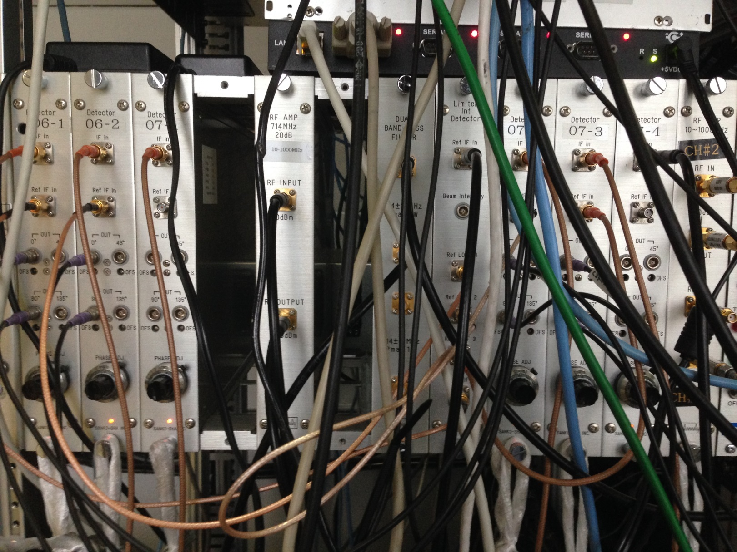
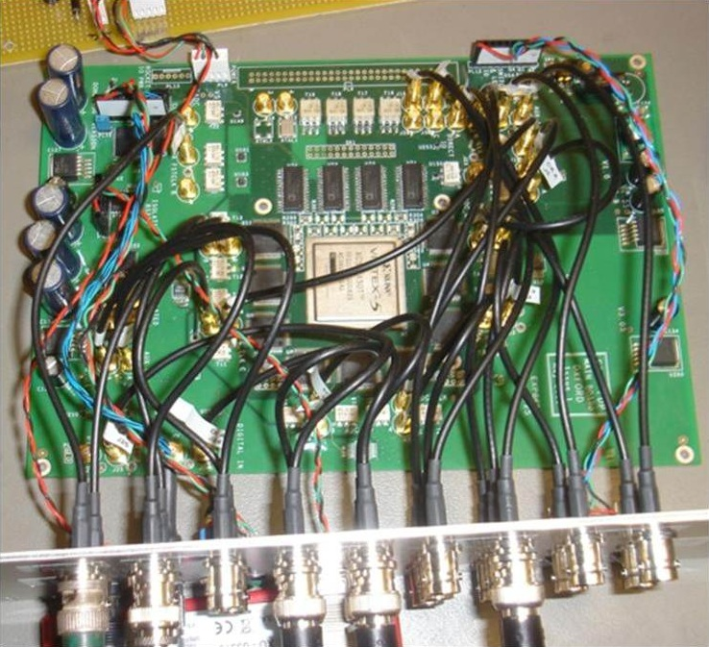
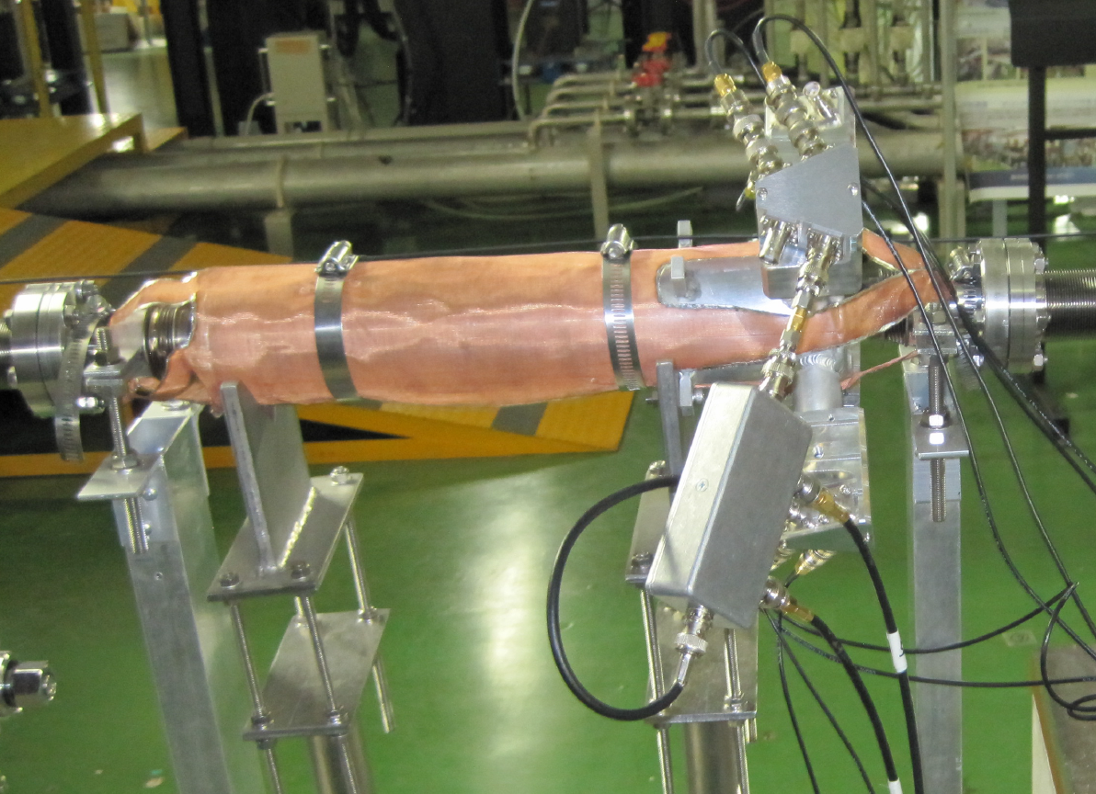
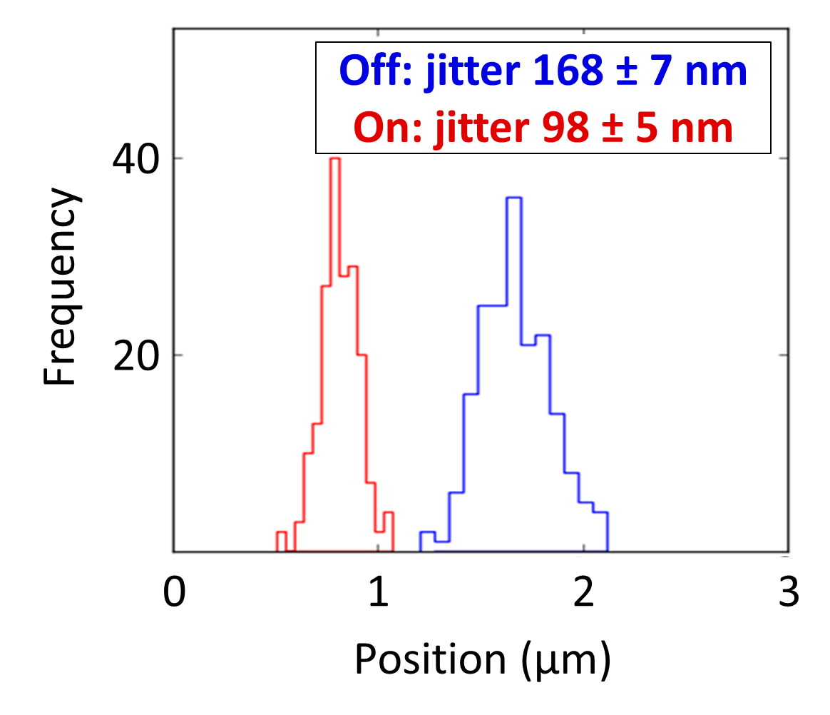
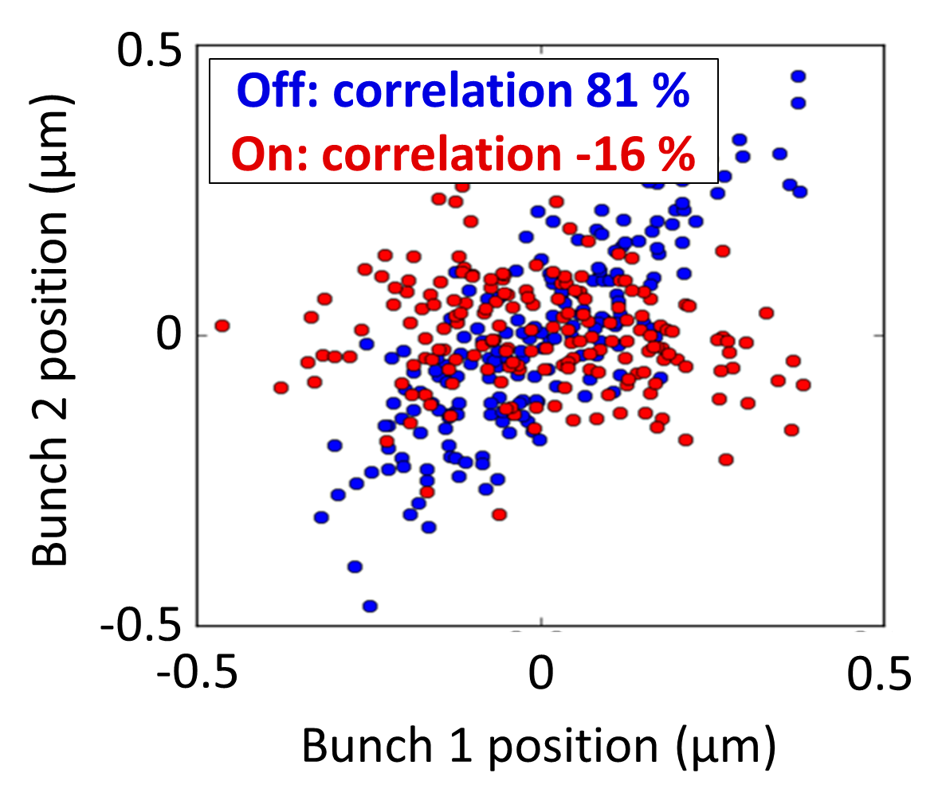
Development of a Low-latency, High-precision, Intra-train Beam Feedback System Based on Cavity Beam Position Monitors
N. Blaskovic Kraljevic, D. R. Bett, P. N. Burrows, G. B. Christian, M. R. Davis, Y. I. Kim, C. Perry
John Adams Institute for Accelerator Science, University of Oxford, UK
International Linear Collider
Accelerator Test Facility
Feedback on Nanosecond Timescales
Extraction line
Ref
IPB
IPK
Final focus
M1
M1
Damping ring
Amplifier
Electron source
M2
1.28 GeV linear accelerator
FONT5 digital board
The International Linear Collider (ILC) is a designed linear electron-positron collider at a centre-of-mass energy of 500 GeV [1]. The schematic above shows the 6.7 km circumference damping rings, followed by the 11 km long superconducting main linacs. The ILC is designed with a vertical beam size at the interaction point of 5.7 nm and a bunch separation of 554 ns.
The Accelerator Test Facility (ATF) at KEK, Tsukuba, Japan is as a test bed for the ILC. The ATF consists of a 1.28 GeV electron linac and a super-low emittance damping ring. ATF’s current goal is to achieve a 37 nm beam size with nanometre beam stability (as measured at the final focus) [2].
The Feedback on Nanosecond Timescales (FONT) [3] project works towards ATF’s high stability goal, by performing intra-train beam-based feedback. Operating with 2-bunch trains at a bunch separation of ~150 ns, the FONT system monitors the path taken by the first bunch to correct the path of the second bunch using the apparatus set-up shown above.
Ref
IPB
Cavities
M1
M1
First stage mixer
M2
Second stage mixer
FONT5 digital board
Amplifier
IPK
Kicker
IPB is a C-band cavity beam position monitor (BPM) with a 6.4 GHz dipole mode for the y signal. The reference cavity has a 6.4 GHz monopole mode used for phase detection and charge normalisation [4].
The first stage downmixer takes the 6.4 GHz reference and IPB signals and mixes each with an external common 5.7 GHz local oscillator (LO) to produce downmixed
714 MHz signals [5].
The second stage downmixer mixes the IPB 714 MHz signal using the reference 714 MHz as LO [5], giving two baseband signals:
I (IPB and reference mixed in phase) and
Q (IPB and reference mixed in quadrature).
The FONT5 digital board contains a Virtex 5 Field Programmable Gate Array (FPGA) [6]. The I, Q and charge signals are digitised at 357 MHz and used to compute the beam position. The kicker voltage is generated.
The kicker voltage from the FONT5 board is amplified by a purpose-built drive amplifier manufactured by TMD technologies [7]. The amplifier provides ±30 A of drive current with 35 ns rise time (to reach 90 % of peak).
The stripline kicker consists of a pair of top and bottom electrodes connected to the corresponding amplifier at its downstream end and shorted together at its upstream end, forming a transmission line [8].
Results
References
The histogram on the right shows the distribution of vertical bunch positions for bunch 2 as measured at IPB. Feedback is interleaved between feedback off (blue bars) and feedback on (red bars). The feedback acts to reduce the vertical position jitter (that is, the standard deviation of the position distributions) from 168 ± 7 nm to 98 ± 5 nm. It also improves the average vertical position from 1.68 ± 0.01 μm to 0.81 ± 0.01 μm. The performance is consistent with a BPM resolution of somewhat better than 100 nm [9]. For best feedback performance, a high incoming bunch-to-bunch position correlation is required, which was measured to be 81 % with feedback off. The scatter plot on the right shows the bunch-to-bunch position correlation with feedback off and on. The feedback proceeds to remove the correlated bunch-to-bunch position component, reducing the correlation to -16 %.
[1] International Linear Collider: www.linearcollider.org/ILC/
[2] Accelerator Test Facility: www-atf.kek.jp/atf/
[3] Feedback on Nanosecond Timescales: www-pnp.physics.ox.ac.uk/~font/
[4] Y. I. Kim, PhD thesis, Kyungpook National University (Korea)
[5] Y. Inoue et al., PRST-AB, vol. 11, p. 062801 (June 2008)
[6] Xilinx Virtex 5: www.xilinx.com/products/virtex5/
[7] TMD Technologies: www.tmdtechnologies.co.uk/
[8] B. Constance, DPhil thesis, Oxford University (UK)
[9] M. Davis, DPhil thesis, Oxford University (UK)

