Slide 1
IP BPM studies with Honda’s electronics
Neven Blaskovic
with
Wunghoa Park
Oscar Blanco
Alexis Gamelin
N. Blaskovic

Slide 2
Introduction
Connected IPB(Y) to Honda electronics
Identified delay in reference signal path
Compensated delay by cable for IPB(Y)
Waveforms
Calibrations at a range of RF attenuations
N. Blaskovic

Slide 3
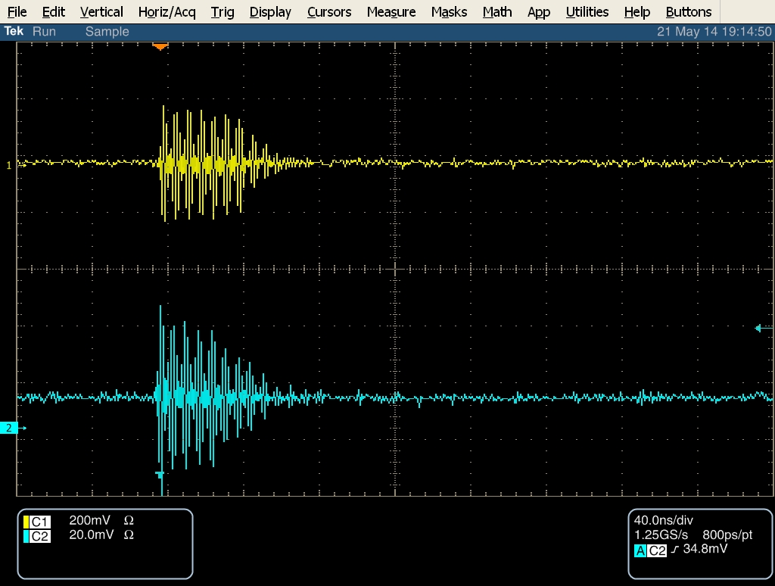
~714 MHz IPB(Y)
Mixer
~714 MHz Ref(Y)
BPF
Amplifier
Limiter
~714 MHz Ref(Y)
before BPF
~714 MHz IPB(Y)
before mixer
N. Blaskovic

Slide 4
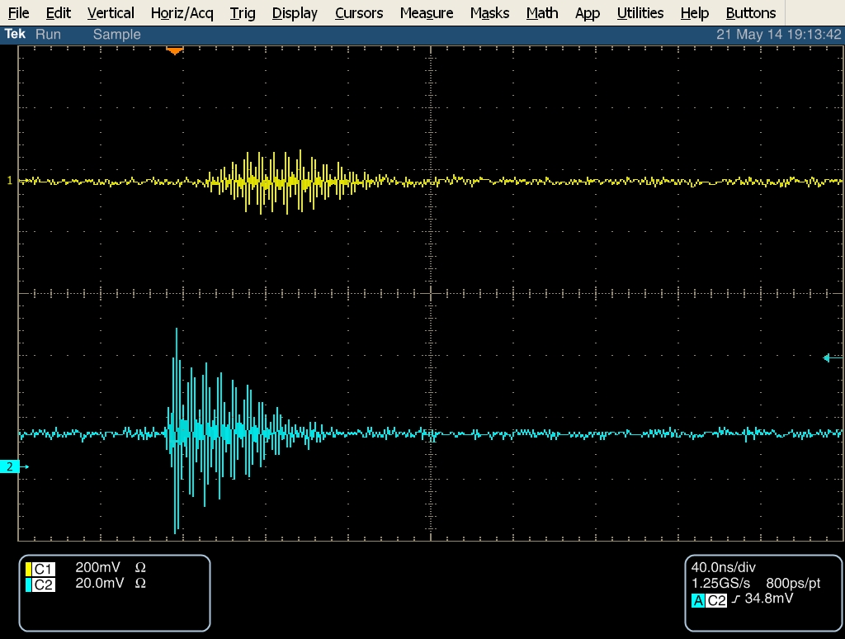
~714 MHz IPB(Y)
Mixer
~714 MHz Ref(Y)
BPF
Amplifier
Limiter
~714 MHz Ref(Y)
before amplifier
~714 MHz IPB(Y)
before mixer
N. Blaskovic

Slide 5
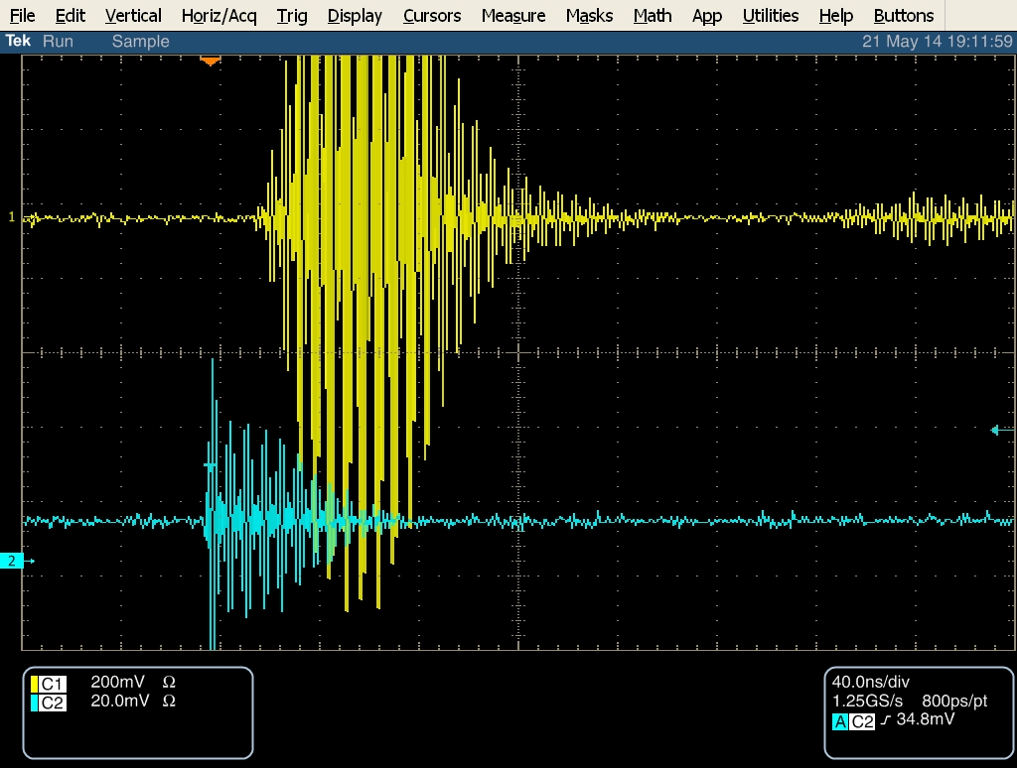
~714 MHz IPB(Y)
Mixer
~714 MHz Ref(Y)
BPF
Amplifier
Limiter
~714 MHz Ref(Y)
before limiter
~714 MHz IPB(Y)
before mixer
N. Blaskovic

Slide 6
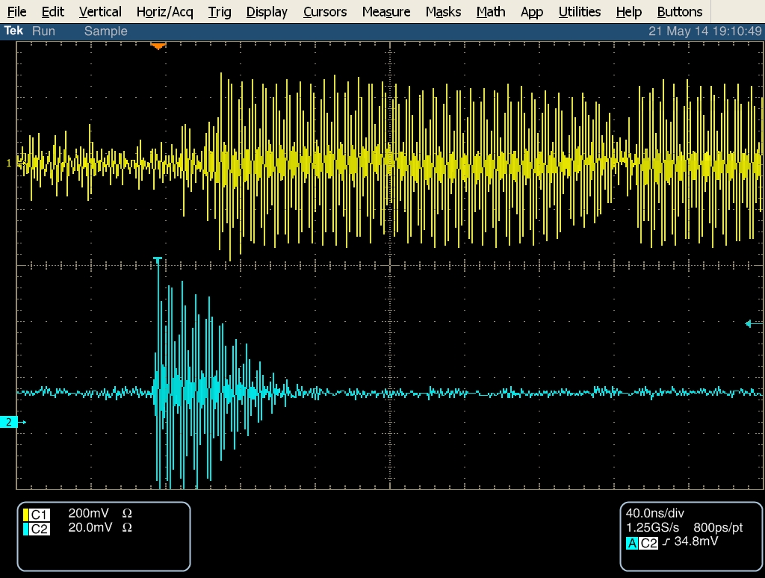
~714 MHz IPB(Y)
Mixer
~714 MHz Ref(Y)
BPF
Amplifier
Limiter
~714 MHz Ref(Y)
before mixer
30 ns
~714 MHz IPB(Y)
before mixer
N. Blaskovic

Slide 7
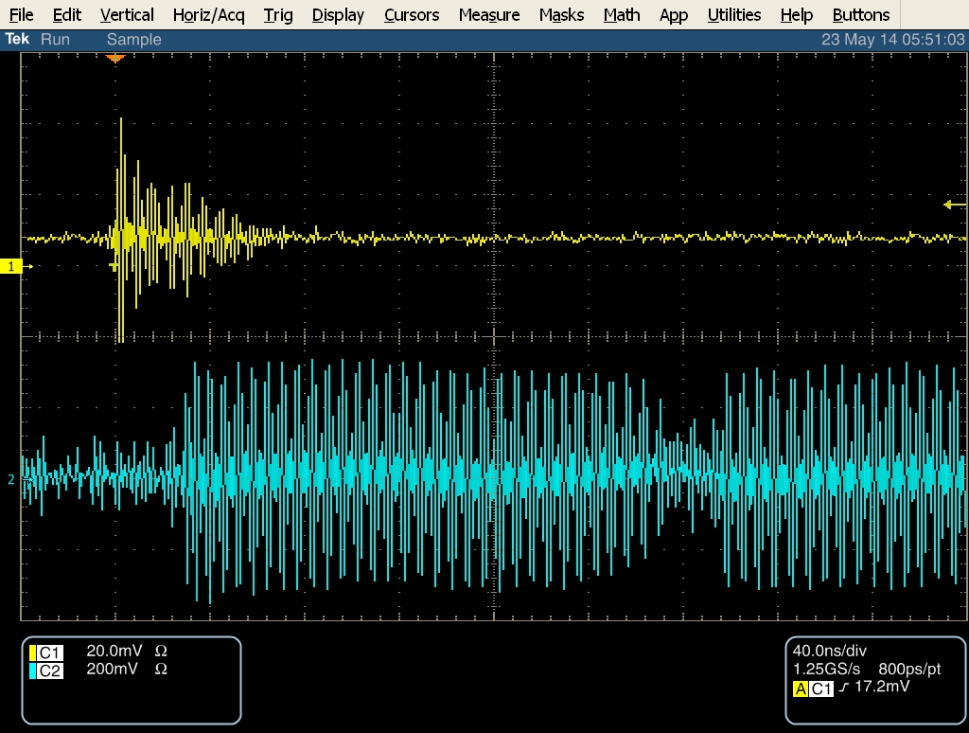
~714 MHz IPB(Y)
Mixer
~714 MHz Ref(Y)
BPF
Amplifier
Limiter
~714 MHz IPB(Y)
before mixer
30 ns
~714 MHz Ref(Y)
before mixer
N. Blaskovic

Slide 8
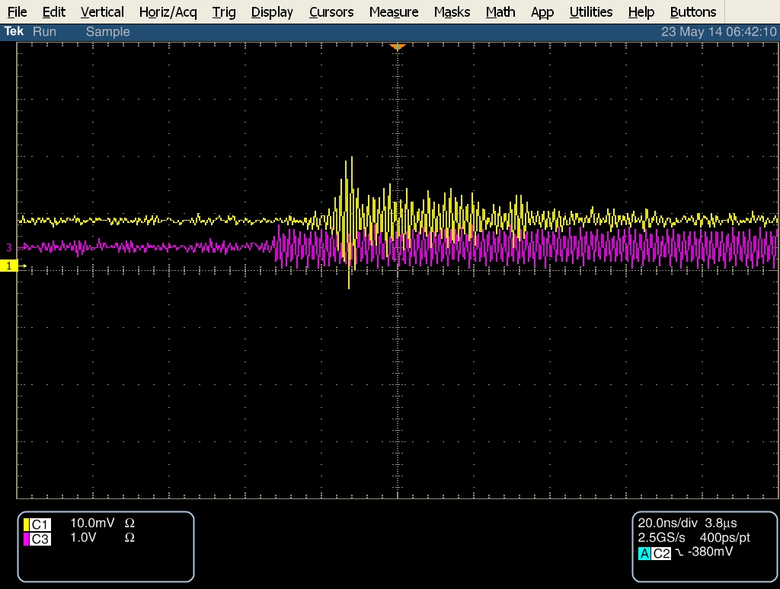
~714 MHz IPB(Y)
delay cable
Mixer
~714 MHz Ref(Y)
BPF
Amplifier
Limiter
~714 MHz IPB(Y)
before mixer
~714 MHz Ref(Y)
before mixer
N. Blaskovic

Slide 9
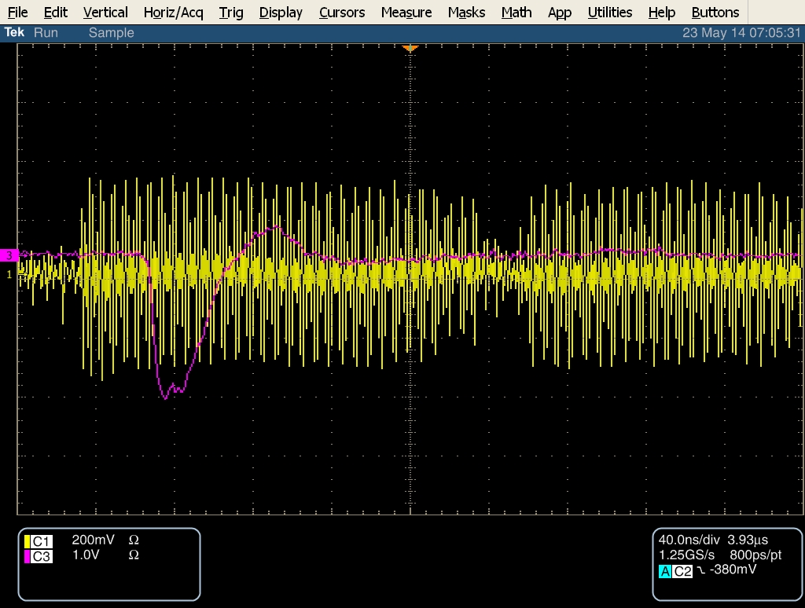
RF attenuator 0 dB
~714 MHz Ref(Y)
before mixer
I mixer output
N. Blaskovic

Slide 10
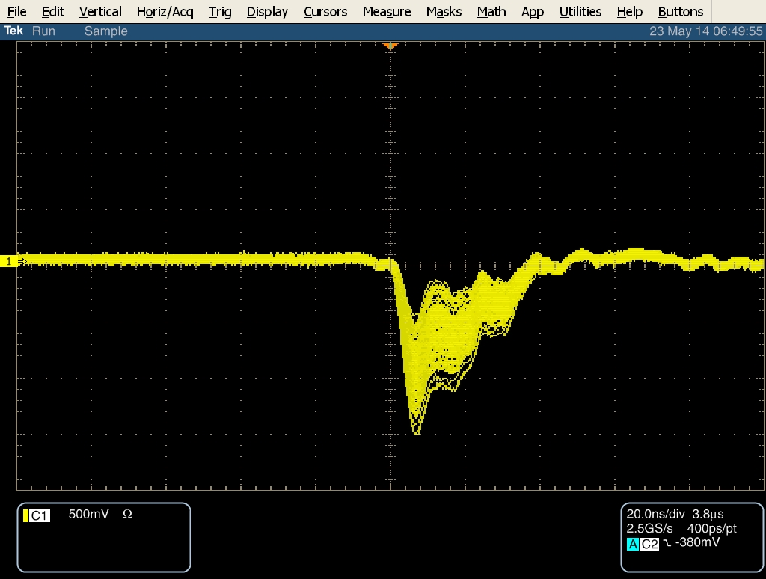
RF attenuator 0 dB
I mixer output
N. Blaskovic

Slide 11
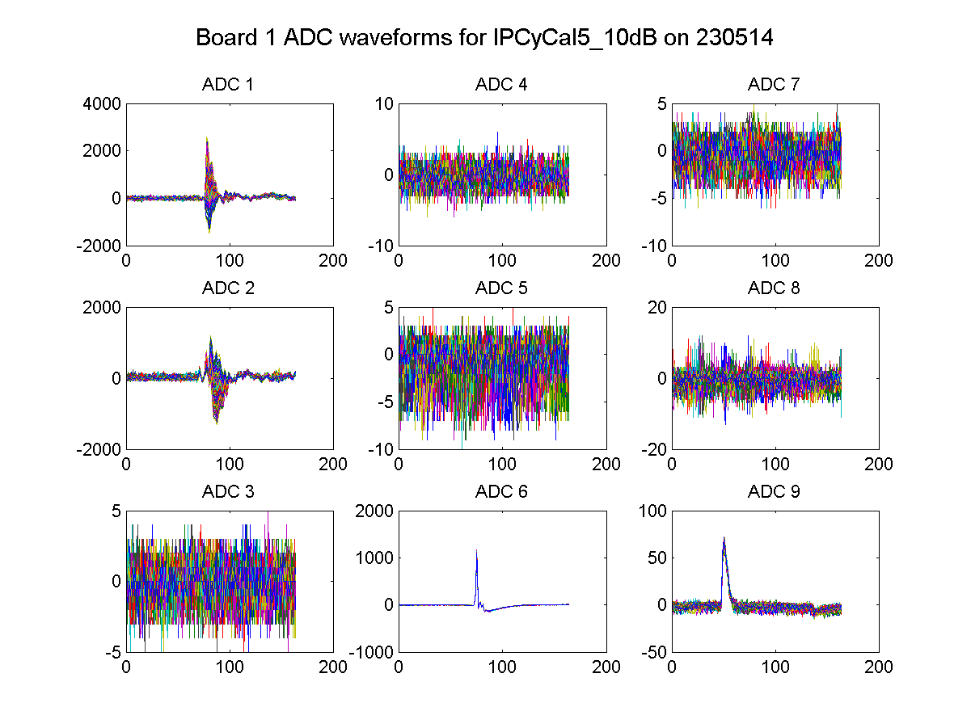
IPB(Y) I
unused
unused
IPB(Y) Q
unused
unused
unused
P2 Σ_{I}
Ref(Y)
N. Blaskovic

Slide 12
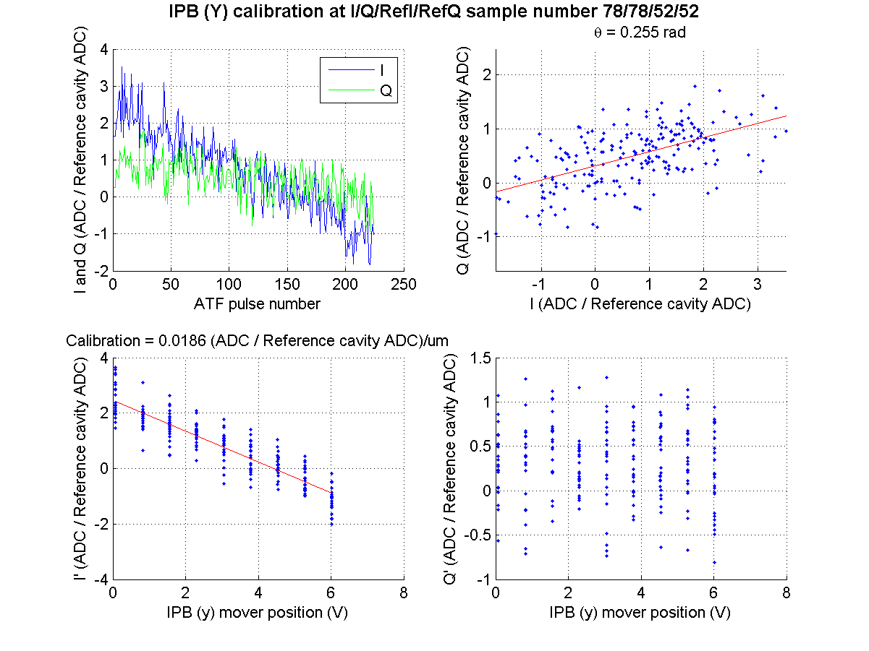
IPB mover scan
waist at IP
attenuator 50 dB
N. Blaskovic

Slide 13
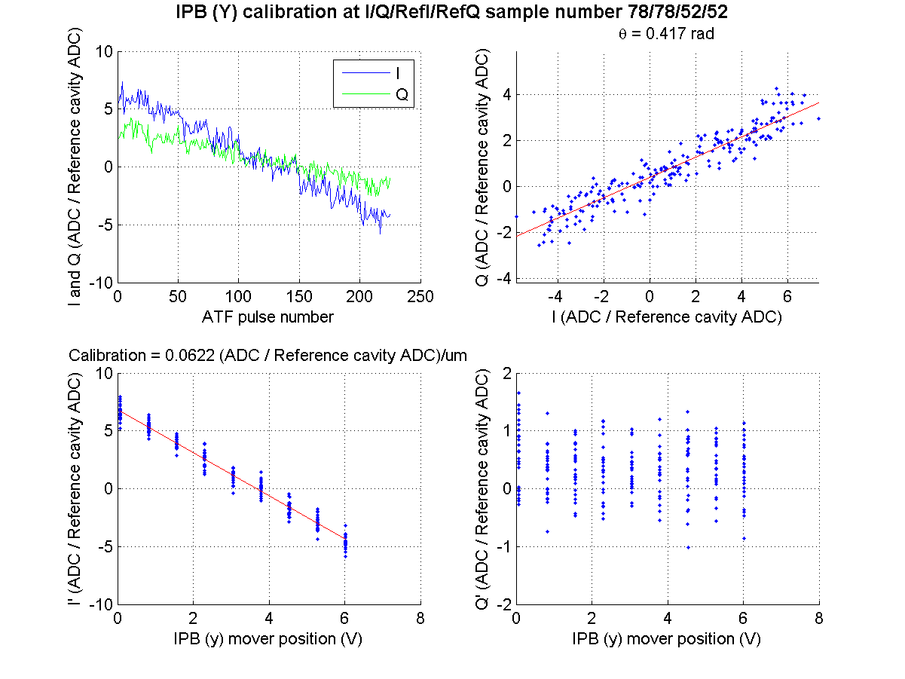
IPB mover scan
waist at IP
attenuator 40 dB
N. Blaskovic

Slide 14
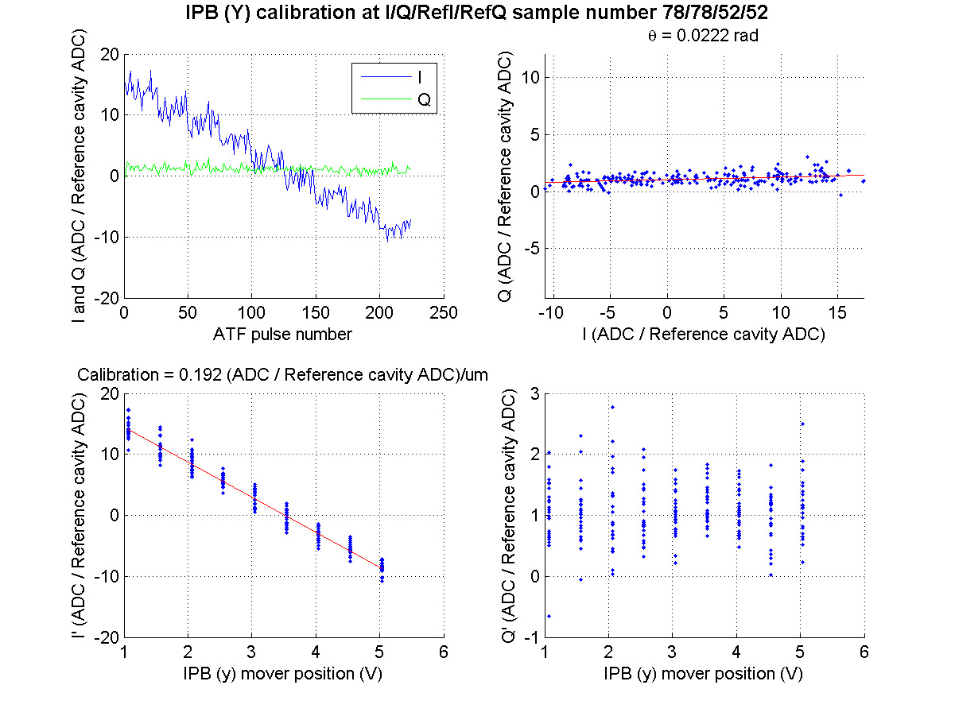
IPB mover scan
waist at IP
attenuator 30 dB
N. Blaskovic

Slide 15
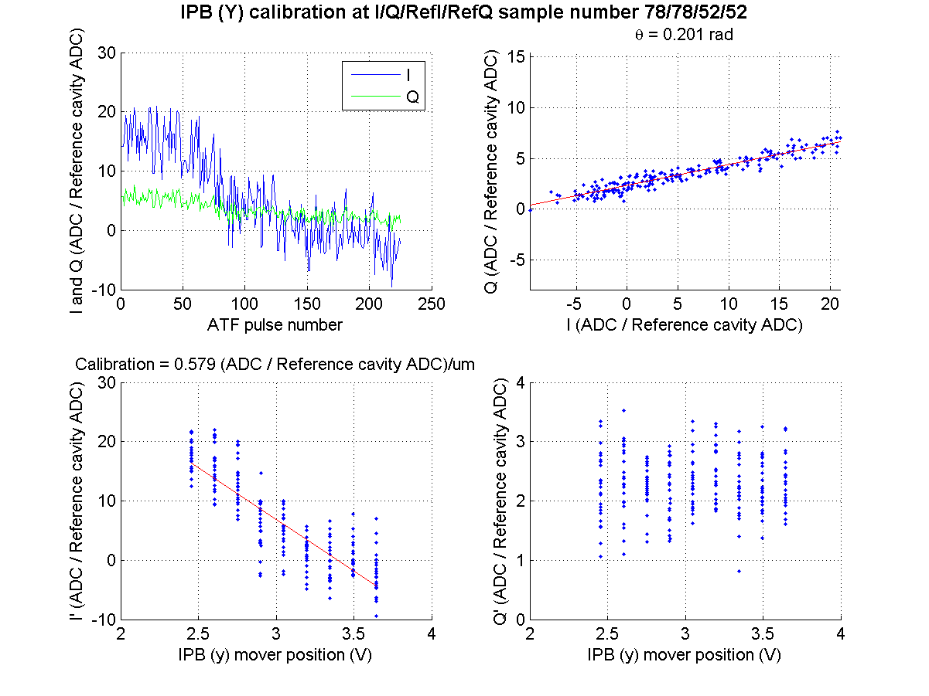
IPB mover scan
waist at IP
attenuator 20 dB
N. Blaskovic

Slide 16
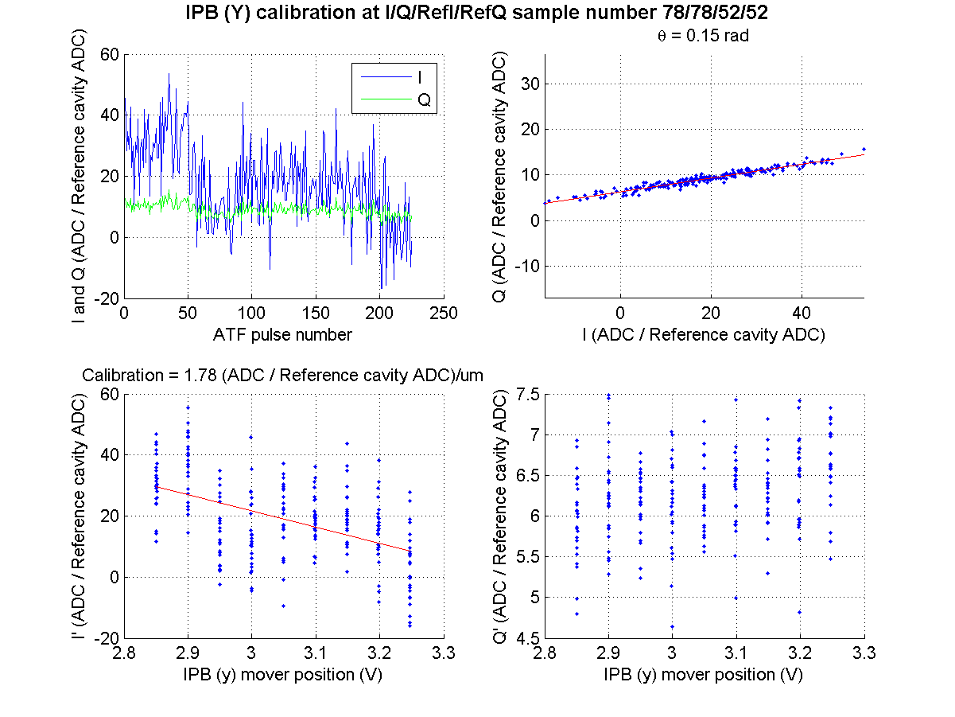
IPB mover scan
waist at IP
attenuator 10 dB
N. Blaskovic

Slide 17
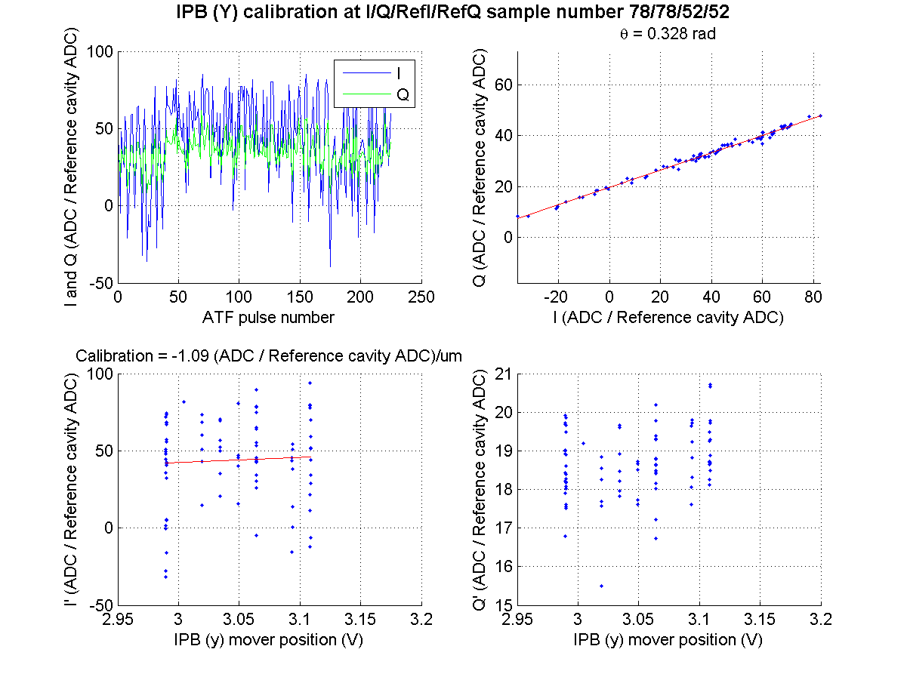
IPB mover scan
waist at IP
attenuator 0 dB
N. Blaskovic

