Slide 1
Initial Summary of Phase Feedforward Tests 16th-20th June 2014
Jack Roberts, Glenn Christian

Slide 2
Overview
Thurs 12th: Fun with connectors and cables
Fri 13th-Tues 17th: Machine set up.
Weds 18th/Fri 20th : Slow feedback tests.
Thurs 19th : Vacuum leak / amplifier installation.
Fri 20th : Tests with amplifier

Slide 3
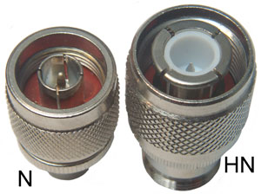
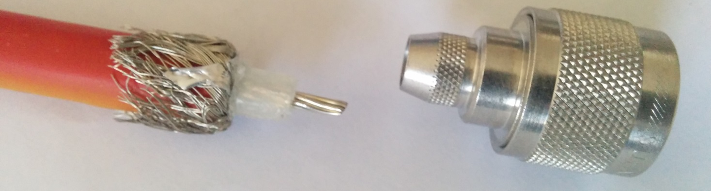
Cables/Connectors
Miscommunication at some point – electricians at CERN expecting to install HN type connectors on kicker cables.
Kicker cables are too thick to install normal N type connectors in a standard way.
N type connectors installed as a temporary solution but requires a bodge job on the cables:

Slide 4
Cables/Connectors
After tests last week, N-type connectors will be cut from cables. Can’t be kept for safety reasons.
Possible solutions:
Patch panel with HN to N type converters.
HN to N type converters directly on the cables/amplifier.
(might be a different N type connector compatible with the cables)
((((((((((Could N type connectors on the amplifier be changed to HN type?))))))))))

Slide 5
Cables/Connectors
The kicker cables weren’t actually connected to the kickers…
Me and Davide went in to connect them.
Cables installed on kickers as follows:
1st KICKER | UPSTREAM | DOWNSTREAM
LEFT | 2907700 | 2907702
RIGHT | 2907701 | 2907703
2nd KICKER | UPSTREAM | DOWNSTREAM
LEFT | 2907838 | 2907840
RIGHT | 2907839 | 2907841

Slide 6
Machine Set Up
One klystron being repaired (only back for Thurs/Fri)
Scaled the machine to run without it.
Uncombined beam.
Phase feedforward optics in TL2.
Took ~2.5 days to get something reasonably stable.

Slide 7
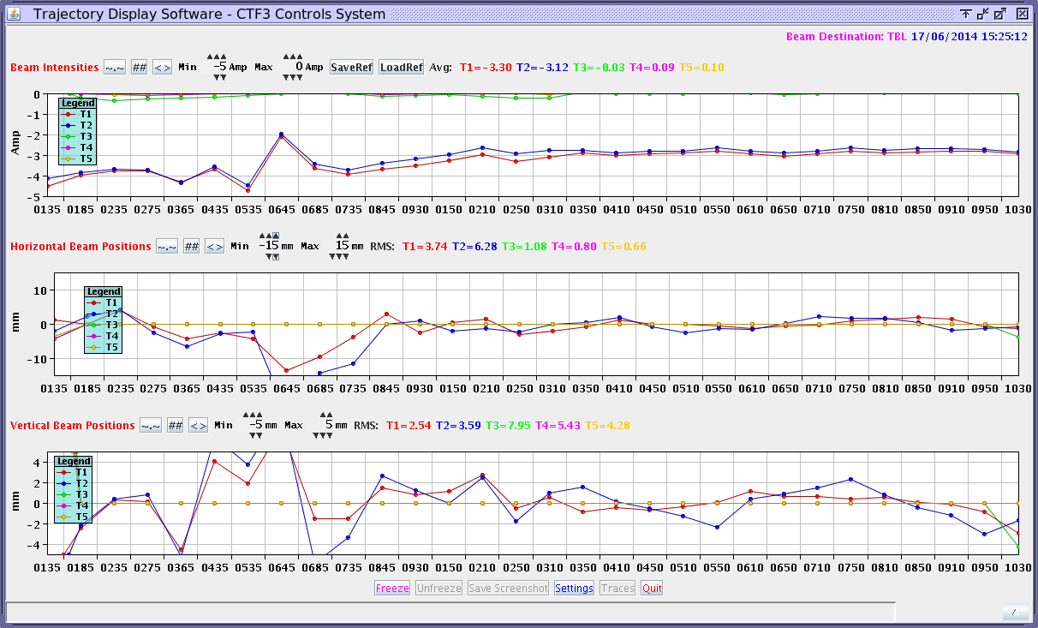
Example Transmission/Orbits

Slide 8
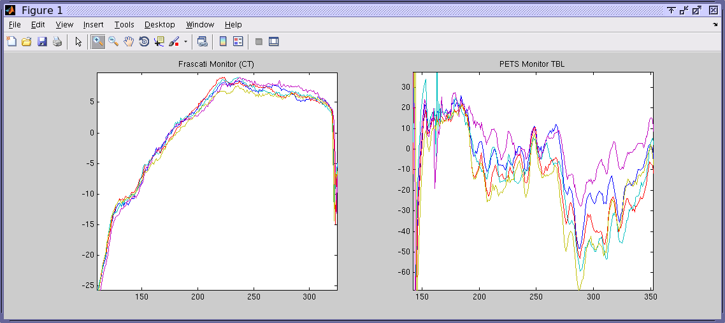
Struggles with stability of transfer to TBL

Slide 9
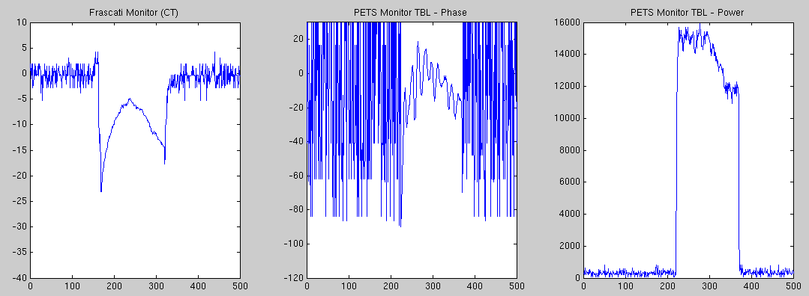
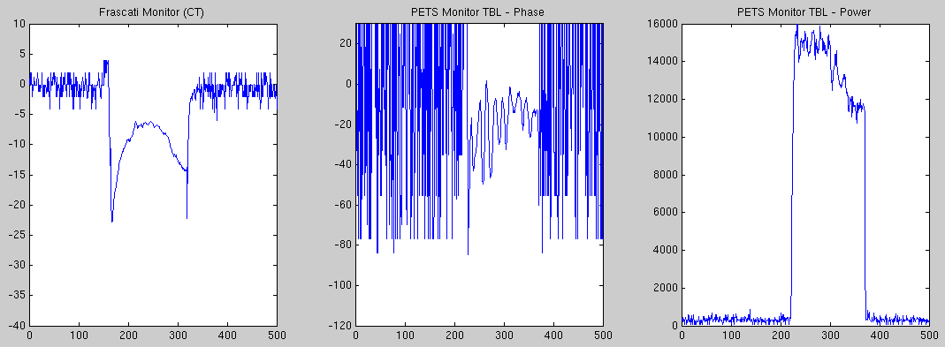
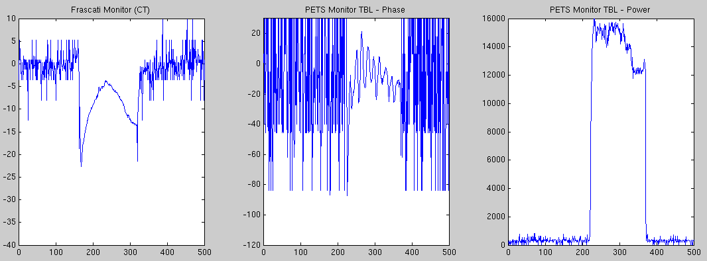
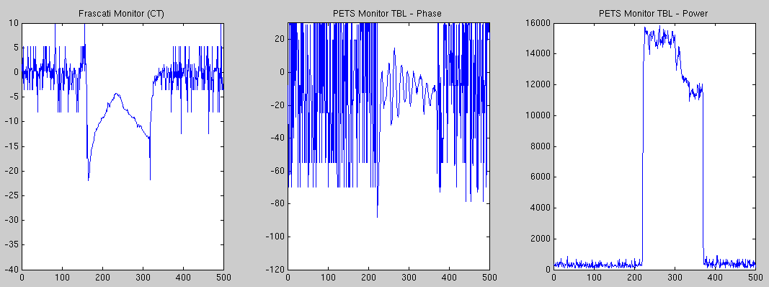
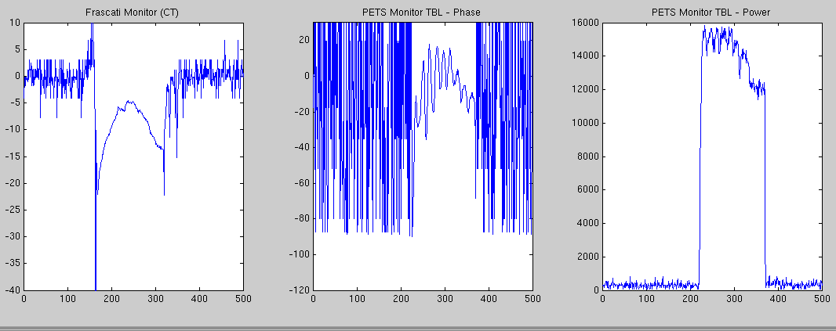
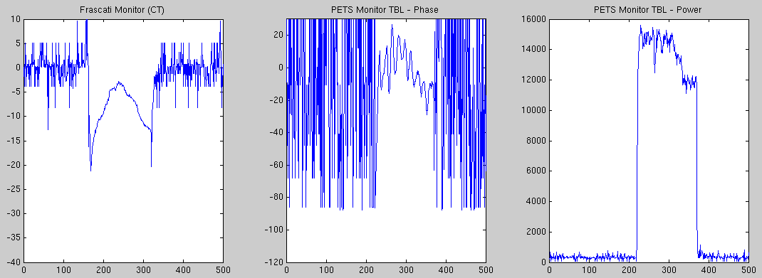
Eventually a bit more stable…

Slide 10
Slow Feedback Tests
Using magnetic correctors installed around the feedforward kickers to prevent slow phase drifts.
Used chicane in the linac to shift the phase of the machine.

Slide 11
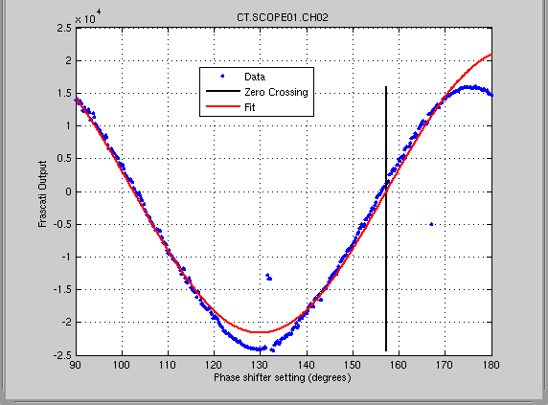
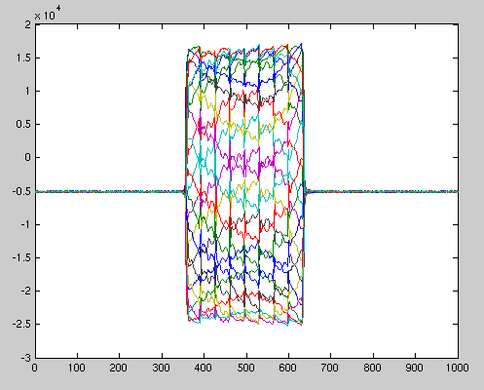
Calibrate Frascati Monitor
Now have digital phase shifter installed so we can do automated calibrations.
Noise from new electronics set up now removed and everything works as expected.
OLD PLOT – FIT IS WRONG!

Slide 12
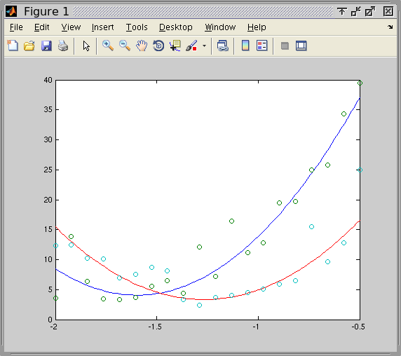
Calculate Ratio of Corrector Strengths For Orbit Closure
Ratio ~1.4
Model ~0.8

Slide 13
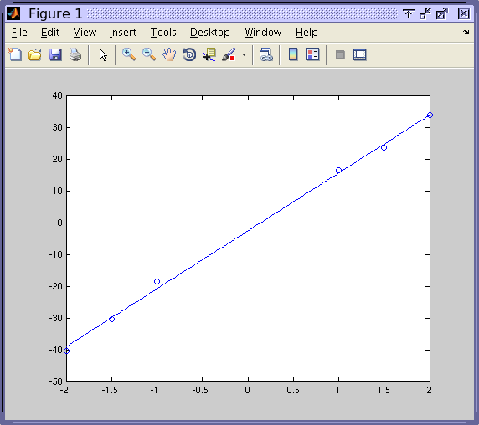
Calculate Phase shift/amp
Phase shift / amp applied to 465:
18.2 degrees / amp (model ~15 with ratio 1.4)

Slide 14
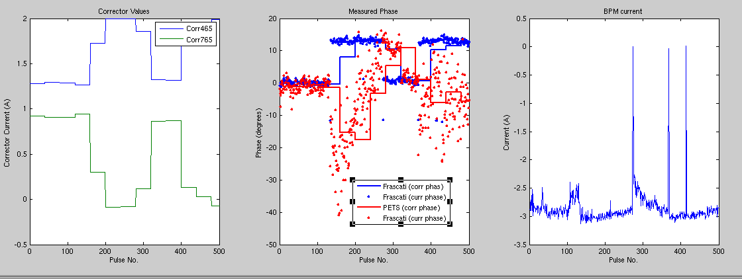
Slow Correction Attempts
CORRECT USING FRASCATI MEASUREMENT

Slide 15
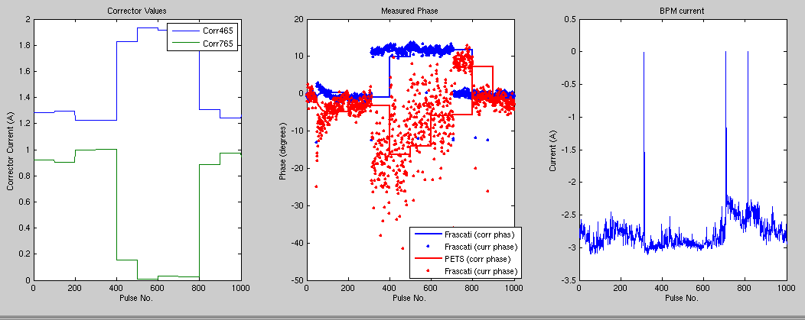
Slow Correction Attempts

Slide 16
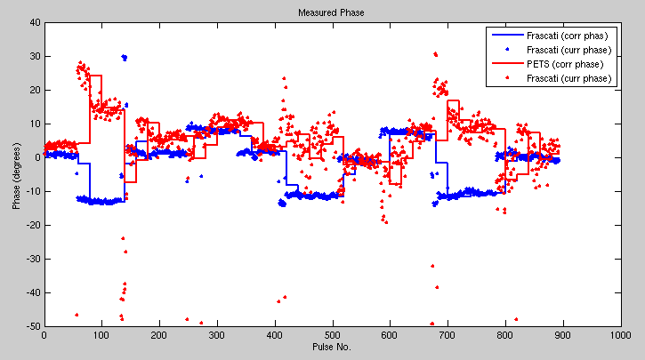
Slow Correction Attempts

Slide 17
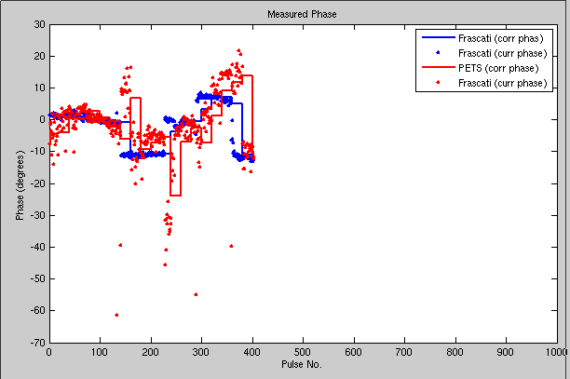
Slow Correction Attempts

Slide 18
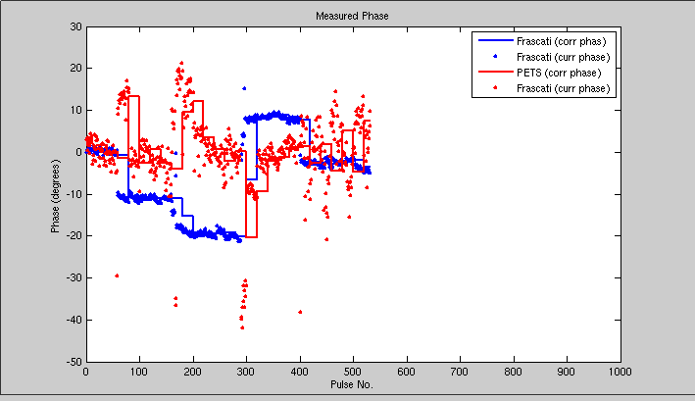
Slow Correction Attempts
CORRECT BASED ON PETS MEASUREMENT

Slide 19
Tests with Amplifier
Thanks Colin!
Installed amplifier in rack in gallery Thursday evening, powered it and viewed outputs without kicker cables connected.
Friday: connected kicker cables, power kickers, attempted to view response to kick in BPMs.
Few tentative latency measurements.

Slide 20
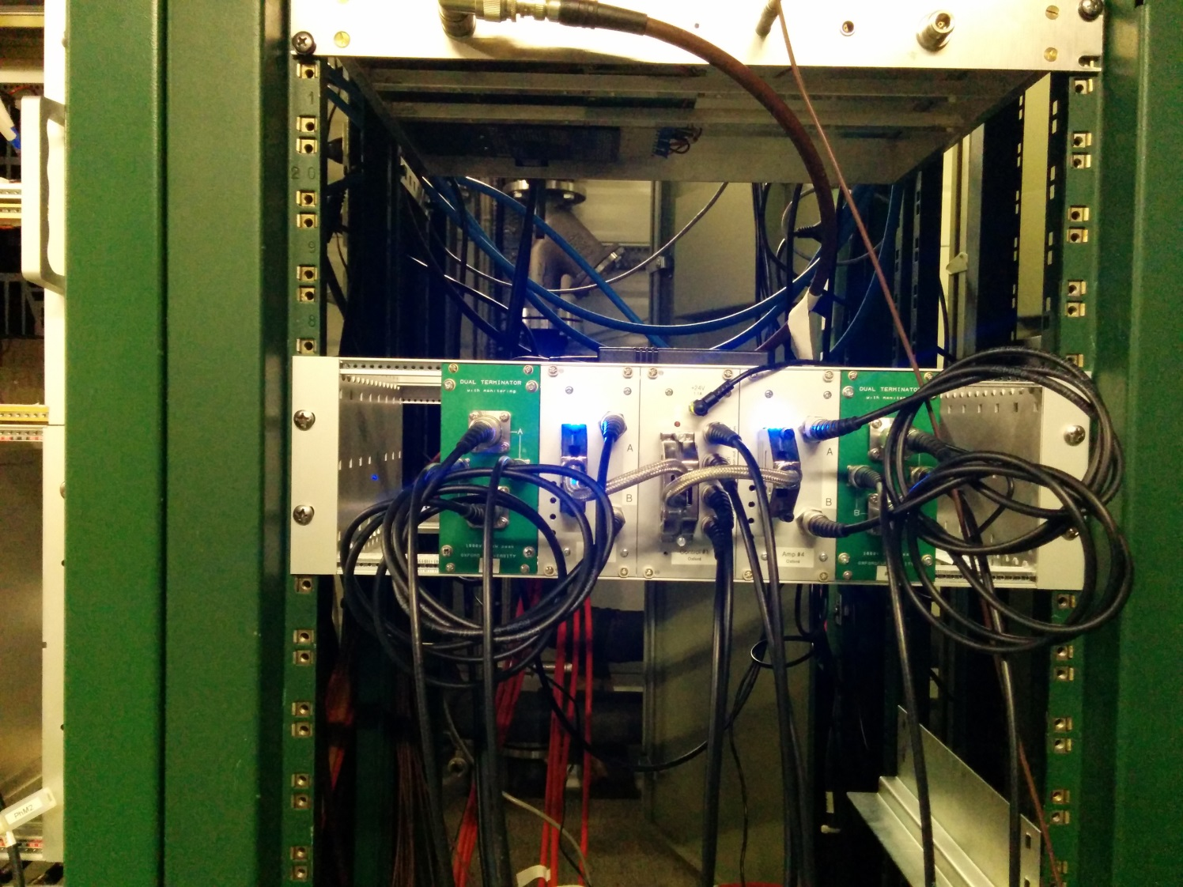
Amplifier Installed in Gallery

Slide 21
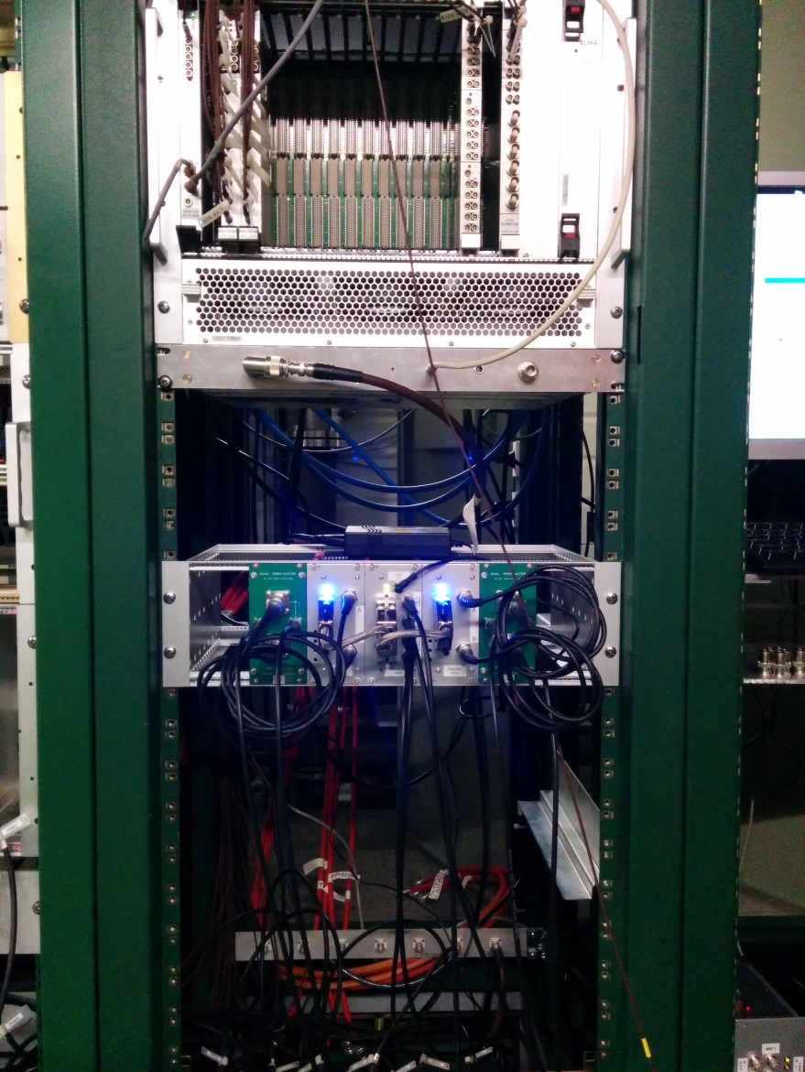
Amplifier Installed in Gallery

Slide 22
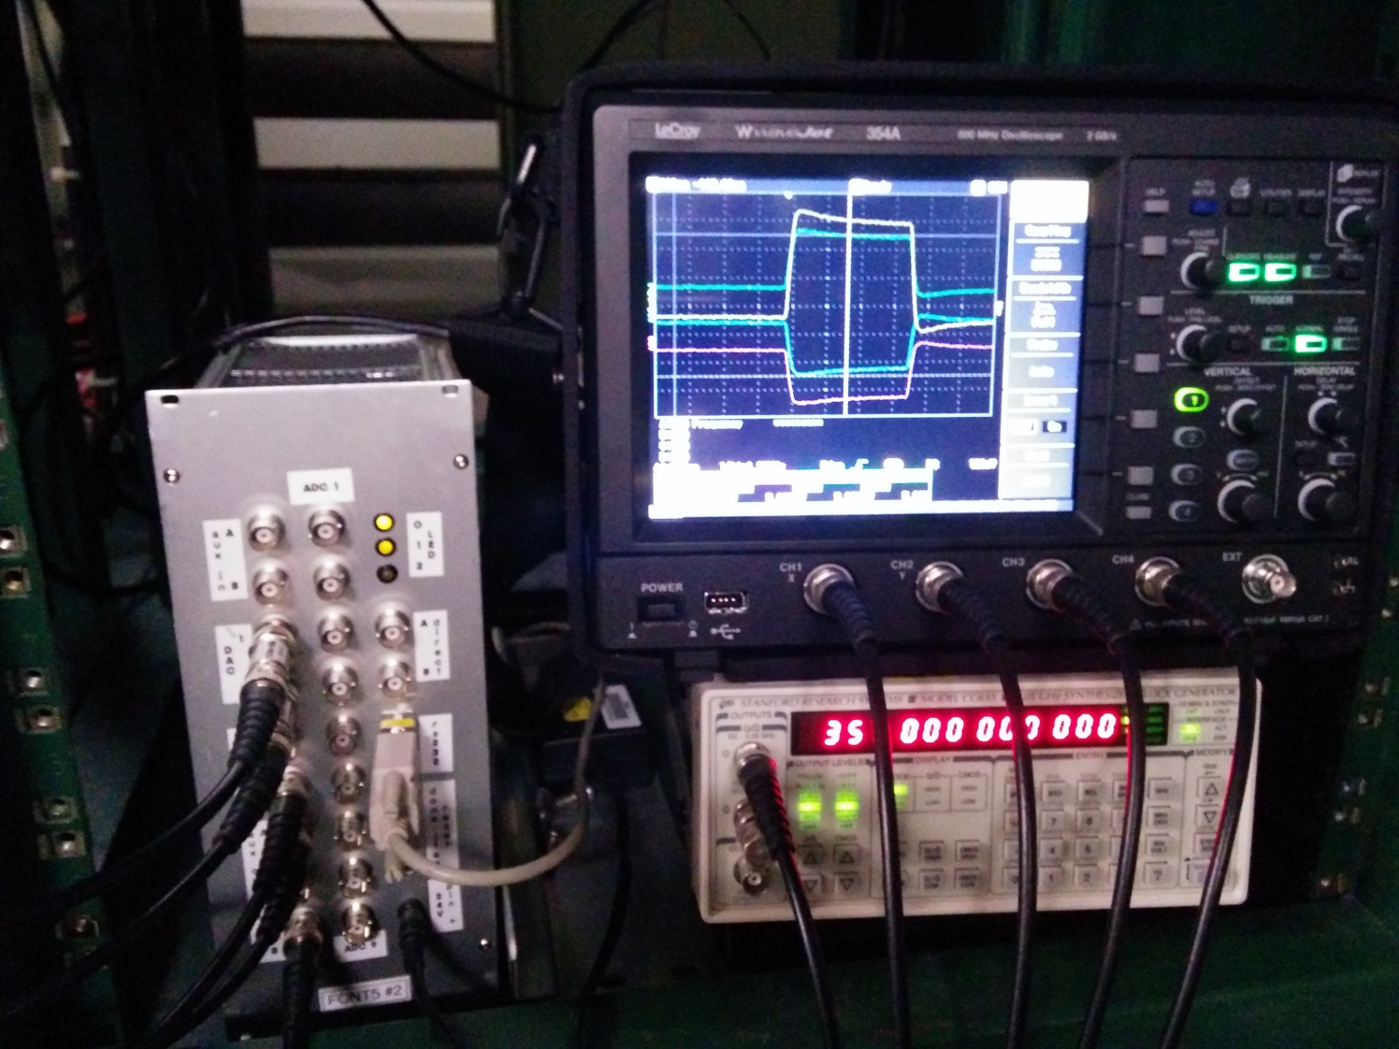
Amplifier Installed in Gallery

Slide 23
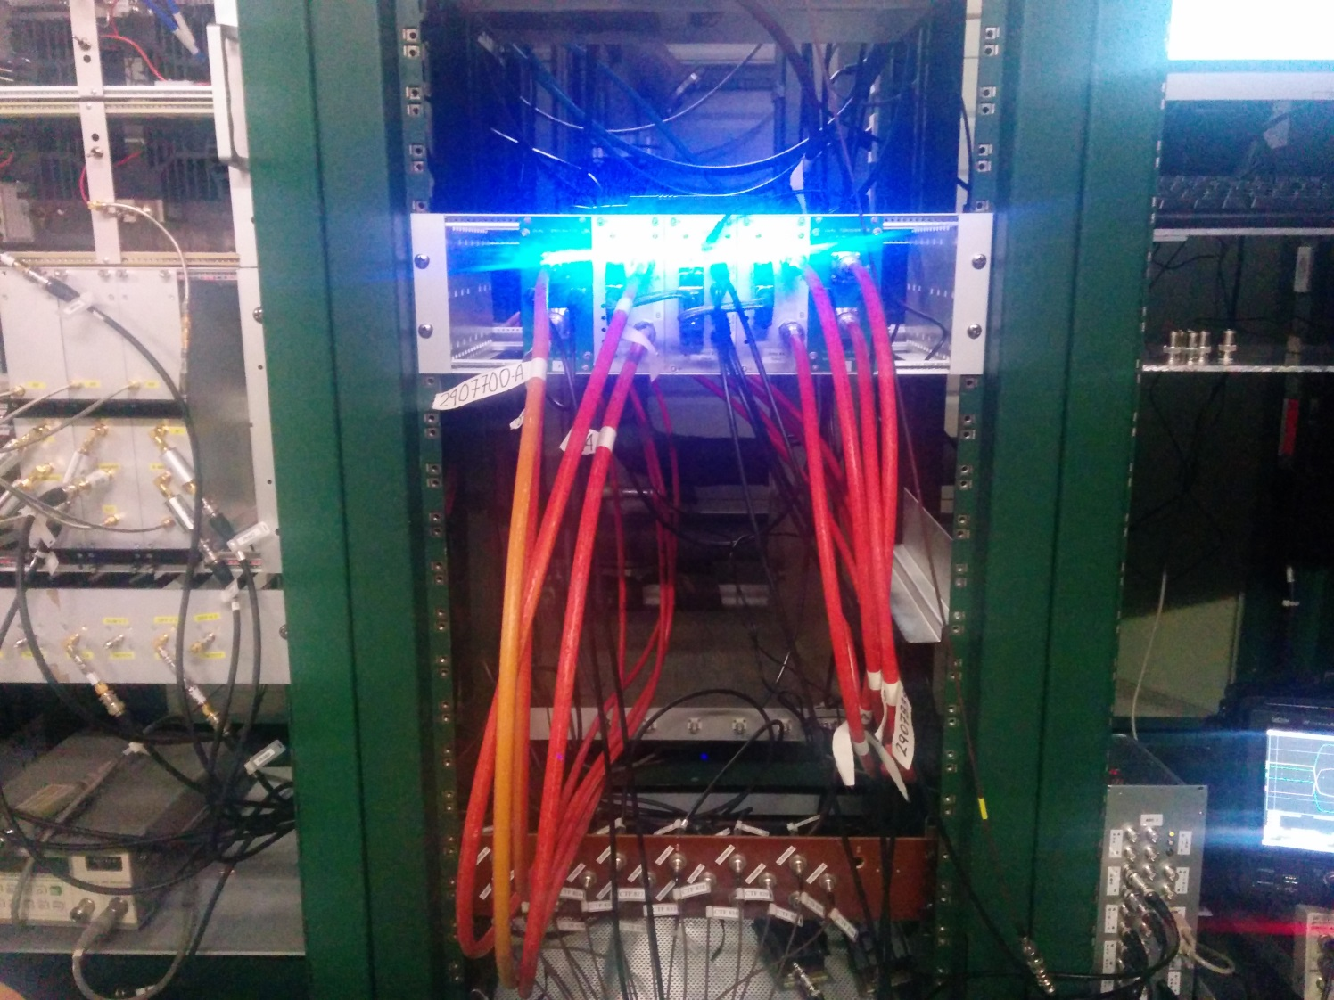
Kicker cables connected to amplifier

Slide 24
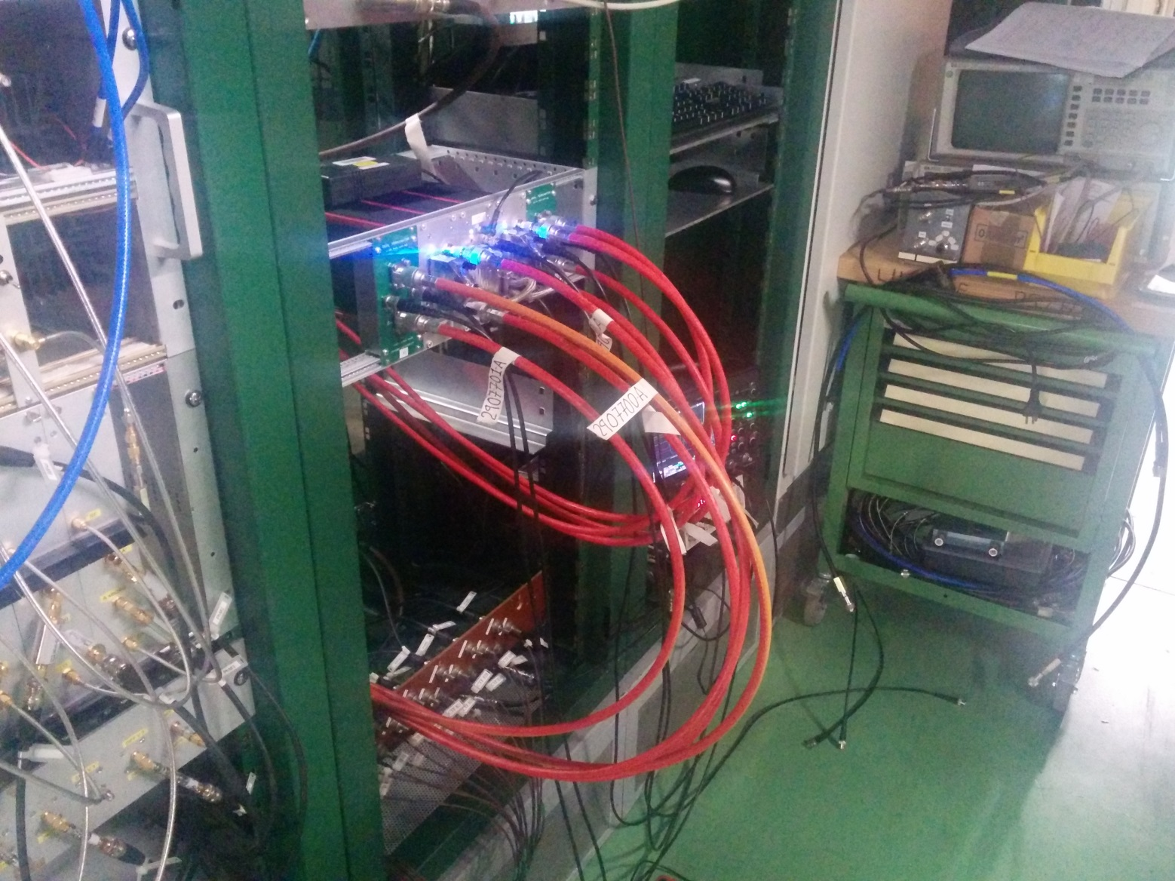
Kicker cables connected to amplifier

Slide 25
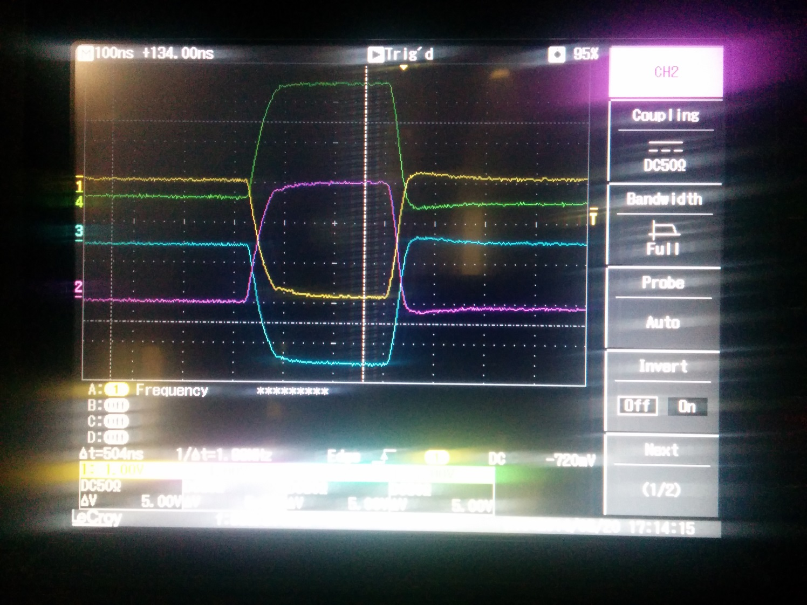
Kicker cables attached to amplifier

Slide 26
Attempts to view effect of kick
With different DAC outputs sent to kickers, attempted to view response to a kick in the BPMs.
Really struggled to see anything initially.
Changed optics slightly to try to amplify kick with quads.
Eventually did observe something, possibly we were powering the opposite kicker to what we thought.

Slide 27
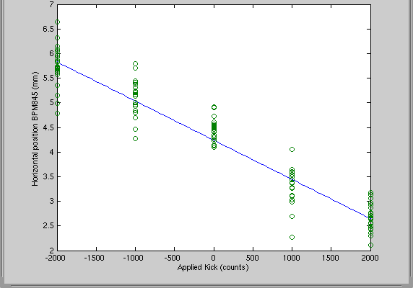
Response to Kick in BPM
Both kickers powered at max output (to kick in same direction), BPM first one after the chicane.

Slide 28
Initial Latency Measurements
Glenn had an initial look at the latency.
When the kickers are not powered we observe pick up from the beam – identify samples corresponding to beam pulse.
Power kickers and observe which samples pulse from amplifier occupies:
We might be a few clock cycles (~10 ns) too late.

Slide 29
Summary
Need to decide what the best solution for the kicker cables/connectors is.
Took a long time to set up the machine and stability in TBL wasn’t great.
Initial slow feedback results are very preliminary but quite promising.
We did manage to observe the beam being kicked by the kickers, but was difficult and cables might have been swapped somewhere.
Latency looks tight.

