Slide 1


Development of a Low-latency, High-precision, Intra-train Beam Feedback System Based on Cavity Beam Position Monitors
N. Blaskovic Kraljevic, D. R. Bett, P. N. Burrows, G. B. Christian, M. R. Davis, Y. I. Kim, C. Perry
John Adams Institute, University of Oxford, UK

Slide 2
Outline
Introduction
Feedback at a linear collider
International Linear Collider
Feedback on Nanosecond Timescales
Experimental setup at Accelerator Test Facility
Cavity beam position monitor signals
Modes of feedback operation
Results
Neven Blaskovic Kraljevic 2

Slide 3
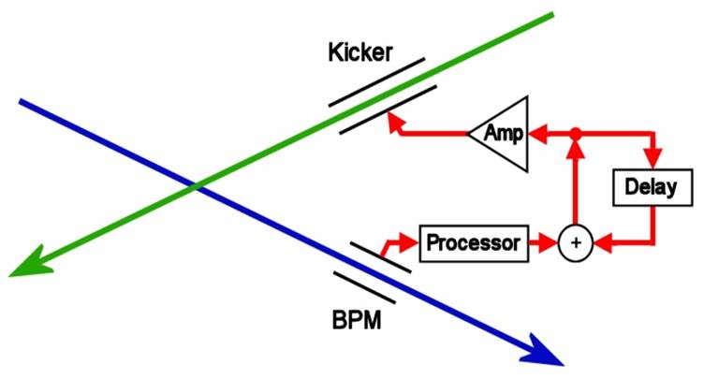
Introduction
Feedback at a Linear Collider
Successful collision of bunches at a linear collider is critical
A fast position feedback system is required
Misaligned beams at interaction point (IP) cause beam-beam deflection
Neven Blaskovic Kraljevic 3

Slide 4
Introduction
Feedback at a Linear Collider
Successful collision of bunches at a linear collider is critical
A fast position feedback system is required
Misaligned beams at interaction point (IP) cause beam-beam deflection
Measure deflection on one of outgoing beams
(beam position monitor)
Neven Blaskovic Kraljevic 4

Slide 5
Introduction
Feedback at a Linear Collider
Successful collision of bunches at a linear collider is critical
A fast position feedback system is required
Misaligned beams at interaction point (IP) cause beam-beam deflection
Measure deflection on one of outgoing beams
Correct orbit of next bunch (correlated to previous bunch due to short bunch spacing)
(beam position monitor)
Neven Blaskovic Kraljevic 5

Slide 6
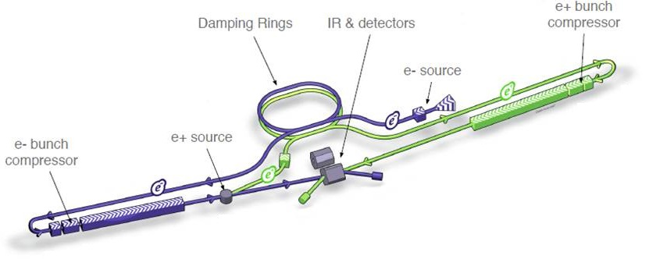
Introduction
International Linear Collider (ILC)
Proposed linear electron-positron collider
Centre-of-mass energy: 250-1000 GeV
Vertical beamsize: 5.9 nm
Bunch separation: 554 ns
(ILC Technical Design Report)
Neven Blaskovic Kraljevic 6

Slide 7
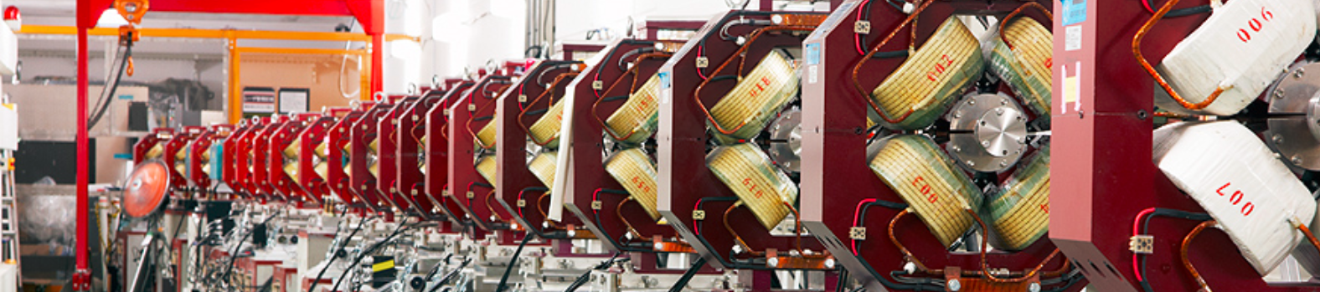
Introduction
Accelerator Test Facility (ATF) at KEK
Test bed for the International Linear Collider
Facility located at KEK in Tsukuba, Japan
Goals:
37 nm vertical spot size at final focus
Nanometre level vertical beam stability
Neven Blaskovic Kraljevic 7

Slide 8
Introduction
Accelerator Test Facility (ATF) at KEK
Electron source
90 meters
Neven Blaskovic Kraljevic 8

Slide 9
Introduction
Accelerator Test Facility (ATF) at KEK
Electron source
1.28 GeV linear accelerator
90 meters
Neven Blaskovic Kraljevic 9

Slide 10
Introduction
Accelerator Test Facility (ATF) at KEK
Damping ring
Electron source
1.28 GeV linear accelerator
90 meters
Neven Blaskovic Kraljevic 10

Slide 11
Introduction
Accelerator Test Facility (ATF) at KEK
Final focus
Extraction line
Model interaction point (IP) of a collider
Damping ring
Electron source
1.28 GeV linear accelerator
90 meters
Neven Blaskovic Kraljevic 11

Slide 12
Introduction
Accelerator Test Facility (ATF) at KEK
Feedback system
Final focus
Extraction line
Model interaction point (IP) of a collider
Damping ring
Electron source
1.28 GeV linear accelerator
90 meters
Neven Blaskovic Kraljevic 12

Slide 13
Introduction
Accelerator Test Facility (ATF) at KEK
ATF can be operated with 2-bunch trains in the extraction line and final focus
The separation of the bunches is ILC-like (tuneable up to ~300 ns)
Our prototype feedback system:
Measures the position of the first bunch
Then corrects the path of the second bunch
Train extraction frequency: ~3 Hz
Neven Blaskovic Kraljevic 13

Slide 14
Introduction
Feedback on Nanosecond Timescales (FONT)
Low-latency, high-precision feedback system
We have previously demonstrated a system meeting ILC latency, BPM resolution and beam kick requirements
We have extended the system for use at ATF
We aim for nanometre level beam stabilisation
Neven Blaskovic Kraljevic 14

Slide 15
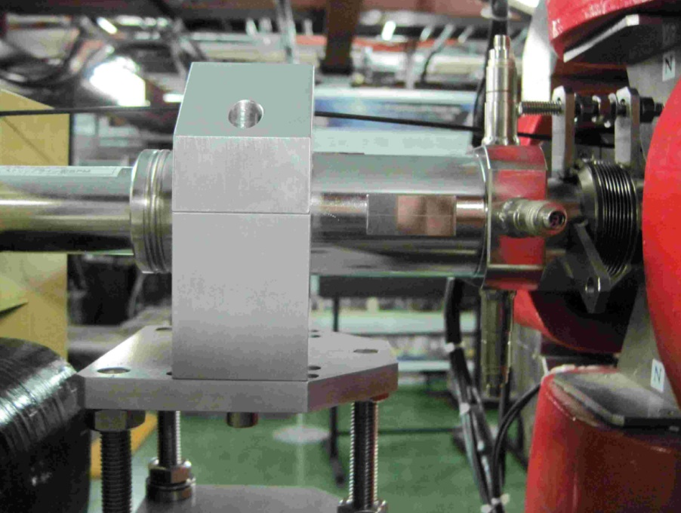
Experimental Setup
beam
P3
P2
P
Stripline BPM
12 cm long strips
12 mm radius
On x and y mover system
Neven Blaskovic Kraljevic 15

Slide 16
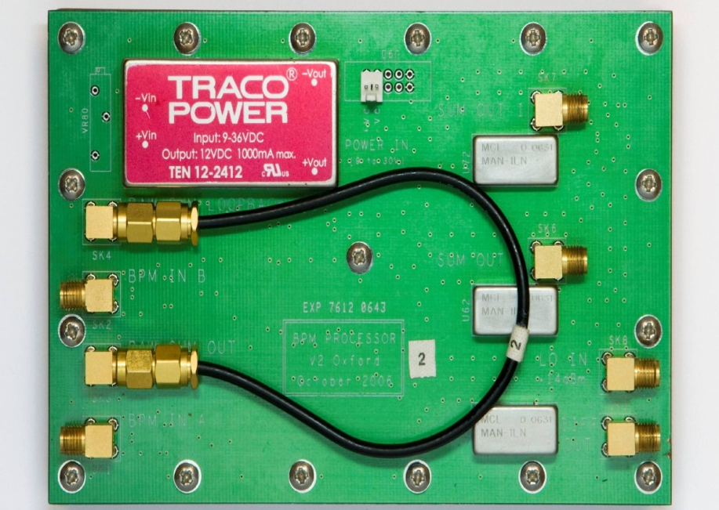
Experimental Setup
beam
P3
P2
Processor
for stripline BPM
Σ
Processor
Processor
BPM bottom
BPM top
Δ
Analogue: latency 13 ns
Resolution of 330 nm
Details in poster TUPME009
Neven Blaskovic Kraljevic 16

Slide 17
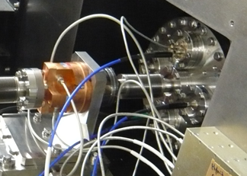
Experimental Setup
IPB
P3
P2
IPB
Cavity BPM at beam waist
Processor
Processor
C-band: 6.4 GHz in y
Low Q: decay time < 30 ns
Resolve 2-bunch trains
Neven Blaskovic Kraljevic 17

Slide 18
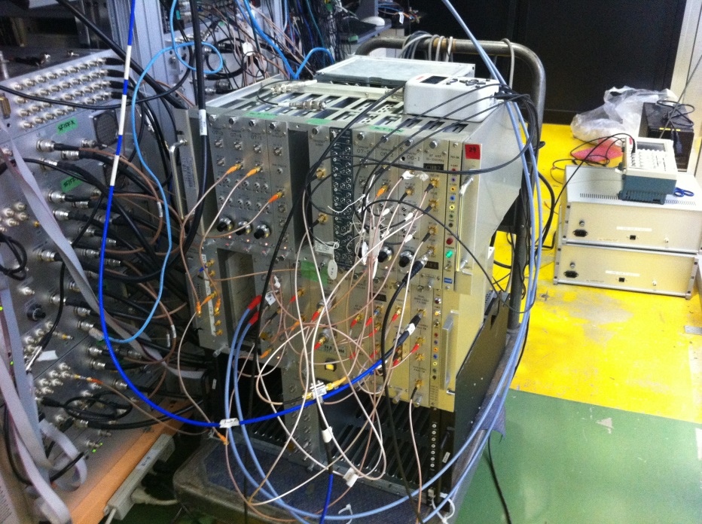
Experimental Setup
IPB
P3
P2
Processor
for cavity BPM
Processor
Processor
Processor
Analogue, 2-stage downmixer
Resolution of < 100 nm
Developed by Honda et al.
Neven Blaskovic Kraljevic 18

Slide 19
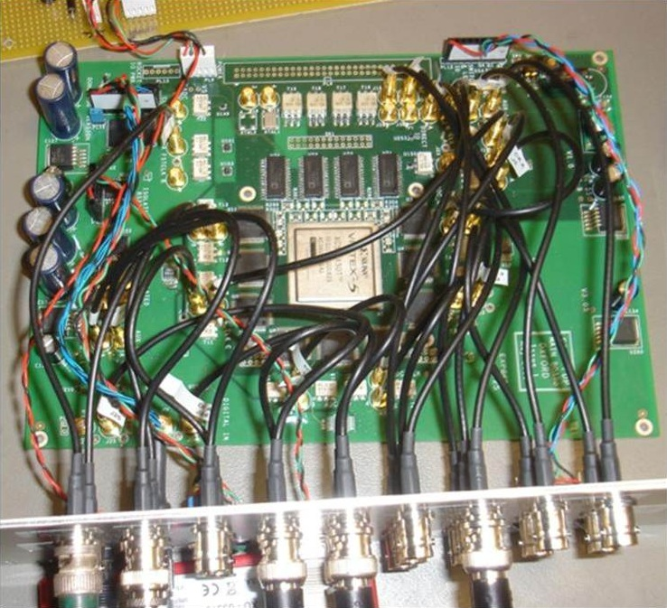
Experimental Setup
IPB
P3
P2
Board
Processor
Processor
Processor
Board
Board
9 ADC channels at 357 MHz
2 DAC channels at 179 MHz
Xilinx Virtex 5 FPGA
Neven Blaskovic Kraljevic 19

Slide 20
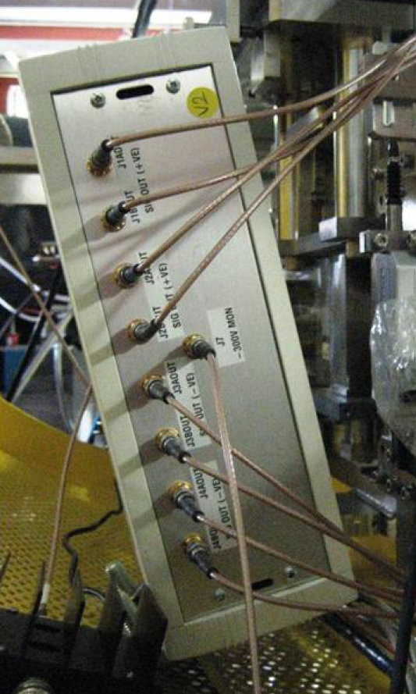
Experimental Setup
IPB
P3
P2
Amplifier
Processor
Amplifier
Processor
Processor
Amplifier
Amplifier
Board
Board
Made by TMD Technologies
± 30 A drive current
35 ns rise time (90 % of peak)
Neven Blaskovic Kraljevic 20

Slide 21
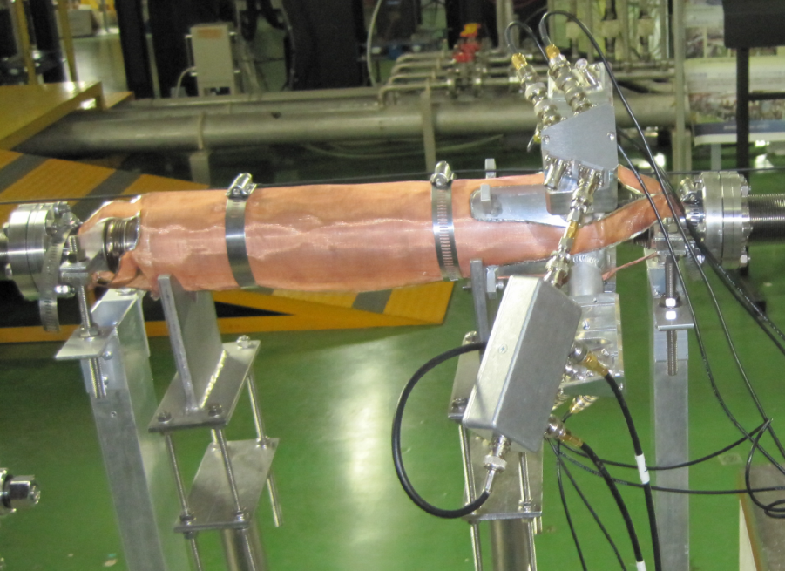
Experimental Setup
IPB
IPK
P3
P2
K2
K1
K
Kicker
Processor
Amplifier
Processor
Processor
Amplifier
Amplifier
Board
Board
Vertical stripline kicker
30 cm long strips for K1 & K2
12.5 cm long strips for IPK
Local upstream feedback results presented in poster TUPME009
Neven Blaskovic Kraljevic 21

Slide 22
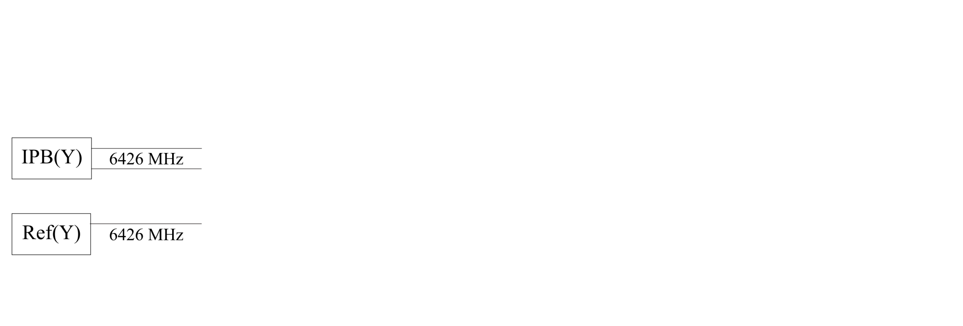
Cavity BPM Signal Processing
IPB cavity
Dipole mode frequency (in y)
~6426 MHz
Reference cavity
Monopole mode frequency (in y)
~6426 MHz
Neven Blaskovic Kraljevic 22

Slide 23
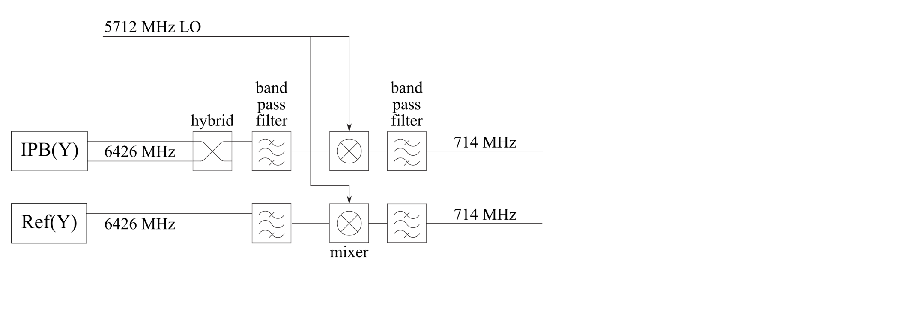
Cavity BPM Signal Processing
simplified schematic
The IPB and reference cavity signals are downmixed using a common, external 5712 MHz local oscillator (LO)
Neven Blaskovic Kraljevic 23

Slide 24
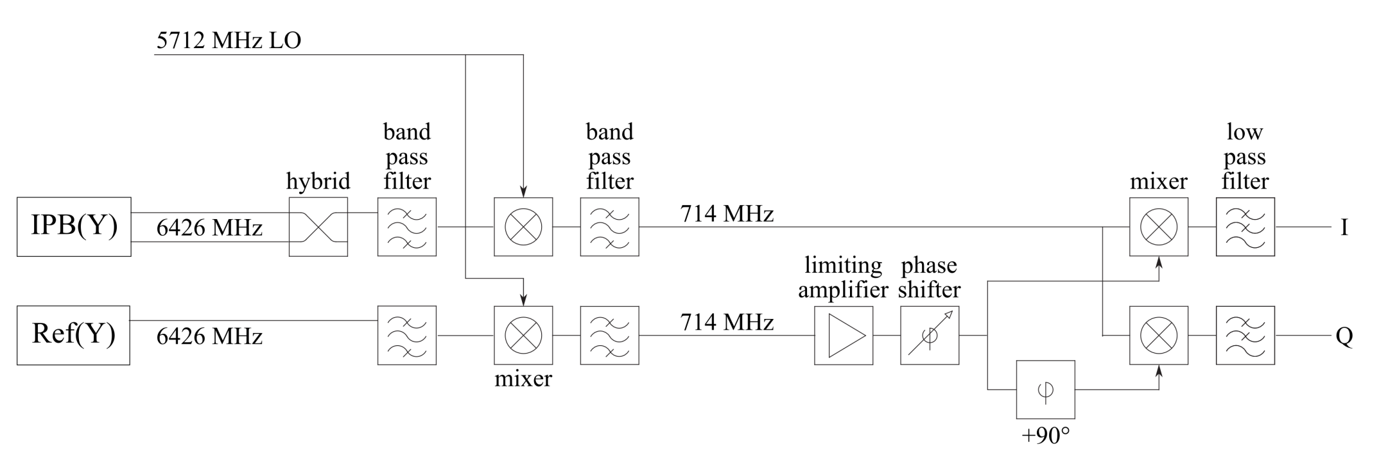
Cavity BPM Signal Processing
simplified schematic
The IPB signal is downmixed using the reference cavity signal as LO
The I and Q output signals at baseband are used to obtain the beam position
Neven Blaskovic Kraljevic 24

Slide 25
Feedforward
IPB
IPK
P3
P2
K2
K1
Use position at P2 & P3 to correct position at IPB
Correction calculated locally, then sent along 60 meters of cable
Latency: 202 ns
Effect measured at IPB
Processor
Amplifier
Processor
Processor
Amplifier
Amplifier
Board
Board
Neven Blaskovic Kraljevic 25

Slide 26
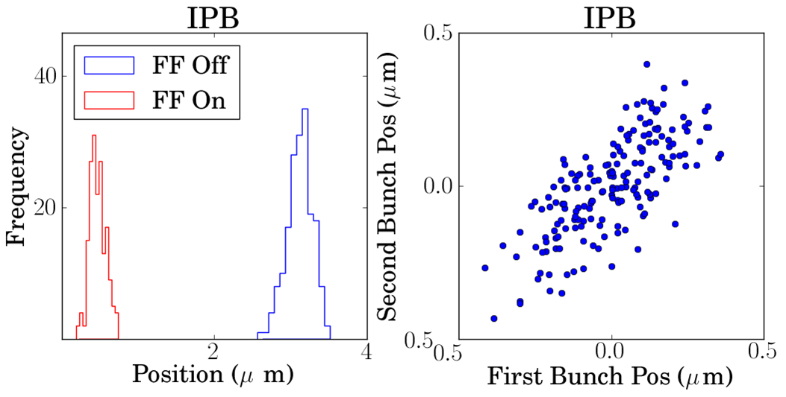
Feedforward
FF Off Jitter: 160 ± 10 nm
FF On Jitter: 106 ± 10 nm
FF Off Correlation: 73 %
Neven Blaskovic Kraljevic 26

Slide 27
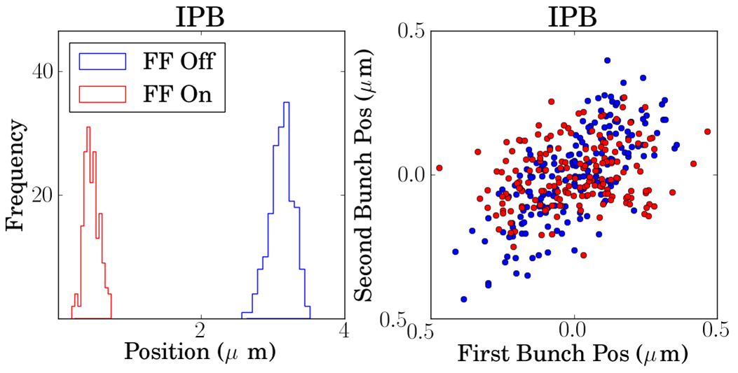
Feedforward
FF Off Jitter: 160 ± 10 nm
FF On Jitter: 106 ± 10 nm
FF Off Correlation: 73 %
FF On Correlation: 23 %
Neven Blaskovic Kraljevic 27

Slide 28
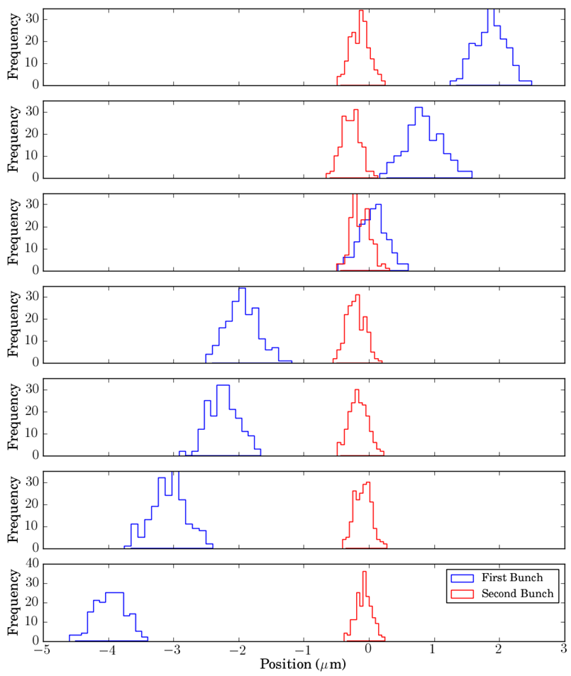
Feedforward
first bunch uncorrected
6 μm incoming beam position scan
second bunch corrected
Neven Blaskovic Kraljevic 28

Slide 29
Interaction Point Feedback
IPB
IPK
P3
P2
K2
K1
IPB position is used to drive the local kicker IPK
Latency: 212 ns
Effect measured at IPB
Processor
Amplifier
Processor
Processor
Amplifier
Amplifier
Board
Board
Neven Blaskovic Kraljevic 29

Slide 30
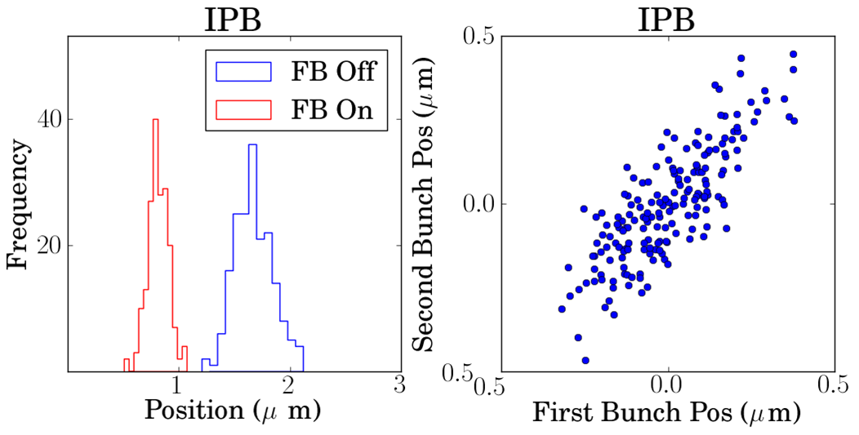
Interaction Point Feedback
FB Off Jitter: 168 ± 7 nm
FB On Jitter: 98 ± 5 nm
FB Off Correlation: 81 %
Neven Blaskovic Kraljevic 30

Slide 31
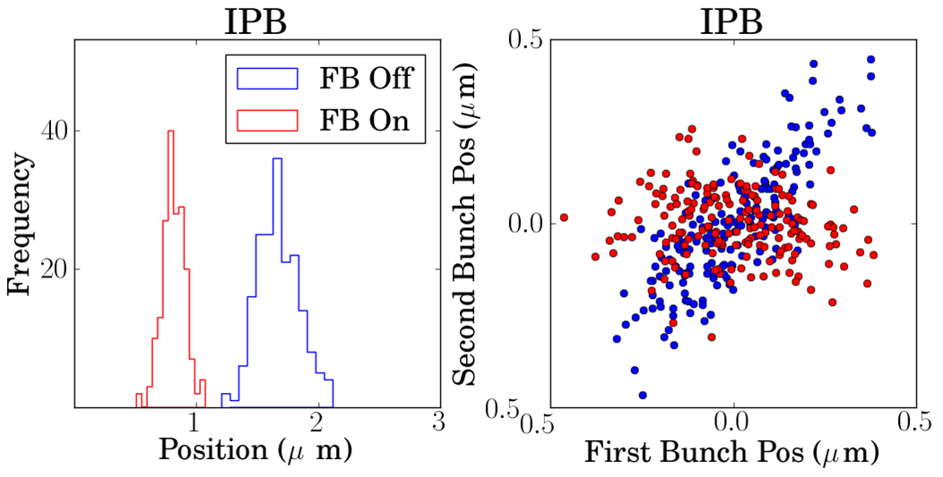
Interaction Point Feedback
FB Off Jitter: 168 ± 7 nm
FB On Jitter: 98 ± 5 nm
FB Off Correlation: 81 %
FB On Correlation: -16 %
Neven Blaskovic Kraljevic 31

Slide 32
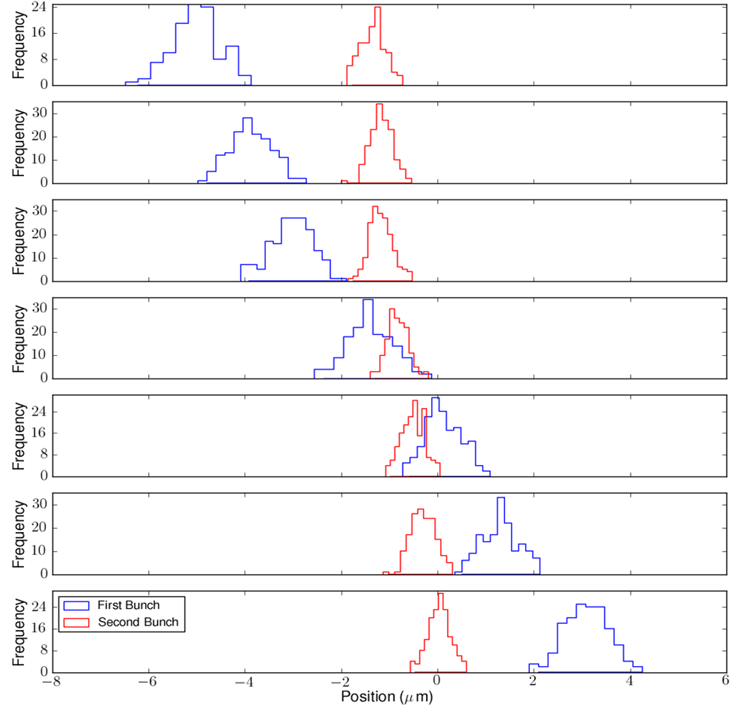
Interaction Point Feedback
first bunch uncorrected
10 μm incoming beam position scan
second bunch corrected
Neven Blaskovic Kraljevic 32

Slide 33
Conclusion
Demonstrated low-latency, high-precision, intra-train feedback systems
Cavity BPM feedback latency: 212 ns
Achieved beam stabilisation at the ATF IP in 2 modes:
Feedforward: ~100 nm
IP feedback: ~100 nm
Neven Blaskovic Kraljevic 33

Slide 34
Thank you for your attention!
We thank the ATF collaboration and the ATF operations team for their support
Neven Blaskovic Kraljevic 34

Slide 35
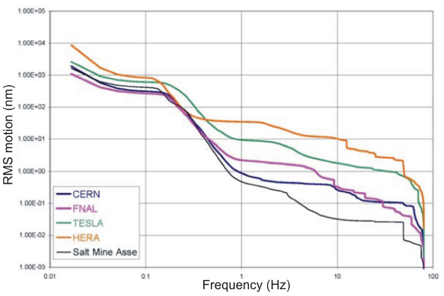
Ground Motion vs. Frequency
Vertical ground motion power spectral density integrated up from a range of cut-off frequencies to give the RMS ground motion as a function of frequency
R. Amirikas et al.
Neven Blaskovic Kraljevic 35

Slide 36
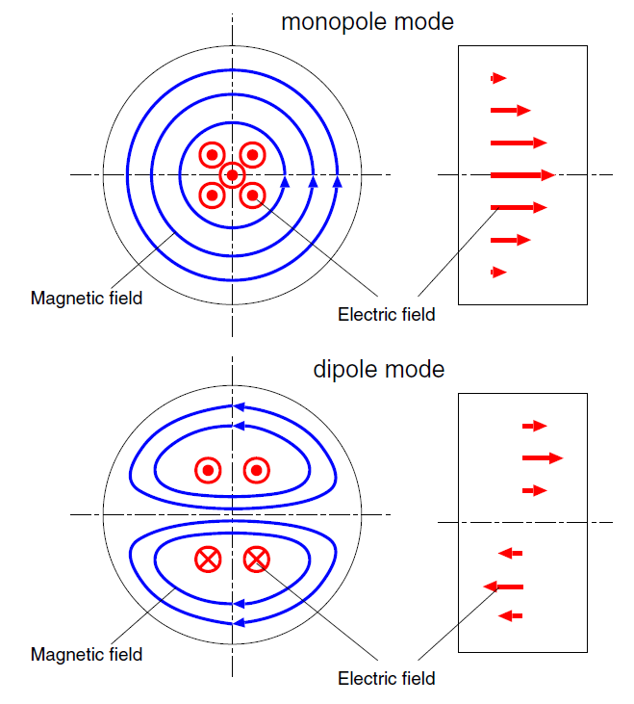
Monopole and Dipole Cavity Modes
Monopole mode
TM_{rφz} = TM₀₁₀
Electric field position independent
Dipole mode
TM_{rφz} = TM₁₁₀
Electric field proportional to position
Y. Inoue et al.
Neven Blaskovic Kraljevic 36

Slide 37
Upstream Feedback
IPB
IPK
P3
P2
K2
K1
Coupled-loop feedback system allows correction of both position & angle
Latency: 134 ns
Effect measured at IPB, located 60 meters downstream from P3
Processor
Amplifier
Processor
Processor
Amplifier
Amplifier
Board
Board
Neven Blaskovic Kraljevic 37

Slide 38
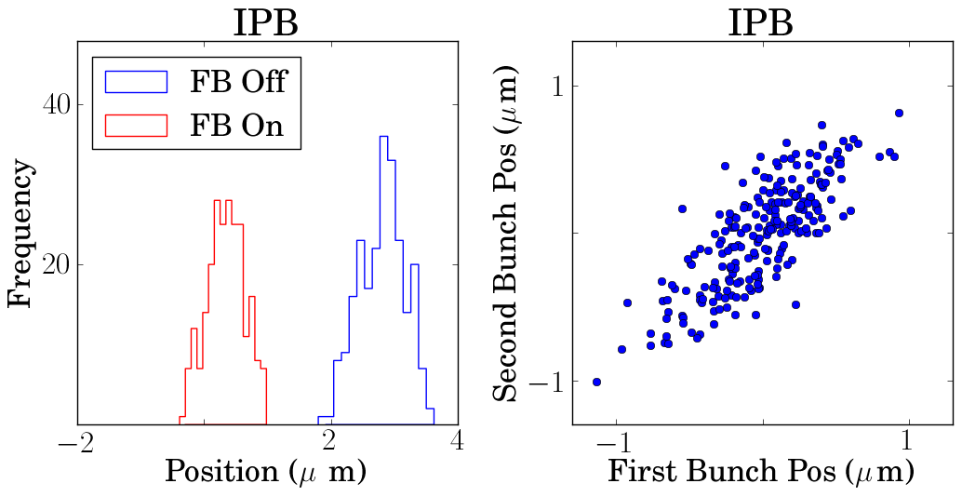
Upstream Feedback
FB Off Jitter: 0.35 ± 0.02 μm
FB On Jitter: 0.30 ± 0.01 μm
FB Off Correlation: 79 %
Neven Blaskovic Kraljevic 38

Slide 39
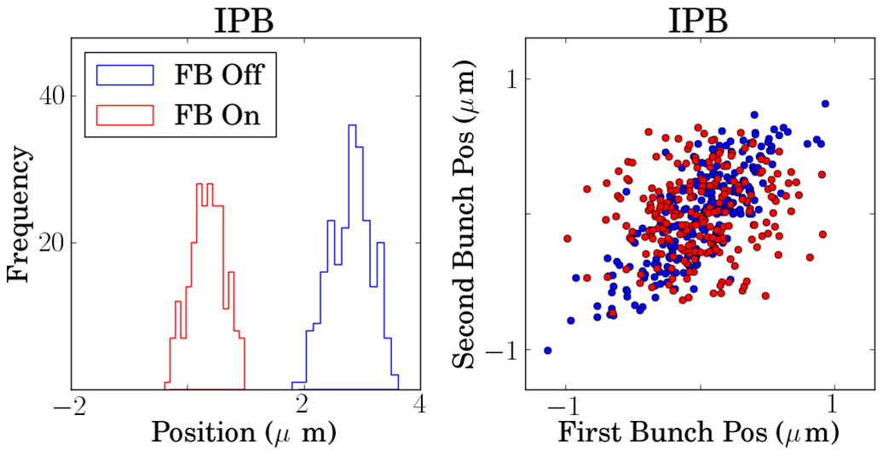
Upstream Feedback
FB Off Jitter: 0.35 ± 0.02 μm
FB On Jitter: 0.30 ± 0.01 μm
FB Off Correlation: 79 %
FB On Correlation: 14 %
Neven Blaskovic Kraljevic 39

Slide 40
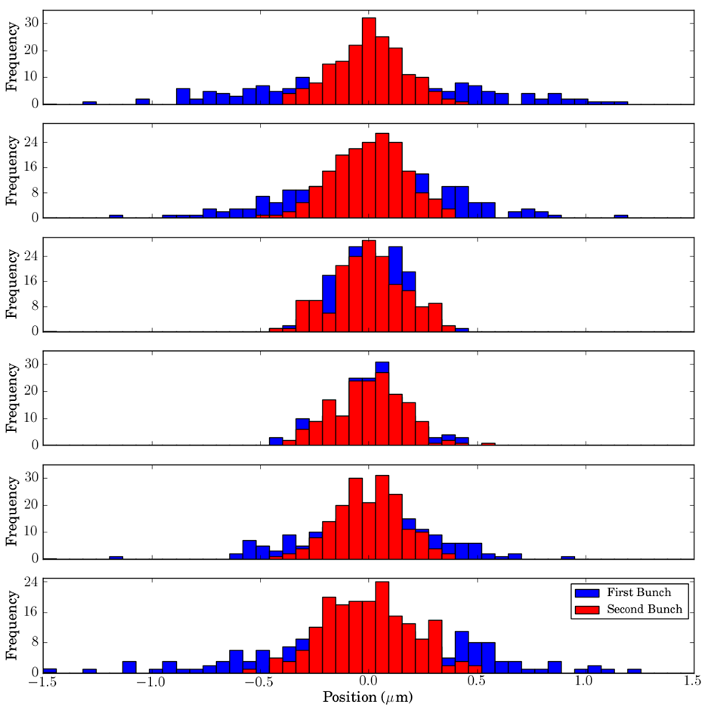
Interaction Point Feedback
first bunch uncorrected
Beam waist scan
second bunch corrected
Neven Blaskovic Kraljevic 40

