Slide 1
Jitter runs with Honda electronics
N. Blaskovic
N. Blaskovic

Slide 2
Contents
Jitter vs. charge
Calibration constant vs. attenuation
Jitter vs. attenuation
Jitter runs at 0 dB
BPM-to-BPM correlation
Bunch-to-bunch correlation
Effect of upstream DR 714 MHz 90° phase shifter on Honda electronics
N. Blaskovic

Slide 3
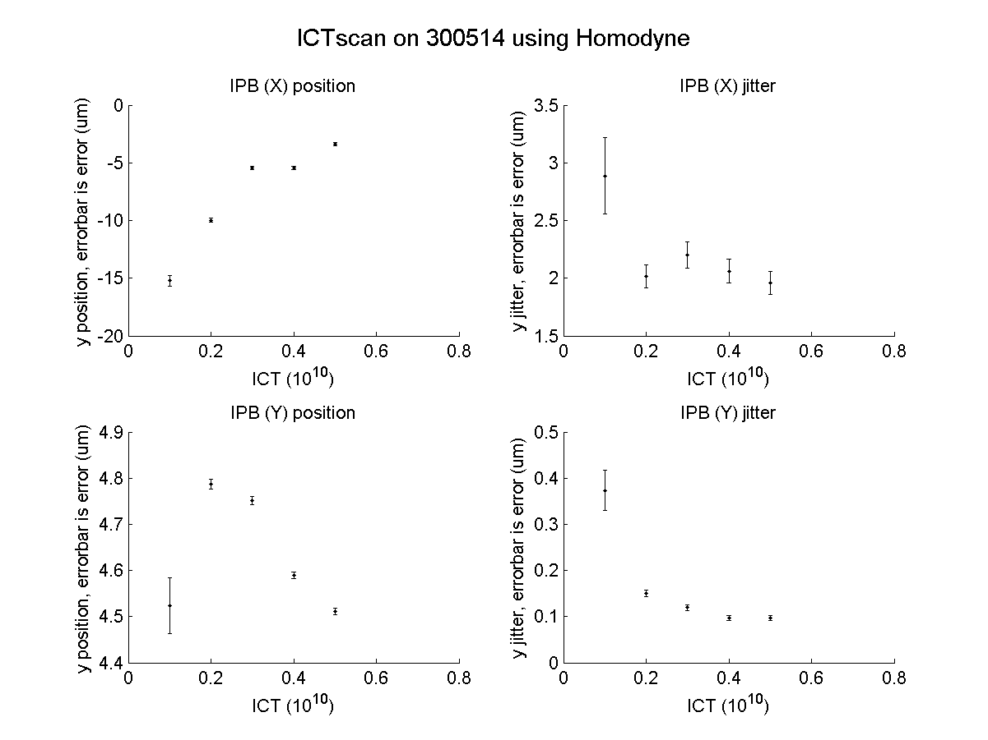
N. Blaskovic

Slide 4
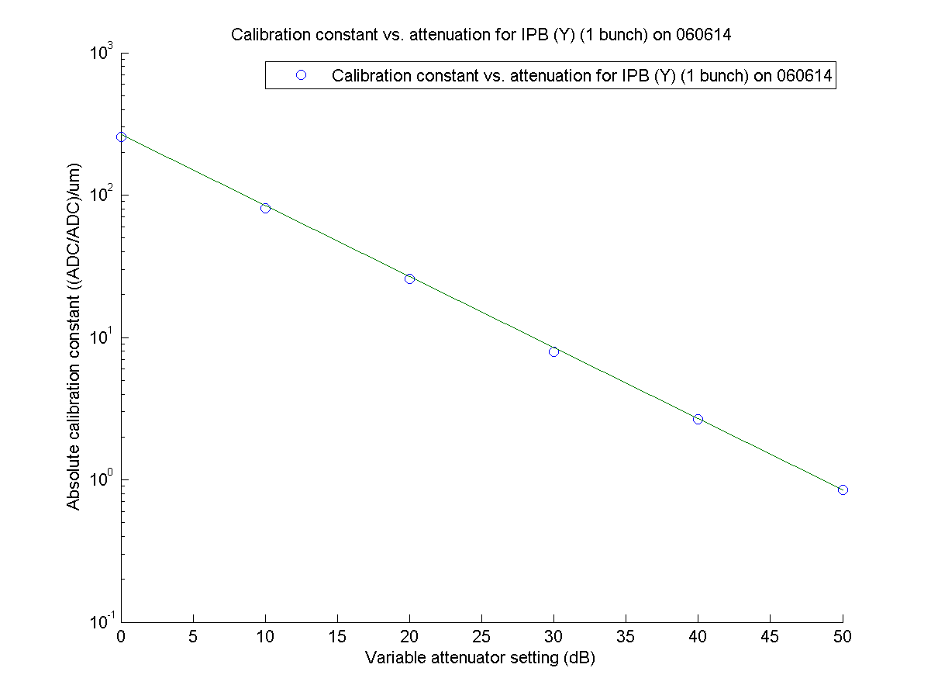
N. Blaskovic

Slide 5
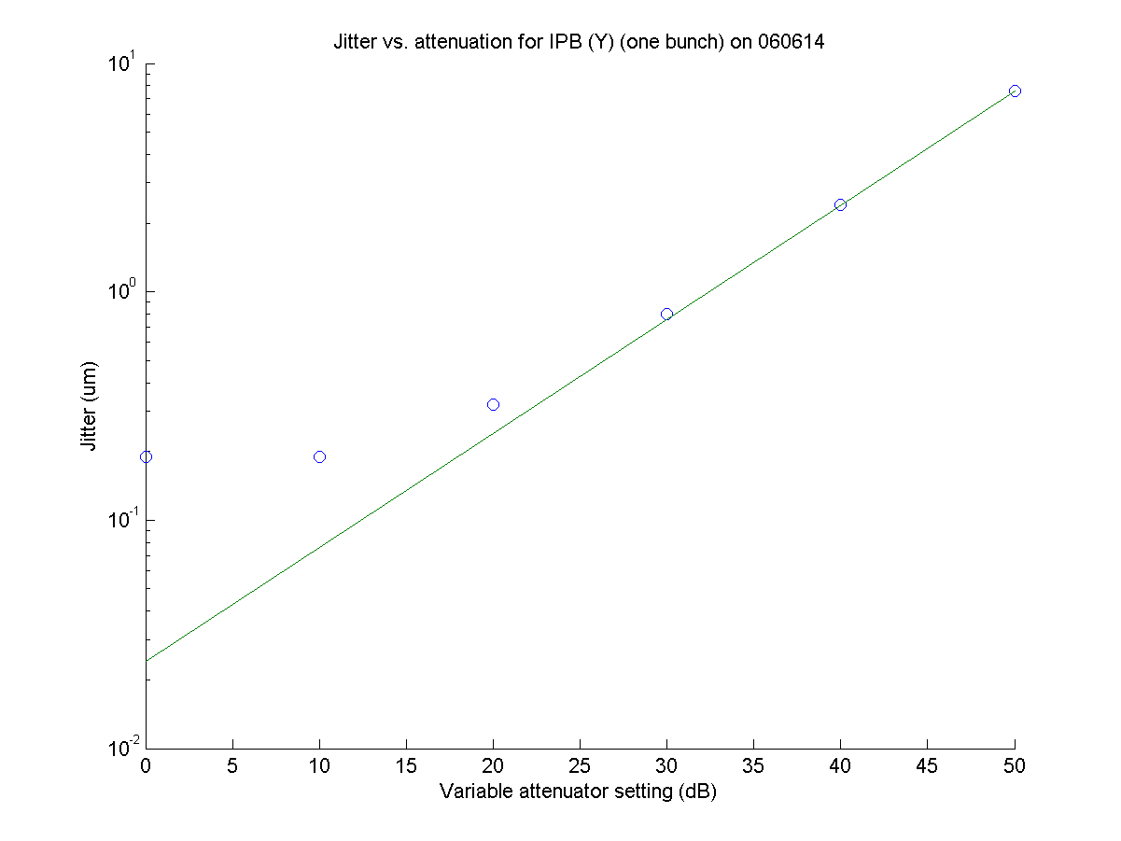
N. Blaskovic

Slide 6
Jitter run
Data taken on 6th June
P2, P3, IPB instrumented in 2-bunch mode
MFB1FF connected but 2nd bunch missing
IPB (y) RF attenuation: 0 dB
Extraction kicker timing not optimised
No offline phase compensation (<0.4 um/°)
No drift subtraction
N. Blaskovic

Slide 7
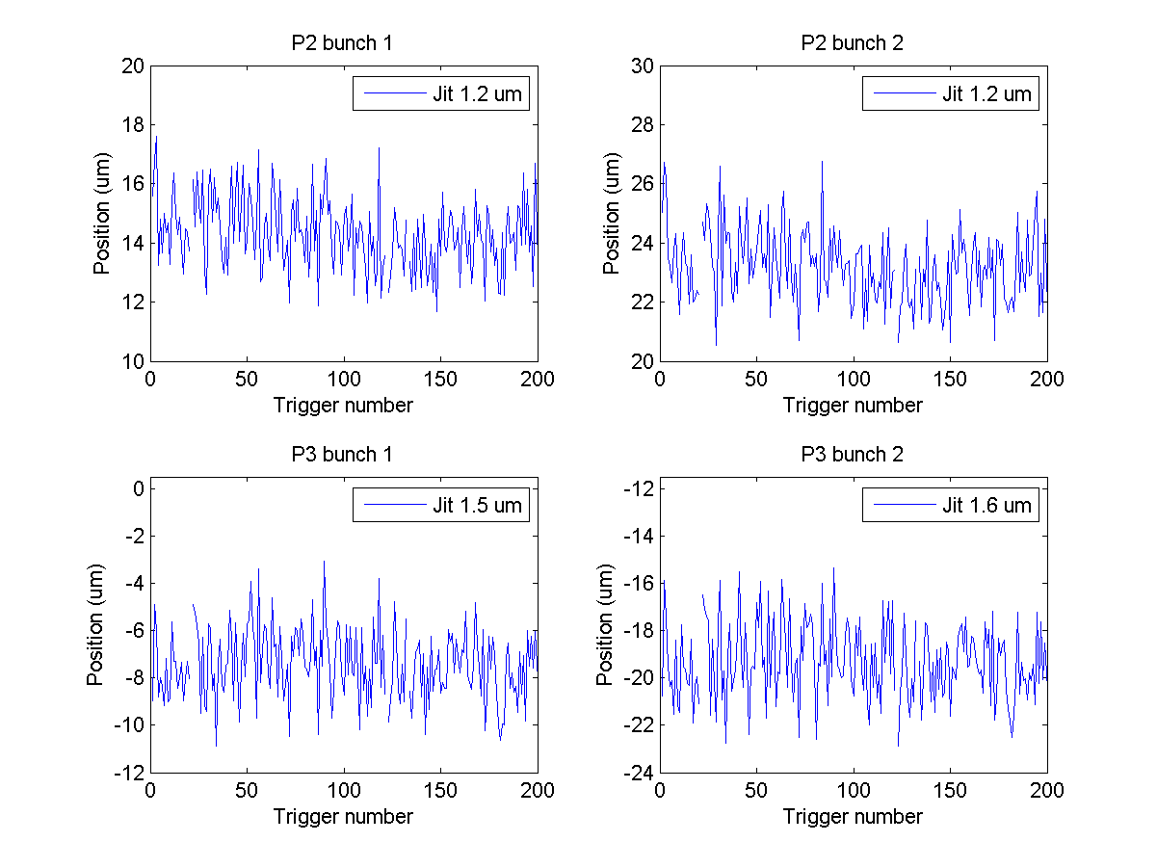
jitRun22 on 060614
jitRun22
N. Blaskovic

Slide 8
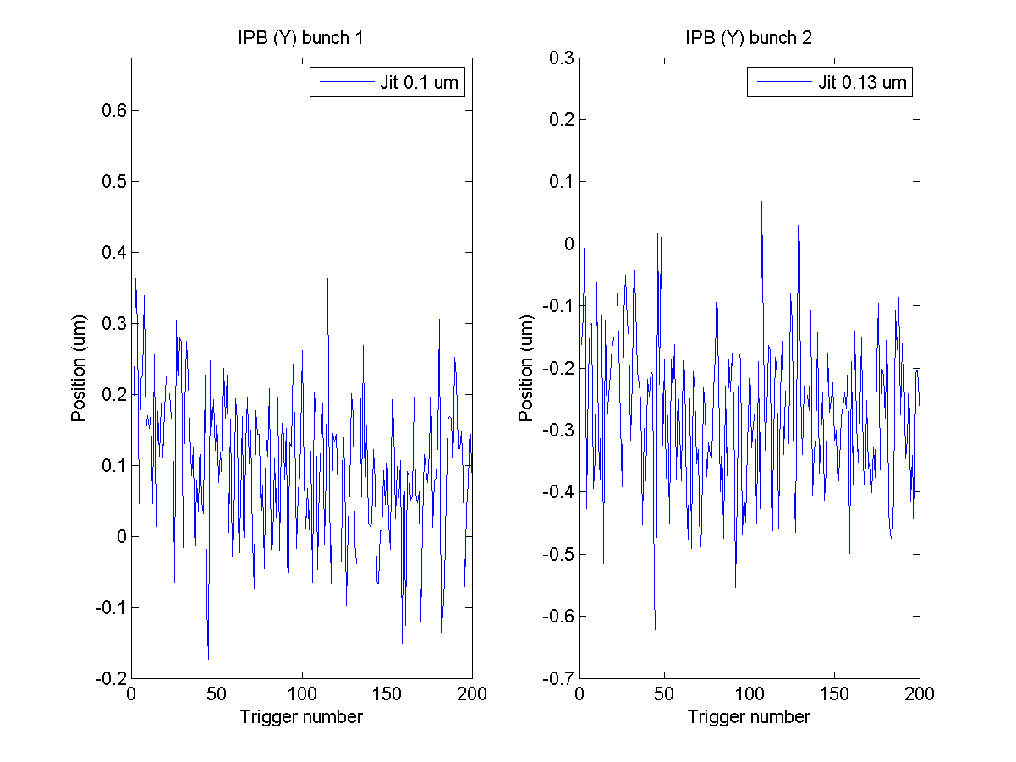
jitRun22 on 060614
jitRun22
N. Blaskovic

Slide 9
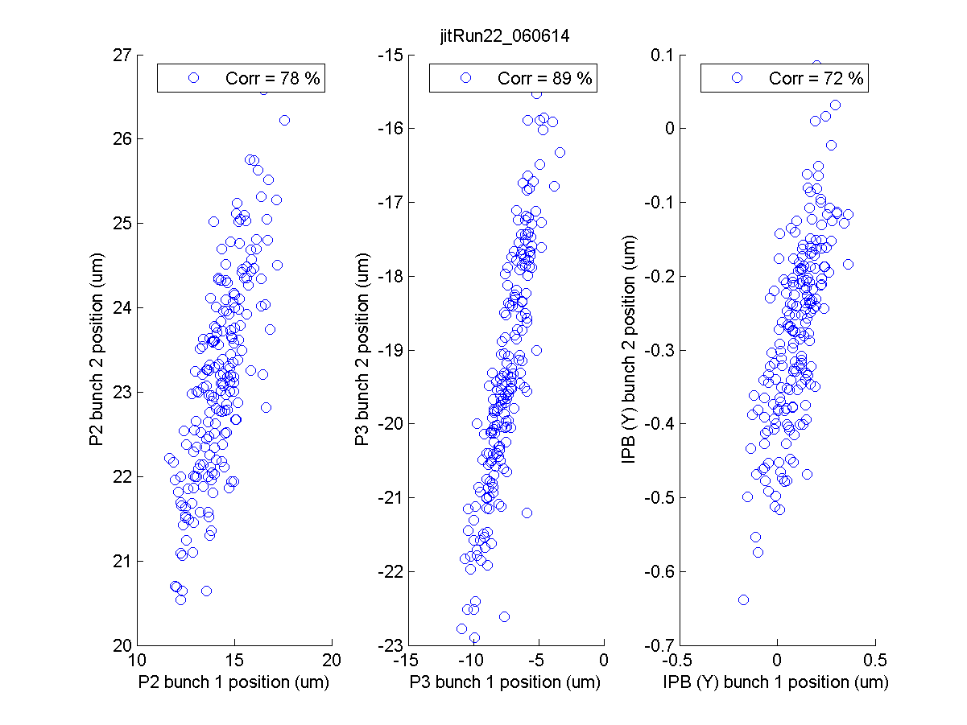
jitRun22
N. Blaskovic

Slide 10
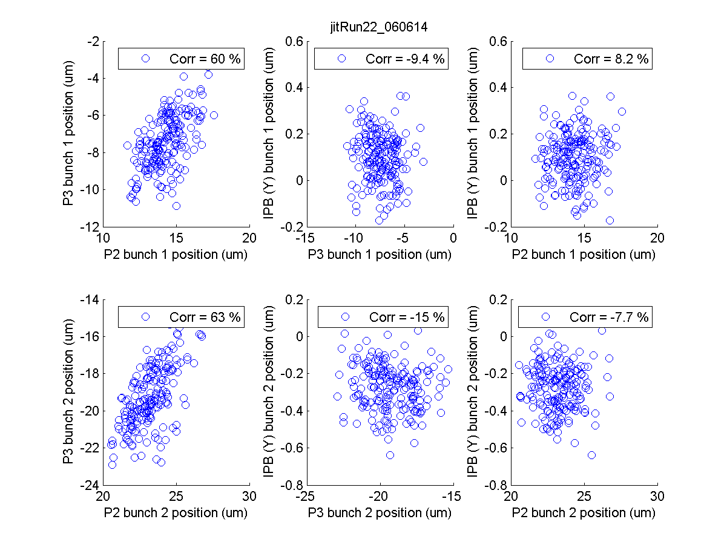
jitRun22
N. Blaskovic

Slide 11
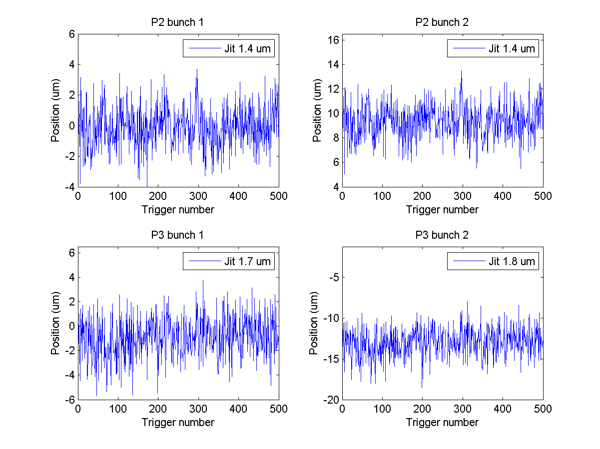
jitRun25_0dB on 060614
jitRun25
N. Blaskovic

Slide 12
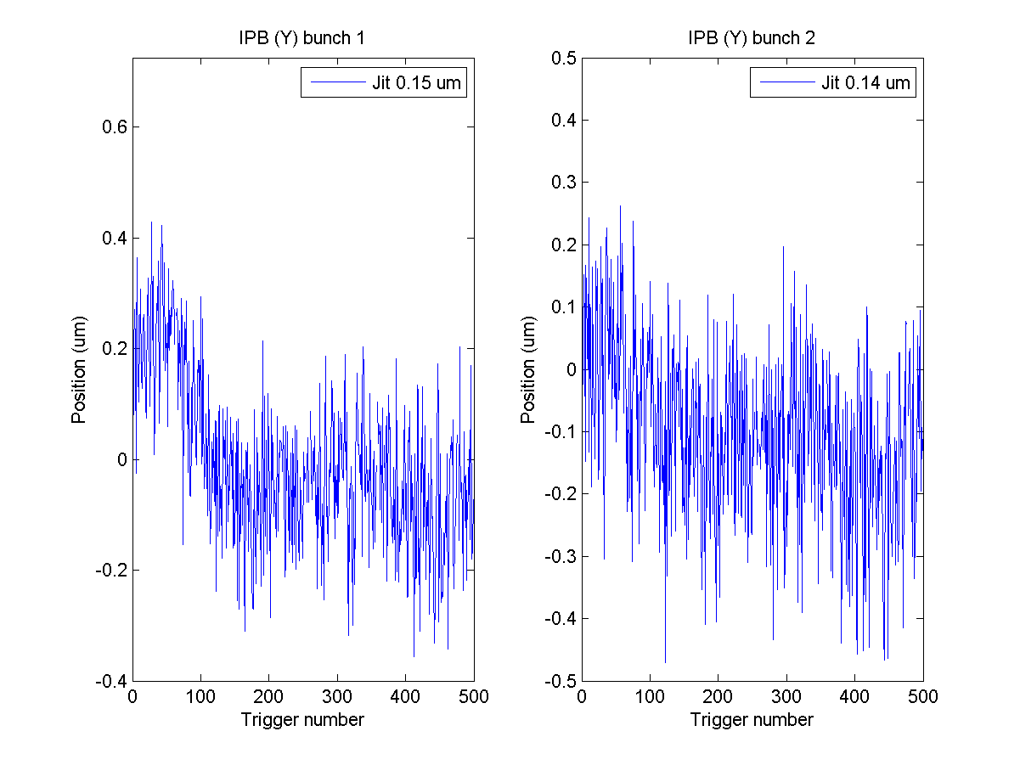
jitRun25_0dB on 060614
jitRun25
N. Blaskovic

Slide 13
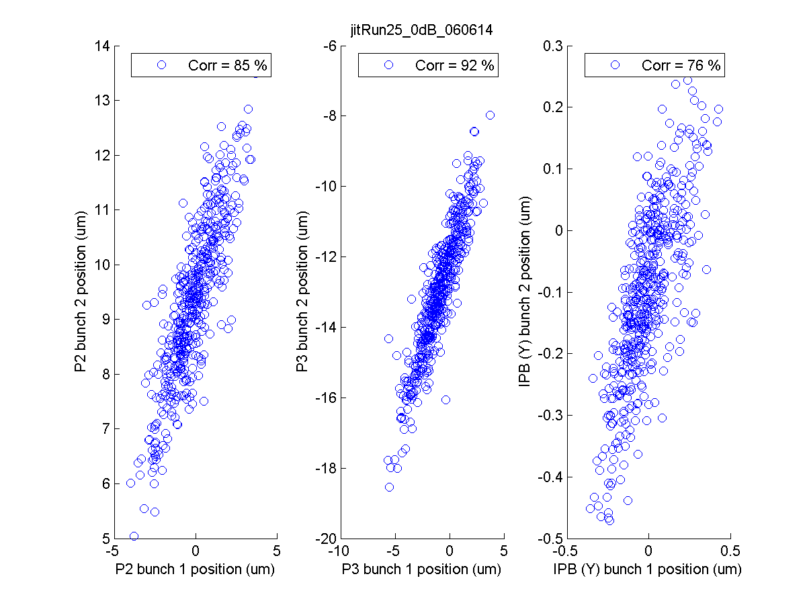
jitRun25
N. Blaskovic

Slide 14
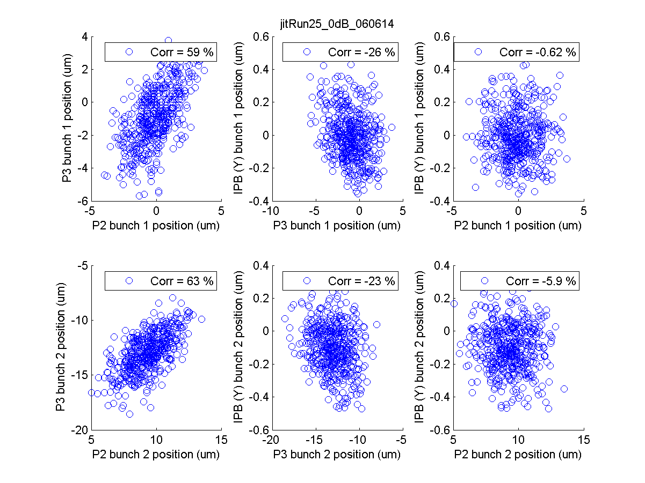
jitRun25
N. Blaskovic

Slide 15
Upstream 90° phase shifter
DR 714 MHz for Honda 1st stage obtained from upstream FONT LO distribution box for weeks 2 & 3 of operation
Signal affected by 90° phase shifter
Jitter runs presented here:
Jitter run 1: 90° phase shifter off, unchanged
Jitter run 2: 90° phase shifter setting changed
Jitter run 3: 90° phase shifter off at sample 50
Jitter run 4: 90° phase shifter on at sample 50
N. Blaskovic

Slide 16
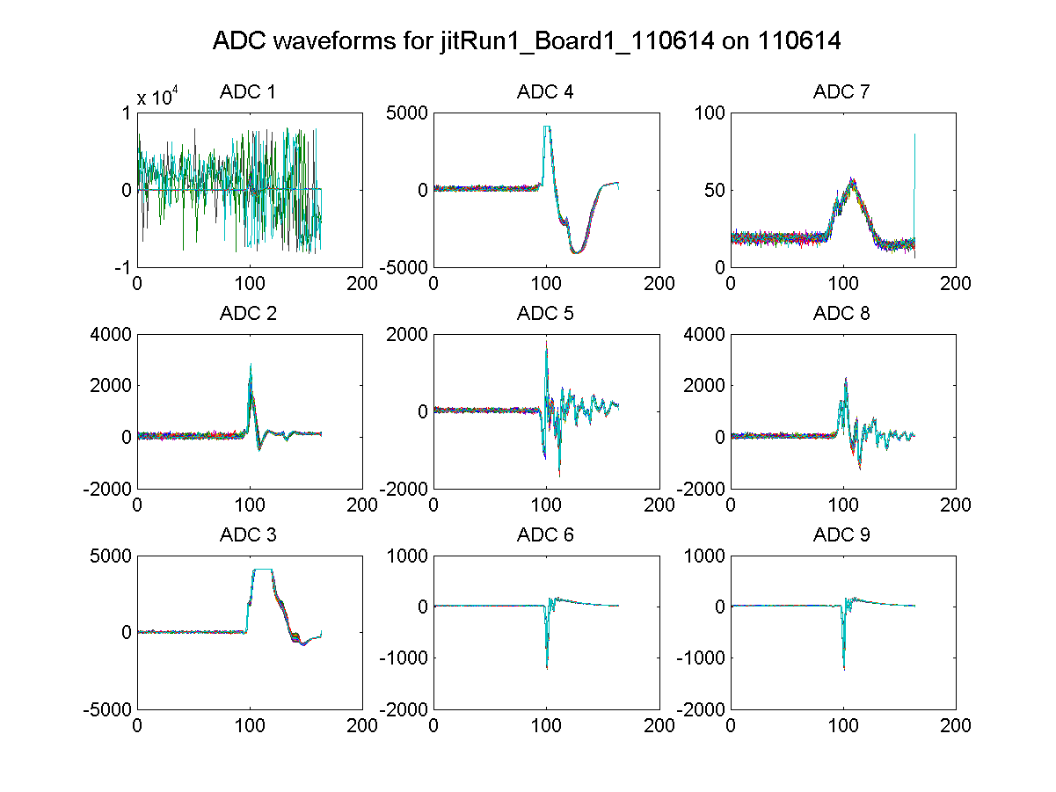
jitRun1
N. Blaskovic

Slide 17
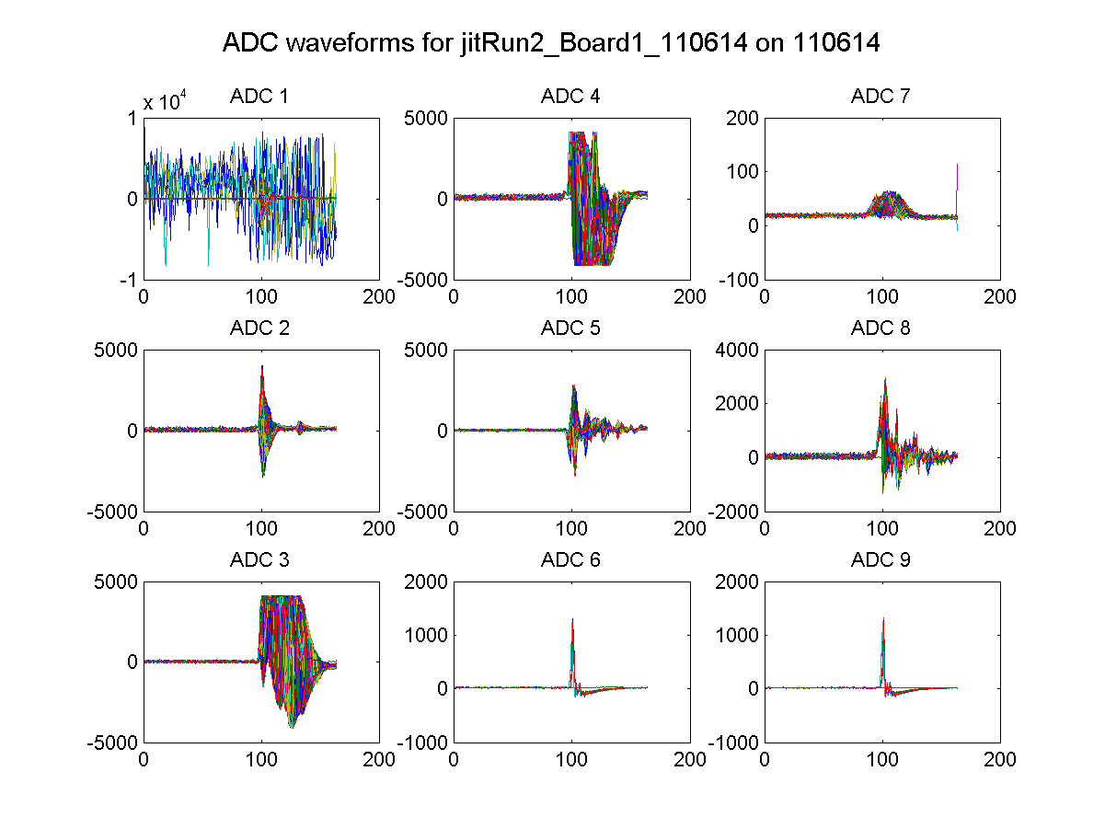
jitRun2
N. Blaskovic

Slide 18
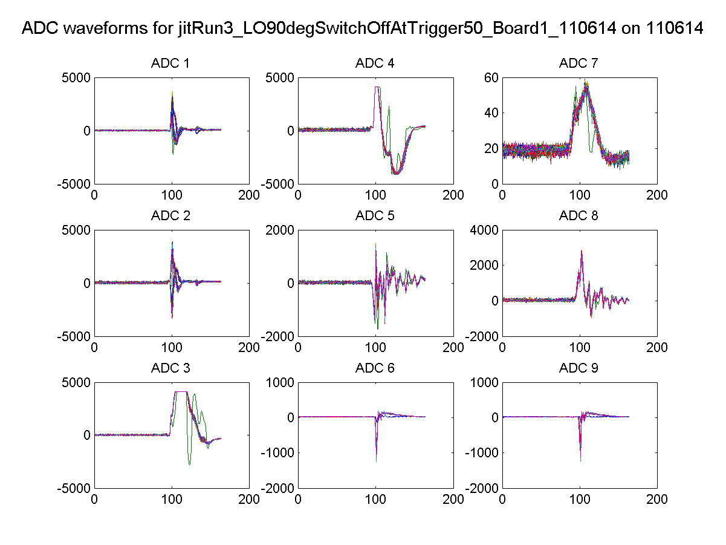
jitRun3
N. Blaskovic

Slide 19
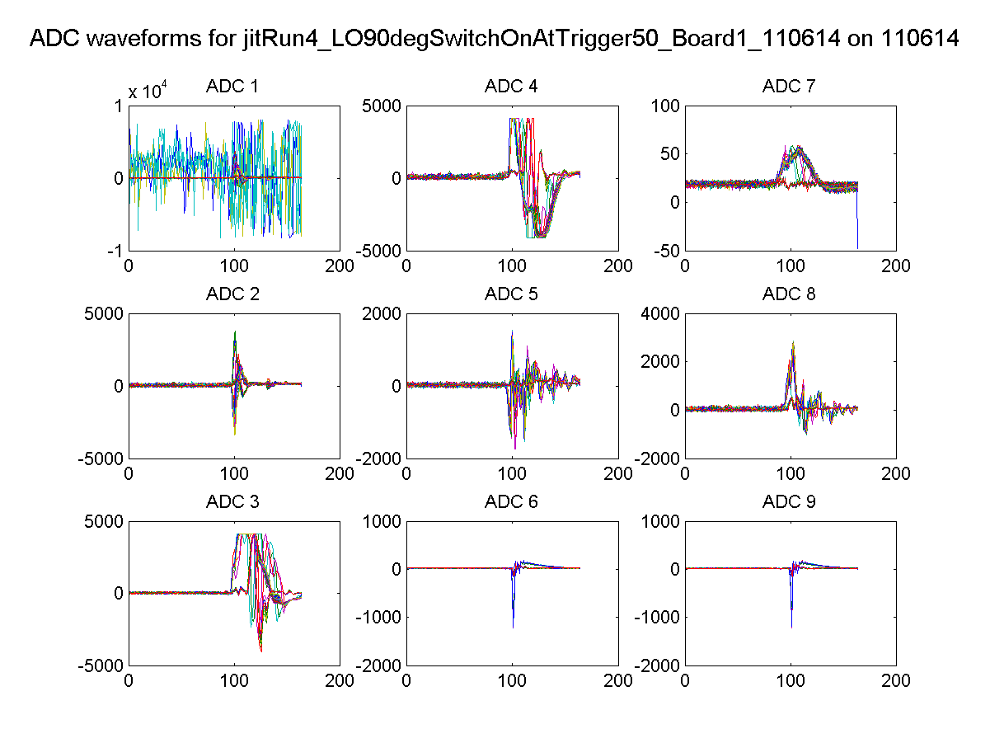
jitRun4
N. Blaskovic

Slide 20
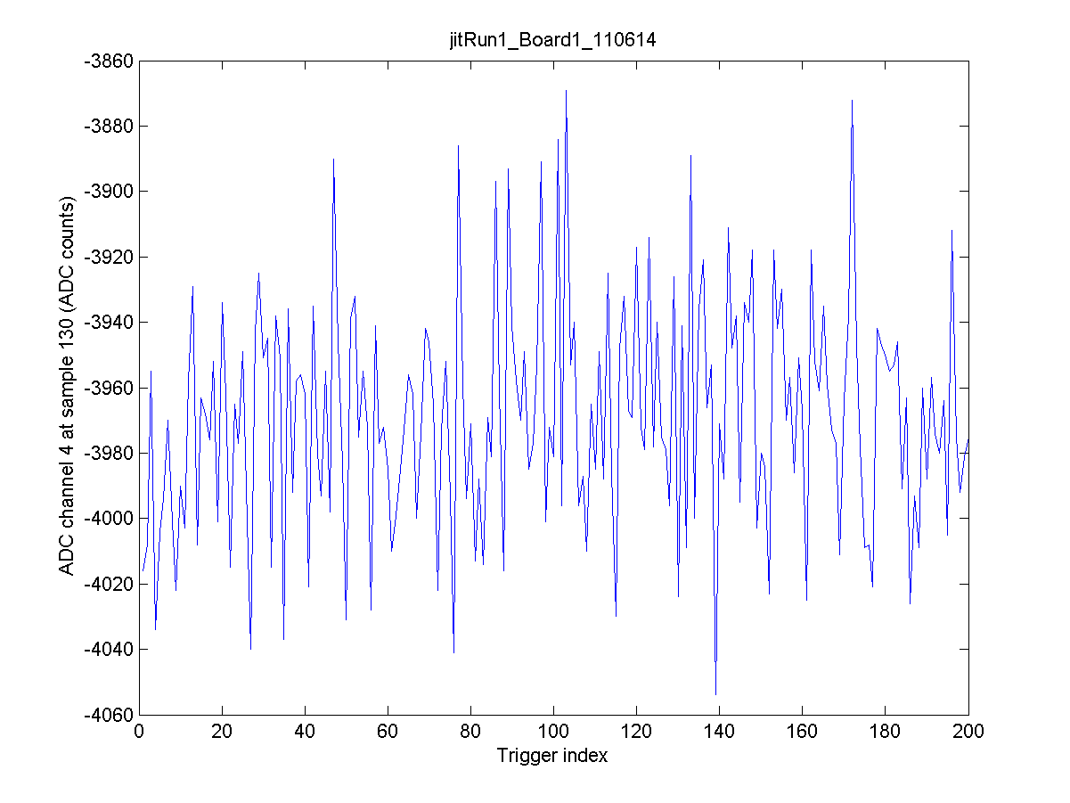
jitRun1
N. Blaskovic

Slide 21
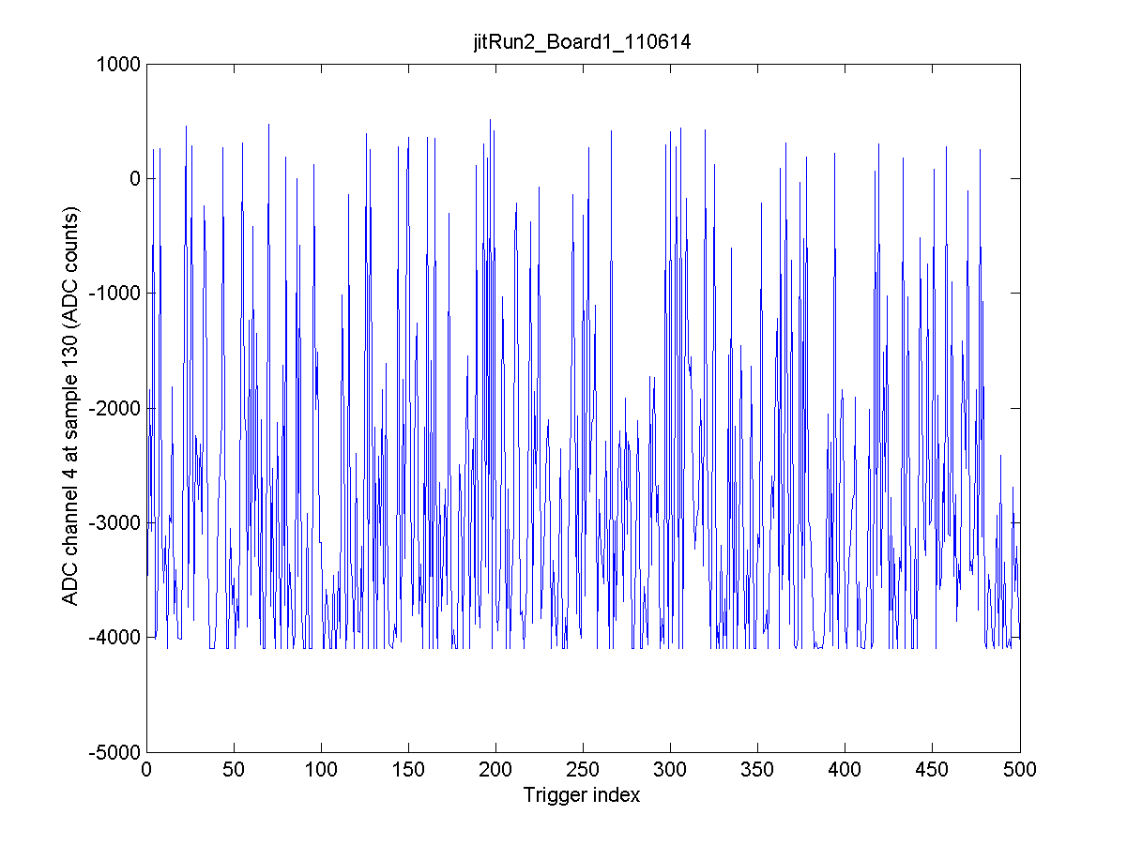
jitRun2
N. Blaskovic

Slide 22
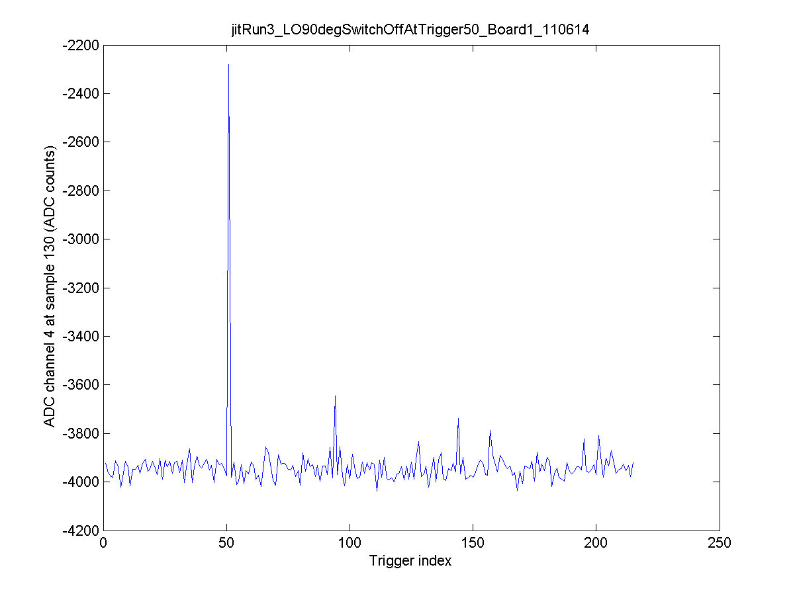
jitRun3
N. Blaskovic

Slide 23
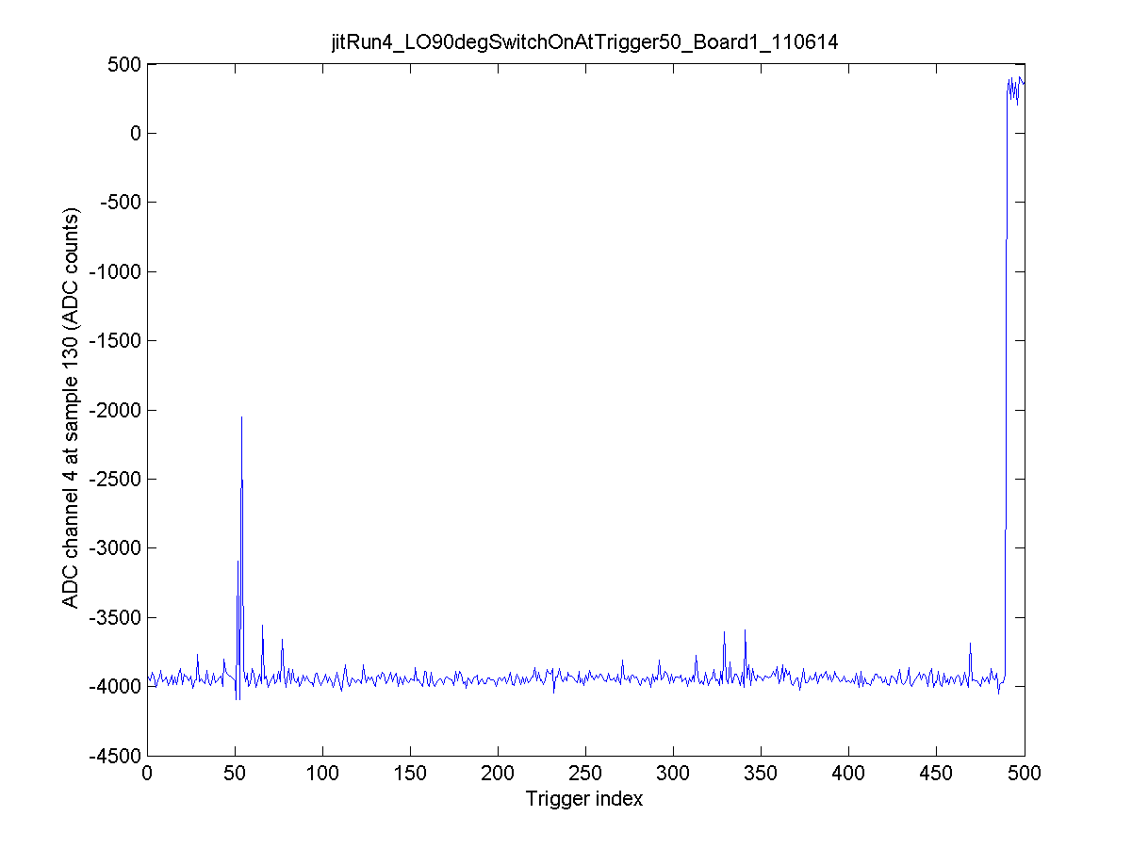
jitRun4
N. Blaskovic

Slide 24
Upstream 90° phase shifter
714 MHz for Honda 1st stage subsequently obtained from source in S-band hut, amplified to appropriate level by ZRL-1200
N. Blaskovic

