Slide 1
Shift Report - 19 June 2014
D. R. Bett

Slide 2
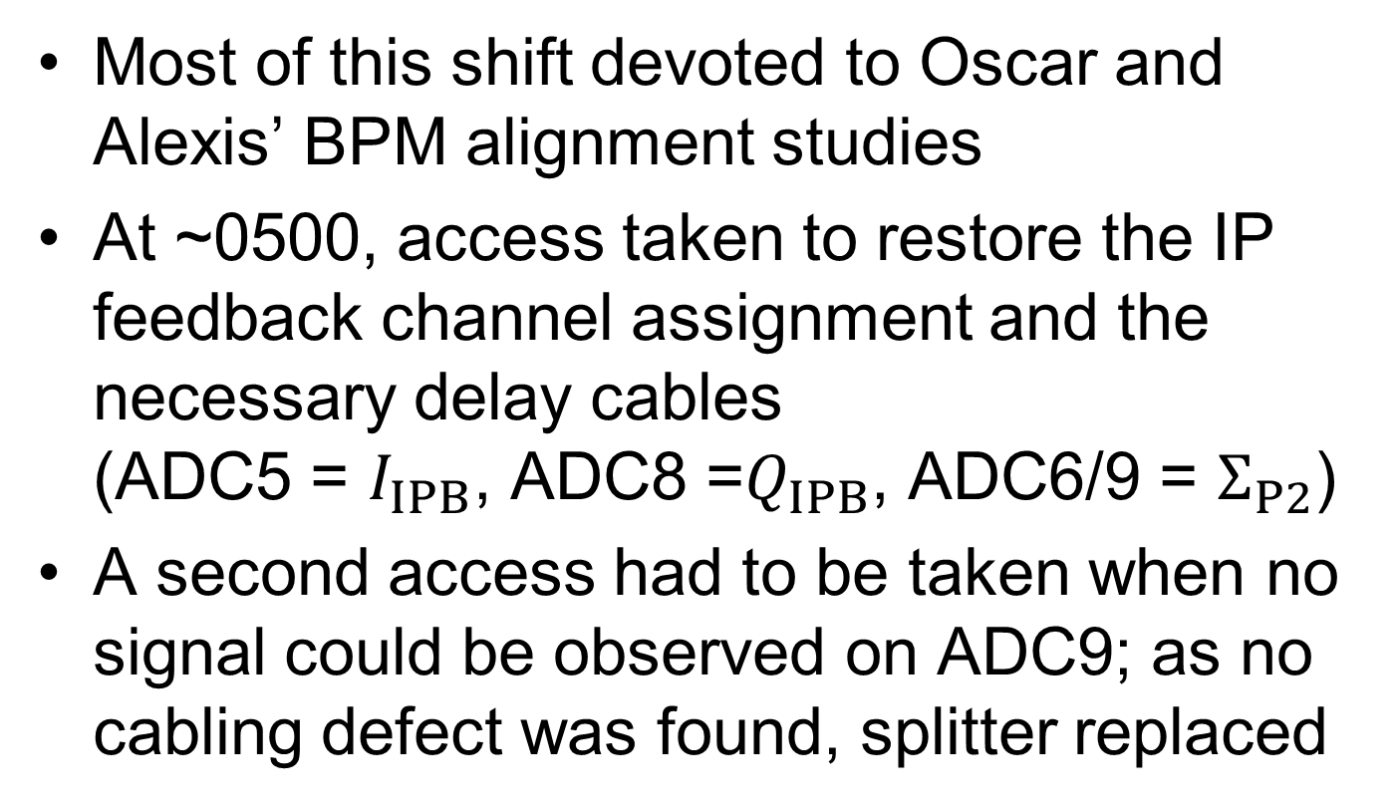
IP feedback
Most of this shift devoted to Oscar and Alexis’ BPM alignment studies
At ~0500, access taken to restore the IP feedback channel assignment and the necessary delay cables (ADC5 = $I_{IPB}$, ADC8 =$Q_{IPB}$, ADC6/9 = $Σ_{P2}$)
A second access had to be taken when no signal could be observed on ADC9; as no cabling defect was found, splitter replaced

Slide 3
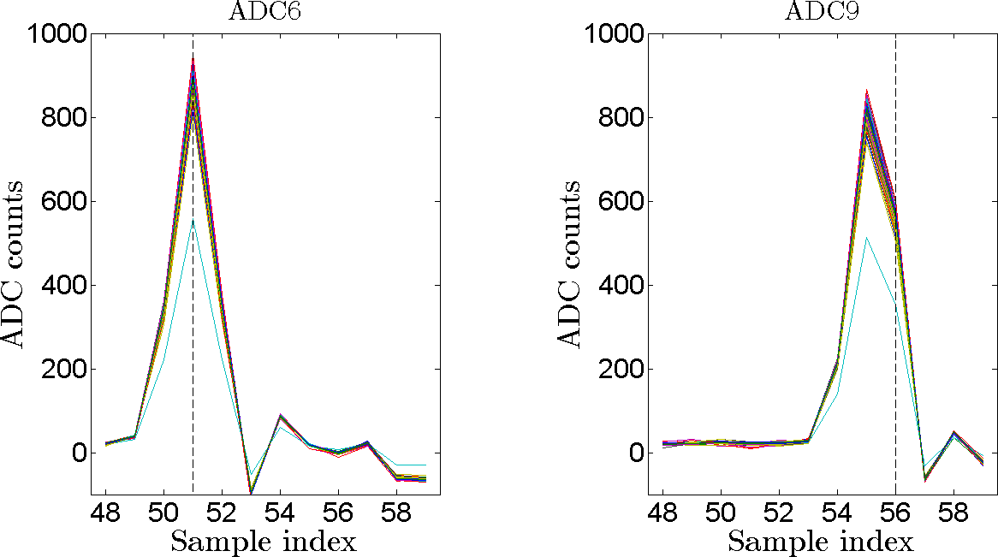

Significant skew on $q_{Q}$
5 sample delay between I and Q required for feedback

Slide 4
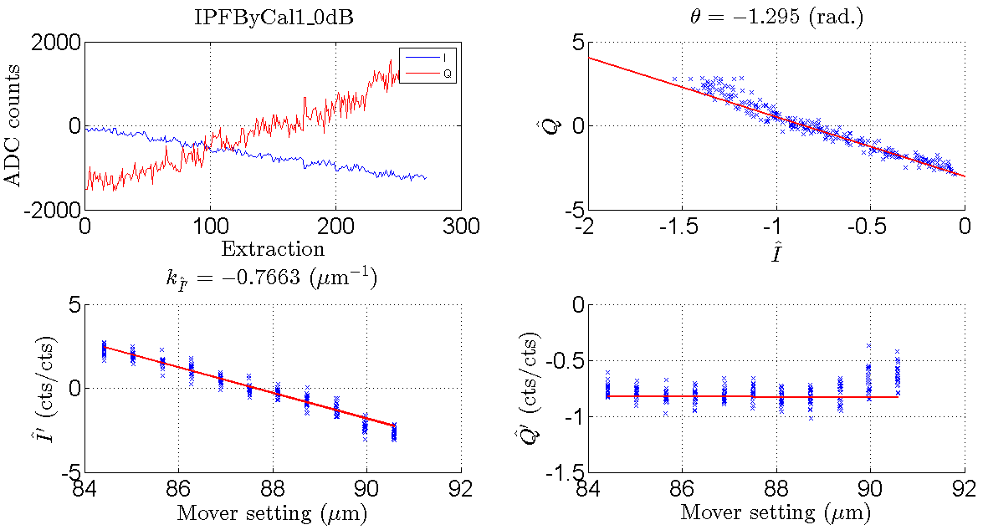
IPFByCal1_0dB

Slide 5
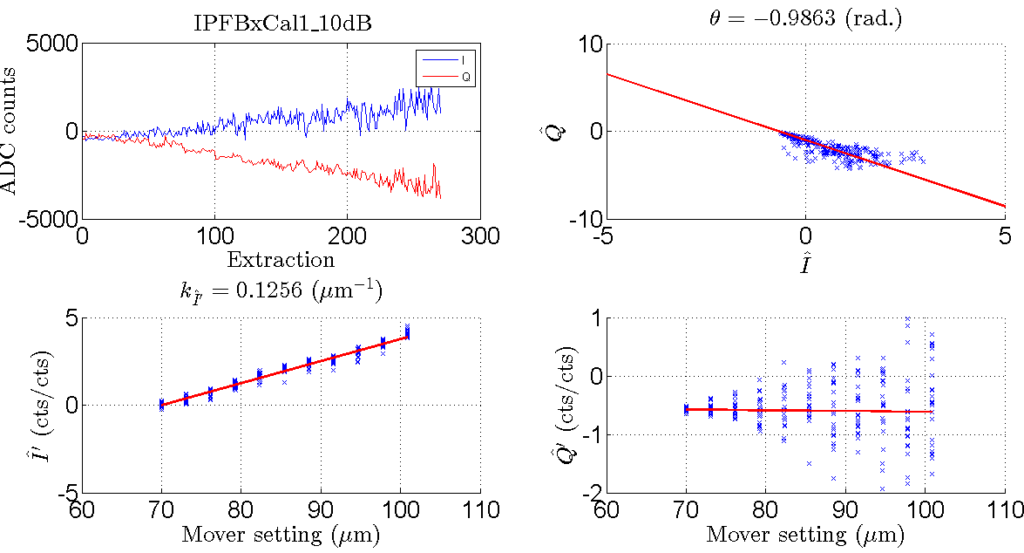
IPFBxCal1_10dB

Slide 6
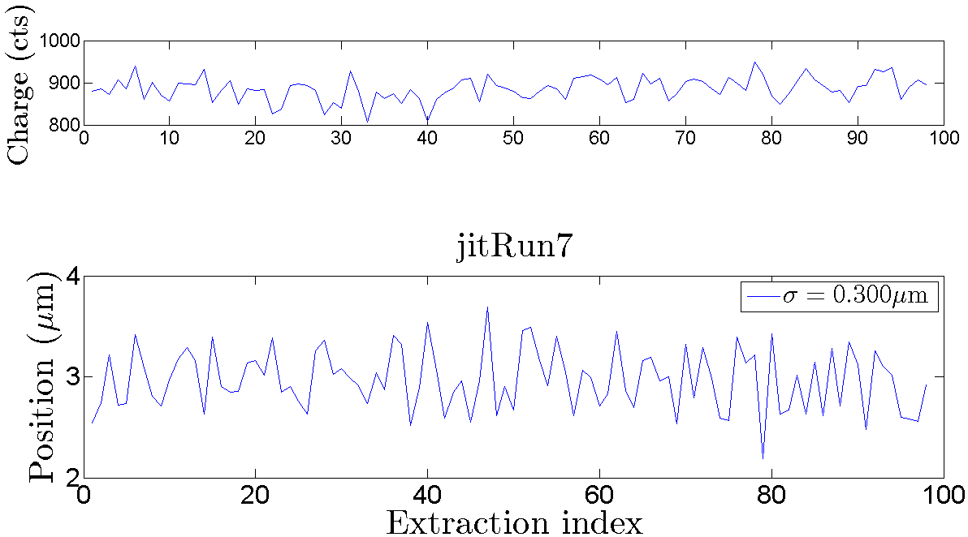
jitRun7

Slide 7
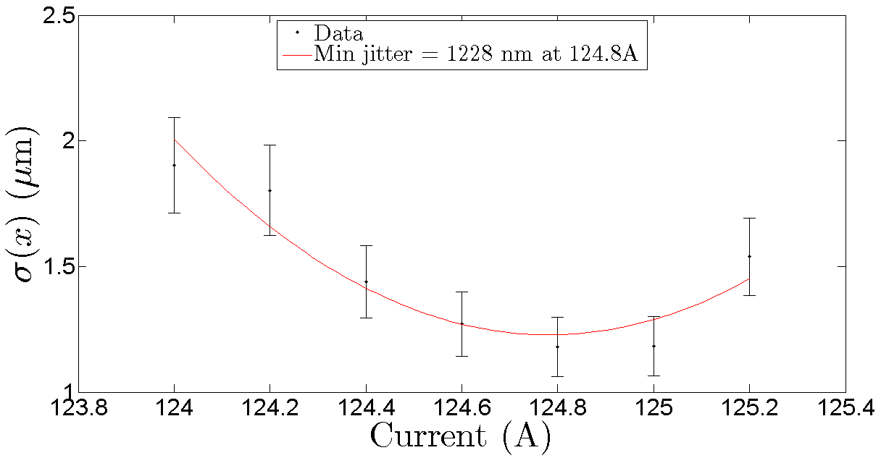
QF1FFzScan1

Slide 8
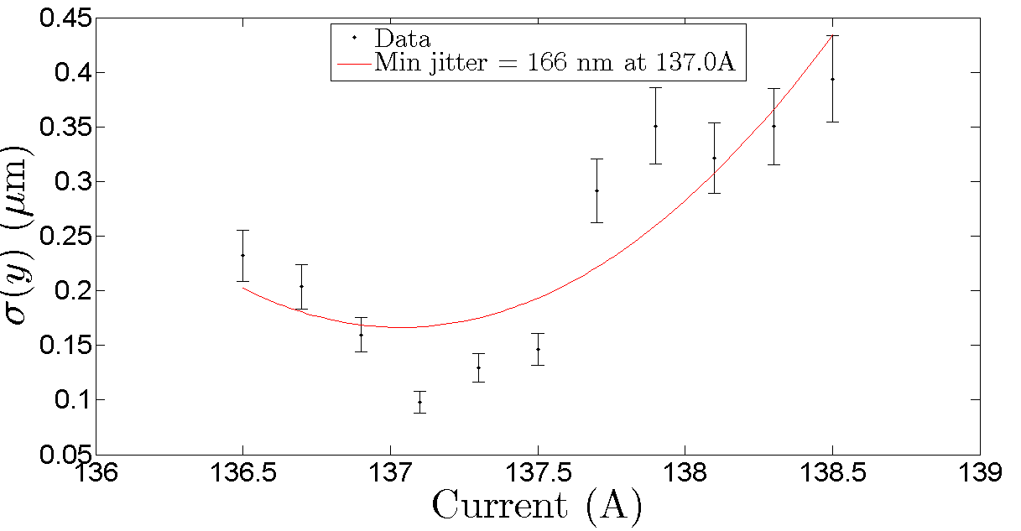
QD0FFzScan1

Slide 9
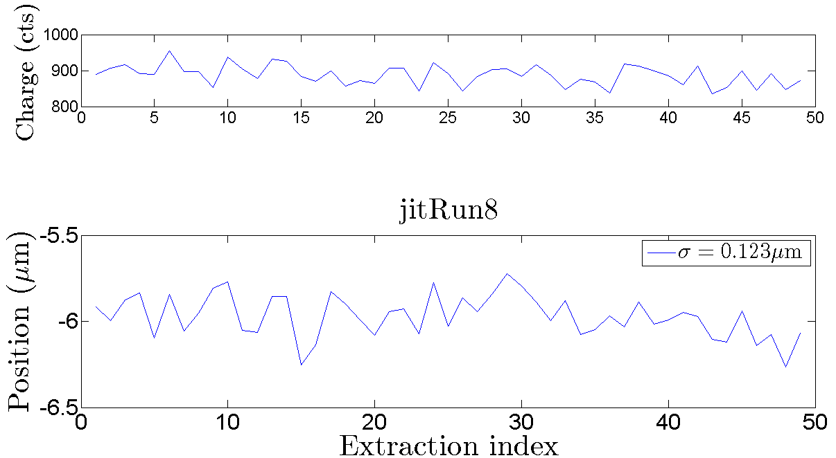
jitRun8

Slide 10
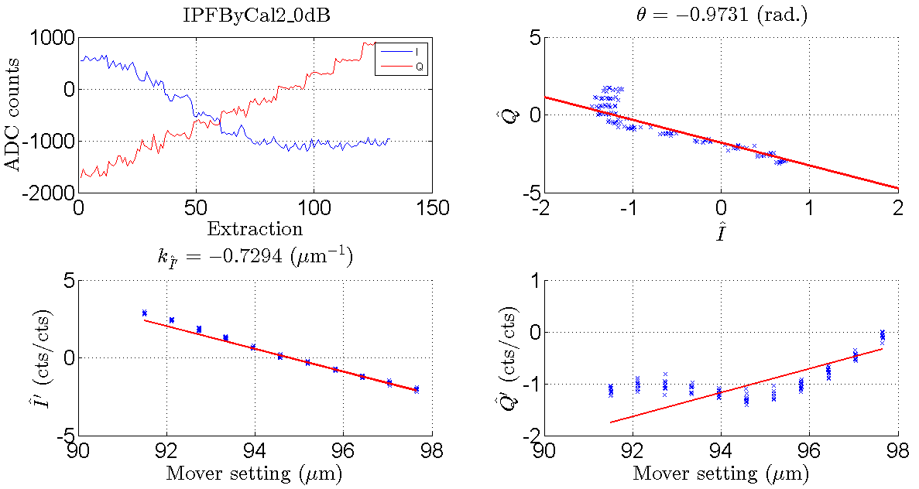
IPFByCal2_0dB (b1)
poor fit

Slide 11
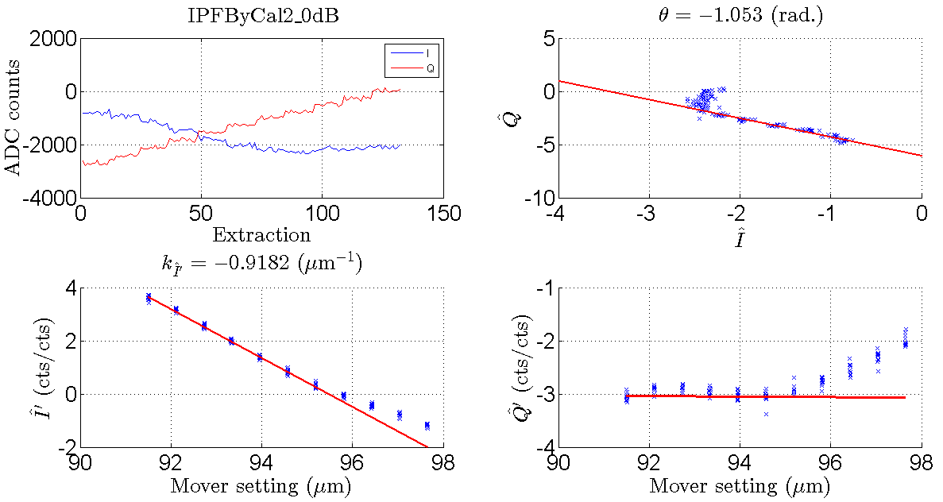
IPFByCal2_0dB (b2)

Slide 12
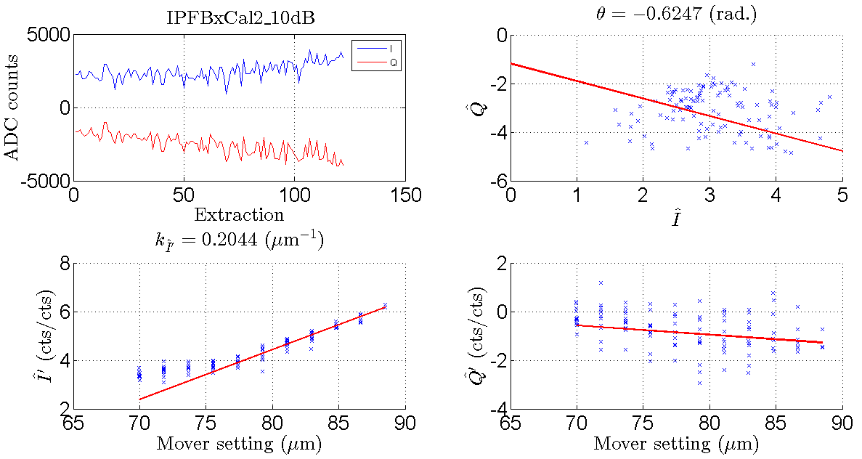
IPFBxCal2_10dB (b1)

Slide 13
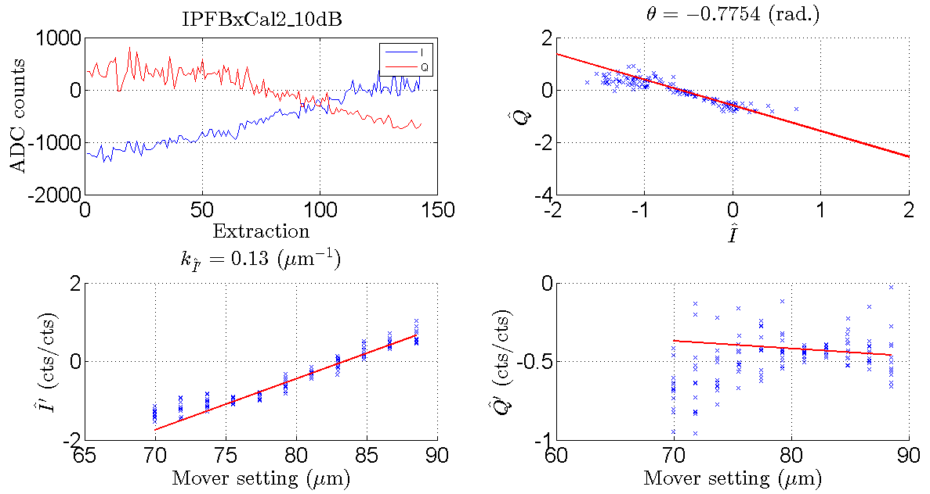
IPFBxCal2_10dB (b2)

Slide 14
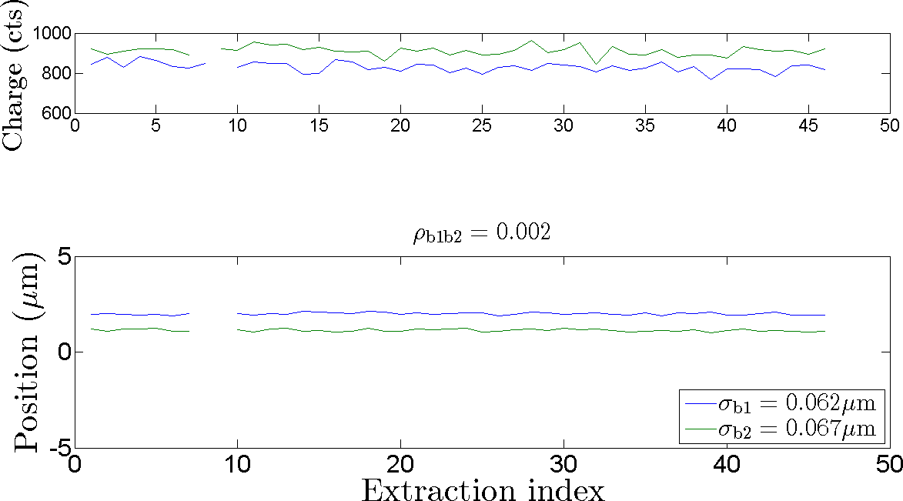
jitRun10
QD0FF 137.1
Mover0 3.15
Mover1 3.15

Slide 15
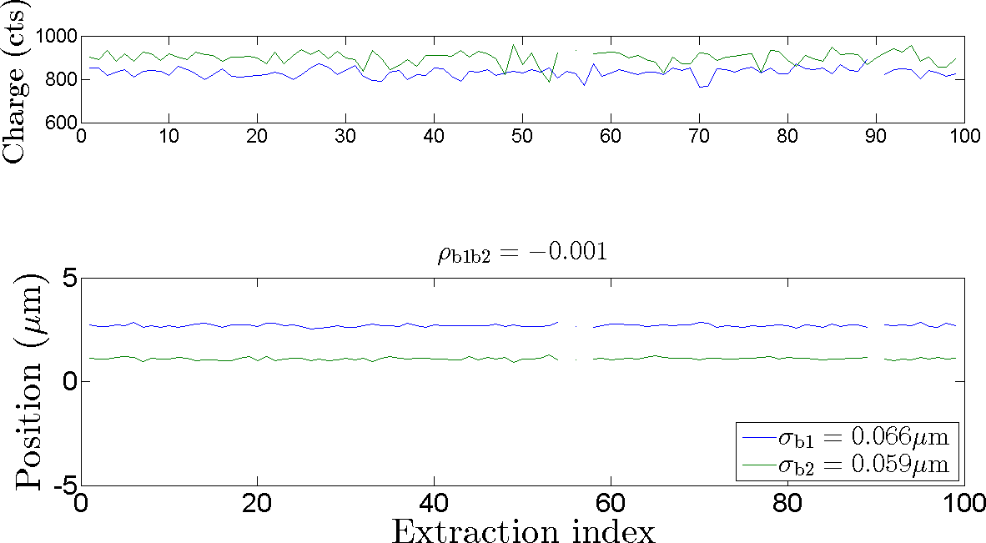
jitRun11
QD0FF 137.1
Mover0 1.56
Mover1 3.15

Slide 16
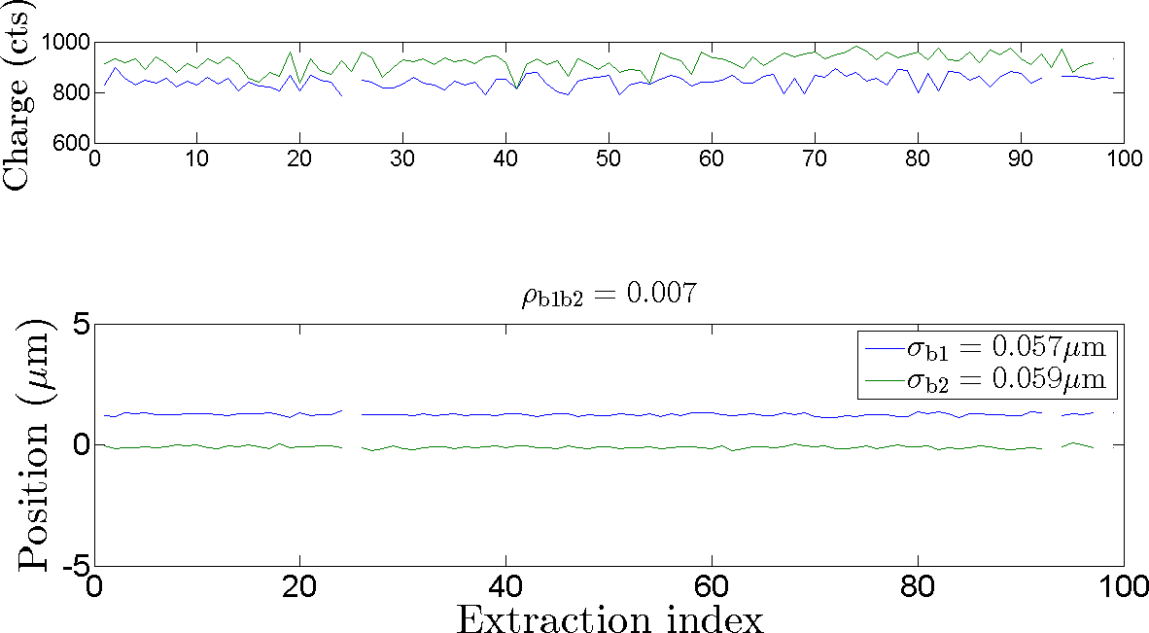
jitRun12
QD0FF 137.1
Mover0 1.56
Mover1 3.10

Slide 17
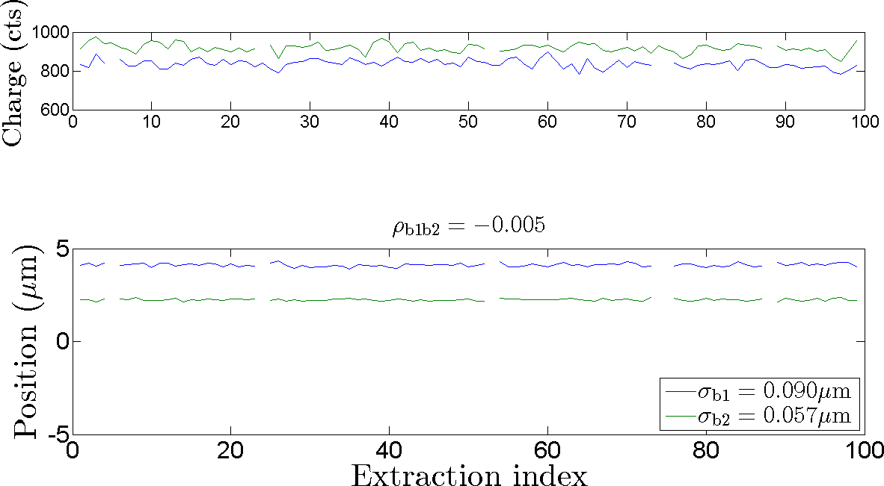
jitRun13
QD0FF 137.1
Mover0 1.56
Mover1 3.20

Slide 18
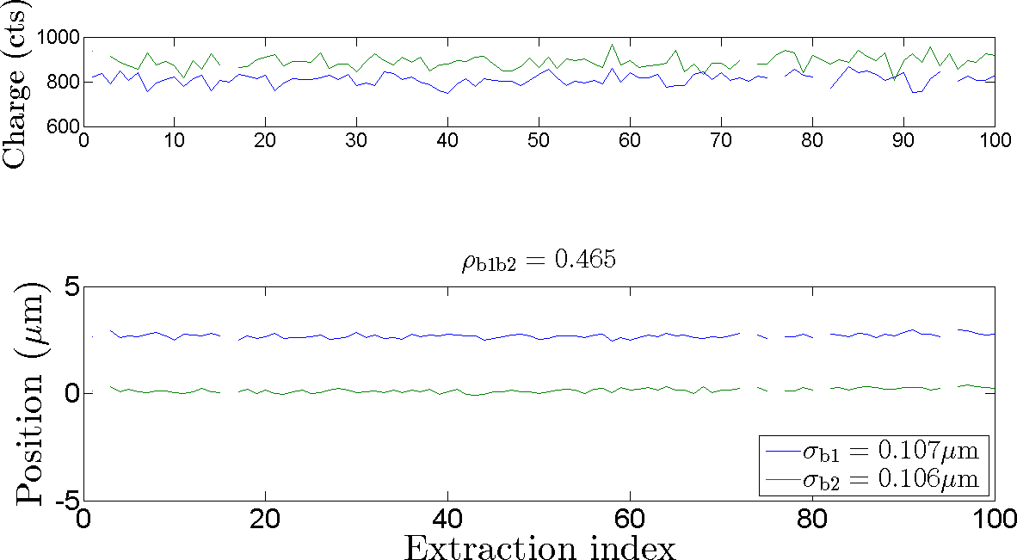
jitRun14
move the waist away from IPB
QD0FF 136.9
Mover0 1.56
Mover1 3.20

Slide 19
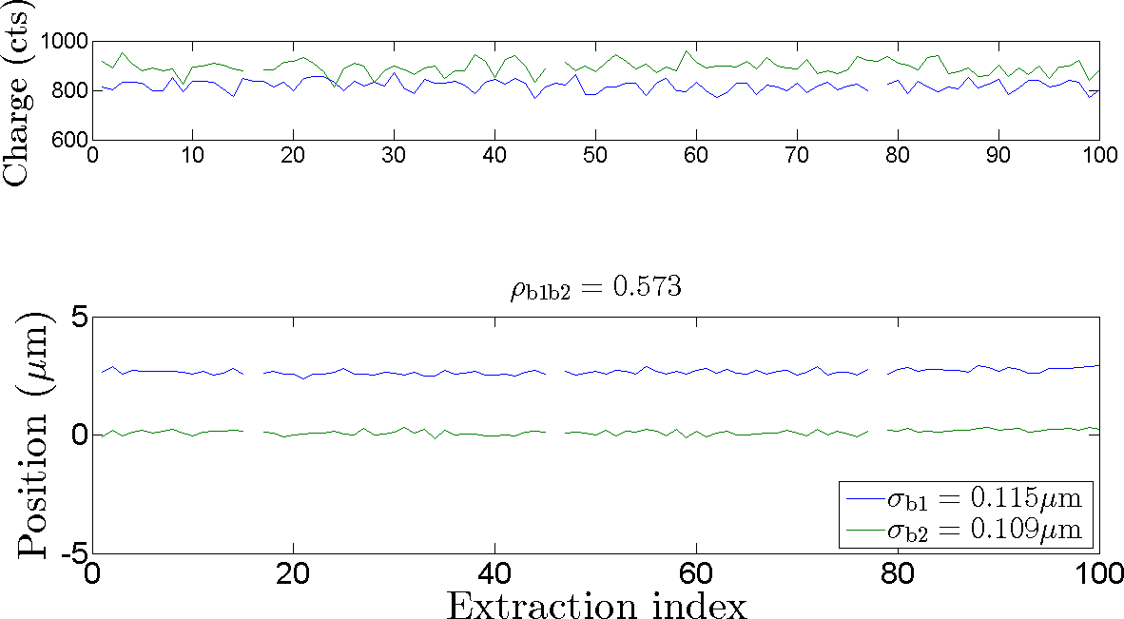
jitRun15
repeat of previous run after adjusting P3 scan delay to prevent two cycle jumps
QD0FF 136.9
Mover0 1.56
Mover1 3.20

Slide 20
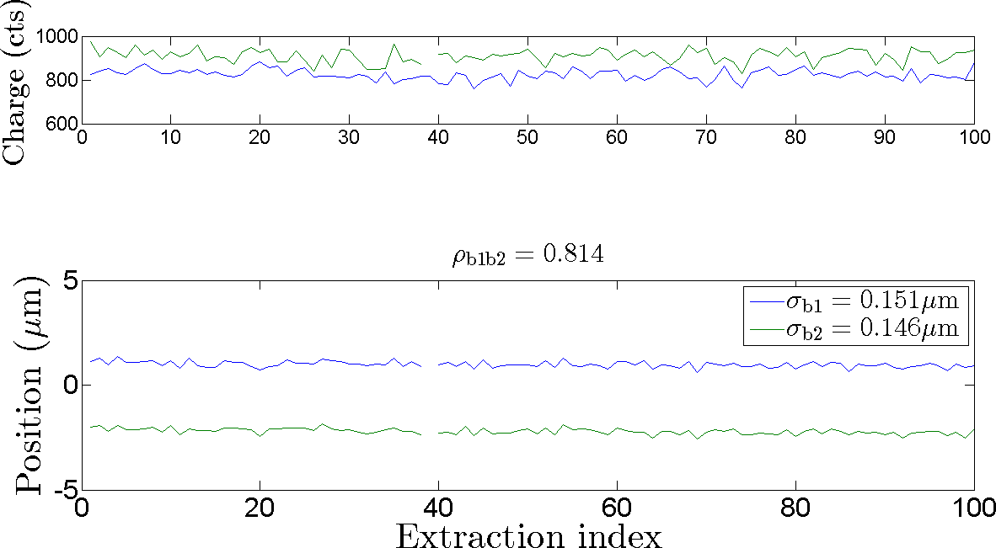
jitRun16
move further off-waist
QD0FF 136.7
Mover0 1.56
Mover1 3.20

Slide 21
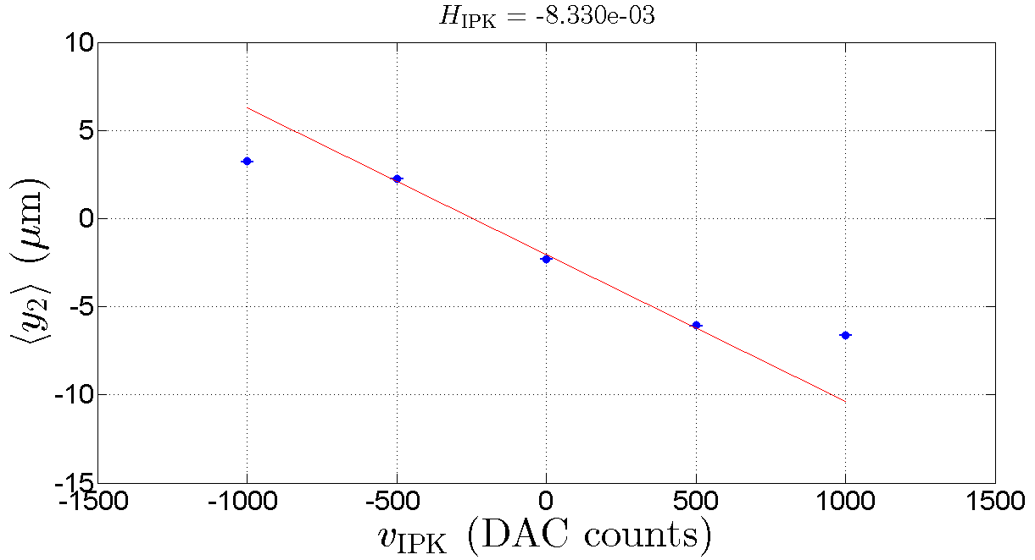




IPKCal1
$$G_{I}≡−H^{−1}\cos{θ_{2}}=59$$
$$−H^{−1}\cos{θ_{1}}=33$$
$$G_{Q}≡−H^{−1}\cos{θ_{2}}=−104$$
$$−H^{−1}\cos{θ_{1}}=−116$$

Slide 22
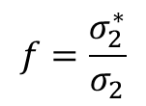
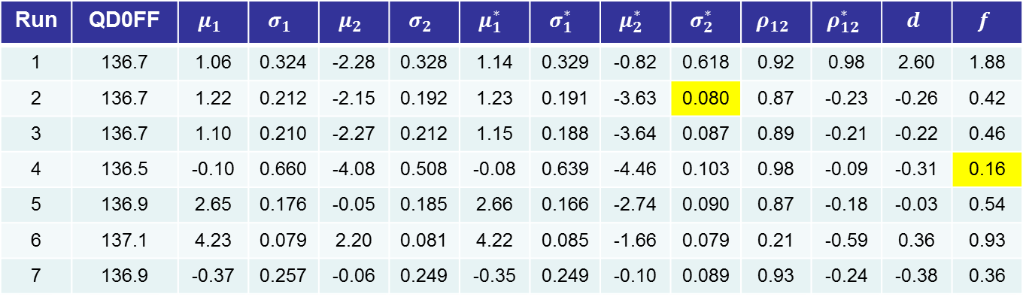

Summary of feedback runs
feedback off
feedback on
Run | QD0FF | $$μ_{1}$$ | $$σ_{1}$$ | $$μ_{2}$$ | $$σ_{2}$$ | $$μ_{1}^{∗ }$$ | $$σ_{1}^{∗ }$$ | $$μ_{2}^{∗ }$$ | $$σ_{2}^{∗ }$$ | $$ρ_{12}$$ | $$ρ_{12}^{∗}$$ | $$d$$ | $$f$$
1 | 136.7 | 1.06 | 0.324 | -2.28 | 0.328 | 1.14 | 0.329 | -0.82 | 0.618 | 0.92 | 0.98 | 2.60 | 1.88
2 | 136.7 | 1.22 | 0.212 | -2.15 | 0.192 | 1.23 | 0.191 | -3.63 | 0.080 | 0.87 | -0.23 | -0.26 | 0.42
3 | 136.7 | 1.10 | 0.210 | -2.27 | 0.212 | 1.15 | 0.188 | -3.64 | 0.087 | 0.89 | -0.21 | -0.22 | 0.46
4 | 136.5 | -0.10 | 0.660 | -4.08 | 0.508 | -0.08 | 0.639 | -4.46 | 0.103 | 0.98 | -0.09 | -0.31 | 0.16
5 | 136.9 | 2.65 | 0.176 | -0.05 | 0.185 | 2.66 | 0.166 | -2.74 | 0.090 | 0.87 | -0.18 | -0.03 | 0.54
6 | 137.1 | 4.23 | 0.079 | 2.20 | 0.081 | 4.22 | 0.085 | -1.66 | 0.079 | 0.21 | -0.59 | 0.36 | 0.93
7 | 136.9 | -0.37 | 0.257 | -0.06 | 0.249 | -0.35 | 0.249 | -0.10 | 0.089 | 0.93 | -0.24 | -0.38 | 0.36
$$f=\frac{σ_{2}^{∗}}{σ_{2}}$$
$$d=\left(μ_{2}^{∗}−μ_{2}\right)−μ_{1}^{∗}$$

Slide 23
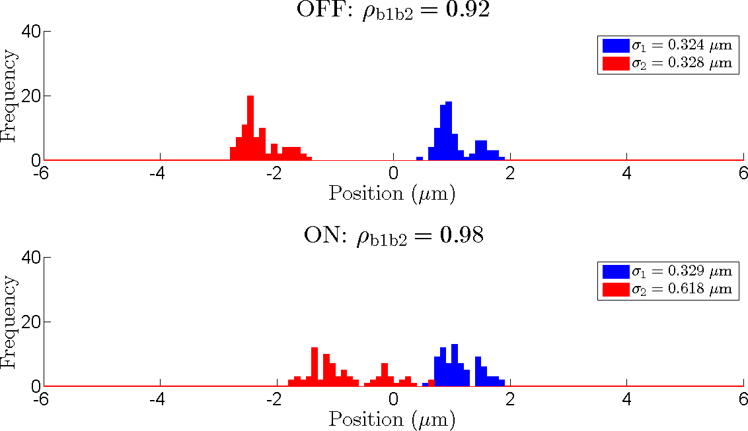
fbRun1
double Gaussian structure caused by step change in mean position
QD0FF 136.7

Slide 24
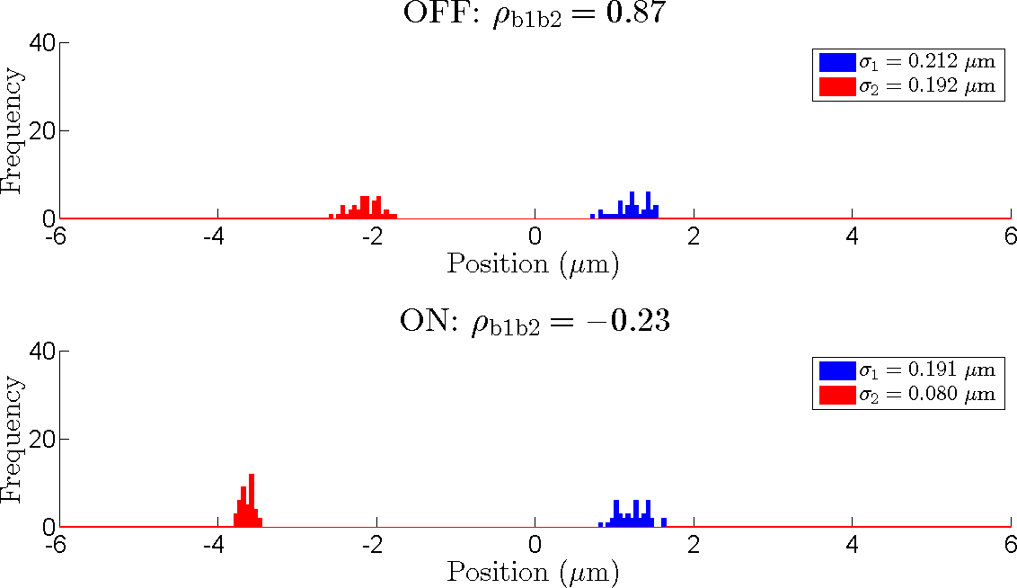
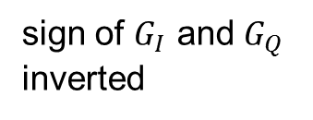
fbRun2
sign of $G_{I}$ and $G_{Q}$ inverted
QD0FF 136.7

Slide 25
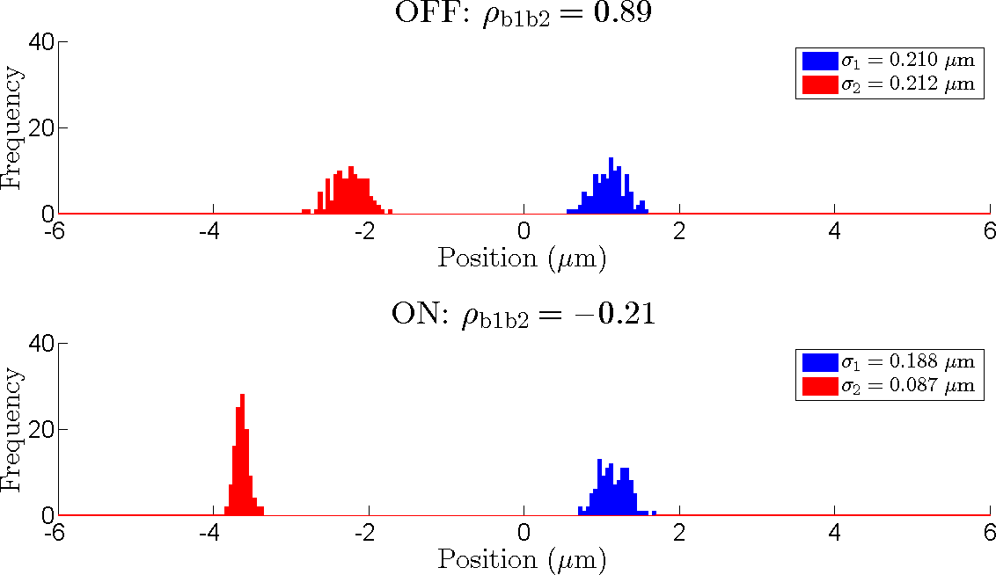
fbRun3
repeat previous run with more triggers
QD0FF 136.7

Slide 26
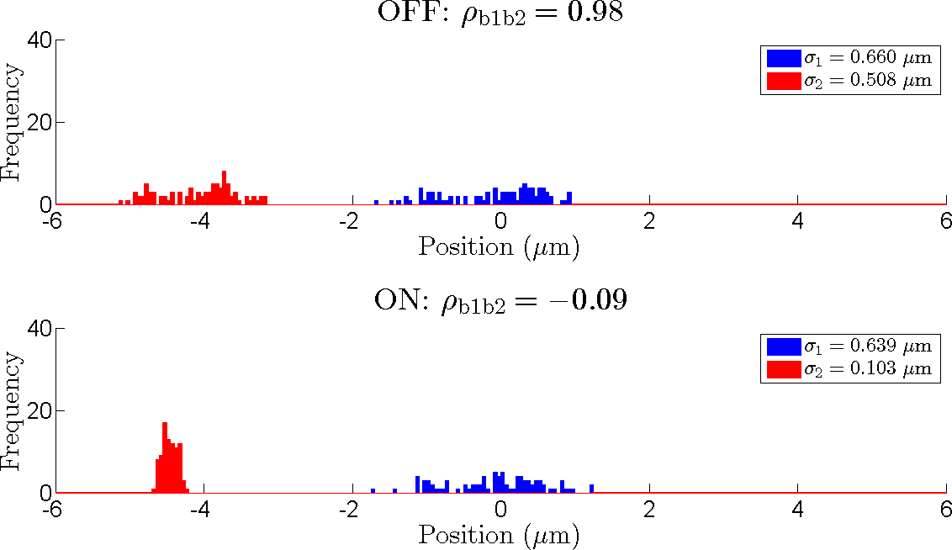
fbRun4
QD0FF 136.5

Slide 27
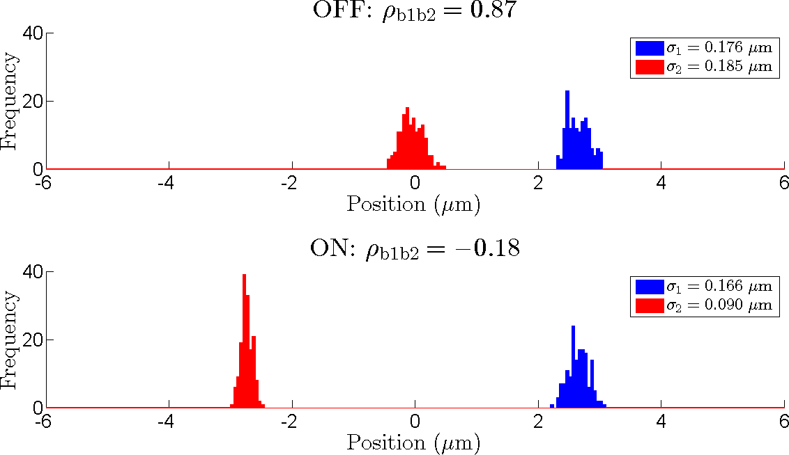
fbRun5
QD0FF 136.9

Slide 28
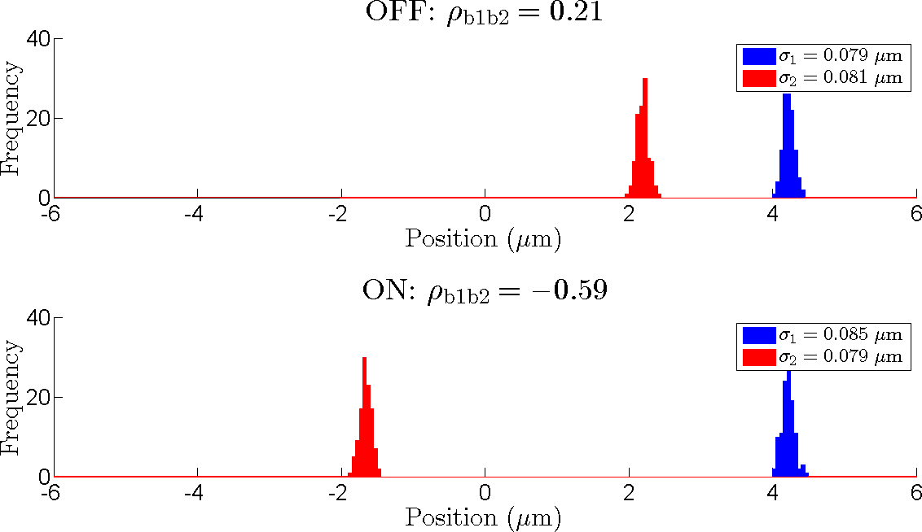
fbRun6
QD0FF 137.1

Slide 29
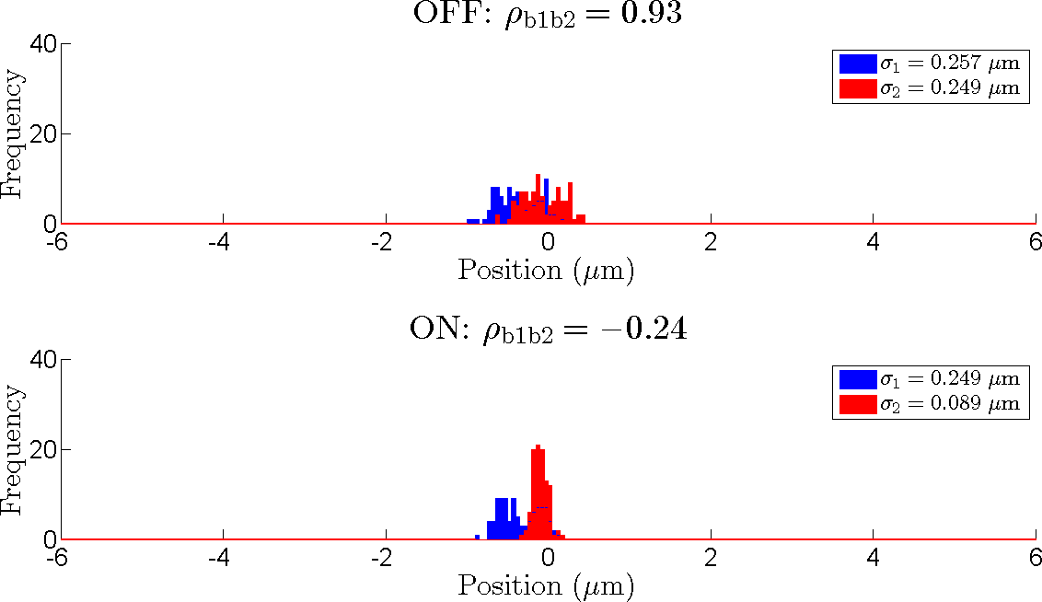
fbRun7
extraction kicker delay changed to 4.325 µs
QD0FF 136.9

Slide 30
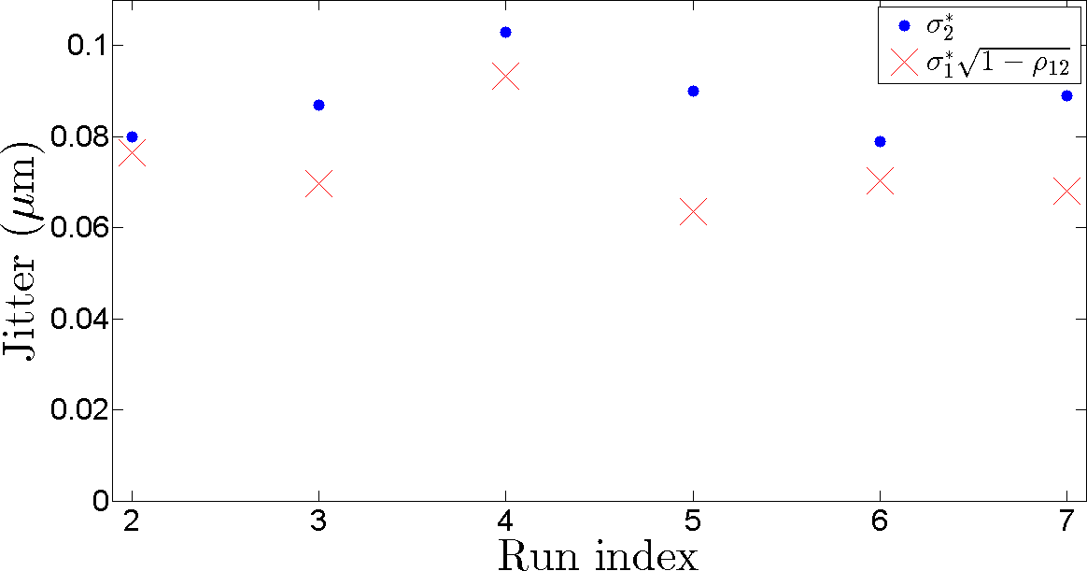
Predicted performance
136.5
136.7
136.9
136.7
136.9
137.1

Slide 31

Conclusions
Some room for improvement:
Non-skewed charge for normalization of Q
Gain parameters from $θ_{1}$

