Slide 1
ATF2 Status
- Most of them will be presented at ICHEP14 -
N.Terunuma, KEK

Slide 2
History of measured minimum beam size
Wake field mitigation,
Stabilization of laser and e beam,..
Wake field mitigation
Removal of SF5( electrically )
To be presented at ICHEP14 by S.Kuroda(KEK), same as IPAC14 (K.Kubo)

Slide 3
What was done since AWLC14 (55nm)?
Suppress the beam orbit drift by slow feedback (software, selection of corrector and BPM) → 50nm
The wakefield mitigation has been tried especially for the high-beta region but no clear improvements were observed.
Moving to the low-beta region; removing low priority devices (LW, wire scanners) then finally shift the vertical position of OTR beam-profile → 44nm
Removed all OTRs with a hope of further improvements but the beam was so much different at downstream of OTR; i.e., orbit, dispersion, matching…

Slide 4
Beam Size Tuning after 3 days shutdown
Small beam (~60 nm) observed
~16 hours from operation start
Repeatability of the beam size tuning is good as reported at AWLC14.
Week 2014 April 14
K.Kubo IPAC14
Presented at IPAC14 by K.Kubo(KEK)

Slide 5
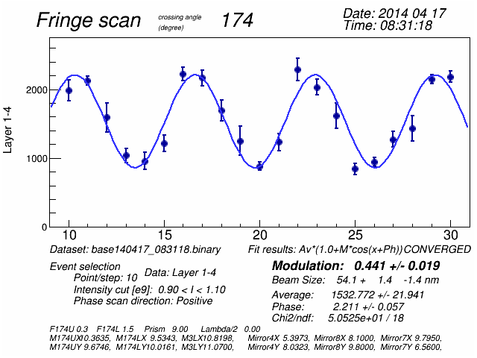
Example of vertical beam size measurement
(On-Line Fringe Phase Scan)
Data on April 17, 2014.
IPBSM with a crossing angle of 174 degrees. Bunch charge ~0.16 nC.
Fitted modulation is 0.44, evaluated beam size 54 nm
There must be some systematic errors, jitter/drift of beam position/monitor’s laser, etc., which tend to reduce modulation and make apparent beam size larger.
Off-line analysis is on-going about monitor systematics and errors.
Study for fast electron beam orbit FB is also on-going( goal 2 ).
Study for magnets vibration is planned.
Presented at IPAC14 by K.Kubo(KEK)

Slide 6
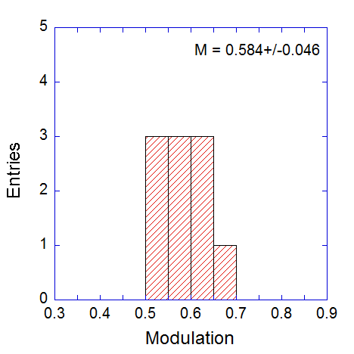
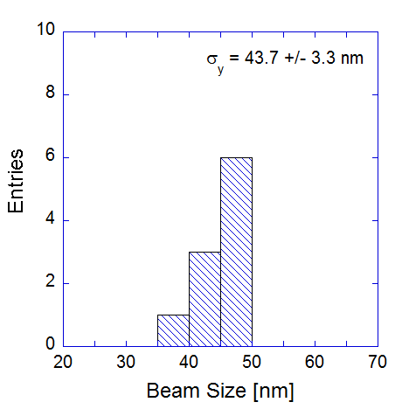
Beam is stable for 30 – 60 min. without tuning.
Examples of consecutive beam size measurements
(Data of 12th June 2014)
IPBSM Modulation
(174 degree Crossing angle)
Beam Size Evaluated from Modulation
(no systematic error assumed)
Mean: 0.58
Standard dev.: 0.05
Mean: 44 nm
Standard dev.: 3 nm
Bunch charge ~ 0.16 nC
To be presented at ICHEP14 by S.Kuroda(KEK), same as IPAC14(K.Kubo)

Slide 7
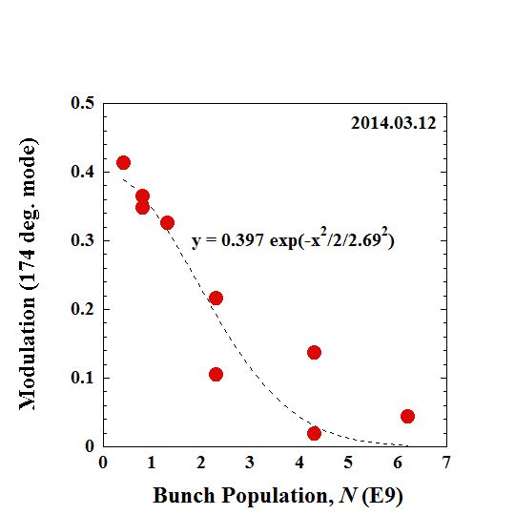
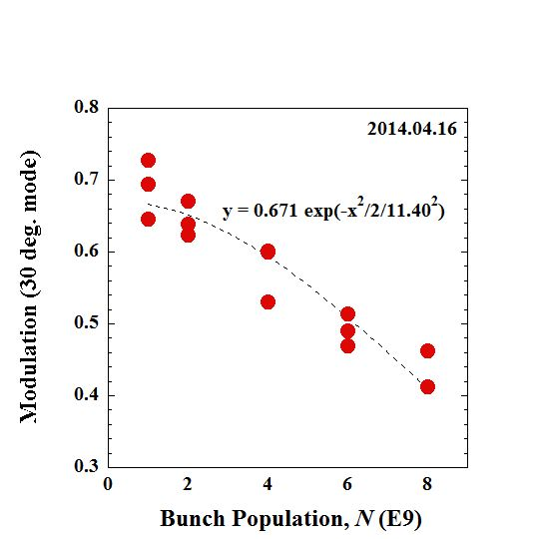
Beam Size Depends on Bunch Intensity
2014 Apr
IPBSM modulation as function of bunch population. Measured with crossing angle 174 degrees (left) and 30 degrees (right).
The effect is bigger than wake field calculation of Cav.BPM, bellows,…
➔ Need to find out sources
K.Kubo IPAC14
Presented at IPAC14 by K.Kubo(KEK)

Slide 8
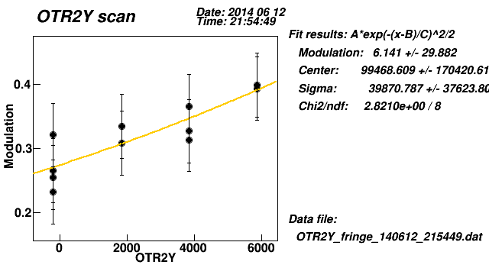
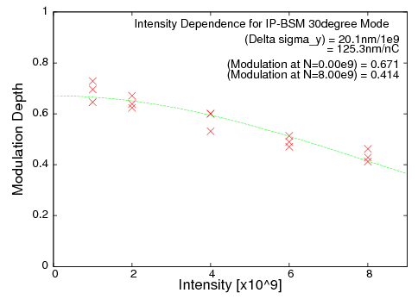
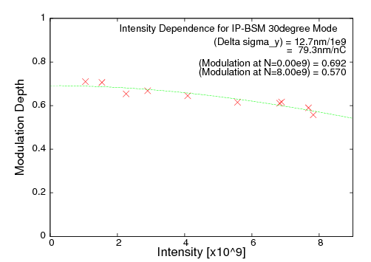
Operation in the Last Week June 2014
We observed strong dependence on OTR position( 174deg mode, I=3e9 )
All the OTR stations were uninstalled.
Situation has completely changed( orbit, dispersion, matching,…)
30 deg mode
modulation
4/16
6/21
OTR removed
Beam time was so short for complete beam tuning.
Possibility of OTR cancelling the effect from other source. Need to confirm in the next operation
To be presented at ICHEP14 by S.Kuroda(KEK)

Slide 9
Beam Intensity Dependence
30-deg mode: 2014 4/16
30-deg mode: 2014 6/21
Weaker dependence was
observed after removing
four OTRs.
Notes:
The beam intensity dependence on the 174-degree mode was realized after the shielding the gaps of bellows and pumping ports.

Slide 10
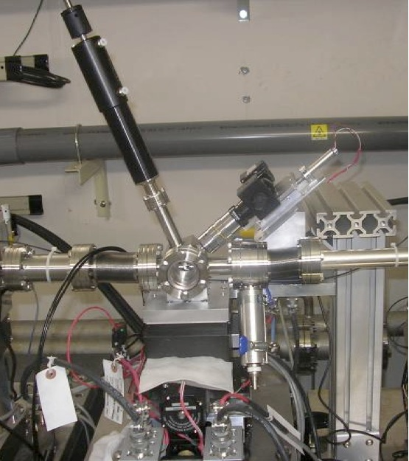
Multi-OTR Monitor at ATF2
IFIC (CSIC-UV)/SLAC/KEK
OTR (Optical Transition Radiation) monitor developed at ATF demonstrated the ability to measure a 5.5 μm beam size in one pulse.
Multiple OTR monitors for the ATF2
Realize the fast emittance measurement
Four OTR monitors with the Wire Scanners
Improved resolution of about 2 μm
Aluminum or Aluminized Mylar target
Installed in summer 2010
ATF2

Slide 11
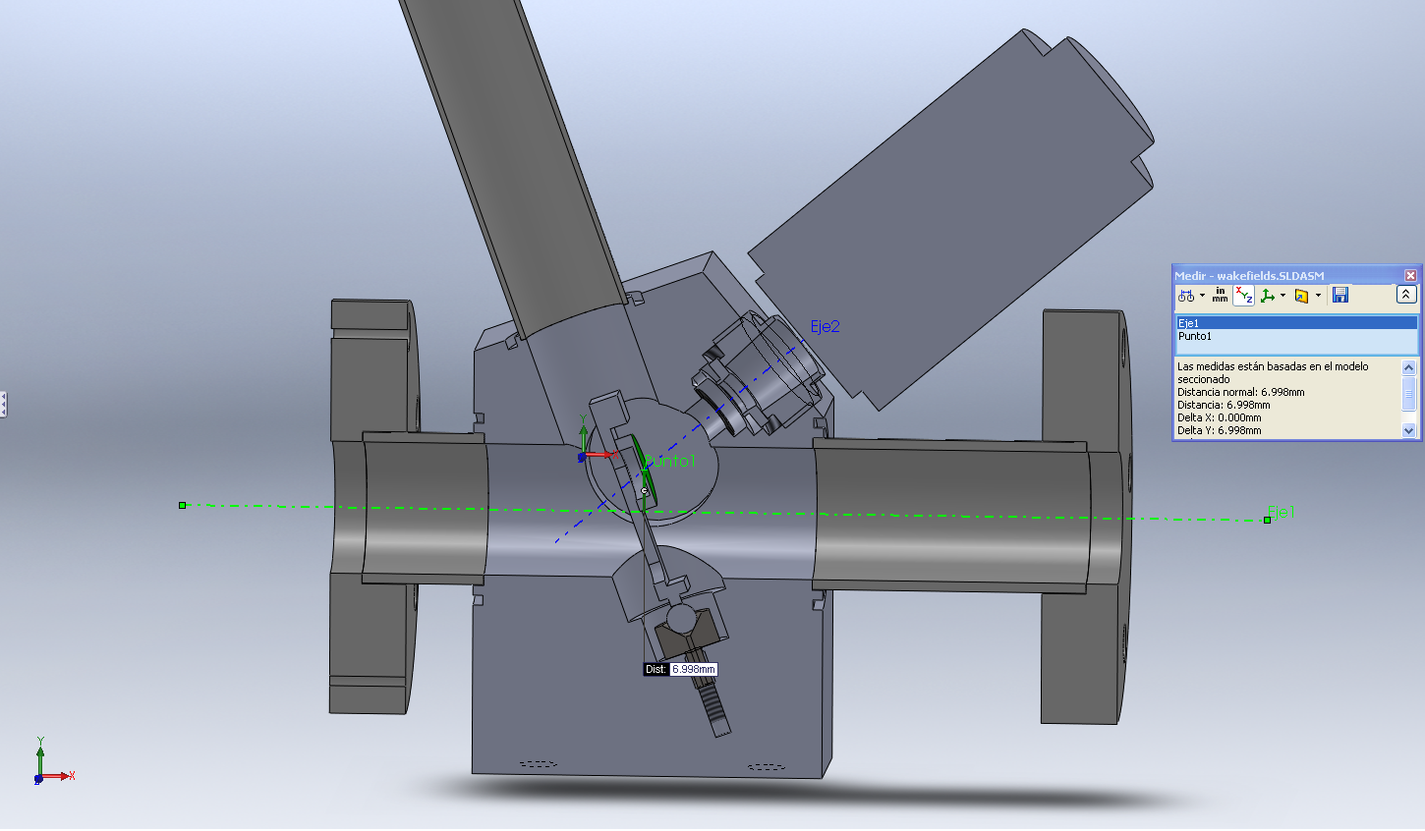
ATF2 OTR monitor (4 units)
Target is inserted during the measurement of a beam profile.
There are a lot of holes, asymmetric in vertical.
Hole for target insertion
Hole for an optics
path
Side hole for
a viewport
Hole for a target
positioner

Slide 12
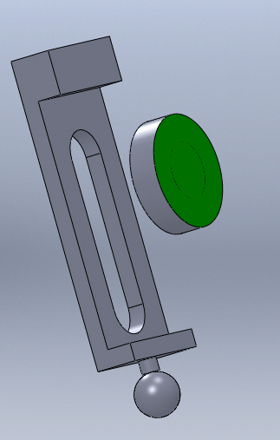
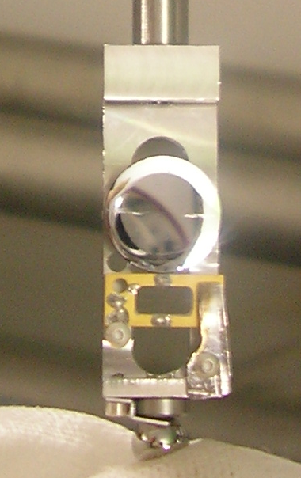
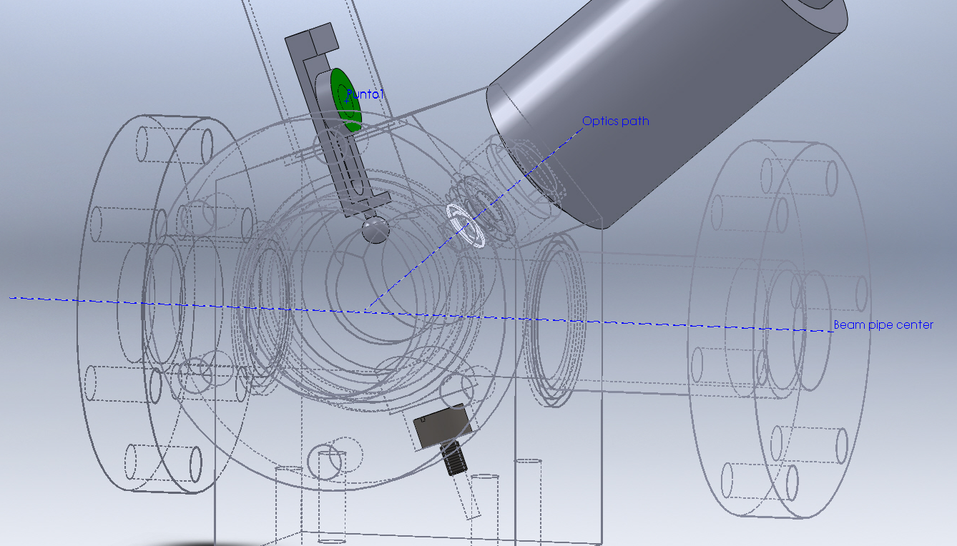
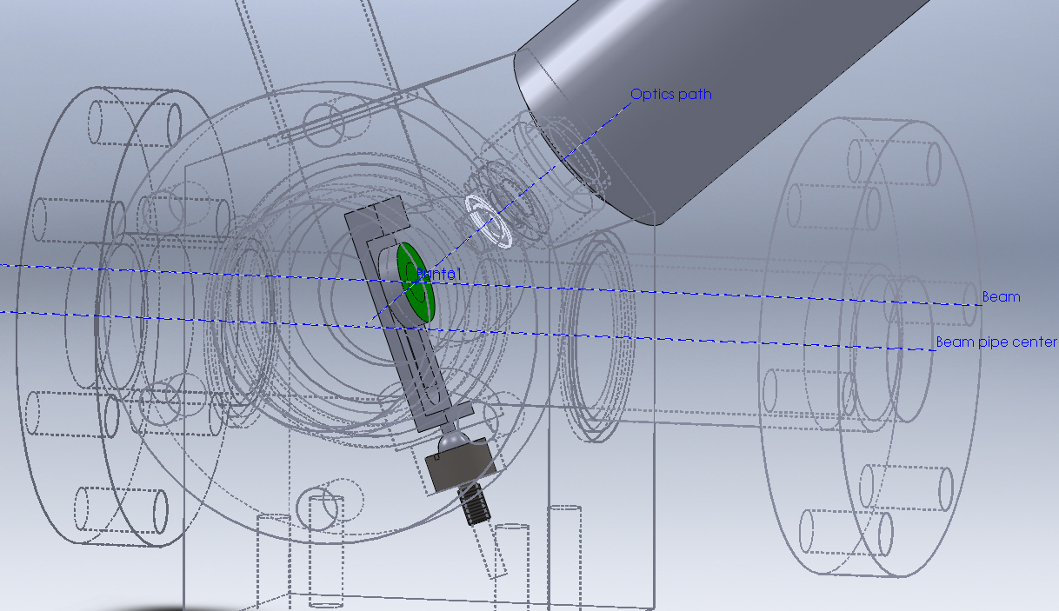
Current target holder
The target is fixed to the holder by a screw in the back.
It places the target about 7mm from the center of the beam pipe when it is inserted.
The beam is in the center of the beam pipe when the OTR is in not measuring position (not lowered).
Target out
Target inserted

Slide 13
Present Status
The 44 nm beam size was observed when an OTR monitor shifted about 6 mm.
It was not recovered well after the OTRs removal but the intensity dependence was improved significantly.
We suspect other wakefield source that OTR cancels. Gate Valves?
Now in the summer shutdown, will be back in October.

