Slide 1
Multi-sample averaging
D. R. Bett

Slide 2
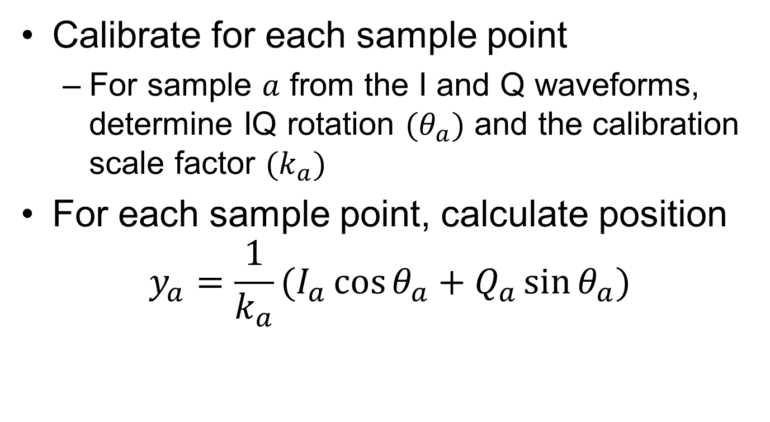
Averaging method (I)
Calibrate for each sample point
  For sample $a$ from the I and Q waveforms, determine IQ rotation $(θ_{a})$ and the calibration scale factor $(k_{a})$
For each sample point, calculate position
$y_{a}=\frac{1}{k_{a}}(I_{a}\cos{θ_{a}}+Q_{a}\sin{θ_{a}})$

Slide 3
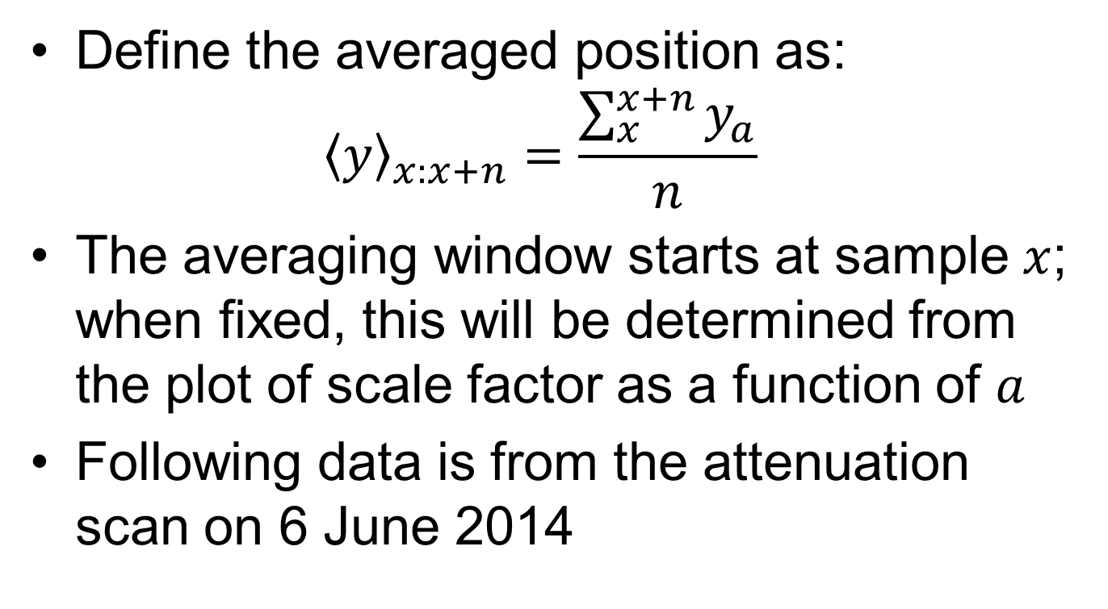
Averaging method (II)
Define the averaged position as:
${〈y〉}_{x:x+n}=\frac{\sum_{x}^{x+n}{y_{a}}}{n}$
The averaging window starts at sample $x$;
when fixed, this will be determined from the plot of scale factor as a function of $a$
Following data is from the attenuation scan on 6 June 2014

Slide 4
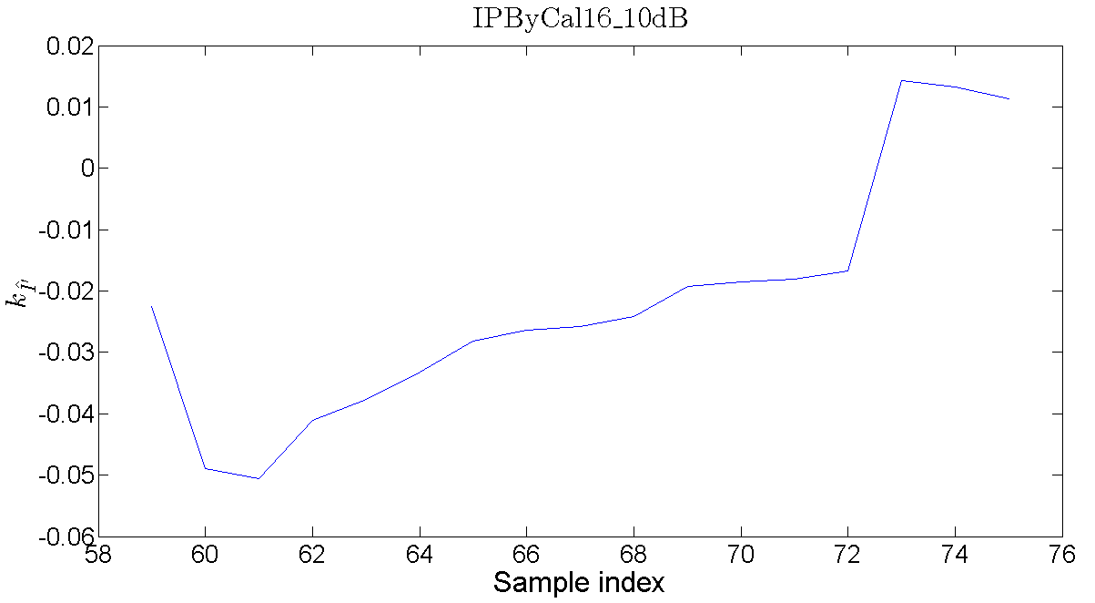
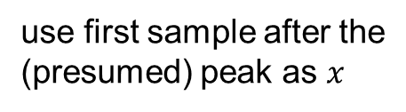
Averaging method (III)
use first sample after the
(presumed) peak as $x$

Slide 5
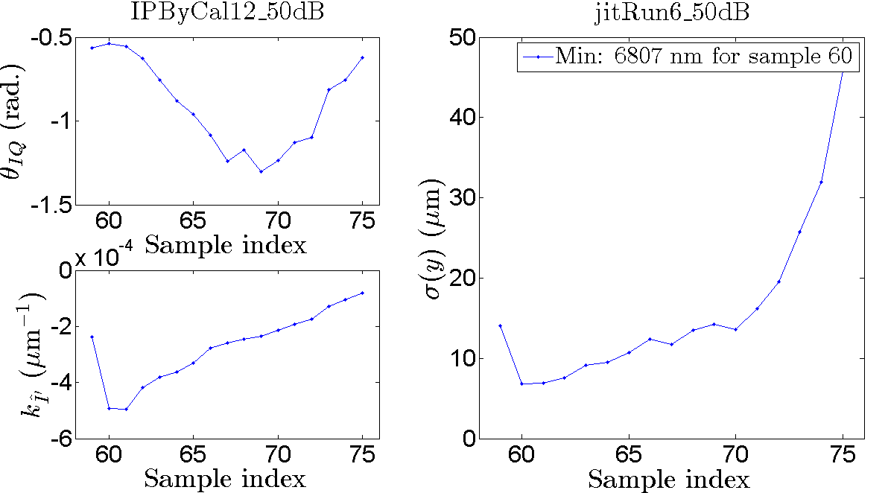

Single sample (50 dB)
$$Σ_{P2} \\ μ=2450$$
$$σ=82$$

Slide 6
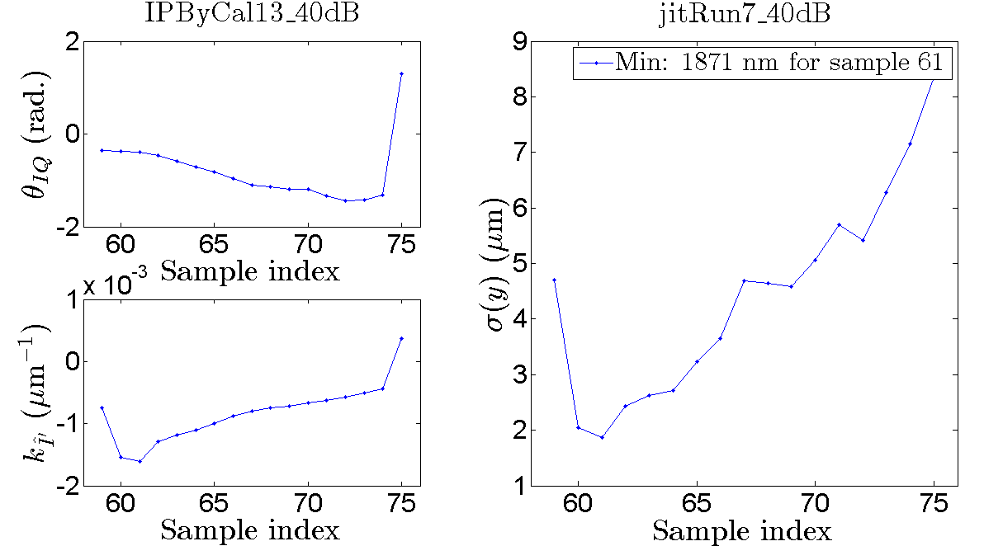

Single sample (40 dB)
$$Σ_{P2} \\ μ=2441$$
$$σ=87$$

Slide 7
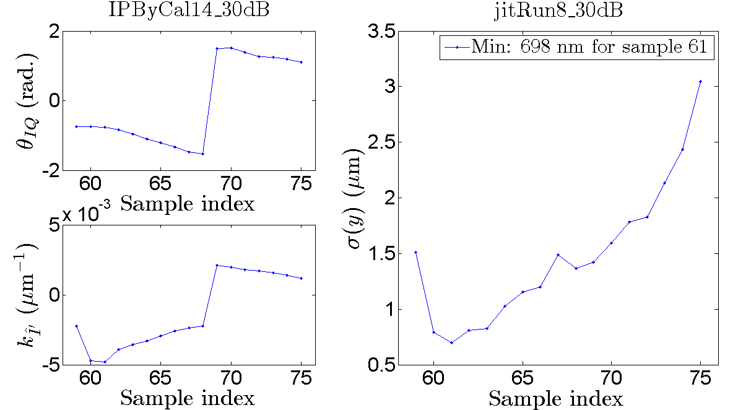

Single sample (30 dB)
$$Σ_{P2} \\ μ=2431$$
$$σ=97$$

Slide 8
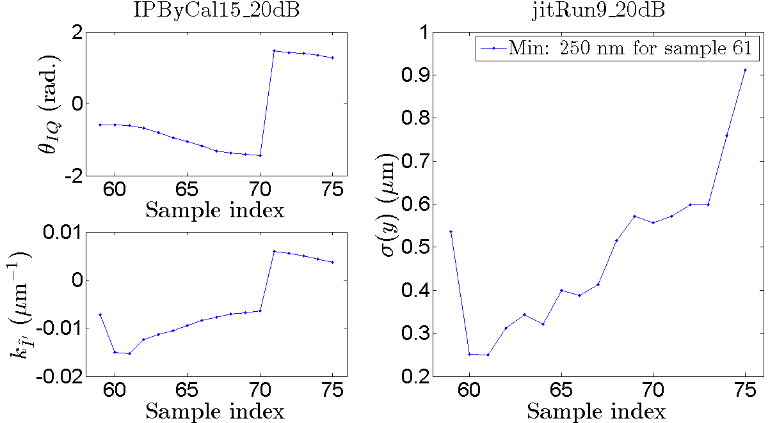

Single sample (20 dB)
$$Σ_{P2} \\ μ=2428$$
$$σ=79$$

Slide 9
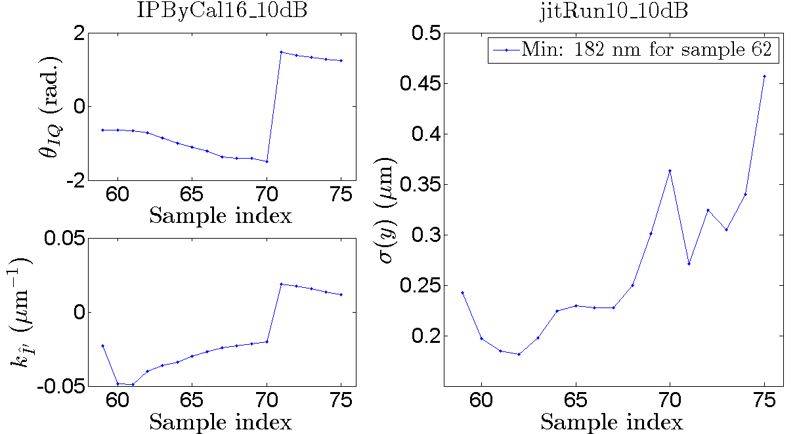

Single sample (10 dB)
$$Σ_{P2} \\ μ=2448$$
$$σ=76$$

Slide 10
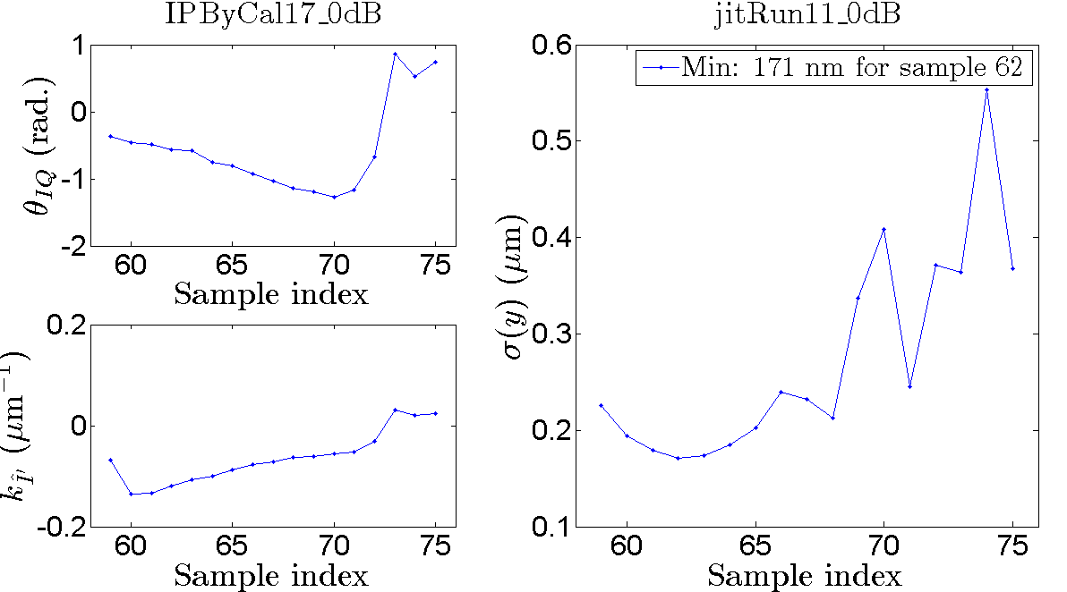

Single sample (0 dB)
$$Σ_{P2} \\ μ=2434$$
$$σ=89$$

Slide 11
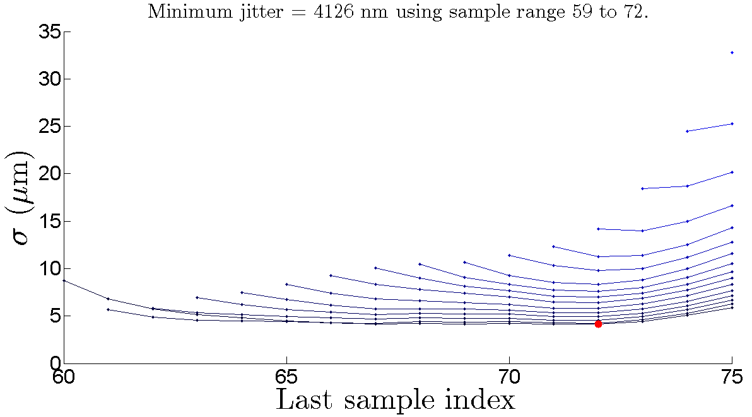
Multi-sample (50 dB)
$$Σ_{P2} \\ μ=2450$$
$$σ=82$$
The four points from this line correspond
to averaging windows starting at sample 71

Slide 12
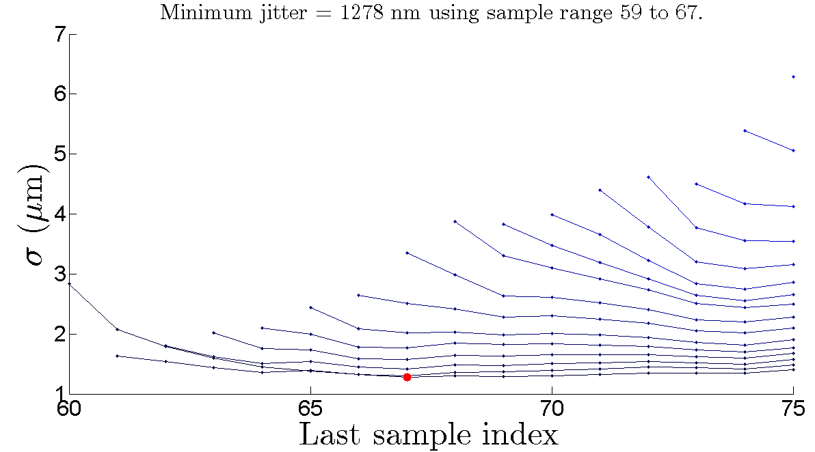
Multi-sample (40 dB)
$$Σ_{P2} \\ μ=2441$$
$$σ=87$$

Slide 13
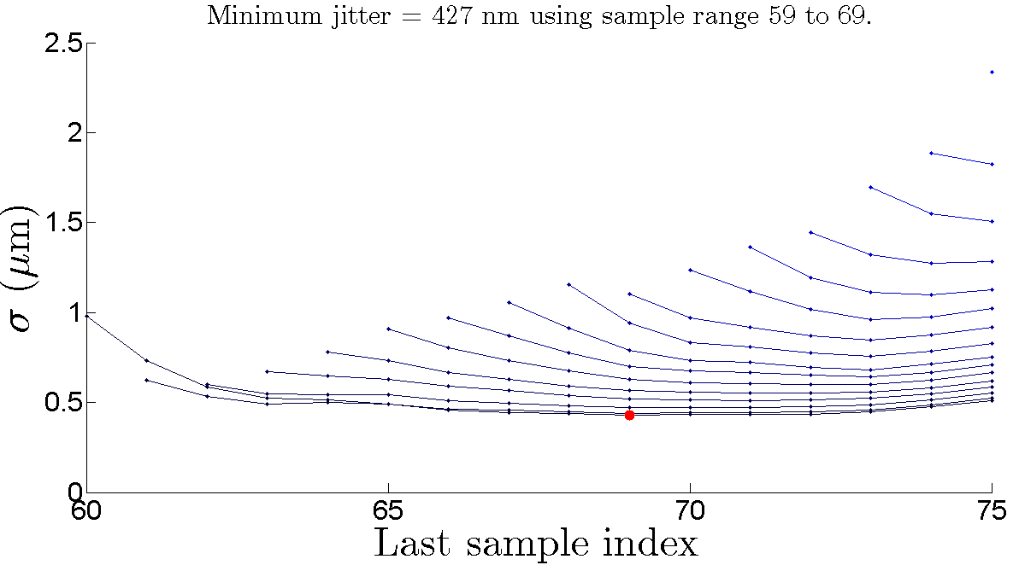
Multi-sample (30 dB)
$$Σ_{P2} \\ μ=2431$$
$$σ=97$$

Slide 14
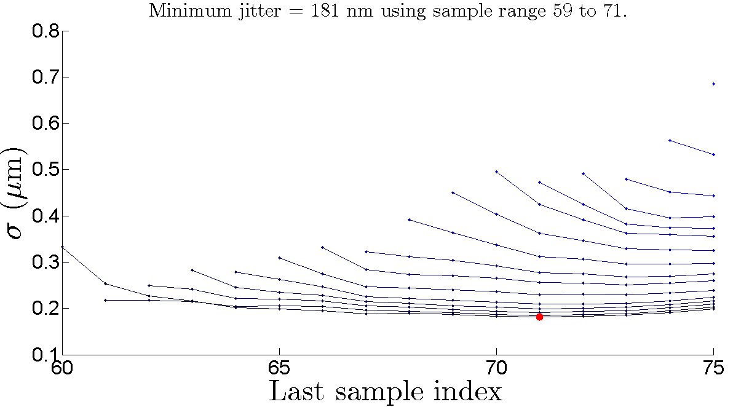
Multi-sample (20 dB)
$$Σ_{P2} \\ μ=2428$$
$$σ=79$$

Slide 15
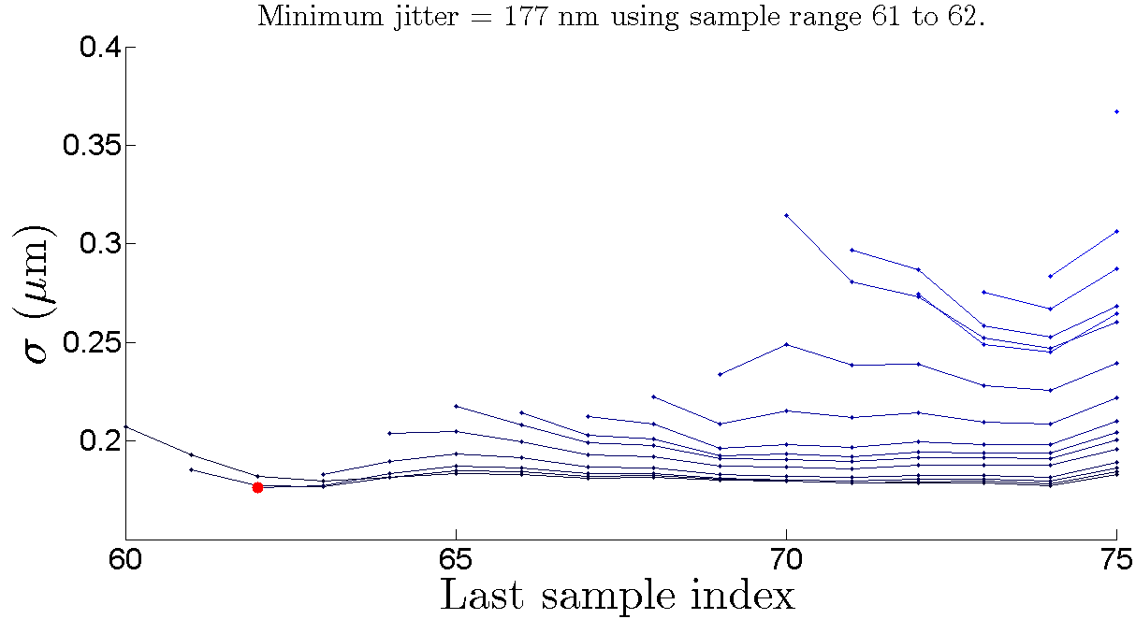
Multi-sample (10 dB)
$$Σ_{P2} \\ μ=2448$$
$$σ=76$$

Slide 16
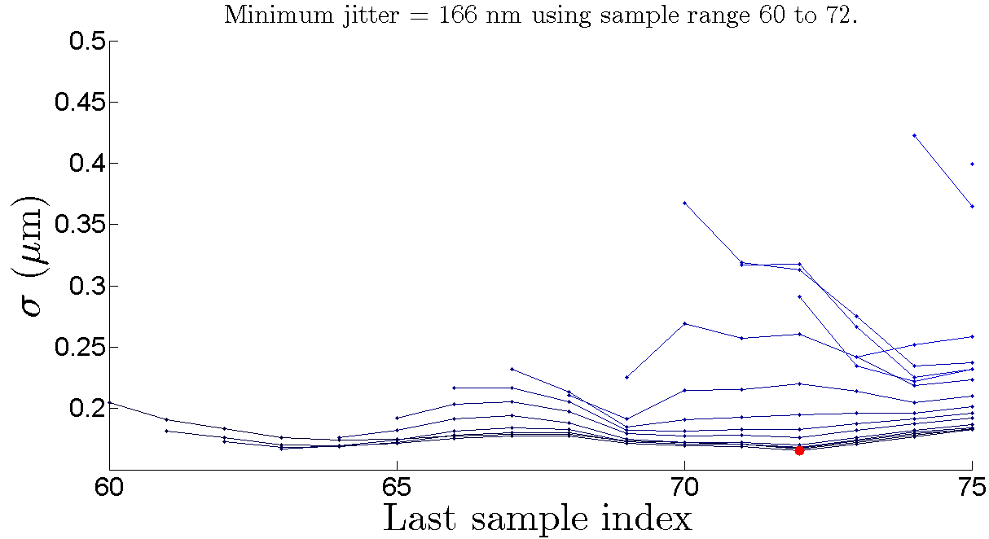
Multi-sample (0 dB)
$$Σ_{P2} \\ μ=2434$$
$$σ=89$$

Slide 17
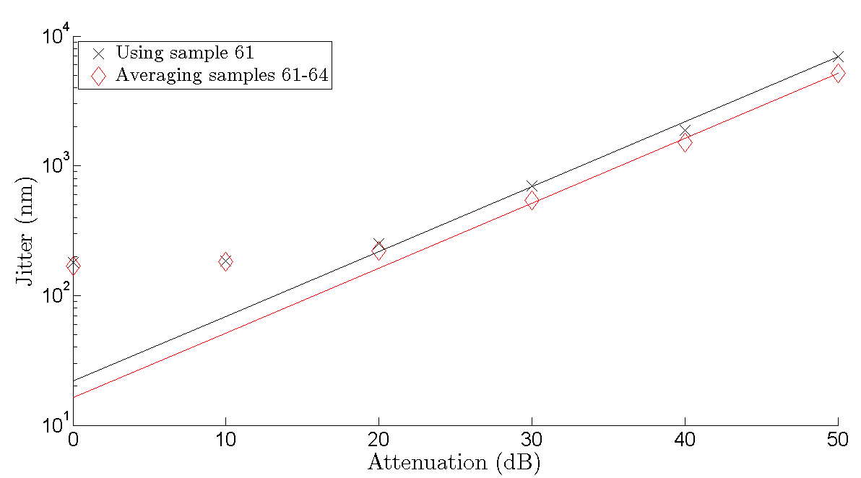
Collected results (I)
Scale performance at 50 dB
22 nm
16 nm

Slide 18
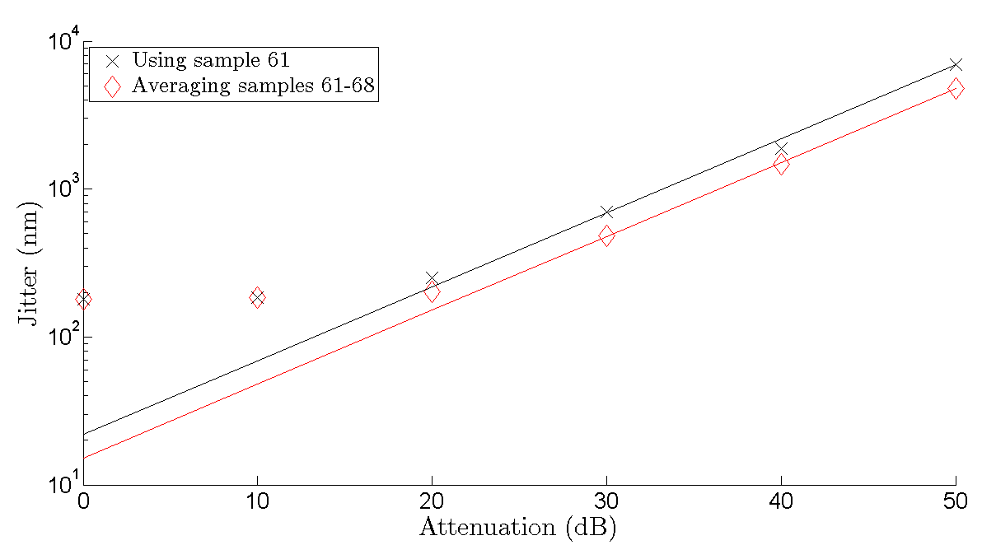
Collected results (II)
22 nm
15 nm

Slide 19
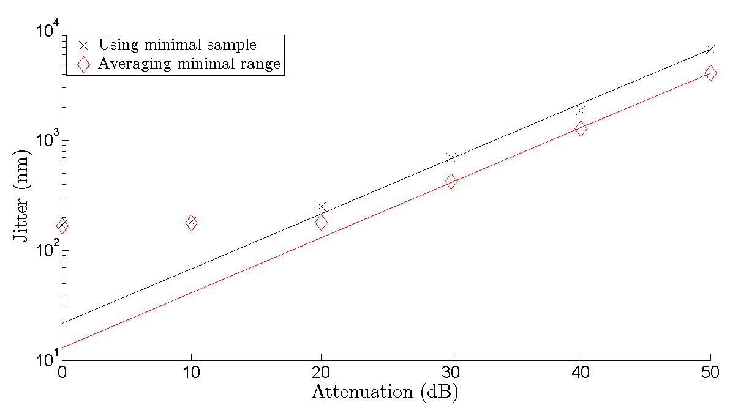
Collected results (III)
22 nm
13 nm

Slide 20
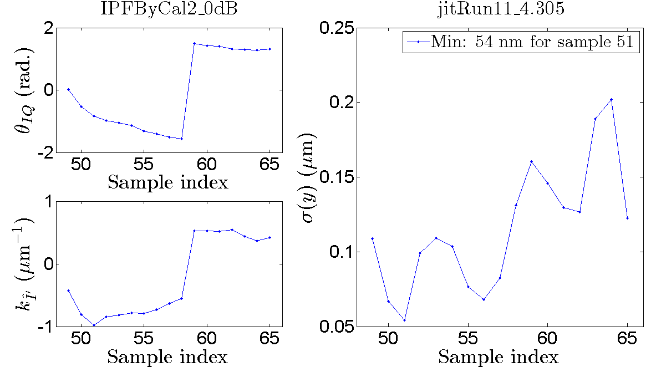

jitRun11 (on waist)
$$Σ_{P2} \\ μ=831$$
$$σ=22$$

Slide 21
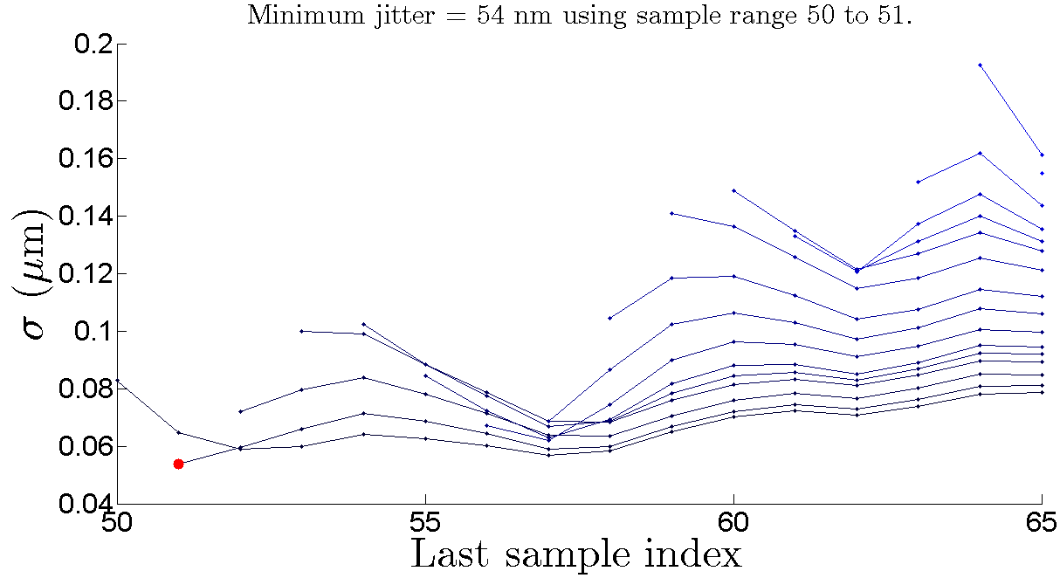
jitRun11 (on waist)
$$Σ_{P2} \\ μ=831$$
$$σ=22$$

Slide 22
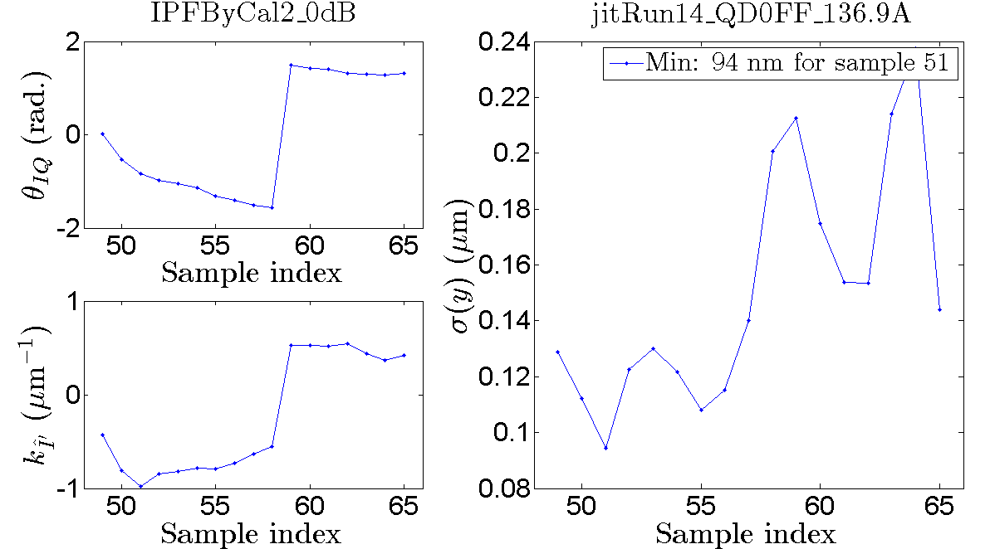

jitRun14 (-0.2 A)
$$Σ_{P2} \\ μ=810$$
$$σ=27$$

Slide 23
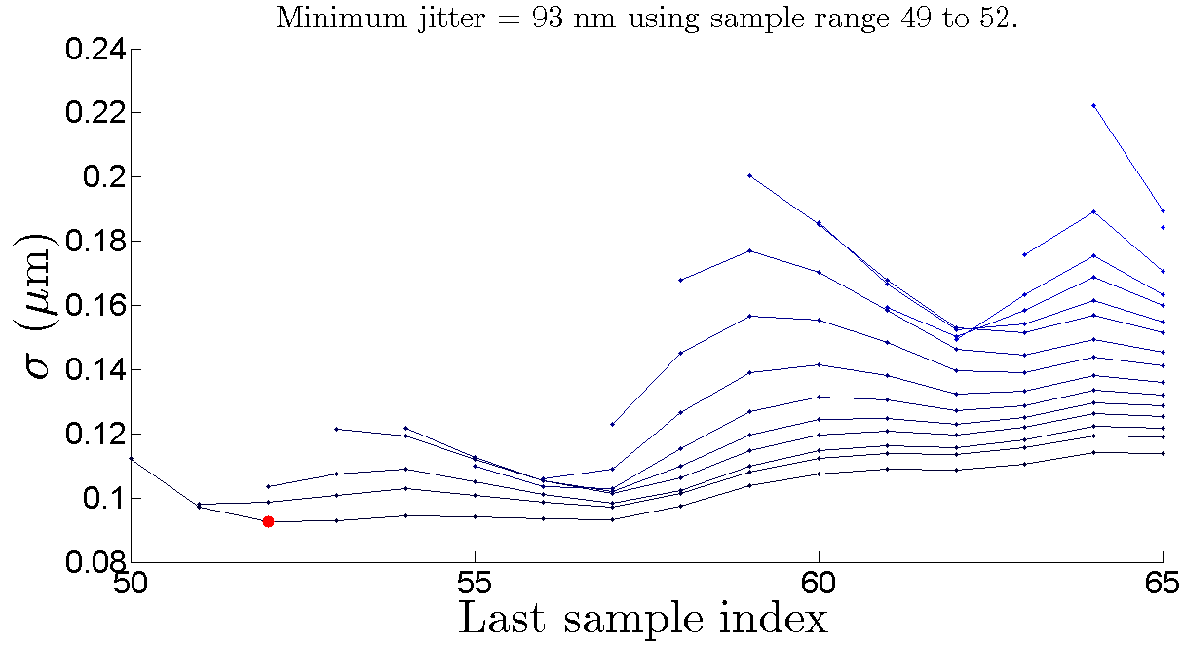
jitRun14 (-0.2 A)
$$Σ_{P2} \\ μ=810$$
$$σ=27$$

Slide 24
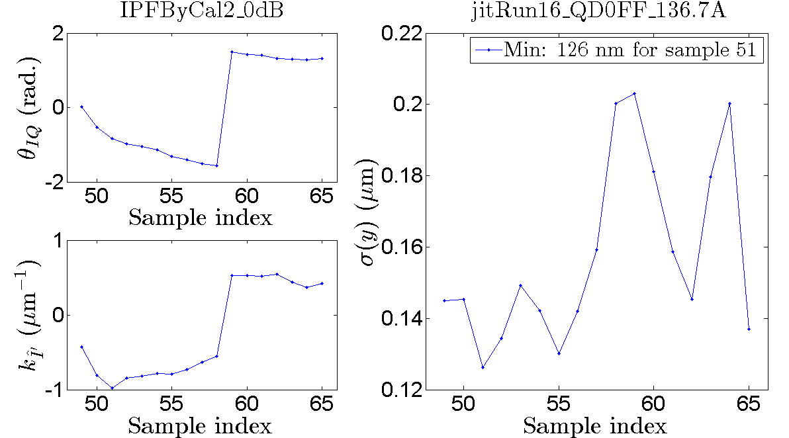

jitRun16 (-0.4 A)
$$Σ_{P2} \\ μ=825$$
$$σ=25$$

Slide 25
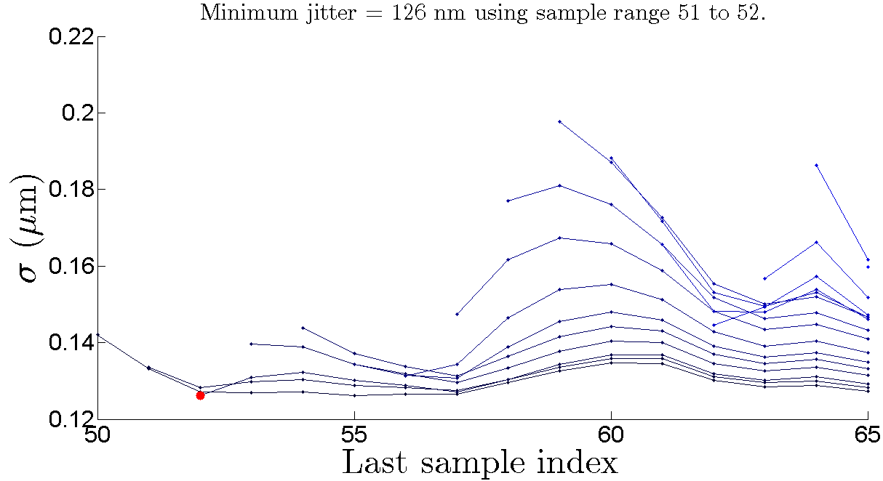
jitRun16 (-0.4 A)
$$Σ_{P2} \\ μ=825$$
$$σ=25$$

Slide 26
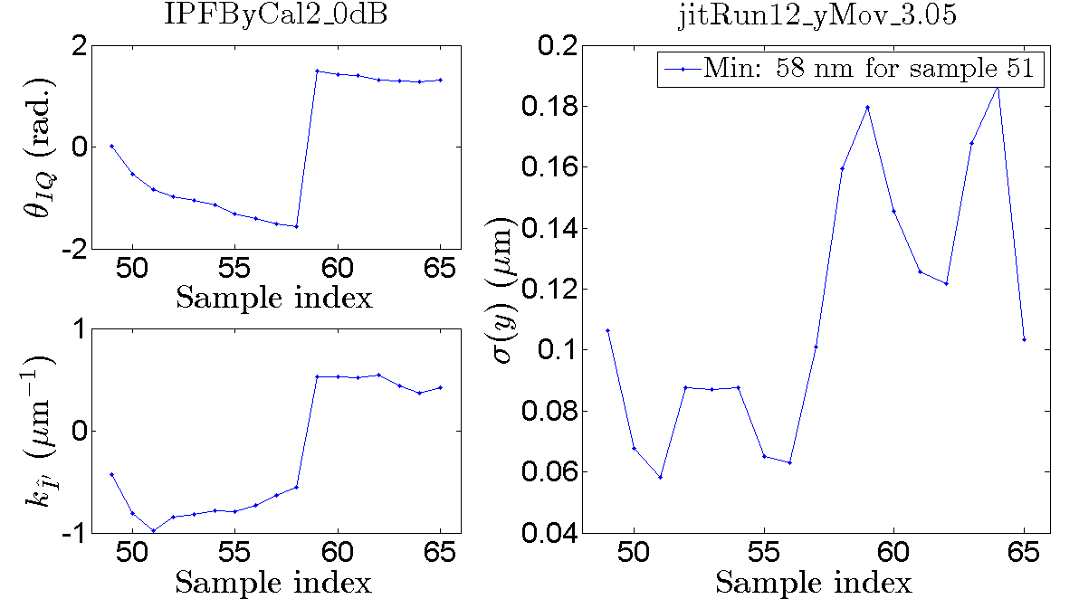

jitRun12 (on waist)
$$Σ_{P2} \\ μ=843$$
$$σ=26$$

Slide 27
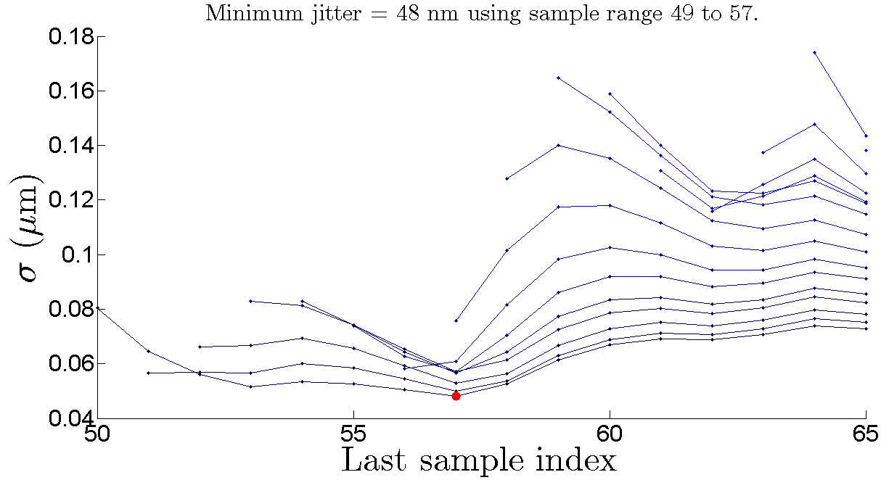
jitRun12 (on waist)
$$Σ_{P2} \\ μ=843$$
$$σ=26$$

Slide 28
Summary
While resolution limited, the jitter can be reduced through multi-sample averaging
Jitter typically reduced by 20%-40%, depending on averaging window chosen

