Slide 1
Effect of IPK at IPB
N. Blaskovic

Slide 2
Contents
Effect of IPK at IPB in June 2012 (operating IPK from S-band hut)
Effect of IPK at IPB in January 2013 (operating IPK via the feedforward cable)
Effect of IPK at IPB in June 2014 (operating IPK with a local board at the IP) with effective bunch spacing of:
116 buckets
77 buckets
N. Blaskovic

Slide 3
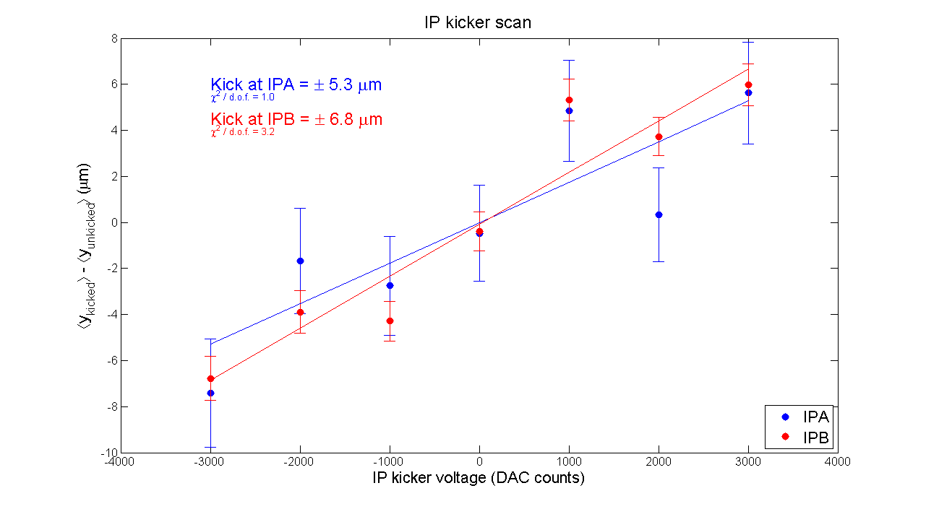
Our first tests using the IPK kicker in June 2012 showed that we could obtain a kick of ± 7 um at IPB
12 June 2012 FONT Twiki
N. Blaskovic

Slide 4
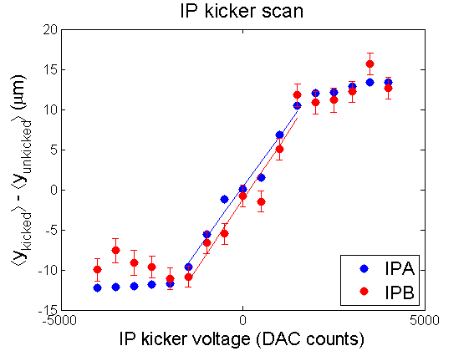
Our next tests using the IPK kicker in June 2012 showed that we could obtain a kick in excess of ± 10 um at IPB
15 June 2012 ATF Operation Meeting report, by Doug
N. Blaskovic

Slide 5
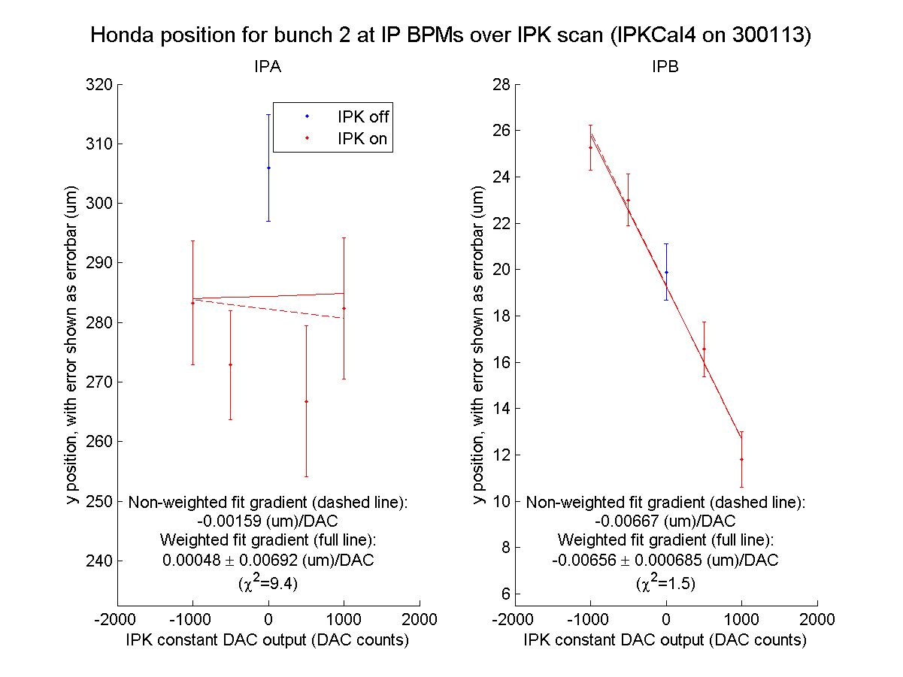
In January 2013, we used to get -0.007 um/DAC kick and a linear range from -1000 to 1000 DAC counts
N. Blaskovic

Slide 6
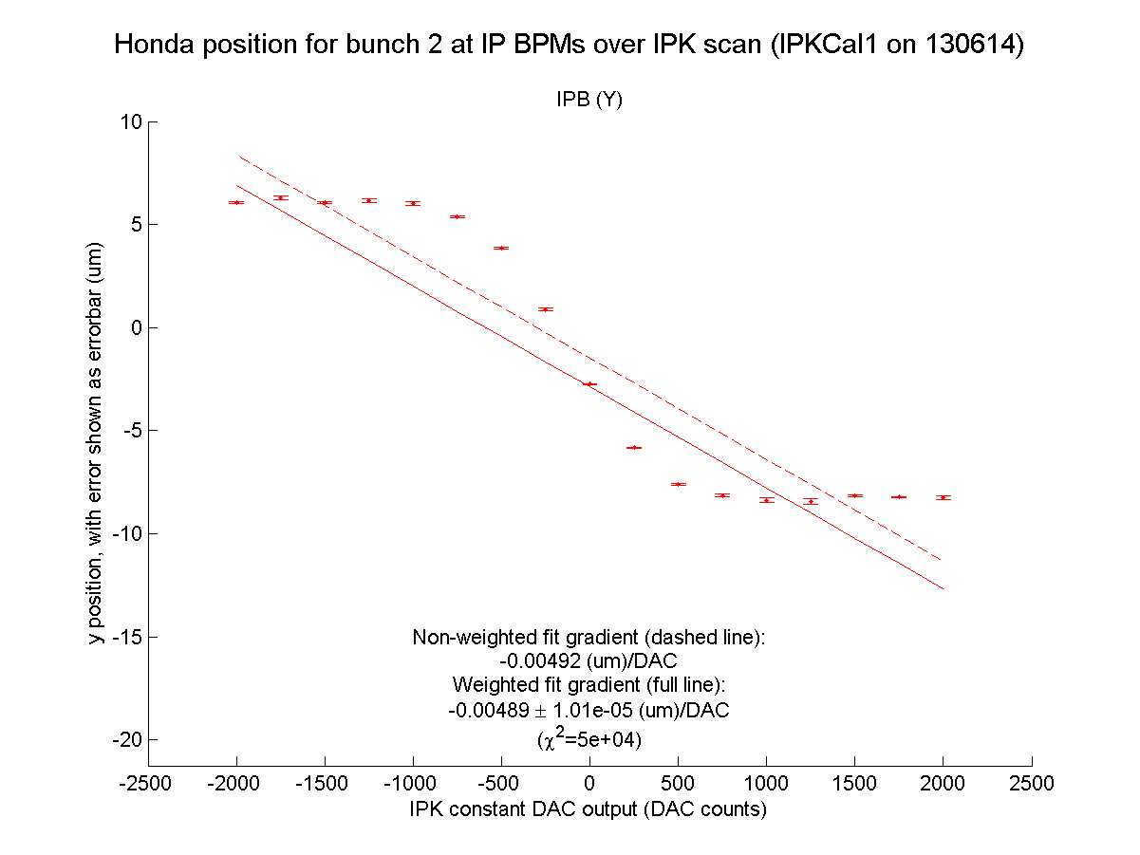
Now in June 2014 with a bunch 1 strobe 116 samples before the bunch, we have a linear range much smaller than -1000 to 1000 DAC
N. Blaskovic

Slide 7
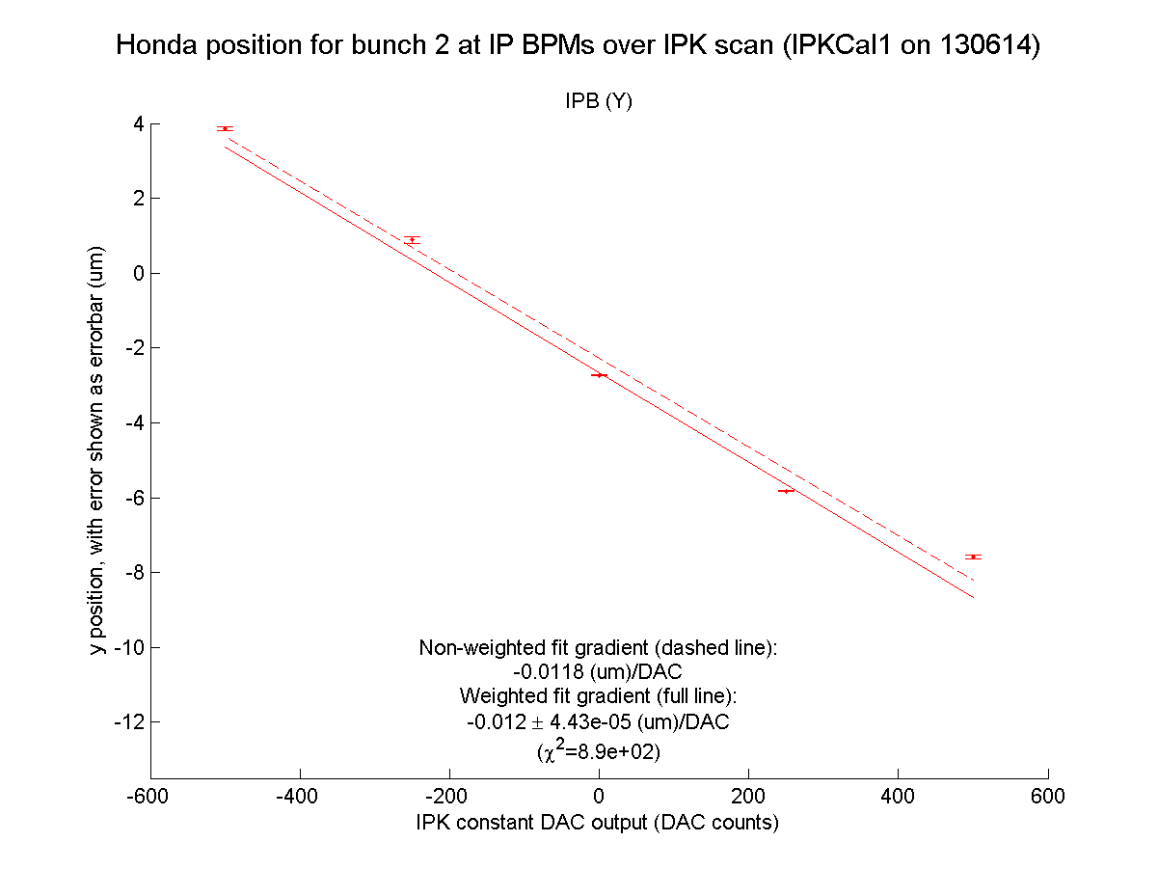
Now in June 2014 with a bunch 1 strobe 116 samples before the bunch, we have a linear range much smaller than -1000 to 1000 DAC but a larger effect with -0.012 um/DAC in the linear range
N. Blaskovic

Slide 8
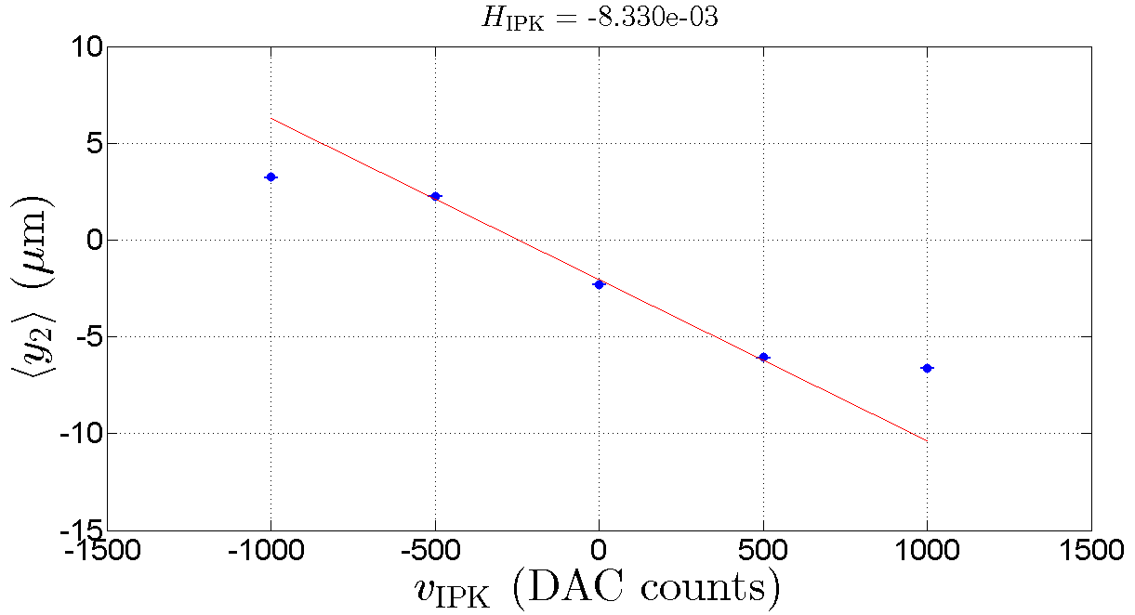
Now in June 2014 with 77 bucket bunch spacing, the linear range is still smaller than -1000 to 1000 DAC counts and the kicker’s effect is reduced to -0.008 um/DAC in the linear range
IPKcal1 on 190614, from Doug
N. Blaskovic

Slide 9
Conclusions
Shorter bunch spacing may yield weaker um/DAC kick (slides 7 & 8)
Kicker saturation appears at lower DAC settings when IPK driven by local board compared to when driven from S-band hut or via feedforward cable (slides 3, 5 & 6)
The maximum kick of IPK at IPB was in excess of ± 10 um in June 2012, but only ± 7 um in June 2014 (slides 4 & 6)
N. Blaskovic

