Slide 1
Honda electronics and IP kicker results
N. Blaskovic
N. Blaskovic

Slide 2
Contents
Limiter in LO for Honda 2nd stage
Waveforms over IP BPM calibration
Jitter (resolution) vs. beam position
Jitter (resolution) vs. charge
IP feedback latency
IP kicker range and strength
N. Blaskovic

Slide 3
LO for 2nd stage
Limiter output is LO for Honda 2nd stage
With Oscar, bunch charge was varied and the 4 outputs of the limiter were monitored
Performed with 2nd stage in S-band hut
Limiter output appears limited as intended for duration longer than BPM decay time
~714 MHz IPB(Y)
delay cable
Mixer
~714 MHz Ref(Y)
BPF
Amplifier
Limiter
N. Blaskovic

Slide 4
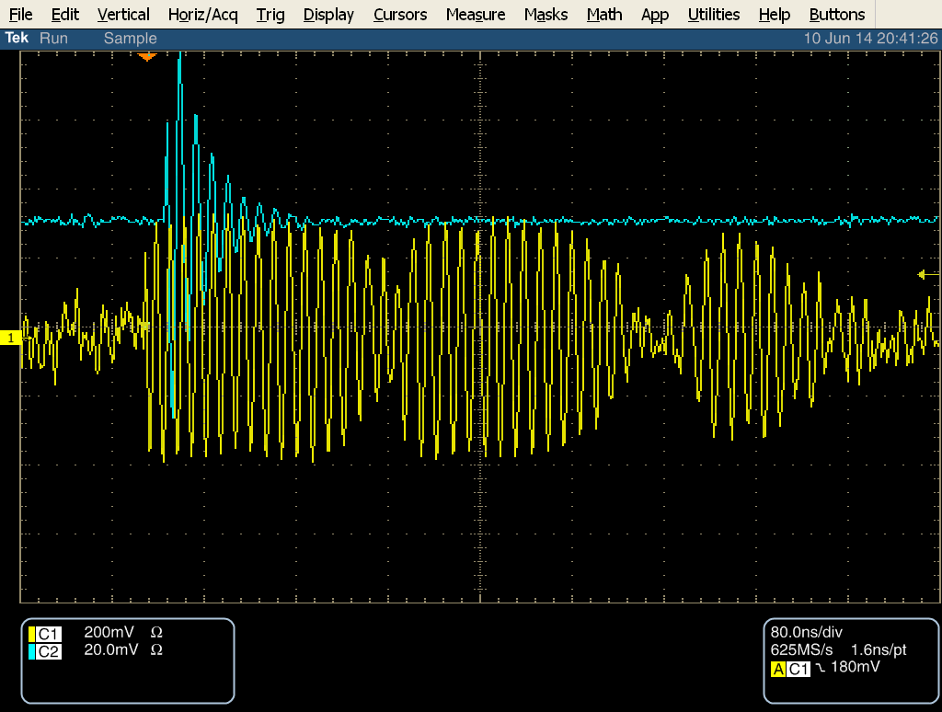
IP ICT charge: 0.066 x 10¹⁰ ± 5 %
IPA (Y) pre-2nd stage mixer
LO for 2nd stage mixer (channel 1)
N. Blaskovic

Slide 5
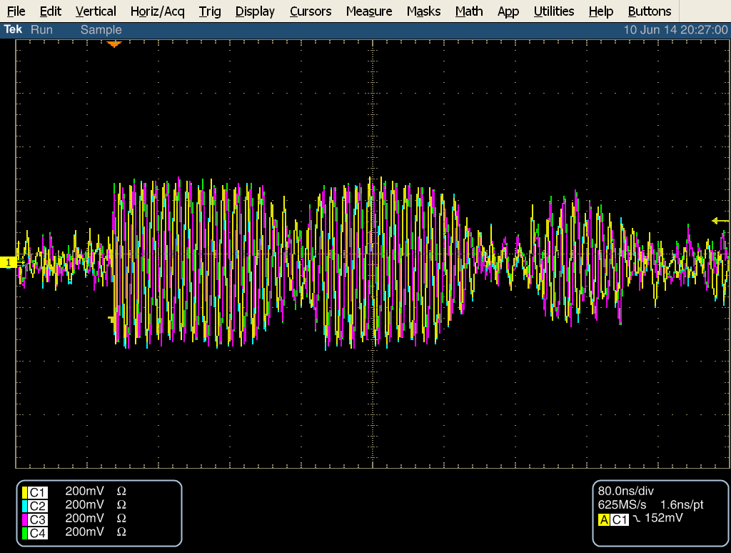
IP ICT charge: 0.046 x 10¹⁰ ± 20 %
LO for 2nd stage mixer (channels 1–4)
N. Blaskovic

Slide 6
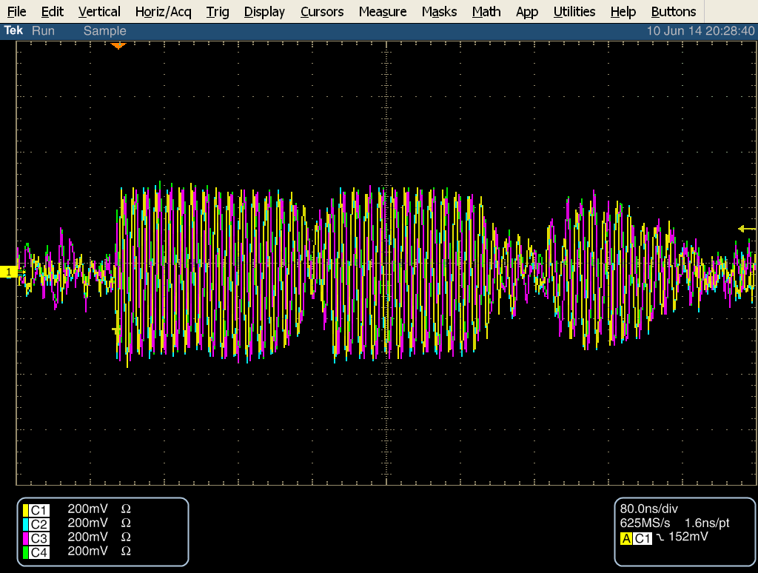
IP ICT charge: 0.102 x 10¹⁰ ± 10 %
LO for 2nd stage mixer (channels 1–4)
N. Blaskovic

Slide 7
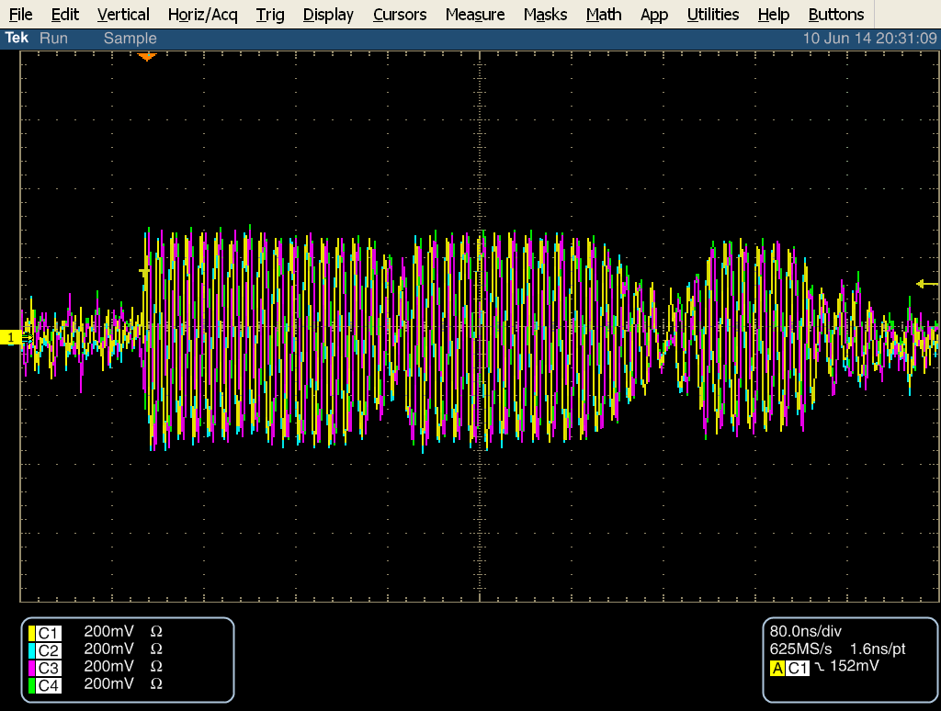
IP ICT charge: 0.206 x 10¹⁰ ± 6 %
LO for 2nd stage mixer (channels 1–4)
N. Blaskovic

Slide 8
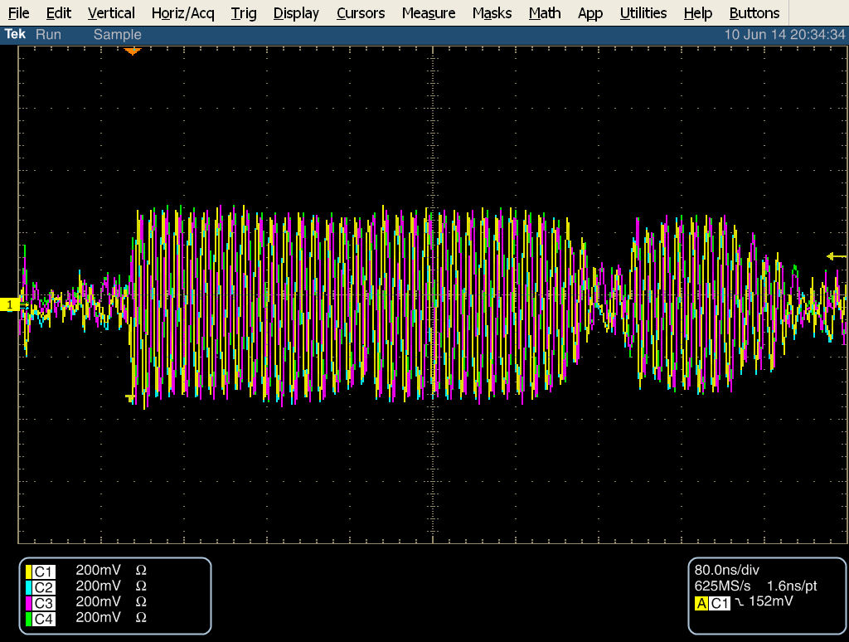
IP ICT charge: 0.406 x 10¹⁰ ± 2 %
LO for 2nd stage mixer (channels 1–4)
N. Blaskovic

Slide 9
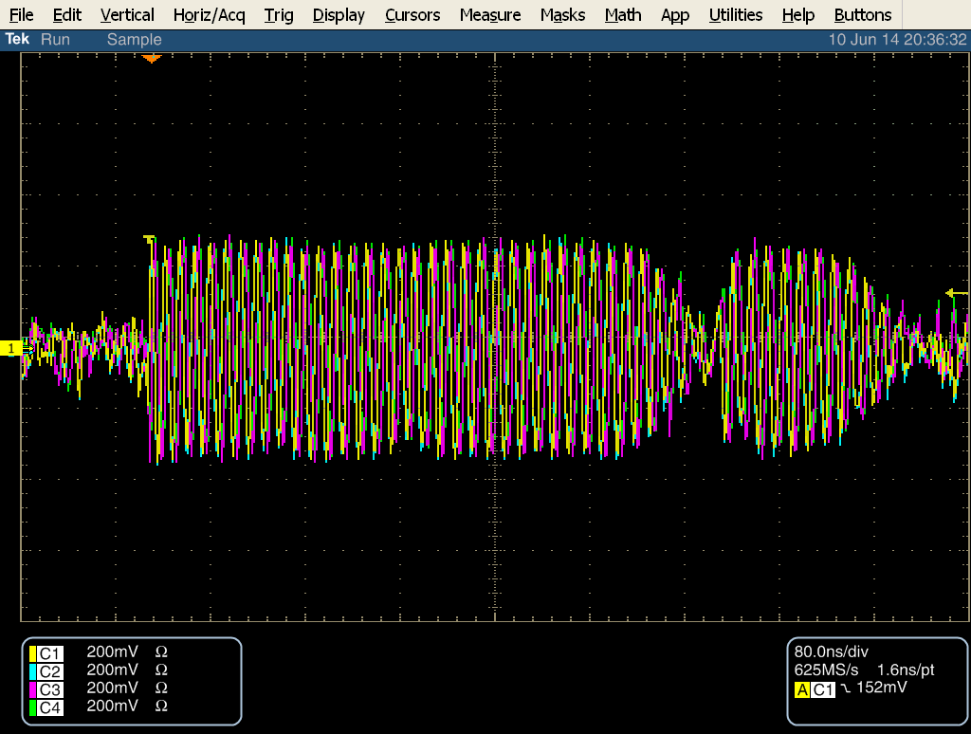
IP ICT charge: 0.504 x 10¹⁰ ± 3 %
LO for 2nd stage mixer (channels 1–4)
N. Blaskovic

Slide 10
Waveforms over calibration
IPB (Y) mover scan
IPB (Y) variable attenuator at 0 dB
Waveform gradually shifts with mover position but significant superimposed structure present
N. Blaskovic

Slide 11
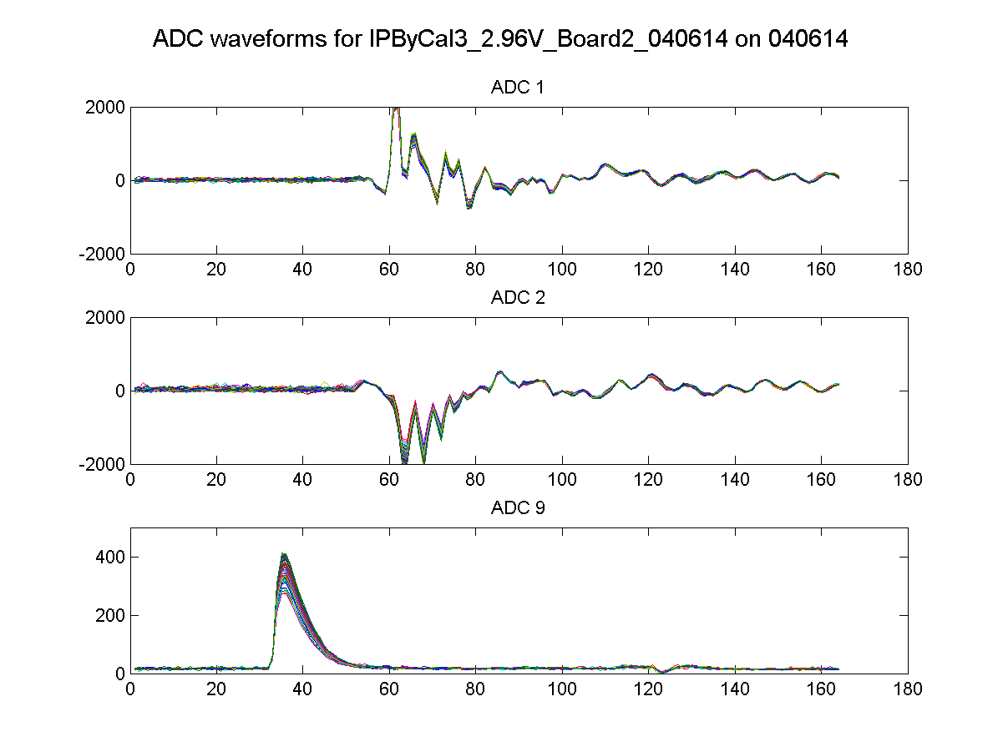
IPB(Y) I
IPB(Y) Q
Ref(Y)
N. Blaskovic

Slide 12
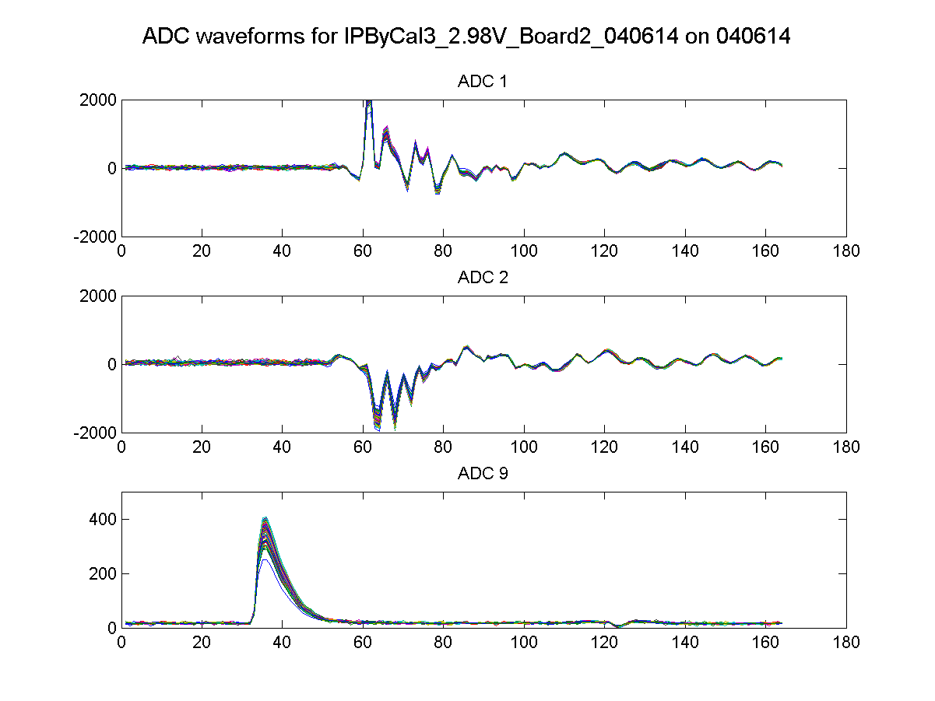
IPB(Y) I
IPB(Y) Q
Ref(Y)
N. Blaskovic

Slide 13
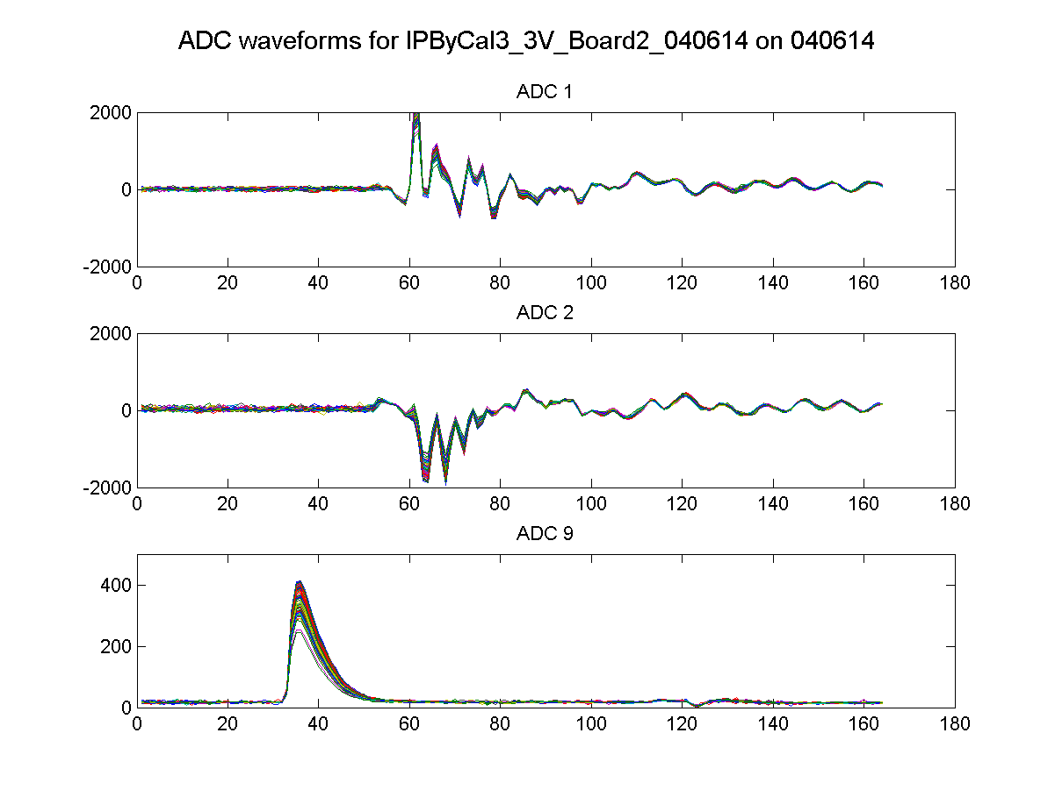
IPB(Y) I
IPB(Y) Q
Ref(Y)
N. Blaskovic

Slide 14
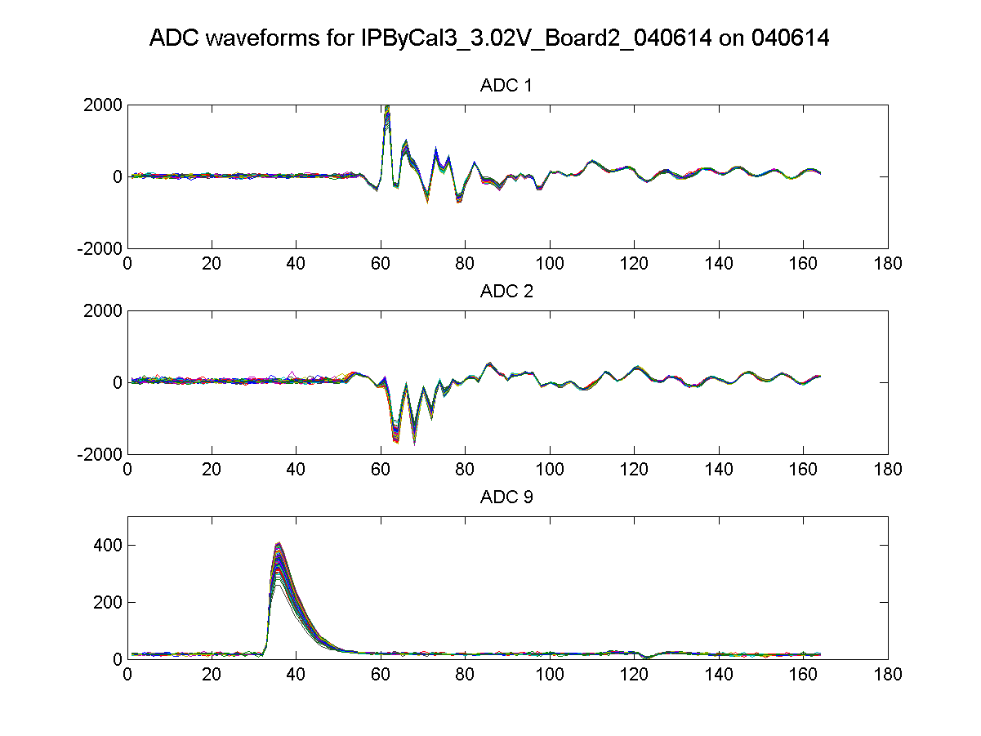
IPB(Y) I
IPB(Y) Q
Ref(Y)
N. Blaskovic

Slide 15
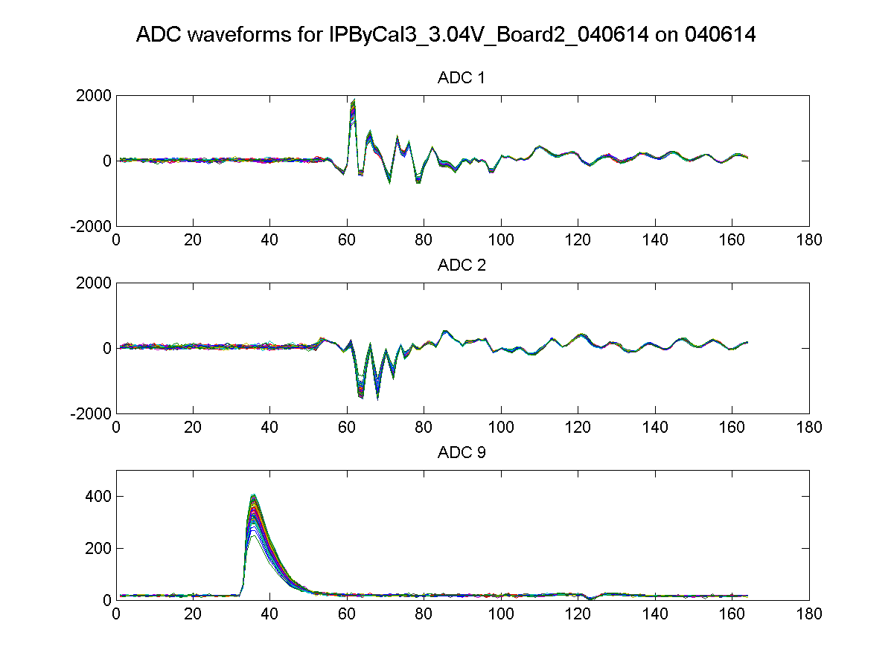
IPB(Y) I
IPB(Y) Q
Ref(Y)
N. Blaskovic

Slide 16
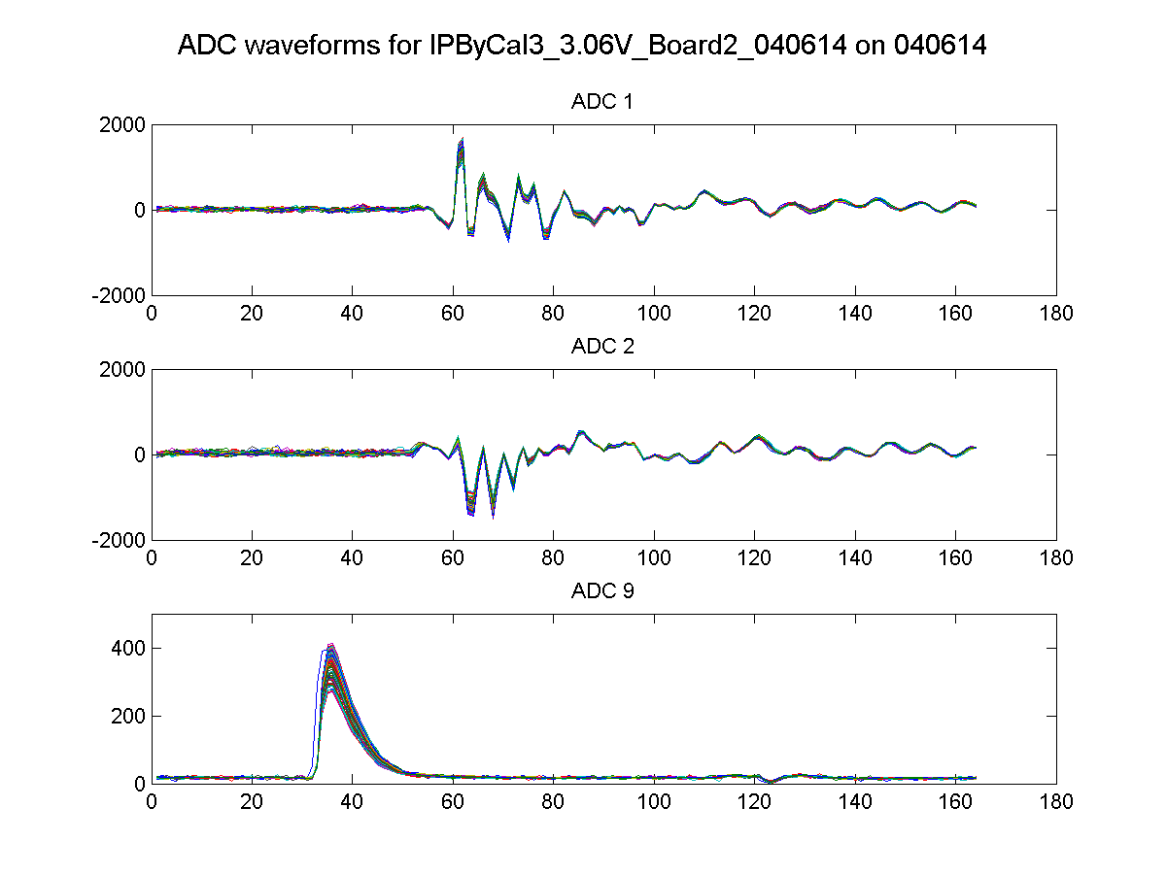
IPB(Y) I
IPB(Y) Q
Ref(Y)
N. Blaskovic

Slide 17
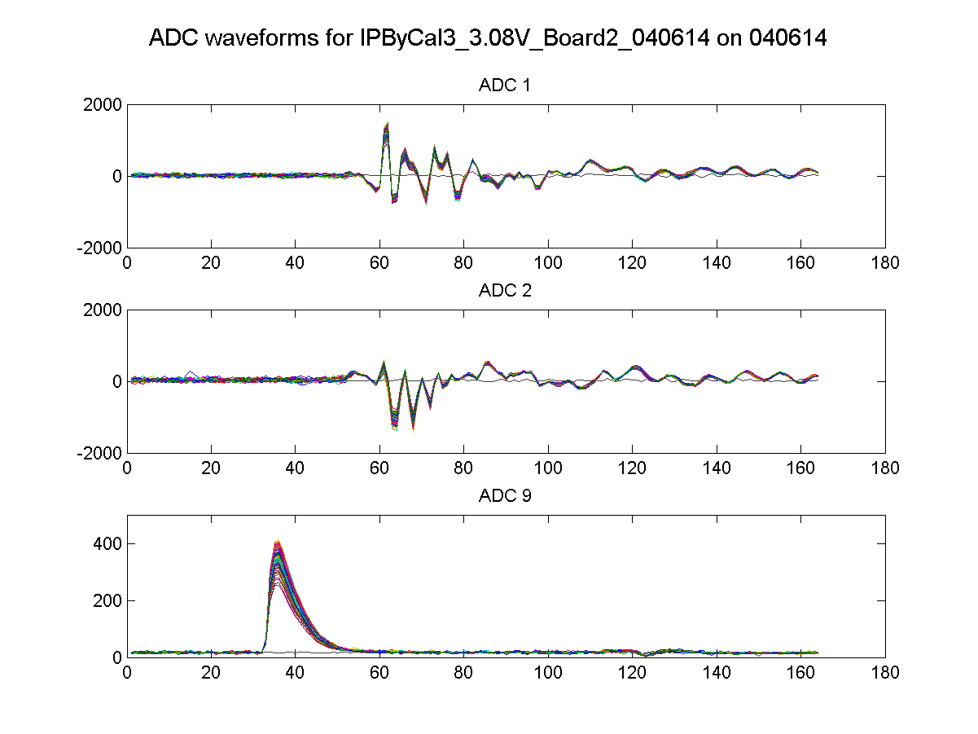
IPB(Y) I
IPB(Y) Q
Ref(Y)
N. Blaskovic

Slide 18
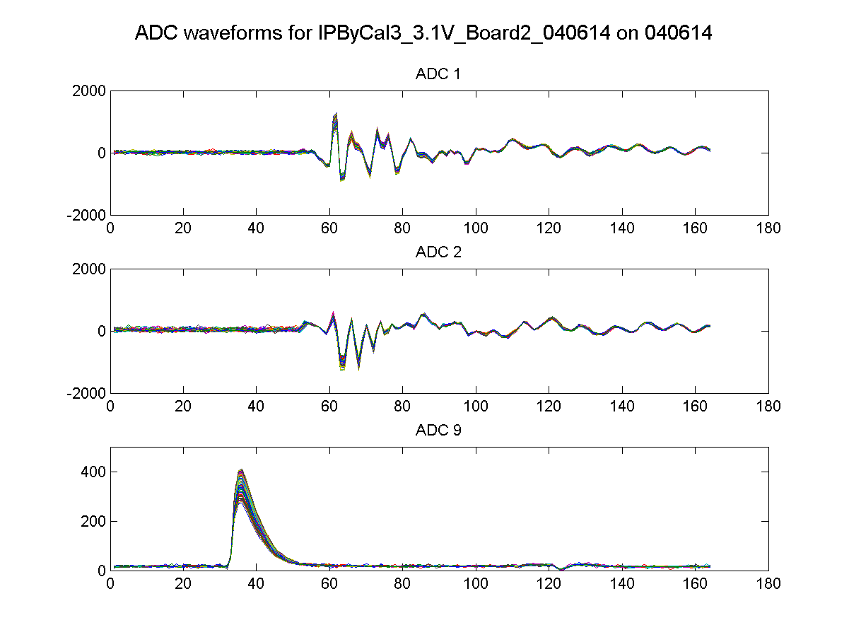
IPB(Y) I
IPB(Y) Q
Ref(Y)
N. Blaskovic

Slide 19
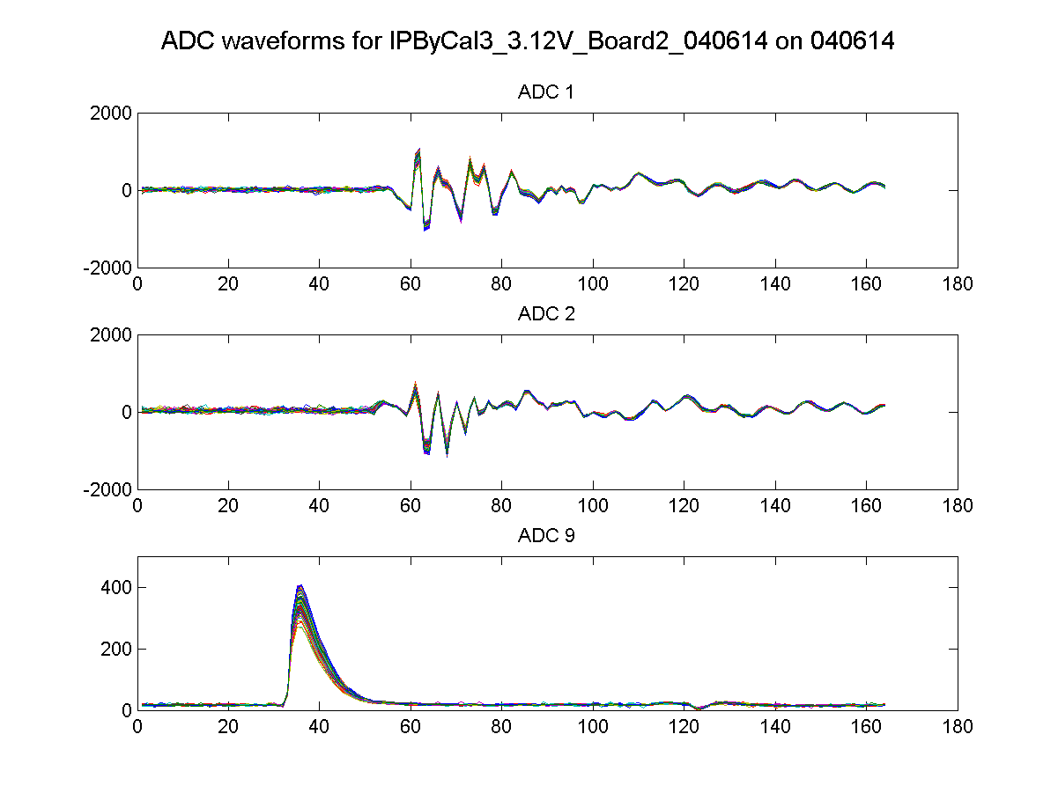
IPB(Y) I
IPB(Y) Q
Ref(Y)
N. Blaskovic

Slide 20
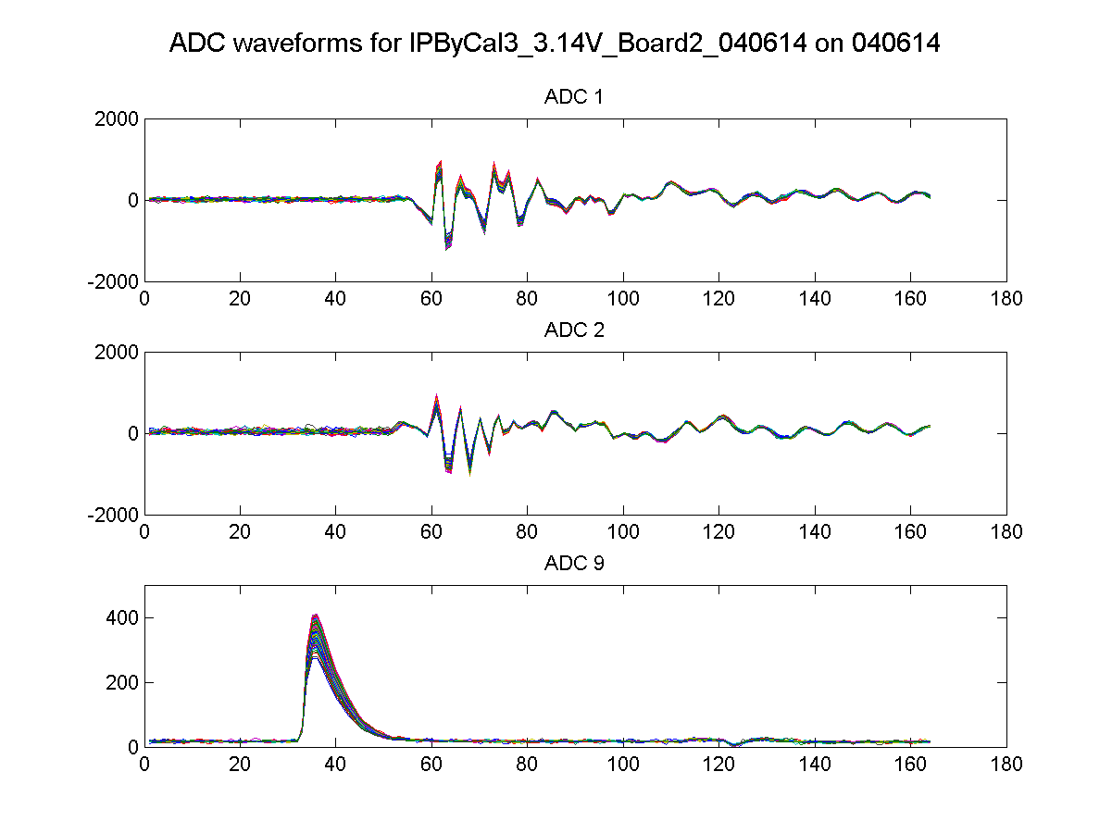
IPB(Y) I
IPB(Y) Q
Ref(Y)
N. Blaskovic

Slide 21
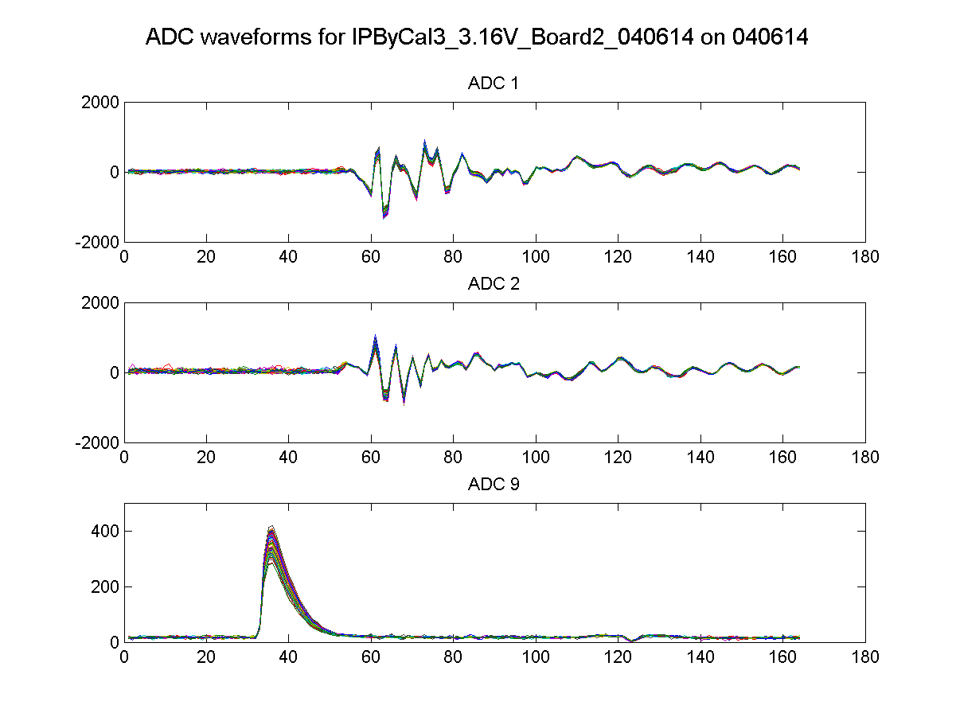
IPB(Y) I
IPB(Y) Q
Ref(Y)
N. Blaskovic

Slide 22
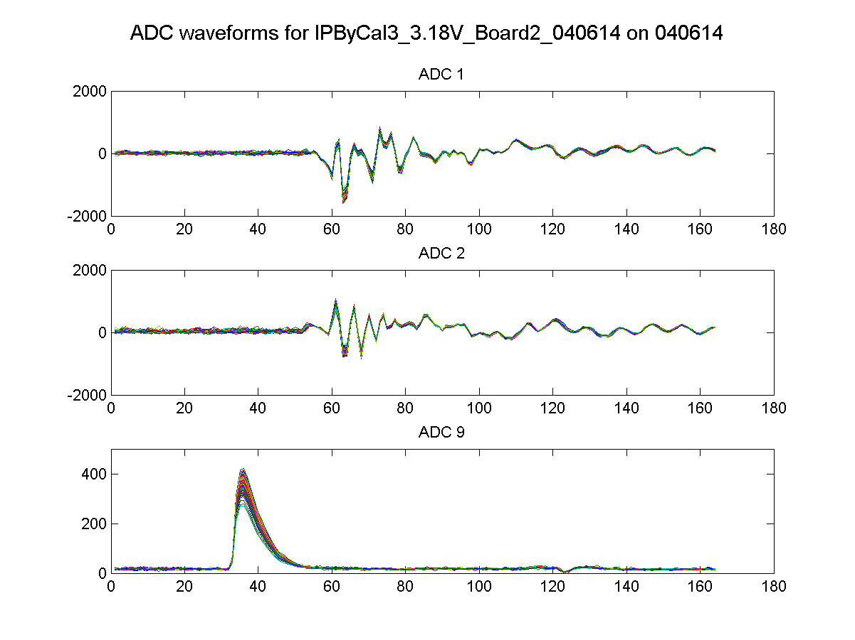
IPB(Y) I
IPB(Y) Q
Ref(Y)
N. Blaskovic

Slide 23
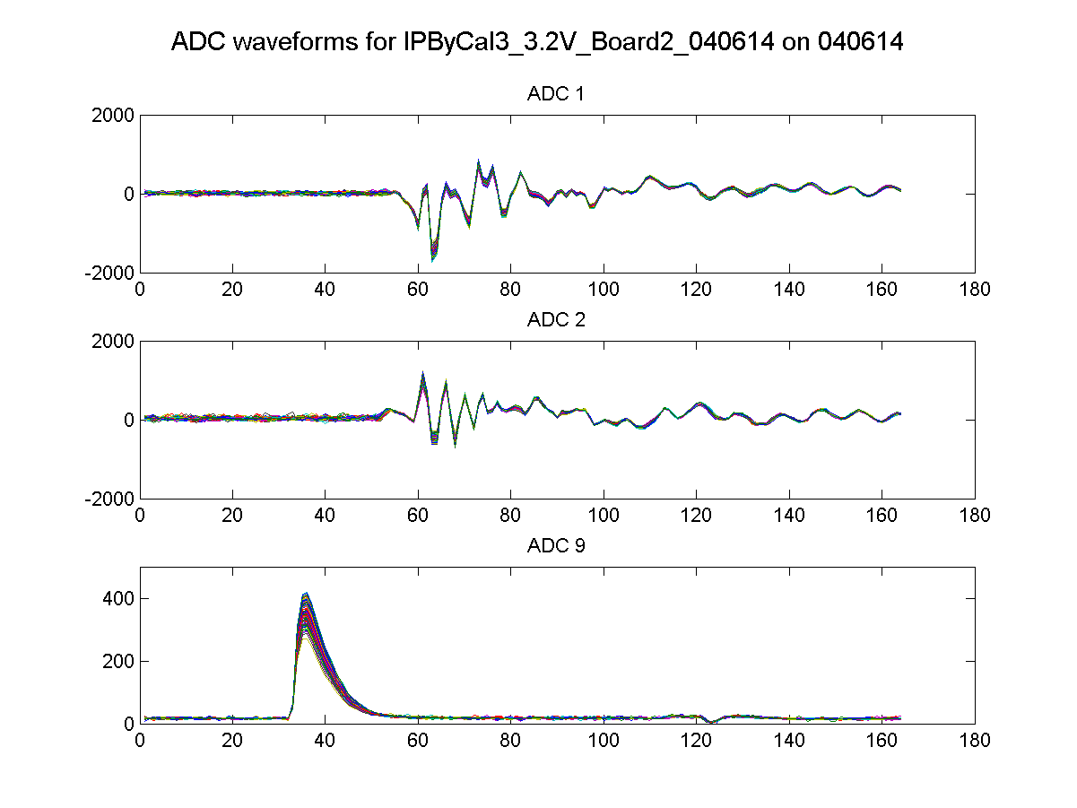
IPB(Y) I
IPB(Y) Q
Ref(Y)
N. Blaskovic

Slide 24
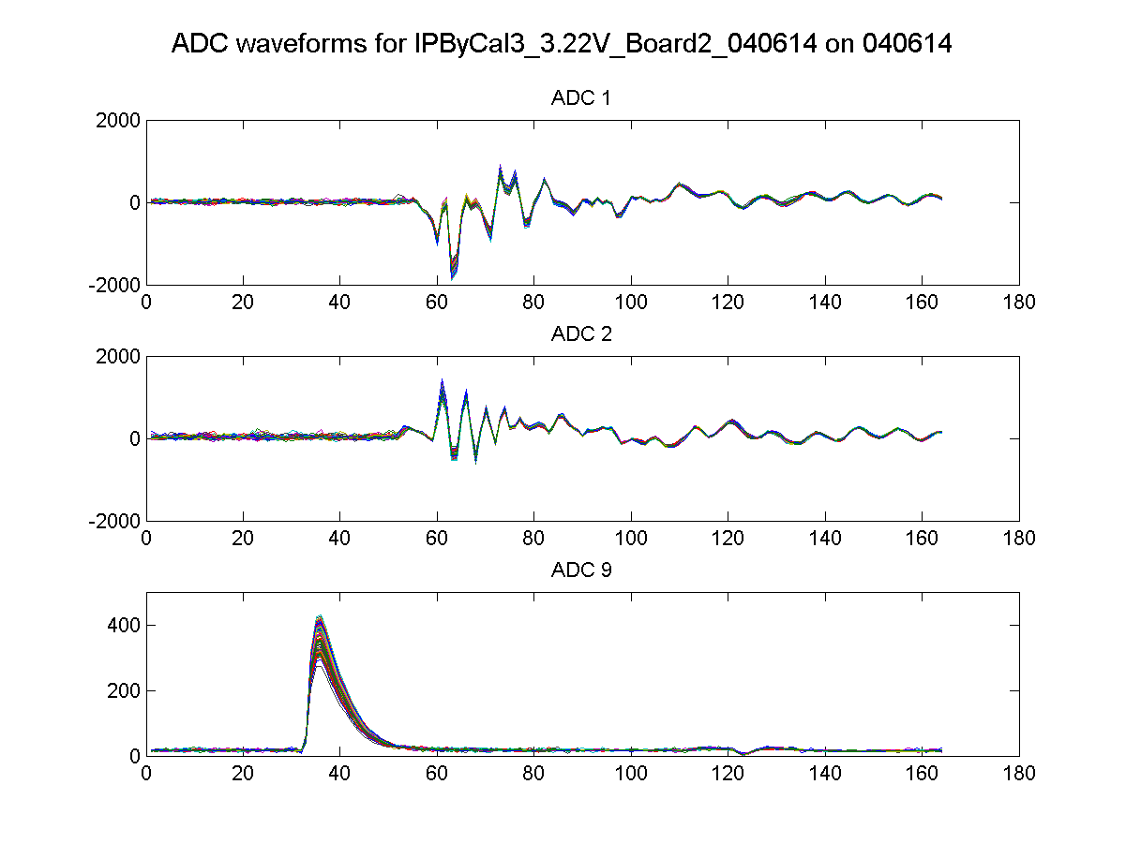
IPB(Y) I
IPB(Y) Q
Ref(Y)
N. Blaskovic

Slide 25
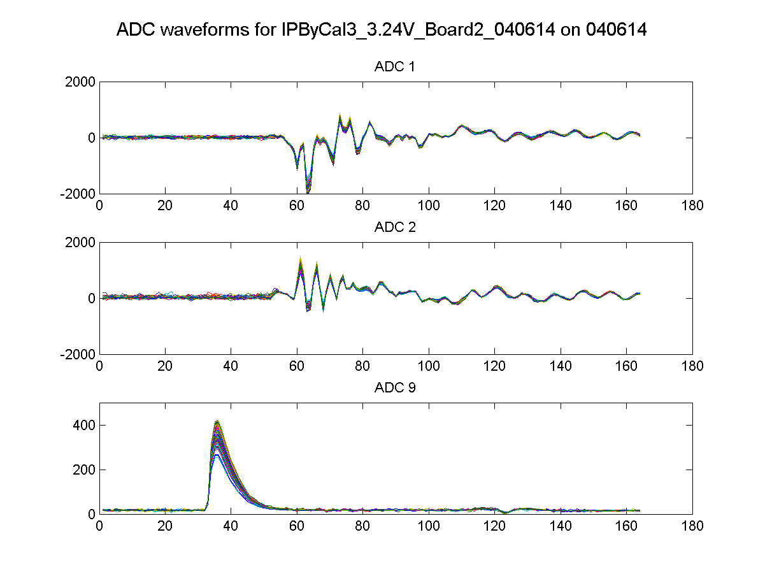
IPB(Y) I
IPB(Y) Q
Ref(Y)
N. Blaskovic

Slide 26
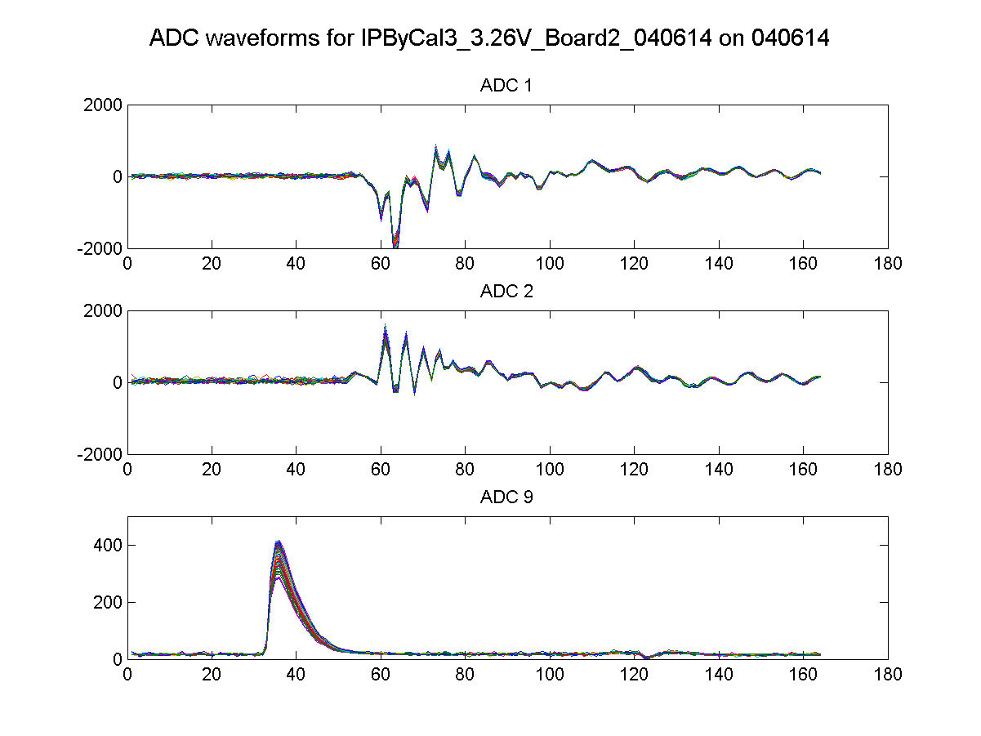
IPB(Y) I
IPB(Y) Q
Ref(Y)
N. Blaskovic

Slide 27
Jitter vs. beam position
Jitter scales with beam position over IP BPM mover scan
As we believe to be resolution-limited, the resolution scales with beam position
N. Blaskovic

Slide 28
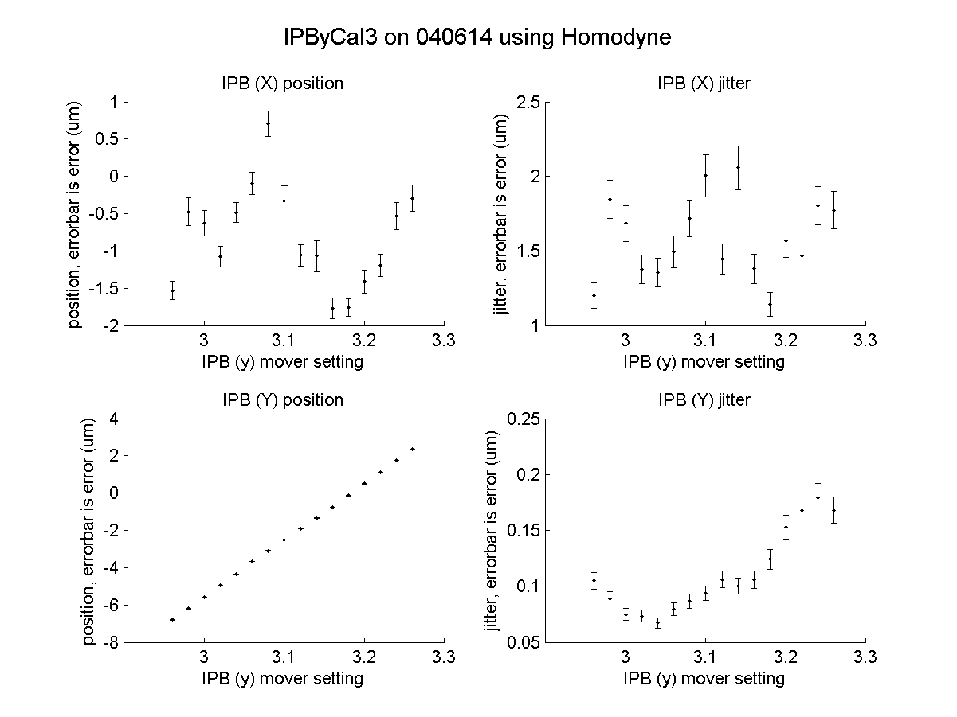
N. Blaskovic

Slide 29
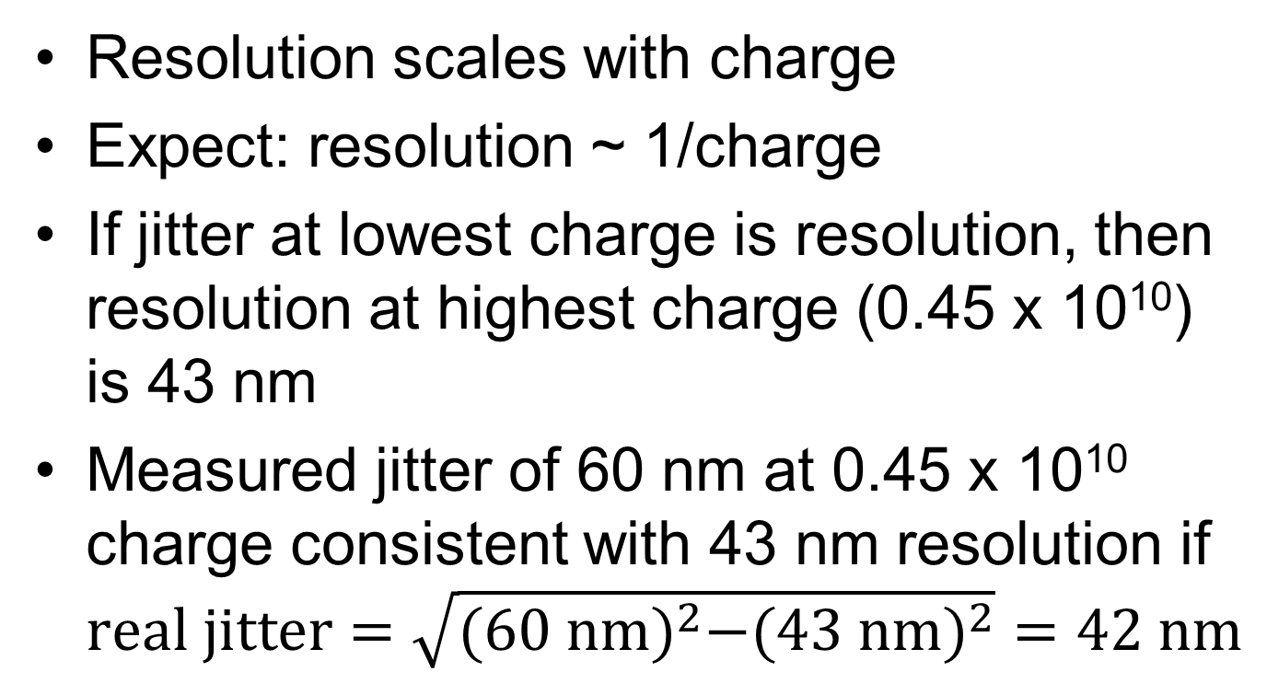
Jitter vs. charge
Resolution scales with charge
Expect: resolution ~ 1/charge
If jitter at lowest charge is resolution, then resolution at highest charge (0.45 x 10¹⁰) is 43 nm
Measured jitter of 60 nm at 0.45 x 10¹⁰ charge consistent with 43 nm resolution if $real jitter=\sqrt{{(60 nm)}^{2}−({43 nm)}^{2}}=42 nm$
N. Blaskovic

Slide 30
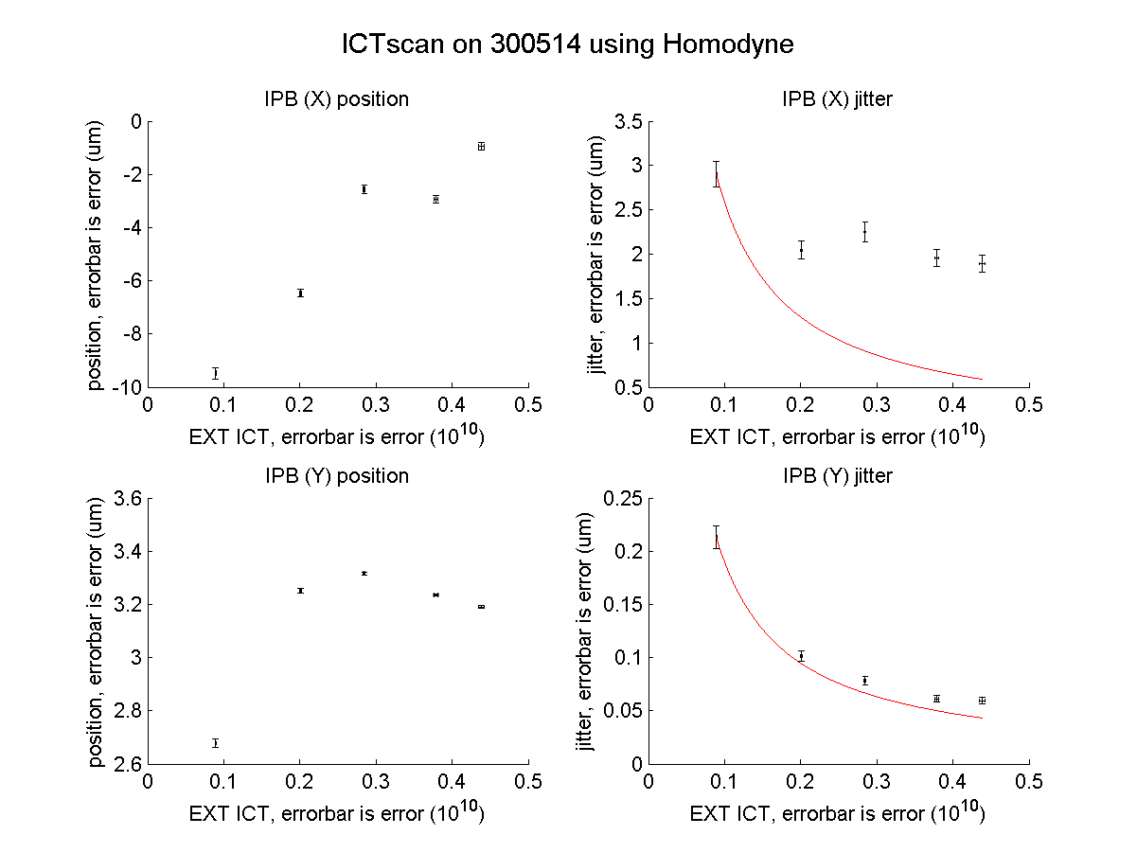
Resolution = 1/charge assuming jitter = resolution at lowest charge
60 nm
43 nm
N. Blaskovic

Slide 31
IP feedback latency
Effect of a constant kick of 2000 DAC counts (driving kicker into saturation) studied as a function of effective bunch spacing
Study does not involve changing the ATF bunch spacing; only the time that the DAC out is issued is varied
N. Blaskovic

Slide 32
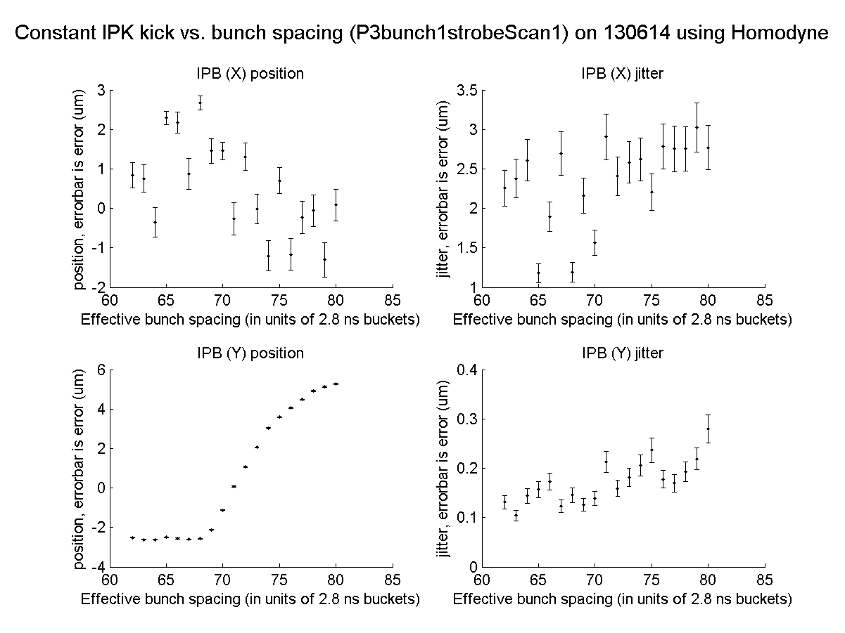
IP feedback
nominal
N. Blaskovic

Slide 33
IP kicker range
IP kicker maximum range at IPB is ± 8 um
Operated into kicker amplifier saturation
Data taken on 13th June 2014
N. Blaskovic

Slide 34
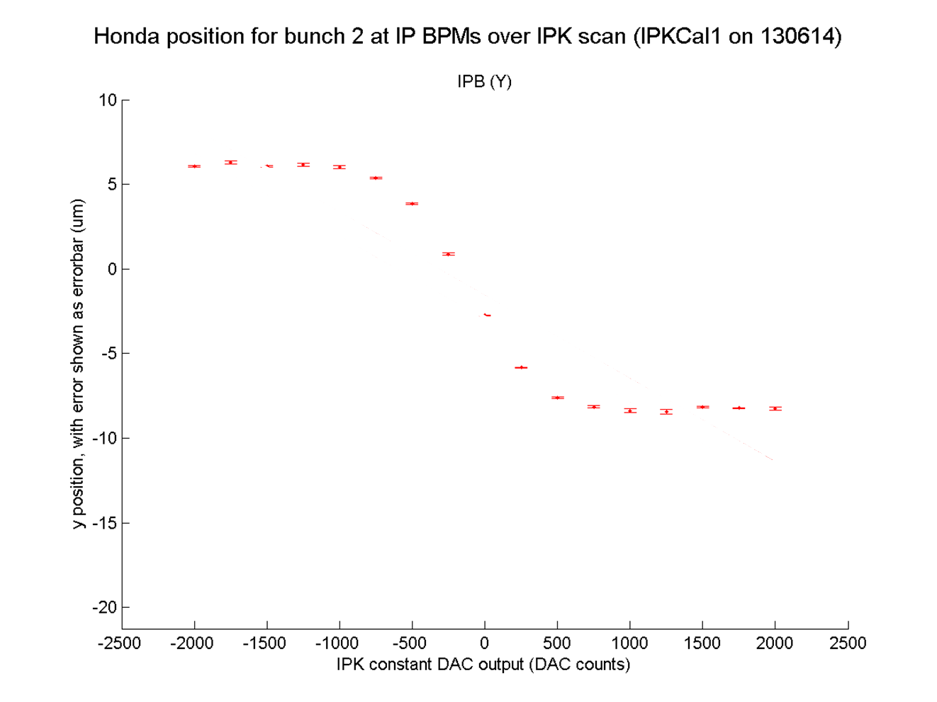
N. Blaskovic

Slide 35
IP kicker strength
IP kicker strength in um/DAC is strongest when bunch spacing is longest as kicker amplifier is fully driving the kicker
N. Blaskovic

Slide 36
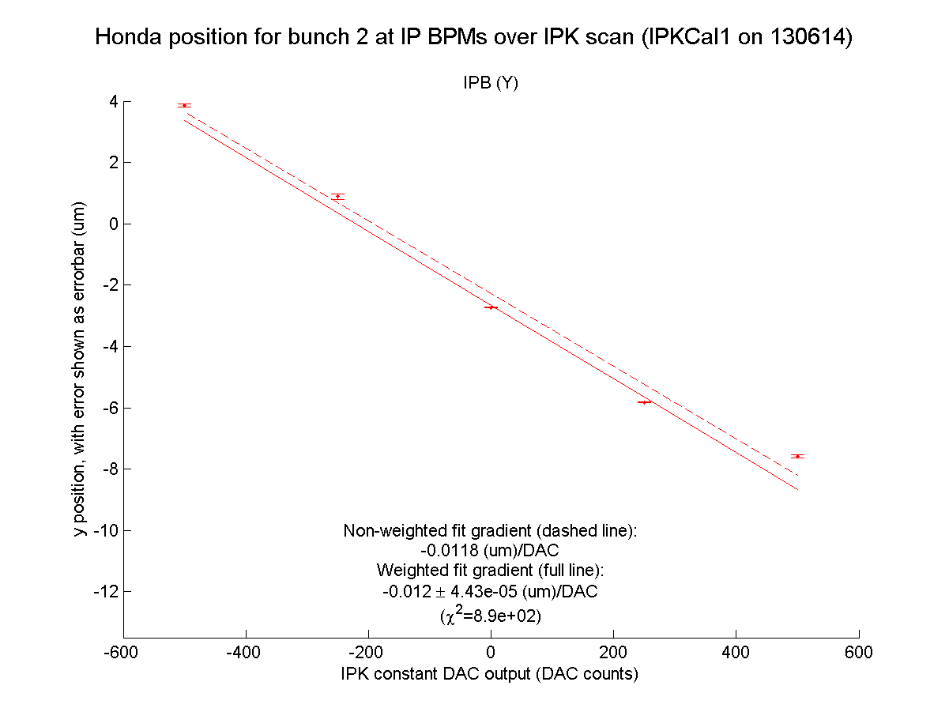
Effective bunch spacing:
116 buckets of 2.8 ns
N. Blaskovic

Slide 37
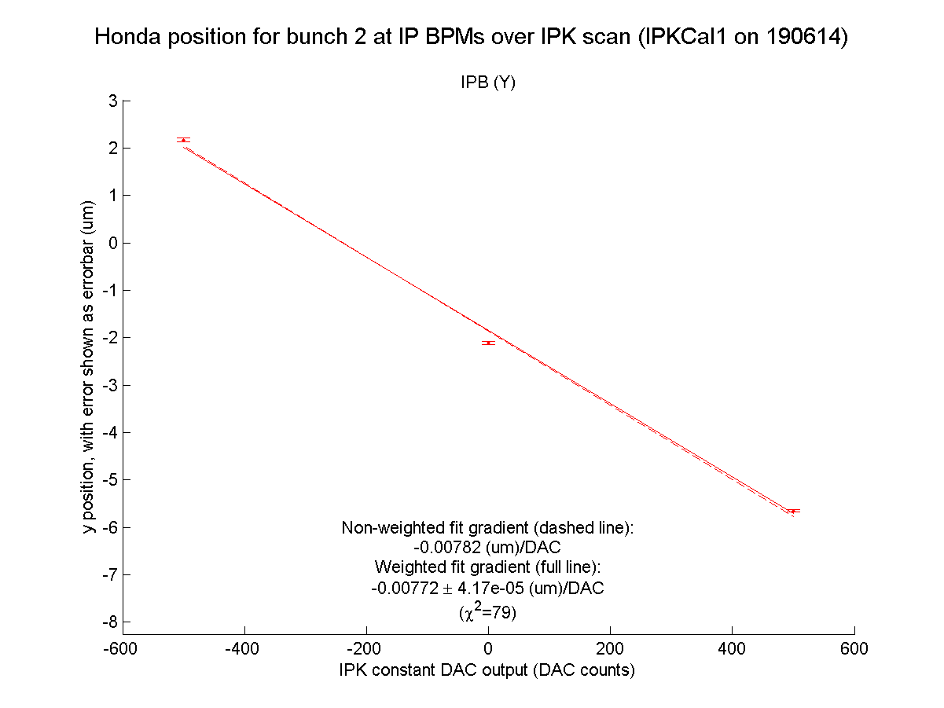
Bunch spacing:
77 buckets of 2.8 ns
N. Blaskovic

Slide 38
Conclusions
Limiter in LO for Honda 2nd stage limits OK
IP BPM calibration linear but waveform has superimposed oscillatory structure
Resolution limited with beam offset
Resolution limited with charge to 40 nm at 0.5 x 10¹⁰
IP feedback bunch spacing ≥ 77 buckets
IP kicker range is ± 8 um at IPB
N. Blaskovic

Slide 39
Appendix
IPK kicker scan in June 2012
N. Blaskovic

Slide 40
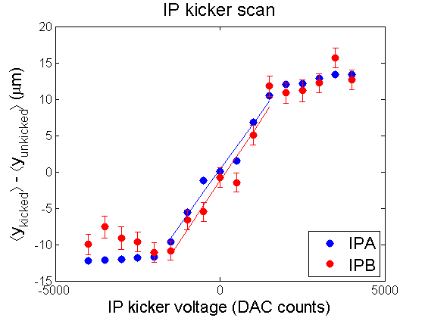
IPK kicker tests in June 2012 showed a kick in excess of ± 10 um at IPB
Data was only taken using SLAC electronics via EPICS
15 June 2012 ATF Operation Meeting report, by Doug Bett
N. Blaskovic

