Slide 1
Feed forward orbit corrections for the CLIC RTML
R. Apsimon, A. Latina

Slide 2
Motivation
Emittance growth from betatron collimation
Strongly dependent on orbit jitter in collimators
Damping ring extraction stability
Kicker and septa stability extremely stringent
FF systems relax requirements

Slide 3
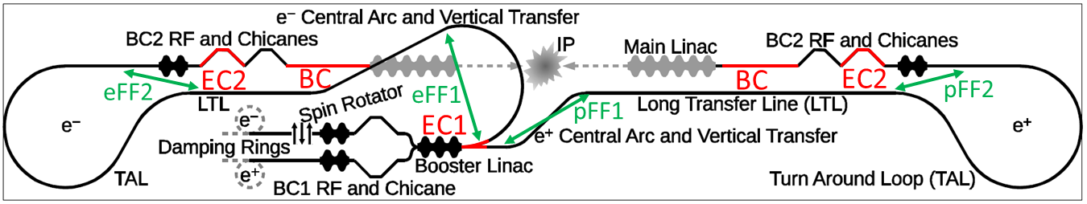
RTML FF systems
EC1: first energy collimator system
EC2: second energy collimator system
BC: betatron collimation system
eFF1: first feed forward system in electron RTML
eFF2: second feed forward system in electron RTML
pFF1: first feed forward system in positron RTML
pFF2: second feed forward system in positron RTML

Slide 4
Design considerations
Hardware:
BPM design, resolution and signal processing
Transmission cable speed and latency budget
Kicker design and stability
Digital feed forward electronics
Machine protection
Optics
Optics designs of BPM and kicker regions

Slide 5
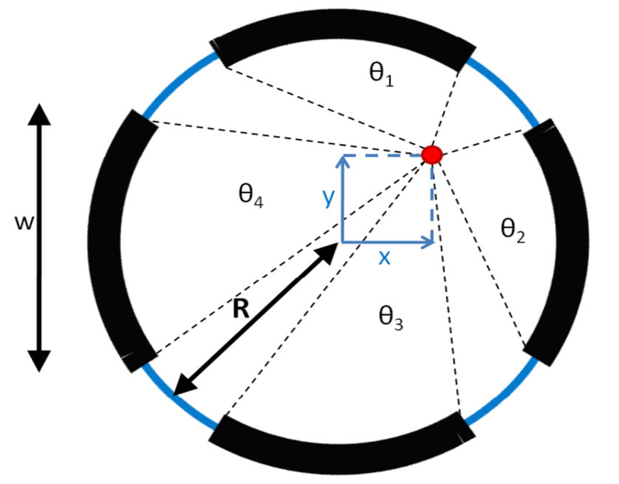
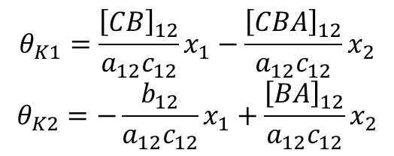
BPM design
Use stripline BPMs for high bandwidth and
reasonably low resolution.
Position $\sim \frac{V_{Δ}}{V_{Σ}}$
where $V_{Δ}$ and $V_{Σ}$ are the difference and sum
of opposing stripline signals.
Resolution $=\frac{Rσ_{V}}{2V_{Σ}}{\left(\frac{g_{d}}{g_{s}}\right)}^{−1}∝R$
Where $\left(\frac{g_{d}}{g_{s}}\right)$ is the gain ratio between difference and sum channels on the digital electronics, $σ_{V}$ is the electrical noise on the BPM system and R is the BPM resolution.
FONT BPMs consistently achieve resolutions ~1.6 times thermal limit of noise.
CLIC RTML BPMs aim for ~1.3 times thermal limit by digitising BPM signals immediately after analogue processing. RTML BPM radius is 6 cm, so expect resolutions ~ 1.4μm

Slide 6
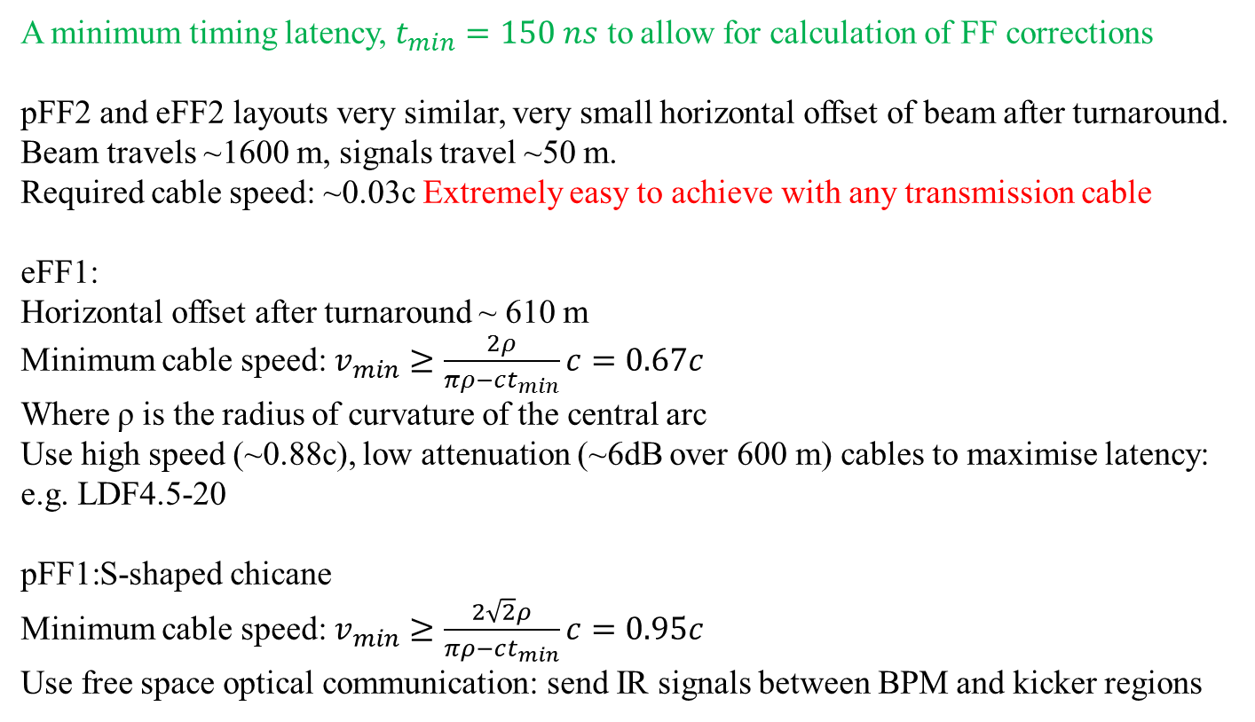
Transmission speed
A minimum timing latency, $t_{min}=150 ns$ to allow for calculation of FF corrections
pFF2 and eFF2 layouts very similar, very small horizontal offset of beam after turnaround.
Beam travels ~1600 m, signals travel ~50 m.
Required cable speed: ~0.03c Extremely easy to achieve with any transmission cable
eFF1:
Horizontal offset after turnaround ~ 610 m
Minimum cable speed: $v_{min}≥\frac{2ρ}{πρ−ct_{min}}c=0.67c$
Where ρ is the radius of curvature of the central arc
Use high speed (~0.88c), low attenuation (~6dB over 600 m) cables to maximise latency:
e.g. LDF4.5-20
pFF1:S-shaped chicane
Minimum cable speed: $v_{min}≥\frac{2\sqrt{2}ρ}{πρ−ct_{min}}c=0.95c$
Use free space optical communication: send IR signals between BPM and kicker regions

Slide 7
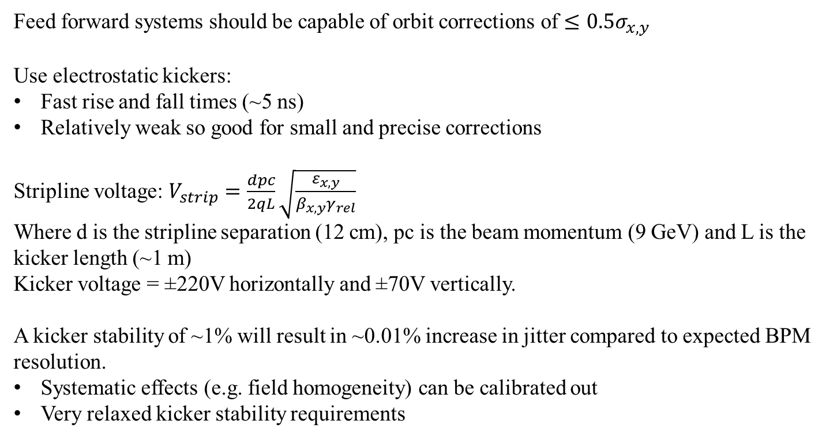
Kicker design
Feed forward systems should be capable of orbit corrections of $≤0.5σ_{x,y}$
Use electrostatic kickers:
Fast rise and fall times (~5 ns)
Relatively weak so good for small and precise corrections
Stripline voltage: $V_{strip}=\frac{dpc}{2qL}\sqrt{\frac{ε_{x,y}}{β_{x,y}γ_{rel}}}$
Where d is the stripline separation (12 cm), pc is the beam momentum (9 GeV) and L is the kicker length (~1 m)
Kicker voltage = ±220V horizontally and ±70V vertically.
A kicker stability of ~1% will result in ~0.01% increase in jitter compared to expected BPM resolution.
Systematic effects (e.g. field homogeneity) can be calibrated out
Very relaxed kicker stability requirements

Slide 8
Digital feed forward electronics
Latency of digital electronics expected to be similar to that of the FONT digital electronics, ~50 ns.
Total latency budget is ≥ 150 ns
Use remaining budget for additional features:
FF systems can only correct orbit jitter ≤0.5 σ, so use BPM measurements to determine when beam is dangerously off-orbit and fire a downstream dump kicker.
Systematic correction of oscillations on bunch train with tuneable analogue ripple on kicker pulses.

Slide 9
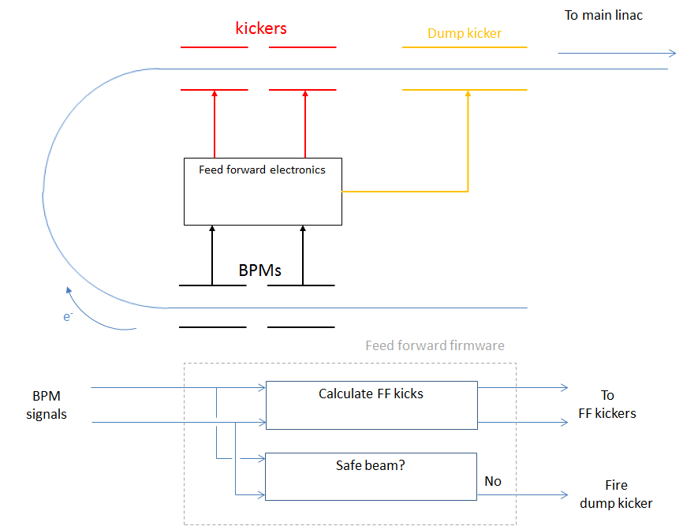

Machine protection
A safe beam determination algorithm can be run in parallel to the normal feed forward correction algorithm.
The safe beam determination can be performed in ~ 5 – 10 ns and a beam dump trigger sent to the dump kicker.
As the dump kicker will be more powerful than the feed forward kickers it will require a longer rise time, thus a dump signal should be sent a quickly as possible.
Given the beam optics described in the next slides, the beam positions in the two feed forward BPMs can be used to determine a safe beam condition by :
$$\frac{x_{1}^{2}{+x}_{2}^{2}}{σ^{2}}≤n_{thresh}$$

Slide 10
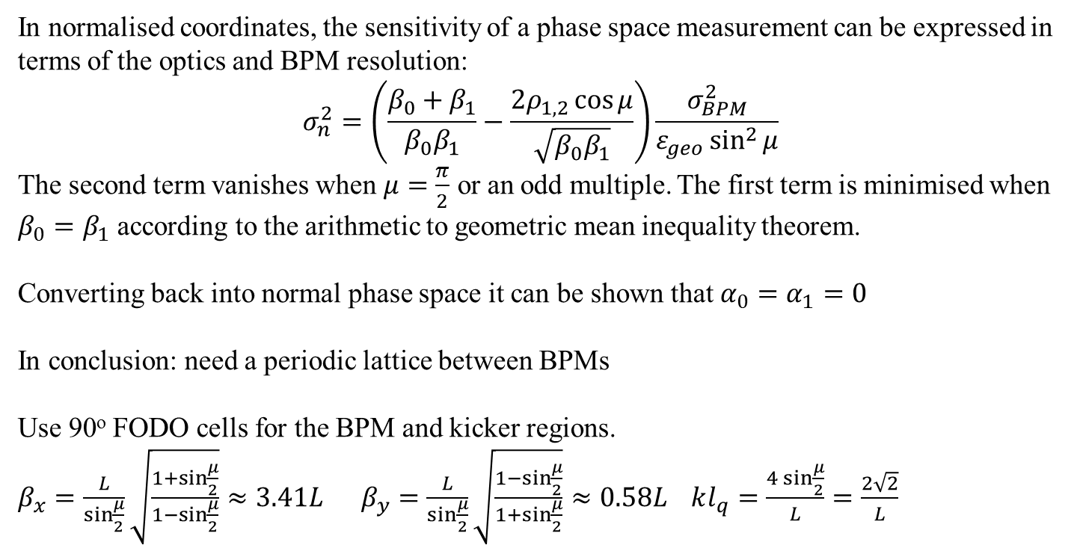
Optics considerations
In normalised coordinates, the sensitivity of a phase space measurement can be expressed in terms of the optics and BPM resolution:
$$σ_{n}^{2}=\left(\frac{β_{0}+β_{1}}{β_{0}β_{1}}−\frac{2ρ_{1,2}\cos{μ}}{\sqrt{β_{0}β_{1}}}\right)\frac{σ_{BPM}^{2}}{ε_{geo}\sin^{2}{μ}}$$
The second term vanishes when $μ=\frac{π}{2}$ or an odd multiple. The first term is minimised when $β_{0}=β_{1}$ according to the arithmetic to geometric mean inequality theorem.
Converting back into normal phase space it can be shown that $α_{0}=α_{1}=0$
In conclusion: need a periodic lattice between BPMs
Use 90º FODO cells for the BPM and kicker regions.
$β_{x}=\frac{L}{\sin{\frac{μ}{2}}}\sqrt{\frac{1+\sin{\frac{μ}{2}}}{1−\sin{\frac{μ}{2}}}}≈3.41L$ $β_{y}=\frac{L}{\sin{\frac{μ}{2}}}\sqrt{\frac{1−\sin{\frac{μ}{2}}}{1+\sin{\frac{μ}{2}}}}≈0.58L$ $kl_{q}=\frac{4\sin{\frac{μ}{2}}}{L}=\frac{2\sqrt{2}}{L}$

Slide 11
Tracking simulations
3 studies undertaken:
Ideal system
Comparison of beam stability through RTML with and without feed forward corrections
Perfect BPM resolution and alignment
Initial beam offset at start of RTML varied to simulate DR extraction errors
Precision study
Impact of BPM resolution of feed forward performance
Perfect BPM alignment
Initial beam offset at start of RTML varied to simulate DR extraction errors
Accuracy study
Impact of BPM alignment errors on feed forward performance
Perfect BPM resolution
Perfectly extracted beam at start of RTML

Slide 12
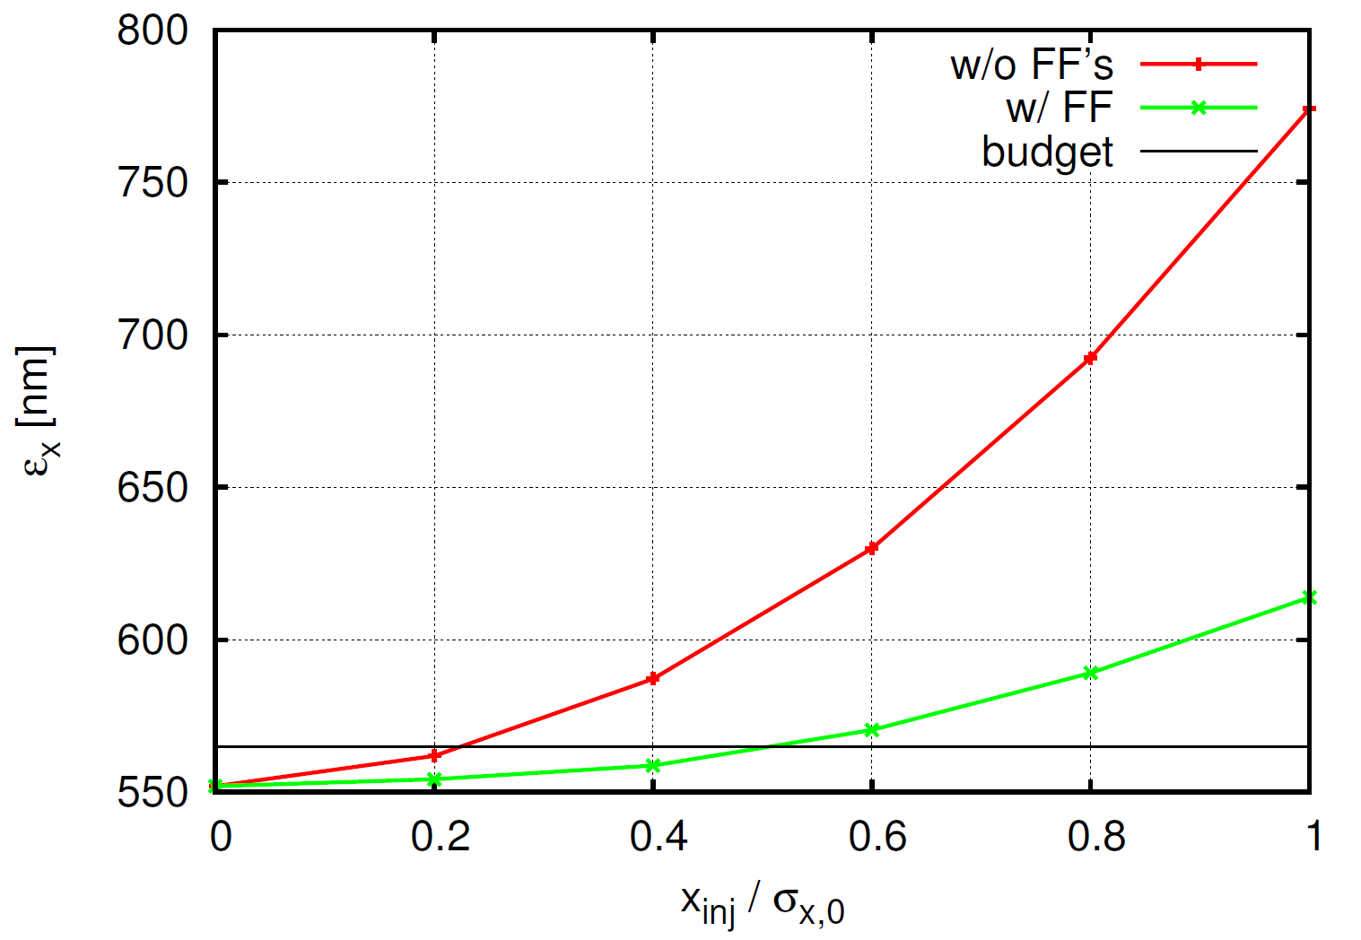

Tracking results: $∆ε_{x}$ Ideal system

Slide 13
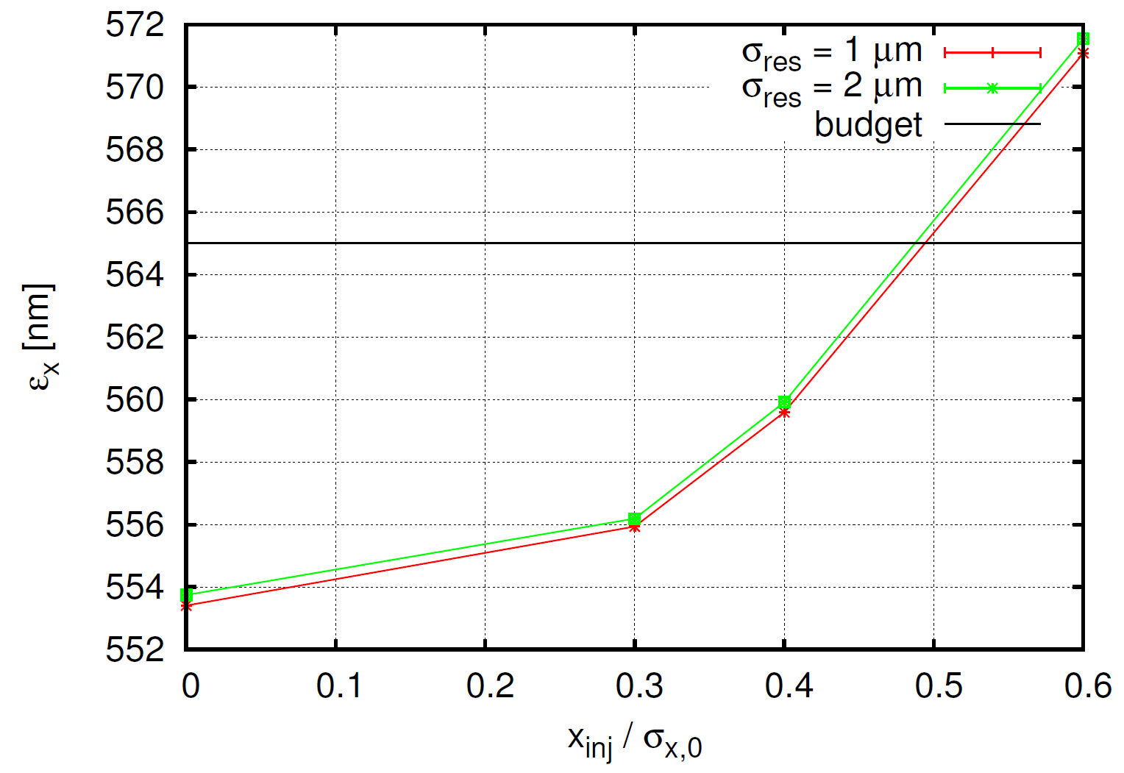

Tracking results: $∆ε_{x}$ Precision study

Slide 14
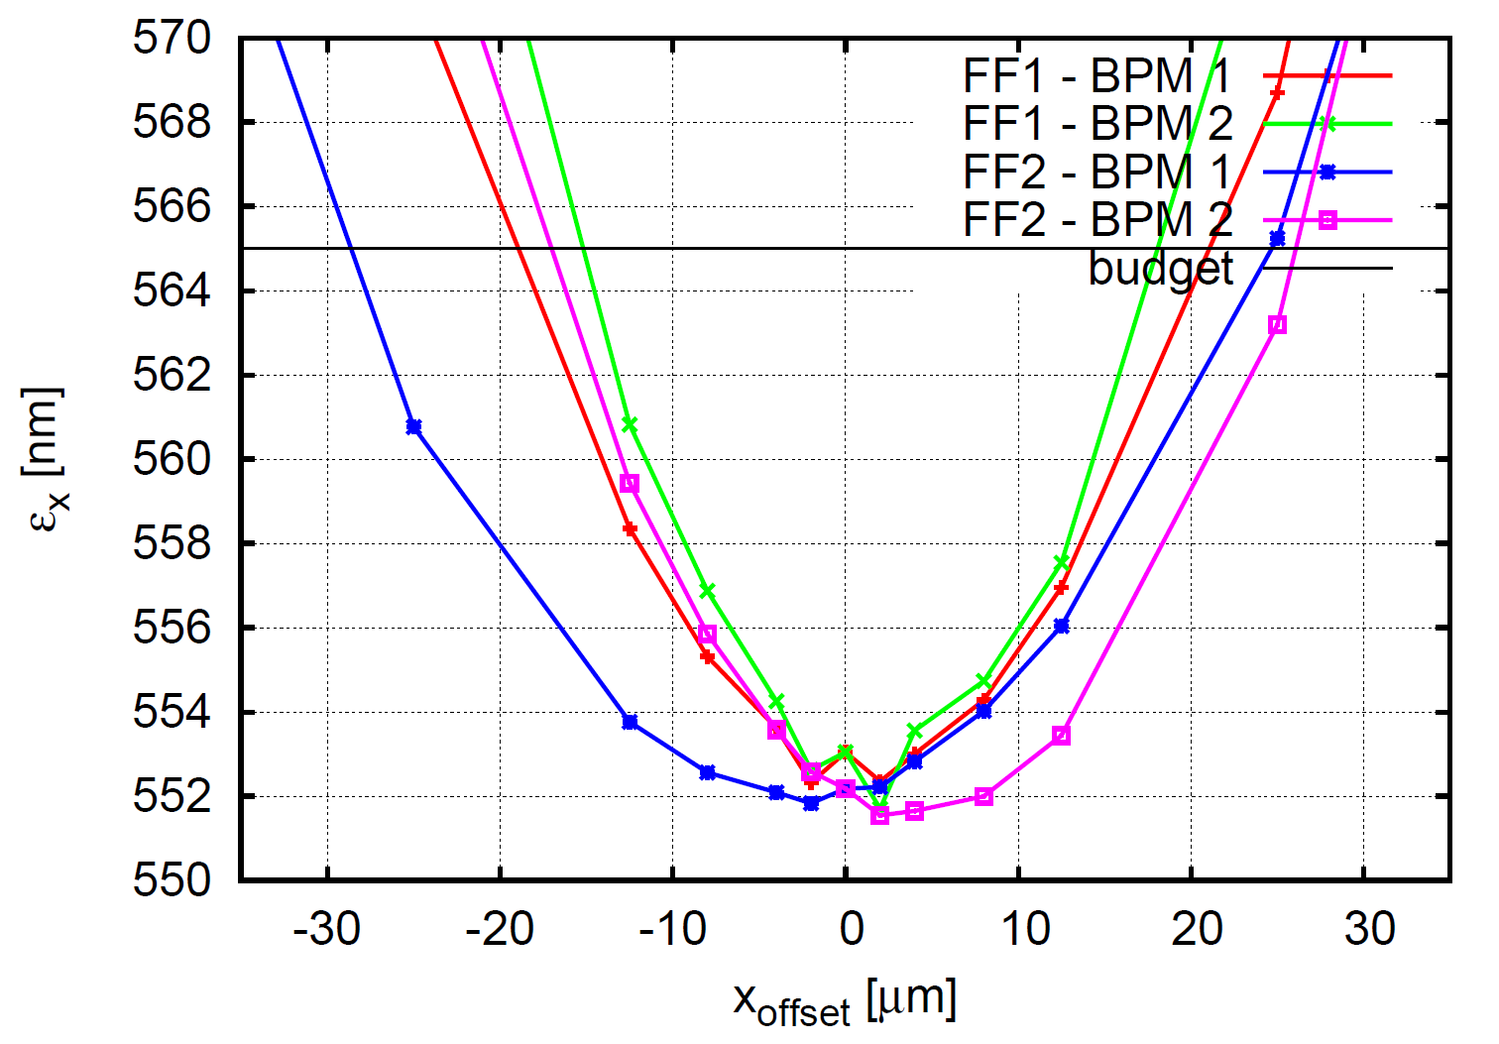

Tracking results: $∆ε_{x}$ Accuracy study

Slide 15
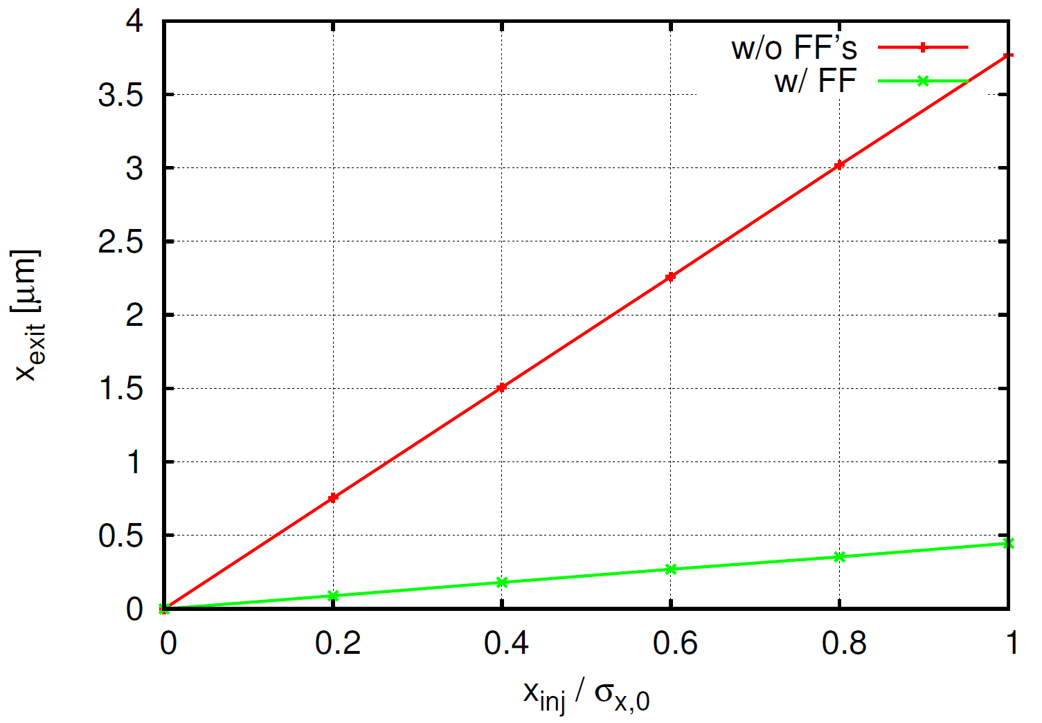

Tracking results: $σ_{x}$ Ideal system

Slide 16
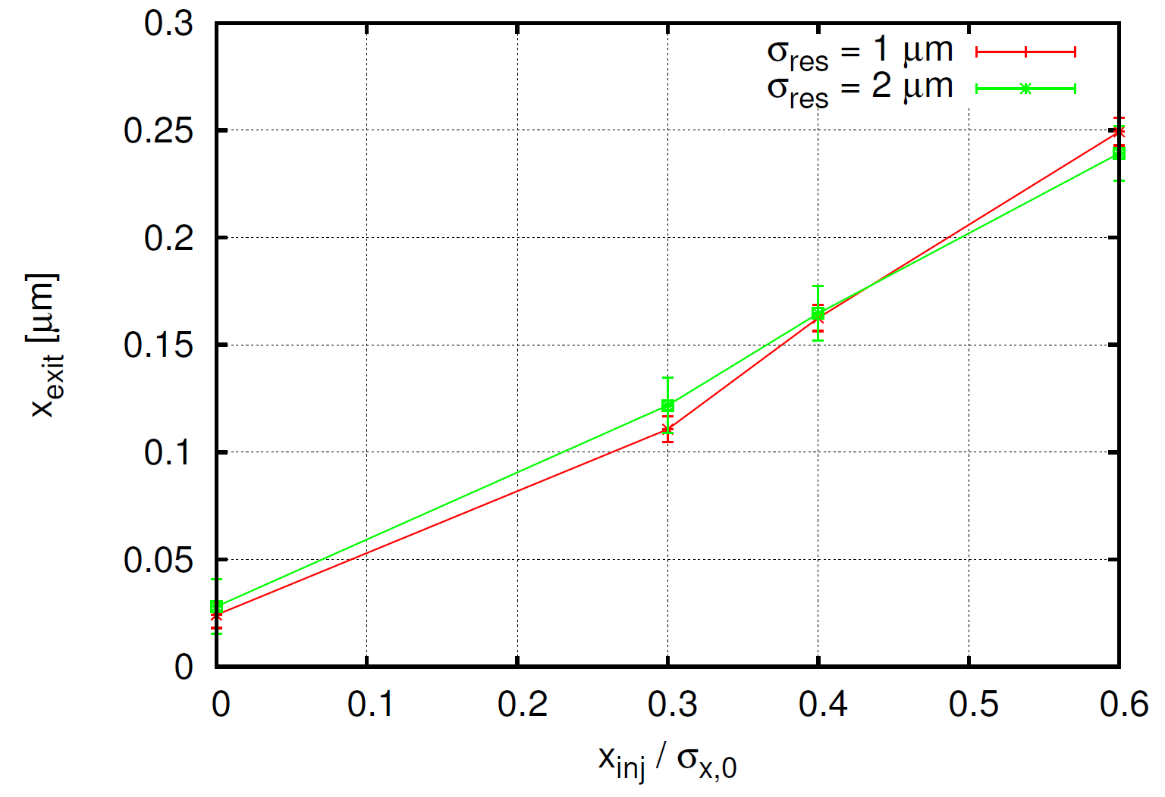

Tracking results: $σ_{x}$ Precision study

Slide 17
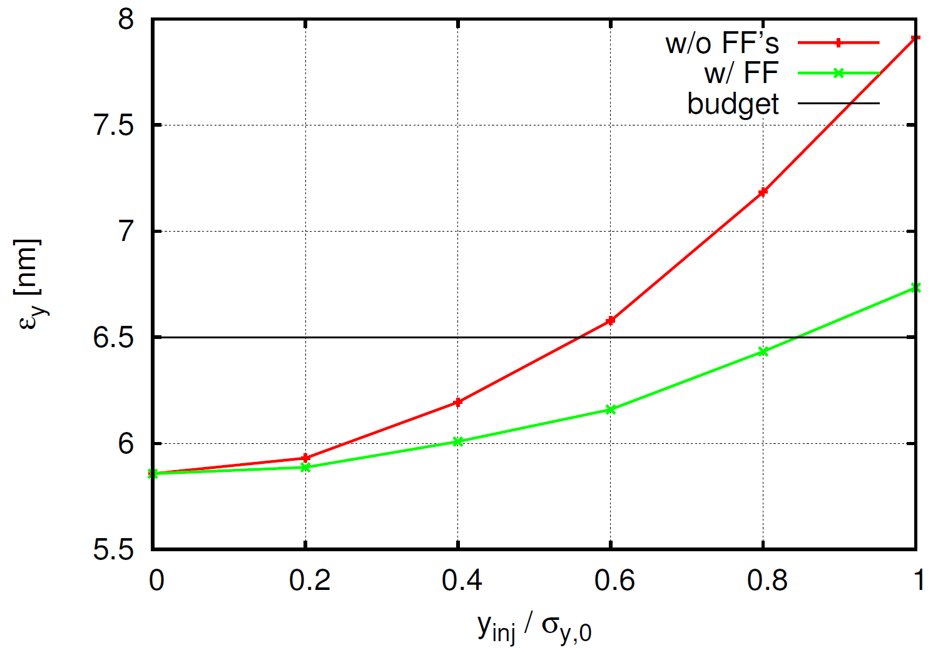

Tracking results: $∆ε_{y}$ Ideal system

Slide 18
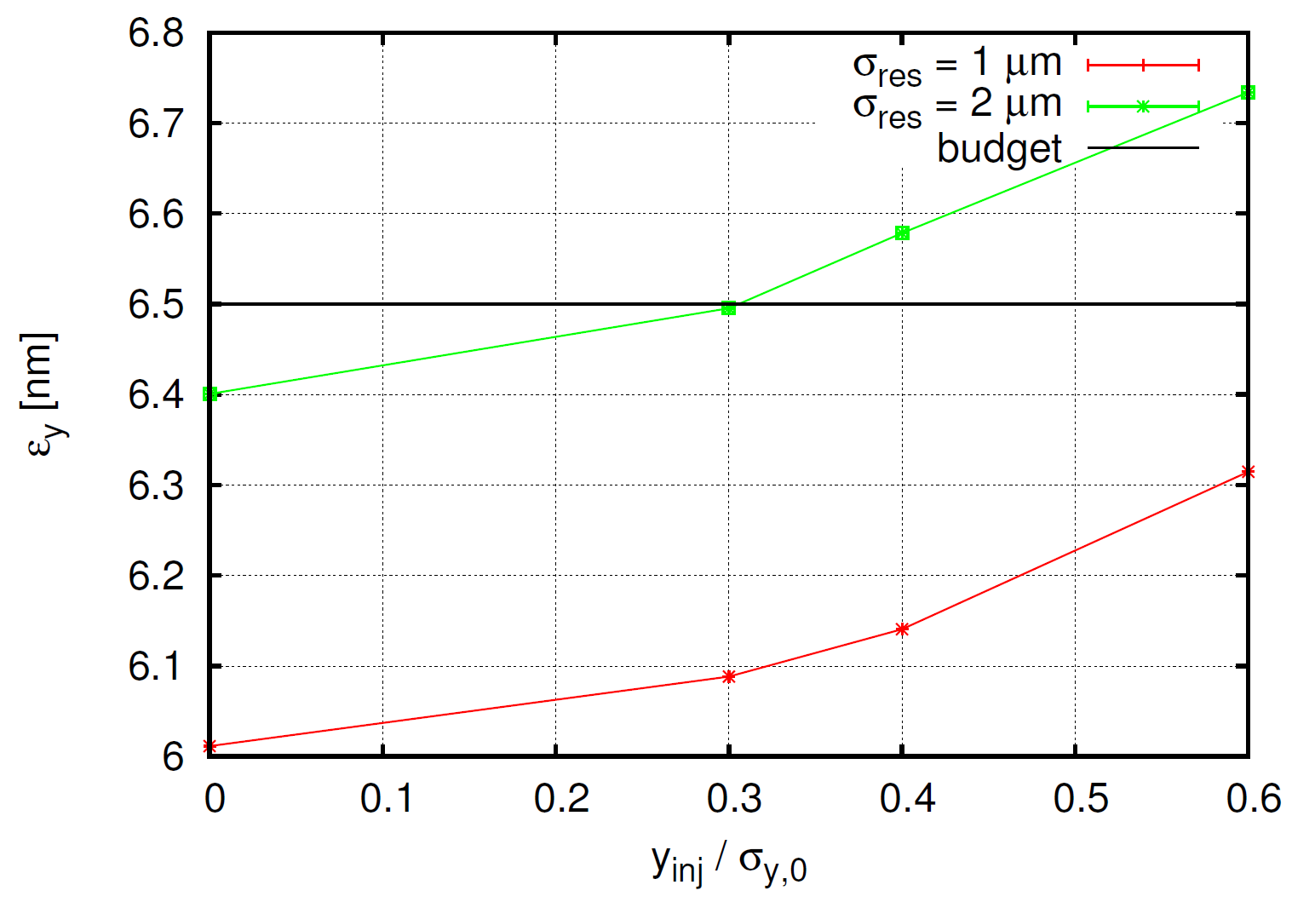

Tracking results: $∆ε_{y}$ Precision study

Slide 19
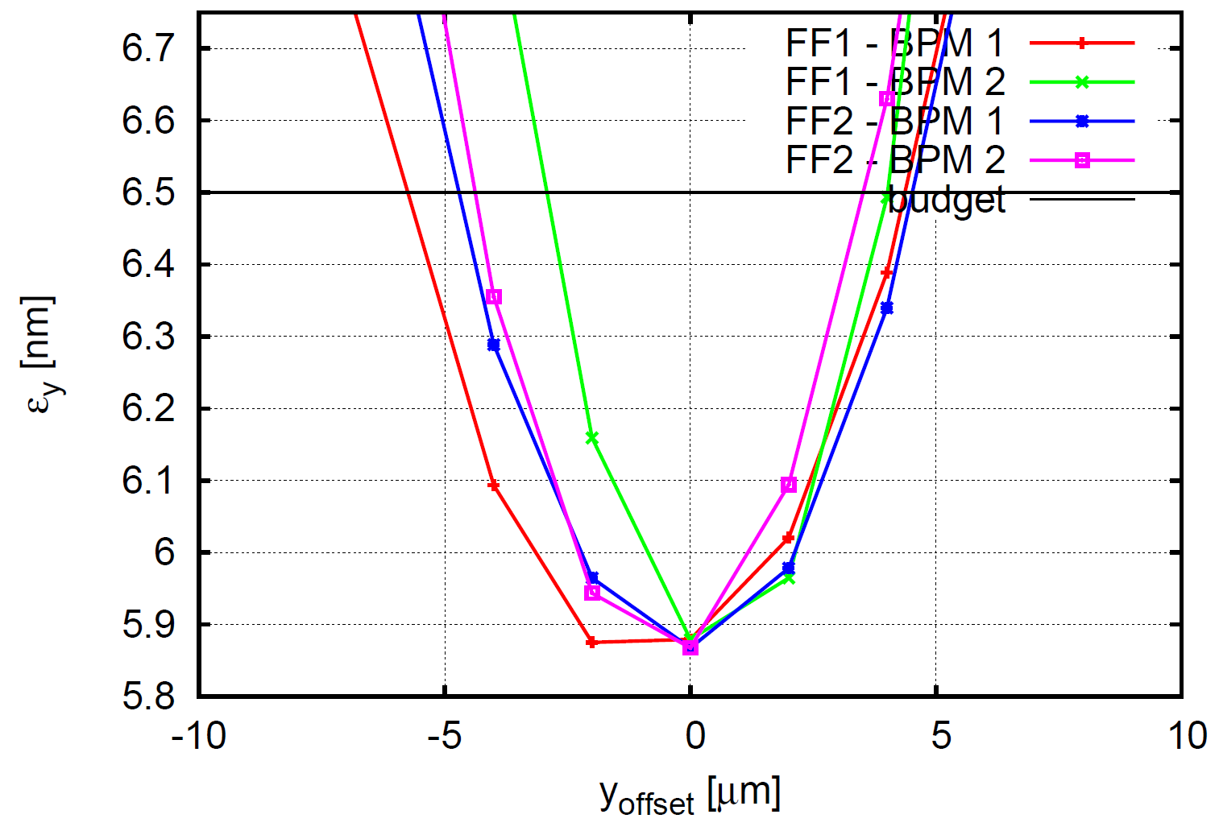

Tracking results: $∆ε_{y}$ Accuracy study

Slide 20
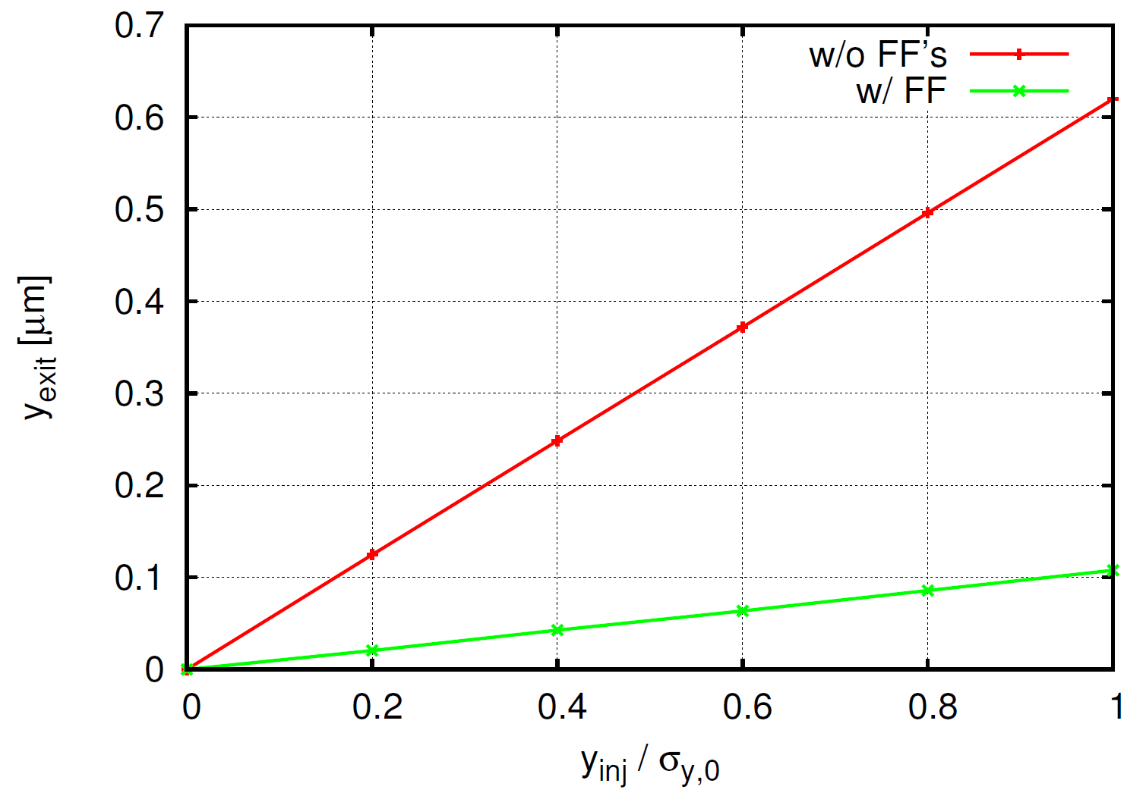

Tracking results: $σ_{y}$ Ideal system

Slide 21
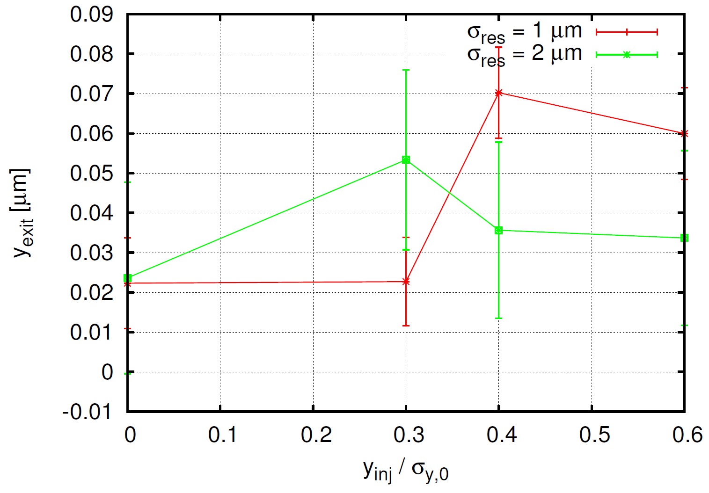

Tracking results: $σ_{y}$ Precision study

Slide 22
Summary of tracking results
Horizontal emittance growth:
Factor 0f ~4 reduction in emittance growth
1-2 μm resolution has a negligible effect on FF performance compared to perfect BPMs
~ ±10 μm alignment tolerance required
Horizontal jitter amplification:
Factor of ~7.5 reduction in jitter amplification
1-2 μm resolution has a negligible effect on FF performance compared to perfect BPMs
Vertical emittance growth:
Factor of ~1.5 reduction in emittance growth
1-2 μm resolution has a tolerable effect on FF performance compared to perfect BPMs
~ ±2-5 μm alignment tolerance required
Vertical jitter amplification:
Factor of ~6 reduction in jitter amplification
1-2 μm resolution has a negligible effect on FF performance compared to perfect BPMs

Slide 23
Conclusions
The design of the feed forward hardware has been based on existing technology and the required performance has been experimentally demonstrated (FONT feedback system at ATF2); thus confirming the feasibility of the system.
The optics of the BPM and kicker regions have been studied analytically to ensure a global optimisation.
Tracking simulations have shown a good performance of the feed forward systems, including resolution and misalignment errors.

