Slide 1





Update on Emittance Optimization at CTF3
Davide Gamba
davide.gamba@cern.ch
18 July 2014
FONT meeting – Oxford

Slide 2
Outlook.
CTF3 and its recombination complex.
Update on the last results using the previously implemented feedback.
Dispersion measurements from jitter.
Simulations.
  Technique
  First results
Summary.

Slide 3
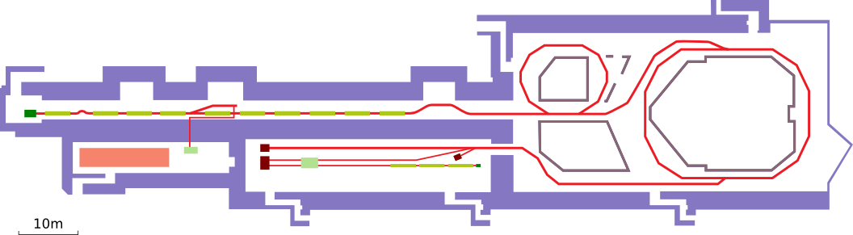
CTF3: the CLIC Test Facility at CERN.
Proof-of-principle experiment to study CLIC feasibility.
  It has a scaled version of a Drive Beam.
  A Probe Beam is generated to test the two-beam acceleration scheme.
Drive Beam
Gun
Dogleg Experiment
Factor 2
Recombination
Factor 4
Recombination
Drive Beam Linac:
4 A; 1.5 GHz; 1.2 μs; 120 MeV
Building 2003
DL
42 [m]
Building 2001
CR
84 [m]
Building 2013
Building 2010
CLEX area
Recombined Beam:
~30 A; 12 GHz; 140 ns; 120 MeV
Photo Injector Tests
Two Beam Test Stand (TBTS)
Probe Beam
Photo-Injector
XBOX
experiment
Deceleration Test Beam Line (TBL)

Slide 4
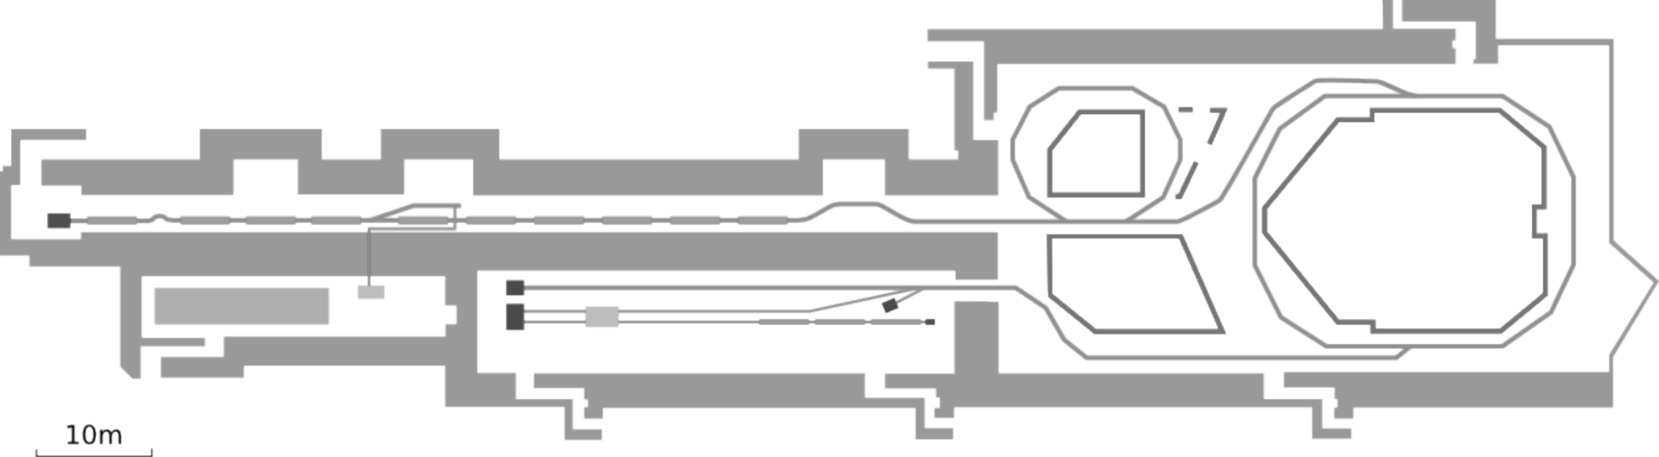
Beam Recombination.
During recombination, different section of the initial train take different paths.
They don’t necessarily come back on the same trajectory and optics function
Only one section every two is delayed into the Delay Loop
Initially we only have a long train “divided” into 8 sections, each 140 ns long
Delay Loop:
2x
4 A; 1.2 μs; 120 MeV; 1.5 GHz
Combiner Ring:
4x recombination
30 A; 140 ns; 120 MeV; 12 GHz
Projected emittance blow-up.
Increased losses.
In the Combiner Ring all the 8 sections can end up in having different orbits/optics

Slide 5
Feedback
For machine operation and optimization we need a general tool to control the orbit of the beam.
It has to deal with some intrinsic limitations
  Data acquisition is affected by noise
    White noise
    Not null dispersion and energy jitter
  Non responsive control system
    Delicate Front-Ends
  Instable beam (mainly coming from RF instabilities)
  Beam position may not be a well defined measurement in case of losses
  Challenging machine
    MADX model not always accurate
    Aperture limitations
Algorithm to measure the response matrix needed
  Has to be “fast” compared to machine faults and drifts
  Has to be able to follow slow drifts of the machine

Slide 6
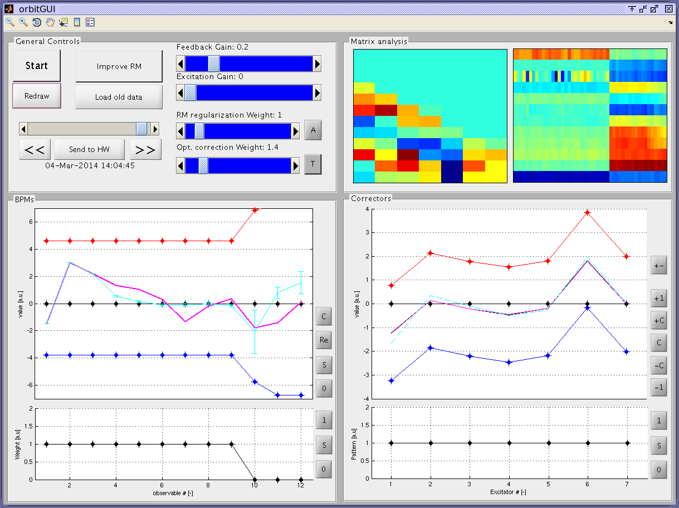
Feedback implementation
Developed a Matlab application for generic linear feedbacks.
New features:
Possibility to target a wanted correction or to minimize it.
(i.e. don’t go too far from current settings)
Introduced regularization weight while measuring RM
  It avoids explosion of RM due to noise.

Slide 7
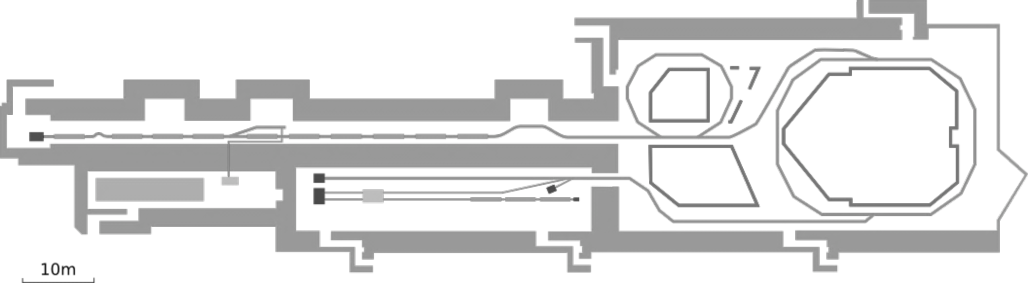
Results: injector optimization
Flattening of BPR waveguide signal acting on the buncher klystron phase along the pulse.
Each line represents a single 1.2 μs long electron beam pulse.
Red traces are shots after correction.

Slide 8
Results: energy optimization along the pulse
Horizontal beam profile at the end of the linac in a dispersive BPM for different single shots.
The blue lines are before energy flattening correction, the red lines after the correction acting on last klystron phase along the pulse.

Slide 9
Results: orbit correction/control
Vertical orbit correction in Transfer Line TL1.
Each line represents the orbit averaged over 5 pulses.
In black, where present, the target orbit.
Red are shots after correction.

Slide 10
Results: CR orbit closure
Difference between the first and second turn horizontal orbit in the Combiner Ring (CR).
Each line is an average over 10 pulses.
The red differences are obtained after minimizing the closure on the green-marked BPMs.

Slide 11
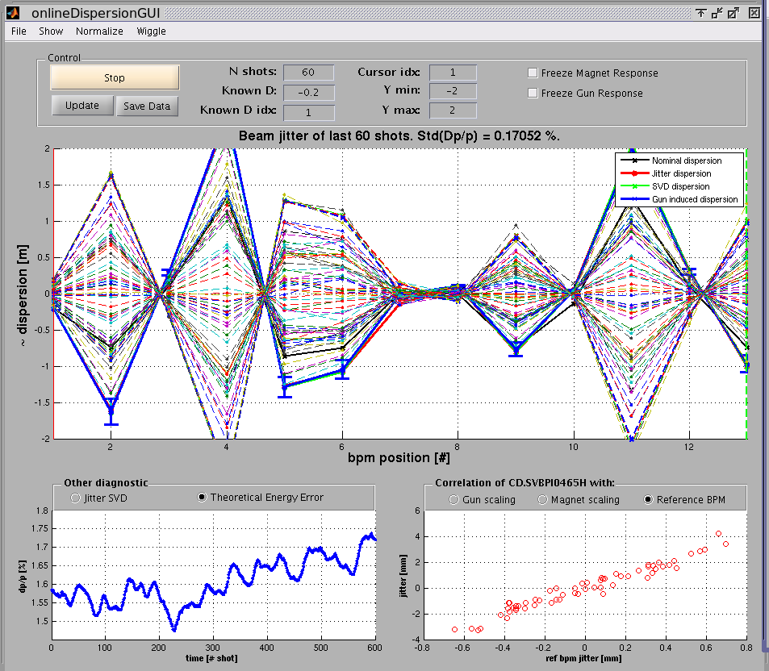
Dispersion measurement from Jitter
Developed an application to passively/actively measure dispersion by beam jitter.
One can measure:
Correlated jitter (passive)
Linear fit on injector beam current induced jitter (active)
Linear fit on main bending scaling (active)
Can be used as online detection of machine drifts.

Slide 12
Dispersion measurement from Bending Scaling
Scaling only the main bending magnets one can have (at first order) the nominal dispersion (depending only on quadrupoles strength and beam energy).
An example: CLEX experimental area.
Dogleg dispersion suppression with quadrupoles
Two Beam Acceleration Test Area
Designed dispersion should be zero
Incoming dispersion should be zero

Slide 13
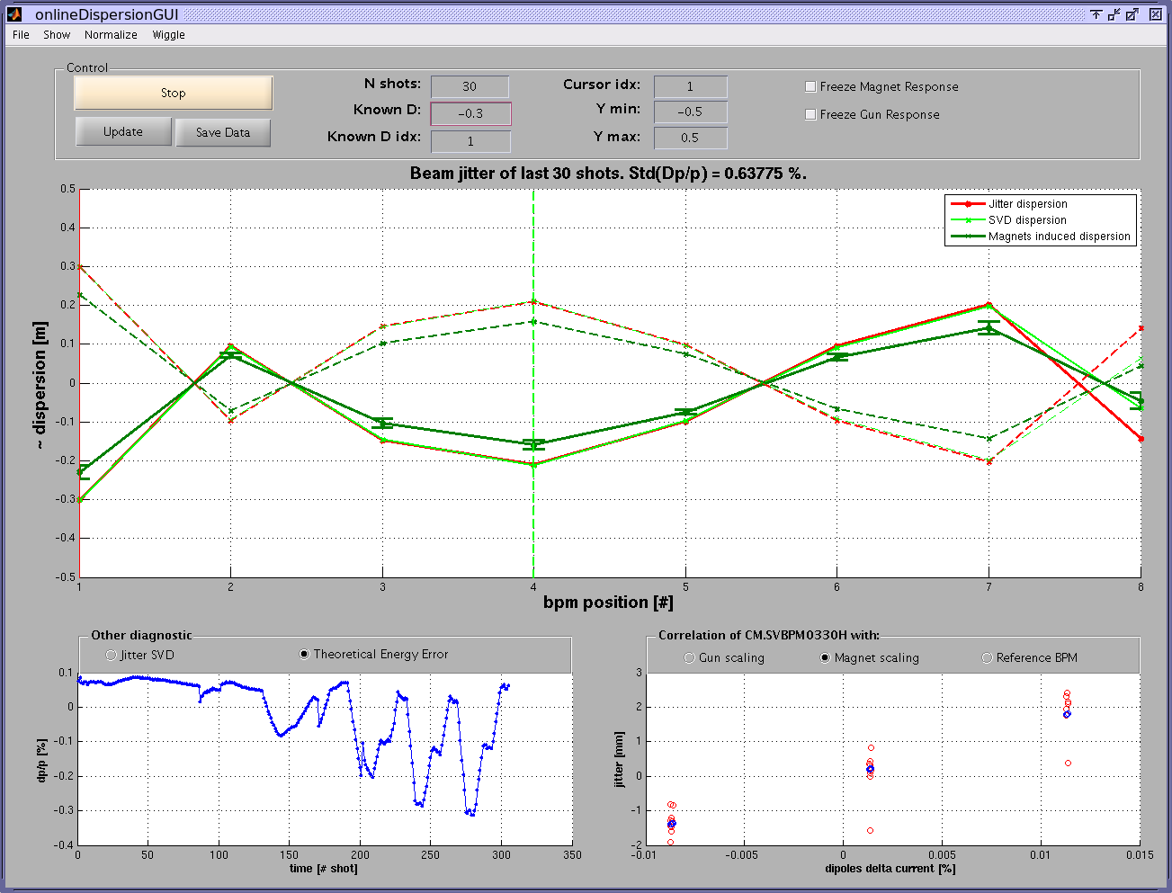
Dispersion measurement from Bending Scaling
Before correction (Dark green line)
Only in the first BPM dispersion is expected!

Slide 14
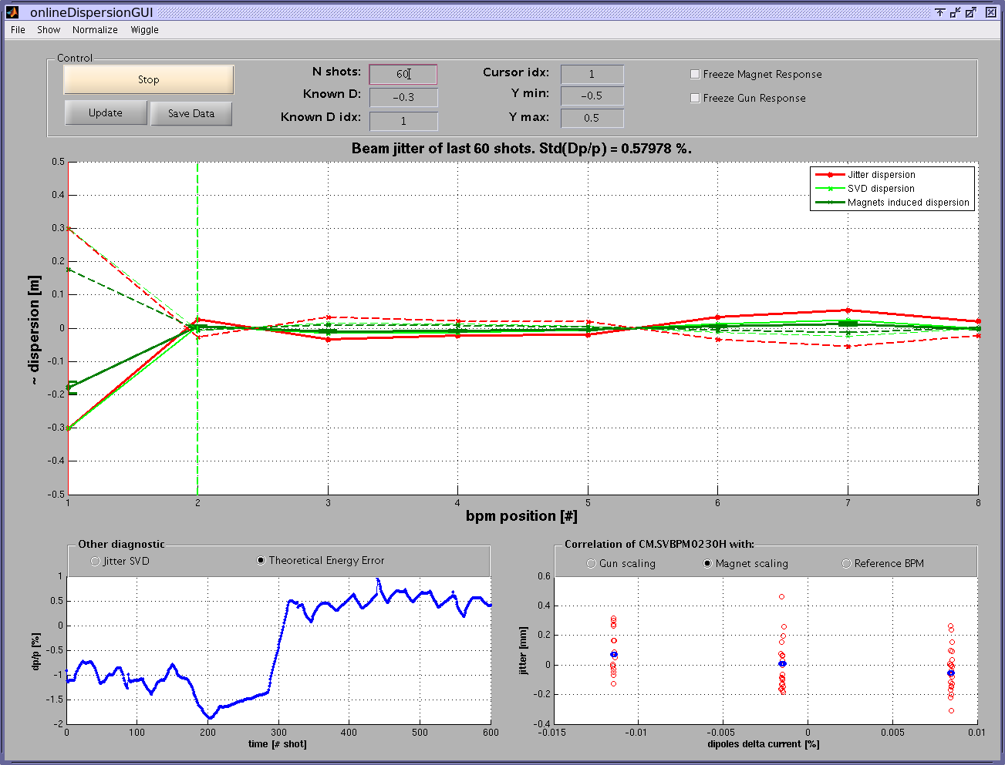
Dispersion measurement from Bending Scaling
Manually changing quadrupoles used for dispersion correction.

Slide 15
Simulations
I want to study the emittance growth we see in the machine using MAD-X.
I want to avoid doing particle tracking, to better identify the sources.
Hypotesys:
  The model we have is reasonably representative of CTF3.
  MAD-X is doing what it claims (not so trivial).
  All our magnetic element are linear (sextupoles are not powered or week).
  We are dominated by energy effects (beam energy spread ~1 % σ).
  The emitance of a monochromatic beam is preserved all around the machine.
  The emittance is defined as determinant of the covariance matrix.
Procedure:
  Simulate many monochromatic beams with different deltap respect to the nominal energy.
  Save the optics and orbit parameters for each beam at each location.
  Combine all the optics and orbits weighting on the real (or expected) energy profile of the real beam, and so compute the projected emittance.

Slide 16
Sources of emittance growth
Injection orbit error (Δx = 0.5 mm)
  After different number of turns the centroide of the ellipses in phase-space is moving accordingly to the tune of the ring.
  “recombined” emittance increased of 10%.
CR: 4x

Slide 17
Sources of emittance growth
Injection optics error (β/β₀ = 1.5)
  After different number of turns the shape of the ellipses in phase-space is rotating accordingly to the tune of the ring.
  “recombined” emittance increased of 10%.
CR: 4x

Slide 18
Sources of emittance growth
Energy spread (Δp/p₀ = 0.5% σ)
  The strong optics and the small bending radius introduce high non linear dispersion and chromatic aberrations.
  Single passage emittance increased > 100%.
DL: 2x
Twiss ellipses:
Different Δp/p₀ (from -3 σ to +3 σ)
Nominal (Δp/p₀ = 0)
Weighted combination

Slide 19
Sources of emittance growth
Effect of quadrupoles misalignments
  Some quadrupoles, if misaligned, leads to a big increase in emittance, mainly due to the dispersion induced after the Chicane.

Slide 20
Summary
What has been done:
  Improved software feedback algorithm.
  Many good results with the feedback, but none of them is actually making the huge improvement expected.
    Still to be properly measured the emittance dependency over orbits closure.
  Dispersion measurements along the machine and some attempt of correction.
  Started simulations on the emittance growth.
    Very interesting and promising results.
What is on the table:
  Continue simulations and studies.
    Need to prove that the all the hypotesis of my simulations are reasonable.
  Probably we will need to think different optics.
  Big issues with BPMs.
    Completely unreliable in many cases. We need to understand way.
  Quadscan sometimes not reliable.
    Emmitance decrese: issue or real?
  There is an idea of implementing a phase-space tomography.
    Nothing done here yet.

Slide 21
  Thank you.

