Slide 1
CTF3 Latency

Slide 2
Signals – without driving amps

Slide 3
Original latency estimates
By putting out constant signal (2000 cnts) on DACs coinciding with the duration of the beam pulse, measured the offset between the correction signal on the monitors and the beam-induced pick-up.
Kicker480 (u/s): -8.4 ns (-3 cycles) ~1.7 m
Kicker780 (d/s): +30.8 ns (+11 cycles) ~6.2 m
Time difference between kicker pickup = 36.4 ns = 10.9m between the kickers (agrees with model)

Slide 4
Latency breakdown
Based on most recent measurements/estimates:
TOF PhM -> TL2 : 380 ns
Kicker cables : 210 ns (TDR)
Phase monitor electronics + cables : 50 ns (?)
Leaves ~ 120 ns for FPGA + amplifiers
Estimate: FPGA (20 clock cycles : ~67 ns), Amplifier (27 – 35 ns), ~20 ns slack

Slide 5
Detailed Latency (1)
Driving amps with 200 cnts
(8% full kick)
Arbitrary timing
Rise of signal (312-318) 316
16.8 ns RT
Beam induced pickup: 508 -516 (peak @ 511)
8.4 ns RT
195 samples = 546 – 380 = 166 ns
Roughly consistent with 210 – 50 =160 ns

Slide 6
Detailed Latency (2)
Drive output timing : 201 – 216 (206)
Constant drive output at T(10) cf 316 (PhM rise)
Sample 206+306= 512
Therefore output would have risen to 80% at T(512), cf beam pickup at T(511)
Present timing very marginal.

Slide 7
Firmware Latency
Full simulation of (pseudo)-top level and below for timing verification

Slide 8
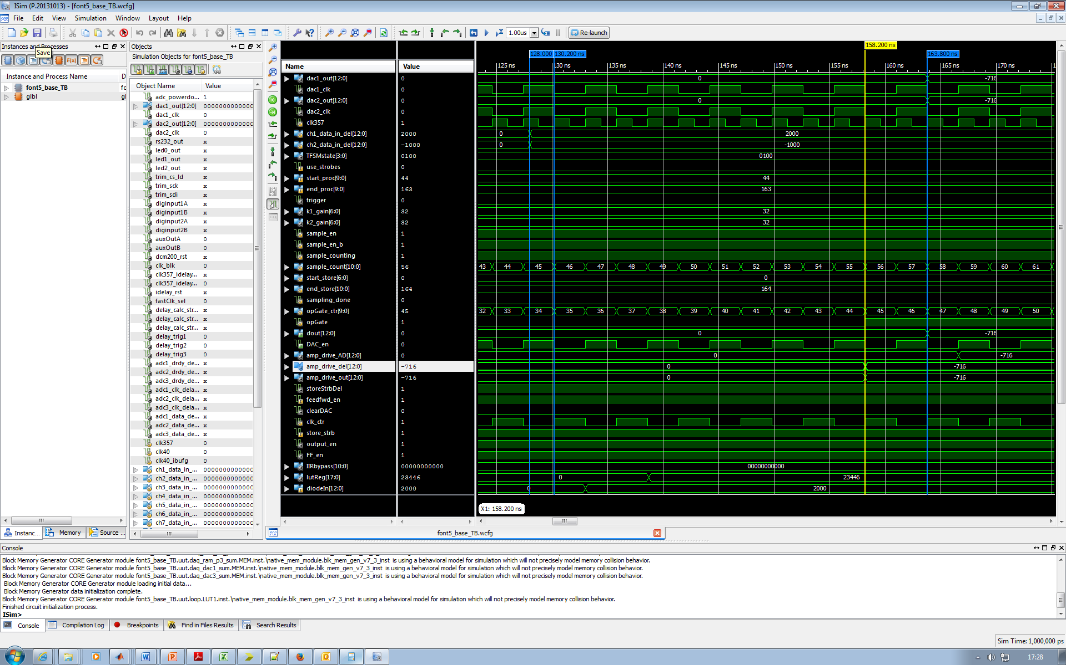

Slide 9
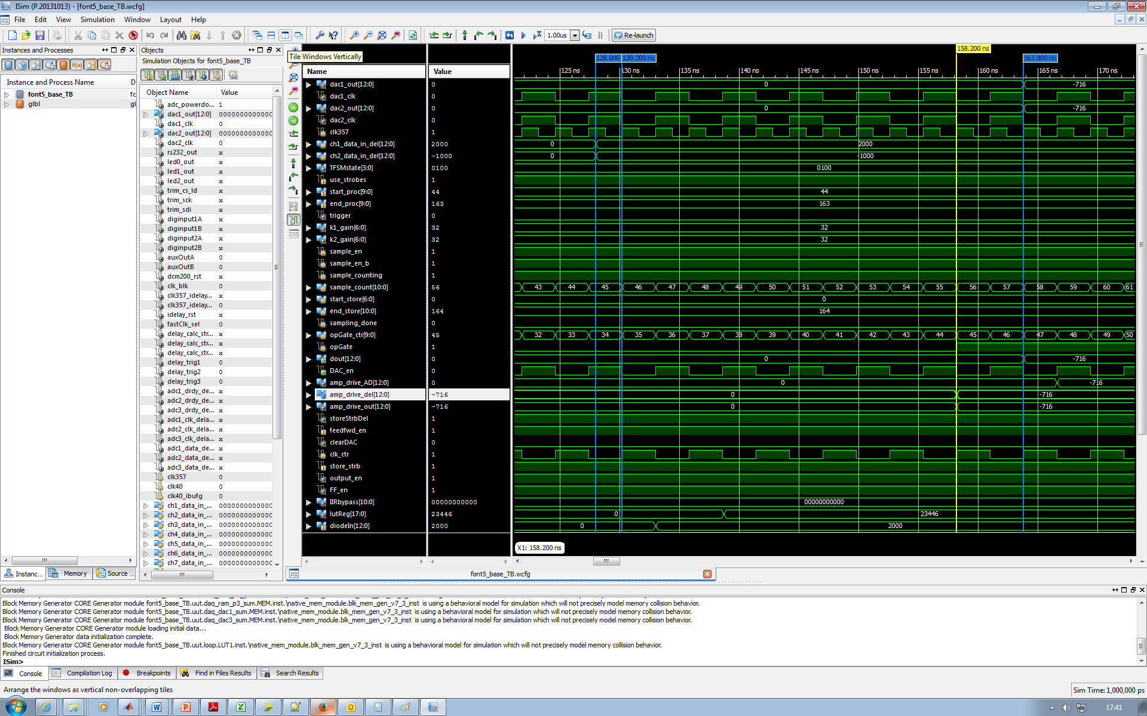

Slide 10
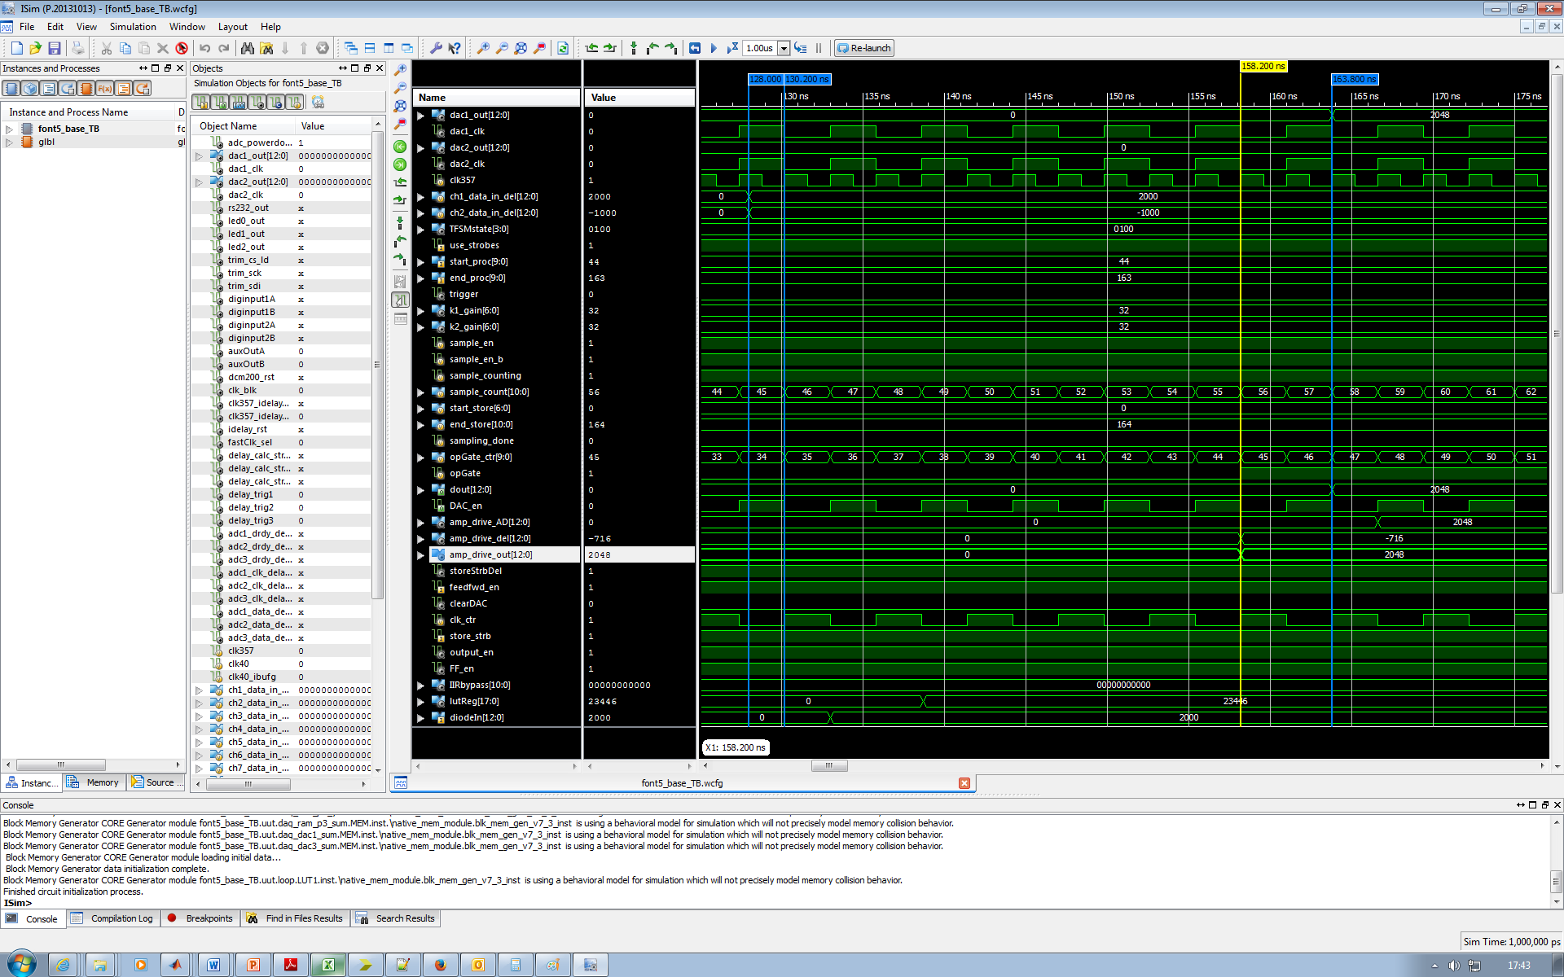

Slide 11


Slide 12


Slide 13
Firmware Latency
Simulated latency:
22.5 cycles : ~63 ns @ 2.8 ns
FPGA logic: up to 18 cycles
input/output buffer x2
input/output filtering (latency 3) x2
BRAM lookup (latency 2)
Mults (latency 2) x2
Shift register (latency 2)
Pipelining x2
ADCs : 3.5 cycles + DAC timing (~ 1 cycle) + up to 1 cycle for synchronising
Measured latency
63.6 ns (@2.8ns) includes 2 times 0.5m RG58
60.4 ns without extra cables (! ? !)
Final timings will need tuning; aim to use minimum pipeling necessary to run as fast as possible (up to 400 MHz) providing there is enough slack.
Lump all slack into the shift registers!!

