Slide 1
Some Further Analysis of PFF Preparation Tests June 2014
Jack Roberts

Slide 2
Overview
Phase propagation from Frascati monitor to PETS.
Results from slow correction tests.
Constant kick tests with Frascati monitor.
Other business: New Frascati monitors, update on summer students.

Slide 3
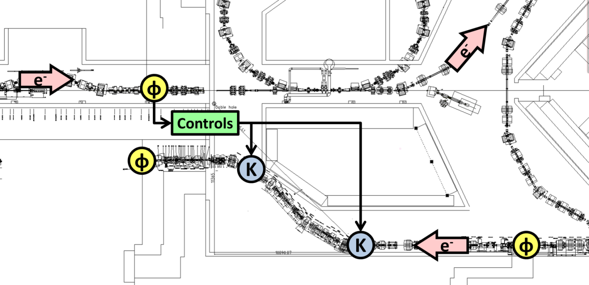
Phase Feedforward System at CTF3
Correct drive beam phase (longitudinal position) by varying path length through TL2 chicane using two kickers.
Current status:
  One functioning high resolution Frascati monitor, PETS lower resolution phase measurement used as interim solution as monitor after chicane.
  One day of initial tests with first stage kicker amplifier.
Frascati Monitor
TBL
TL2
PETS Monitor

Slide 4
Phase Propagation
I’ve had a look at the propagation in mean phase between the Frascati monitor and PETS monitor.
    The (in)stability of the beam between the two makes any attempts to cross-correlate the pulse shape between the two useless.
For the slow correction (see later) we shifted the mean phase by varying the bends in the stretching chicane.
  Induces R56 in the chicane which increases phase jitter as you will see.

Slide 5
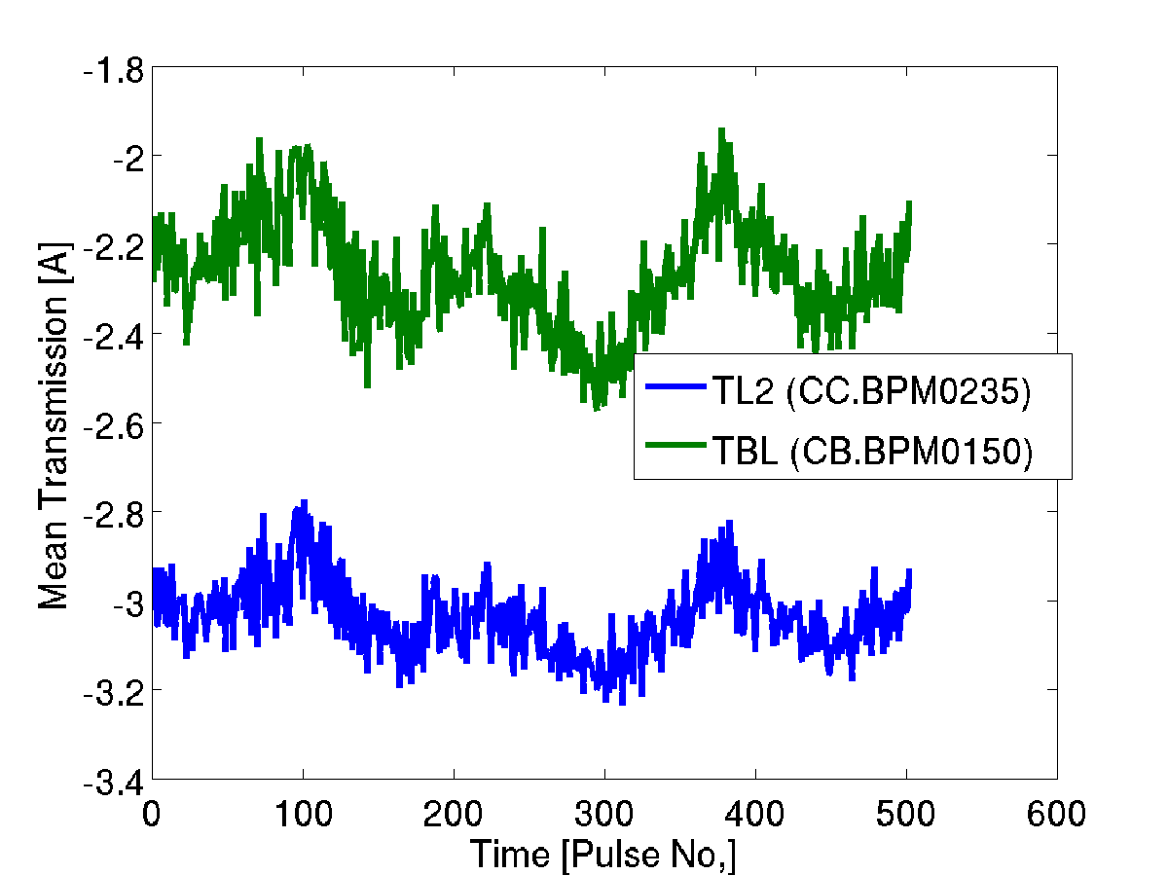
Transmission
STRETCHING CHICANE
NOMINAL

Slide 6
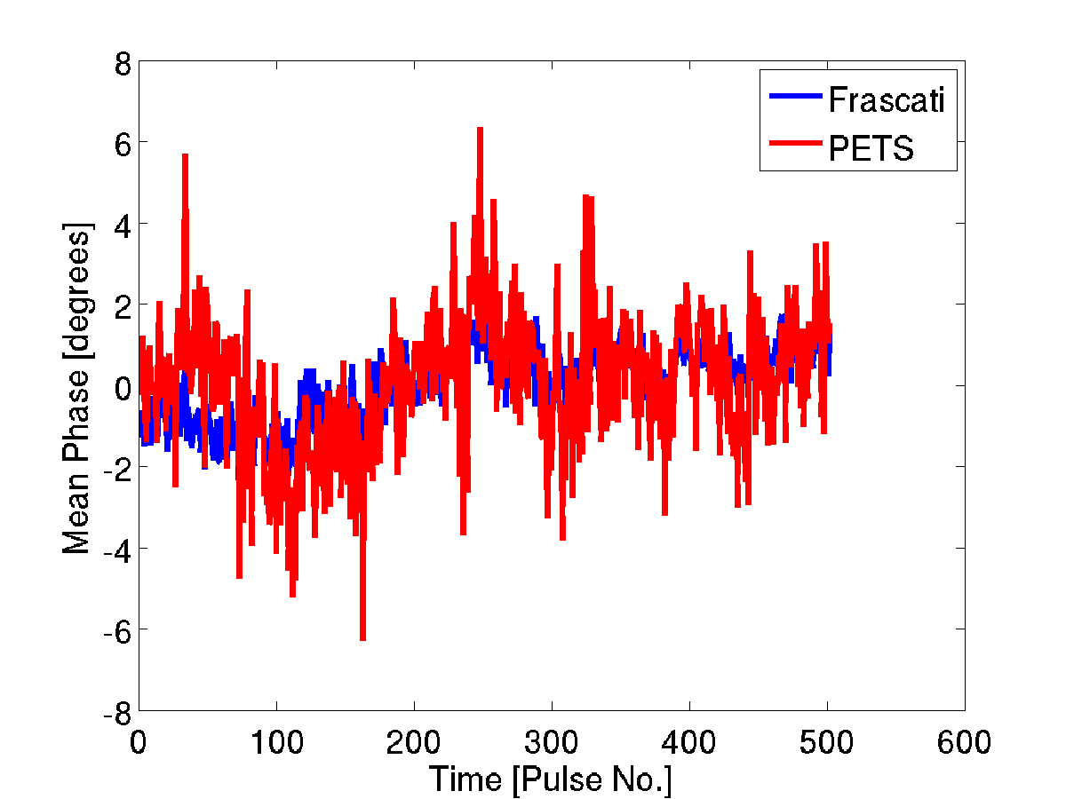
Mean Phase vs. Time
STRETCHING CHICANE
NOMINAL

Slide 7
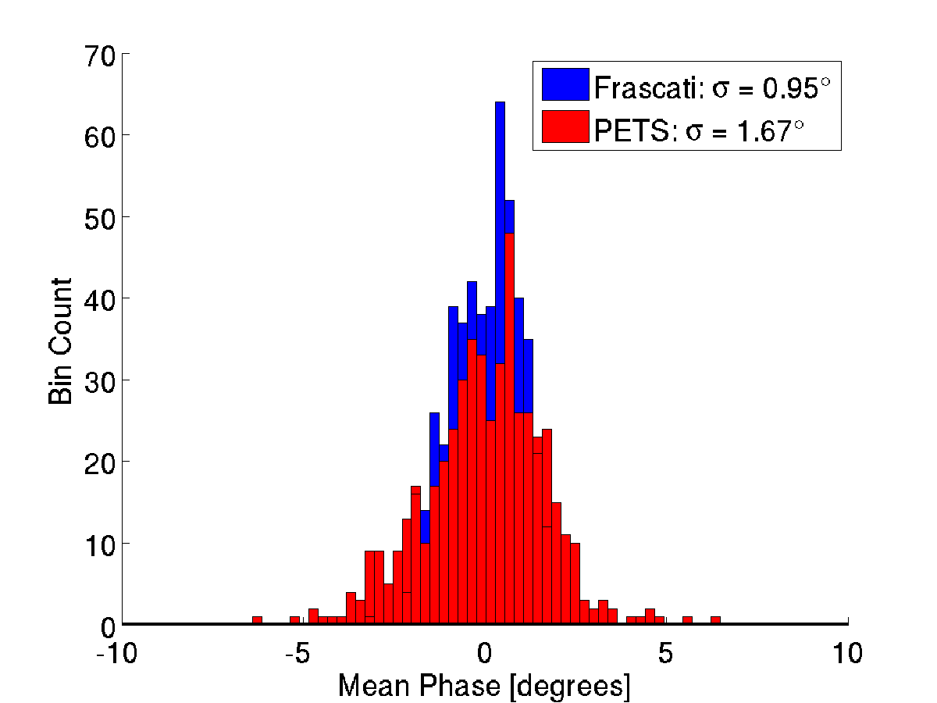
Jitter
STRETCHING CHICANE
NOMINAL

Slide 8
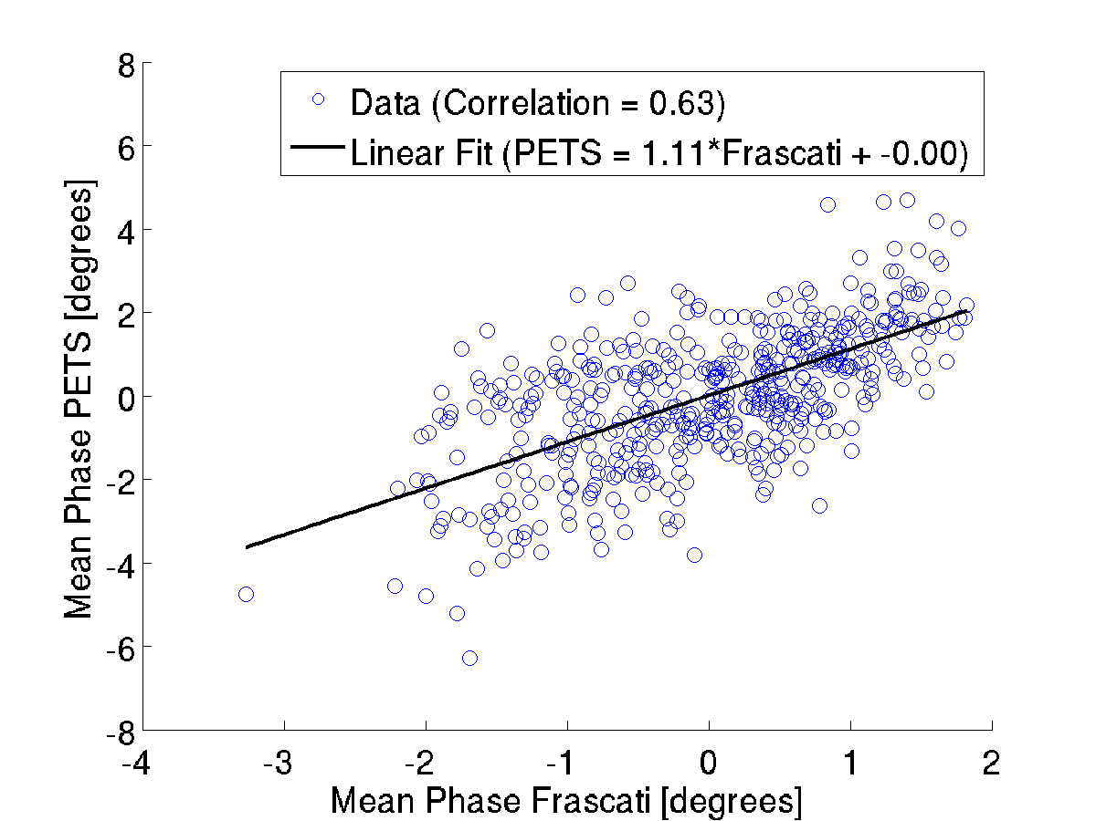
Correlation
CHICANE
NOMINAL

Slide 9
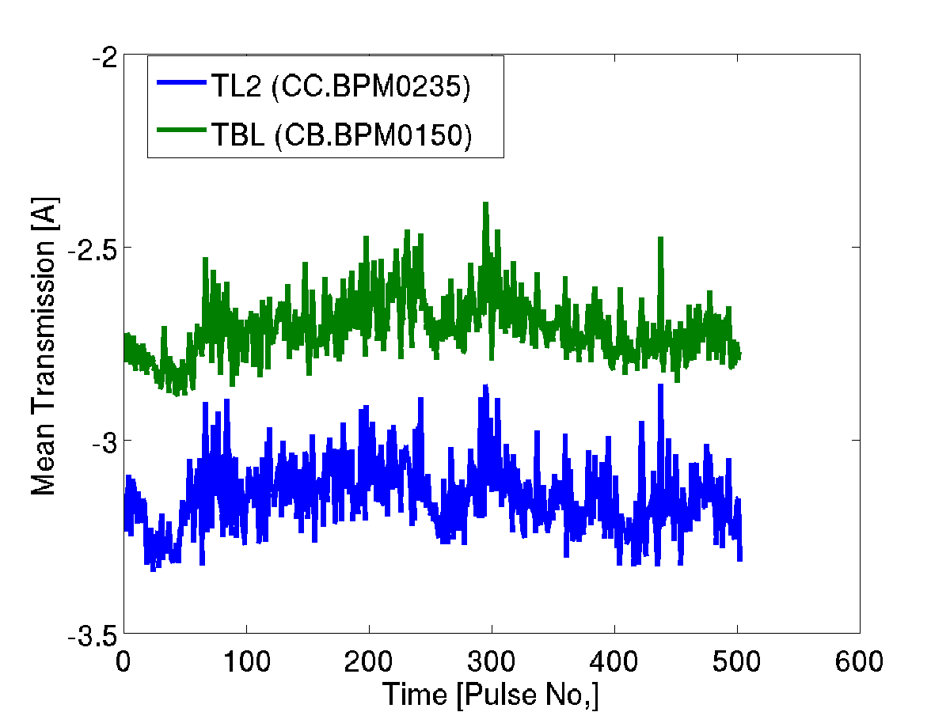
Transmission
STRETCHING CHICANE
3A LOWER

Slide 10
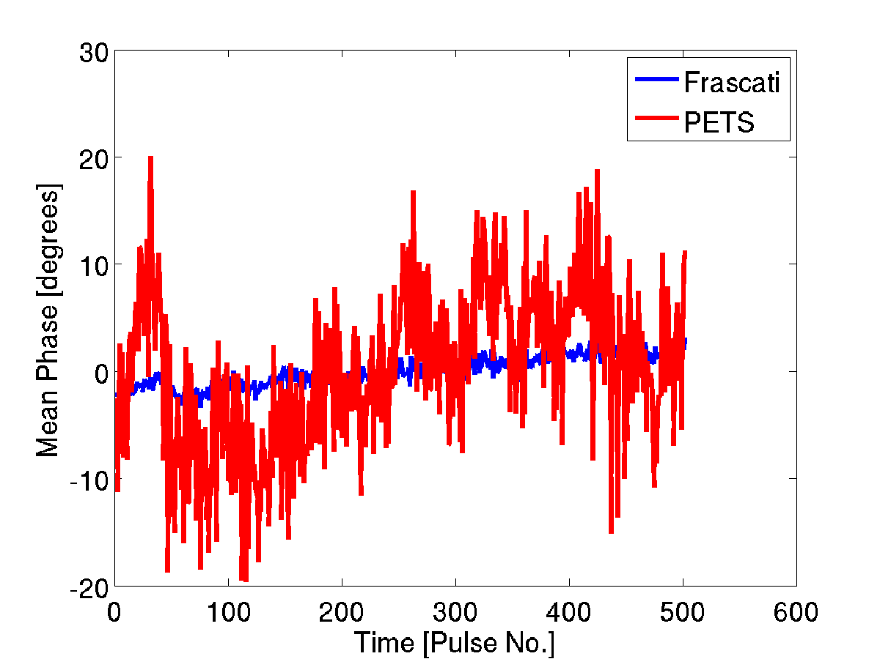
Mean Phase Vs. Time
STRETCHING CHICANE
3A LOWER

Slide 11
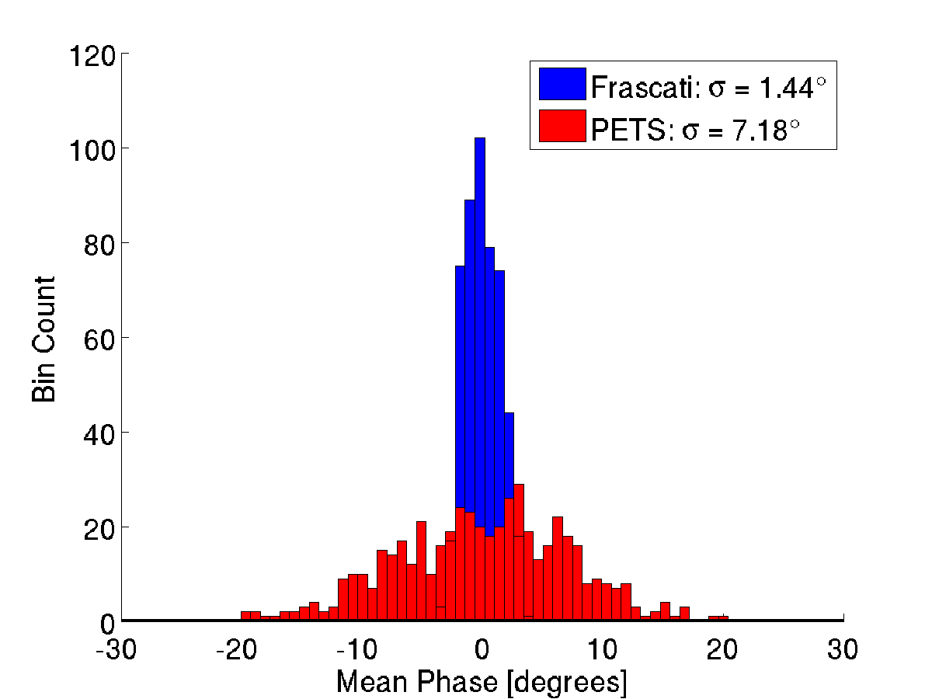
Jitter
STRETCHING CHICANE
3A LOWER

Slide 12
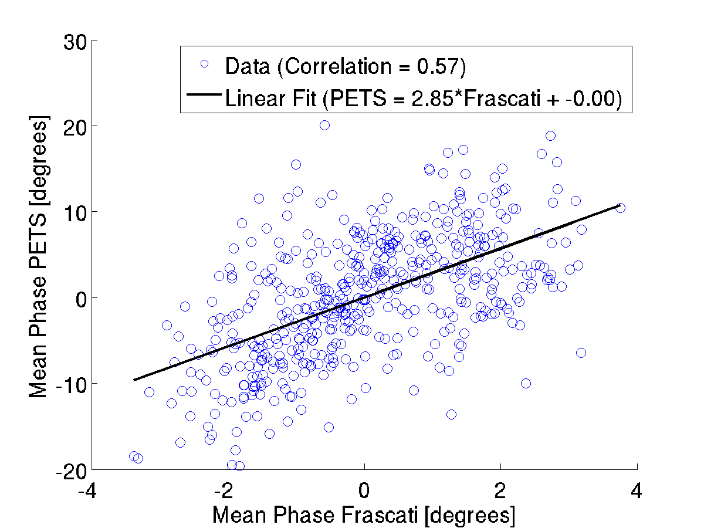
Correlation
STRETCHING CHICANE
3A LOWER

Slide 13
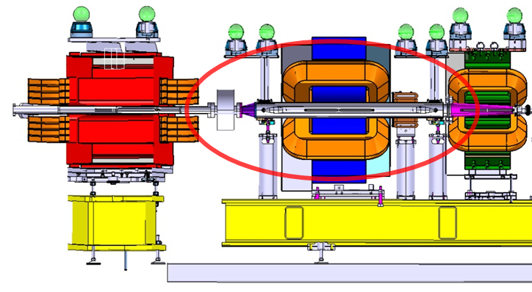
Slow Correction
Two magnetic kickers installed around the phase feedforward kickers to correct slow drifts in the mean phase.
Took first tests, both using the Frascati monitor as the input to the system and the PETS.
  Tried to present some results in a clearer way here.
NB – The sign of the phase shift is opposite in the Frascati and PETS monitors. Need to correct this in calibrations.

Slide 14
Slow Correction
Calibrate phase monitor.
Calculate ratio of currents to apply to each corrector for orbit closure.
Calculate phase shift per Amp applied to correctors.
Run slow correction. Corrector values changed every 20 pulses (for example) to shift phase back to zero based on mean phase of last 20 pulses.
For tests, shift the mean phase of the beam by changing bends in the stretching chicane.

Slide 15
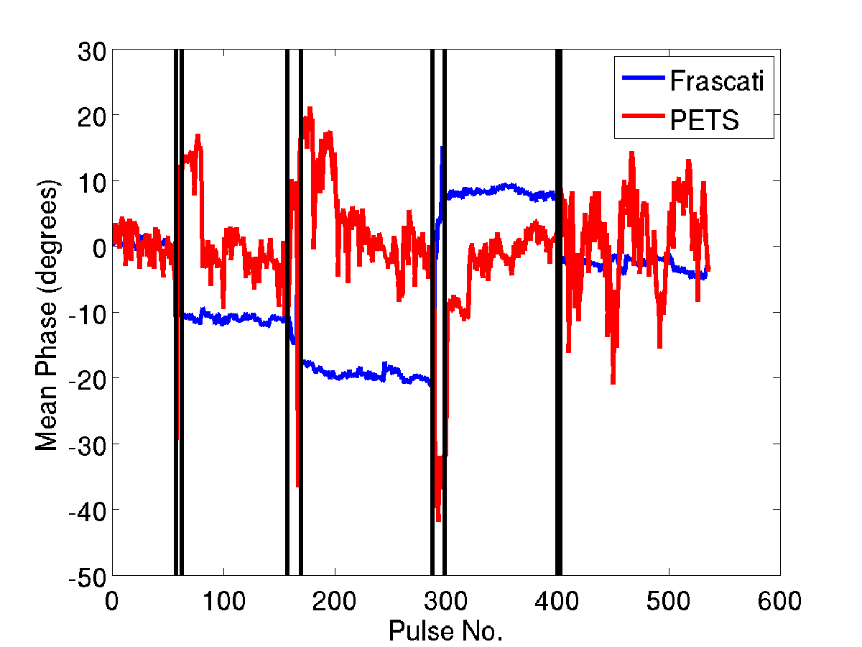
Slow Correction - Phase

Slide 16
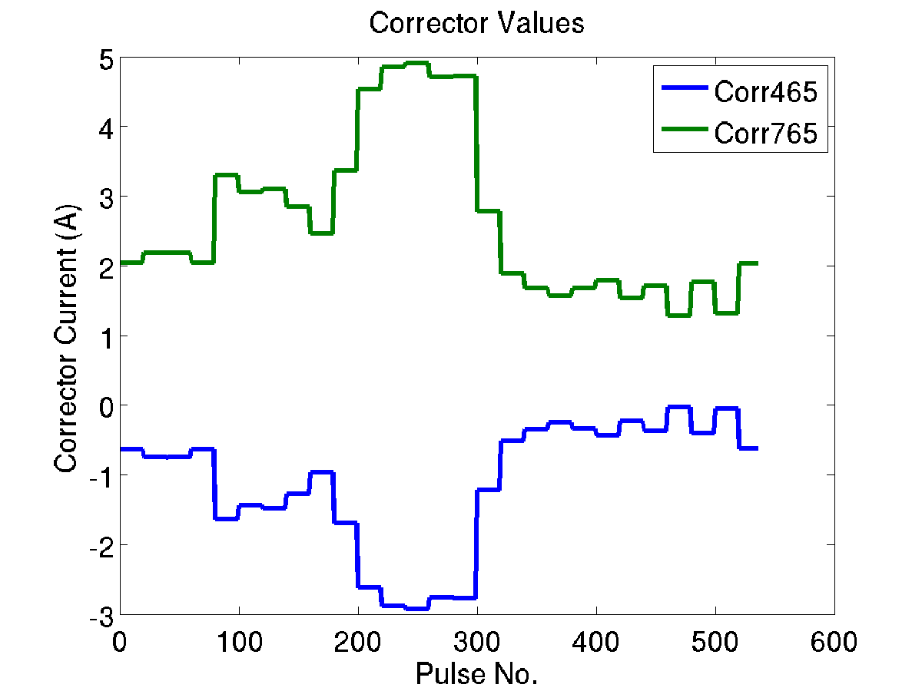
Corrector Settings

Slide 17
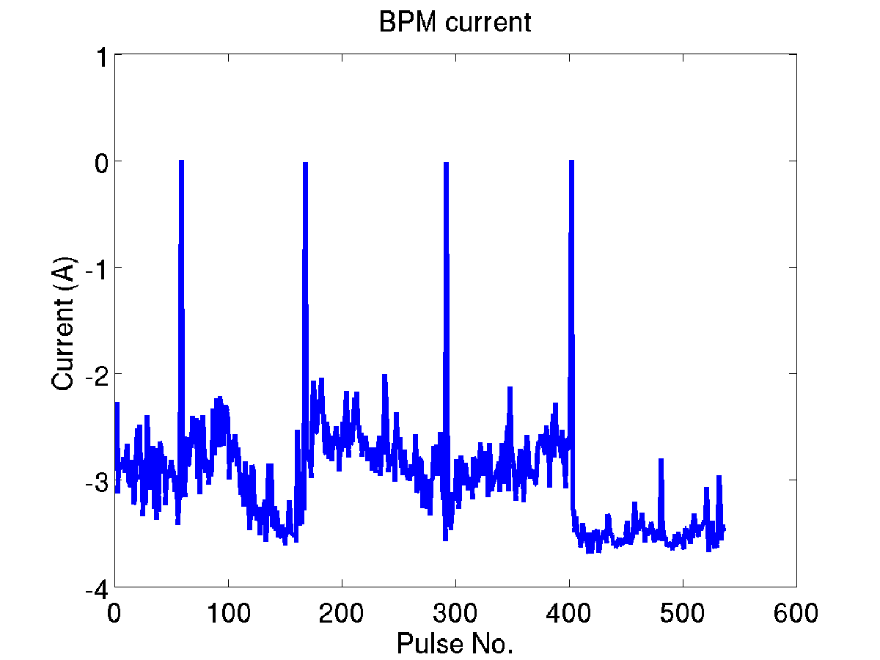
Transmission

Slide 18
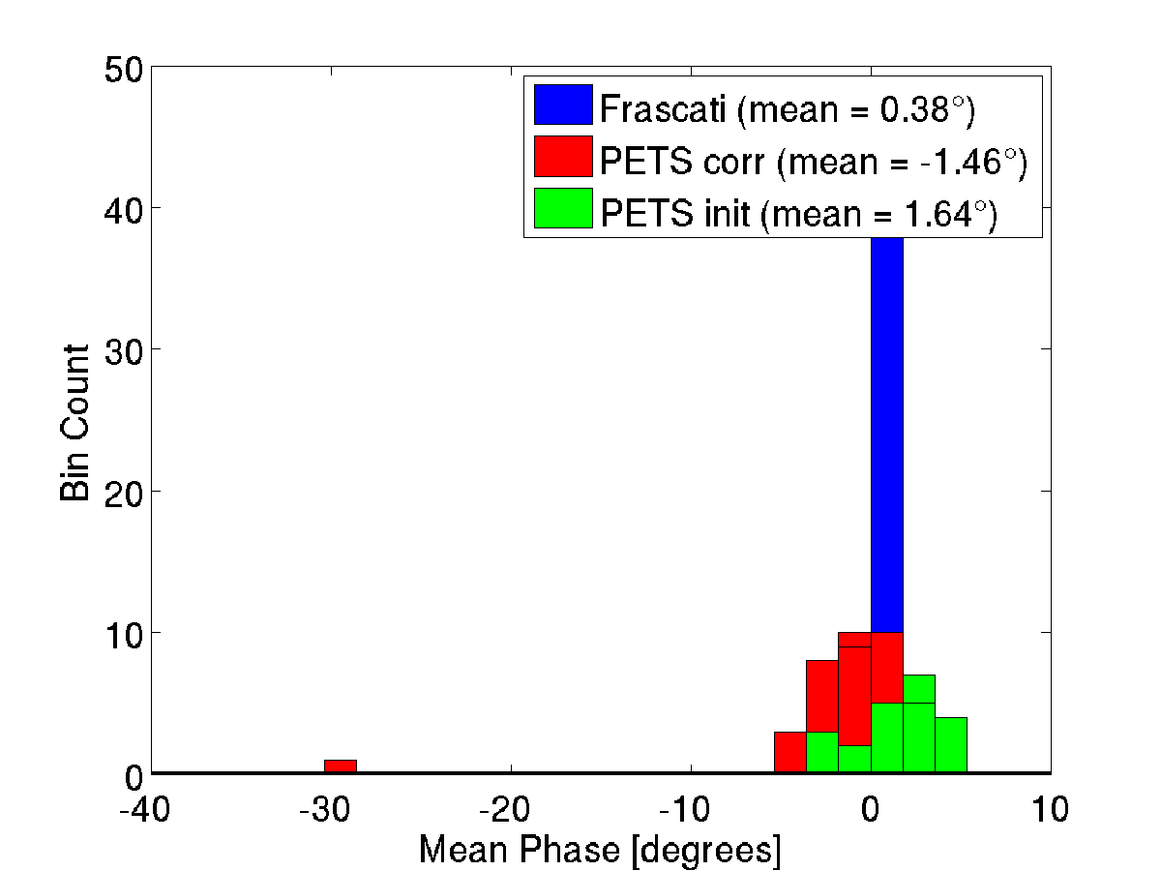
Pulse 1 to 58 (Chicane Nominal)

Slide 19
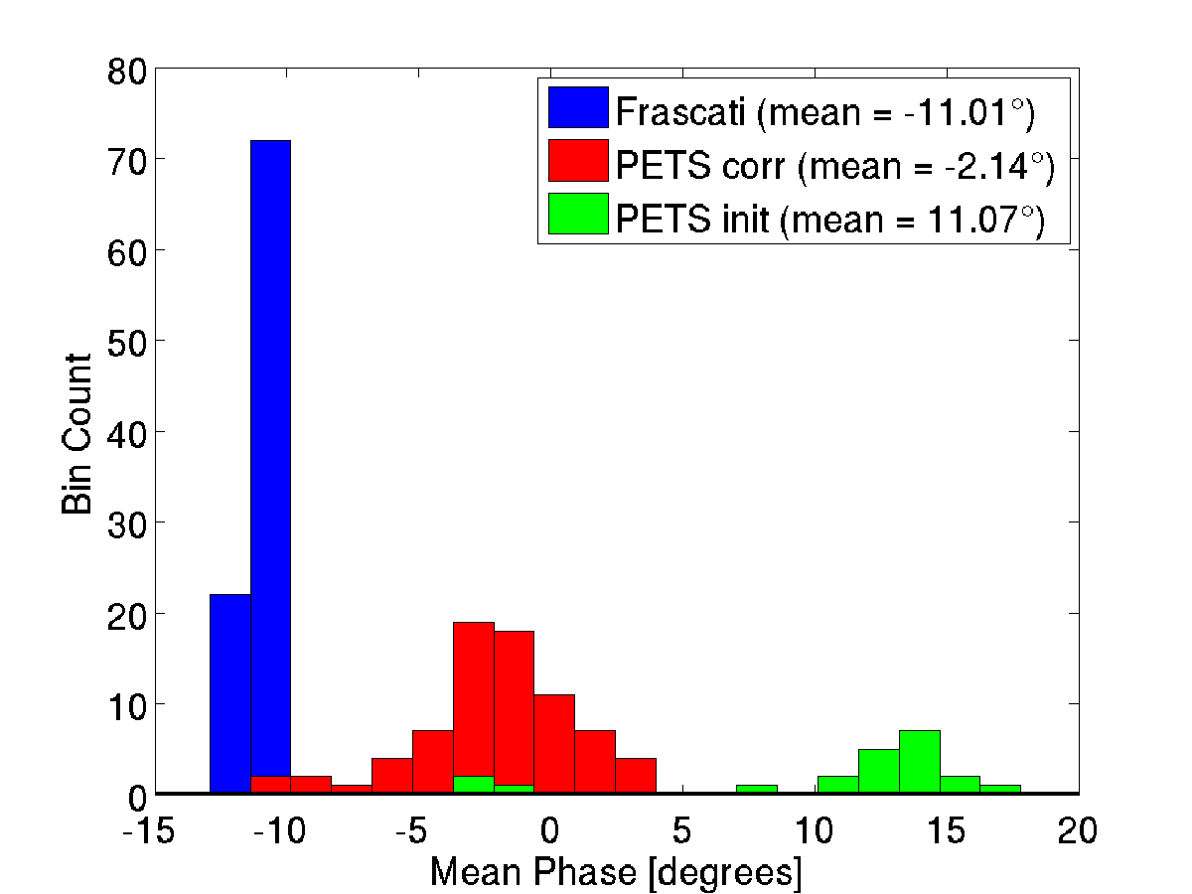
Pulse 63 to 158 (Chicane 10 degrees lower)

Slide 20
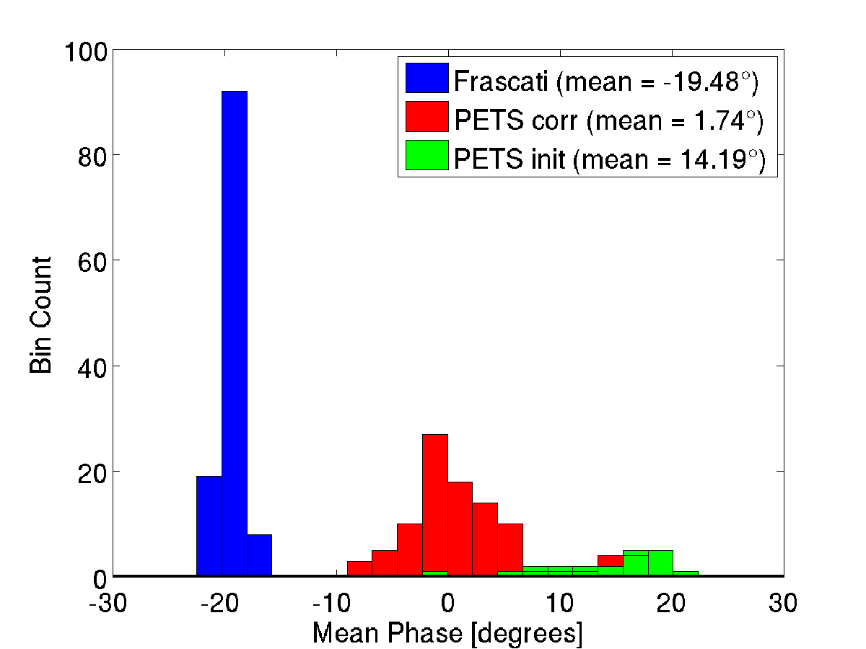
Pulse 170 to 288 (Chicane 20 degrees lower)

Slide 21
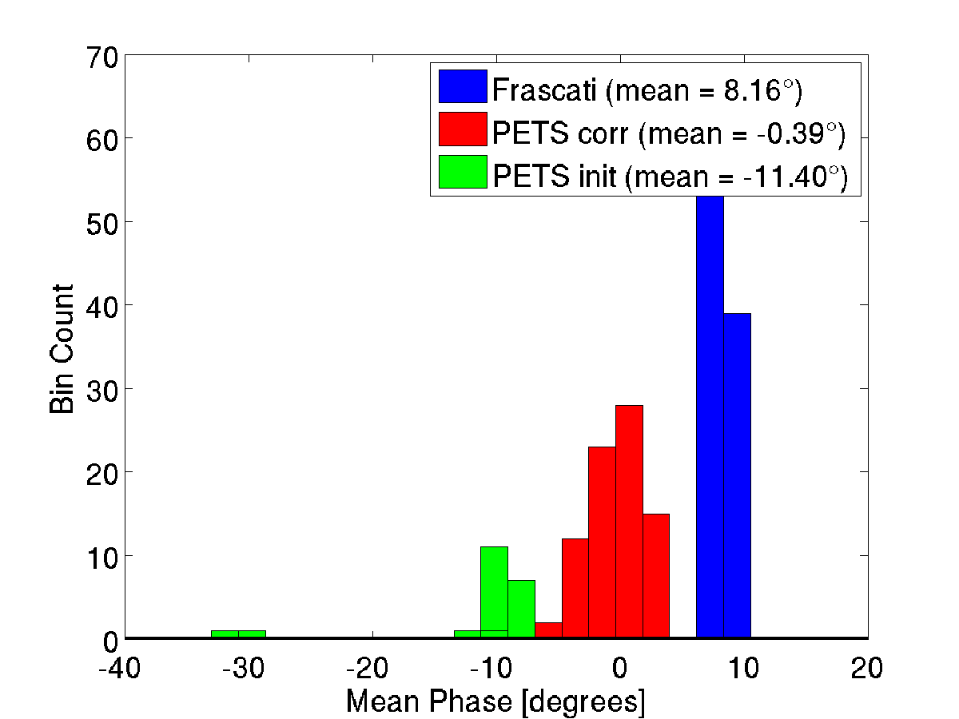
Pulse 299 to 400 (Chicane 10 degrees higher)

Slide 22
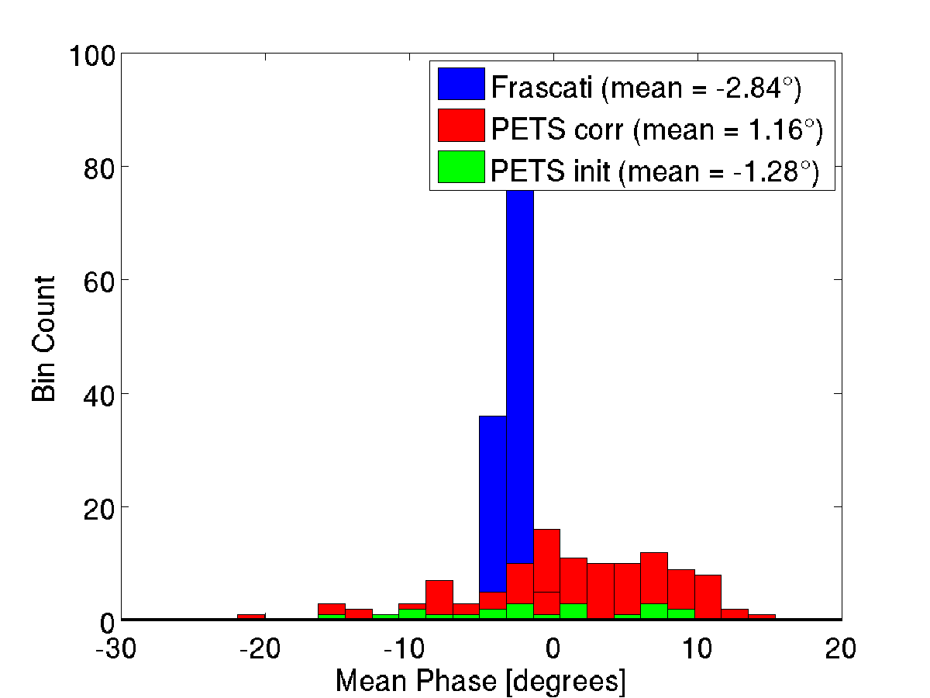
Pulse 403 to 536 (Chicane Nominal)

Slide 23
Constant Kick Tests
First tests powering the Frascati kickers and trying to observe the resulting position offset in the BPMs.
Results compared to expectation from MADX model
Assumed amplifier output: 350 V at 2000 counts (was more like 345 V).
Had some question marks about whether we were really kicking the beam.

Slide 24
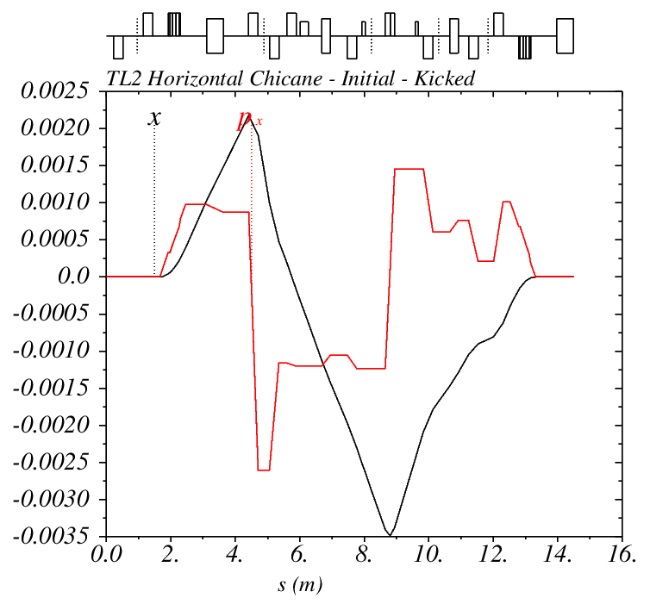
Optics Orbit With Maximum Kick

Slide 25
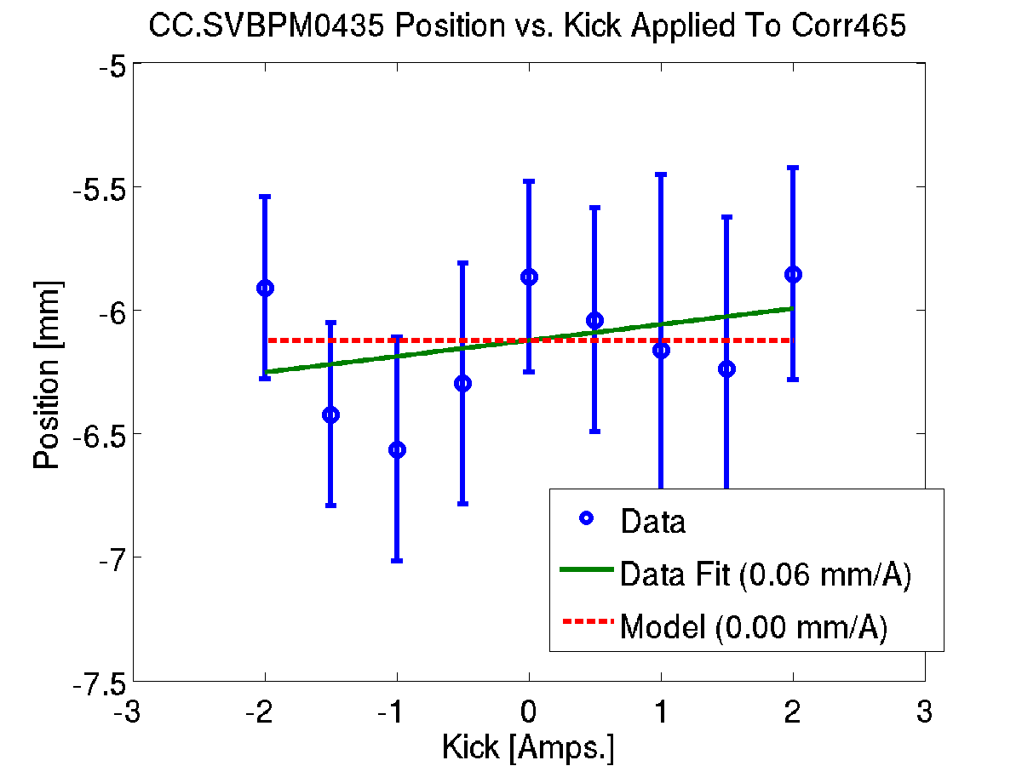
Last BPM Before 1st Kicker
CORRECTOR
465

Slide 26
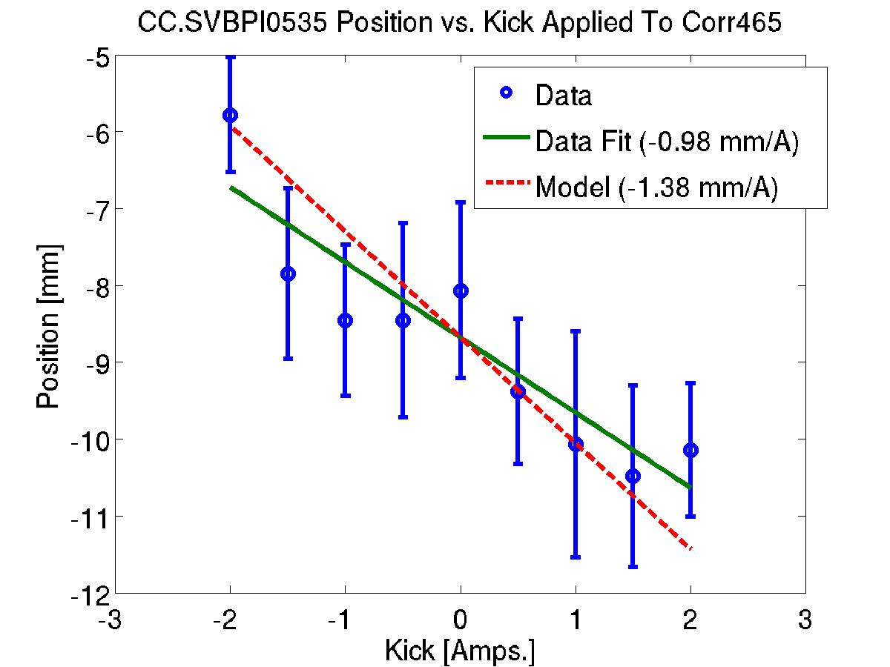
1st BPM After 1st Kicker
CORRECTOR
465

Slide 27
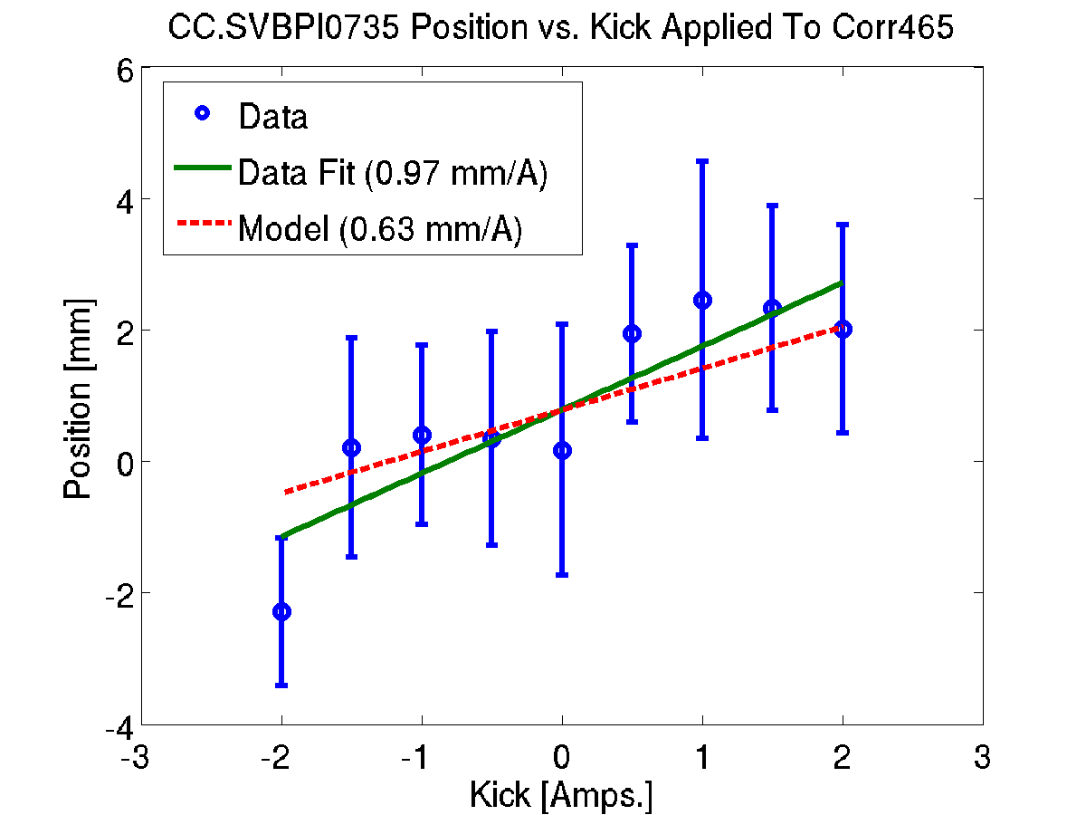
Last BPM Before 2nd Kicker
CORRECTOR
465

Slide 28
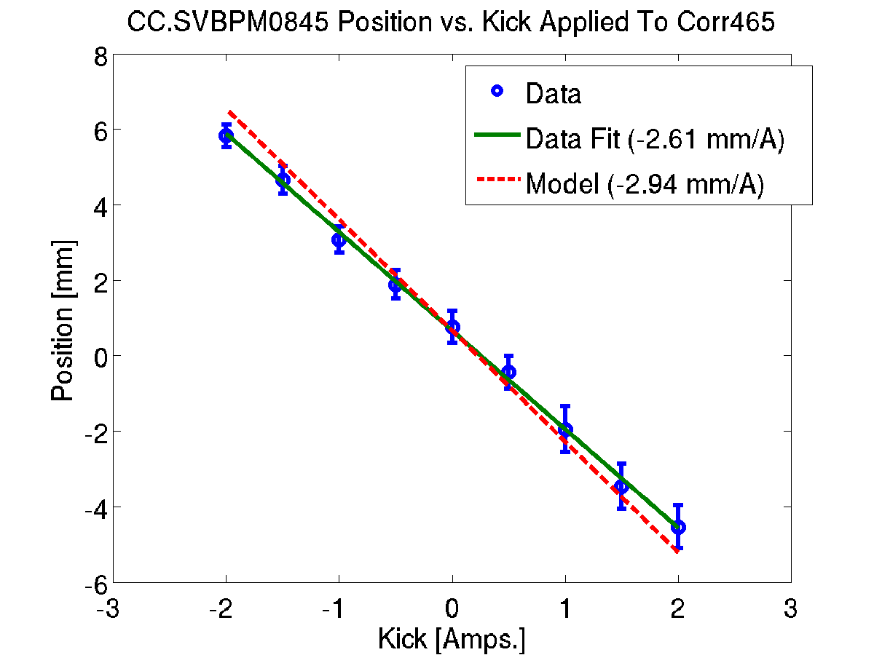
First BPM After 2nd Kicker
CORRECTOR
465

Slide 29
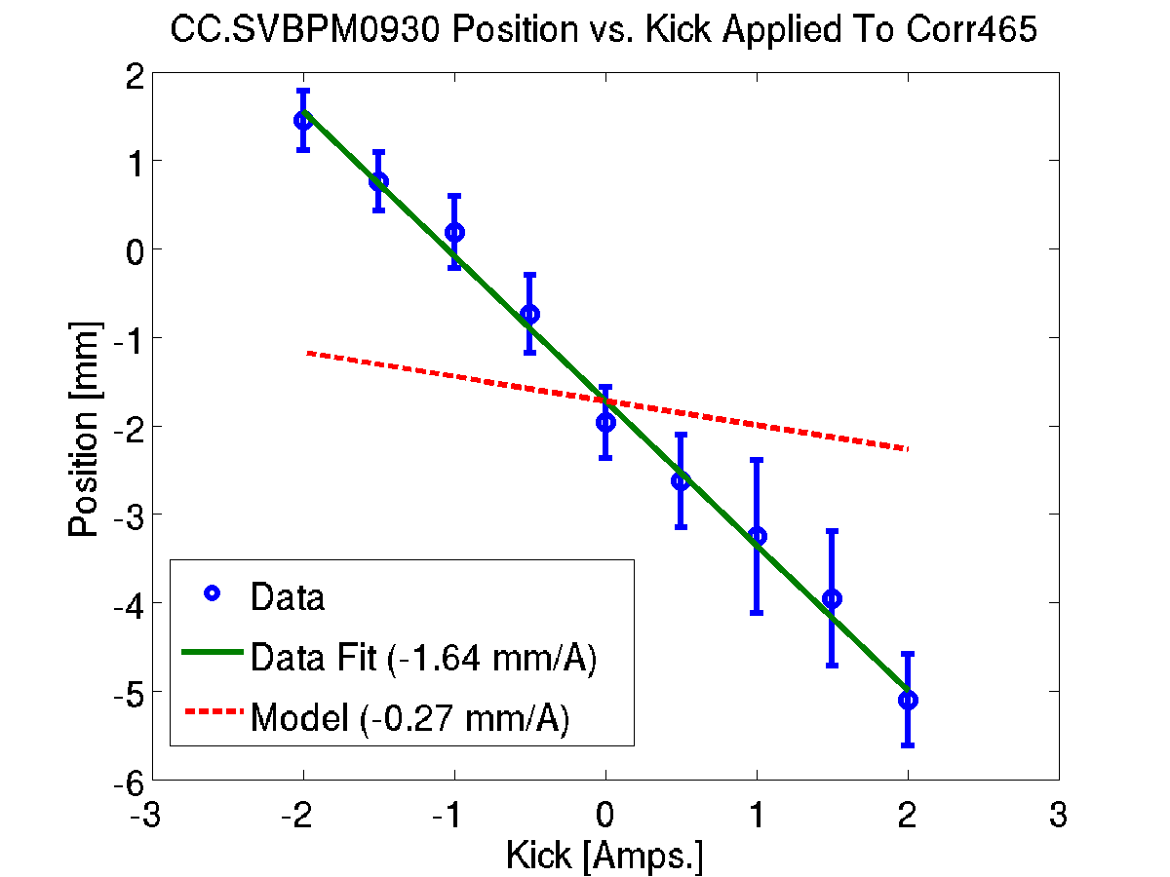
2nd BPM After Chicane
CORRECTOR
465

Slide 30
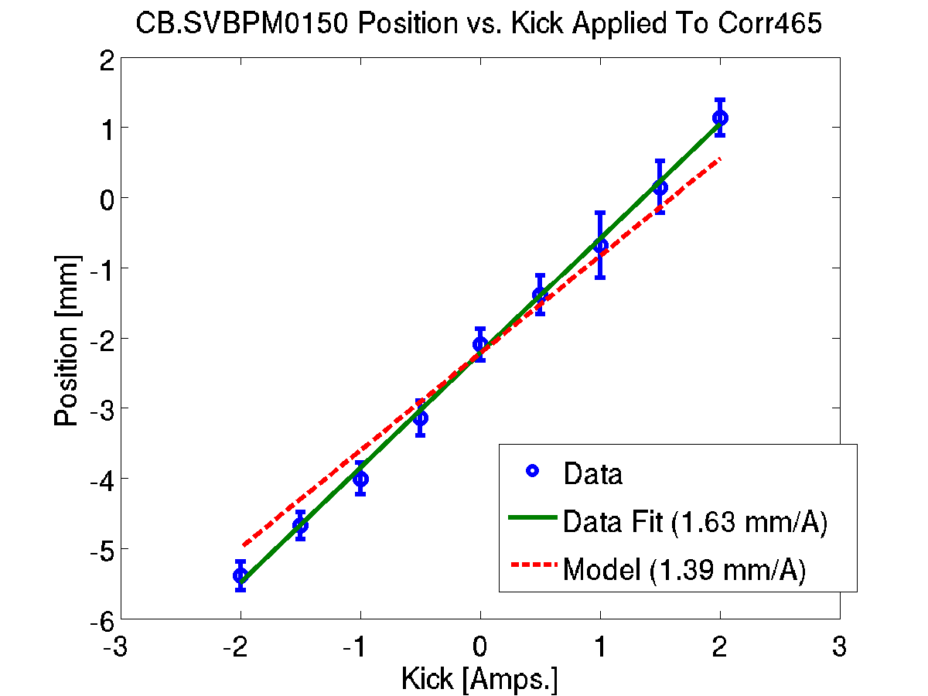
3rd BPM After Chicane
CORRECTOR
465

Slide 31
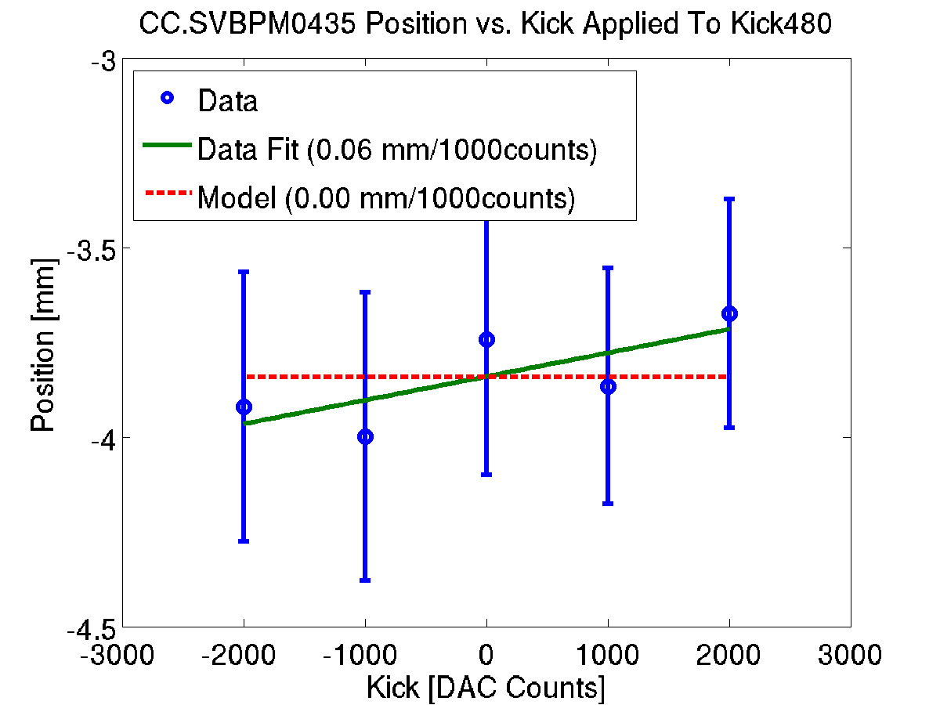
Last BPM Before 1st Kicker
KICKER
480

Slide 32
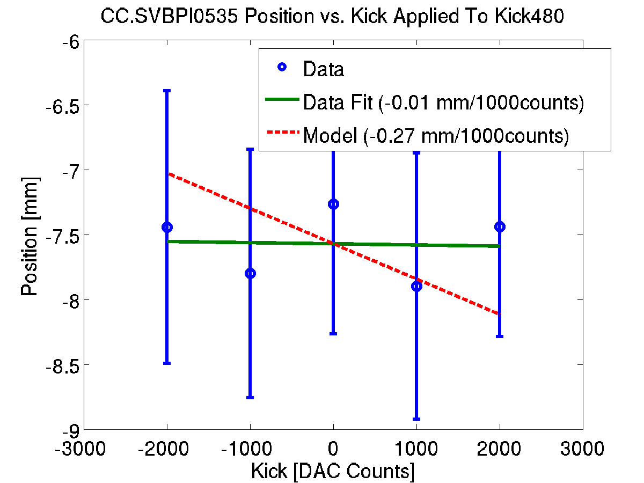
1st BPM After 1st Kicker
KICKER
480

Slide 33
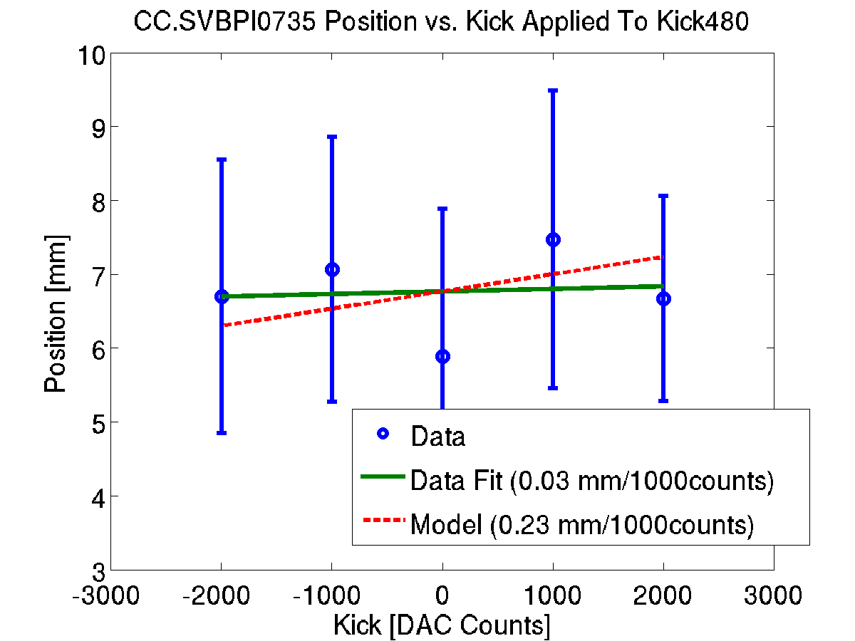
Last BPM Before 2nd Kicker
KICKER
480

Slide 34
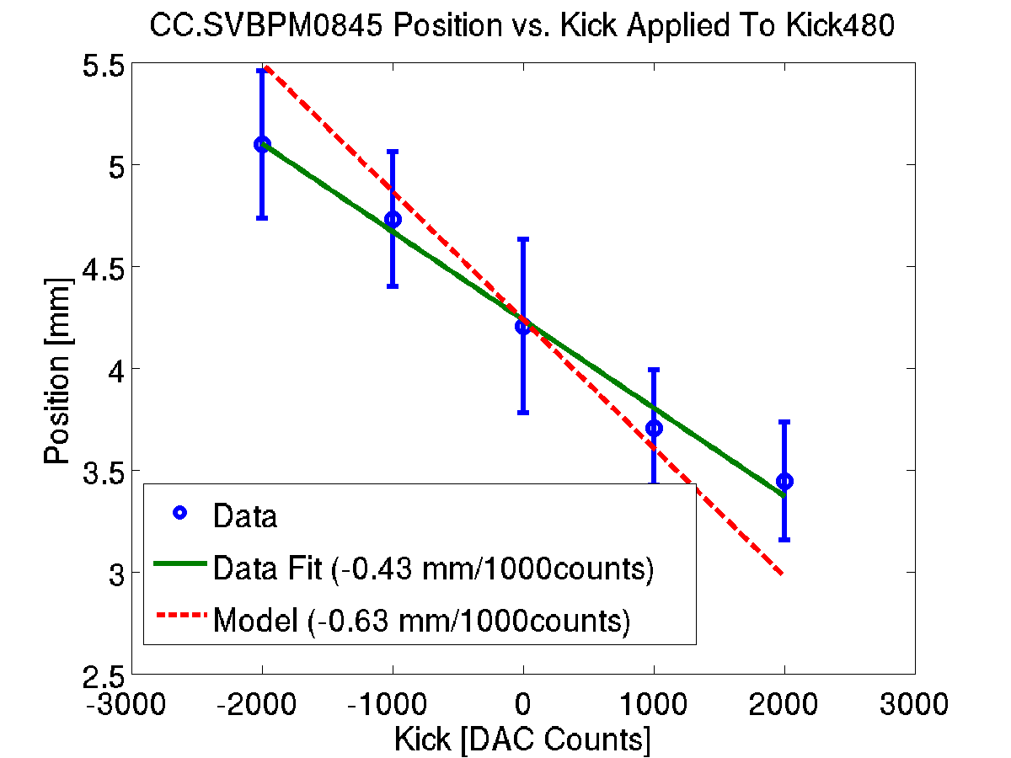
1st BPM After 2nd Kicker
KICKER
480

Slide 35
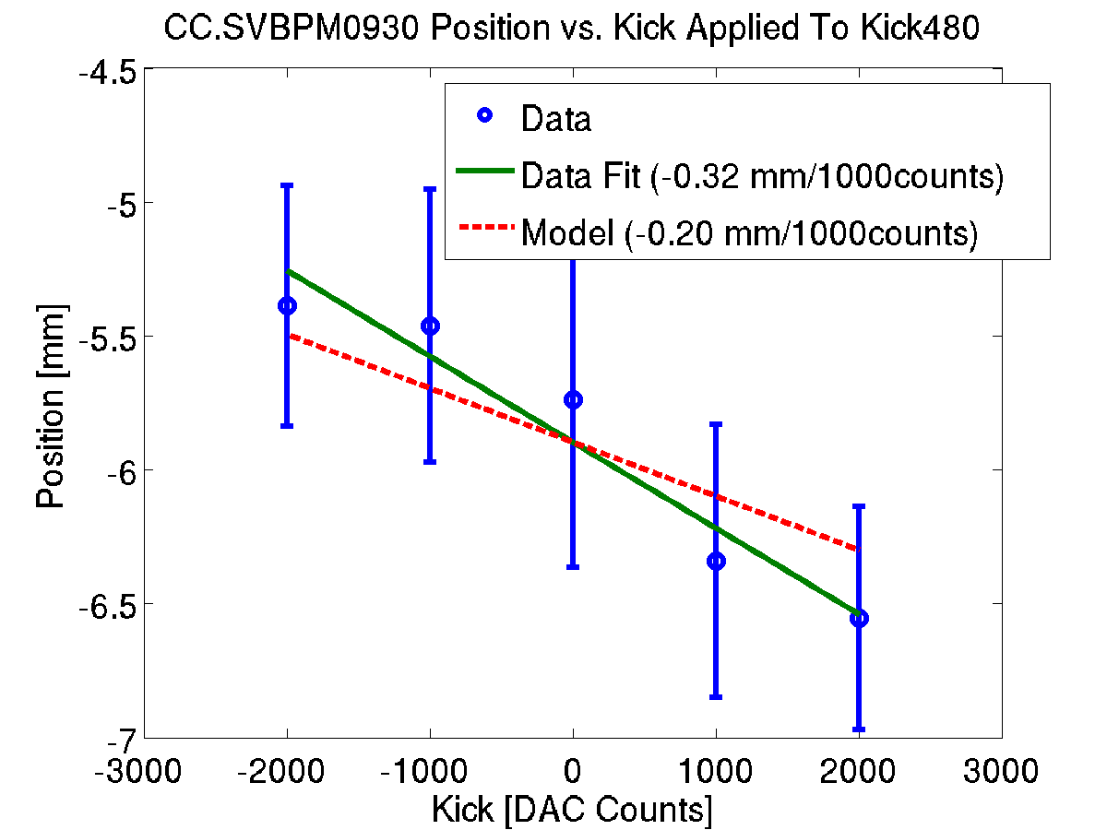
2nd BPM After Chicane
KICKER
480

Slide 36
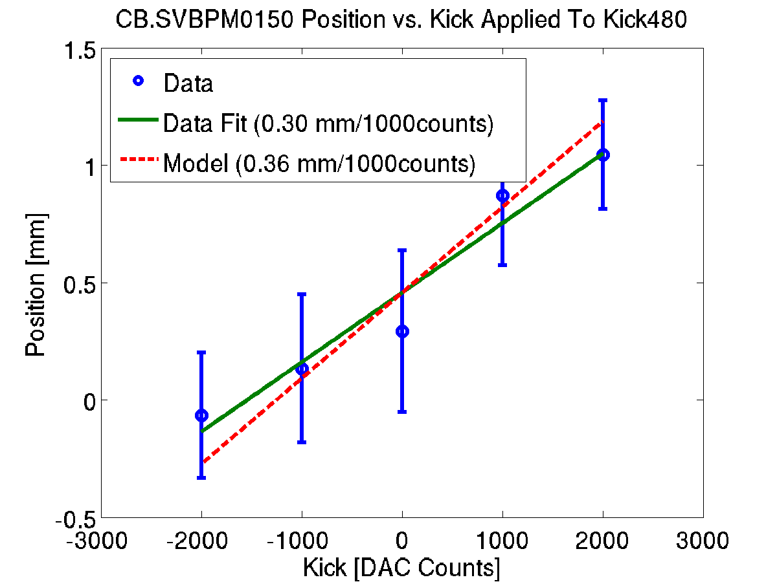
3rd BPM After chicane
KICKER
480

Slide 37
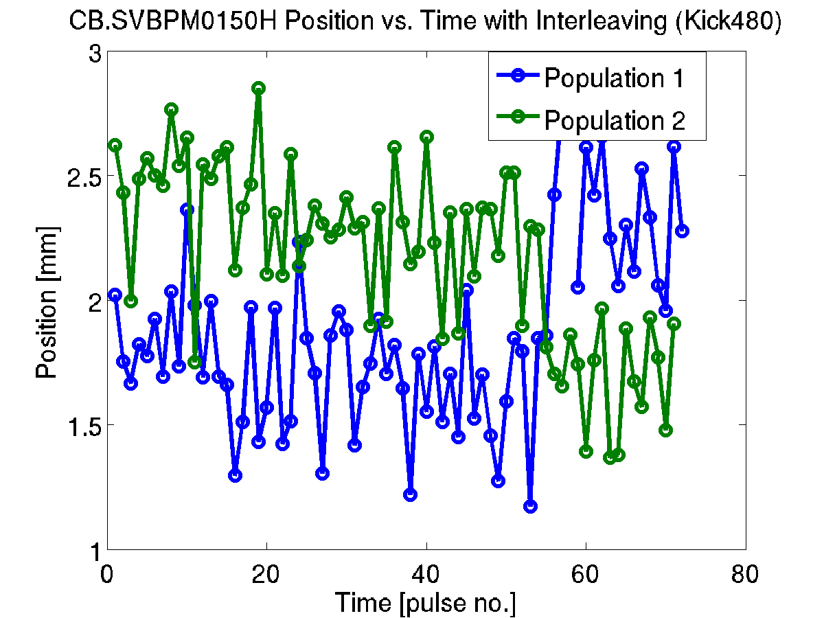
Constant Kick with Interleaving
KICKER
480

Slide 38
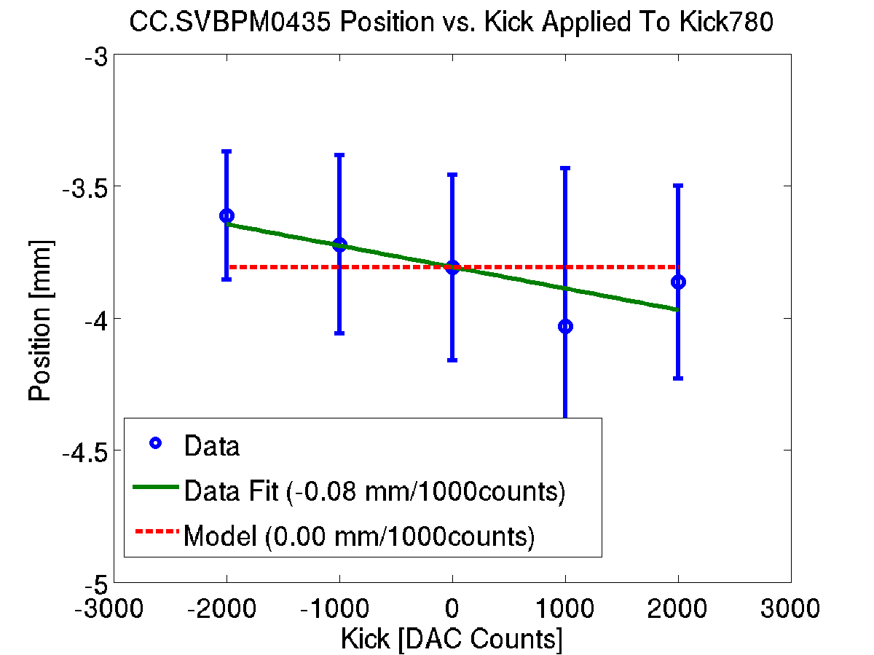
Last BPM Before 1st Kicker
KICKER
780

Slide 39
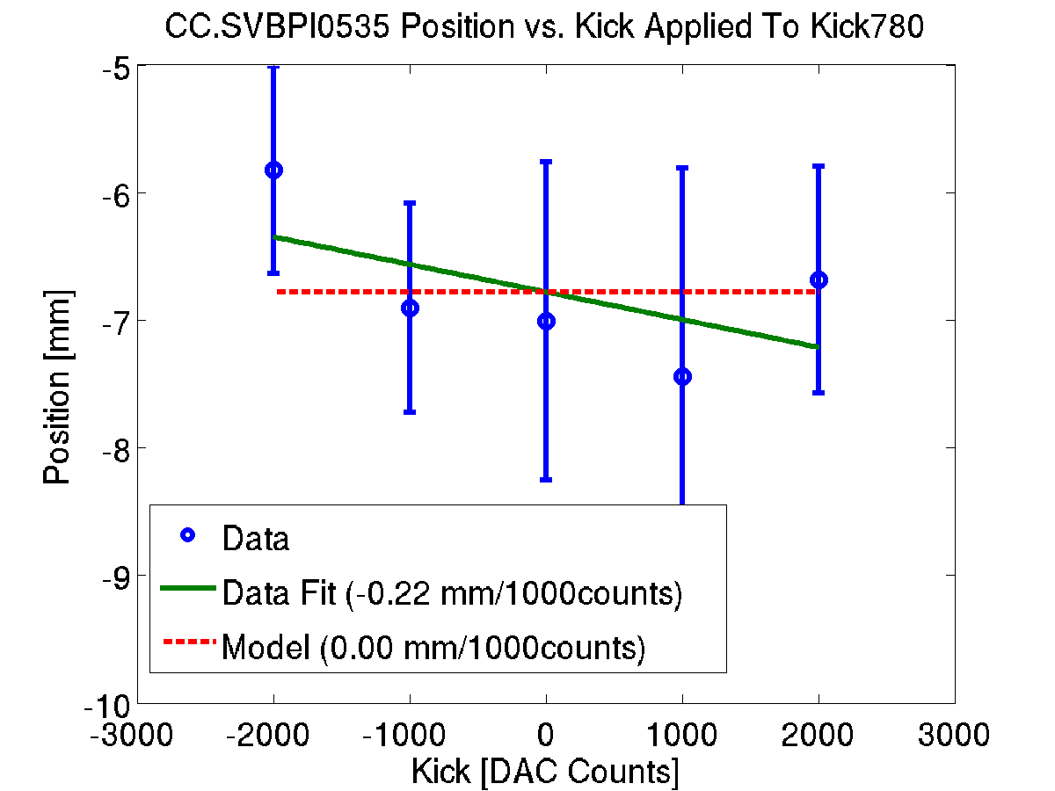
1st BPM After 1st Kicker
KICKER
780

Slide 40
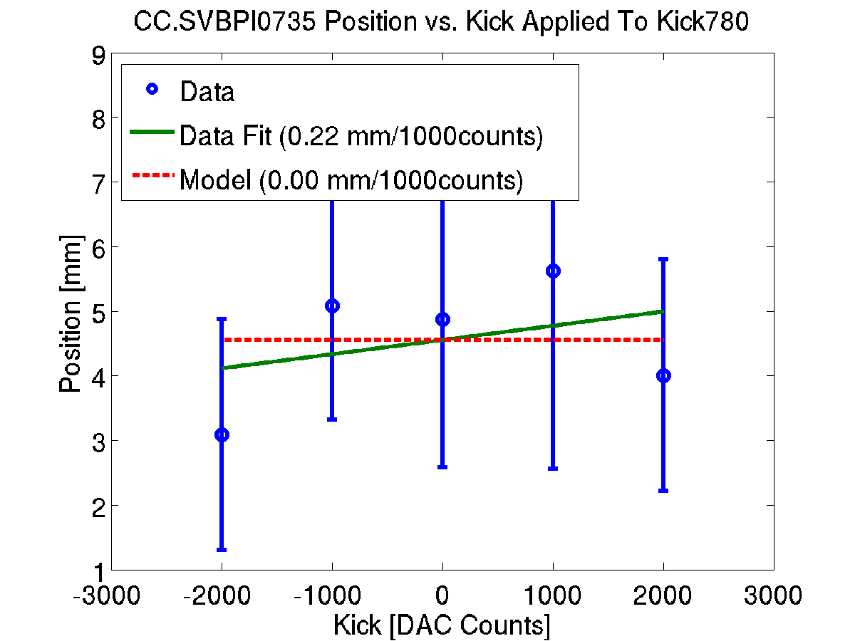
Last BPM Before 2nd Kicker
KICKER
780

Slide 41
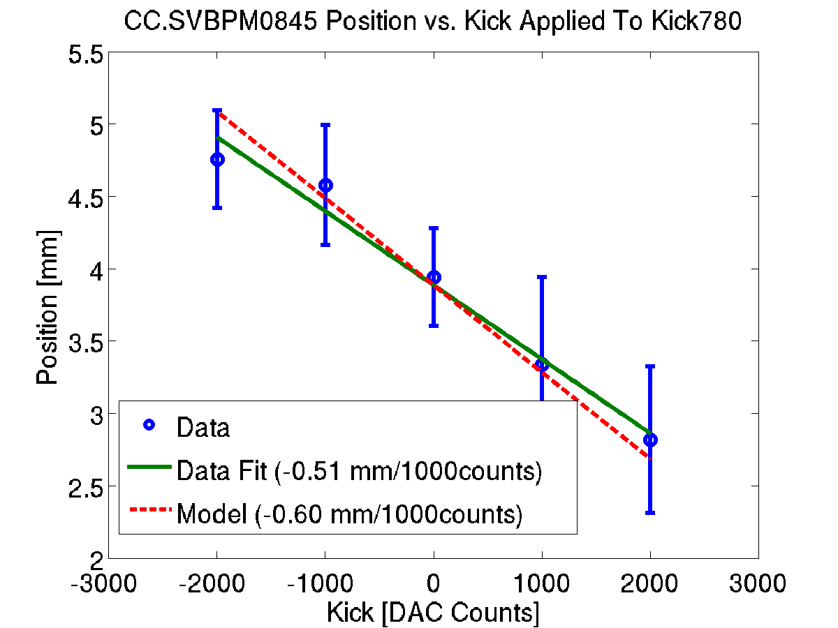
1st BPM After 2nd Kicker
KICKER
780

Slide 42
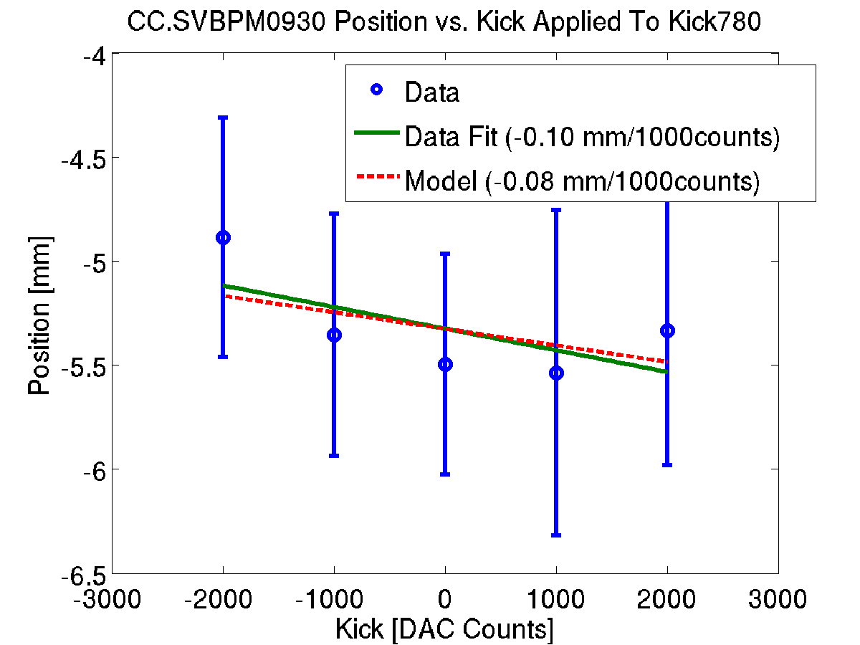
2nd BPM After Chicane
KICKER
780

Slide 43
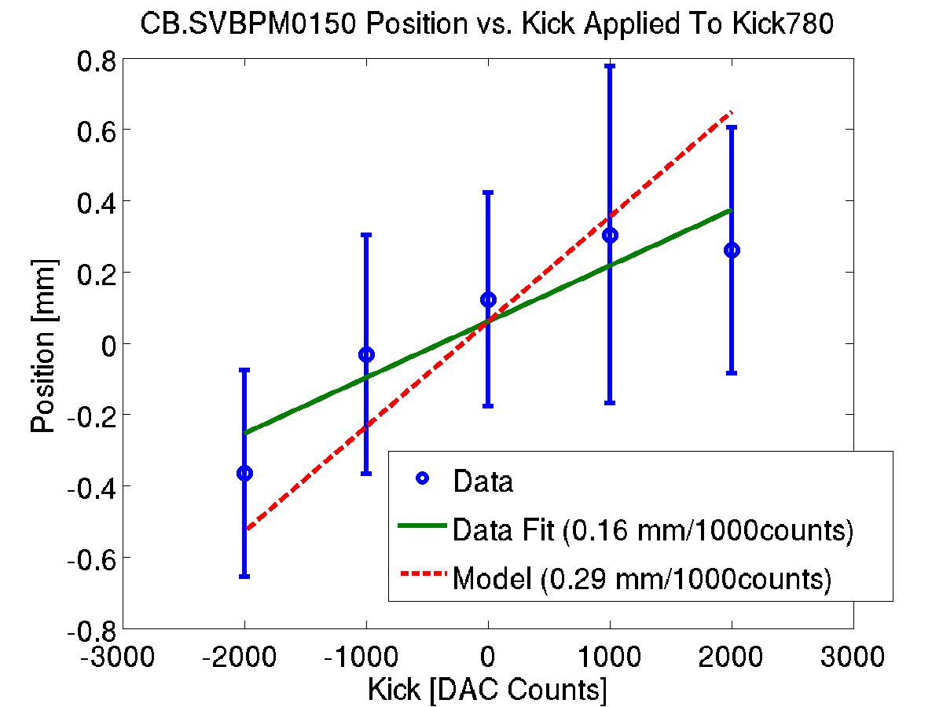
3rd BPM After Chicane
KICKER
780

Slide 44
New Frascati Phase Monitors
3 new Frascati phase monitors arrived at CERN this week!
… but they all have a vacuum leak in one of the feedthroughs which needs to be fixed.
Where to install them?
  One after the chicane (obviously)
  One in TL2 before the chicane won’t be installed initially due to aperture restrictions.
  Install one/two by original first monitor for performance cross-checks.

Slide 45
Update on Alex & Joe
Registration sorted! They have access cards, dosimeters, bikes etc. etc.
Given them exercises to get familiar with MatLab and MADX.
They’ve started taking some cable length measurements.
They’re enjoying lectures and all sorts of social adventures.
Will try to look at some optics measurements (Jack) and MADX simulations (Davide) with them in the coming weeks.

Slide 46
Summary
Phase propagation: A lot of work needed on optics and machine stability to improve the correlation in phase between the two monitors.
Slow correction: In the run correcting the phase using the PETS measurement we were systematically correcting the phase back to/close to zero.
Constant Kick Tests: We were definitely kicking the beam! Scale of position offset in BPMs in rough agreement with the model. Still difficult to identify kick inside the chicane.

