Slide 1
OMEGA ROC chips
ILD/ECAL MEETING 2014, 東京大学, JAPAN
Stéphane Callier on behalf of OMEGA microelectronics group
Ecole Polytechnique CNRS/IN2P3 , Palaiseau (France)

Slide 2

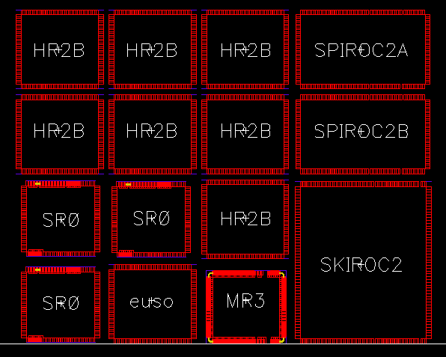



Production Run : End 2014
MAROC3A
MAROC4
HARDROC3B
SPIROC2D
SKIROC2B
PARISROC3
PETIROC2A
SPACIROC3A
CITIROC1A
CITIROC1B
(EASIROC2)
DOSIROC1A
DOPIROC1B
TRIROC2
Technology :
0.35µm SiGe
Production Run 2010
  EASIROC
  HARDROC3B
  MAROC3
  SKIROC2B
  SPACIROC
  SPIROC2A
  SPIROC2B

Slide 3
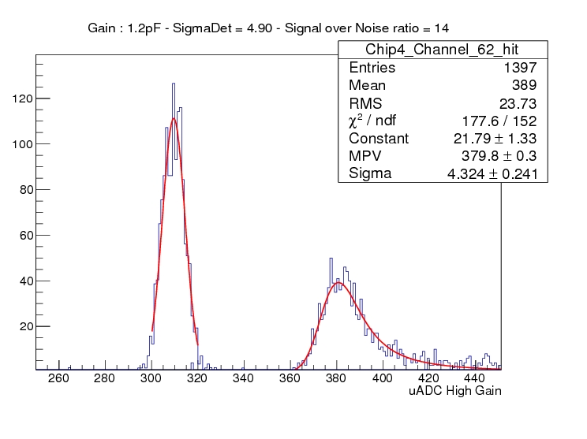
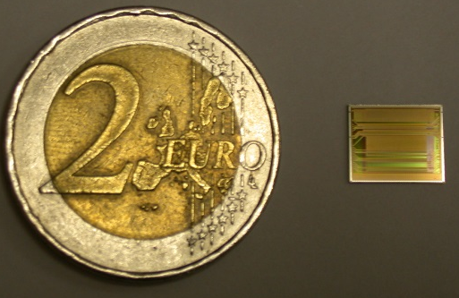
SKIROC2
Properly working, but few bugs/mistakes/coupling
  Event w/o hits (artefact due to ASIC clock/beam synchronization)
  Plane events (modify the power management on the FEV itself)
  Channel to Channel cross talk for large signal
  Channel to Channel Trigger Adjustment (too little effect)
  Different pedestal per memory cell
  External Trigger creates noise
  Some ‘0’ events during readout
  Auto Gain selection when using TDC
  TDC has 30% of dead time @5MHz
  TDC noisy, avoid 1MIP trigger
  Test system for naked dies

Slide 4
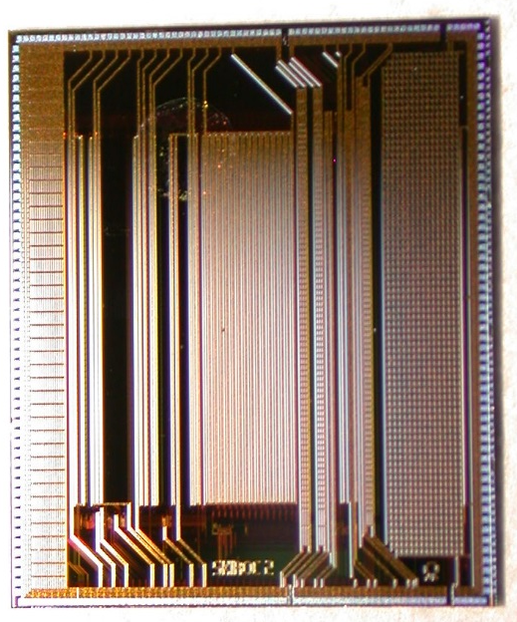
SKIROC2
Properly working, but few bugs/mistakes/coupling
  Event w/o hits (artefact due to ASIC clock/beam synchronization)
  Plane events (modify the power management on the FEV itself)
  Channel to Channel cross talk for large signal
  Channel to Channel Trigger Adjustment (too little effect)
  Different pedestal per memory cell (would require power)
  External Trigger creates noise
  Some ‘0’ events during readout
  Auto Gain selection when using TDC
  TDC has 30% of dead time @5MHz
  TDC noisy, avoid 1MIP trigger
  Test system for naked dies
Foreseen in Skiroc2B : Will be corrected /
Small internal improvements / No change / Should be changed

Slide 5
SKIROC2B Modifications
BUG CORRECTIONS
  Some « Zero events » during digitization : WILL BE DONE
  Substrate Shielding, Inputs Shielding : IMPROVED
  Probe & Slow control reset command inverted : CORRECTED
  Test mode for naked dies (voltage drop off & missing pads) : CORRECTED
  Trig Ext not delayed anymore to store the analog data : WILL BE DONE
IMPROVEMENTS
  4-bit DAC for trigger level adjustment : WILL BE OPTIMIZED
  Bandgap : WILL BE CHANGED (HR3)
  Delay Cell : IMPROVED
  AutoGain Selection: WILL BE CHANGED (SP2C)
  Gain Select & Threshold DACs switched OFF indepedently
  LVDS Receivers switched OFF independently : SHOULD BE DONE

Slide 6
SKIROC2B Modifications
SUGGESTIONS
  PLL to generate the 40MHz (avoid 40MHz clock distribution) : WILL BE EMBEDED
  15 depth SCA dynamically switched ON w.r.t. the events occured : MAY BE DONE
  TDC architecture change : TO BE STUDIED
  Power ON reset
  Peak Detector to sample the maximum : TO BE STUDIED

Slide 7
Thank you for your attention

Slide 8
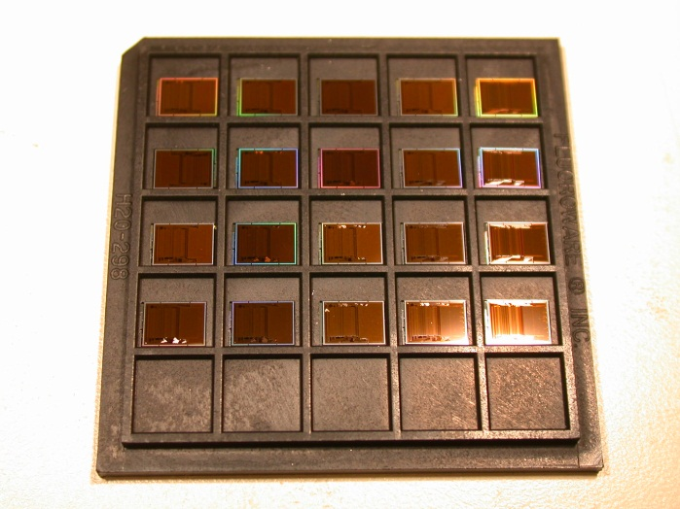
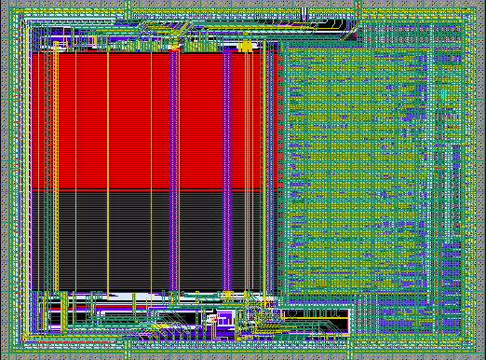

HARDROC3B Modifications
HARDROC3 chip is properly working except :
  I2C link : CORRECTED
  PLL start : CORRECTED
Add capability to emulate a HARDROC2B : DONE
  (all channels trigger stored in digital memory when one event occurs)
Internal Temperature sensor added on the Analog Multiplexed Output : DONE
Power On Reset : TBA

Slide 9
SPIROC2D Modifications

