Slide 1



Fourier analysis of residual IPBPM signals
D. R. Bett

Slide 2
Residual IPBPM signals
Data run: jitRun5_70dB_110614
70 dB of attenuation on both x and y
Procedure:
  Take the FT of each recorded waveform
  Average results over the number of triggers
Compare region before bunch arrives (“noise”) to nominal “signal”

Slide 3
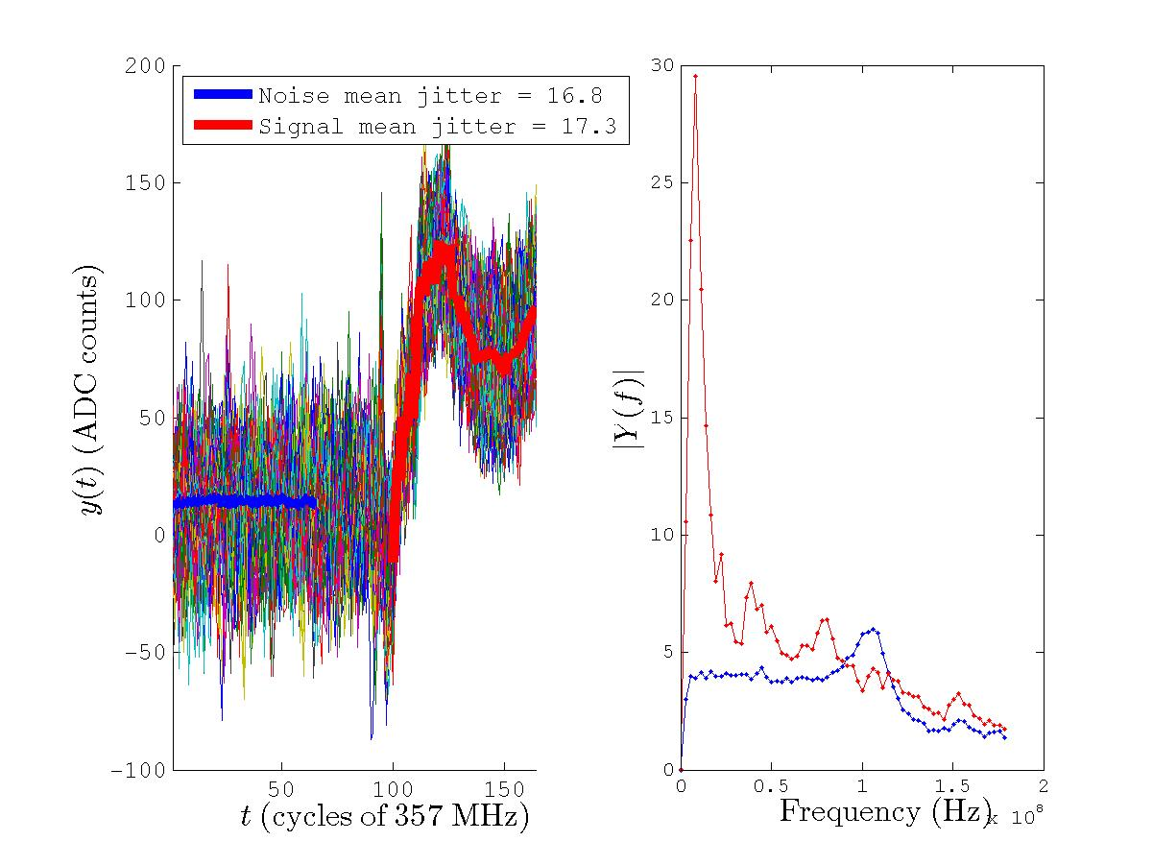
ADC1: IPB(X) I [06-2]

Slide 4
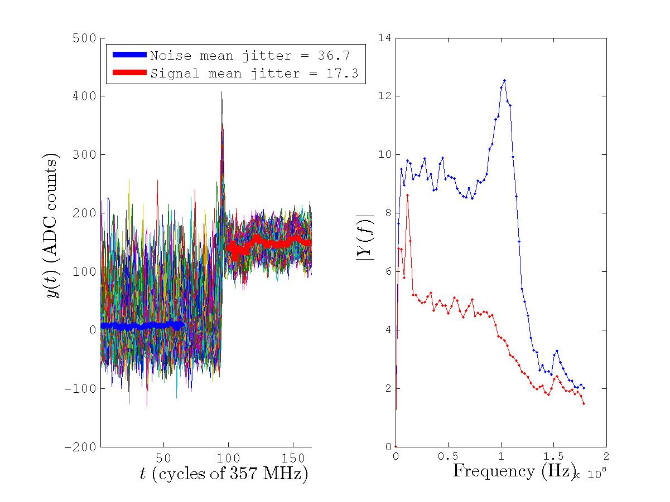
ADC2: IPB(X) Q [06-2]

Slide 5
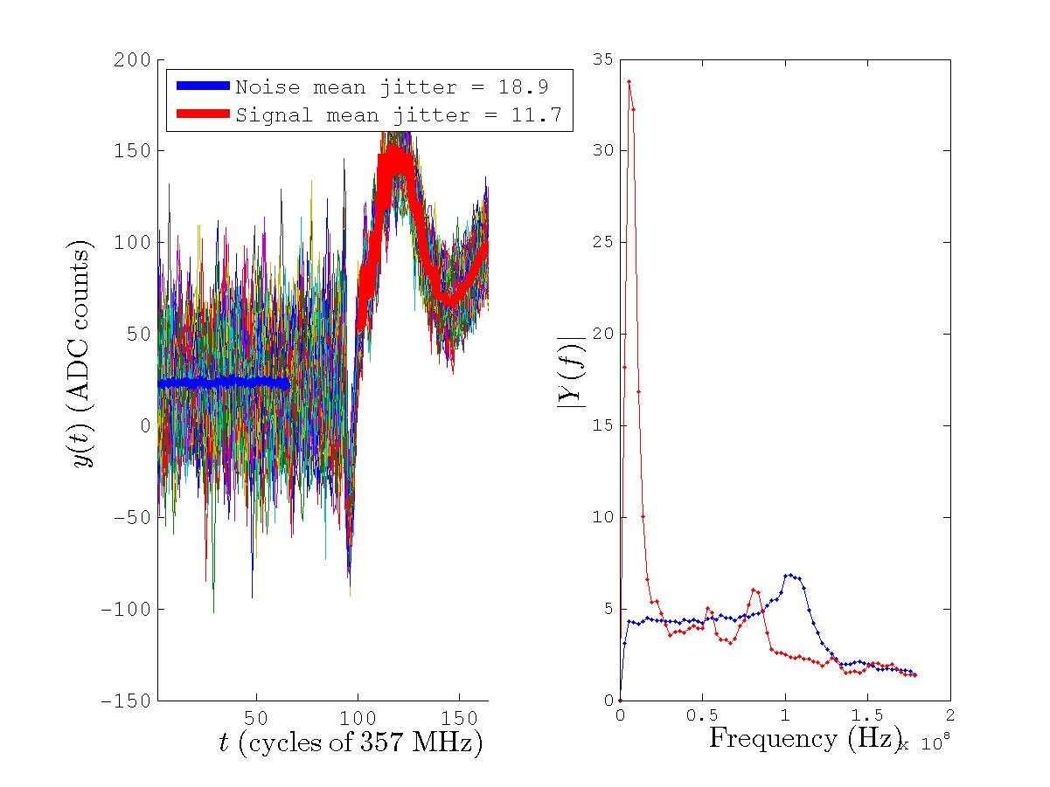
ADC3: IPA(Y) I [07-2]

Slide 6
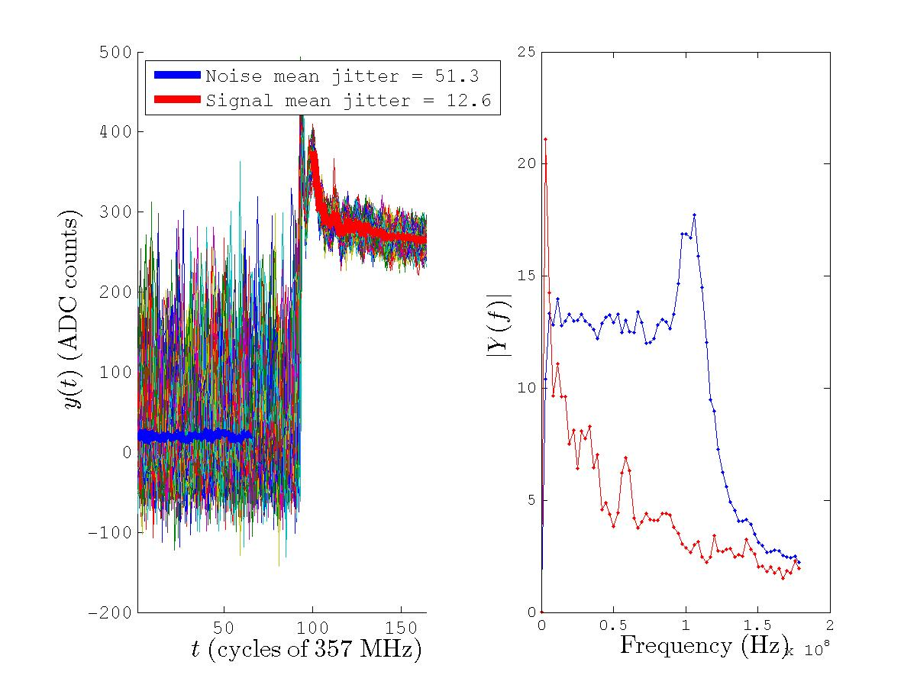
ADC4: IPA(Y) Q [07-2]

Slide 7
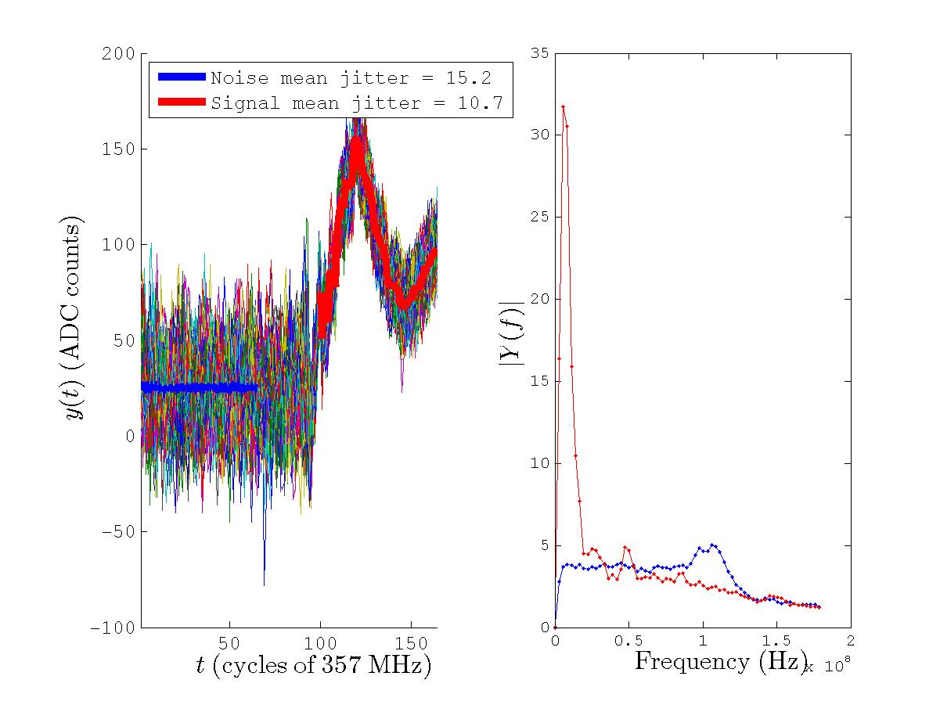
ADC5: IPB(Y) I [07-3]

Slide 8
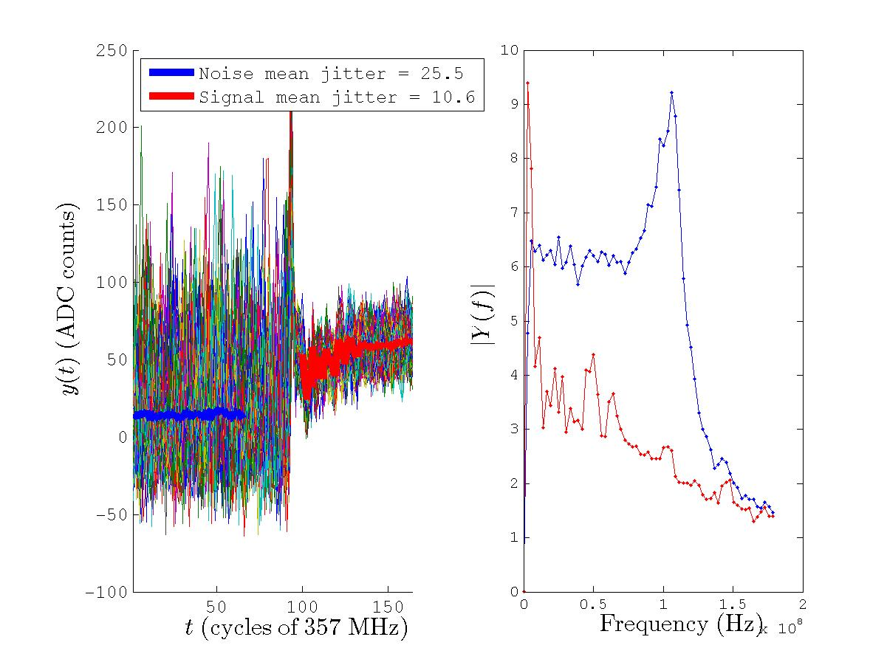
ADC8: IPB(Y) Q [07-3]

Slide 9
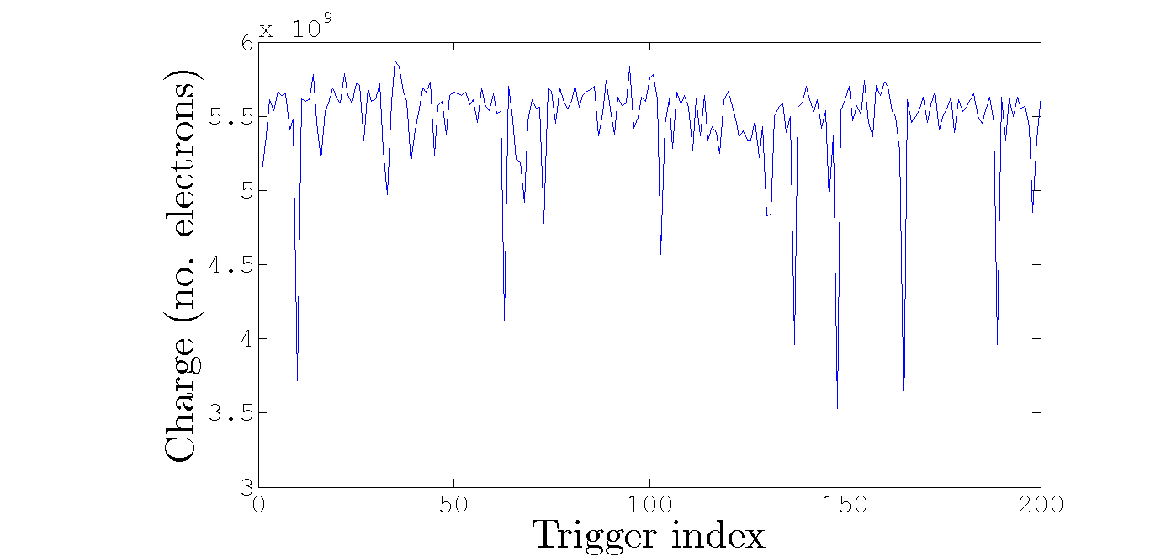

Charge: $μ=0.55$; $σ=0.04$

Slide 10
Conclusion
Large ripple on I (~10 MHz) absent from Q
Q jitter about twice that of I jitter before signal arrives (but similar thereafter)
Noise spike at 100 MHz only exists before signal arrives

