Slide 1

Determination of branching ratios for Higgs to di-jet states and WW-fusion fraction at the ILC at 250 GeV CME
by Christian Drews
2014.08.01
Academic advisor: Hitoshi Yamamoto

Slide 2
Motivation
What can we measure at the ILC @ 250 GeV?
Branching Ratio of Higgs linear to mass
  test the Standard Model
  or find Higgs Doublet Model
Analyzing simulation data
Determine accuracies:
  WW-fusion cross section
influence of beam
background overlay
cross section
  left-handed: 129 fb @ 250 GeV
  right-handed: 65 fb
  P(-80, 30): 77.5 fb
Z-boson mass

Slide 3
Event Selection
finding cut range
maximize significance program structure
  while change in siginificance
    for cut in cut_list
      looking for cut limit with highest siginificance
      save cut limit
after selection with cuts – template fit on b-/c-likeness histogram (2D).

Slide 4
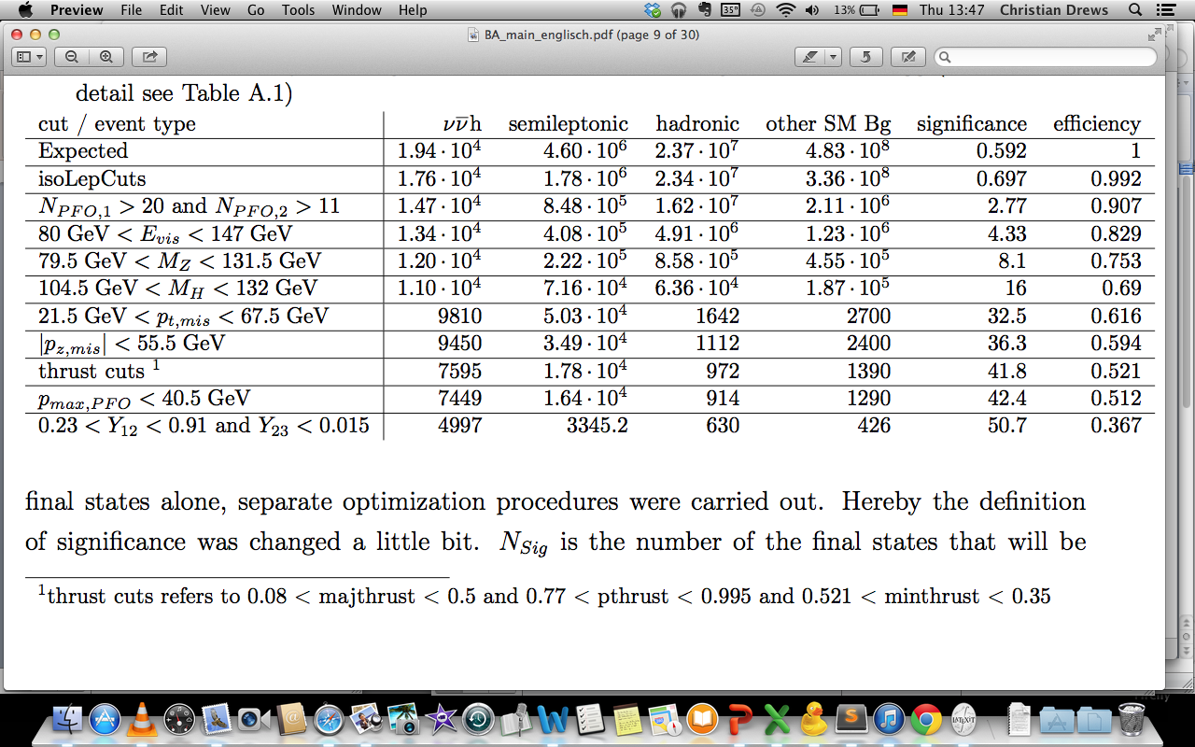
Cut flow
Main background: semileptonic events
  qqlv larger then qqvv
    maybe isolated lepton finder needs tuning

Slide 5
Fitting templates
Data
H → other
SM Background
H → bb
H → cc
H → gg
(b-tag_1 +b-tag_2)/2
(c-tag_1 +c-tag_2)/2

Slide 6
Toy study
Higgs to gluon slightly
shifted

Slide 7
optimisation on each final state
the final states are different in
  detector resulution
  number of events
  nature of jets
recoil mass
nmoun

Slide 8
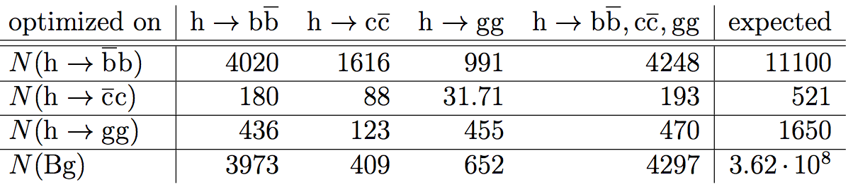
optimisation on each final state
the final states are different in
  detector resulution
  number of events
  nature of jets
maximize on

Slide 9
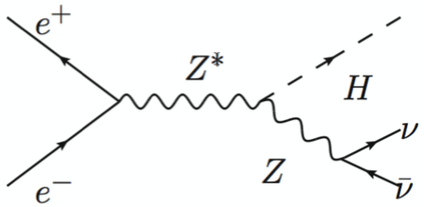
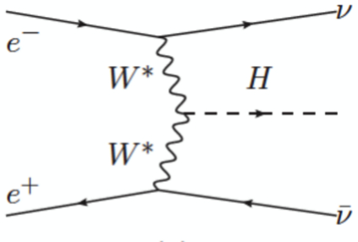
Higgs-Strahlung and WW-fusion
9
two separate production in this channel
branching ratio and Higgs-Strahlung cross section are collected from other studies
results into an uncertainty of 32 %
Feynman diagrams: Higgs-Strahlung WW-fusion

Slide 10
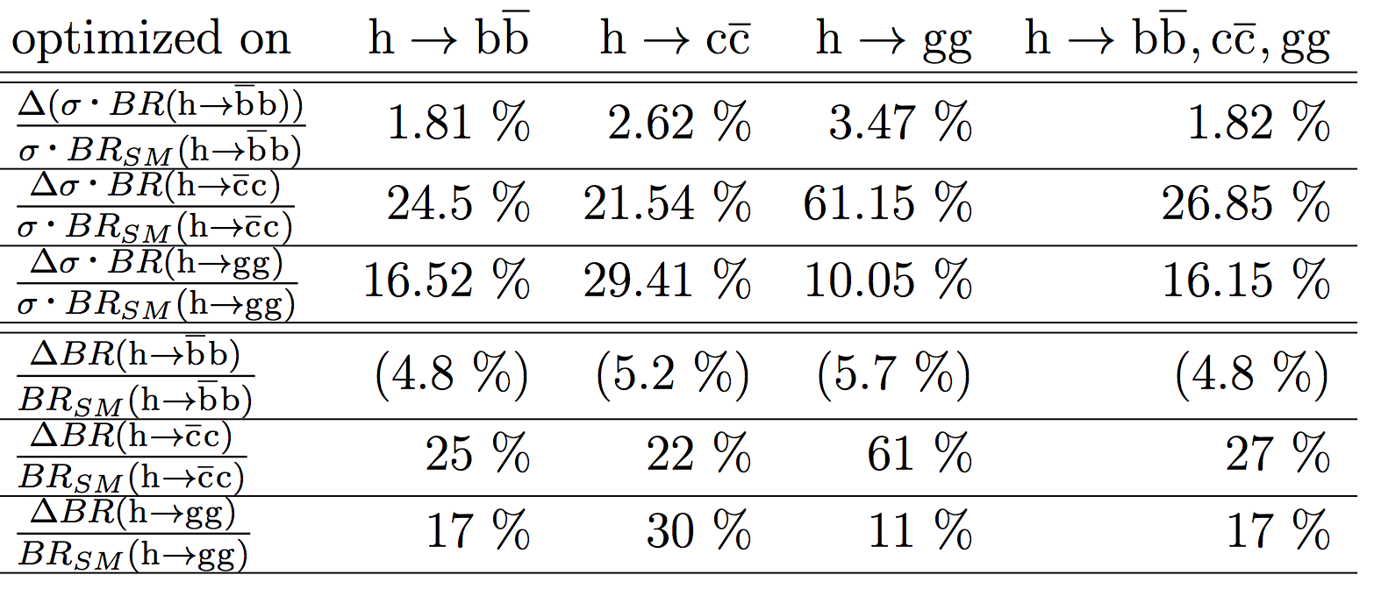
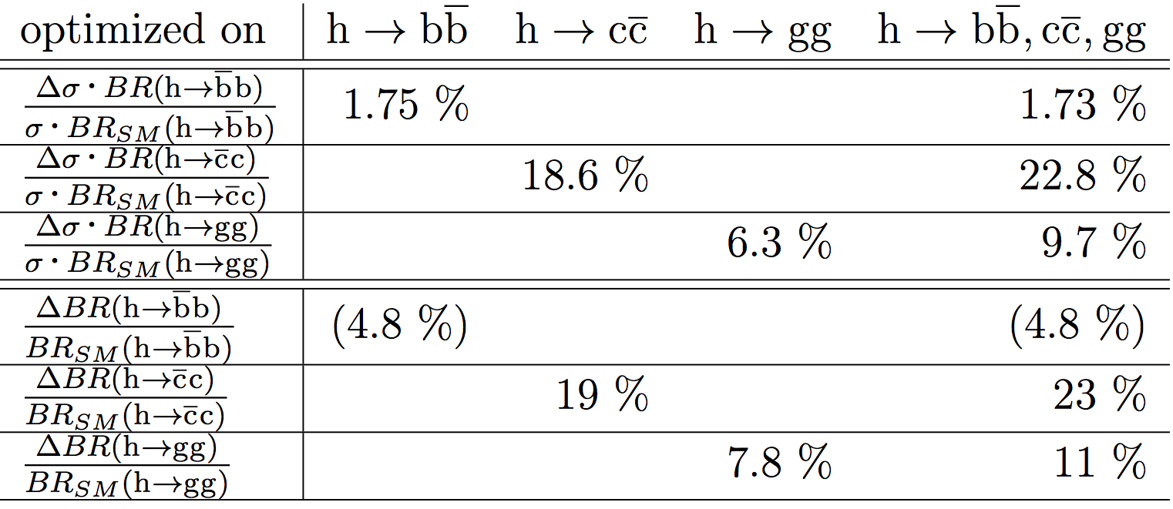
Fitting uncertainty
WW-fusion production x-section ~ 32 %
Higgs-Strahlung production x-section ~ 1.5 %
bracketed values can not be determined with this method
by template fitting:
by TMVA:

Slide 11
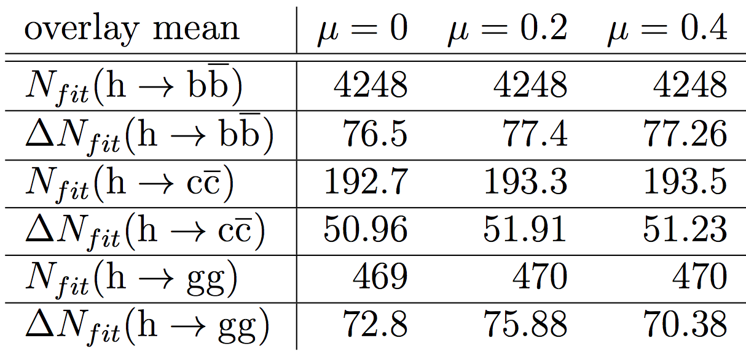
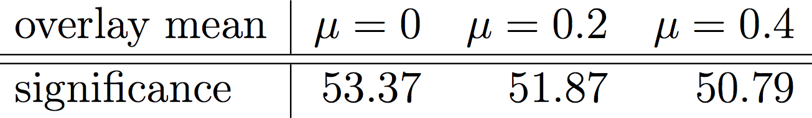
Hadronic Beam Background
tested for mean 0, 0.2 and 0.4
0.2 in normal samples – 0.4 expected from DBD
Toy Study:
  Signal changed mean, Background mean 0.2
no influence on fit expected
Significance:
  Scaling number of events with and without overlay to the number
  in the corresponding
  signal file
    but always using
    samples with mean 0.2
Results into ~ 2% increase
of uncertainty
Result Toy Study:
Result Significance Study:

Slide 12
Conclusion
12
for gluon and charm final states separate cut optimization is useful
Beam background influence is small
Accuracy on WW-fusion production cross section 32 %
  needs further study to develop direct measurement
*Higgs to bottom branching ratio can not be measured from my analyais
embraced values from TMVA
 | H -> bb | H -> cc | H -> gg
Accuracy branching ratio times cross section | 1.8 % | 22 % (19) | 10 % (6)
Accuracy branching ratio | * | 22 % (19) | 11 % (8)

Slide 13
Backup

Slide 14
Significance after optimising
with WW-fusion
optim on | bb | cc | gg | bb, cc, gg
Significance | 50.6 | 38.3 | 32 | 50.7
Effi | 0.347 | 0.137 | 0.111 | 0.367
Purity | 0.551 | 0.803 | 0.689 | 0.523
Sig_bb | 43.8 | 33.8 | 21.3 | 43.8
Sig_cc | 1.95 | 1.81 | 0.655 | 1.97
Sig_gg | 4.79 | 2.7 | 9.97 | 4.89

Slide 15
cut limits
optim on | bb | cc | gg | bb, cc, gg
npfos1> | 20 | 14 | 30 | 20
npfos2> | 11 | 9 | 23 | 11
maxPFOMomentum< | 40.5 | 42.5 | 26.5 | 40.5
mass_z< | 131.5 | 107.5 | 123.5 | 131.5
mass_z> | 81.5 | 82 | 83 | 79.5
mass_higgs> | 104.5 | 117 | 117.5 | 104.5
mass_higgs< | 132 | 129 | 130 | 132
mom_t< | 66.5 | 66.5 | 68 | 67.5
mom_t> | 25.5 | 34 | 21 | 21.5
Abs(mom_z)< | 55 | 49 | 57 | 55.5
majthrust< | 0.5 | 0.48 | 0.56 | 0.5
pthrust> | 0.8 | 0.83 | 0.64 | 0.77
minthrust< | 0.35 | 0.3 | 0.47 | 0.35
minthrust> | 0 | 0 | 0.09 | 0.03
nmuon< | 4 | 3 | 1 | 4
y12> | 0.29 | 0.285 | 0 | 0.29
y12< | 0.955 | 0.885 | 0.96 | 0.91
yplus< | 0.015 | 0.005 | 0.055 | 0.015
majthrust> | 0.08 | 0.15 | 0 | 0.08
gloun-events
  sharper cuts on z and higgs
  mass
  no mouns
  maximal PFO Momenten
  smaller
  different event shape
nmoun
maximal PFO Momentum
recoil mass

Slide 16
Interverance depandent on CME
@ 250 Interverence is important to study
plots by Junping

Slide 17
Interverance of ZH/WW in Z-mass
Recon.
Z-mass
cut
Sig ~ 43
Recon.
Z-mass

Slide 18
Fitting uncertainty
with WW-fusion
WW-fusion turned of
optim on | bb | cc | gg | bb, cc, gg | bb with WW
BG | 3.14 | 12.84 | 9.69 | 3.07 | 3.12
BG in % | 3.14 | 12.84 | 9.69 | 3.07 | 3.12
bb in % | 1.82 | 2.65 | 3.53 | 1.79 | 1.78
cc in % | 26.43 | 25.14 | 210.32 | 19.35 | 30.44
optim on | bb | cc | gg | bb, cc, gg | bb with WW
BG | 3.26 | 15.12 | 10.38 | 3.27 | 3.13
bb | 1.8 | 2.6 | 3.64 | 1.77 | 1.8
cc | 20.03 | 30.81 | 143.4 | 19.95 | 21.81
gg | 15.43 | 18.44 | 11.57 | 16.74 | 13.73

Slide 19
Fitting WW-fraction
electron neutrinos
mu/tau neutrinos
cosh no cuts no mpt cut all cuts
Z-mass no cuts no mpt cut all cuts

Slide 20
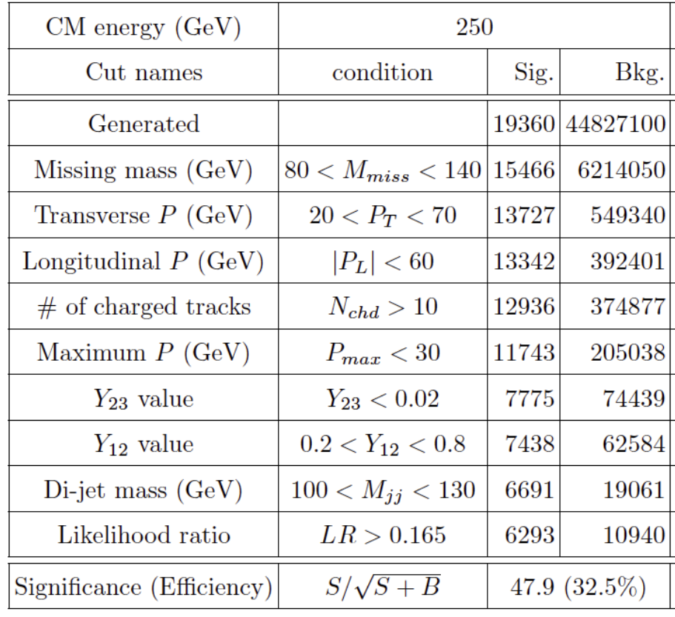
Compare to Ono/Miyamoto’s paper
 | vvH | BG
Expected | 19383 | 5.11E+08
isoLepCuts | 17644 | 3.62E+08
npfo | 14677 | 1.92E+07
E_vis | 13338 | 6.55E+06
Z-Mass | 12013 | 1.54E+06
Higgs-mass | 10977 | 321243
missMo_t | 9807 | 54591
missMo_z | 9451 | 38490
majthrust | 8369 | 24327
pthrust | 7598 | 20220
minthrust | 7590 | 20171
maxPFOMom | 7450 | 18586
y-Cuts | 4994 | 4407
 | 51,5 | (25,7 %)

Slide 21
evis

Slide 22
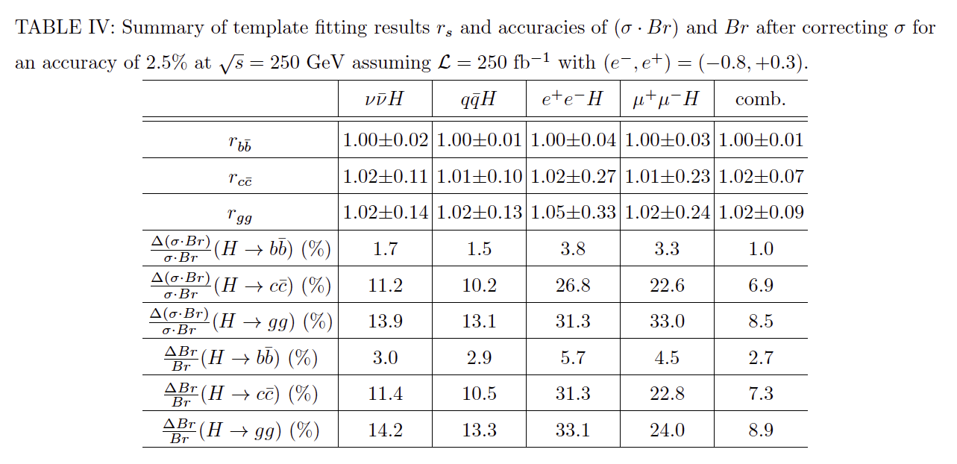
Comparing fitting result
 | X = x₁ + x₂ |  |  | X = x₁*x₂ /(x₁*x₂ +(1- x₁)(1- x₂)
 | Reconst. N | abso. Error | rel. Error | Reconst. N | abso. Error | rel. Error
numBack | 6290.00 | 103.00 | 2 % | 6523.30 | 141.00 | 2 %
bb | 4080.70 | 70.20 | 2 % | 4089.20 | 74.30 | 2 %
cc | 162.38 | 24.10 | 15 % | 193.78 | 50.70 | 26 %
gg | 582.03 | 58.20 | 10 % | 410.78 | 77.10 | 19 %

Slide 23
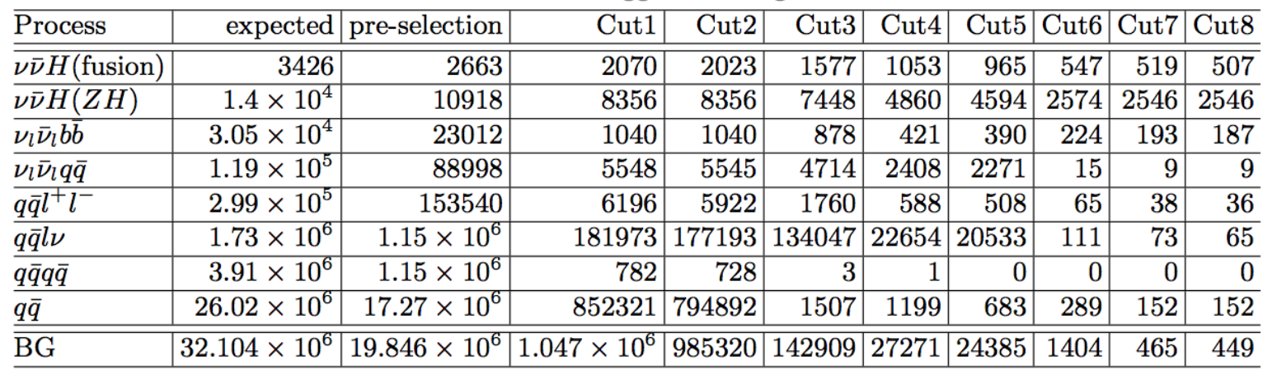
Compare to Claude Düring’s study
qqll before zz_sl + zee_sl (now only to l+l-)
qqlv before only sw_sl (now + ww_sl)
 | Expected | isoLepCuts | npfo | E_vis | Z-Mass | Higgs-mass | missMo_t | missMo_z | cosTHiggs | B-Tag | all cuts
vvH(fusion) | 3960 | 3610 | 3280 | 2890 | 2570 | 2410 | 1970 | 1830 | 1830 | 1240 | 1170
vvH(ZH) | 1.54E+04 | 1.54E+04 | 1.54E+04 | 1.54E+04 | 1.54E+04 | 1.54E+04 | 9970 | 9890 | 9880 | 6530 | 6250
vvbb | 3.31E+04 | 3.31E+04 | 3.31E+04 | 3.31E+04 | 3.31E+04 | 3.31E+04 | 2630 | 2160 | 2150 | 2020 | 1570
vvqq | 1.26E+05 | 1.26E+05 | 3.31E+04 | 3.31E+04 | 3.31E+04 | 3.31E+04 | 3.31E+04 | 9420 | 9420 | 104 | 54.8
qqll | 2.18E+05 | 2.18E+05 | 2.18E+05 | 18700 | 7630 | 3900 | 1380 | 1140 | 1140 | 394 | 251
qqlv | 4.22E+06 | 4.22E+06 | 4.22E+06 | 4.22E+06 | 4.22E+06 | 4.22E+06 | 4.22E+06 | 4.22E+06 | 4.22E+06 | 1190 | 677
qqqq | 4.20E+06 | 4.20E+06 | 4.20E+06 | 486 | 331 | 217 | 5.6 | 5.6 | 5.6 | 0.717 | 0.132
qq | 1.95E+07 | 1.95E+07 | 1.95E+07 | 1.95E+07 | 1.95E+07 | 1.95E+07 | 3550 | 2470 | 2450 | 1710 | 1510

Slide 24
How I decided on cuts

Slide 25
Fitting WW-fraction
electron neutrinos
mu/tau neutrinos
cosh no cuts no mpt cut all cuts
Z-mass no cuts no mpt cut all cuts

Slide 26
Flavor tagging weights

Slide 27
B-tagging weights on jets?

