Slide 1



Fourier analysis of residual IPBPM signals
D. R. Bett

Slide 2
Residual IPBPM signals
Data run: trimDACzeroed_060614
70 dB of attenuation on both x and y
Trim DACs used to compensate for the offset due to the pedestal
Imperfect correction due to:
  Limited correction range of the trim DACs
  Structure of the pedestal

Slide 3
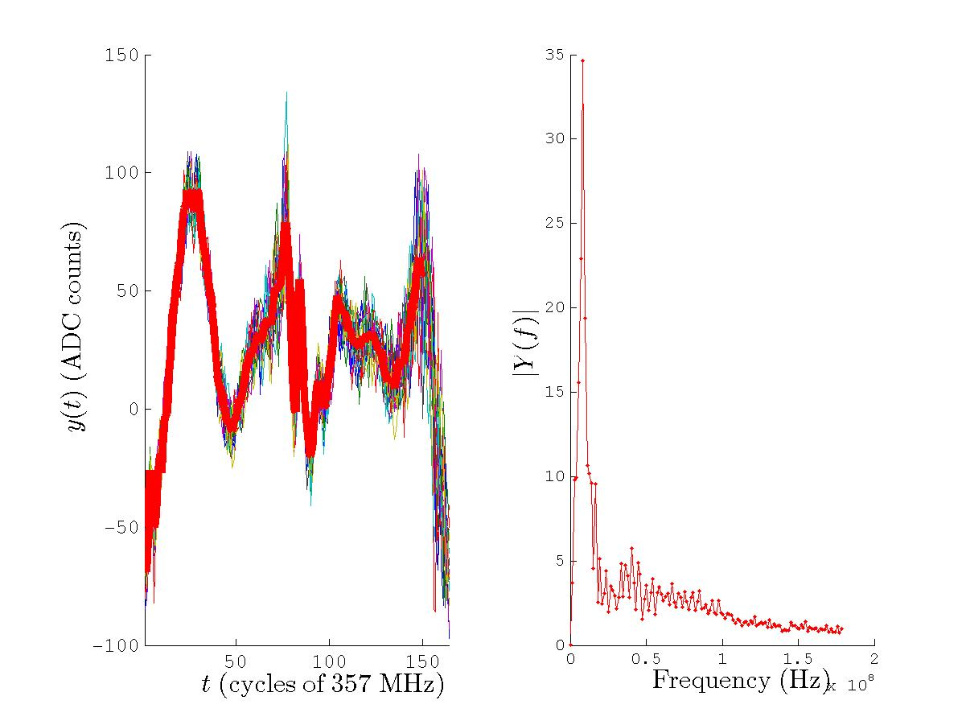
ADC1: IPB(Y) I [07-3]

Slide 4
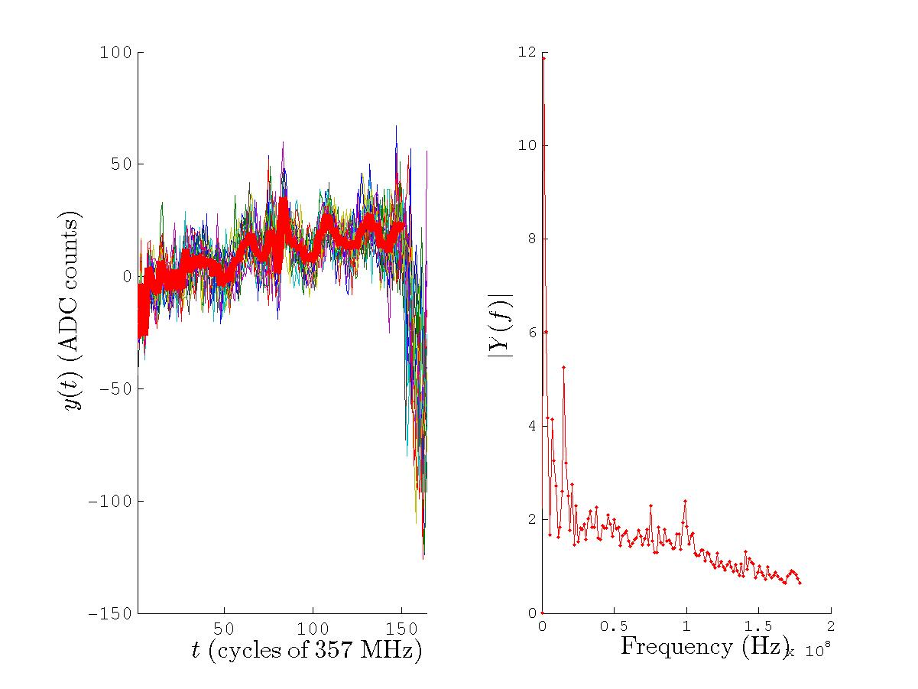
ADC2: IPB(Y) Q [07-3]

Slide 5
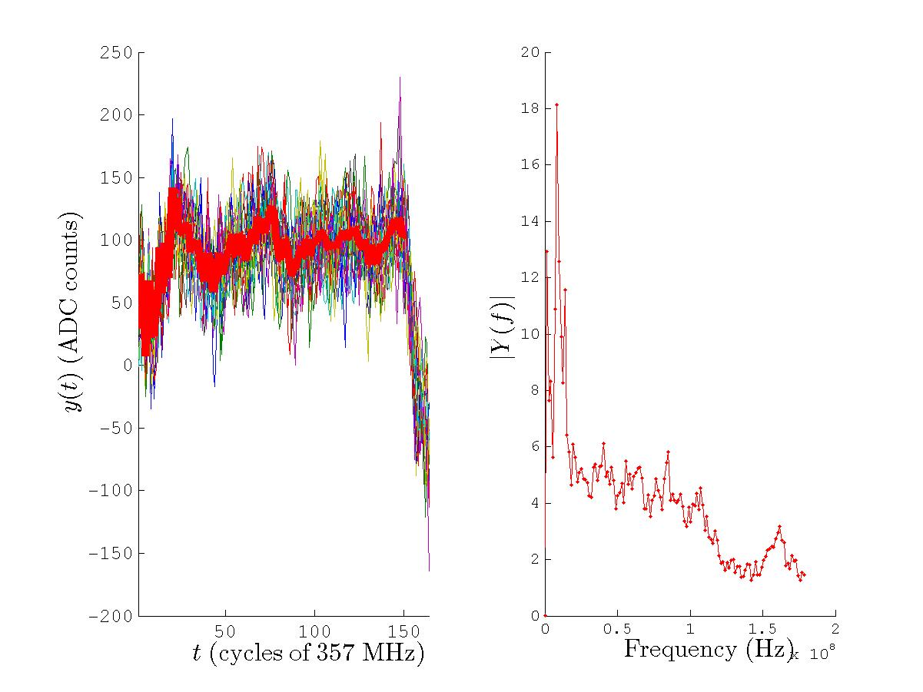
ADC3: IPA(X) I [06-1]

Slide 6
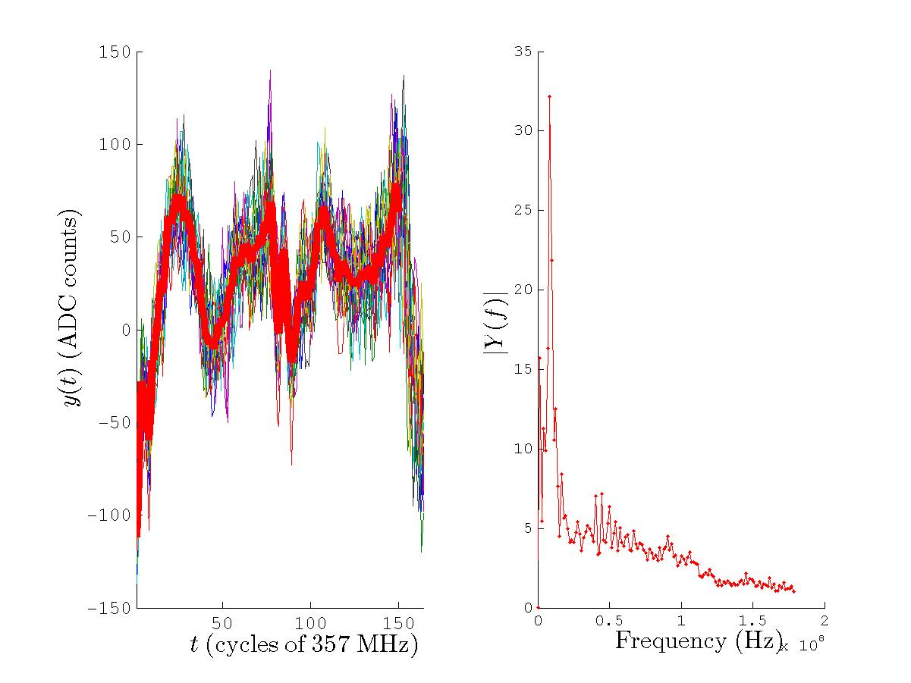
ADC4: IPB(X) I [06-2]

Slide 7
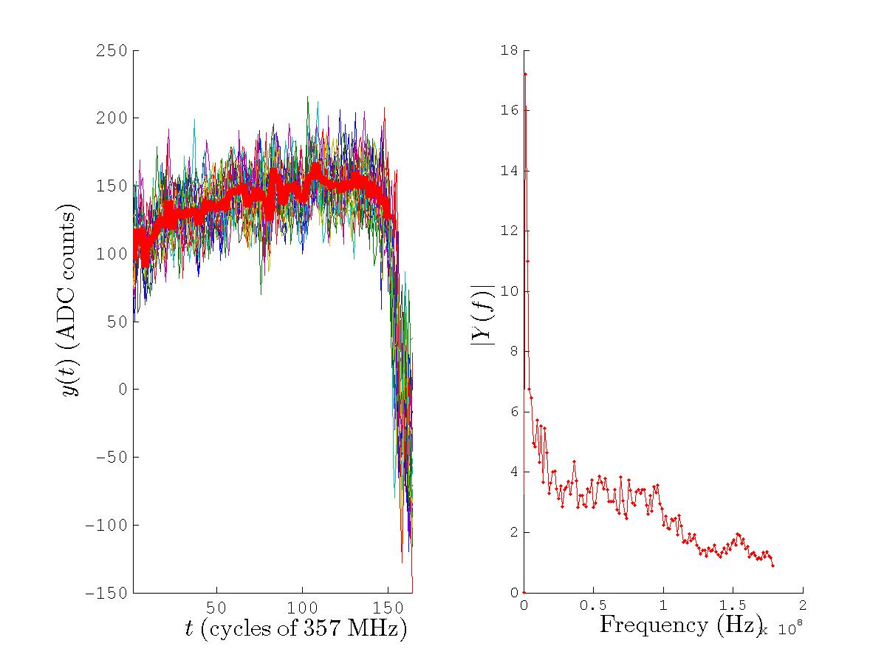
ADC5: IPB(X) Q [06-2]

Slide 8
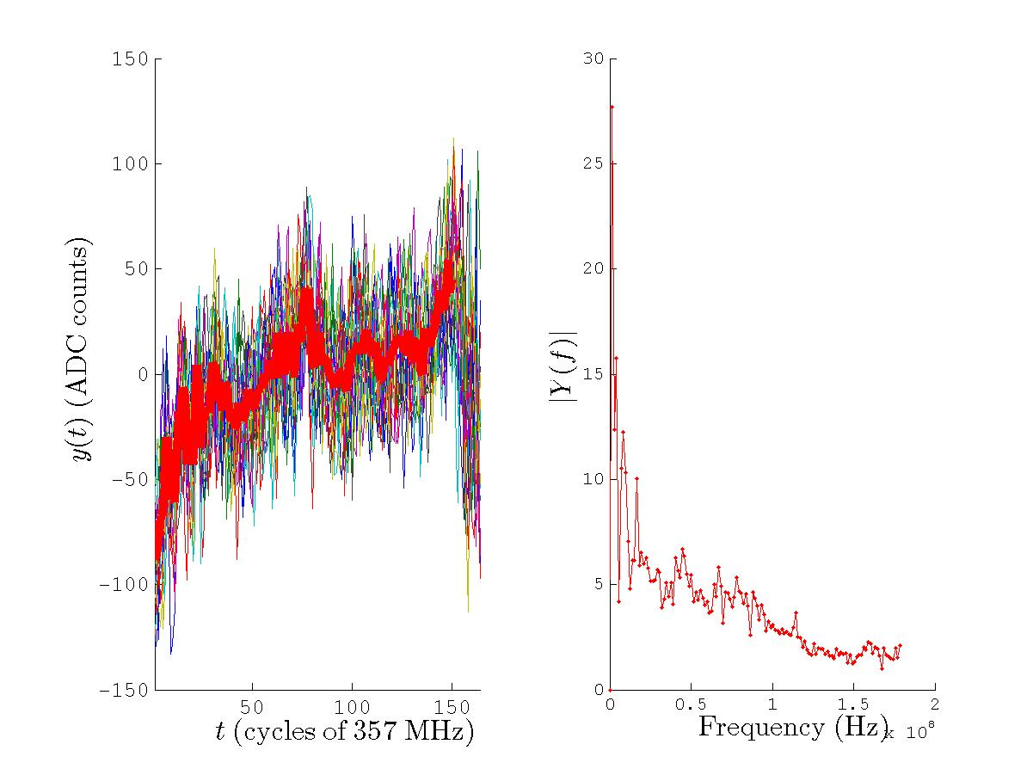
ADC6: IPA(X) Q [06-1]

Slide 9
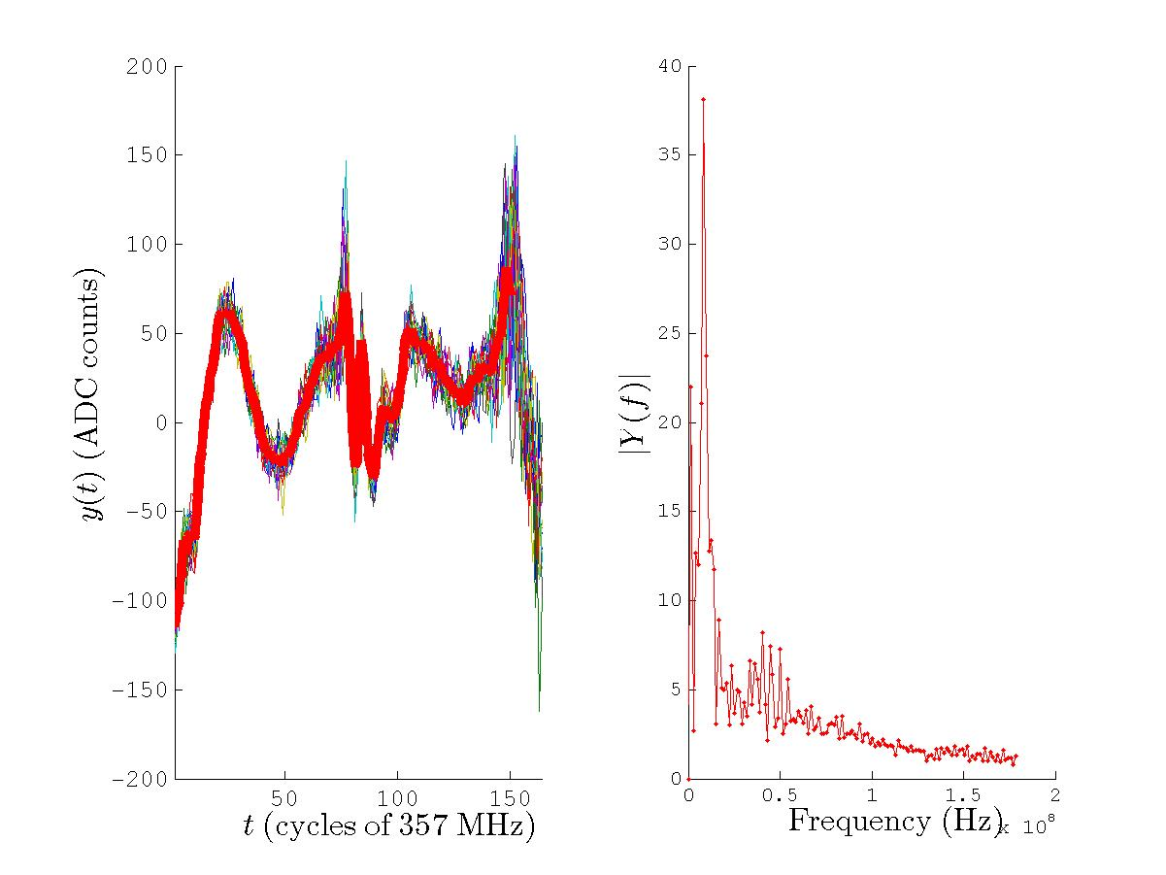
ADC7: IPA(Y) I [07-2]

Slide 10
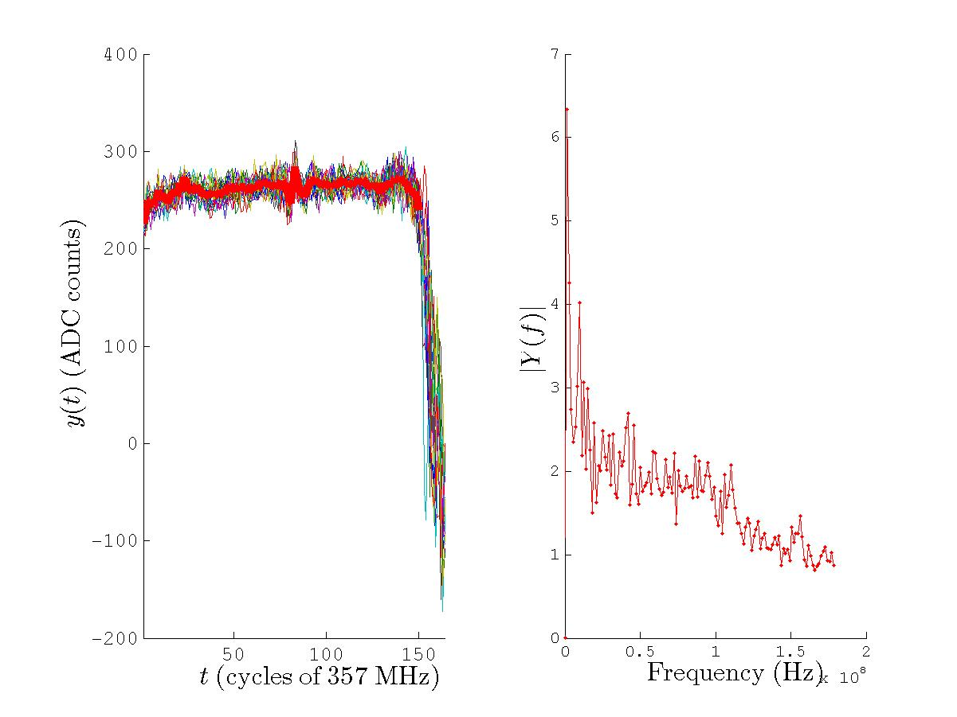
ADC8: IPA(Y) Q [07-2]

Slide 11
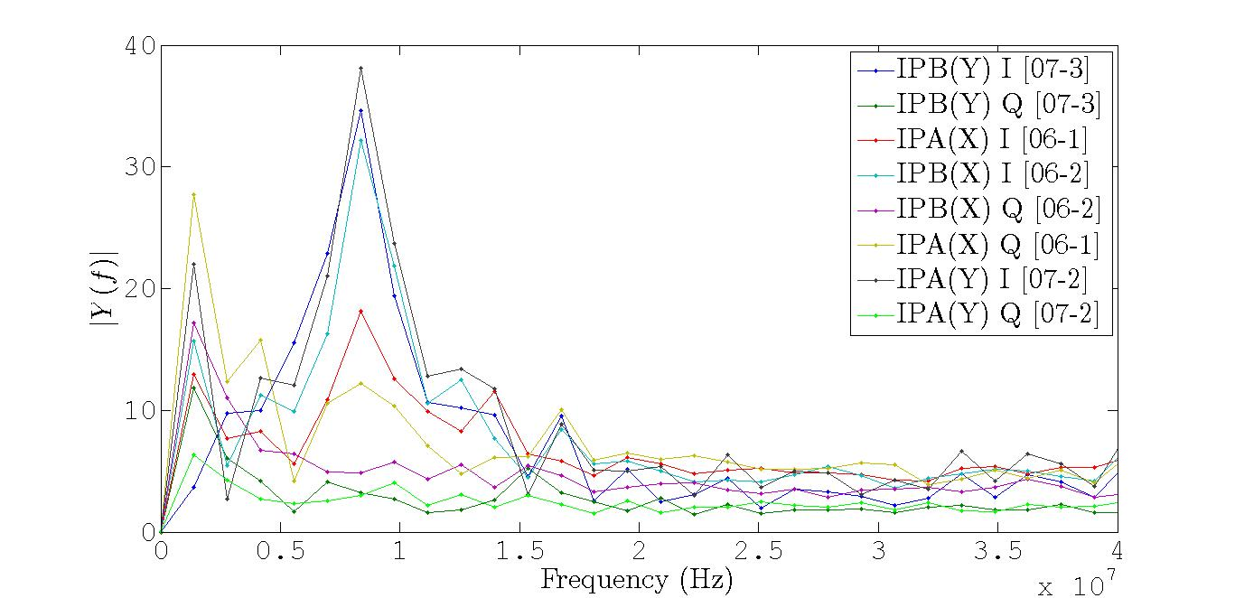
Conclusions
Q signals: dominant frequency ~1.4 MHz
I signals: dominant frequency ~8 MHz

