Slide 1



Position dependent components of IP waveforms
D. R. Bett

Slide 2
Data sets
Oscar’s data from 19 June 2014
Position/pitch scan for each IP BPM
IPC pitch scan missing as wrong movers used
Procedure:
Take a subset of mover settings from the run
Calculate the mean I and Q waveforms
Subtract from each setting the “central” setting to see how the waveforms change

Slide 3
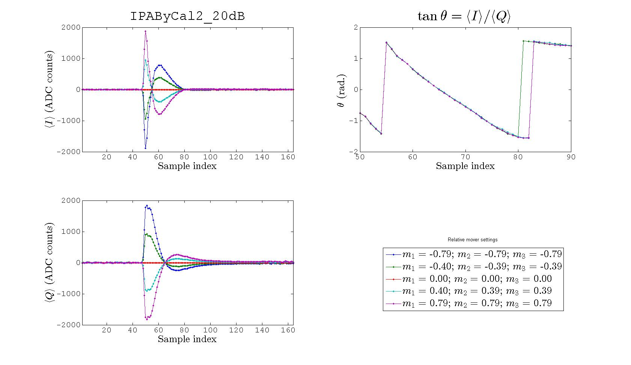
IPA position

Slide 4
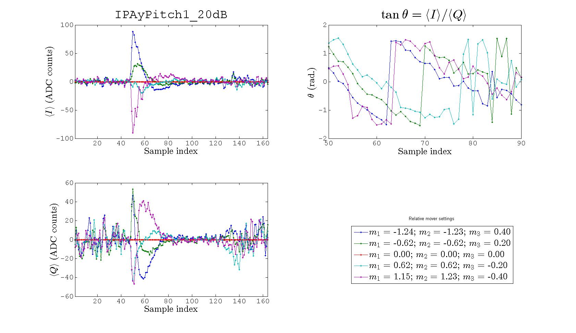
IPA pitch

Slide 5
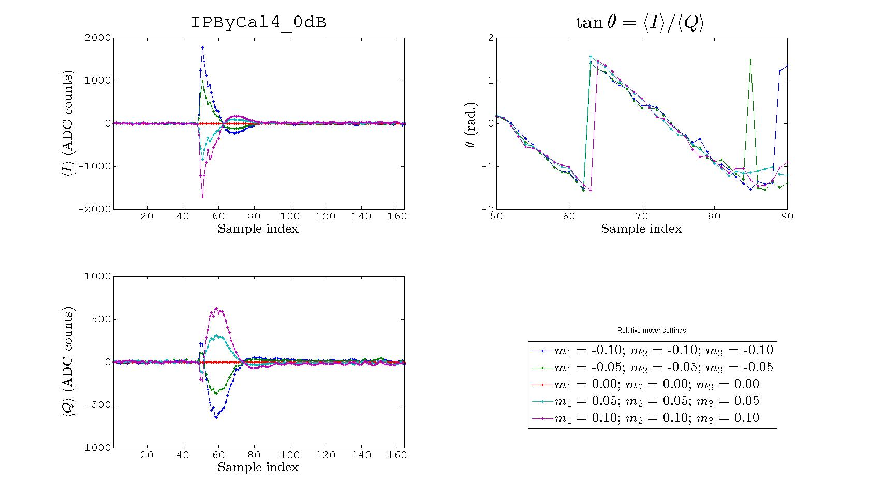
IPB position

Slide 6
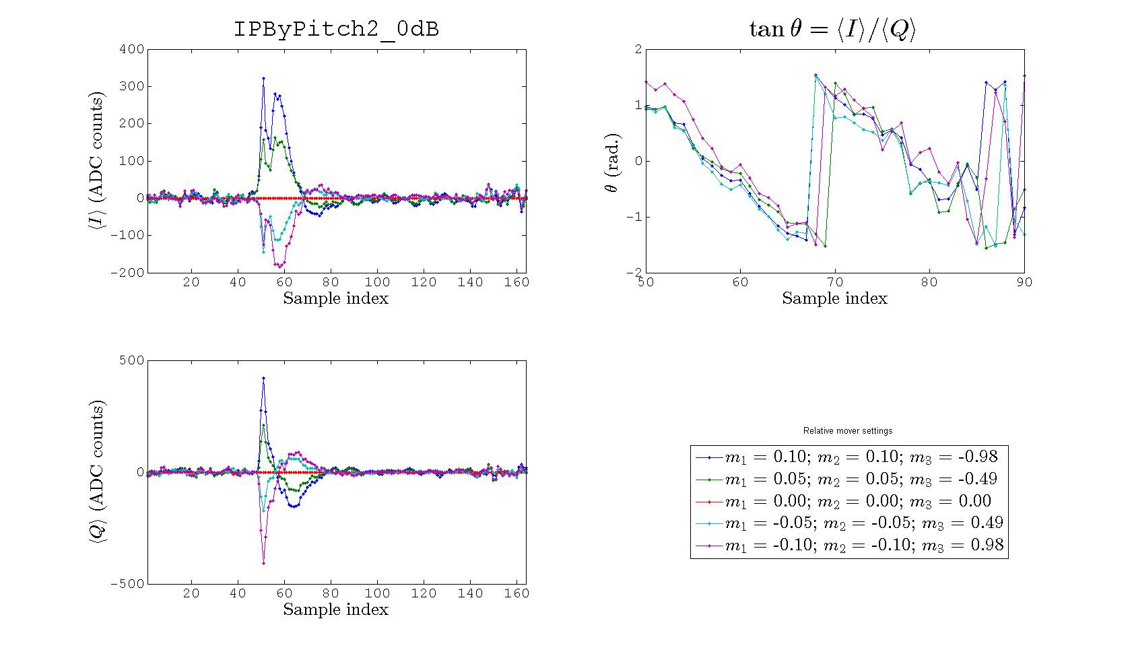
IPB pitch

Slide 7
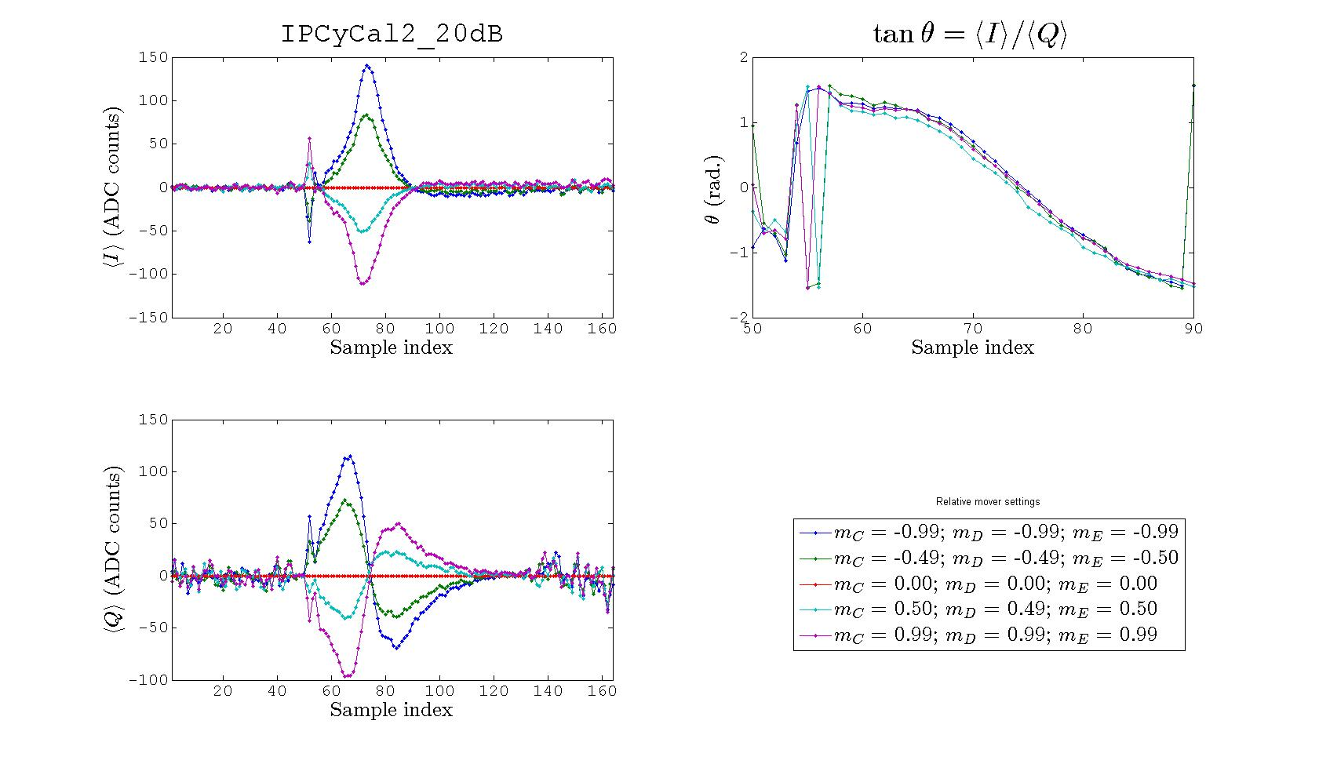
IPC position

Slide 8
Conclusions
Change in position affects I the same way a change in pitch affects Q

