Slide 1
Kicker Cable Length Measurements
Jack Roberts,
Alex Rollings, Joe Taylor,

Slide 2
Overview
Observed around a 8 ns latency deficit for the first kicker, 31 ns slack for first kicker (beam time of flight difference).
Cables for first kicker have been shortened (and rerouted) by around 30 ns or 6 m to bring latency in budget.
Joe and Alex took cable length measurements before and after the cables were cut.

Slide 3
Short Version:
 | Cable Label | End | Side | Old Length (ns) | New Length (ns)
Upstream/ 1st Kicker (480) | 2907700 | Upstream | Left | 206.0 ± 0.3 | 170.9 ± 0.3
 | 2907701 | Upstream | Right | 206.0 ± 0.4 | 171.3 ± 0.3
 | 2907702 | Downstream | Left | 205.8 ± 0.4 | 171.2 ± 0.3
 | 2907703 | Downstream | Right | 205.4 ± 0.4 | 171.6 ± 0.3
Downstream/ 2nd Kicker (780) | 2907838 | Upstream | Left | 211.2 ± 0.4 | 204.3 ± 0.3
 | 2907839 | Upstream | Right | 210.5 ± 0.3 | 205.2 ± 0.3
 | 2907840 | Downstream | Left | 211.3 ± 0.4 | 205.4 ± 0.3
 | 2907841 | Downstream | Right | 209.8 ± 0.4 | 204.3 ± 0.3
Using old approach with new data:
  Lengths for 2nd kicker agree to 0.8 ± 0.2 ns between data sets.
  Cables for first kicker shortened by 28.9 ± 0.3 ns.
How well matched do the lengths need to be
(1 ns ~= 20 cm)?
Different data analysis technique used.

Slide 4
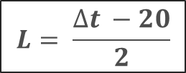
Equipment Setup
PULSE
GENERATOR
10 ns
KICKER CABLE
SCOPE
10 ns
10 ns
L
SPLITTER
Two signal components:
Signal as seen on scope:
SIGNAL
SIGNAL
Δt
Δt
TIME
TIME
$$L= \frac{∆t −20}{2}$$

Slide 5
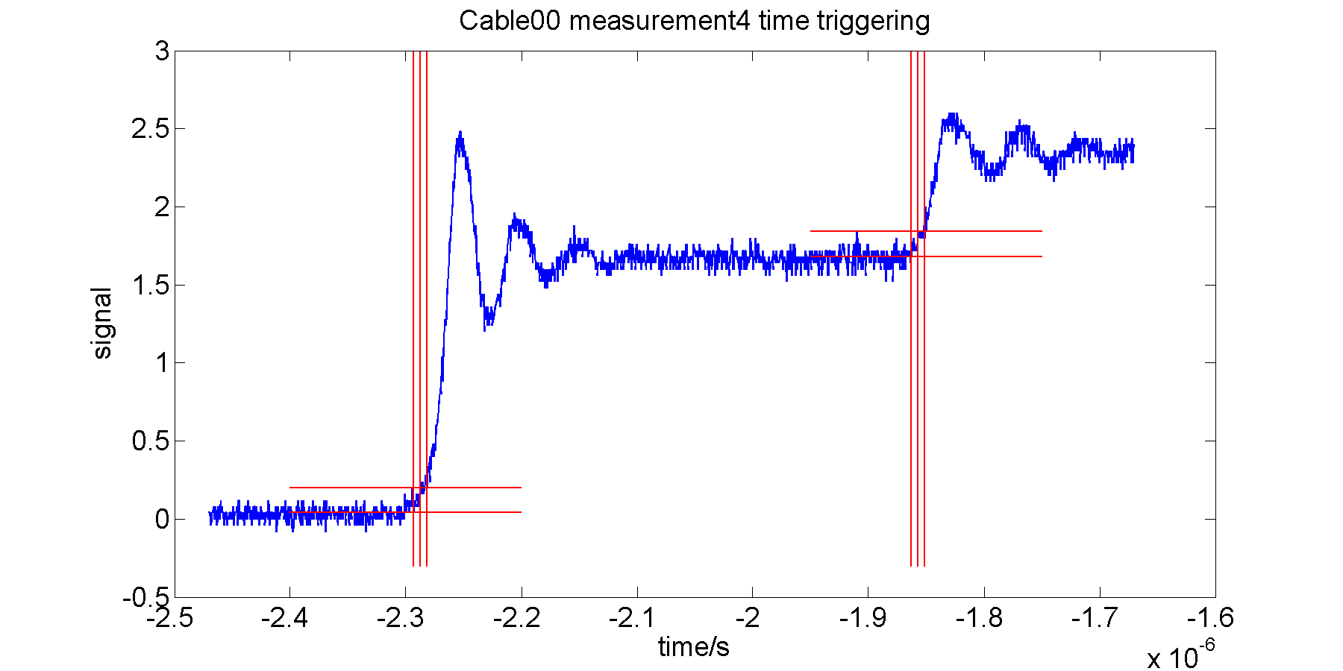
Data Before Cable Cutting
4σ above noise
Noise level
4σ above noise
Noise level
Δt
1 point every 0.4 ns.
Strange oscillations in signal.
Width 1st slope ~40 ns, width 2nd slope ~30 ns

Slide 6
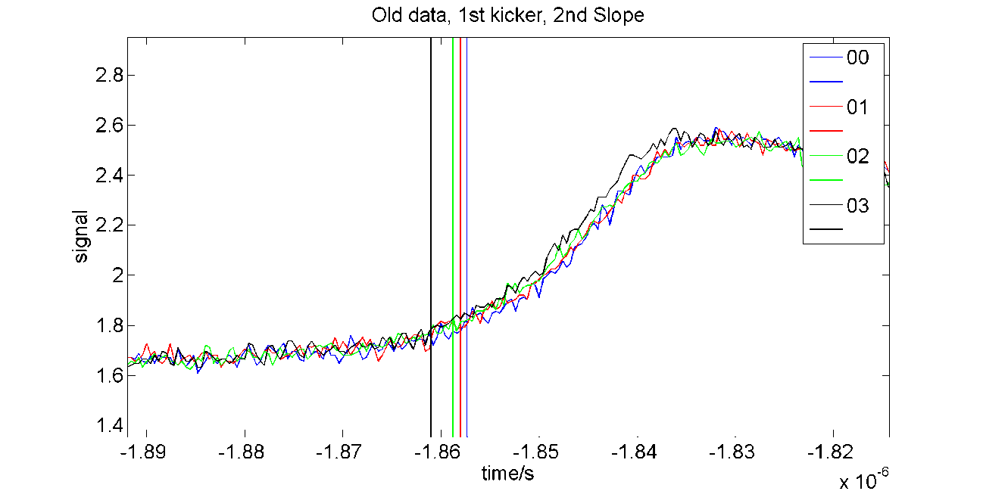
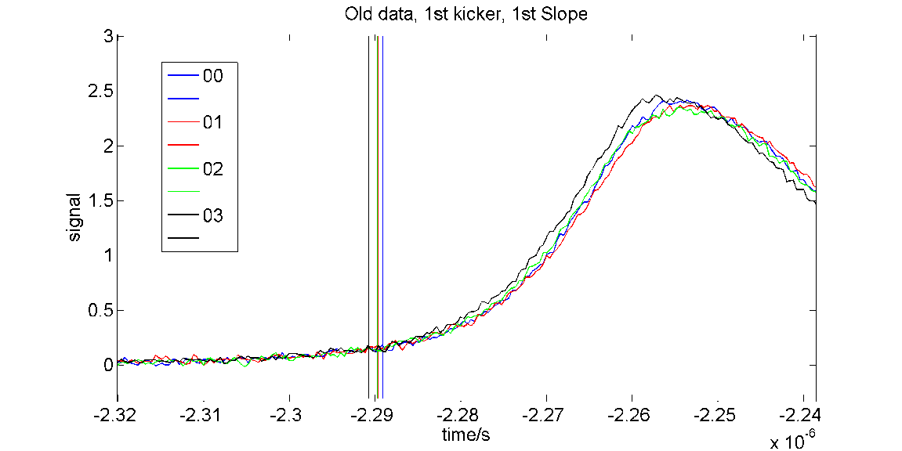
1st Kicker, Before Cable Cutting

Slide 7
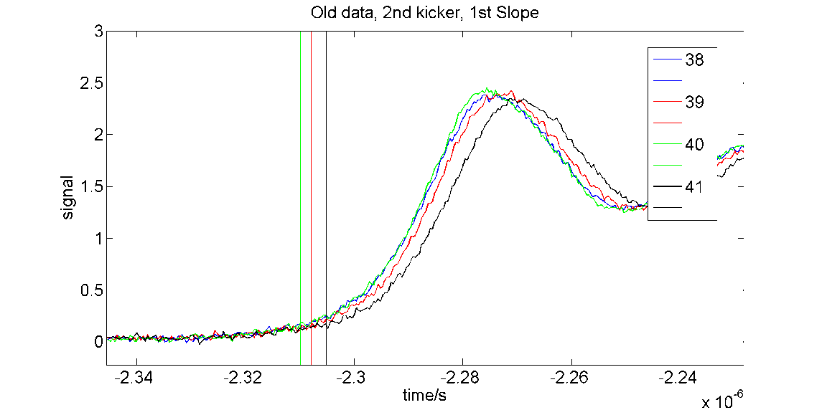
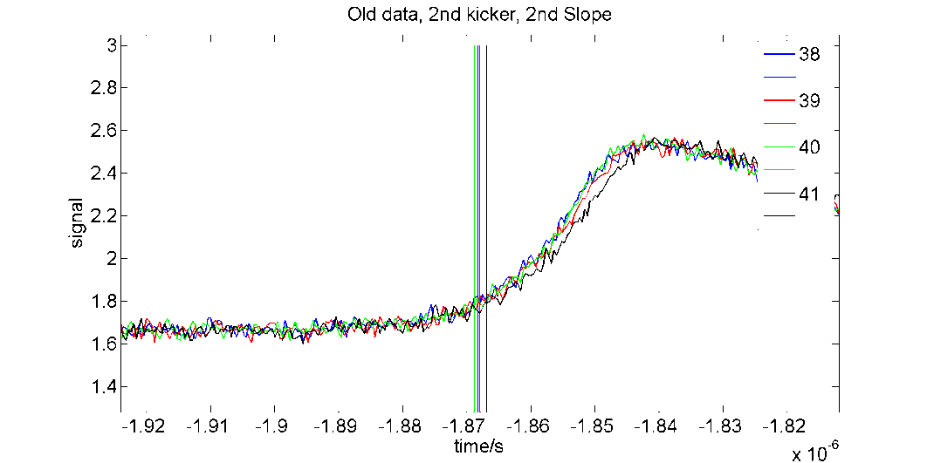
2nd Kicker, Before Cable Cutting

Slide 8
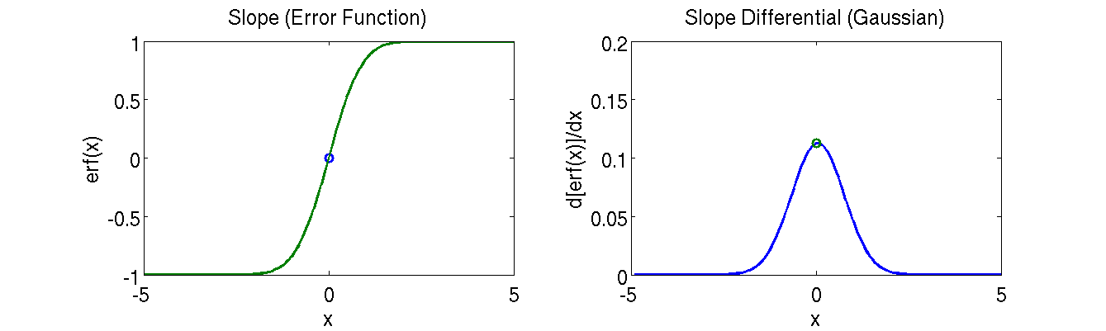
New Edge Detection Method
If each slope is well defined by the Gauss error function, the differential of the slope is a Gaussian with peak at the mid-point of the slope.

Slide 9
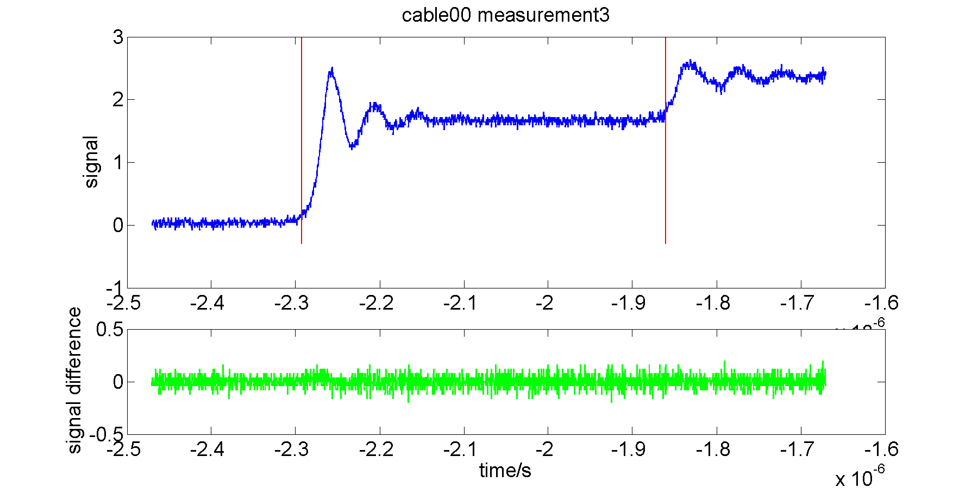
Data Before Cable Cutting
Peaks not visible outside the noise of the difference.

Slide 10
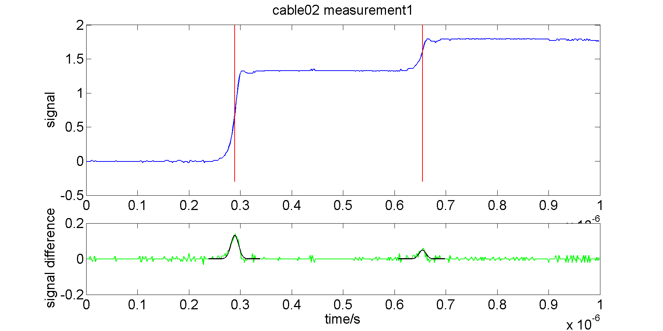
Data After Cable Cutting: 1st Kicker
Δt
Δt
LeCroy (FONT owned) scope: 2 ns between points.
Peaks visible in the difference, Gaussian fits shown.
Width 1st slope ~40 ns, width 2nd slope ~30 ns.

Slide 11
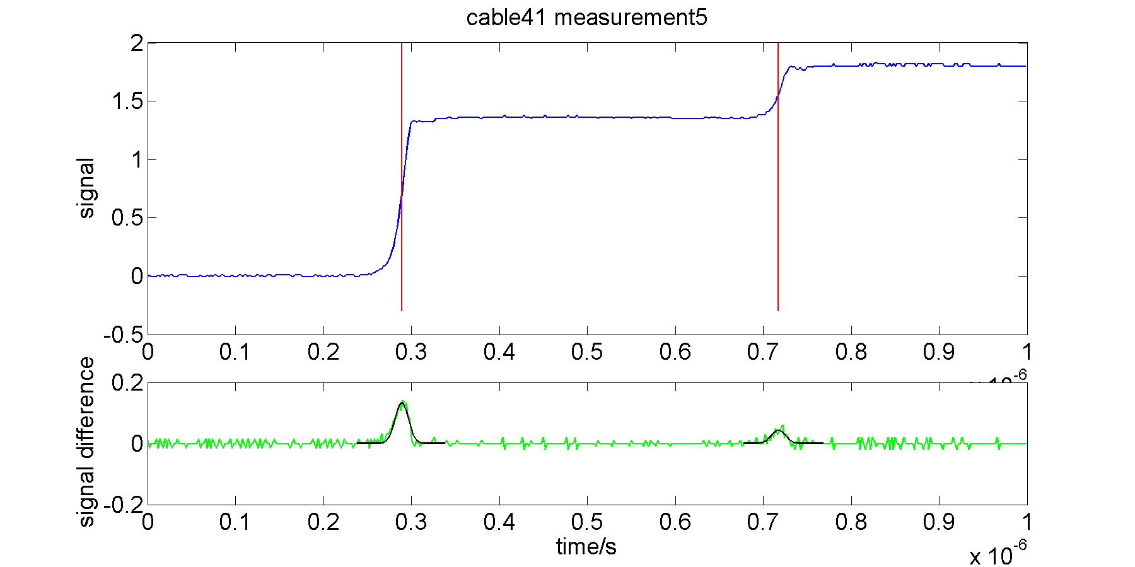
Data After Cable Cutting: 2nd Kicker
Δt
Δt
LeCroy (FONT owned) scope: 2 ns between points.
Peaks visible in the difference, Gaussian fits shown.
Width 1st slope ~40 ns, width 2nd slope ~30 ns.

Slide 12
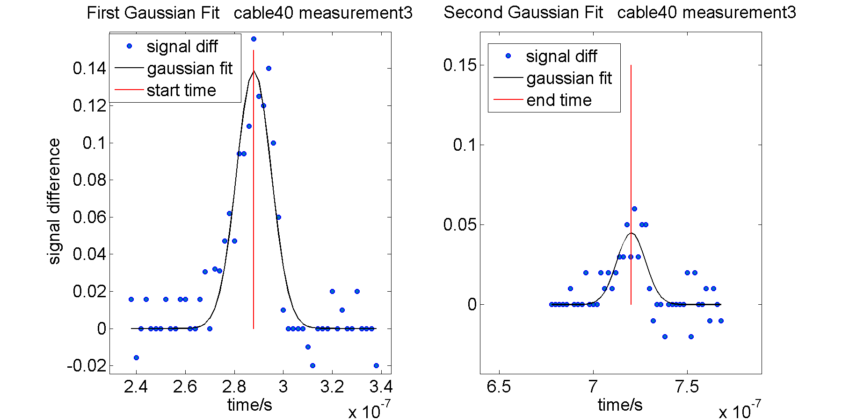
Example Fits

Slide 13
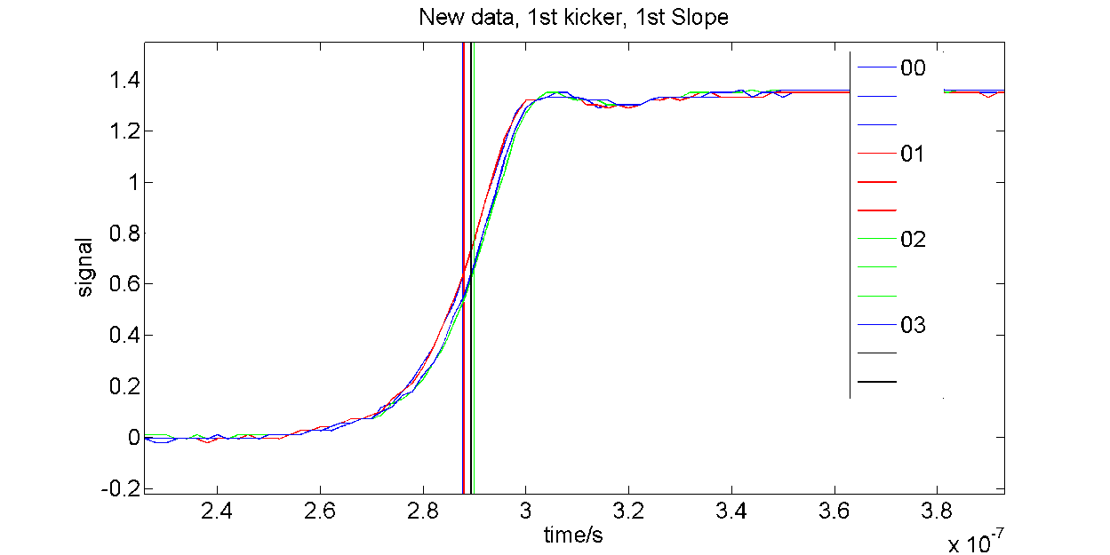
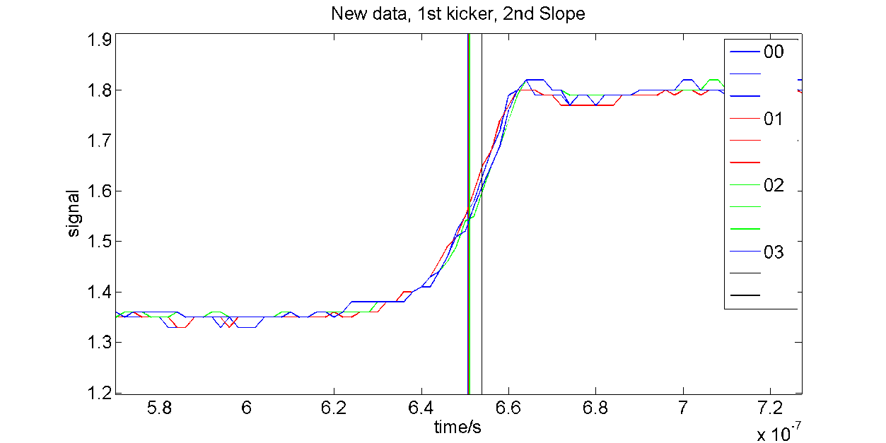
1st Kicker, After Cable Cutting

Slide 14
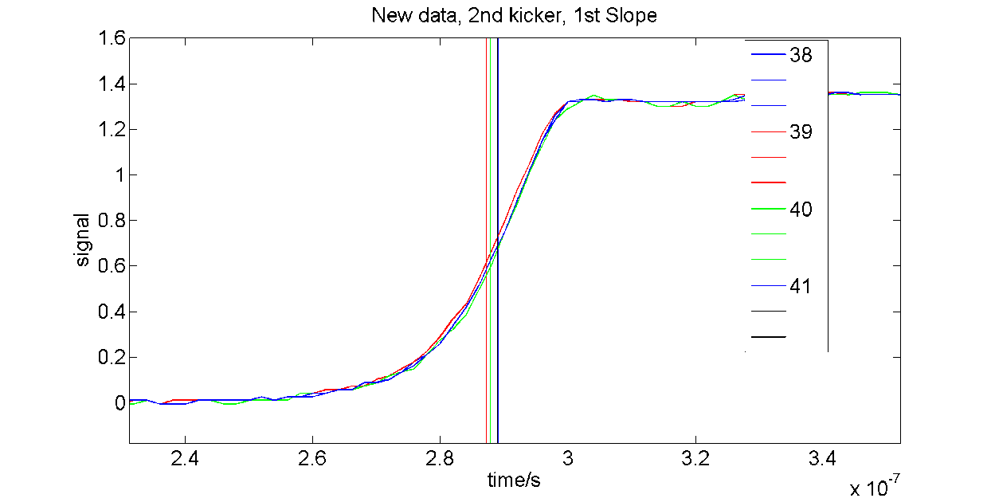
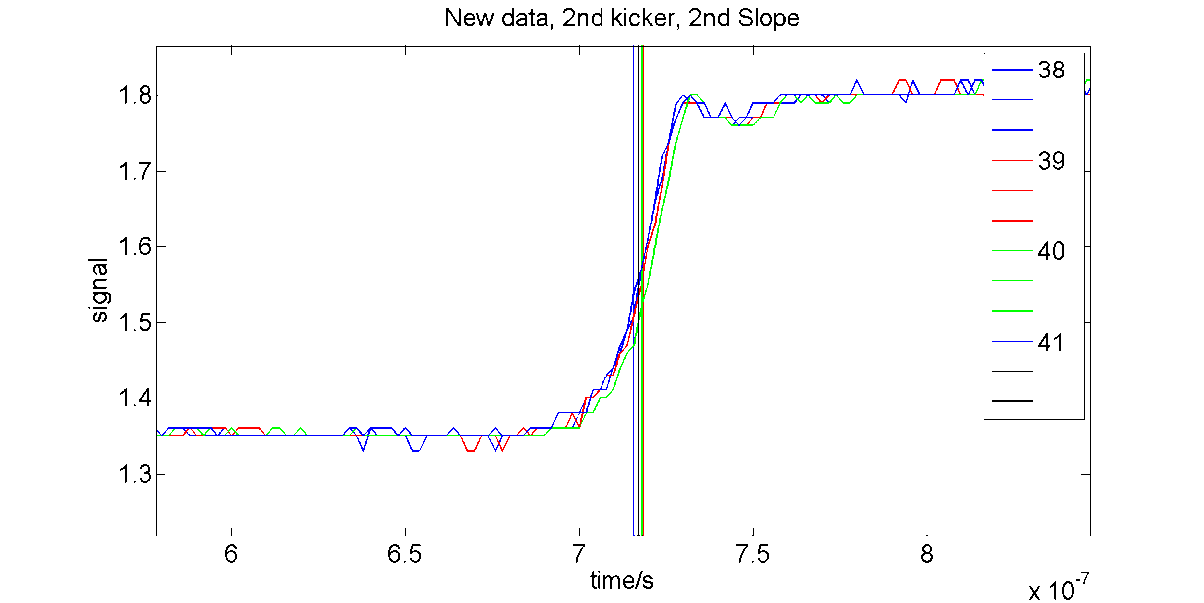
2nd Kicker, After Cable Cutting

Slide 15
Lengths:
 | Cable Label | End | Side | Old Length (ns) | New Length (ns)
Upstream/ 1st Kicker (480) | 2907700 | Upstream | Left | 206.0 ± 0.3 | 170.9 ± 0.3
 | 2907701 | Upstream | Right | 206.0 ± 0.4 | 171.3 ± 0.3
 | 2907702 | Downstream | Left | 205.8 ± 0.4 | 171.2 ± 0.3
 | 2907703 | Downstream | Right | 205.4 ± 0.4 | 171.6 ± 0.3
Downstream/ 2nd Kicker (780) | 2907838 | Upstream | Left | 211.2 ± 0.4 | 204.3 ± 0.3
 | 2907839 | Upstream | Right | 210.5 ± 0.3 | 205.2 ± 0.3
 | 2907840 | Downstream | Left | 211.3 ± 0.4 | 205.4 ± 0.3
 | 2907841 | Downstream | Right | 209.8 ± 0.4 | 204.3 ± 0.3
Using old approach with new data:
  Lengths for 2nd kicker agree to 0.8 ± 0.2 ns between data sets.
  Cables for first kicker shortened by 28.9 ± 0.3 ns.
How well matched do the lengths need to be
(1 ns ~= 20 cm)?
Different data analysis technique used.

