Slide 1



Enhanced Fit Method
or
The Douglas R. Bett Farewell Lecture

Slide 2
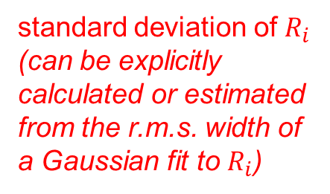
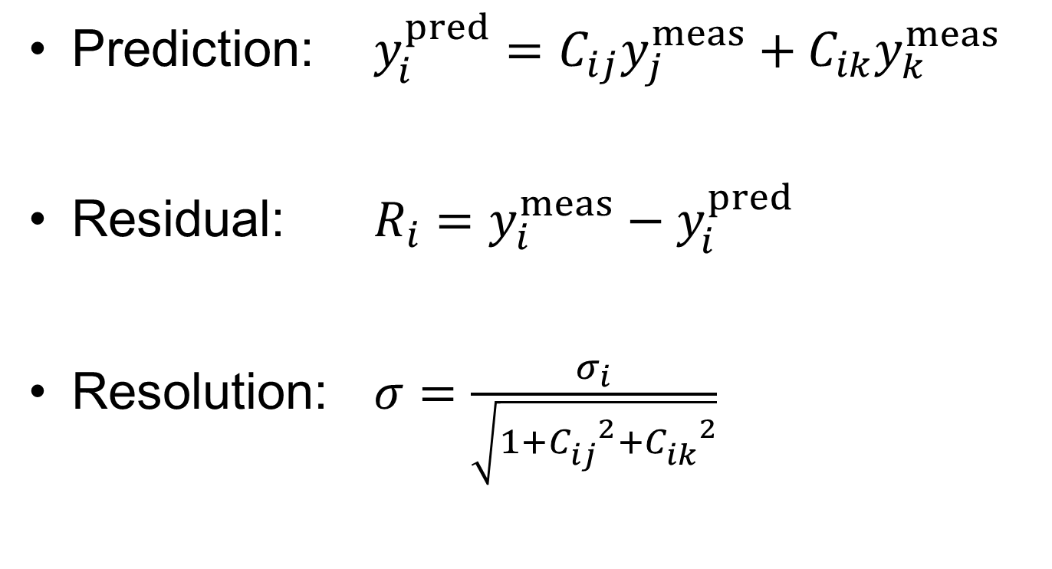
Resolution calculation
Prediction: $y_{i}^{pred}=C_{ij}y_{j}^{meas}+C_{ik}y_{k}^{meas}$
Residual: $R_{i}=y_{i}^{meas}−y_{i}^{pred}$
Resolution: $σ=\frac{σ_{i}}{\sqrt{1+{C_{ij}^{}}^{2}+{C_{ik}^{}}^{2}}}$
prediction coefficients
standard deviation of $R_{i}$ (can be explicitly calculated or estimated from the r.m.s. width of a Gaussian fit to $R_{i}$)

Slide 3
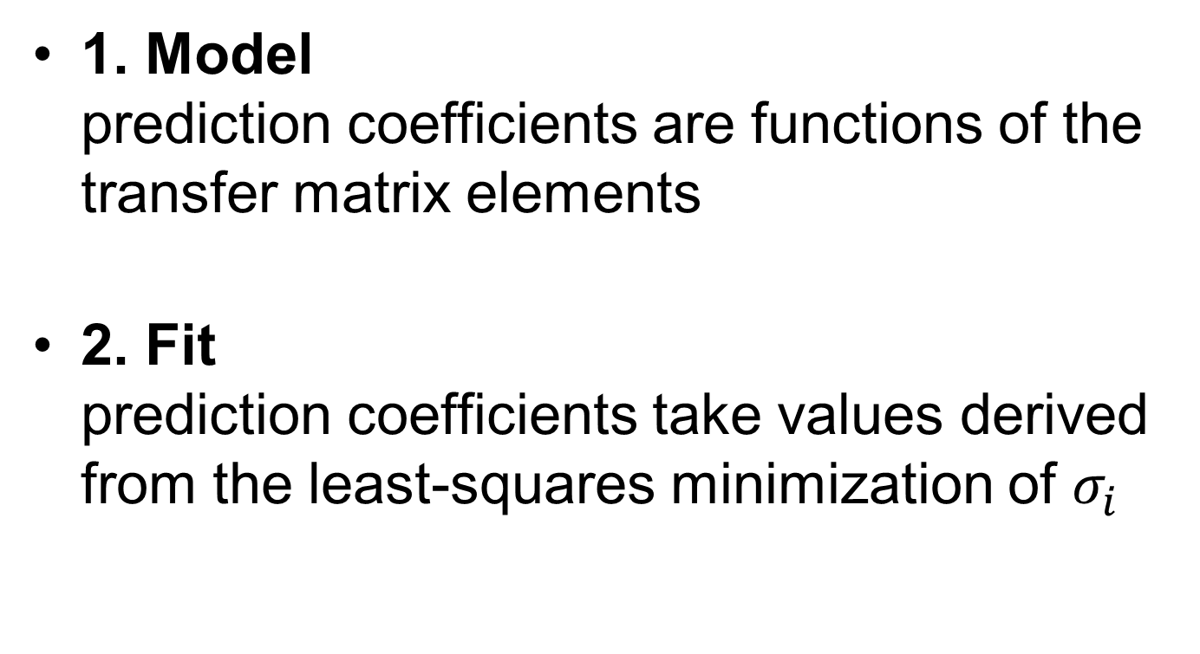
Methods
1. Model prediction coefficients are functions of the transfer matrix elements
2. Fit prediction coefficients take values derived from the least-squares minimization of $σ_{i}$

Slide 4
Example data set
RCPSresoTest_0_281113 (used in paper)
 | Model | Fit
P1 | 297 | 322
P2 |  | 309
P3 |  | 272
worse than model method
better than model method
Seemed counterintuitive that the fit method did not always outperform the model method

Slide 5
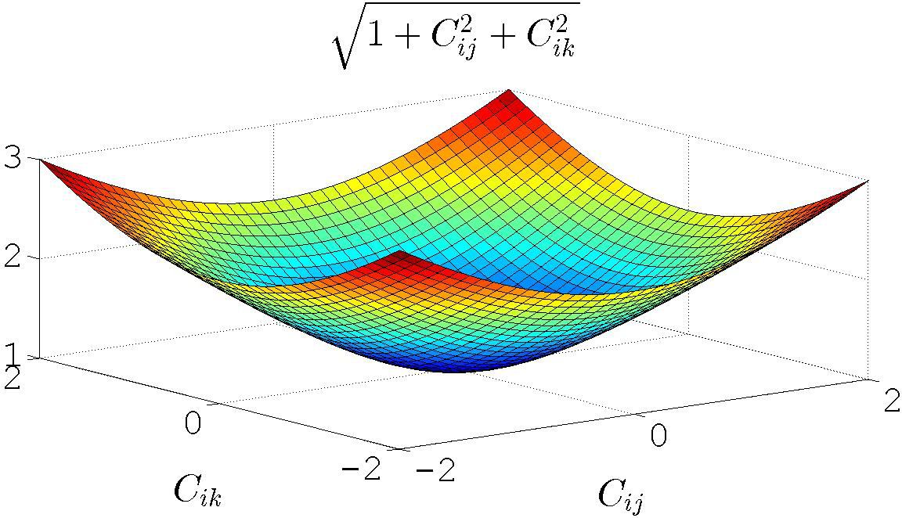

Resolution calculation (II)
Fit method neglects the impact of the factor $\sqrt{1+{C_{ij}^{}}^{2}+{C_{ik}^{}}^{2}}$

Slide 6
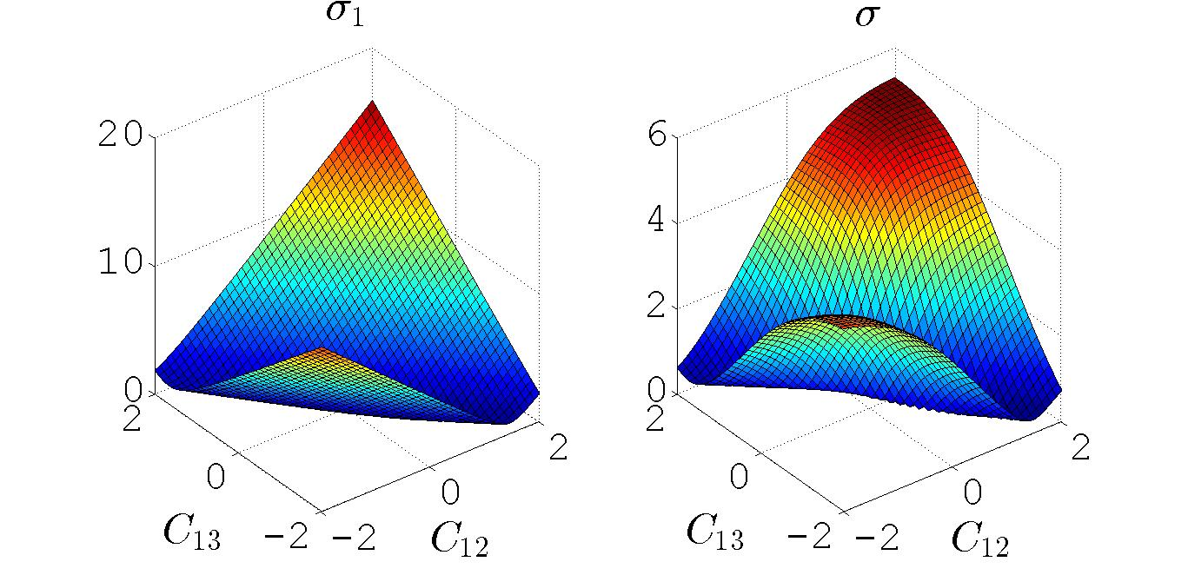
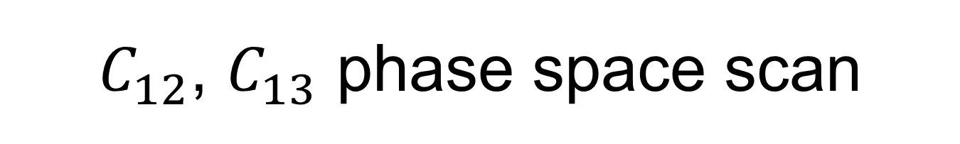
$C_{12}$, $C_{13}$ phase space scan

Slide 7
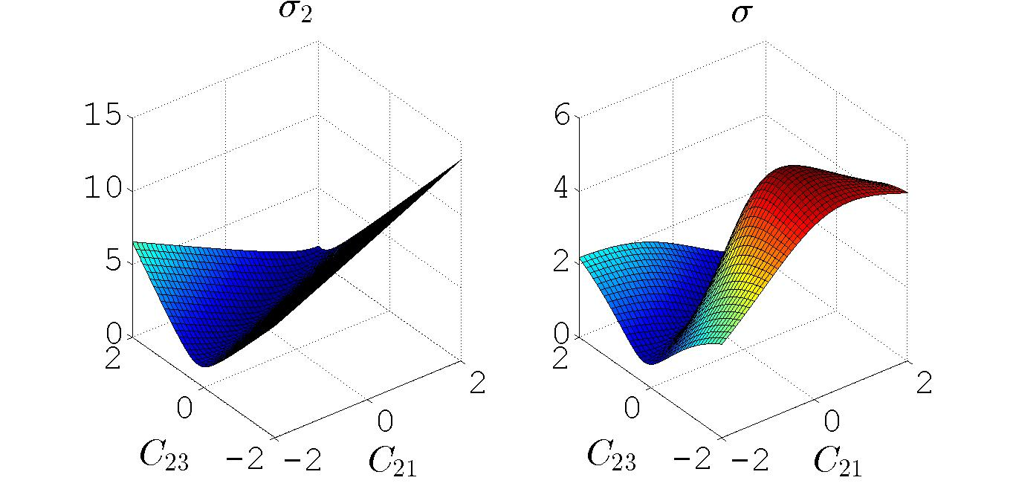
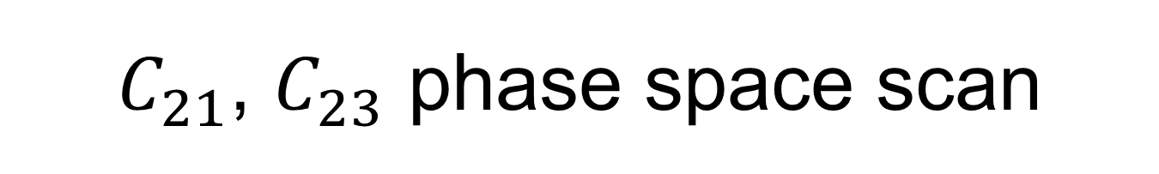
$C_{21}$, $C_{23}$ phase space scan

Slide 8
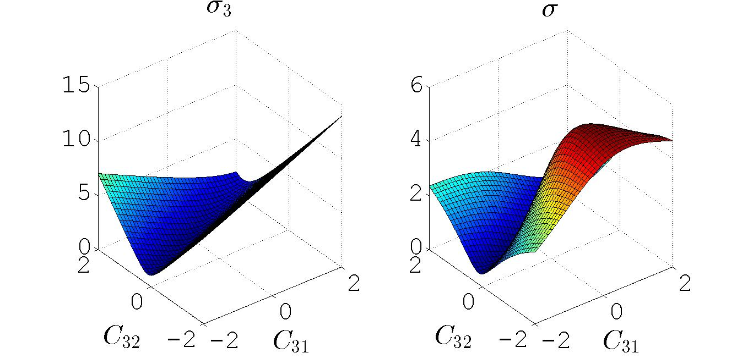
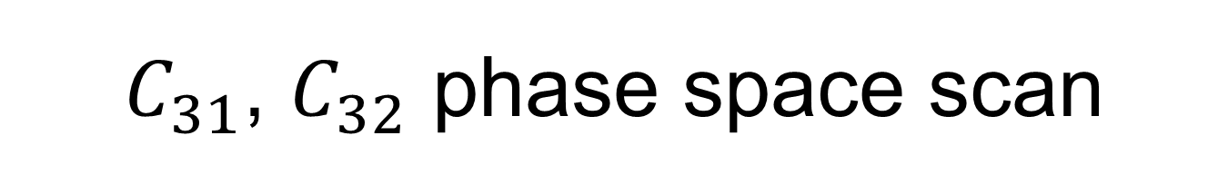
$C_{31}$, $C_{32}$ phase space scan

Slide 9
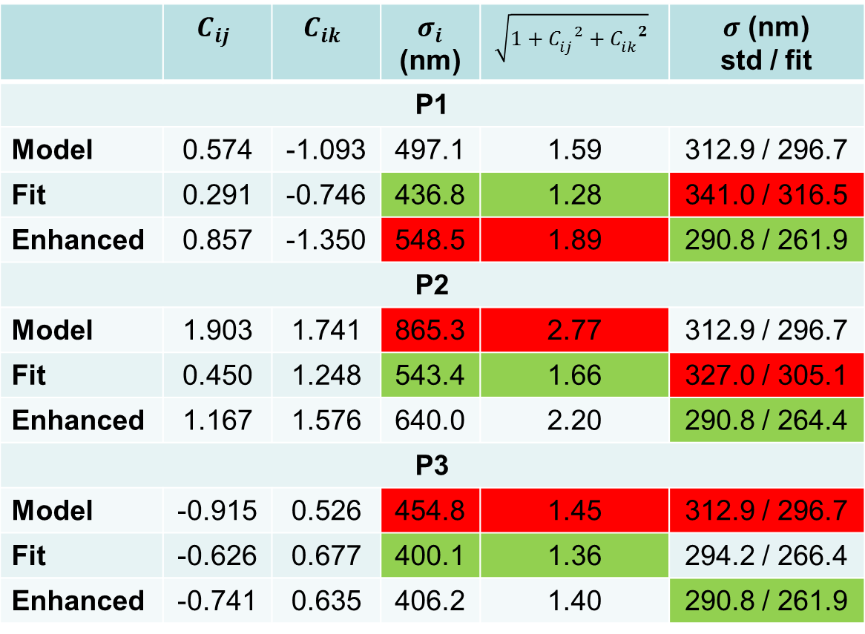
Comparison of methods
 | $$C_{ij}$$ | $$C_{ik}$$ | $σ_{i}$ (nm) | $$\sqrt{1+{C_{ij}^{}}^{2}+{C_{ik}^{}}^{2}}$$ | $σ$ (nm) std / fit
P1
Model | 0.574 | -1.093 | 497.1 | 1.59 | 312.9 / 296.7
Fit | 0.291 | -0.746 | 436.8 | 1.28 | 341.0 / 316.5
Enhanced | 0.857 | -1.350 | 548.5 | 1.89 | 290.8 / 261.9
P2
Model | 1.903 | 1.741 | 865.3 | 2.77 | 312.9 / 296.7
Fit | 0.450 | 1.248 | 543.4 | 1.66 | 327.0 / 305.1
Enhanced | 1.167 | 1.576 | 640.0 | 2.20 | 290.8 / 264.4
P3
Model | -0.915 | 0.526 | 454.8 | 1.45 | 312.9 / 296.7
Fit | -0.626 | 0.677 | 400.1 | 1.36 | 294.2 / 266.4
Enhanced | -0.741 | 0.635 | 406.2 | 1.40 | 290.8 / 261.9
max
min

Slide 10
Conclusion
The enhanced fit method explicitly minimizes the resolution
Like the model method, it returns the same result regardless of BPM of prediction
It can therefore be inferred that the enhanced fit method corresponds to fitting a consistent set of transfer matrices

