Slide 1

Search for Invisible Higgs Decays at the ILC
Akimasa Ishikawa
(Tohoku University)

Slide 2
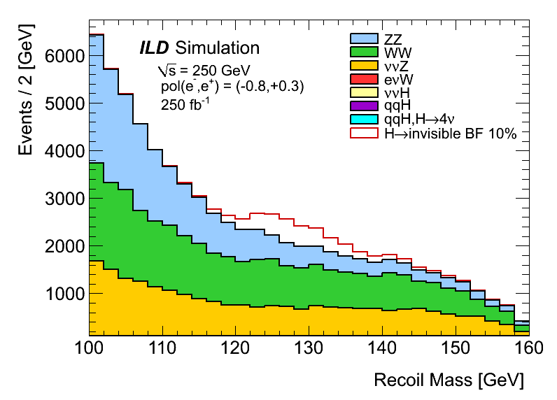
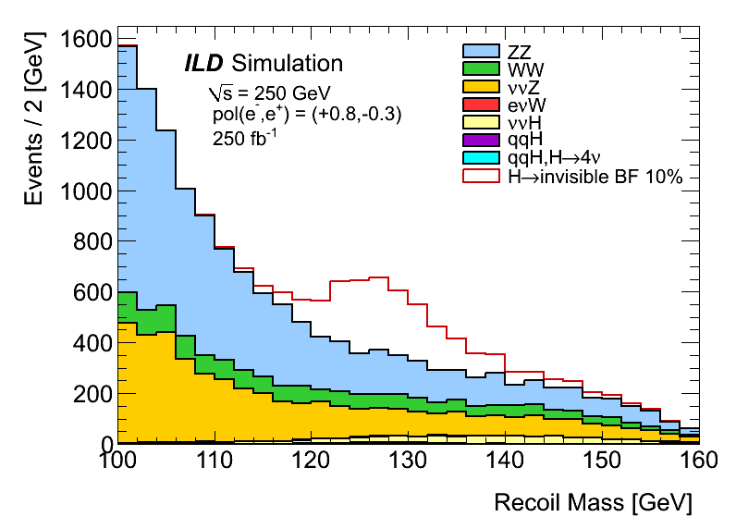
250GeV
Results at E_{CM}=250GeV were obtained last year.
The upper limits with 250fb⁻¹ (3 years running) are 0.95% and 0.69% for “Left” and “Right” cases.
  “Left” : P(e⁻,e⁺) = (-80%,+30%), “Right” : P(e⁻,e⁺) = (+80%,-30%)
Today, I will show the results with 350GeV and 500GeV compared with 250GeV.
“Left”
“Right”
20141019

Slide 3
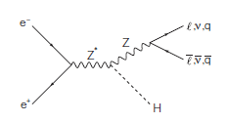
Invisible Higgs Decays at the ILC
Invisible Higgs can be searched using a recoil mass technique with model independent way!
  e+e- → ZH
At the ILC, initial e+ e- momenta are known, and the four momentum of Z is measured from di-jet or di-lepton decays, we can reconstruct Higgs mass which is a powerful tool!
In this study
  Z→qq decay is used (BF(Z→qq) = 69.9%)
  Ecm = 250GeV, 350GeV and 500GeV
known
measured

Slide 4
Predictions of Invisible Higgs Decays beyond the SM
Predictions of B(H→invisible) widely range.
  Vector Higgs portal DM arXiv:1111.4482
    B(H→invisible) < 80%
  Self-interacting Dark Radiation arXiv:1305.6521
    Parital width < 1MeV
    → B(H→invisible) <~ 24%
  Asymmetric DM arXiv:1306.5878
    20% > B(H→invisible) > 10⁻⁵ %
  nMSSM with Singlino resonant DM arXiv:1405.7371
    6.2% ~> B(H→invisible) ~> 0.01%
  pMSSM JoAnne L. Hewett at LCWS12
    50% ~> B(H→invisible) >~0.01%?
  Higgs portal DM arXiv:1112.3299
    B(H→invisible) < 10% (assumption)

Slide 5
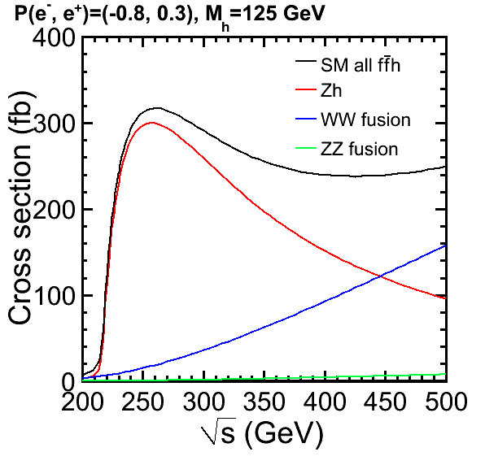
Cross Section of e⁺e⁻ → ZH → qqH
Three important energy points
  250GeV, 350GeV, 500GeV
Two polarization configurations (P_{e-}, P_{e+})
  (-80%, +30%) = “Left”
  (+80%, -30%) = “Right”
The cross section is maximum around 250GeV and decreasing for higher energy
σ_{ZH→qqH}[fb] | “Left” | “Right” | Ratio to 250GeV
250GeV | 210.2 | 142.0 | 1
350GeV | 138.9 | 93.7 | ~2/3
500GeV | 69.7 | 47.0 | ~1/3

Slide 6
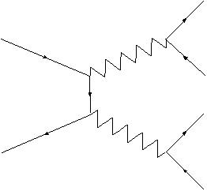
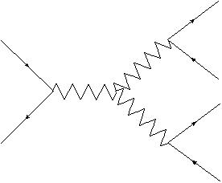
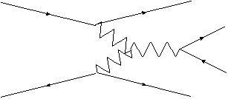
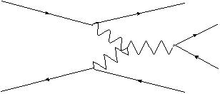
Backgrounds
Z
q
e⁻
q
(1)
ν
e
Z
ν
Backgrounds
  found qqll, qqlν and qqνν final states are the dominant backgrounds.
    other backgrounds also studied
    Pure leptonic and hadronic final states are easily eliminated.
We considered following main backgrounds.
  (1) ZZ semileptonic : one Z→qq, the other Z→ll, ν_{μ}ν_{μ}, ν_{τ}ν_{τ}
  (2) WW semileptonic : one W→qq, the other W→lν
  (3) Zν_{e}ν_{e}, Z→qq
  (4) Weν_{e}, W→qq
  ννH, generic H decays
  qqH, generic H decays
q
e⁻
W
Z
q
(2)
W
l
e
ν
e⁻
ν
W
q
(3)
W
Z
q
e⁺
ν
e⁻
e⁻
(4)
γ
W
q
W
q
e
ν

Slide 7
MC setup, Samples and Cross Sections
Generator : WHIZARD
  Higgs mass 125GeV
  Pseudo signal : e⁺e⁻ → ZH, Z→qq, H→ZZ*→4ν
Samples
  Official DBD samples and Private Productions based on DBD setting
    Full simulation with the ILD detector
  Half of the samples are used for cut determination. The other used for efficiency calculation and backgrounds estimation.
E_{CM}/σ[fb] | Pol | ZZ sl | WW sl | ν_{e}ν_{e}Z sl | eν_{e}W sl | ννH | qqH | qqH H→4ν
250GeV | “Left” | 857 | 10993 | 272 | 161 | 78 | 210 | 0.224
 | “Right” | 467 | 759 | 93 | 102 | 43 | 142 | 0.151
350GeV | “Left” | 564 | 8156 | 355 | 4981 | 99 | 139 | 0.148
 | “Right” | 300 | 542 | 73 | 421 | 31 | 94 | 0.100
500GeV | “Left” | 366 | 5572 | 559 | 4853 | 167 | 70 | 0.074
 | “Right” | 190 | 360 | 68 | 572 | 23 | 47 | 0.050

Slide 8
Overview of the Selections
Selection | 250GeV | 350GeV | 500GeV
Kt jet algorithm | No | No | Yes
Forced two-jet | Yes | Yes | Yes
Isolated lepton veto | Yes | Yes | Yes
N_{PFO} && N_{trk} | >16 && >6 | >16 && >6 | >16 && >6
M_{Z} | 80 < M_{Z} < 100 | 80 < M_{Z} < 104 | 80 < M_{Z} < 120
cosθ_{Z} | < 0.99 | < 0.99 | < 0.98
M_{recoil} | 100< M_{recoil} < 160 | 100< M_{recoil} < 160 | 100< M_{recoil} < 160
LR(M_{Z} , cosθ_{Z} , cosθ_{hel}) | > 0.3 (L), > 0.4 (R) | > 0.6 (L), > 0.5 (R) | > 0.6 (L), > 0.6 (R)

Slide 9
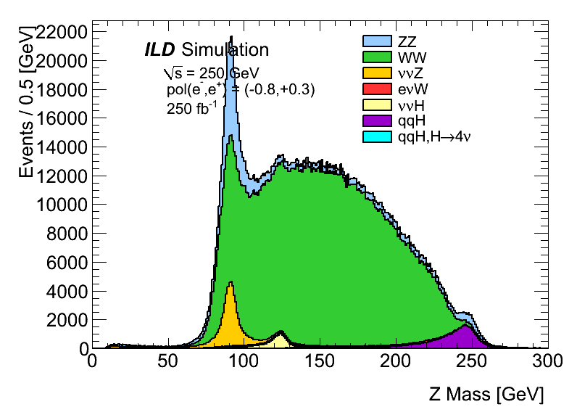
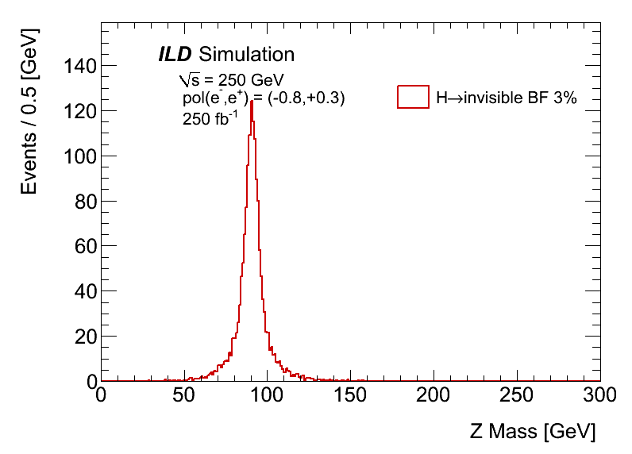
Z mass for 250GeV
To suppress backgrounds not having Z in final states, Z mass invariant mass selection is applied
  80 GeV < mZ < 100GeV
  RMS for Z mass for signal is 10.6GeV and fitted Gaussian width is 5.5GeV
“Left”
“Left”
backgrounds
signal

Slide 10
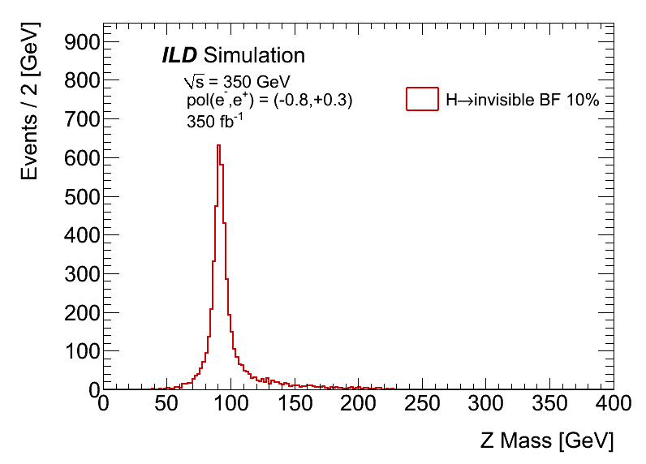
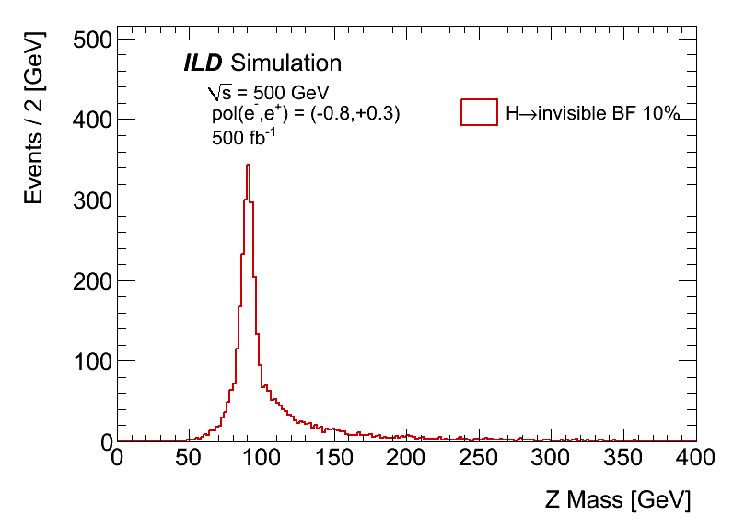
Comparison of Z mass resolution
As you see, only 20% difference at peak regions thanks to good jet energy resolution.
  Please do not take the σ‘s seriously since they can be changed by fitting region due to tails.
There is a tail for higher side for 350GeV case which is due to pile-up events.
  could be improved by pile-up reduction with kt jet algorithm
  For 500GeV, the tail was much improved by kt algorithm but still there.
250GeV
σ=5.5GeV
350GeV
σ=6.0GeV
500GeV
σ=6.6GeV

Slide 11
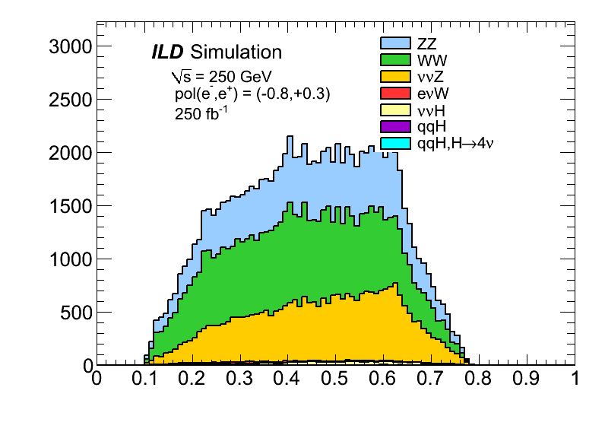
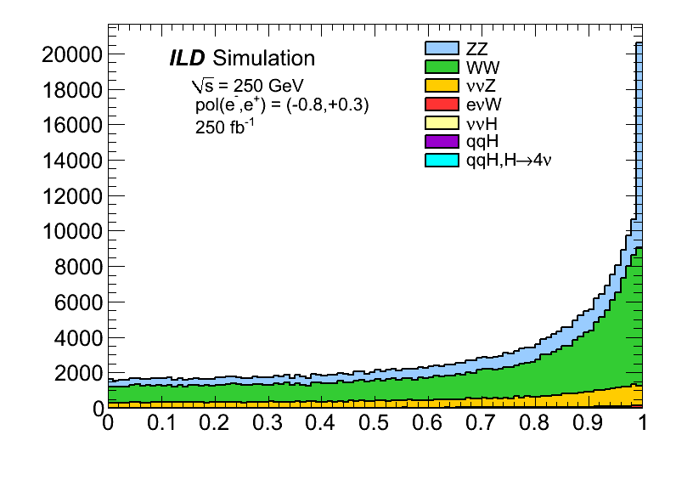
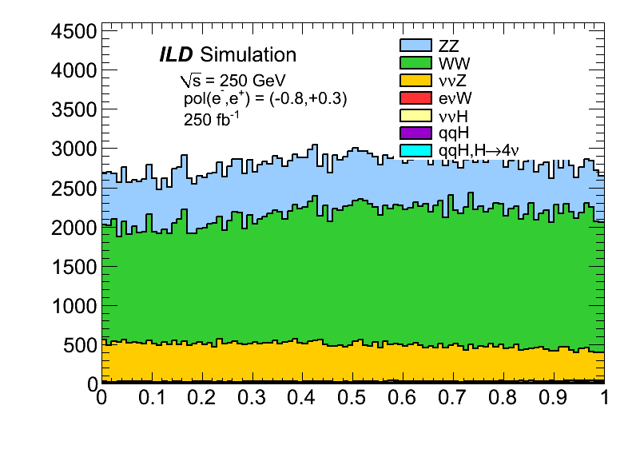
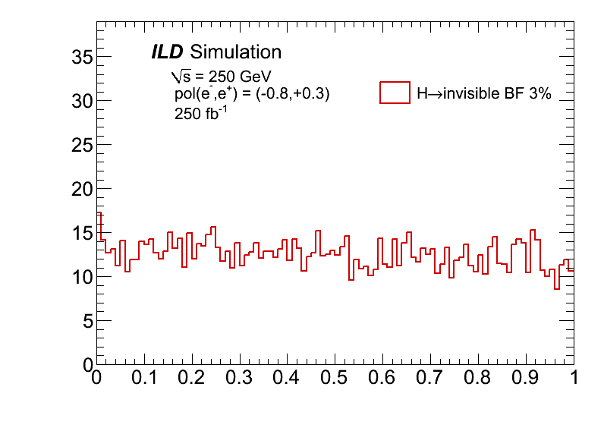
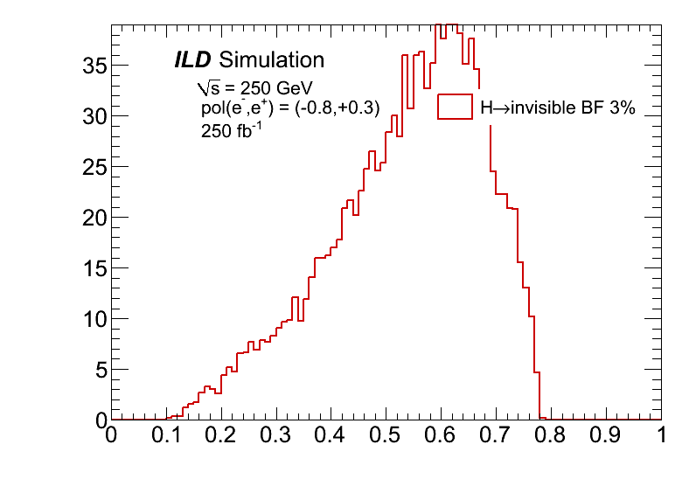
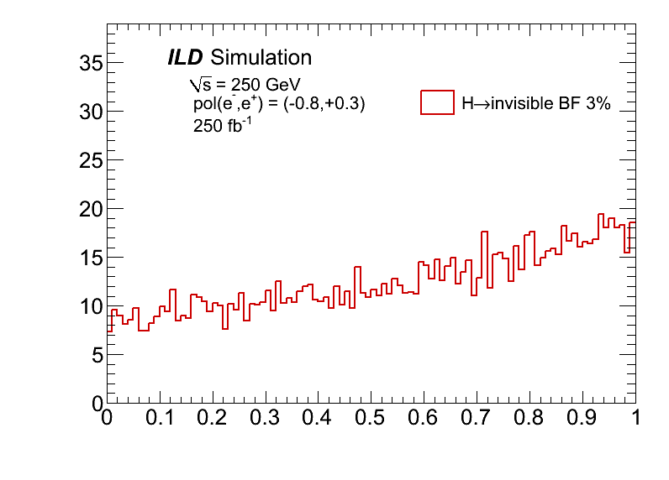
Background Suppression for 250GeV
Likelihood Ratio (LR) method is used to combine three variables
  Z mass (see previous page)
  Polar angle of Z direction : cosθ_{Z} < 0.99
  Helicity angle of Z : cosθ_{hel}
LR
cosθ_{Z}
“Left”
cosθ_{hel}
“Left”
cosθ_{Z}
“Left”
“Left”
LR
cosθ_{hel}

Slide 12
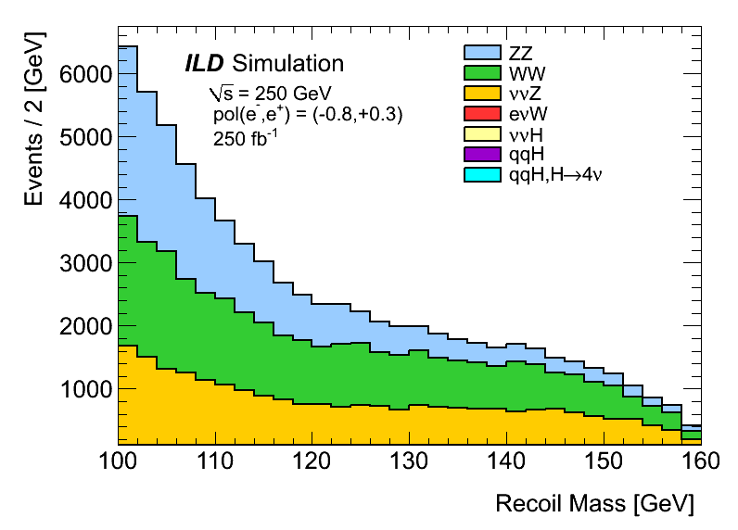
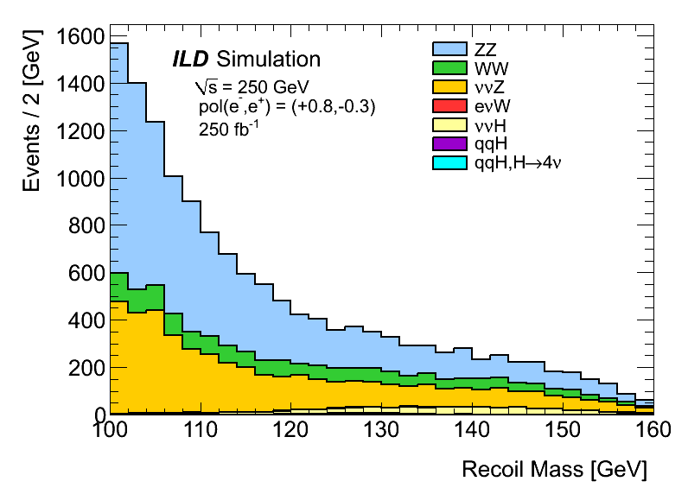
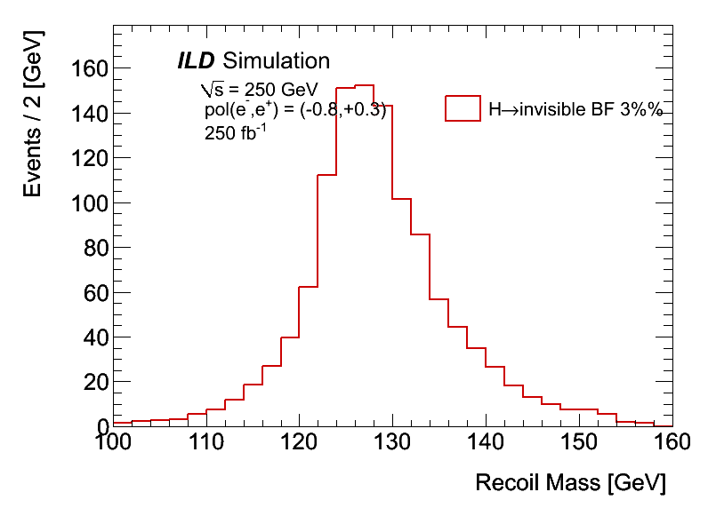
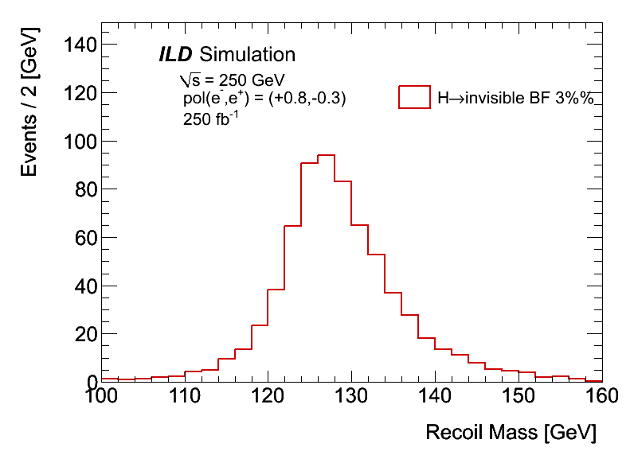
Final Recoil Mass for 250GeV
Dominant backgrounds are ZZ, WW, ννZ
“Left”
“Right”
“Left”
“Right”

Slide 13
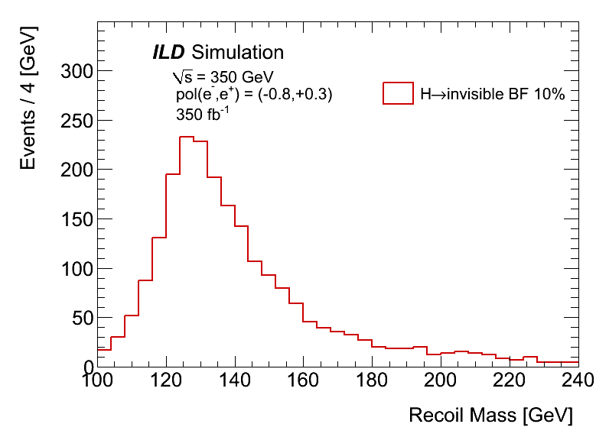
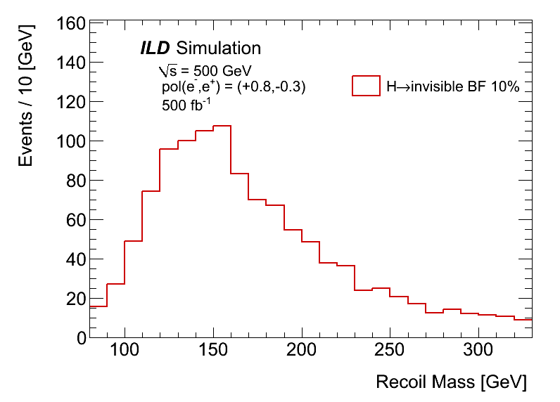
Comparison of signal M_{recoil} distributions
Higher energy gives worse recoil mass resolution
Recoil mass peak is also shifted to higher side.
Higher energy is not good for invisible search due to
  Lower cross section
  Wider recoil mass resolution
Note. Scale and binning are different
250GeV
350GeV
500GeV

Slide 14
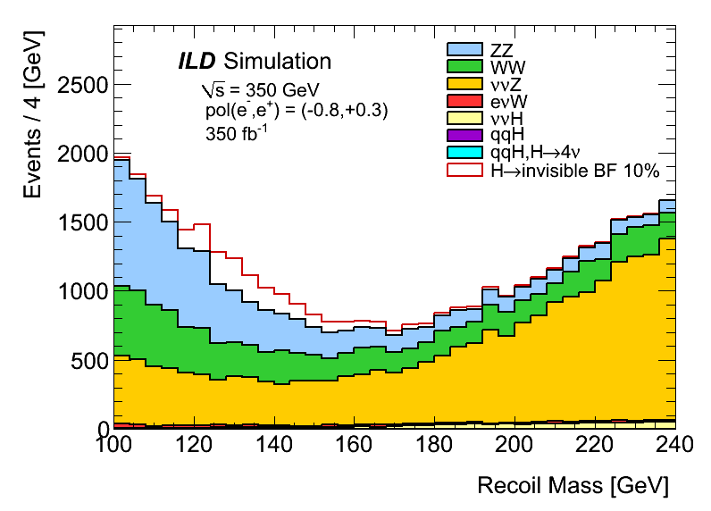
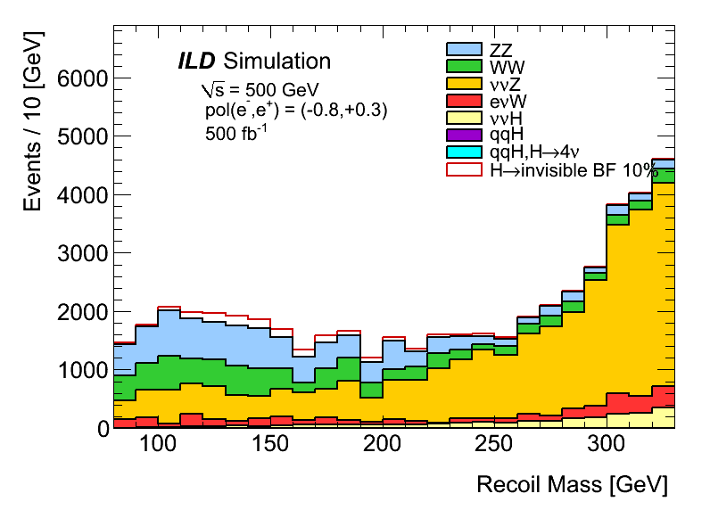
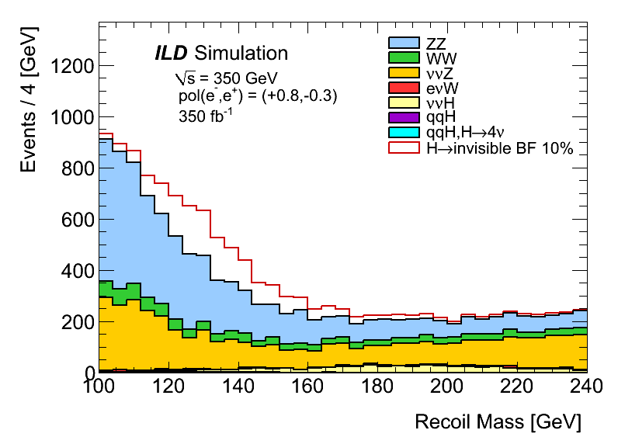
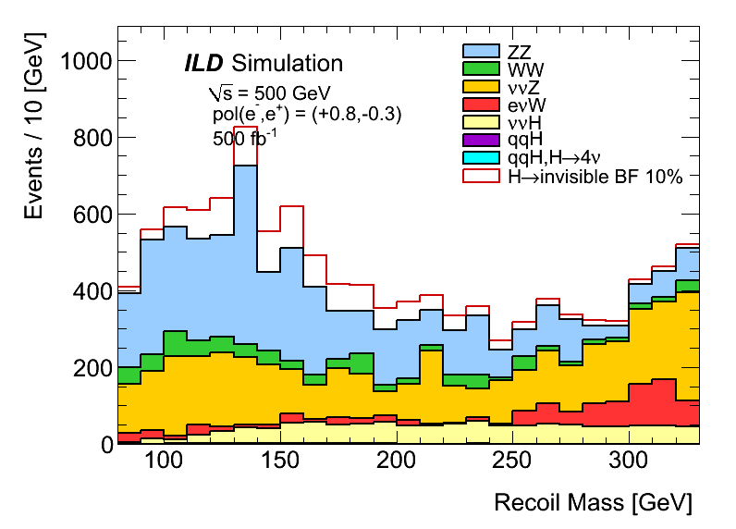
Signal overlaid M_{recoil} distributions
BF(H→invisible) = 10% assumed.
Dominant backgrounds are ZZ, WW, ννZ
“Right” gives smaller backgrounds
250GeV
350GeV
500GeV
“Left”
“Right”

Slide 15
Upper Limits set by Toy MC
We performed Toy MC to set the upper limit on BF(H→invisible).
  This invisible does not include H→ZZ*→4ν
Integrated luminosity assumed
  ∫Ldt = 250, 350, 500fb⁻¹ for E_{CM}=250, 350, 500 GeV
  Corresponding to running about 3 snowmass years (3x10⁷ sec) with nominal ILC
“Left” is about 1.5 times worse than “Right”.
  1.5²=2.3 times longer running time needed to achieve the same sensitivity
350GeV (500GeV) is about 1.5 (3.2) times worse than 250GeV
  1.5²=2.3 (3.2²=10) times longer running time needed to achieve the same sensitivity
UL on BF [%] (time needed to achieve upper limit of 0.69% [year]) | “Left” | “Right”
250GeV | 0.95 (5.7) | 0.69 (3.0)
350GeV | 1.49 (14) | 1.37 (12)
500GeV | 3.16 (63) | 2.30 (33)

Slide 16
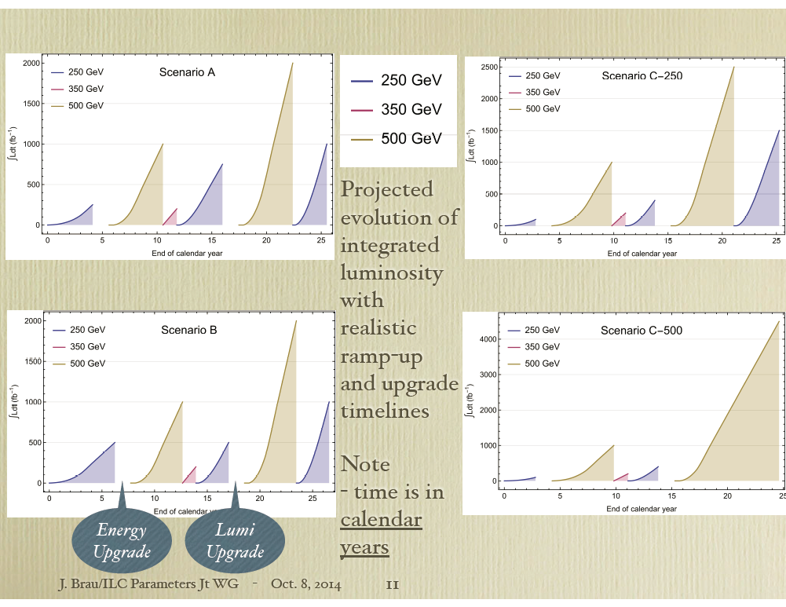
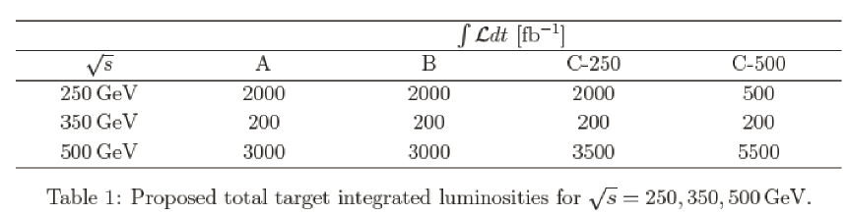
The Running Scenario
ILC parameter working group chose Scenario C-500 as a Single running Scenario
  This is the worst case for Invisible Higgs Decays since Luminosity at 250GeV is the smallest
  But good for Higgs couplings to the SM particles and new heavy particle searches.
I would propose to take 250GeV right handed pol. run if we can not find any new physics at 500GeV and/or 1TeV runs

Slide 17
Summary and Plan
Full simulation studies of search for invisible Higgs decays at the ILD with the ILC using recoil mass technique are performed
  e+e- →ZH, Z→qq processes
  E_{CM}=250, 350, 500 GeV with ∫Ldt = 250, 350, 500fb⁻¹
  Pol(e⁻,e⁺) = (-0.8, +0.3) and (+0.8, -0.3)
These results should be also used as a input to running scenario
Plan
  Mass constraint fit for 250GeV
  Null polarization for positrons (±0.8, 0)
    In case polarized positrons can not be used.
UL on BF [%] | “Left” | “Right”
250GeV | 0.95 | 0.69
350GeV | 1.49 | 1.37
500GeV | 3.16 | 2.30

Slide 18
backup

Slide 19
Overview of the Selections for 250GeV (350GeV, 500GeV)
0. kt jet algorithm to eliminate pile-up events only for 500GeV
Forced two-jet reconstruction with Durham jet algorithm
Isolated lepton veto
Numbers of Particle Flow Objects (PFO) and charged tracks
  N_{PFO} > 16 & N_{trk} > 6
  Eliminate low multiplicity events like ττ
Z mass reconstructed from di-jet : M_{Z}
  80GeV < M_{Z} < 100GeV (80 < Mz < 104, 80< Mz < 120)
  Also used for Likelihood ratio cut
Polar angle of Z direction : cos(θ_{Z})
  Just apply < 0.99 (0.99, 0.98) to eliminate peaky eeZ background before making likelihood ratio
Loose Recoil mass selection : M_{recoil}
  100GeV < M_{recoil} < 160GeV (100 < M_{recoil} < 240GeV, 80 < M_{recoil} < 330GeV )
Likelihood ratio of M_{Z}, cos(θ_{Z}), cos(θ_{hel}) to give the best upper limit : LR
  cos(θ_{hel}) : Helicity angle of Z
  LR > 0.3 (0.6, 0.6) for “Left” and LR > 0.4 (0.5, 0.6) for “Right”
Toy MC to set upper limit

Slide 20
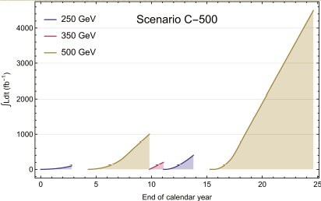
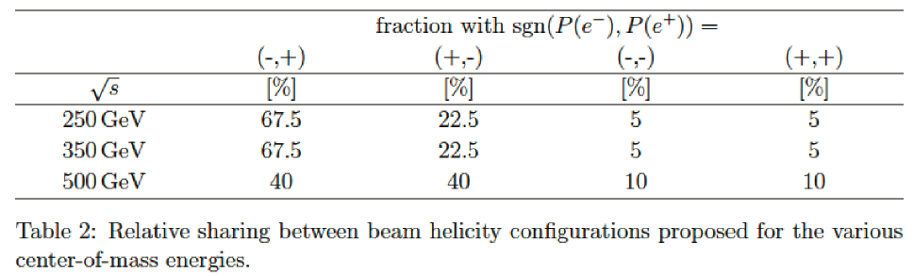
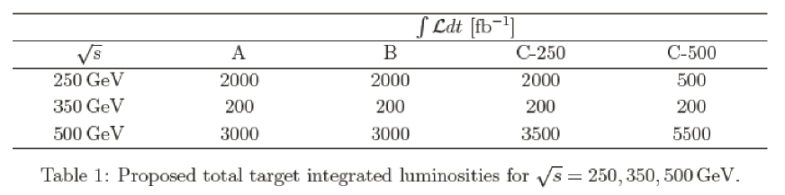
The Running Scenario

Slide 21
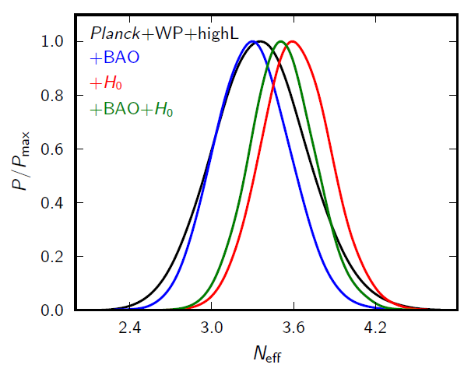
Invisible Higgs Decays
In the SM, an invisible Higgs decay is H → ZZ* →4ν process and its BF is small ~0.1%
If we found sizable invisible Higgs decays, it is clear new physics signal, especially, of Dark Sectors
  Higgs Portal Dark Matter?
    Cold matter in the universe
  Dark Radiation?
    Slight excess (less than 3σ) in effective # of ν from astro physical observations
    Relativistic matter in the universe
1303.5076

Slide 22
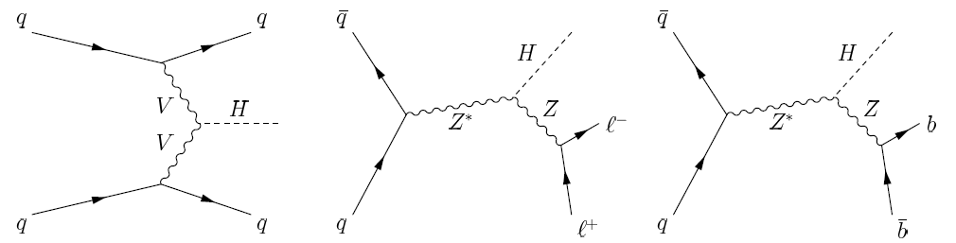
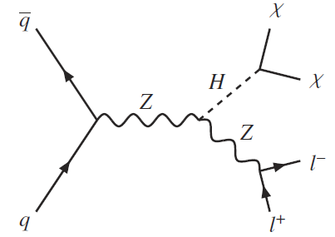
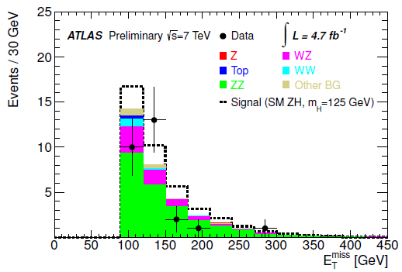
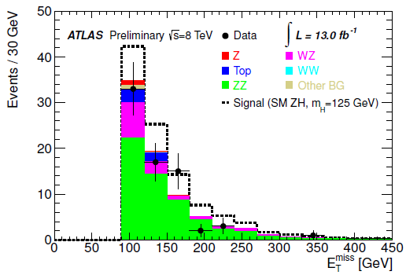
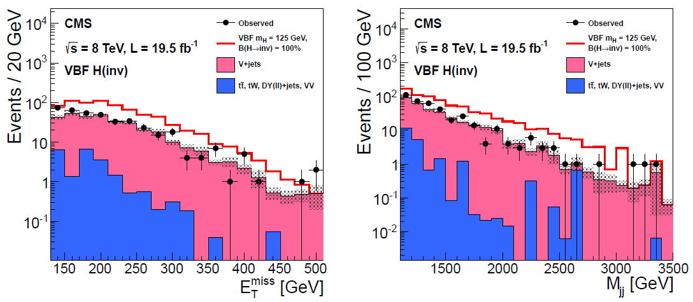
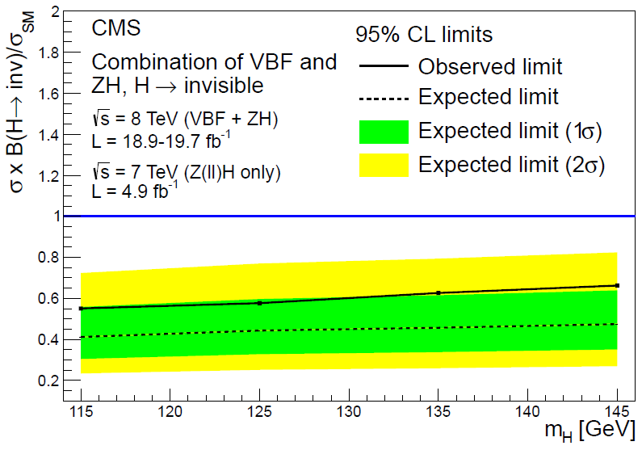
Invisible Higgs Decays at the LHC
CMS Collaboration Eur. Phys. J. C 74 (2014) 2980
Invisible Higgs Decays were searched with qq→ ZH and qq→ qqH (VBF) processes using missing E_{t} (and M_{qq}).
  They cannot reconstruct missing Higgs mass since they don’t know momenta of initial quark pairs
This method is model dependent since the cross sections in pp collision are assumed as those in the SM.
  Current upper limit on BF is 58%@95%CL (expected 44%).
  Very hard to achieve much better than 10% at the LHC
http://cds.cern.ch/record/1523696

Slide 23
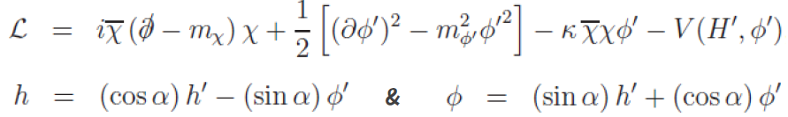
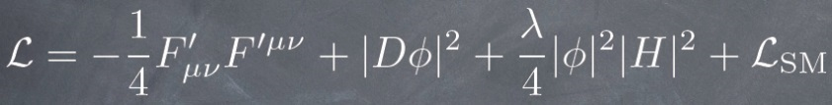
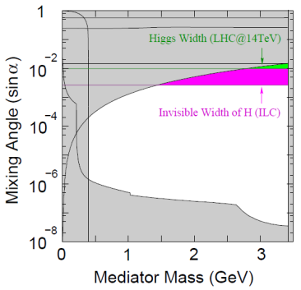
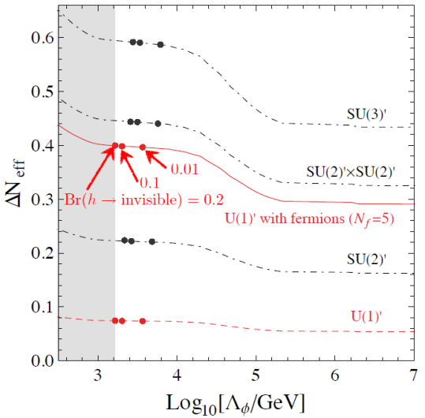
Constraint?
Asymmetric DM
Mixing angle of Dark scalar and SM Higgs, and mediator mass
Dark radiation
together with number of effective neutrinos, gauge structure of hidden sector and scale of dark scalar determined
Fermionic Asymmetric DM
S. Matsumoto@ECFA 2013
Precision Cosmology meets particle physics.
(Dark Radiation)
F. Takahashi@Higgs and Beyond

