Slide 1
Readout electronics for FPCCD VTX in 2014
Yasuhiro Sugimoto (KEK),
Hisao Sato (Shinshu U.)
2014/12/18

Slide 2
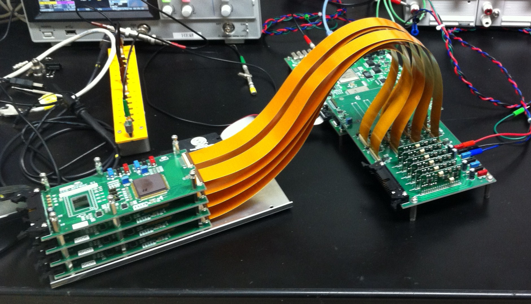
R&D in 2014
3-level clock driver
New interface board for 3-level clock drivers
SEABAS2 board
Clock drivers
Interface board
CCD/AFFROC Boards

Slide 3
3-level clock driver
Suppression of power consumption
  Smaller pulse height is preferable: P=fCV²
Suppression of dark current
  Inverted mode (V_{L}<~-7V) is preferable to suppress surface dark current
In order to achieve these two contradictory requirements, 3-level clock for horizontal register is suitable

Slide 4
Inverted Mode
In inverted mode, holes are collected near SiO2-Si interface
→ Neutralize dark charge (electrons) of the interface states
→ Drastic suppression of surface dark current
Energy band structure of MIS structure

Slide 5
H-clock with 3-level driver
Use normal mode (V_{L}>-7V) for H-shift
Use inverted mode (V_{L}<-7V) only once per line

Slide 6
Driver circuit
Driver cards using discrete parts
Pin-compatible with present driver cards, except for one pin which selects Normal/Inverted
New interface board is also necessary to make use of 3-value function

Slide 7
Possible circuit
Driver IC EL7156 has tri-state output
Use two EL7156 with different output pulse height (different V_{L} and V_{H}), and enable only one
Even in tri-state, transistors in EL7156 become “on” if Vout>V_{H} or Vout <V_{L} → Diodes are inserted in the V_{H} and V_{L} line
Ringing in Vout has to be avoided because it causes voltage shift in Vout due to the diodes
Rev.0 circuit diagram

Slide 8
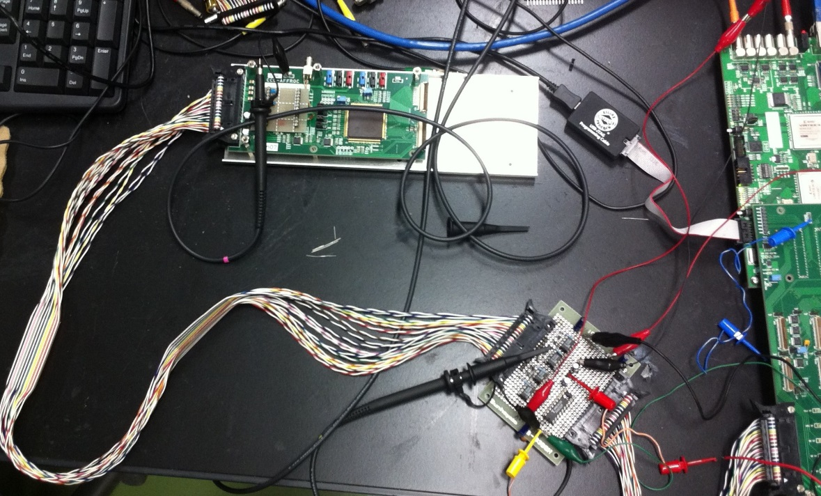
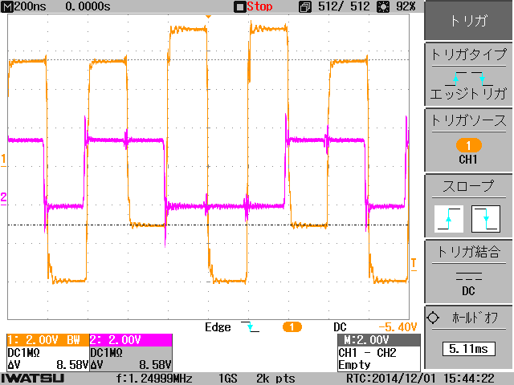
Test at Shinshu Univ.
3 (4)-level waveform (V1H>V2H>0>V2L>V1L) has been obtained

Slide 9
V-clock with 3-level driver
3-value clock in V-clock might suppress “spurious charge”
Takuya Imayoshi, Master Thesis

Slide 10
Status
Sato-san has studied the driver circuit, and made some improvements
We have ordered the 3-level driver cards to a company (GND)
Design of new interface board is on-going (by Sato-san) → will be ordered by the end of December and delivered by the end of FY2014

