Slide 1
as a test case for quark flavor violation in the MSSM
K. Hidaka
Tokyo Gakugei University / RIKEN, Wako
Collaboration with
A. Bartl, H. Eberl, E. Ginina, W. Majerotto
Reference: arXiv:1411.2840 [hep-ph] (to be published in Phys. Rev. D)
ILC Tokusui Workshop 2014, 17 December 2014, KEK

Slide 2
Contents
1. Introduction
2. MSSM with Quark Flavour Violation (QFV)
3. Constraints on the MSSM
4. Benchmark QFV Scenario
5. h → c cbar at full 1-loop level
6. Numerical results
7. Theoretical and Experimental errors
8. Conclusion

Slide 3
1. Introduction
What is the SM-like Higgs boson discovered at LHC?
It can be the SM Higgs boson.
It can be a Higgs boson of New Physics.
This is the most important issue in the present particle physics world!
Here we study the possibility that it is the lightest Higgs boson of Minimal
Supersymmetric Standard Model (MSSM) focusing on the width of the
decay .
We compute the width at full one-loop level in the scheme in the
MSSM with non minimal Quark Flavor Violation (QFV).
We find that the difference of the MSSM and SM predictions for the width
can be quite significant compared with expected experimental errors at
a future lepton colliders such as ILC.

Slide 4
2. MSSM with QFV
The basic parameters of the MSSM with QFV:
{tanβ, m_{A} , M₁ , M₂ , M₃ , μ , M²_{Q,αβ} , M²_{U,αβ} , M²_{D,αβ} , T_{Uαβ} , T_{Dαβ} }
(at Q = m_{h} scale ) (α,β = 1,2,3 = u, c, t or d, s, b)
tanβ : ratio of VEV of the two Higgs doublets <H⁰ ₂>/<H⁰₁>
mA : CP odd Higgs boson mass (pole mass)
M_{1,} M₂ ,M₃ : U(1), SU(2),SU(3) gaugino masses
μ : higgsino mass parameter
M²_{Q,αβ} : left squark soft mass matrix
M²_{Uαβ} : right up-type squark soft mass matrix
M²_{Dαβ} : right down-type squark soft mass matrix
T_{Uαβ} : trilinear coupling matrix of up-type squark and Higgs boson
T_{Dαβ} : trilinear coupling matrix of down-type squark and Higgs boson

Slide 5
Key parameters in this study are:
QFV parameters: δ^{LL}₂₃ , δ^{uRR}₂₃ , δ^{uRL}₂₃ , δ^{uLR}₂₃
QFC parameter: δ^{uRL}₃₃

Slide 6
3. Constraints on the MSSM
We respect the following experimental and theoretical constraints:
(1) the recent LHC limits on the masses of squarks, gluino, charginos and neutralinos.
(2) the constraint on (m_{A ,} tanβ ) from the recent MSSM Higgs boson search at LHC.
the constraints on the QFV parameters from the B meson data.
etc.
(4) the constraints from the observed Higgs boson mass at LHC
(allowing for theoretical uncertainty): 122.7 GeV < m_h⁰ < 127.6 GeV.
(5) theoretical constraints from the vacuum stability conditions for the
QFC/QFV trilinear couplings T_{Uab} .
(6) The experimental limit on SUSY contributions to the electroweak ρ parameter
Δρ(SUSY) < 0.0012.
Notes:
Experimental constraint from B(b -> s l+ l-) ;
The low-s region (1 GeV^2 < s < 6 GeV^2) is dominated by the Wilson
coefficients C_9 and C_10, has sizable integrated branching ratio and is very
sensitive to the C_7 - C_9 interference. In the following, we utilize the latter
to put constraints on the Wilson coefficients C_7,8,9,10.
We calculate the integrated branching ratio in the low-s region following Ref. [52]:

Slide 7
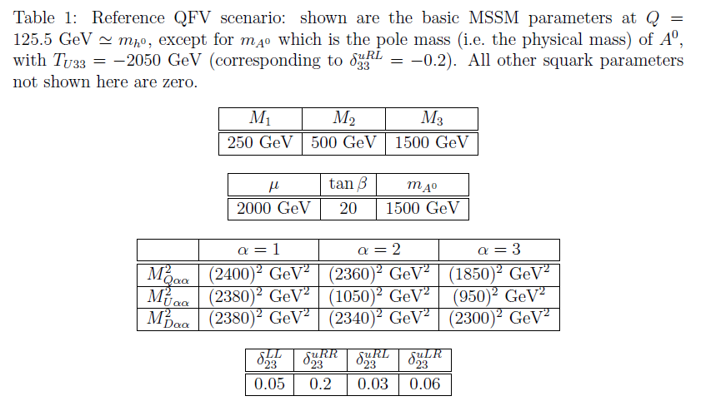
4. Benchmark QFV Scenario
large mixing scenario
(large top-trilinear-coupling scenario)
decoupling Higgs scenario
QFV parameters

Slide 8
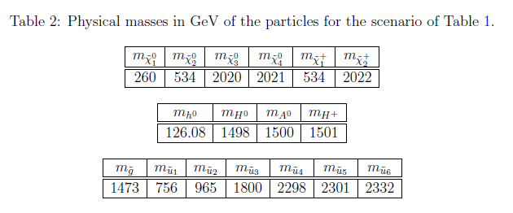
Physical masses in our benchmark scenario

Slide 9
Benchmark QFV scenario
< up-squark sector >
< down-squark sector >
mass-splitting due to large
mixing

Slide 10
Main features of our scenario:
- Large scharm-stop mixing terms M²_{Q23,},M²_{U23}, T_{U23} ,T_{U32}
- Large QFV/QFC trilinear couplings T_{U23} ,T_{U32} , T_{U33}
The gluino loop contributions to the width are
enhanced! (see next page)
Large deviation of the MSSM prediction for from
the SM prediction!
This makes it easier to discover the QFV SUSY effects in
this decay !

Slide 11
In this large & mixing scenario;
In our scenario “trilinear couplings“ ( , ,
couplings) = (T_{U23} T_{U32} , T_{U33} ) are large!
coupling is large!
Gluino loop contributions can be large!

Slide 12
5. h⁰ → c cbar at full 1-loop level
We compute the width at full 1-loop level in the
renormalization scheme in the MSSM with QFV.
We take the normalization scale as Q = .
We study the normalization scale Q dependences of the width
in the range .
For details, see arXiv:1411.2840 [hep-ph] (to be published in Phys. Rev. D).

Slide 13
Invariant decay amplitude :
M_{inv} = M ^{tree} + M^{1-loop} + . . .
= + + + + . . .
M^{1-loop} = M^{SUSY QCD-loops} + M^{EW-loops}
= M(gluon-loop) + M(gluino-loop)
+
+ M(neutralino/chargino/squark - loop)
(Note) M^{EW-loops} is small.
(Note) In our benchmark scenario, M(gluino-loop) is significantly
larger than M(gluon-loop):
M(gluon-loop): M(gluino-loop) ~ 1 : 2

Slide 14
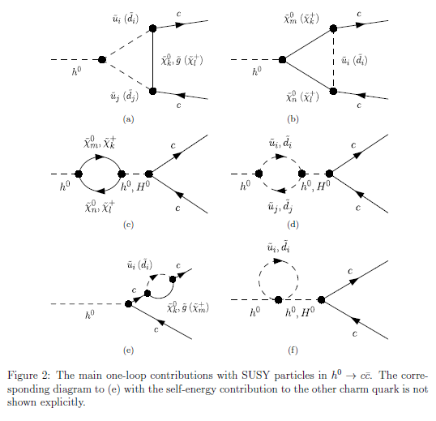
Main one-loop contributions with SUSY particles

Slide 15
The decay width :
~ |M_{inv}|²
= (M ^{tree} + M ^{1-loop} + . . .)* (M ^{tree} + M ^{1-loop} + . . .)
= | M ^{tree} |² + 2 Re(M ^{tree*} M ^{1-loop}) + . . .
Each 1-loop diagram contributes to the width separately
without interfering with each other!
(Note) We include real photon /gluon emissions in the width in order to
cancel the IR divergences.
(Note) We improve gluon loop contribution by including gluonic
contributions. (See Spira, hep-ph9705337)

Slide 16
5. Numerical results
Contour plots of the deviation of the MSSM prediction from the SM prediction
(PDG2014) in plane
mixing parameter
mixing parameter
The MSSM prediction is very sensitive to the
QFV parameters !
- The deviation of the MSSM prediction from the SM prediction can be very
large (as large as ~ - 35%)!

Slide 17
Contour plots of the deviation of the MSSM prediction from the SM prediction
in plane
mixing parameter
mixing parameter
The MSSM prediction is very sensitive to the
QFV parameters !
- The deviation of the MSSM prediction from the SM prediction can be very
large (as large as ~ 20%)!

Slide 18
Contour plots of the deviation of the MSSM prediction from the SM prediction
in plane
mixing parameter
mixing parameter
The MSSM prediction is very sensitive to the
QFV parameters !
- The deviation of the MSSM prediction from the SM prediction can be very
large (as large as ~ - 30%)!

Slide 19
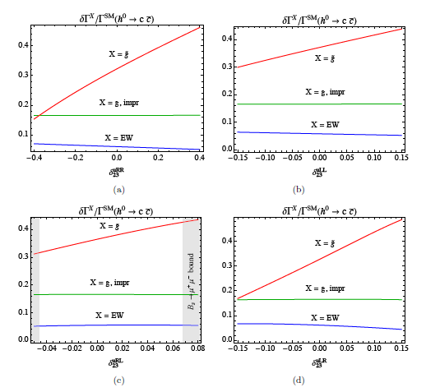
QFV parameter dependences of one-loop , improved g, and EW contributions to
The gluino loop contribution is sensitive to the QFV parameters!
- The gluino loop contribution can be very large (up to 45%)!

Slide 20
Comment on QFC SUSY contributions
If we switch off all the QFV parameters in our benchmark QFV scenario,
then the MSSM prediction becomes nearly equal to the SM prediction!:
The QFC supersymmetric contributions change the width
by only ~ -1.5% compared to the SM value.

Slide 21
7. Theoretical and Experimental Errors
(a) 6%
See; arXiv:1310.8361: Higgs WG Report Snowmass2013
arXiv:1307.1347: Report of the LHC Higgs Cross Section Working Group
arXiv:1311.6721v3: Phys. Rev. D 89 (2014) 033006
arXiv:1404.0319: Lepage-Mackenzie-Peskin
(b) 6%
(for our benchmark QFV scenario)
* uncertainties due to error of charm quark mass : 5.2%
* uncertainties due to error of QCD coupling : 2%
* uncertainties due to errors of the other SM input parameters, such as
, are negligible.
* uncertainties due to renormalization scale Q dependences of the width: 0.5%
(see next plot)

Slide 22
The renormalization scale Q dependence of the MSSM width in the range
The renormalization scale Q dependence of the MSSM width is small;
it results in ~ 0.5% theoretical uncertainties.

Slide 23
(c) 3% (5.6%)
(at ILC (500GeV) with 1600 fb-1 (500 fb-1 ) )
See; ILC Higgs White Paper, arXiv:1310.0763
J. Tian and K. Fujii, PoS(EPS-HEP2013) 316, arXiv:1311.6528
The deviation of the MSSM prediction from the SM width can be very large (as large as ~ 35%) as shown above!
Such a large deviation can be observed at ILC (500GeV),
even if we take into account the theoretical uncertainties
of the predictions!
(Note) A measurement of the width at LHC (even at HL-LHC)
is very difficult due to the difficulty in charm-tagging.

Slide 24
8. Conclusion
- We have calculated the width of the SM like Higgs boson decay
h -> c cbar at full one-loop level (in the DRbar renorm. scheme)
in the MSSM with non minimal QFV.
- The QFV effect (i.e. scharm-stop mixing effect) on the width can be quite large
despite the very strong constraints on QFV from the B meson data.
- The deviation of the MSSM prediction from the SM width can be strongly
enhanced (up tp ~ 35%) by the QFV effect!
- The deviation of the MSSM prediction from SM width can be quite significant
compared with the expected experimental errors at ILC(500GeV),
even if we take into account the theoretical uncertainties of the predictions!
Therefore, we have a good chance to discover
the QFV SUSY effect in this decay h -> c cbar
at ILC!

Slide 25
Our analysis suggests the following:
PETRA/TRISTAN discovered virtual Z⁰ effect for the first time.
Similarly, ILC could discover virtual SUSY effects for the first time!

Slide 26
END

Slide 27

Backup Slides

Slide 28
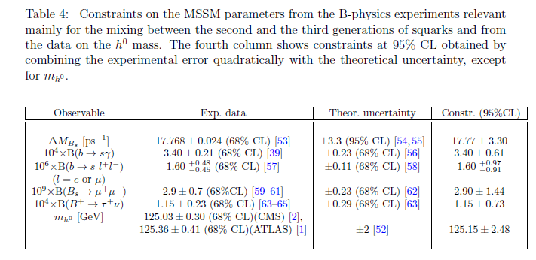
Constraints on the MSSM parameters from B meson data and Higgs boson mass

Slide 29
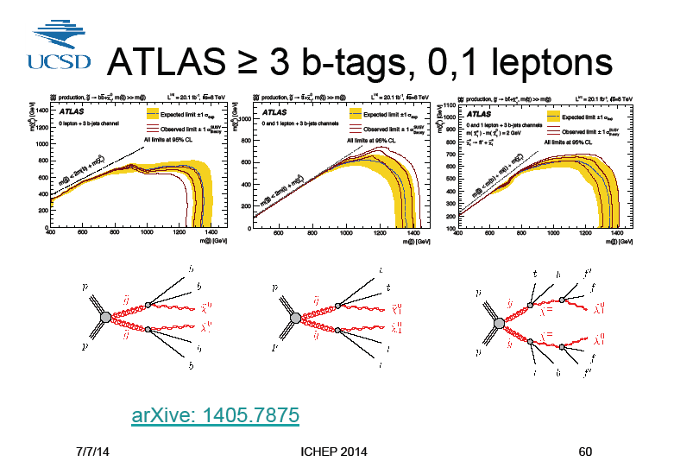
Gluino mass limit from LHC(7/8 TeV)
x
x
x
Our benchmark QFV scenario:

Slide 30
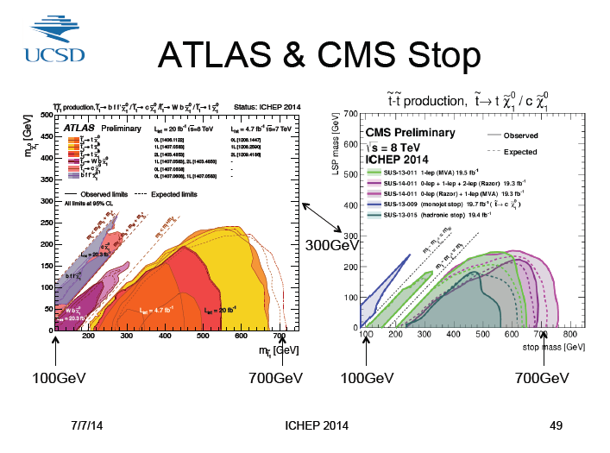
STOP mass limit from LHC(7/8 TeV)
x
x
Our benchmark QFV scenario:

Slide 31
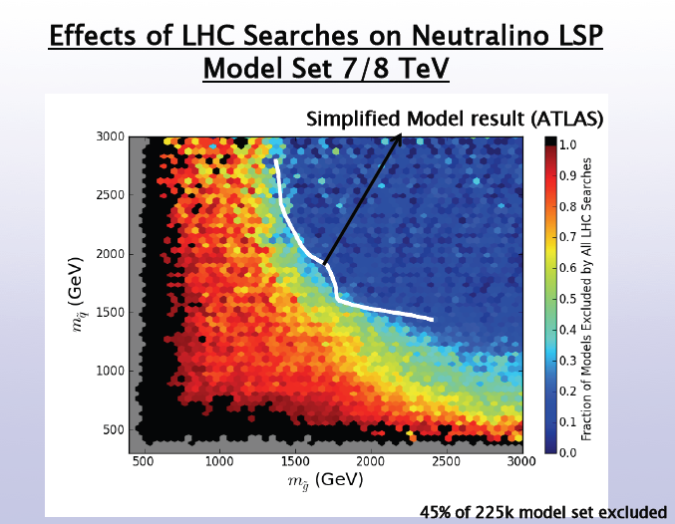
Squark - gluino mass limit from LHC(7/8 TeV)
x
Black area is an excluded region in pMSSM = (MSSM with MFV)
Our benchmark QFV scenario:
= (degenerate mass of 1st & 2nd generation squarks)

Slide 32
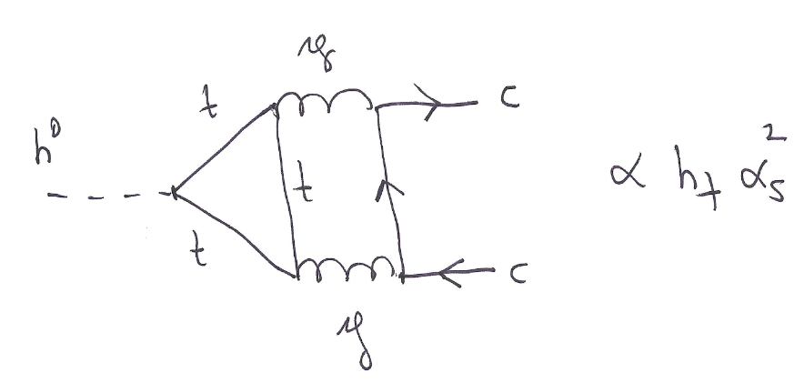
Example of gluonic contributions

