Slide 1
Chip Developments of the Bonn Group
Hans Krüger, Bonn University

Slide 2
ASIC Design Projects
ATLAS Pixel Detector
  Hybrid pixel sensors
    FE-I3 (250nm, current pixel detector)
    FE-I4 (130nm, Insertable B-layer, current upgrade) → done
    FE-x (65nm, future HL upgrade, RD53 collaboration) → work just started
  Fully depleted Active CMOS Sensors (DMAPS)
    Commercial CMOS technology for the sensing layer, monolithic or hybrid → HL upgrade option
Belle II Pixel Vertex Detector (SuperKEKB e+ / e- collider)
  Digital signal processing on pixel module (65nm, DHP chip) → (alomost) done
    1.6GHz PLL
    High speed serial links
    High density digital signal processing
    Low power, high density 10 Msps 8-bit ADC
X-ray imaging (low energy, synchrotron light sources, X-FEL)
  AGIPD (130nm hybrid pixel detector, XFEL@DESY)
  New developments: monolithic or hybrid with active CMOS sensors

Slide 3
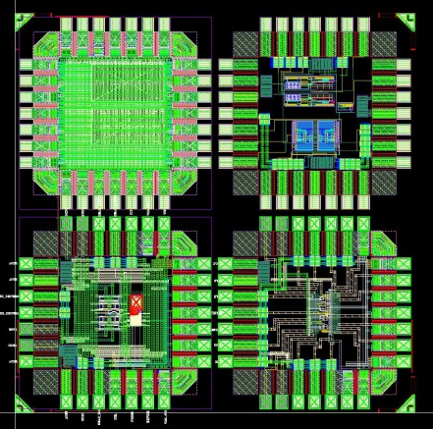
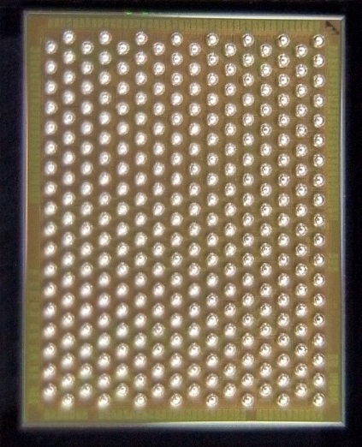
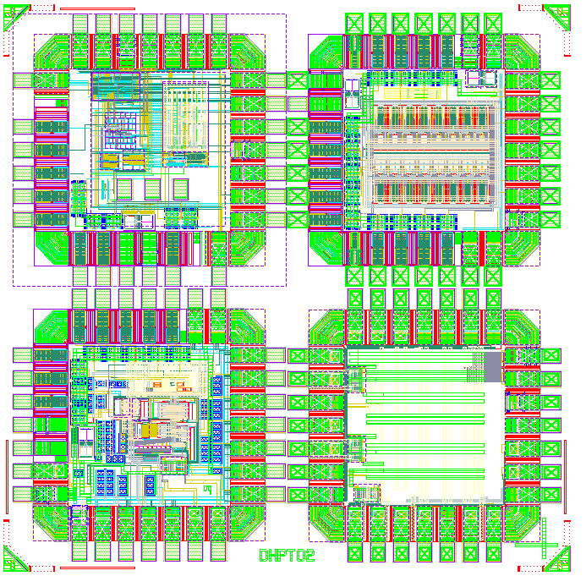
65nm CMOS Design Activities – Belle II
Projects
DEPFET Pixel Vertex Detector for BELLE II (2015)
Data handling processor (DHP), mainly digital design, including full custom blocks:
  PLL (1.6 GHz)
  High speed serial link (1.6 Gbps)
  LVDS IO
„Generic“ (future pixel chips)
  Low power analog front-end (CSA + discr.)
  Low power, small area ADC
  SEU test structures
Chip submissions
DHPT 0.1, four chiplets, Oct. 2011
DHPT 0.2, four chiplets, June 2012
DHPT 1.0
  14 mm² MPW
  C4 bumps

Slide 4
Chip Design Activites – RD53
Focused on 65nm CMOS technology for HL pixel detector upgrades
Joint CMS/ATLAS (+CLIC) development
RD53 collaboration recommended by LHCC June 2013
  Institutes: 17 (+ 3 new applicants)
    ATLAS: CERN, Bonn, CPPM, LBNL, LPNHE Paris, NIKHEF, New Mexico, RAL,
    UC Santa Cruz.
    CMS: Bari, Bergamo-Pavia, CERN, Fermilab, Padova, Perugia, Pisa, PSI, RAL, Torino.
  Collaborators: ~100, ~50% chip designers
  Initial work program covers ~3 years to make foundation for final pixel chips
  Co-spokes persons: ATLAS: M. Garcia-Sciveres, LBNL. CMS: J. Christiansen, CERN
RD53 web: www.cern.ch/RD53/

Slide 5
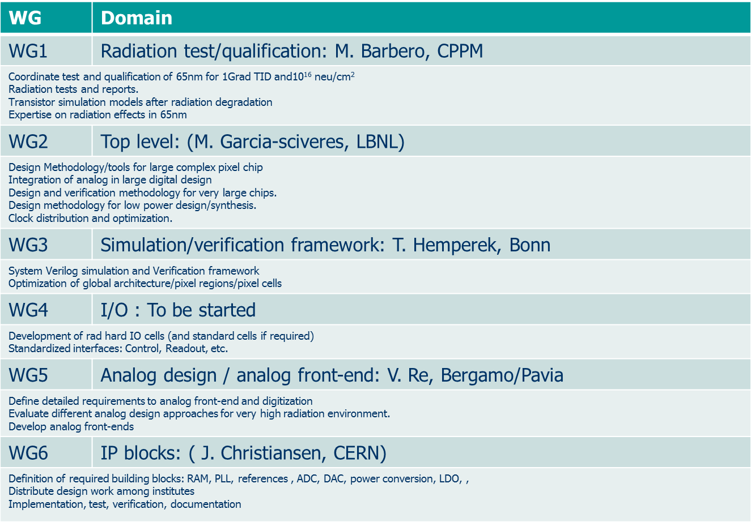
RD53 Working Groups

Slide 6
Backup

Slide 7
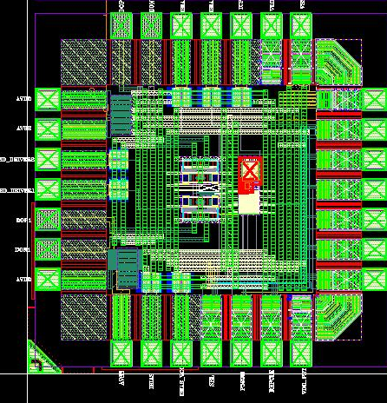
PLL & High Speed Link Driver
PLL
  80 MHz reference clock
  1.6 GHz, 800MHz & 320 MHz outputs
Pseudo random bit sequence generator (8 bit LFSR)
Current mode logic (CML) driver
  Programmable pre-emphasis (first order FIR filter)
  Two differential pairs with adj. bias currents (tap weights a, b)
  Programmable delay dt
PLL_CML Test Chip,
T. Kishishita
320 MHz
CML driver
TXO_P
TXO_N
PLL
320 MHz
CML driver
50 Ω
50 Ω
80 MHz
800 MHz
TX1_P
TX1_N
1.6 GHz
LFSR
pre
drv.
I₀
I₁
del
2
dt
a
b

Slide 8
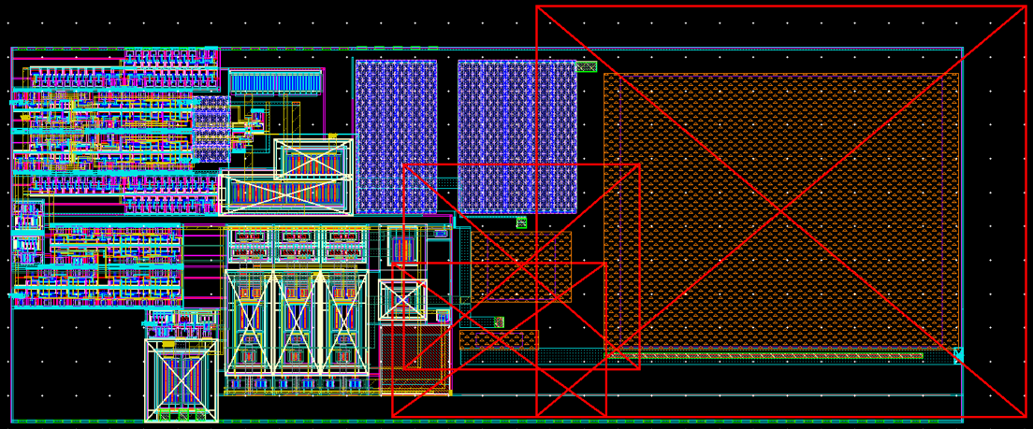
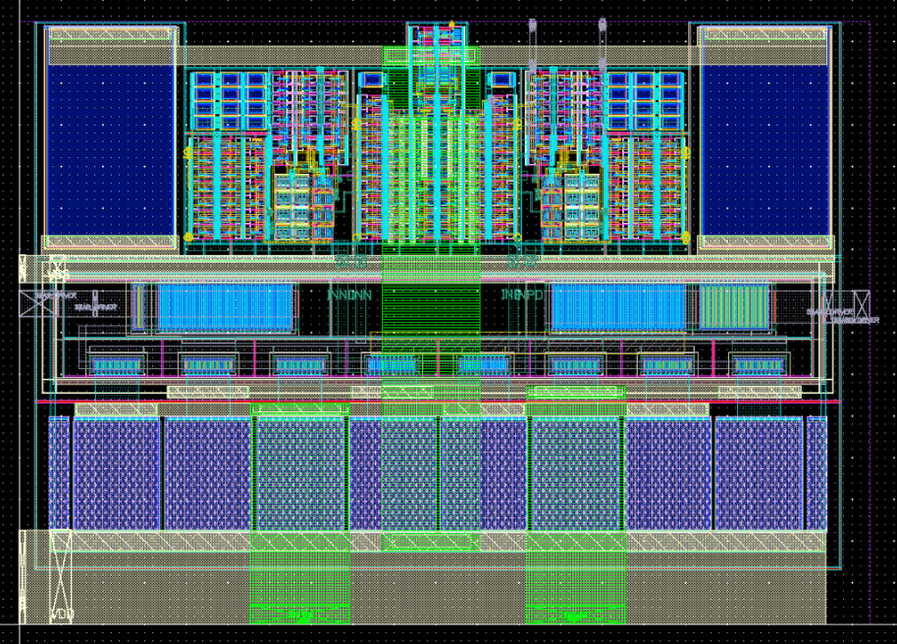
Layouts
140um
CP
PFD
PLL
LPF
55um
DIV
VCO
105 µm
Predriver circuit
Decoupl. C
CML driver
75 µm
poly-res. with dummy structures
T. Kishishita

Slide 9
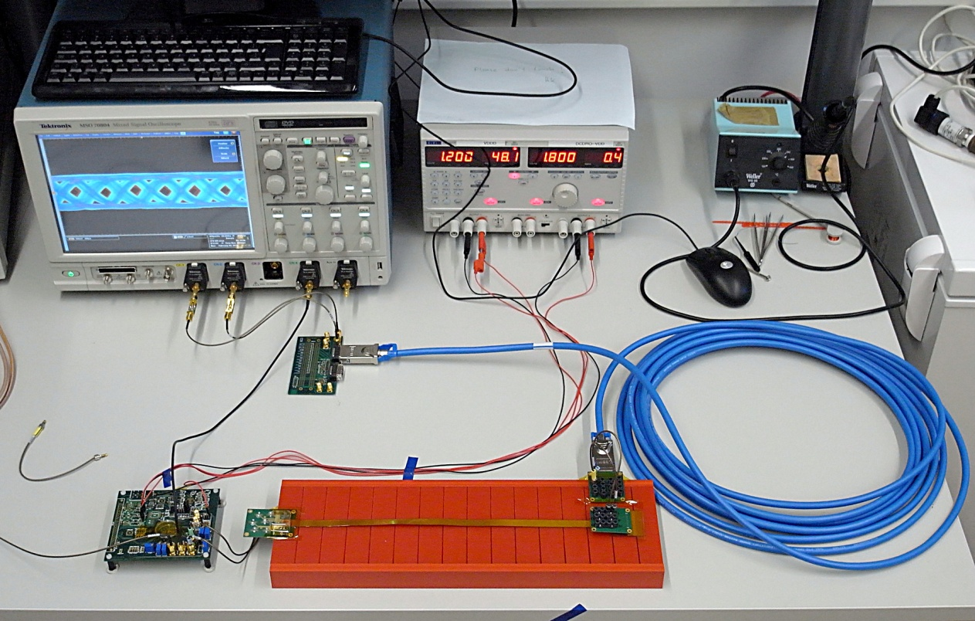
Gbit Link Test Setup
Signal Integrity Analysis
Flex cable, 38cm
TWP cable, 10 (20) m
DHPT 0.1

Slide 10
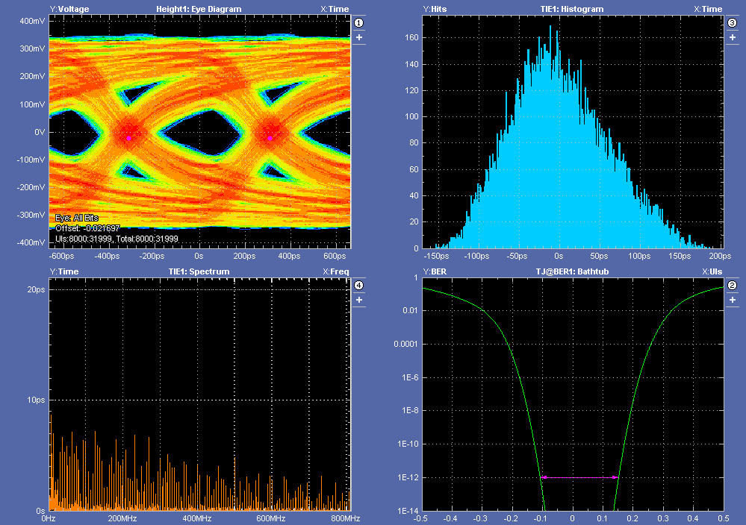
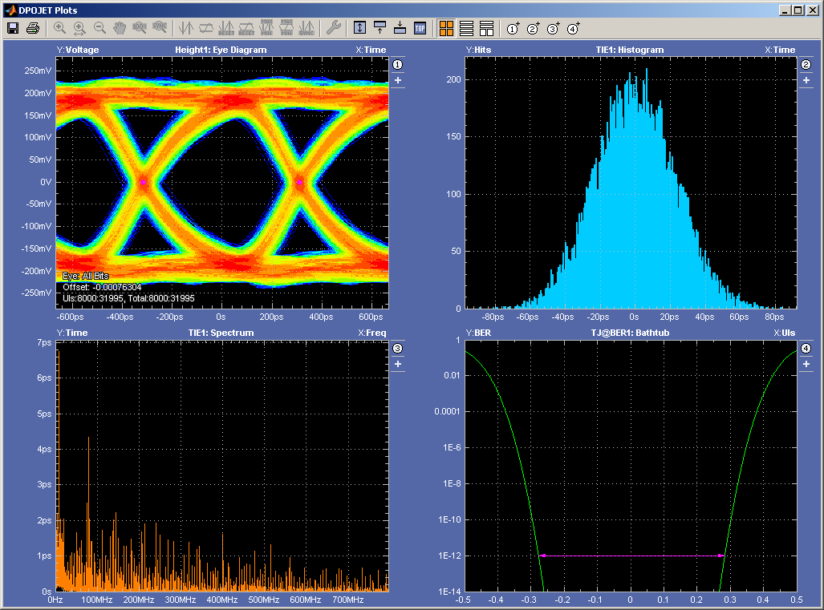
Signal Integrity Analysis
1.6 Gbps, 8bit LFSR sequence
10m Infiniband cable (LEONI, AWG 26)
600 mV
400 mV
Preemphasis off
Preemphasis on (600ps, max. I_{boost})

Slide 11
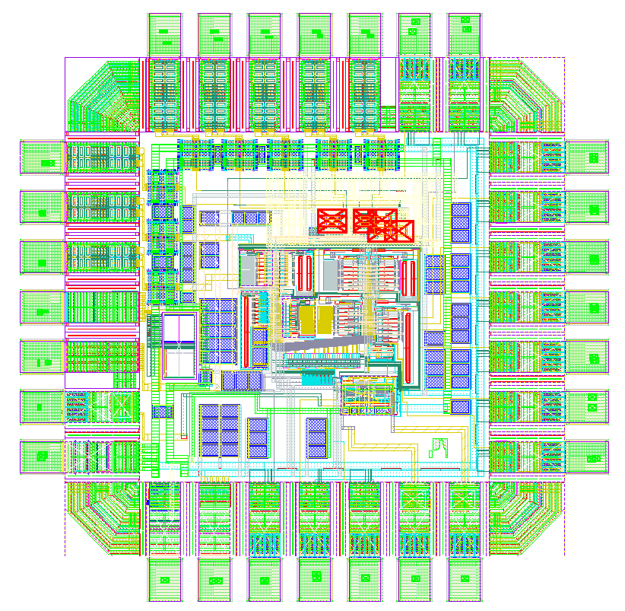
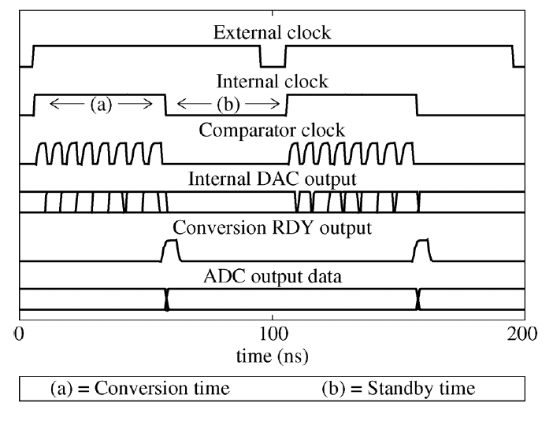
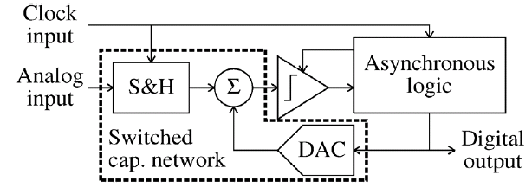
Low Power ADC
8bit ADC
  10 Msps
  Charge redistribution
Asynchronous operation → low power
  No clock distribution needed
  Sample signal triggers digitization sequence
Serial LVDS data out
T. Hemperek, T. Kisisita
Asynchronous ADC timing
Function Diagram

Slide 12
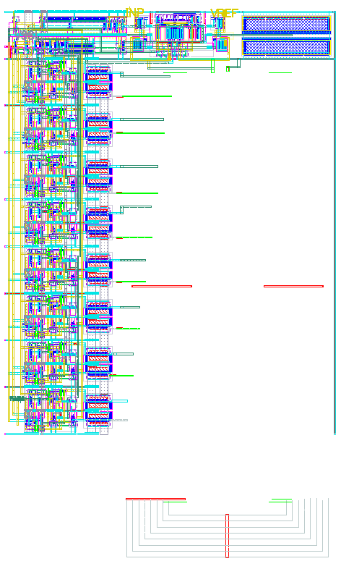
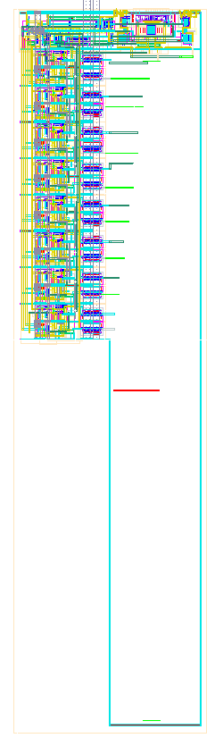
ADC Layout
ADC area dominated by DAC
Switched capacitor DAC layout critical for DNL performance
8 bit ➔ 7 bit: half size
Straight DAC
Folded DAC
40 um
30 um
DAC
DAC
70um
120 um

Slide 13
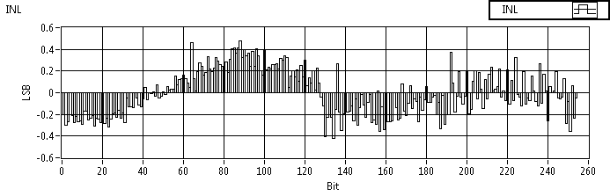
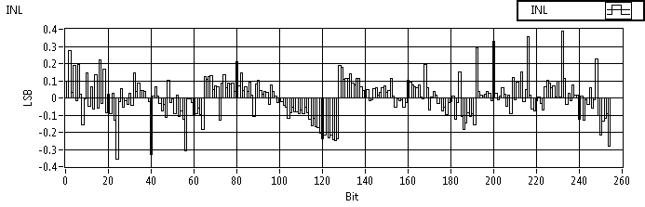
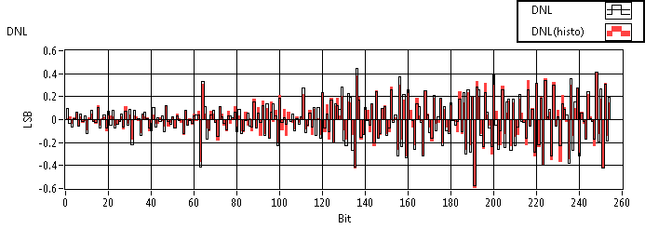
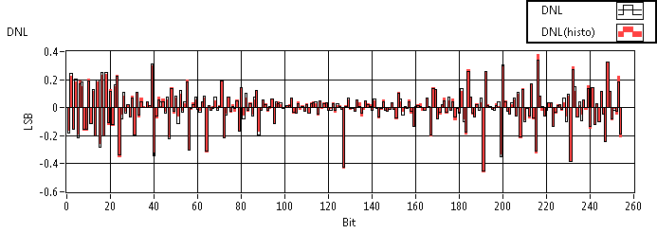
Asynchronous ADC Measurements
Single Ended Mode
Differential Mode
Measured at 10 MHz sample rate
Power consumption: ~40uW
Works up to 12.5 Msps

