Slide 1
BGS WG Summary
Glen White, SLAC
ADI Meeting
Sept. 26, 2014

Slide 2
BDS Lattice Review @ Ichinoseki
½ day discussions during Ichinoseki meeting Sept. 4
Summarised baseline 3.5m/4.5m optics
  FFS optics solutions for both
  SR Collimation studies, EXT loss studies for both
    4.5m collimation considerably tighter than 3.5m
Proposed CR for single-L*
Discussed optimum L* & QF1 positioning
Work ongoing looking at optimum parameters w.r.t. tuning and tolerances etc (e.g. β_{x}* / β_{y}* ratio)
Optics decks being rationalised by MDW
  Error in deck parsing => deck ~30m longer than necessary due to LW chicane definition error
Timing
  Request made to list methods and consequences for removing ~300m from e+ system. Looking into on timescale of LCWS.
Beam loss in EXT
  Losses for high-lumi 1 TeV case look too high >100W in some magnets, >40kW in collimators
X-ing angle
  Brett presented possible more compact QD0 design
  X-ing angle may be reduced to as low as 10 mrad
  No decision to adopt this yet, statement made that CFS flexible at the few 100m level to “re-point” the linacs at a later stage.
FFB kicker / additional IR BPM
  See last slide

Slide 3
Summary of Recent Activity
Preparations for LCWS
  BDS sessions, including parallel sessions with MDI & Beam Dynamics & ATF2, ATF2 TB (Tues, Wed, Thurs parallel sessions)
  8 sessions, 28 presentations
  https://agenda.linearcollider.org/conferenceTimeTable.py?confId=6389#20141007
CR1: Additional dogleg in e- or e+ side
  Presented at CMB meeting Sept. 25 by K. Yokoya
  Decision postponed pending policy discussion RE: mandate considering >1TeV
CR2: Single-L* option for push-pull
  CR formally submitted and accepted to EDMS
  CMB meeting Sept. 25
    Generally agreed upon, still in process pending design work by ILD
    Provisionally assuming a common L* = 4m
Baseline design work for 3.5,4,4.5m L* optics
  Optics design, collimation, EXT solution, beam dynamics
  Ongoing work to find optimal parameters (tunability, tolerances…)
  Deck preparation

Slide 4
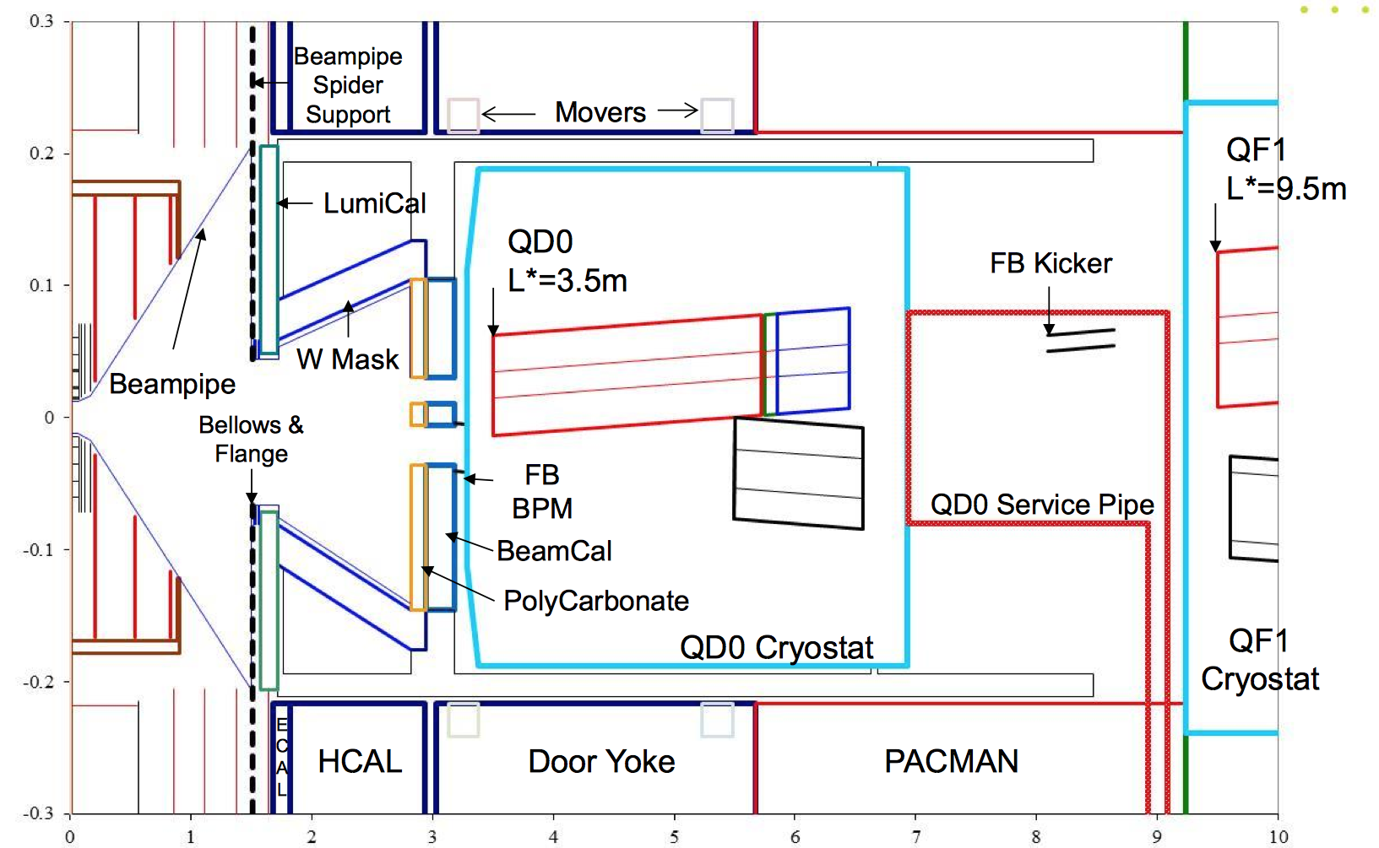
Possible Future CR: IR Layout with Additional BPM and Moved FFB Kicker
Additional BPM would provide “virtual IP” orbit readout useful for BBA
Moving FFB kicker in front of QD0 opens up FFB dynamic range and greatly relaxes QD0 jitter tolerance
  (Does not kick through SD0)
+ “IPBPM”

