Slide 1
IP BPM resolution study
N. Blaskovic

Slide 2
Introduction
Following IP BPM meeting, new IP BPMs will be not be installed before November
Suggested plan for IP BPM resolution study in October:
  Two electronics on one BPM study
  Two BPM resolution study exploiting small focal point and large expected position correlation between IPB and IPC
N. Blaskovic

Slide 3
Propagation to IP
P2 and P3 positions can be propagated to the IP waist using the MAD linear transfer matrices
The propagated jitter at the waist is 9 nm
A longitudinal waist shift of 2 mm leads to a 200 nm increase in jitter
The jitter at IPB and IPC is 8 um using standard optics
N. Blaskovic

Slide 4
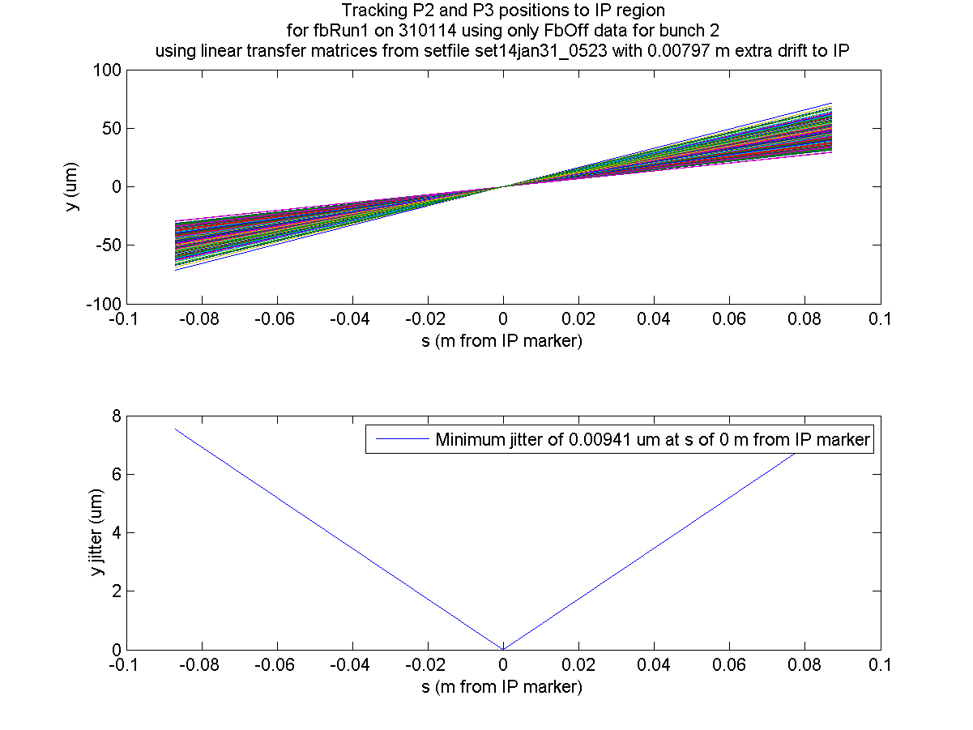
IPB
IPC
IPB
IPC
N. Blaskovic

Slide 5
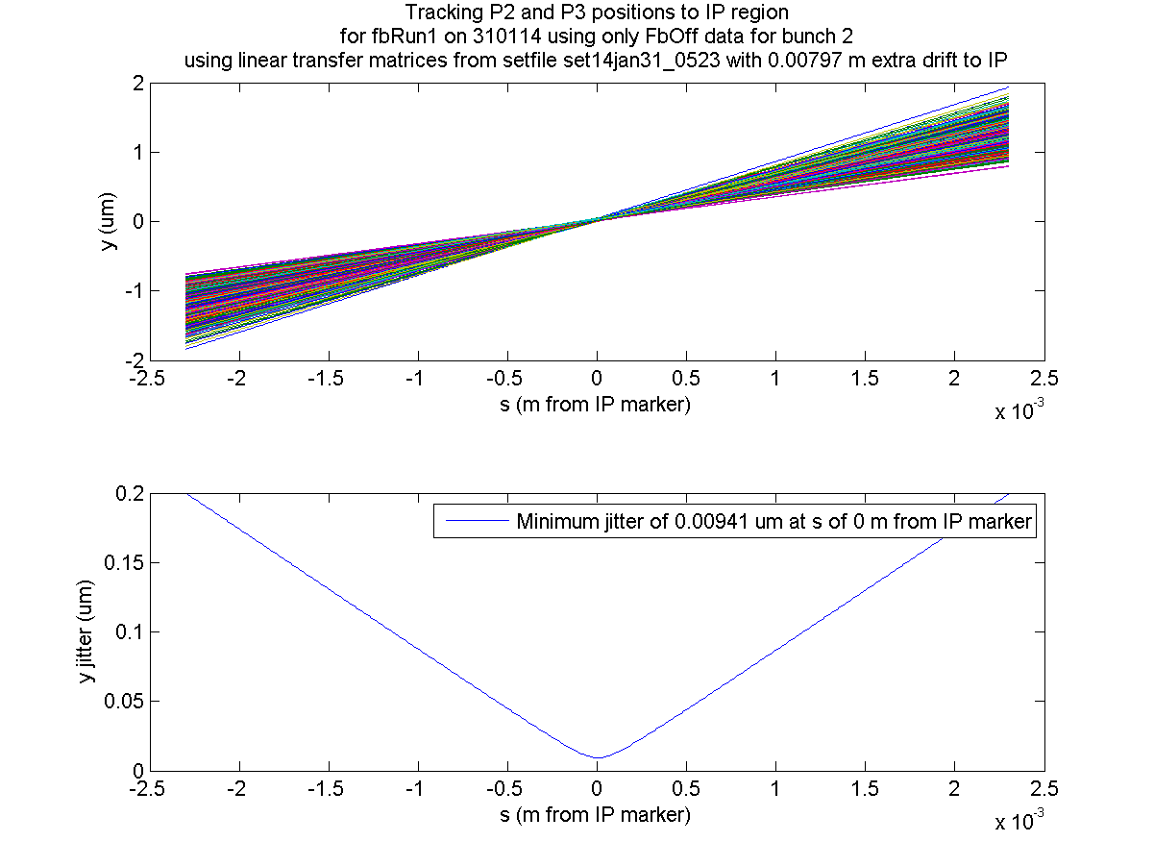
Jitter: 200 nm
Jitter: 200 nm
N. Blaskovic

Slide 6
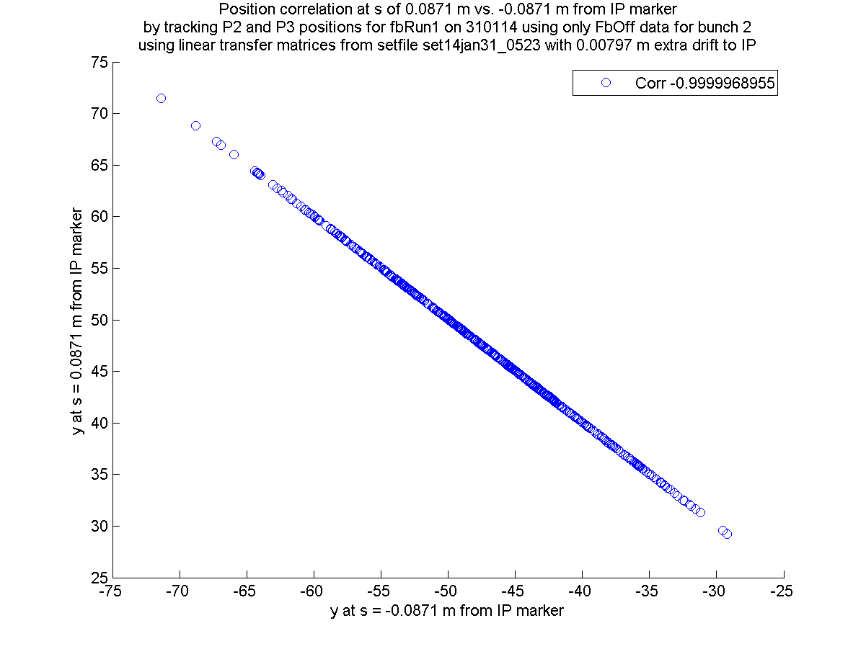
99.999997 %
(IPC)
(IPB)
N. Blaskovic

Slide 7
Simulation
IPB and IPC positions can be propagated from P2 and P3 using model
Interpolate IPB and IPC positions from model to obtain IP jitter, then repeat by:
  Adding resolution (uncorrelated measurement errors) to IPB and IPC
  Adding correlated jitter to IPB and IPC (simulating beam jitter over 9 nm or correlated measurement errors)
N. Blaskovic

Slide 8
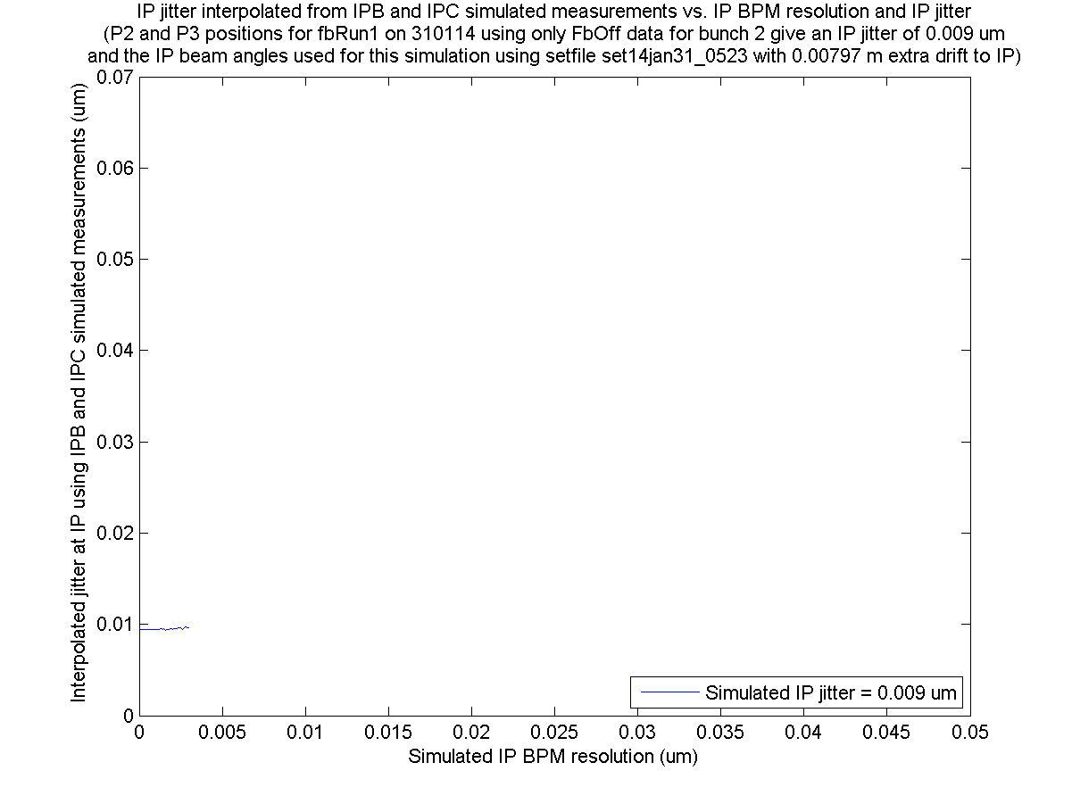
Model jitter
Perfect resolution
N. Blaskovic

Slide 9
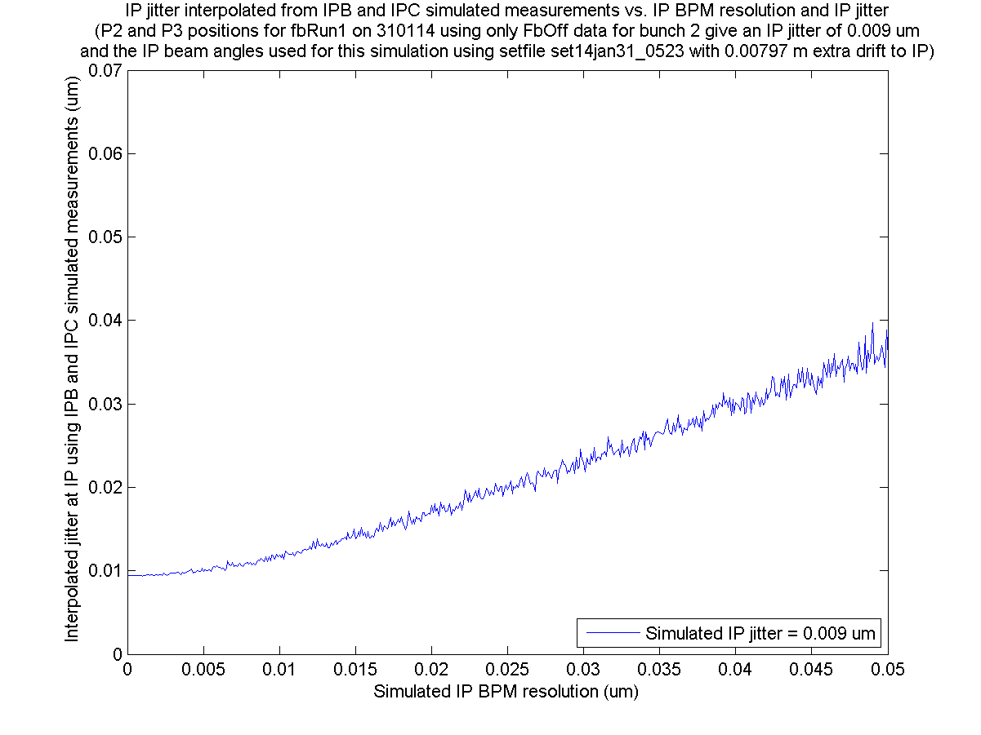
Model jitter
N. Blaskovic

Slide 10
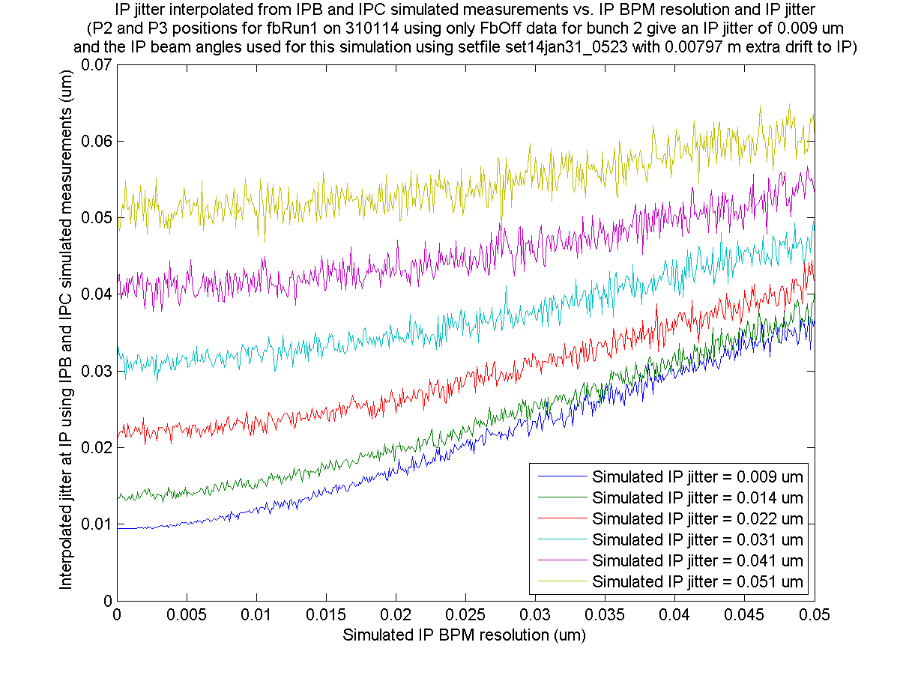
N. Blaskovic

Slide 11
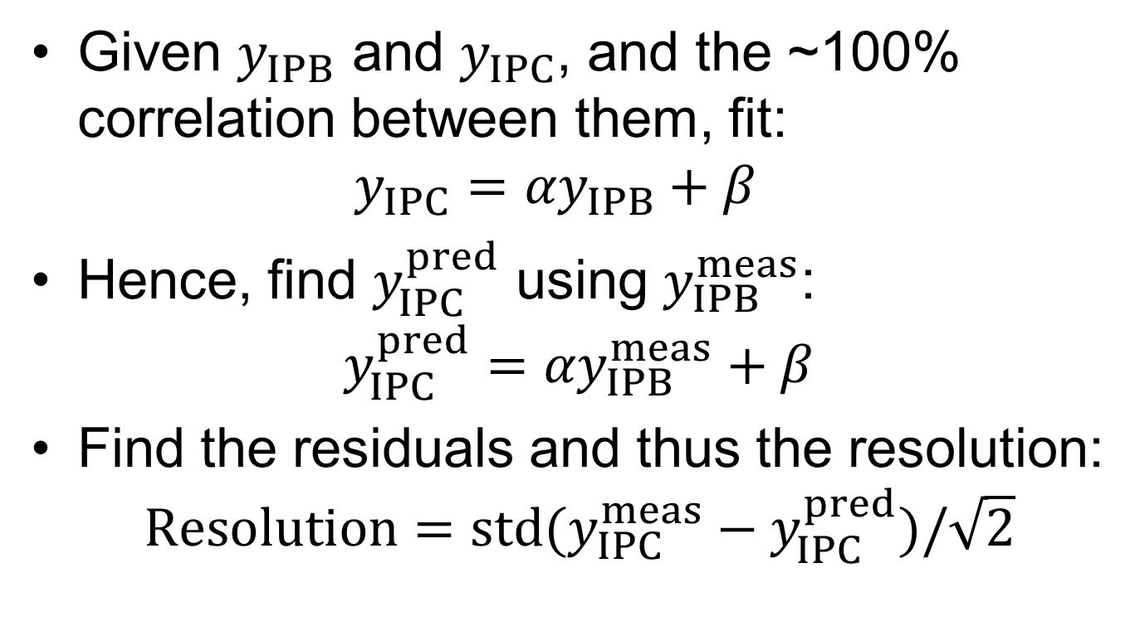
Resolution
Given $y_{IPB}$ and $y_{IPC}$, and the ~100% correlation between them, fit:
$y_{IPC}={αy}_{IPB}+β$
Hence, find $y_{IPC}^{pred}$ using $y_{IPB}^{meas}$:
$y_{IPC}^{pred}={αy}_{IPB}^{meas}+β$
Find the residuals and thus the resolution:
$Resolution=std(y_{IPC}^{meas}−y_{IPC}^{pred})/\sqrt{2}$
N. Blaskovic

Slide 12
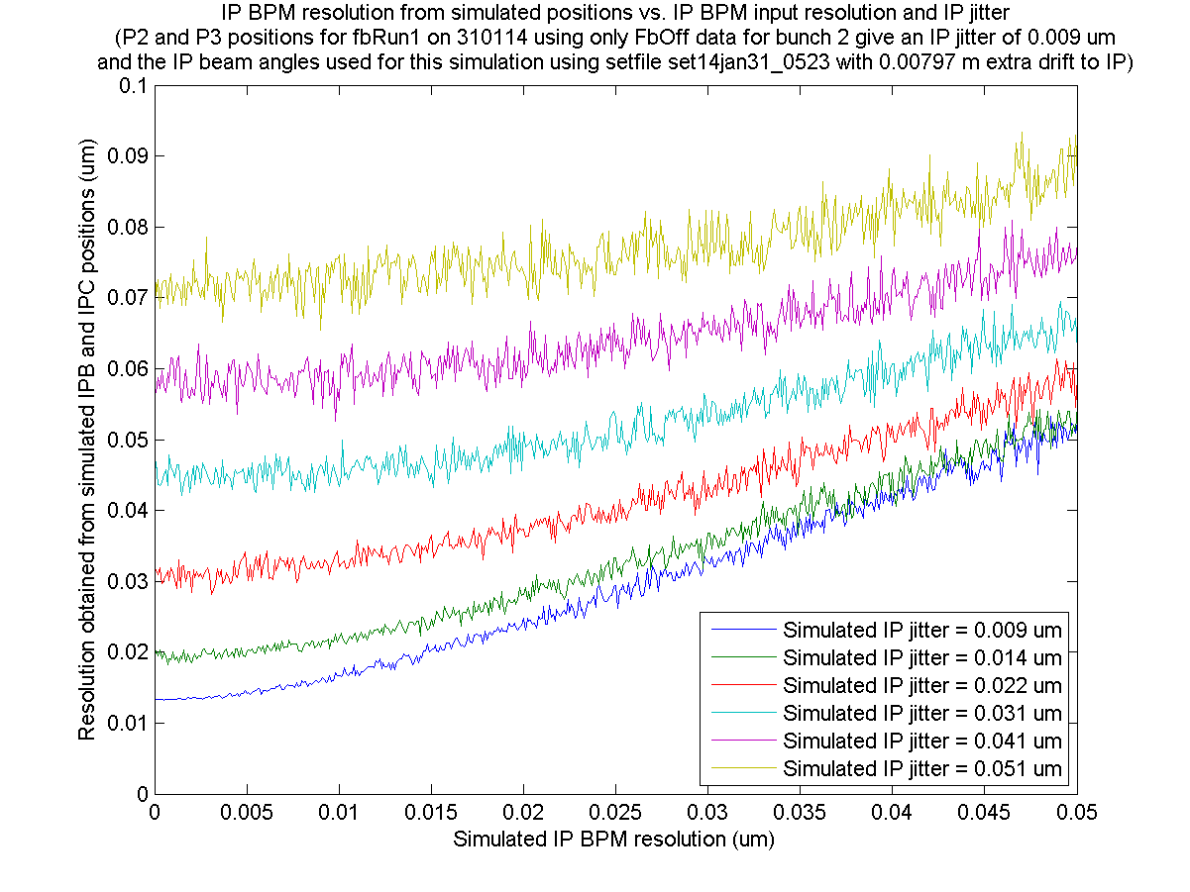
N. Blaskovic

Slide 13
2-BPM resolution limitations
Correlated sources of error remain undistinguishable from beam jitter
Requires working with ~um beam jitters
Assumes ballistic beam transport in IP area
N. Blaskovic

Slide 14
Appendix
Code for addition of correlated and uncorrelated sources of error, and interpolation of IP position from positions at IPB and IPC

Slide 15
% yA(TriggerIndex,1) and yB(TriggerIndex,1) obtained by
% propagating P2 and P3 positions to IP area (IPB and IPC)
% Add extra correlated jitter to yA and yB:
OffsetDueToCorrelatedJitter =
ExtraCorrelatedJitter*randn(NumberOfTriggers,1);
yA = yA + OffsetDueToCorrelatedJitter;
yB = yB + OffsetDueToCorrelatedJitter;
% Add measurement error to yA and yB:
yA = yA + ResolutionA*randn(NumberOfTriggers,1);
yB = yB + ResolutionB*randn(NumberOfTriggers,1);
% Calculate position at mid-point between A and B:
yM = mean([yA yB], 2);
% Calculate jitter at mid-point between A and B:
jM = std(yM);
N. Blaskovic

