Slide 1

Future Perspective
Andy White
University of Texas at Arlington
for the SiD Consortium

Slide 2
SiD/ILC Status
The ILC project has been endorsed (EU Strategy, ACFA, Snowmass, P5) as a major future HEP project.
We have an accelerator design that will deliver the required luminosity – at a range of energies.
We have a SiD detector design that can deliver the physics.
However, we still face a challenging period while the negotiations take place.
We must use this period to move SiD forward and position ourselves for an eventual real experiment.

Slide 3
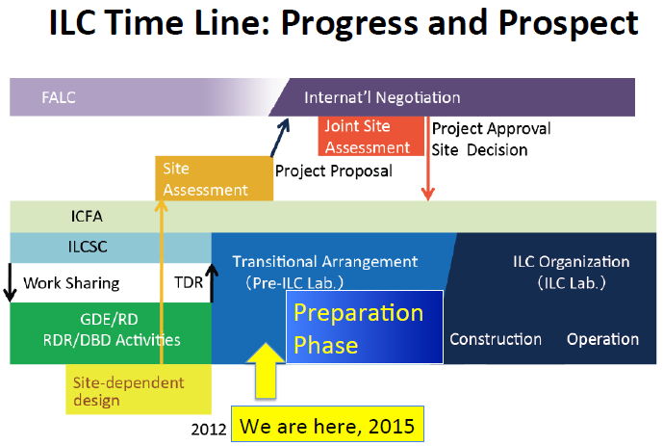
Akira Yamamoto

Slide 4
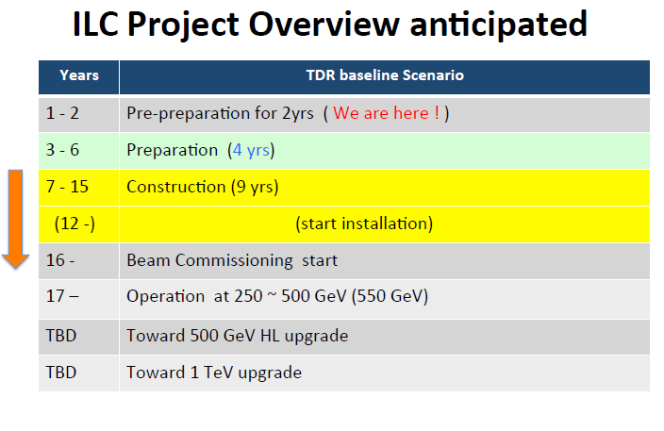
Akira Yamamoto

Slide 5
What’s next?
SiD 3-5 year goals include:
⬇ Optimization of the detector (physics and detector studies by physicists with input of engineering realities) –
SiD Optimization meetings take place every week – please join in and offer your ideas!
⬇ Further benchmark studies as new ideas/new LHC results emerge (by physicists, with support for computing services)
⬇ Detector prototype R&D completion (physicists, technicians; will require a budget)
⬇ Ramp up towards a TDR with subsystem engineering and detector integration(physicists and engineers at a minimal level to begin, increasing with time)

Slide 6
What’s next for SiD
We invite you to contribute to the planning for the next steps:
- Offer your ideas for optimization of the SiD design
- New technologies ??
- Involve students/postdocs in short/medium term detector and physics studies
- Be prepared to discuss new ideas with new people joining SiD
- Contribute to the preparation of resource requests for the TDR
- Connect to the SiD General meetings
- Connect to the Institutional Board meetings
- Offer your ideas for the SiD organization moving forward
- Give talks and talk to your colleagues about ILC and SiD !

Slide 7
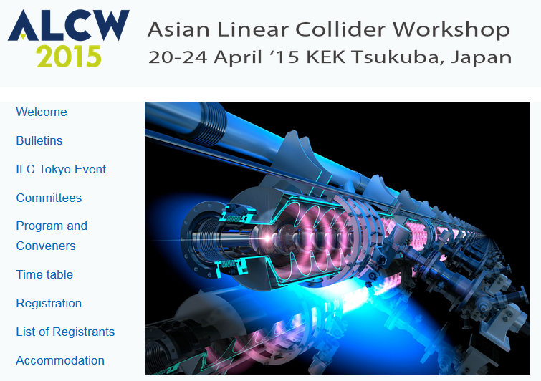

Slide 8
Conceptual Time Table: ver 2014.12.18
Tokyo event
 | 4/19(Sun) | 4/20(Mon) | 4/21(Tue) | 4/22(Wed) | 4/23(Thu) | 4/24(Fri) | 4/25(Sat)
Morning |  | Registration | Acc/Phys/R&D |  | Acc/Concept | Acc/Concept | Reserved
 |  | Opening
 |  | Acc/Phys/R&D |  | Plenary @Tokyo
Afternoon | Reserved |  | Acc/Phys/R&D | Symposium | Acc/Concept | Acc/Concept
 |  | Acc/Phys/R&D
 |  |  | Plenary
 |  |  |  |  | Plenary | Closing Plenary
 |  |  | Reception | Food Festa

Slide 9
4/19 (Sun) | 10:00-12:00 |  |  | CALICE
 |  | Lunch
 | 13:00-15:00 | LOC Preparation and Registration |  | CALICE
 |  |  |  | break
 | 15:30-18:00 |  |  | CALICE
4/20 (Mon) | 8:30-9:30 | Registration
 | 9:30-10:30 | Opening ( Welcome + Guidance )
 |  | break
 | 11:00-12:30 | Physics | MDI | CALICE
 |  | Lunch
 | 14:00-15:30 | Physics | MDI | CALICE | LCTPC |  | ACC1 | ACC1 | ACC1
 |  | break
 | 16:00-18:00 | Physics | MDI | CALICE | LCTPC | Vertex&Silicon | ACC1 | ACC2 | ACC3
4/21 (Tue) | 9:00-10:30 | Physics | MDI | CALICE | LCTPC | Vertex&Silicon | ACC1 | ACC2 | ACC3
 |  | break
 | 11:00-12:30 | Physics | MDI | CALICE | LCTPC | Vertex&Silicon | ACC1 | ACC2 | ACC3
 |  | lunch
 | 14:00-15:00 | Physics | MDI | CALICE | LCTPC | Vertex&Silicon | ACC1 | ACC2 | ACC3
 |  | break
 | 15:30-17:30 | Plenary - 2 ( Reports from LCB, ICFA, Status in Japan and panel discussion )
 | 17:30-18:30 | Reception
4/22 (Wed) | 8:00 | Bus to Tokyo
 | 10:30-12:15 | Plenary - 3 ( reports on LCC, ILC Acc, LCC Phys.&Det, & Physics talk )
 |  | lunch
 | 14:00-17:30 | ILC Tokyo Event (Symposium)
 | 17:30-19:30 | ILC48 Food Festa
 | 20:00-22:00 | Return to Tsukuba
4/23 (Thu) | 9:00-10:30 | Physcs+ILD+SiD joint |  |  |  |  | ACC1 | ACC2 | ACC3
 |  | break
 | 11:00-12:30 | ILD | SiD |  |  |  | ACC1 | ACC2 | ACC3
 |  | lunch
 | 14:00-16:30 | ILD | SiD |  |  |  | ACC1 | ACC2 | ACC3
 |  | break
 | 17:00-18:00 | Plenary - 4 (Physics & MDI summary , etc.)
4/24 (Fri) | 9:00-10:30 | ILD |  |  |  |  | ACC1 | ACC2 | ACC3
 |  | break
 | 11:00-12:30 | ILD |  |  |  |  | ACC1 | ACC2 | ACC3
 |  | lunch
 | 14:00-16:30 | ILD |  |  |  |  | ACC1 | ACC2 | ACC3
 |  | break
 | 17:00-18:00 | Closing
ALCW2015
Detailed program

Slide 10
ILC Tokyo event
Title(draft): International Linear Collider Tokyo Event
-subtitle: Recipe for Discovery or The Best Recipe for Discovery
14:00 –17:30 April 22 (Wed. ) Ito Hall, The University of Tokyo
Draft Program 3.5 hours
  Introduction Lyn Evans 15min.
  Hiroya Masuda（Japan Policy Council） 45min.
  Break 15min
  Panel Discussion 75 min.
    Moderator Hitoshi Murayama
    Panelists
      Lockyer, Mnich, Bagger (As of Jan. 9, Positive answers from Mnich , Bagger)
      Hiromi Yokoyama
      ALCW participants
  Messages 40min.
    Diet member
    MEXT
    Embassies
    new KEK DG
  Summary 20min.
    Hiroshi Murayama
Mylinearcollider videos
  Before session, break

Slide 11
ALCW2015
Detailed program
Plenary 1 (Mon 9:30-10:30) Welcome and Guidance
Plenary 2 (Tue 15:30-17:30) Reports from LCB, ICFA, Status in Japan and panel discussion
Plenary 3 (Wed 10:30-12:15 in Tokyo)
Reports on LCC, ILC Acc, LCC Phys.&Det
Physics talk covering HEP at large
Plenary 4 (Thu 17:00-18:00) Physics & MDI summary, etc.
Plenary 5 (Fri 17:00-18:00) Closing

Slide 12
Registration is now OPEN – please register!
Early registration ends on March 22

Slide 13
Thank you
For attending and your participation !
To all those who gave talks/chaired sessions !
To our SLAC colleagues who organized the meeting !
We hope to see many of you in Japan in April !

