Slide 1


Digital Hadron Calorimetry using Gas Electron Multipliers
Andy White
University of Texas at Arlington

Slide 2
Digital Hadron Calorimetry using Gas Electron Multipliers
Overview
GEM/DHCAL basics
Review of GEM/DHCAL developments
Results to date
Plans
ThickGEM/DHCAL
THGEM structures
Recent results/CERN test beam

Slide 3
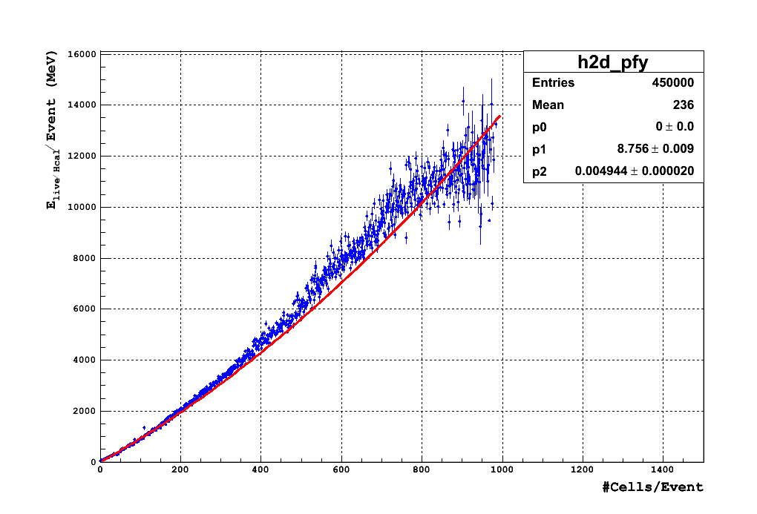
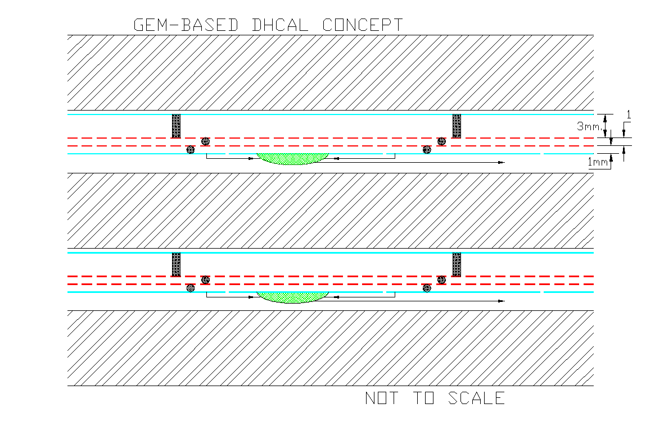
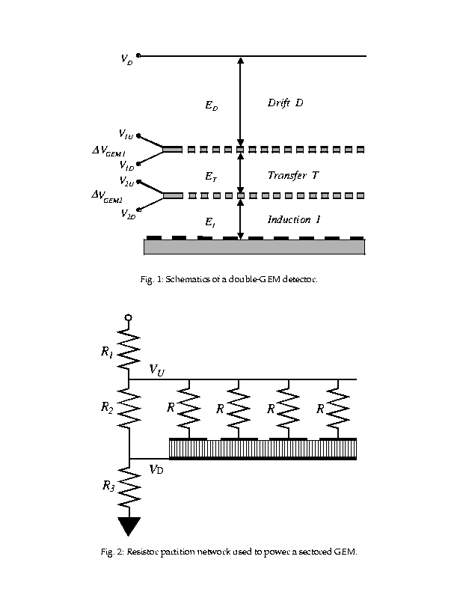
GEM-based Digital Calorimeter Concept
Use Double GEM layers to minimize gap size
N_{max}∝E₀
{
~6.5mm
-2100V
∆V ~400V
∆V ~400V
0V

Slide 4
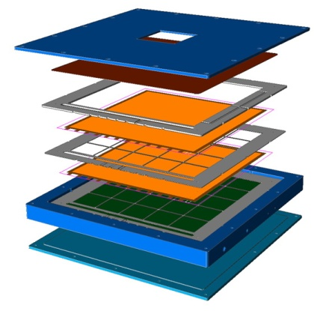
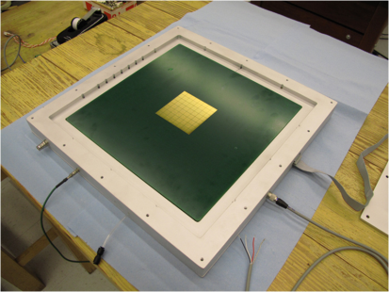
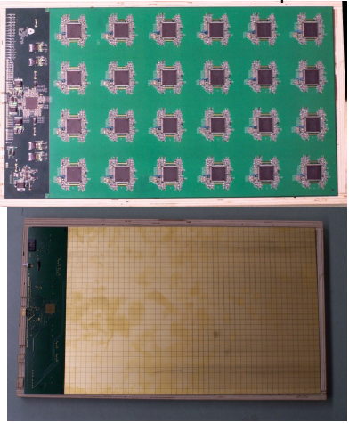
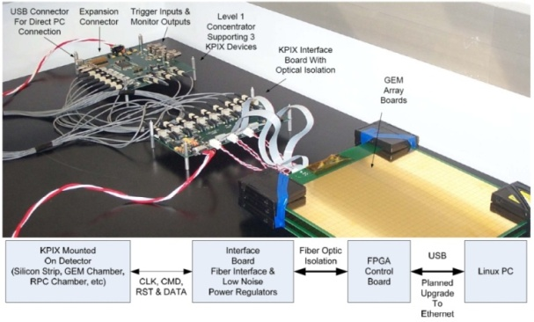
30x30 prototype GEM chamber and Readout Electronics
GEM Foils(3M)
Chamber
310x310 mm²
Active area : 280x280 mm²
Active gas volume
350x350x6 mm³
→ For 3/1/1 gaps
Readout channels: KPIX(64), DCAL(256)
64-readout pads(KPIX)
KPiX readout system/SLAC
  13 bit resolution(ADC)
  Handles 1024 channels/chip,
  3 gain ranges
  Normal gain
DCAL readout system/ANL
  1 bit resolution(ADC)
  64 channels/chip
  2 gain ranges
  High gain for GEMs (10 fC~200 fC signals)
  Low gain for RPCs (100 fC~10 pC signals)
FE board
Pad board
Readout systems

Slide 5
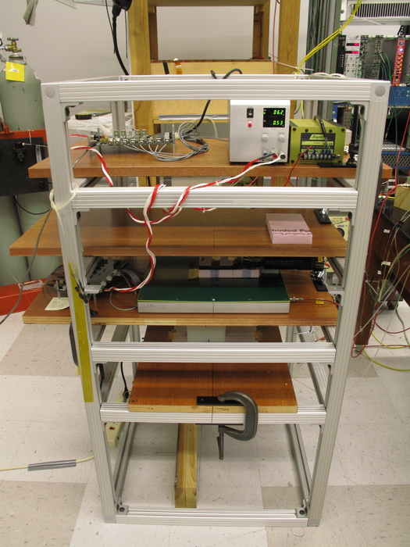
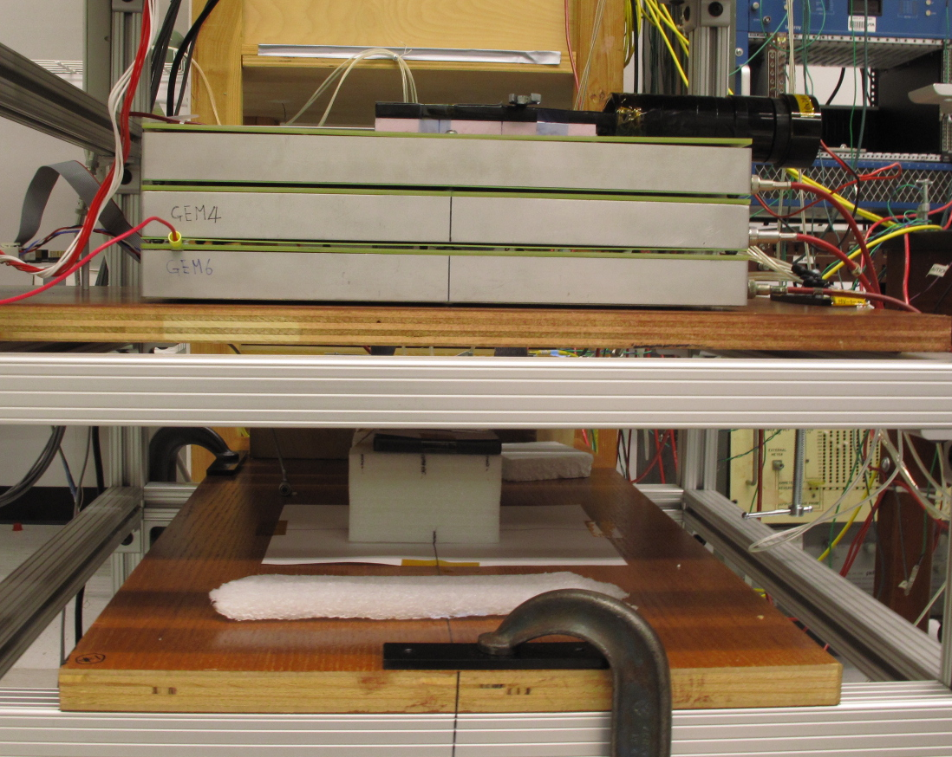
UTA GEM-DHCAL Cosmic Test Stand
KPiX FPGA board
Trg counter1
DCAL chamber 1
KPiX Interface board
DCAL chamber 2
KPIX chamber
Trg Counter2

Slide 6
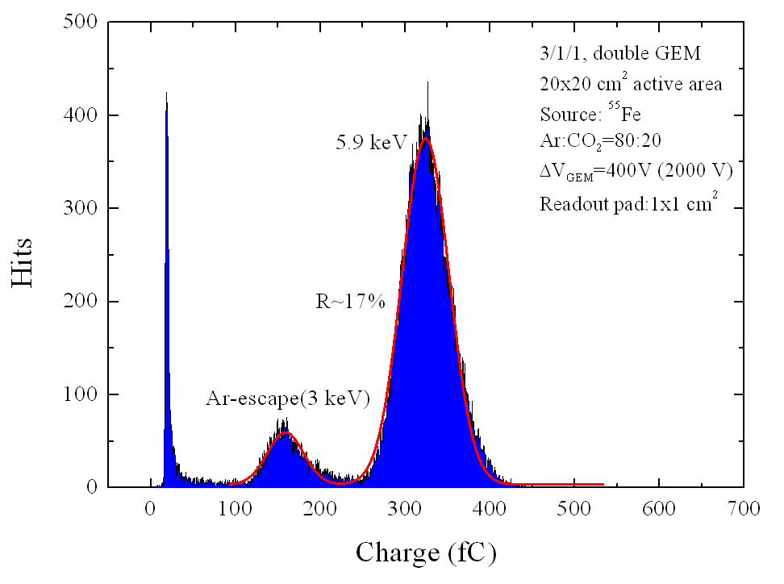
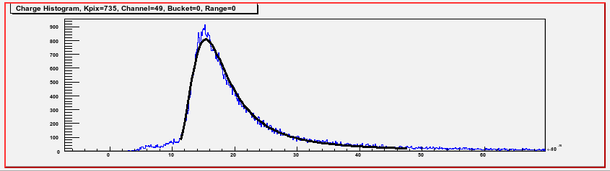
GEM+KPiX7 Fe⁵⁵ and Ru¹⁰⁶ Spectra
Fe⁵⁵
Ru¹⁰⁶
Good conformation to characteristic Minimum Ionizing Landau fit

Slide 7
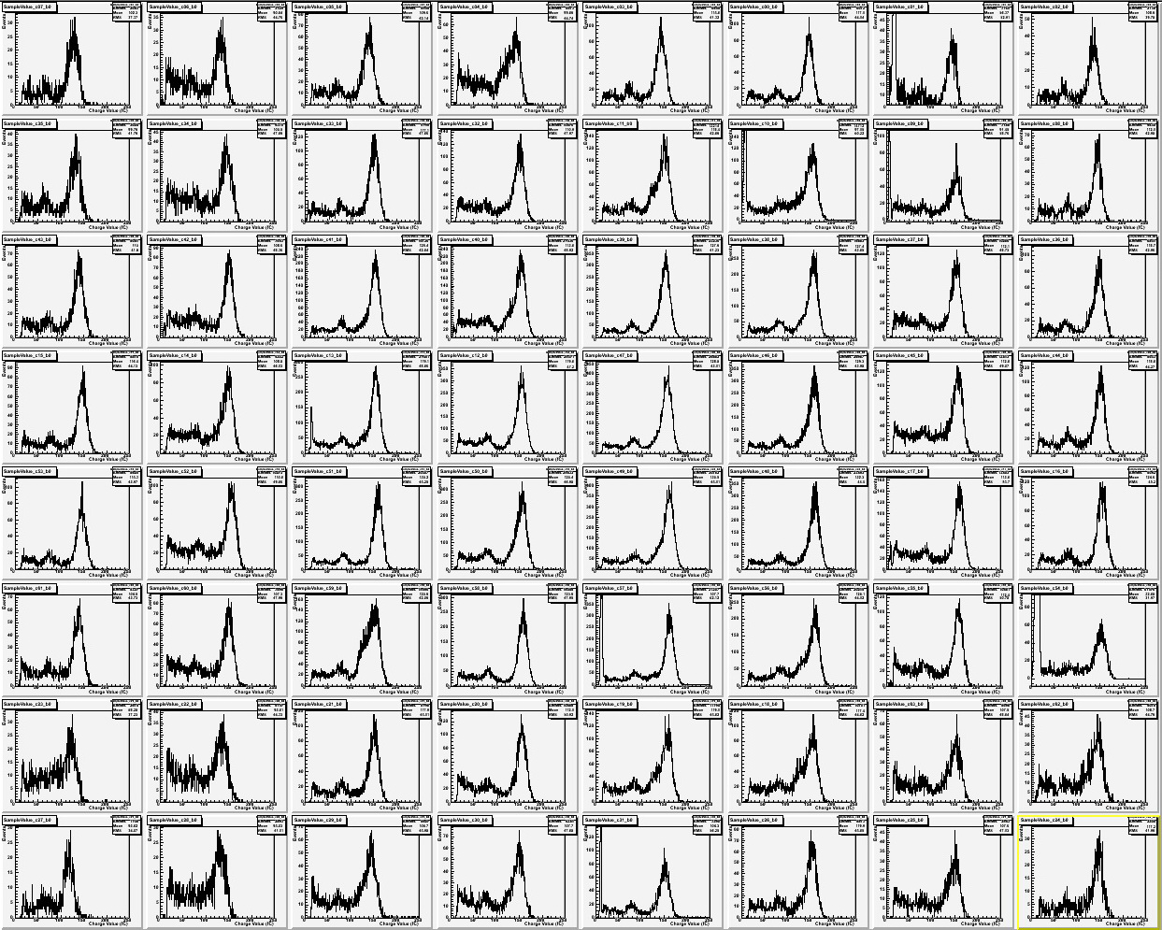
HV=1950V, Fe55, ST=1.8V=14 fC
2009_11_18_10_20_49
7

Slide 8
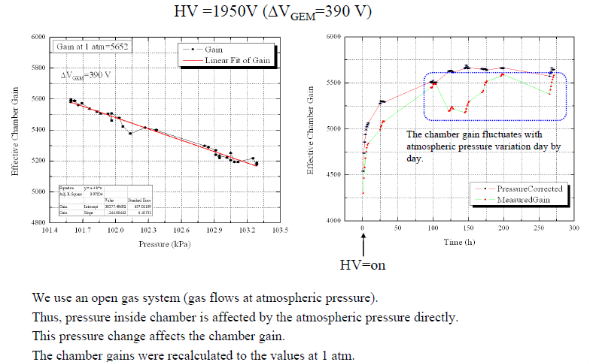
Pressure Dependence of Gain

Slide 9
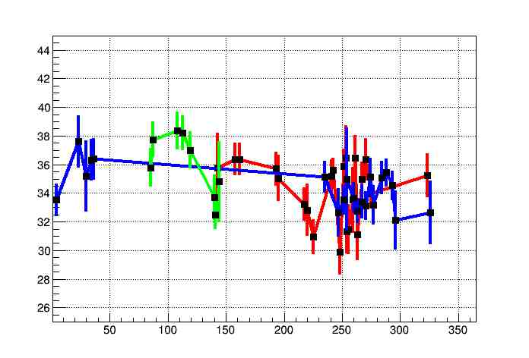
Study the seasonal change of GEM detector gain.
Red: 2012, blue: 2013, green:2014
Mean signal (fC)
Yvonne Ng – UTA Student
Days

Slide 10
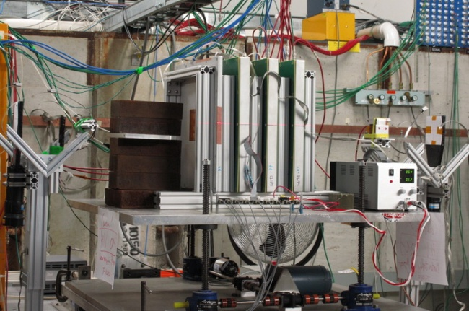
T-1010 Experiment Setup

Slide 11
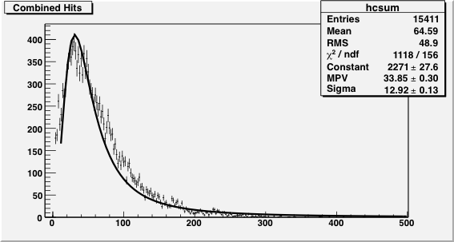
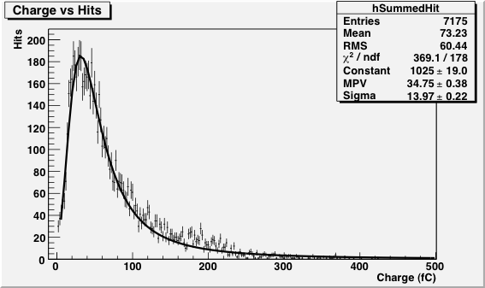
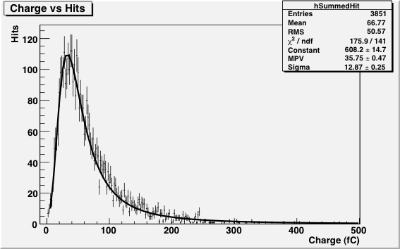
GEM Response with KPiX
Particle: Muon
High Voltage: 1950V
Energy: 32 GeV
Trigger: 10x10cm²
Particle: Proton
High Voltage: 1950V
Energy: 120 GeV
Trigger: 2x2cm²
Results pressure corrected
Particle: Pion
High Voltage: 1950V
Energy: 32 GeV
Trigger: 2x2cm²

Slide 12
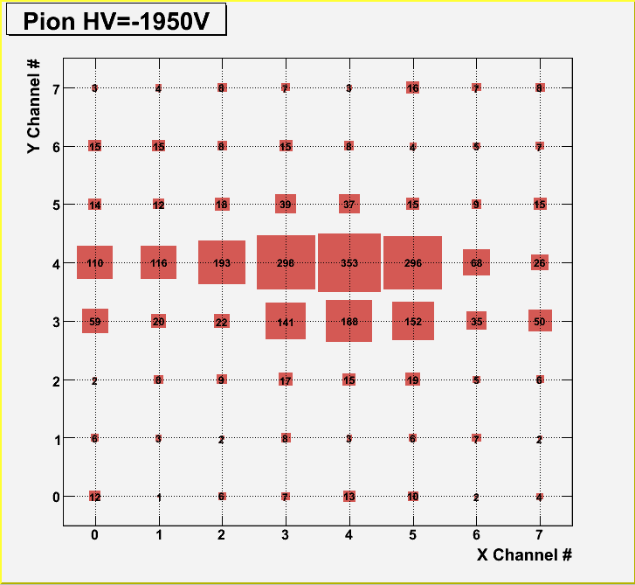
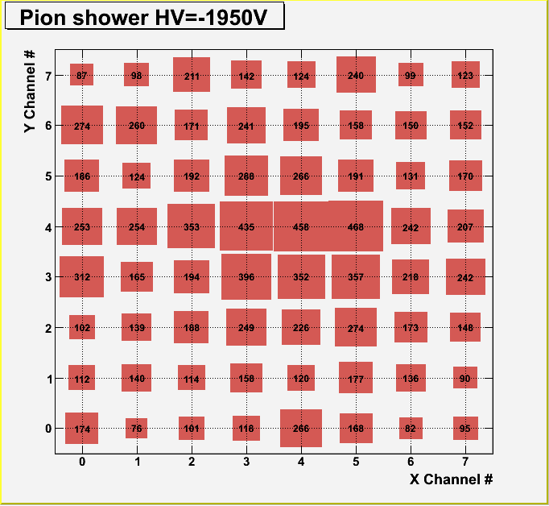
Hit Map for Pions vs Pion Showers (KPiX)
Hits above 5fC were counted and normalized to 1000
Demonstrates the KPIX capability to take many hits simultaneously

Slide 13
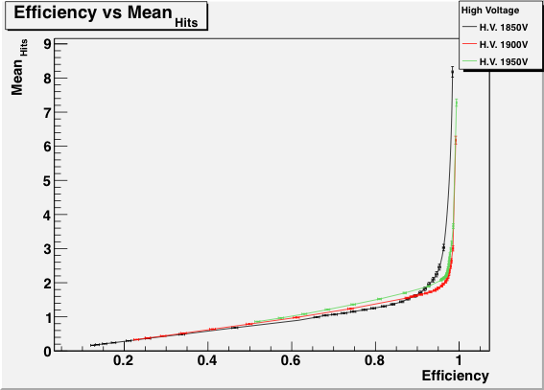
Efficiencies and Hit multiplicities (KPiX)
Results pressure corrected

Slide 14
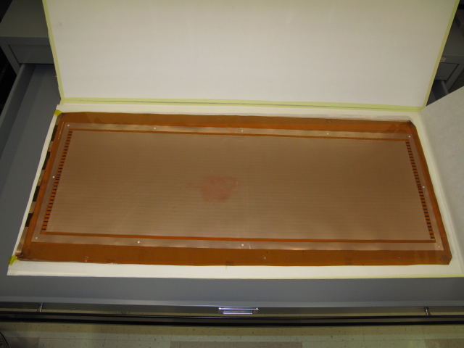
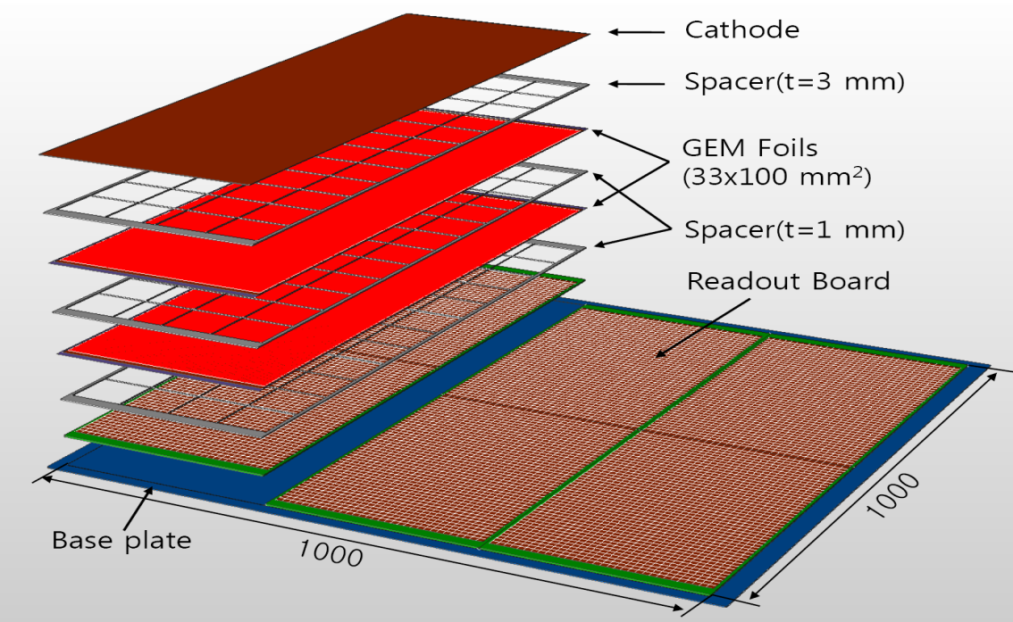
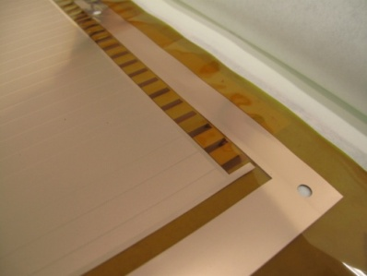
Toward 100cmx100cm GEM Planes
Each of the GEM 100cmx100cm planes will consist of three 33cmx100cm unit chambers
GEM DHCAL A.White

Slide 15
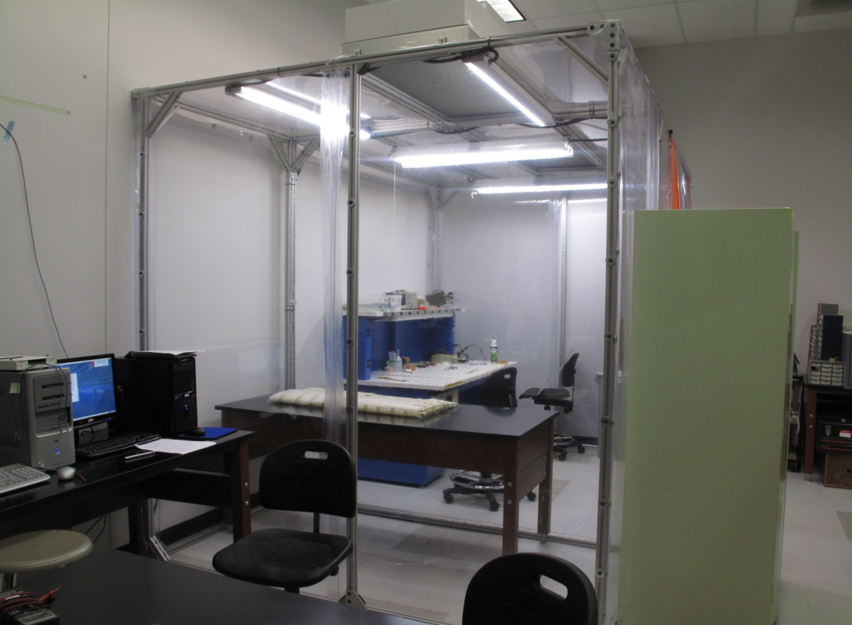
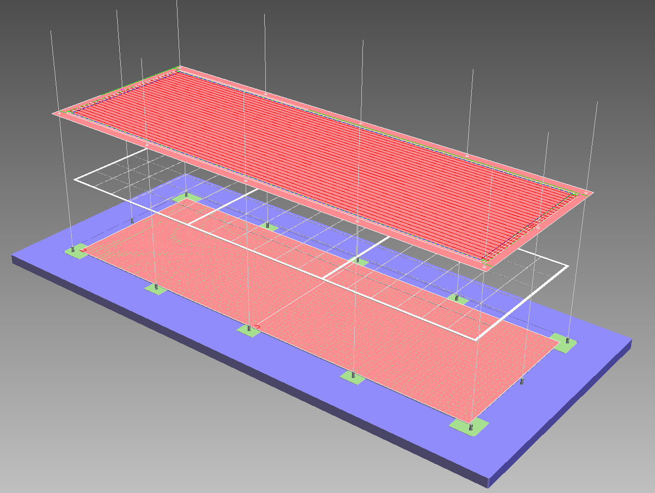
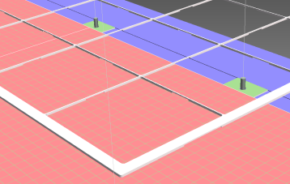
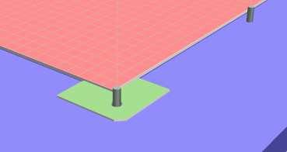
Toward 100cmx100cm GEM Planes!!
Class 10,000 clean room (12’x8’) construction completed
Two 33cmx100cm chamber parts delivered
Jig for 33cmx100cm chamber being procured
Positioners
Spacer
GEM Foil
Anode
Assembly jig
GEM DHCAL A.White
Positioners

Slide 16
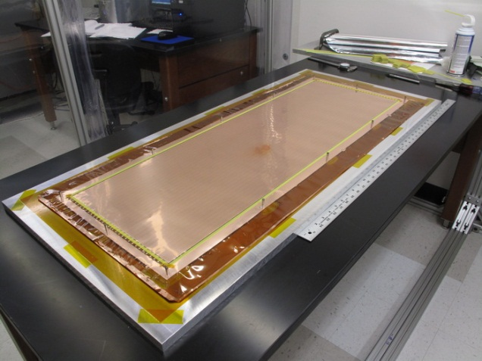
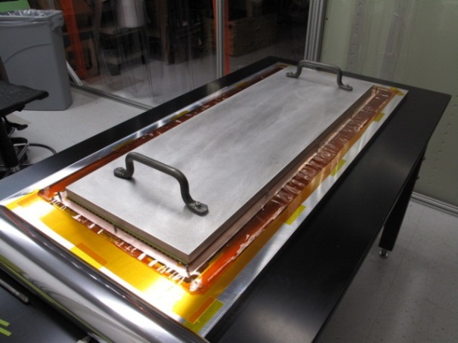
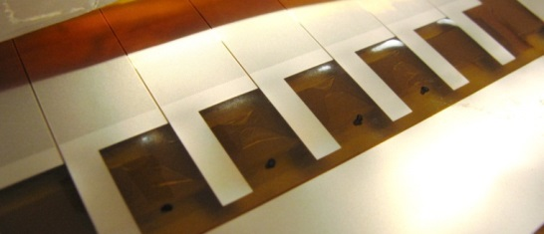
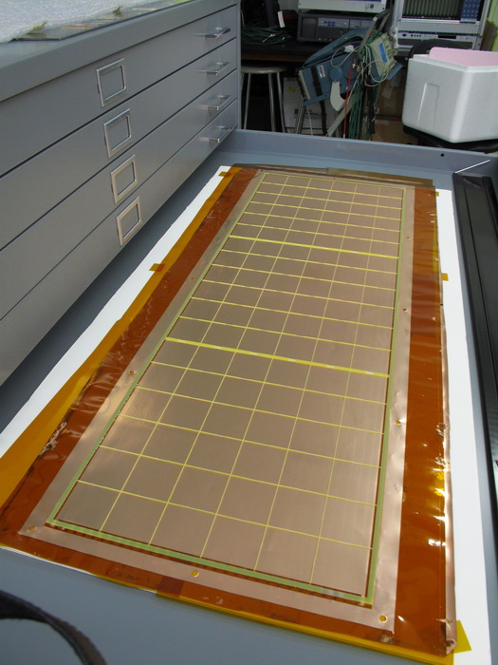
Preparation for LGEM Assembly
Current situation:
Waiting resumption of detector R&D support
Characteristics of GEM chambers (Eff. vs. mult, long term stability) show suitability fro DHCAL application.
Next:
Complete one 33cm x 100cm chamber
Test chamber in lab
Build two more chambers
Beam test with KPiX/synchronous beam at SLAC ESTB

Slide 17
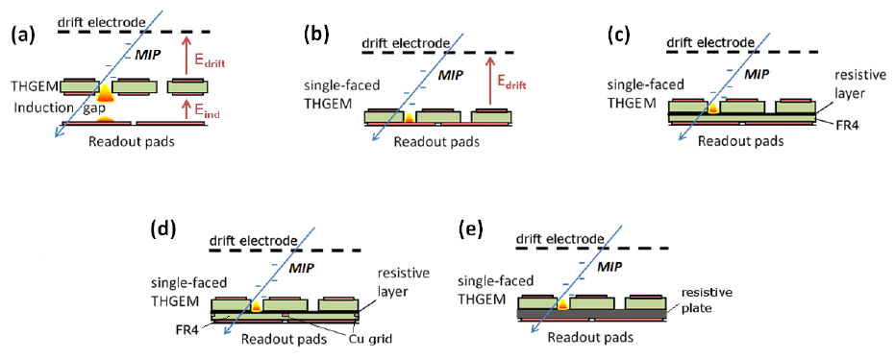
DHCAL – Thick GEM
ThickGEM technology developed at Weizmann Institute of Science, Israel
Tested in collaboration with Portugal (Aveiro, Coimbra), US(SLAC,UTA)
Slides courtesy Dr. Shikma Bressler (WIS)
From very recent CERN test beam
RPWELL
2012 JINST 7 C05011

Slide 18
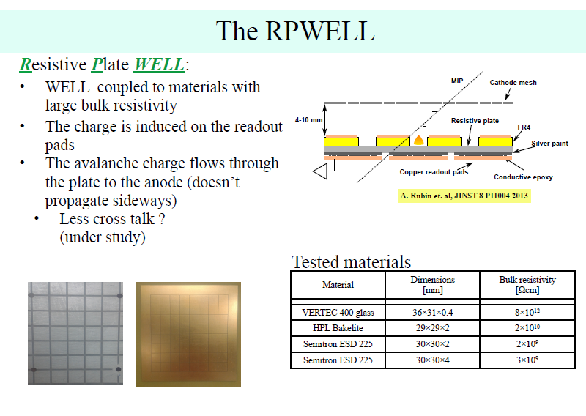

Slide 19
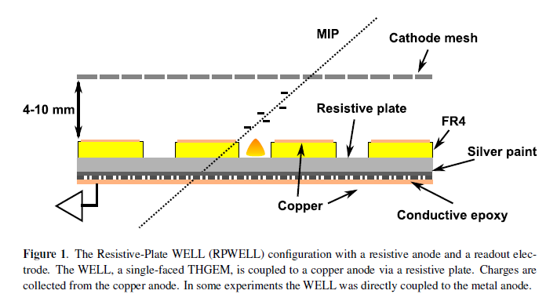
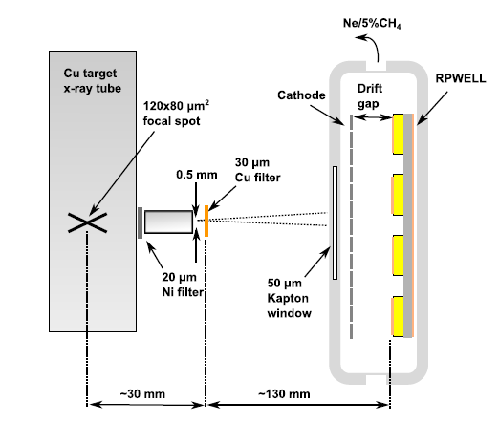
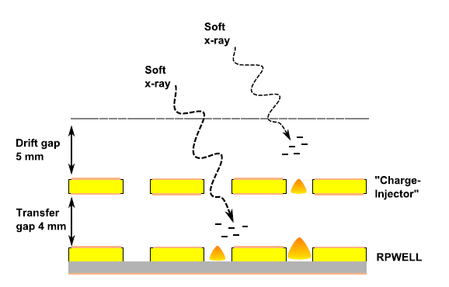
RPWELL
THGEM “preamp” to mimic HIPs

Slide 20
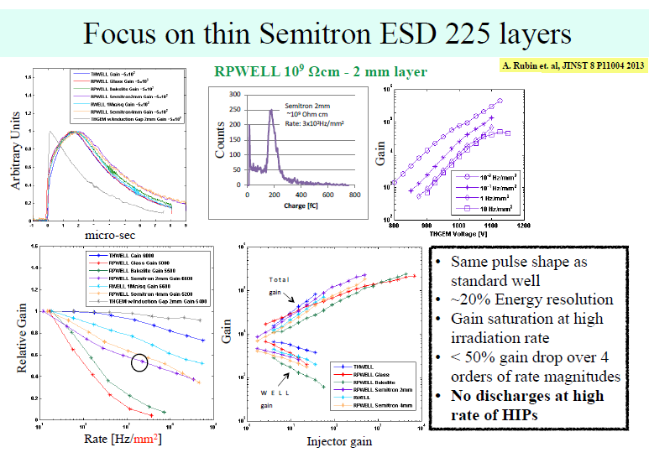
10⁴
10³
Laboratory studies with X-Rays

Slide 21
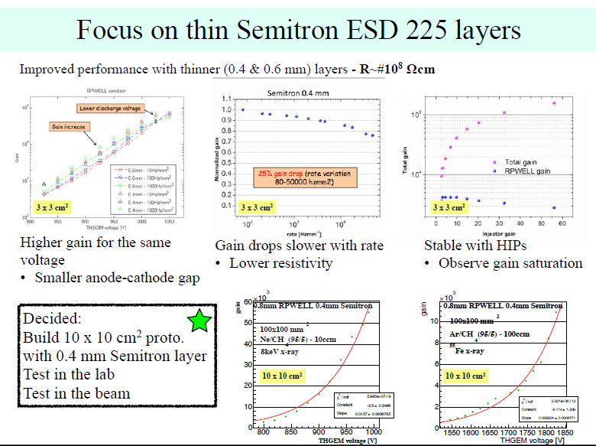
Laboratory studies with X-Rays

Slide 22
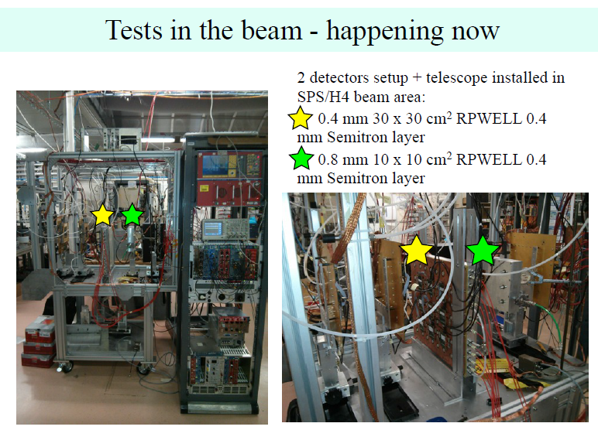
Before CERN shutdown

Slide 23
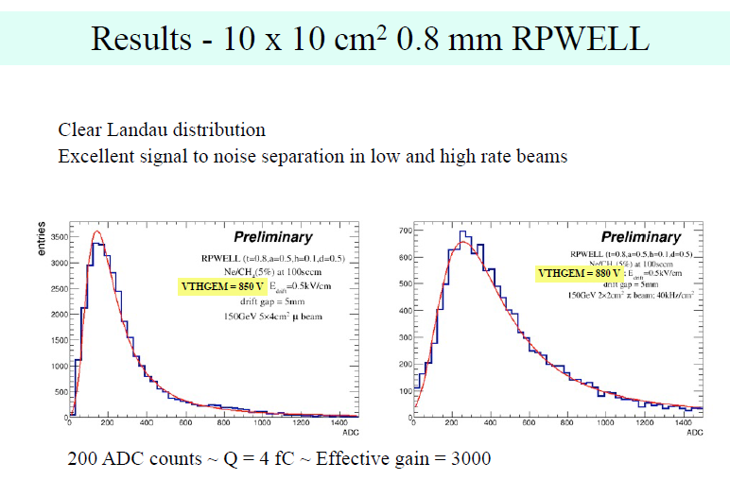
π
μ

Slide 24
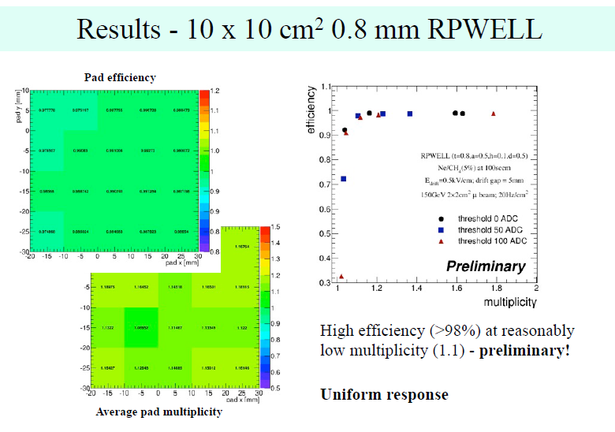

Slide 25
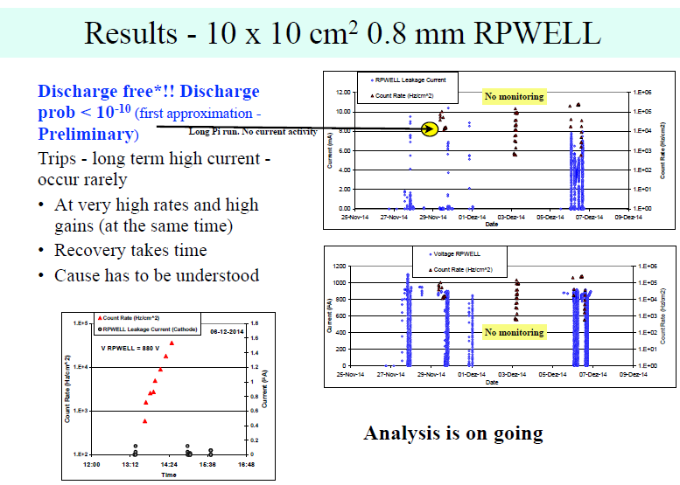

Slide 26
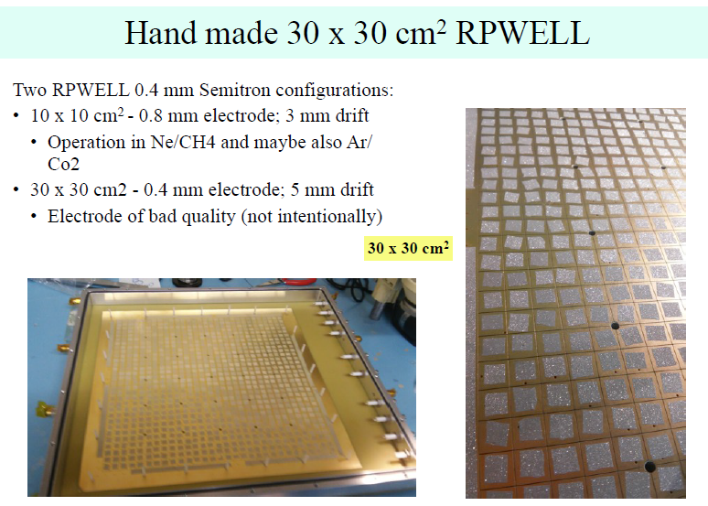

Slide 27
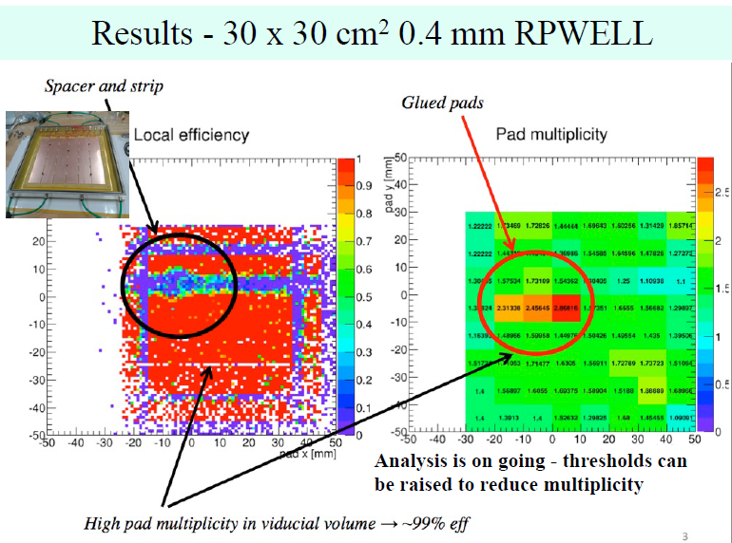

Slide 28
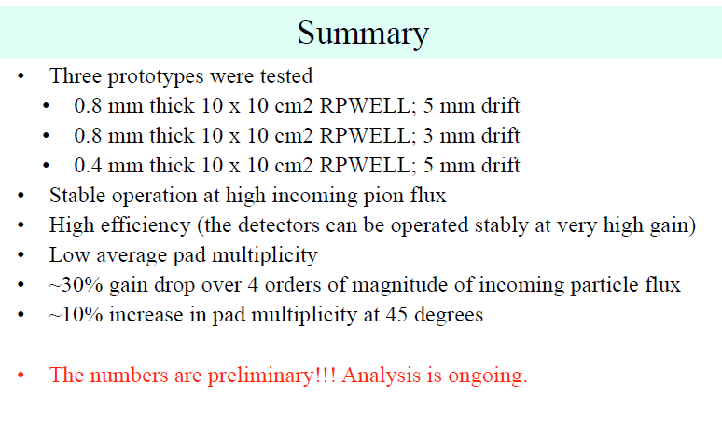
DHCAL – Thick GEM

Slide 29
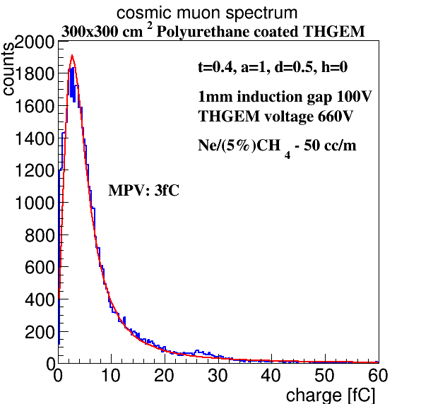
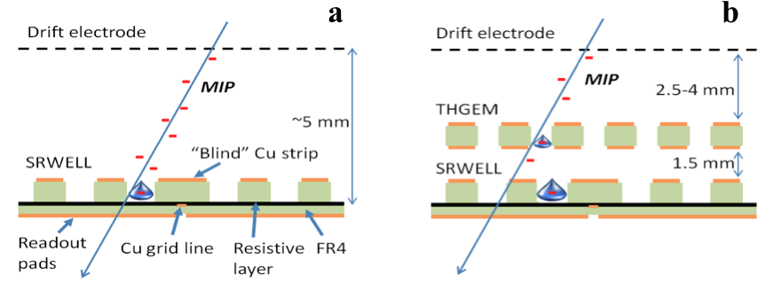
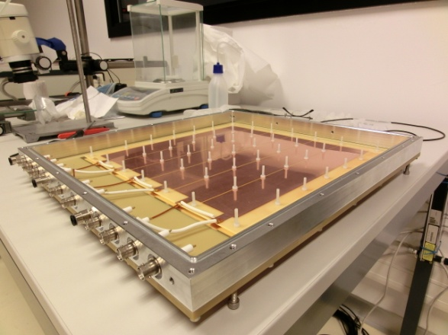
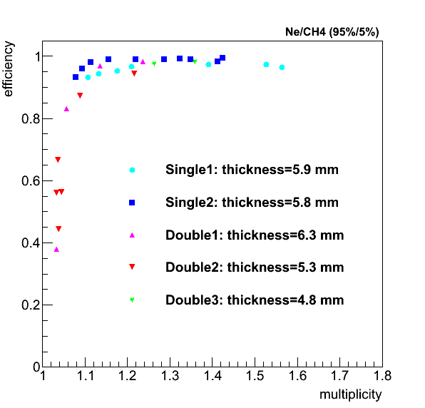
DHCAL – Thick GEM technology
ThickGEM
The DHCAL requirements were met
(Near) future plans
Build meter-scale single-stage detector
One prototype in collaboration with Israeli industry
Prototype(s) to test within CALICE’s DHCAL module
Study extensively THGEM concepts with broader dynamic range
RPWELL
Using newly developed techniques
Test in beam of 100 x 100 mm² prototype
Rubin 2013 JINST 8 P11004
Single; 5.9 mm
Single; 5.8 mm
Double; 6.3 mm
Double; 5.3 mm
Double; 4.8 mm
Bressler 2014 JINST 9 P03005

Slide 30
EXTRA

Slide 31





Fe55 Source Signal
Gas outlet
Top side
1 cm² anode pads
Data cable
HV power
Analog signal
LV power

Slide 32

KPiX Readout scheme (SLAC)
DHCAL anode pad
4-deep
“pipeline”
Amplifier
Storage buffers
ADC
Shaper
Calibration circuit
Trigger logic
→ADC/fC
Notes:
32

Slide 33
T-1010 Experiment Setup
GEM7
GEM6
GEM5
GEM7
GEM6
GEM5
GEM4
GEM4
10x10
10x10
10x10
10x10
2x3 V
2x3 V
GIA
GIA
2x3 H
2x3 H
GEM6: Read out by 13bit KPiX designed for the ILC time line
GEM7, GEM5, GEM4: Read out by 1bit DCAL chip by ANL and FNAL
GIA: Medical image intensifier prototype with 12 bit ADC in-house readout
Triggers formed off the motion table:
10x10 coincidences for guaranteed beam penetration through the detector array
2x3 coincidences arranged perpendicular to each other for 2x2 coverage in the center of the detector array
Coincidence of 1*2: Guaranteed beam penetration with center 2x2 coverage (efficiency ~95%)

Slide 34

33cmx100cm DHCAL Unit Chamber Construction
Readout Board
320x500 mm²
1000 mm
Base steel plate, t=2 mm
320 mm
Readout boards are part of the gas volume!!
GEM foils with 31 HV strips delivered
2mm steel strong-back + thin cathode layer
3mm
G10 spacers will be used without aligned dead areas.
Readout boards will be glued in the seam
1mm
1mm
1mm pad board
2mm FE board
1mm assister strong back

Slide 35


Slide 36

RPWELL with thinner Semitron layer has improved rate performance

